Slide 1
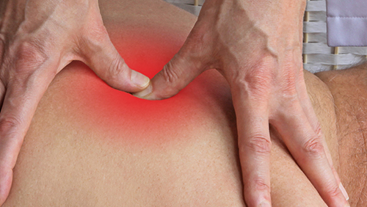
Triggered Points
Definition: A localized area of muscle hypertonicity that radiates in a predictable pain pattern.

Slide 2
GENERAL INFORMATION
• Cyclical causes: insufficient cellular energy (adenosine triphosphate [ATP]) to a specific muscle area secondary to localized ischemia (restricted blood flow), from prolonged muscle contraction, leading to further insufficient ATP
• Contributing factors: poor posture; repetitive motion; muscle compensation from injury, accident, or prolonged inactivity; nutritional deficiency; chronic infection; sleep deprivation; depression
• Usually occurs in skeletal muscles, especially the trapezius, rhomboids, sternocleidomastoid (SCM), masseter; can occur in organs and bones

Slide 3
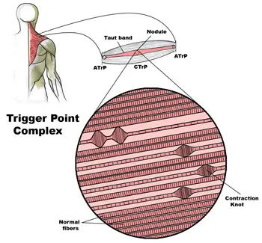
• Common in most adults, either latent or active, at some point in life; rare in children
• Often associated with chronic headaches, tendonitis, bursitis, arthritis, and stress
• Often incorrectly referred to as “knots”; the more correct term is “nodule”

Slide 4
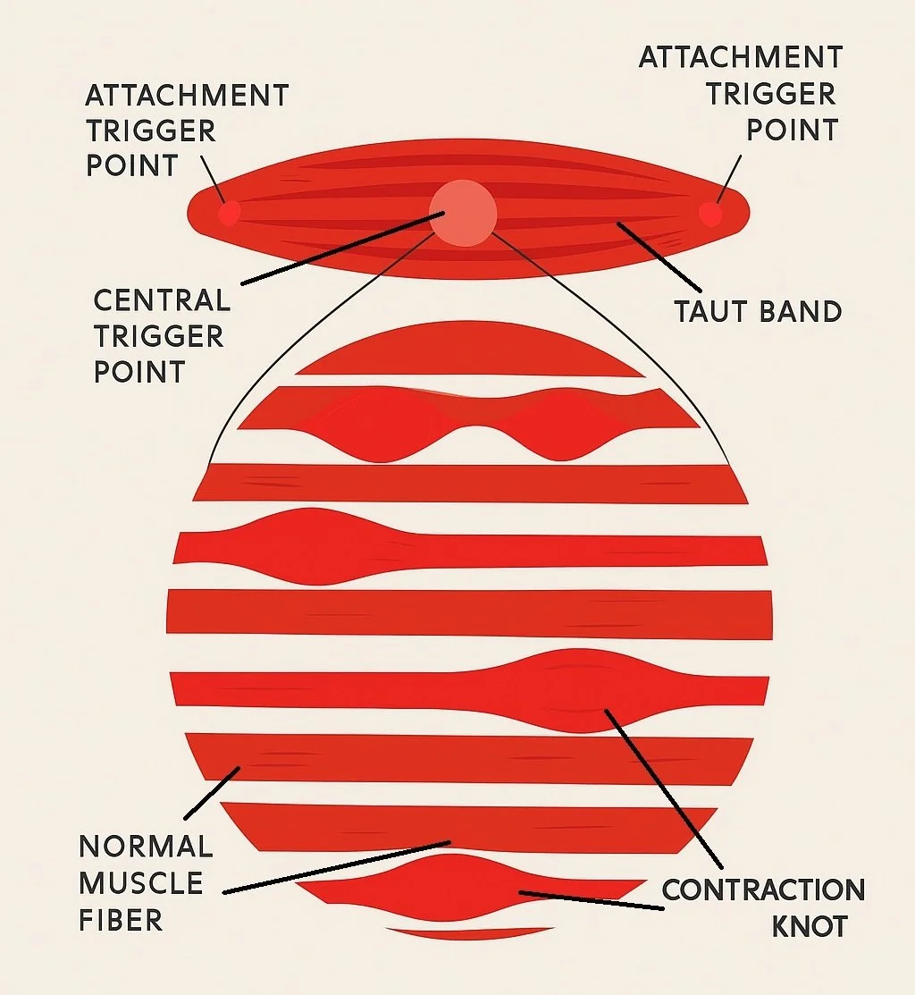
PATHOPHYSIOLOGY
In order to function, every cell needs oxygen delivered via the bloodstream. In addition to pain, the body’s response to insufficient blood supply can be dramatic. The person might faint or convulse; the affected body part might turn blue, decay, and fall off.

Slide 5
The causes of insufficient blood supply are numerous, but in the case of trigger points, the cause is subtle and cellular. Nodules are created as follows: (1) a small fragment of the muscle contracts; (2) this fragment pulls on another, progressively tightening, band of muscle; (3) blood flow to the constricted region is reduced because of the tightness; (4) oxygen debt occurs; (5) local ischemia follows; (6) this cycle of poorly vascularized cellular muscle structures causes an involuntary painful contraction; (7) the lack of oxygen, combined with the sustained contraction, causes pain signals to flood the region; (8) pain is experienced in the focal and more frequently in the referred pain zone that characterizes the muscle harboring a TrP.

Slide 6
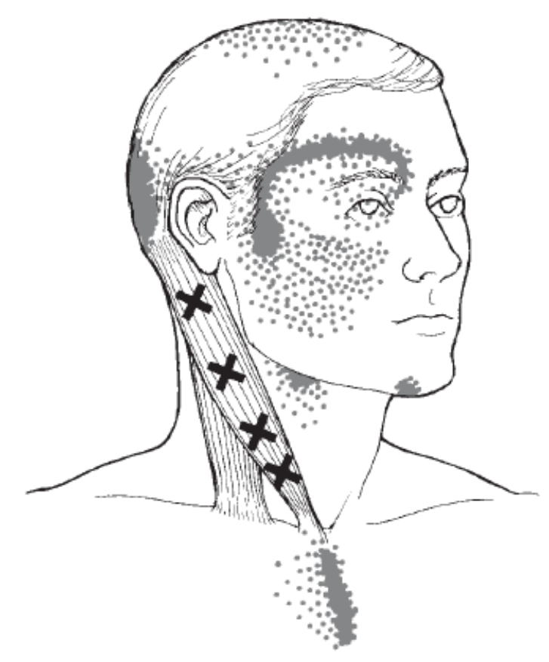

Persistently restricted or weakened muscles may develop latent trigger points that do not refer pain and are not painful unless palpated. Latent TrPs can be seen as active trigger points waiting to happen. If ischemia persists and if the cellular flood of pain signals accumulate sufficiently in a latent trigger point; it can turn into an actively painful, radiating trigger point very quickly. Active TrPs cause exquisite local and radiating pain, even when the muscle is at rest.

Slide 7
OVERALL SIGNS AND SYMPTOMS
• Hypertonicity palpable as a taut band
• A palpable nodule usually in the muscle belly
• Often a palpable twitch when the nodule is stimulated by a “snapping palpation”
• Dramatic response from the client (wincing, pulling away), called a jump sign, upon direct TrP palpation
• Visible holding pattern of compensating structures
• Shooting pain radiating from the focal point, which may or may not seem directly related

Slide 8
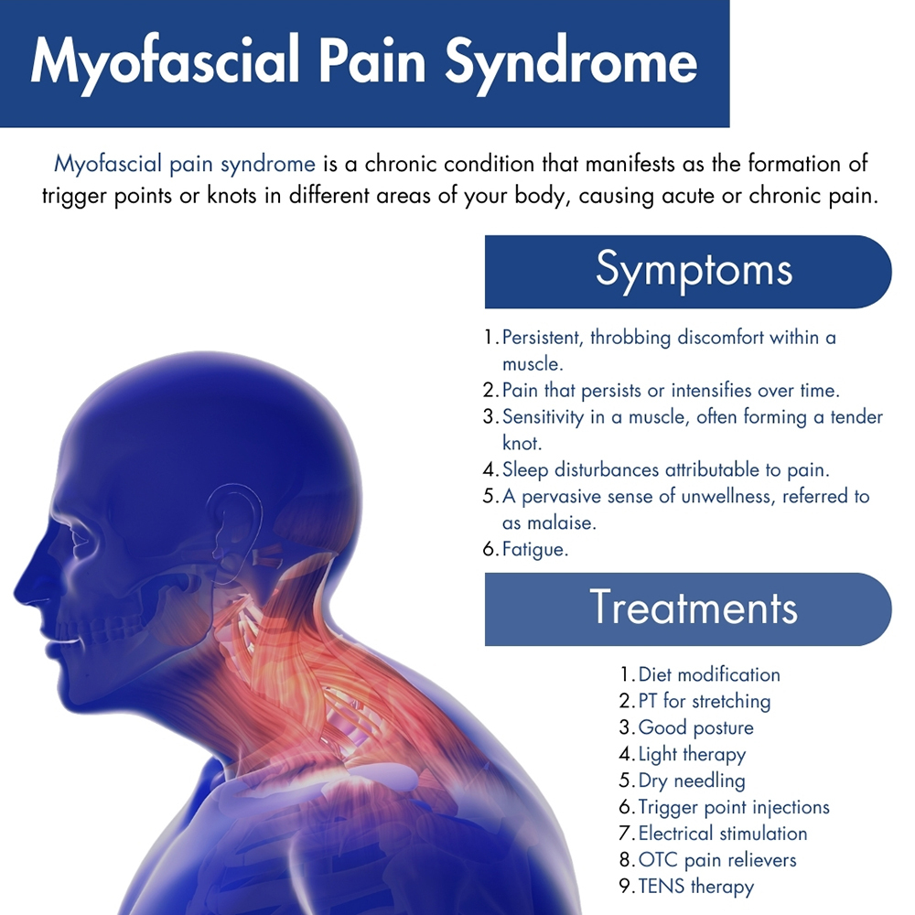
• Dull, aching, throbbing, and burning pain at the focal point
• Pain at rest or with activity, often worse with activity

Slide 9
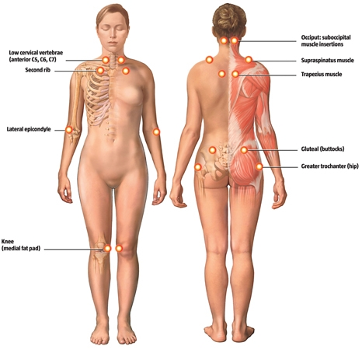
SIGNS AND SYMPTOMS MASSAGE THERAPY CAN ADDRESS
• Relieving hypertonicity is a centerpiece for most massage therapy and is regularly addressed with many traditional techniques.
• Compensatory hypertonicity and pain, as well as the accumulation of cellular debris and metabolic waste, are also treated with basic massage skills.

Slide 10
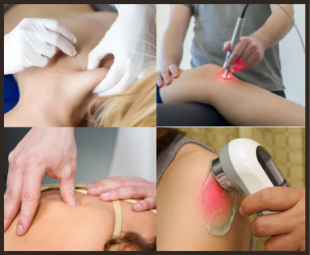
TREATMENT OPTIONS
Most people do not seek medical attention for muscle tightness alone. Temporary muscular discomfort is usually self-treated with over-the-counter (OTC) creams or patches that claim to provide relief. Those in pain may also take OTC anti-inflammatory medications, apply hot or cold packs, and (erroneously) rest the affected area. If pain becomes intolerable, a sports medicine physician or physical therapist may treat with non-invasive, conservative techniques.

Slide 11

Common Medications
Medications are not usually prescribed. In extreme cases of multiple, intolerable trigger points, as in people with cerebral palsy, partial paralysis, Lou Gehrig’s disease, and conditions that involve unrelenting hypertonicity, muscle relaxants may be prescribed.

Slide 12
MASSAGE THERAPIST ASSESSMENT
Asking questions about the client’s general state of health and activity will give the therapist a sound baseline to start her assessment. A client’s report of a recent accident that has produced compensating patterns, or prolonged inactivity, a desk job, or complaints about pain that “won’t go away, burns and shoots from here to here,” will help clarify the appropriate treatment.

Slide 13
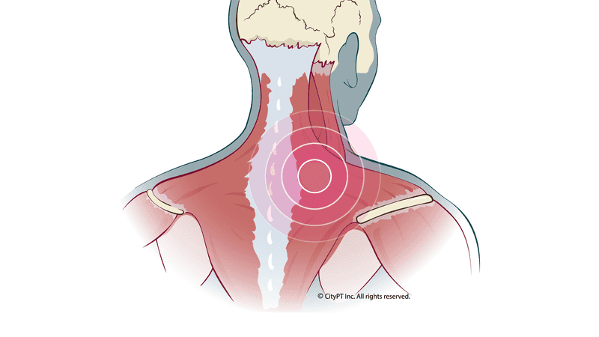
A word of caution about the assessment: The quality of the pain should be described as dull, aching, nagging, steady, throbbing, and sometimes burning. The specific terms used for describing neurologic pain (shooting, tingling, numbness, and burning) are similar and may muddy the therapist’s assessment. Knowing, or having a picture reference that indicates, typical trigger point referral patterns will help differentiate between TrP and neurological pain.

Slide 14
THERAPEUTIC GOALS
Decreasing pain and hypertonicity in the immediate and referred regions, increasing circulation to the affected muscles, increasing range of motion (ROM), restoring normal muscle resting length, and reducing secondary stress and tension—all of these are reasonable therapeutic goals for treating trigger points.
Palpation restores ROM to the tissues, and compression acts to move the myofascial. A properly trained therapist would move the muscle through ROM. Because improper technique will often stimulate TrPs and not deactivate them, the therapist’s goal is to use techniques that precisely avoid a flare-up.

Slide 15
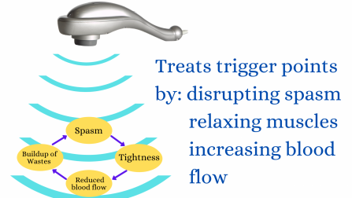
A properly trained therapist would move the muscle through ROM. Because improper technique will often stimulate TrPs and not deactivate them, the therapist’s goal is to use techniques that precisely avoid a flare-up.

Slide 16
MASSAGE SESSION FREQUENCY
Trigger points can both develop and resolve quickly. However, they often reside in the muscle belly for weeks or months and thus need frequent, consistent treatment and self-care. Most people begin to notice relief in about 4–6 visits. If no resolution occurs, then therapy may not be effective and a perpetuating factor or another pathology may be present. At this point, a client should be referred to another health care practitioner for evaluation.
The following frequency suggestions assume that the client’s symptoms are decreasing with massage therapy treatment and that he is doing his homework assignments
60-minute sessions twice a week until resolution, for severe cases
• 60-minute sessions once a week, for normally painful cases

Slide 17
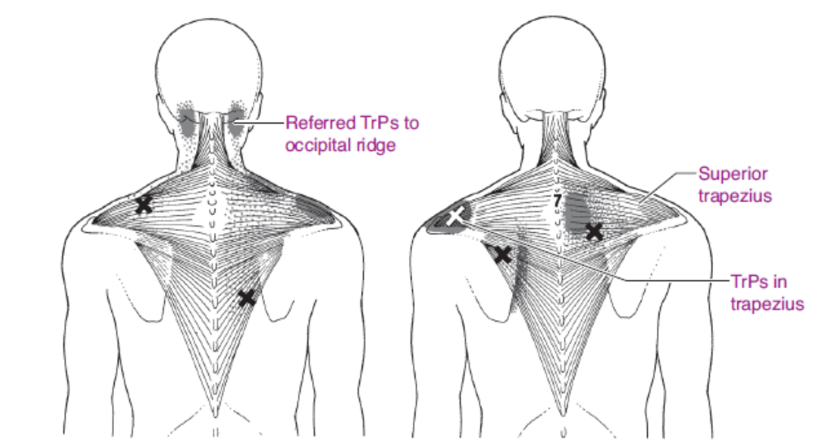

Slide 18
MASSAGE PROTOCOL
Trigger point pressure release is the application of slowly increasing, nonpainful pressure over a trigger point until a barrier of tissue resistance is encountered. Contact is then maintained until the tissue barrier releases, and pressure is increased to reach a new barrier to eliminate the trigger point tension and tenderness. Rather than “digging” into the tight muscle, thereby causing a painful response to which the body will react, constrict, and shut down, you will be respectfully, slowly, and carefully approaching the taut band of muscle and the surrounding area in order to flood the region with fresh blood. This will help release the constriction, remove the ischemia, flush waste products, alleviate pain, and increase function and ROM. The methods are simple.

Slide 19
Before and after ROM is used to demonstrate initial restrictions and then subsequent, post-treatment improvement. Heat, effleurage, petrissage, and intermittent deep stroking and kneading are used to bring blood into the restricted area, and remove metabolites from it. The medium-pressure fingertip pumping used at the center of the nodule replaces the sustained-pressure, elbow-to-the-bone techniques. No instruments are necessary.
Stubborn or long-standing trigger points will require several sessions for resolution. Homework is essential to keep the region fl ushed with blood and to prevent reconstriction of the muscle fibers. The following protocol focuses on trigger point treatment of the superior trapezius, as this is one of the most common complaints you will encounter.

Slide 20
Getting Started
Have hot packs ready. Be patient.
You’ll notice that there are no durations indicated for the techniques in this protocol. With any soft tissue work, you must be keenly aware of the tissue’s condition before moving mechanically onto the next step. In the case of trigger point work, you will want to train yourself to remain very aware of the depth to which you are working, the tissue’s response, the presence of any spasms or tissue flinching, the width of the taut muscle band, the presence of “Rice Krispies,” and whether or not the TrP is softening. It would be impossible to impose time restrictions on this process. Do not overwork the tissue in which the trigger points are embedded. Try, instead, to approximately spread your time evenly between all the steps, spending the most time directly on the trigger points themselves.

Slide 21
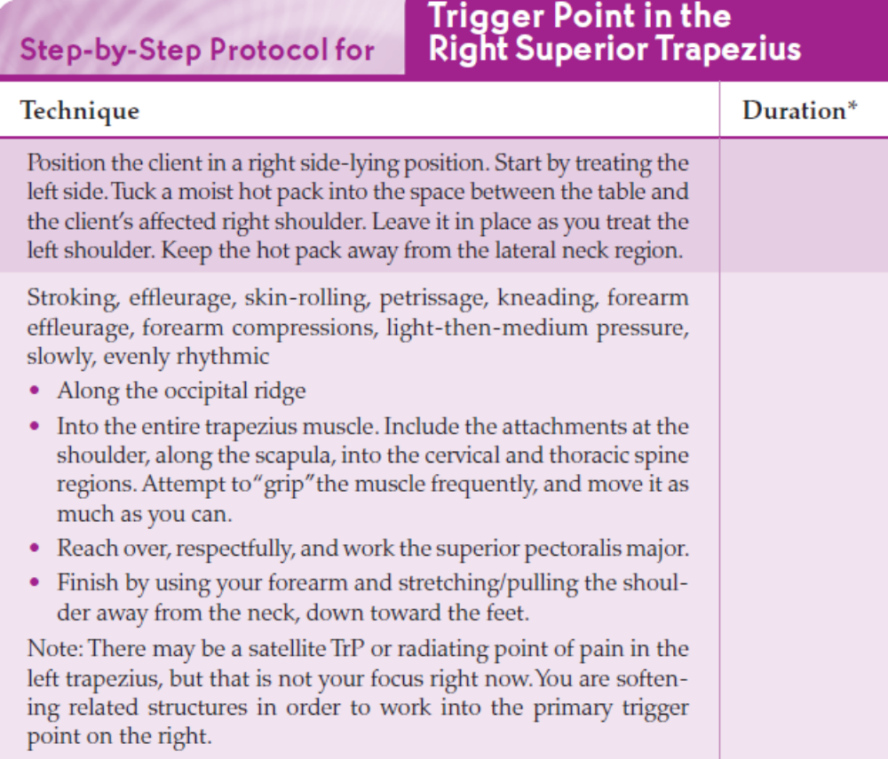

Slide 22
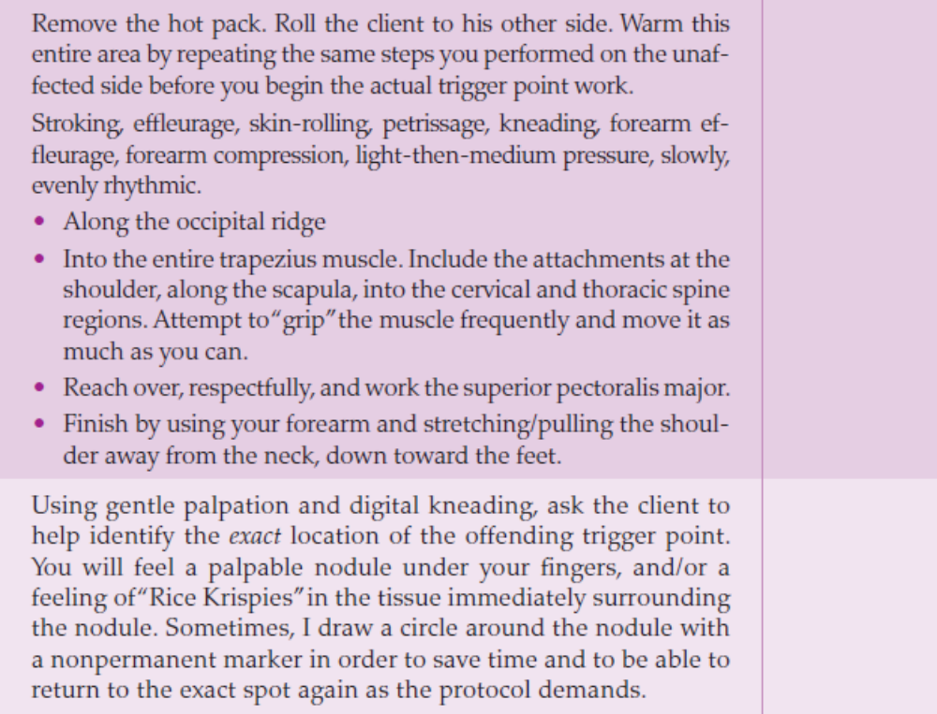

Slide 23
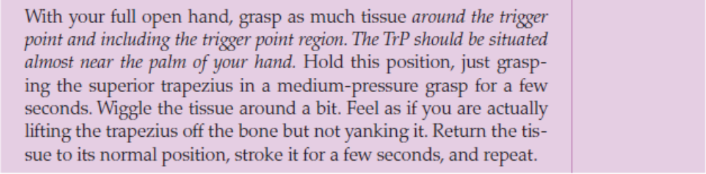
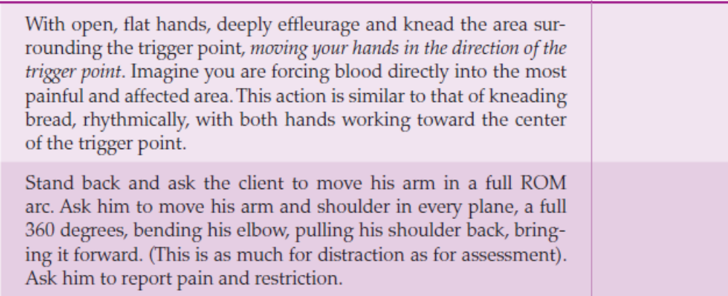

Slide 24
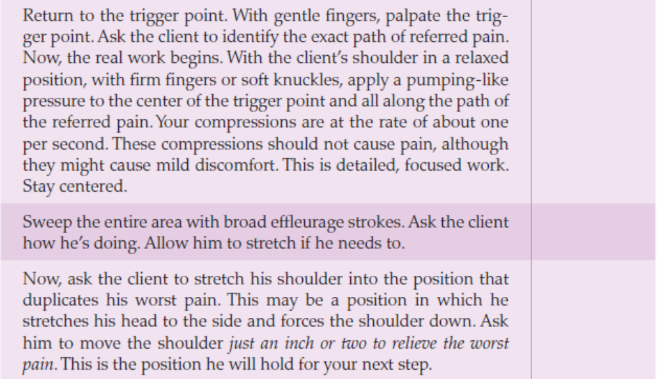

Slide 25
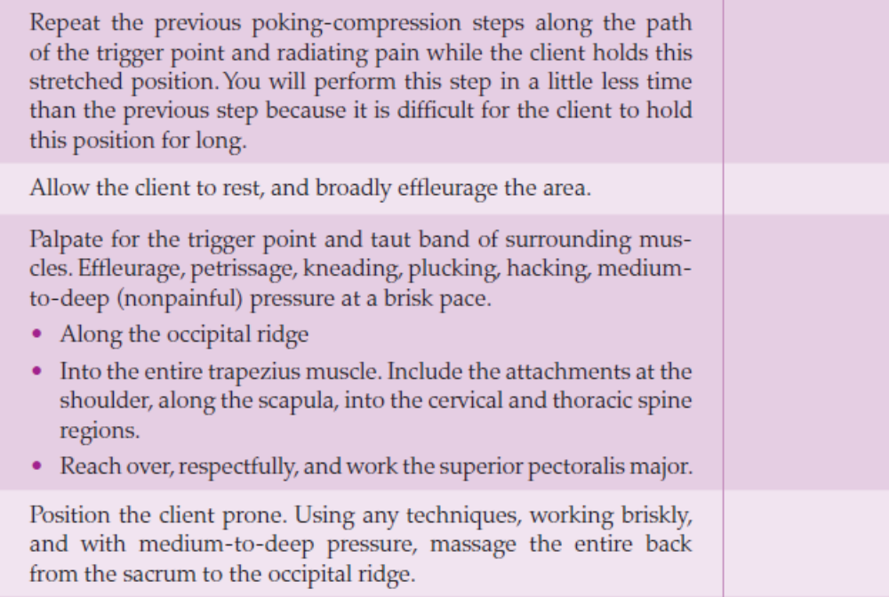

Slide 26

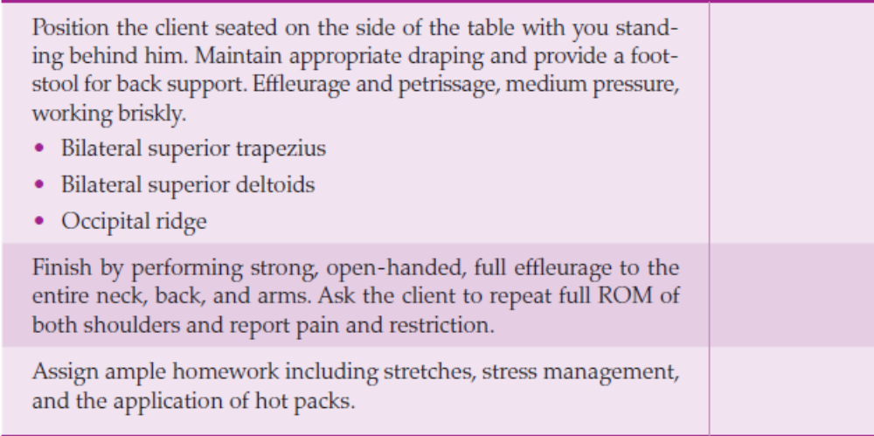

Slide 27
Contraindications and Cautions
Clients taking daily aspirin or anticoagulants are at risk for serious bruising resulting from any form of prolonged deep work.
• Be keenly aware of the medical history of those clients whose trigger points do not resolve after several sessions. Seemingly persistent localized muscle pain can be an indicator of cancer recurrence or other systemic diseases.
• Although you may be well-intentioned, overzealous work at a focused point of pain can cause extremely uncomfortable soreness or even pain for the client the next day. Monitor the depth and vigor with which you perform this work.

Slide 28
• Although a trigger point does not manifest all the symptoms of a thrombus (blood clot), to the layperson or the inexperienced massage therapist, the two can be confused. If any swelling, redness, or heat is present along with the exquisite radiating pain of the typical trigger point, you should halt all work (that means anywhere on the body) and refer the client to a physician. It’s possible to inadvertently move a thrombus into an embolus by attempting to work on a presumed nodule.
• If the trigger point is injury-related and accompanied by local inflammation, the application of heat to the region is contraindicated.

Slide 29
• If the trigger point is secondary to an overstretch injury, passive and active stretching exercises are contraindicated.
• The application of ice to a “burning” trigger point may worsen symptoms.

