Slide 1
Patellofemoral Syndrome

Slide 2
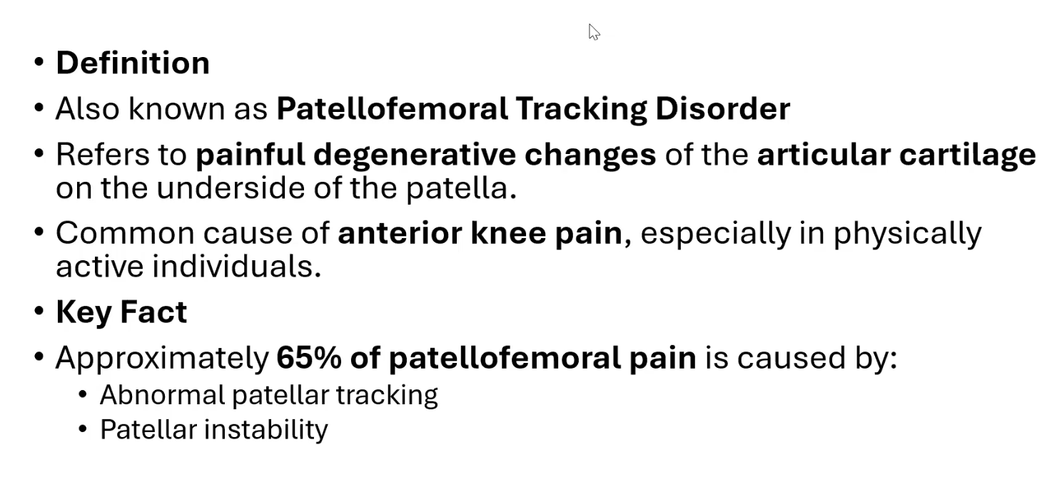

Slide 3
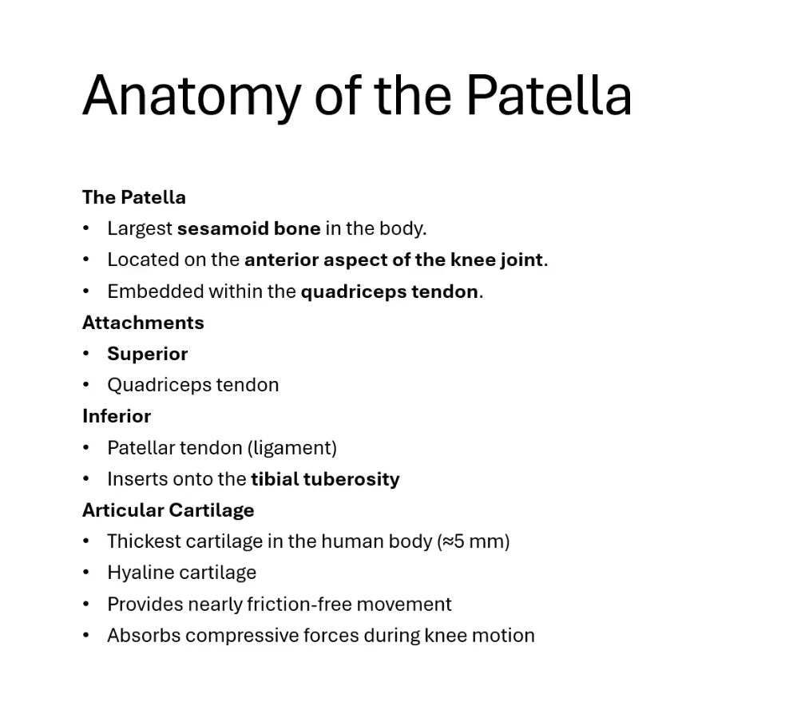
Anatomy of the Patella

Slide 4
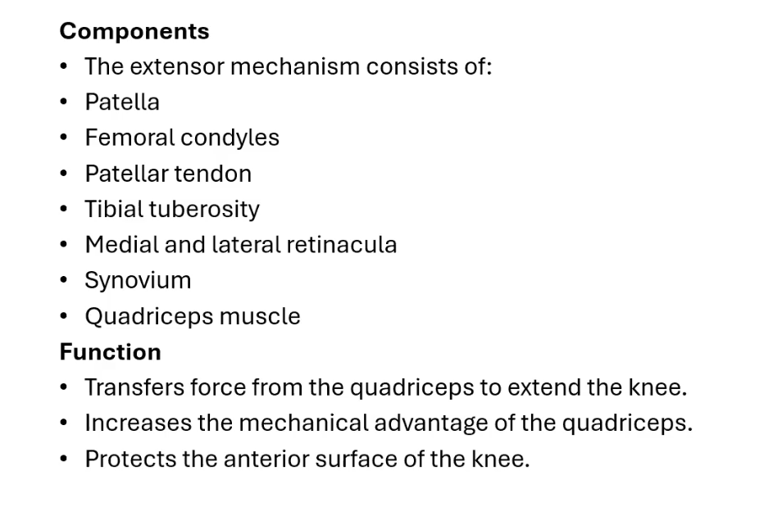
Extensor Mechanisms of the Knee

Slide 5
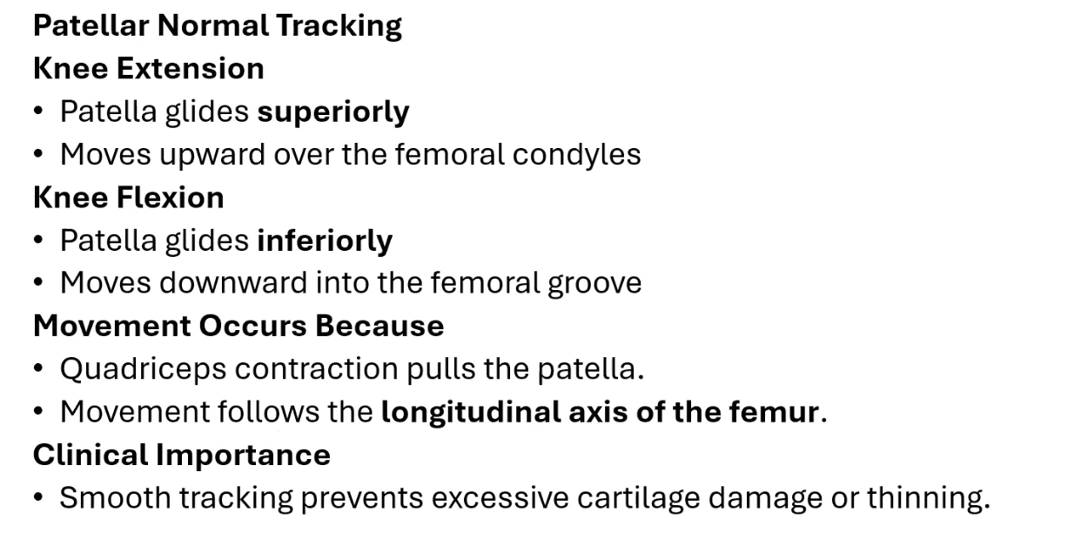
Patellar Movement During Knee Motion

Slide 6
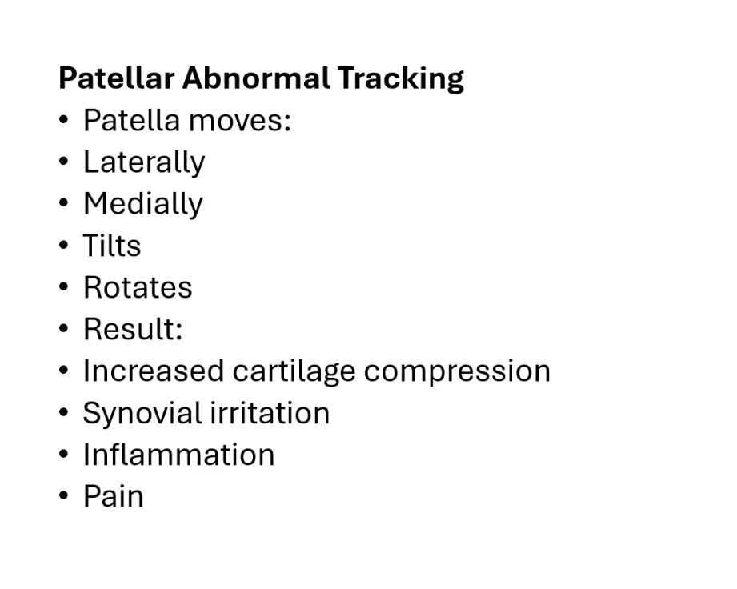

Slide 7
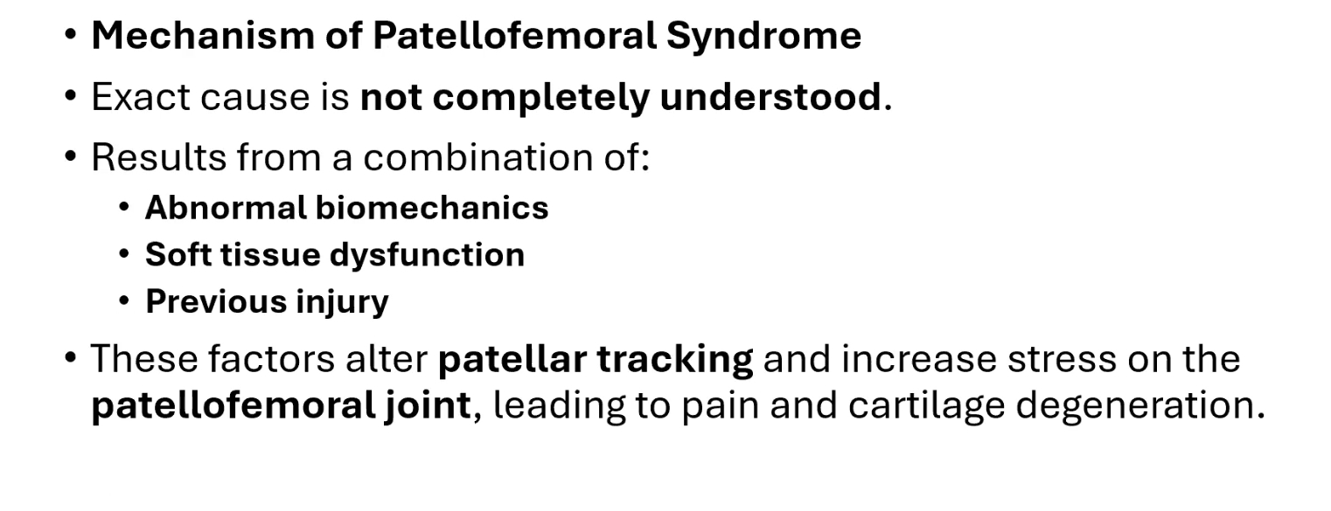
Mechanism and Causes of Patellofemoral Syndrome

Slide 8
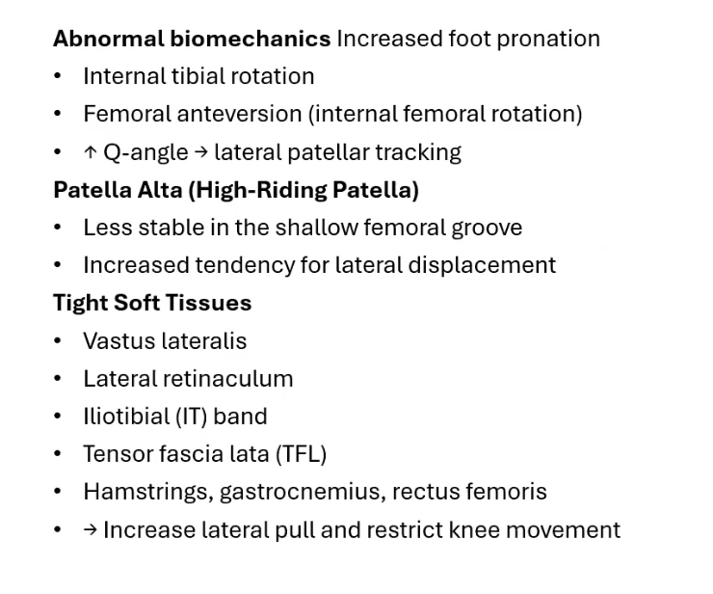
Predisposing Factors

Slide 9
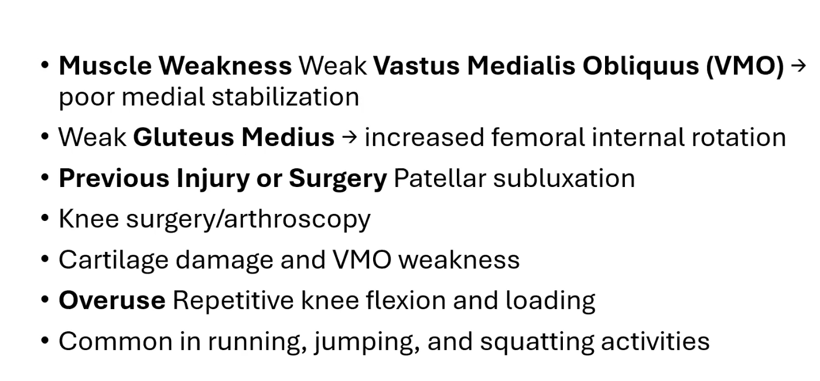

Slide 10
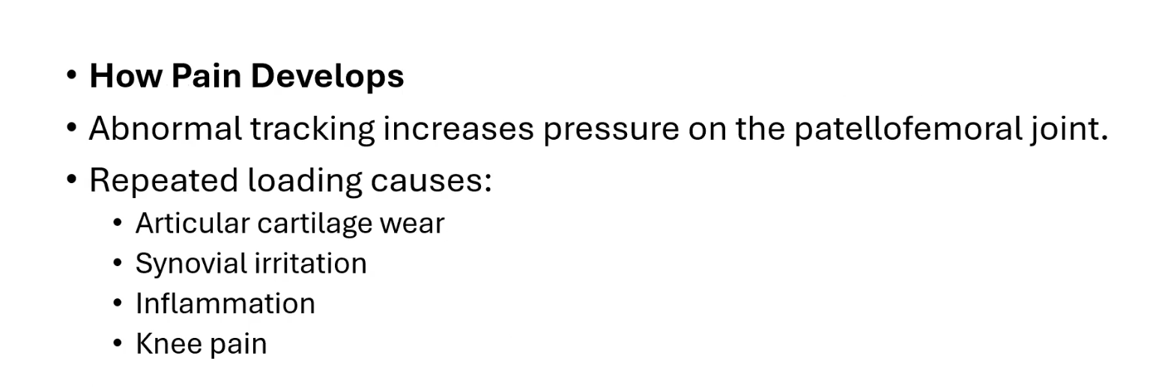

Slide 11
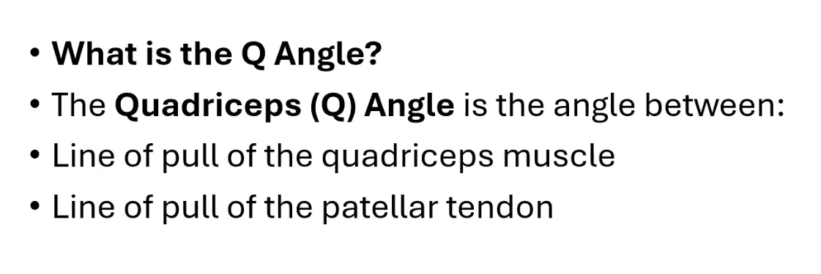
The Quadriceps (Q) Angle

Slide 12
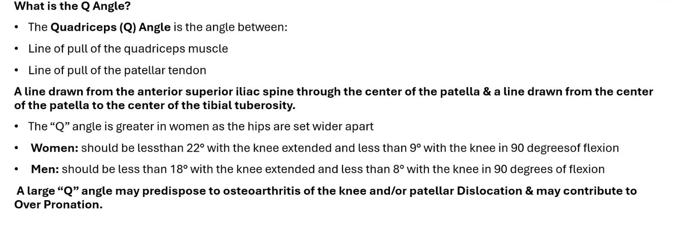
The Quadriceps (Q) Angle

Slide 13
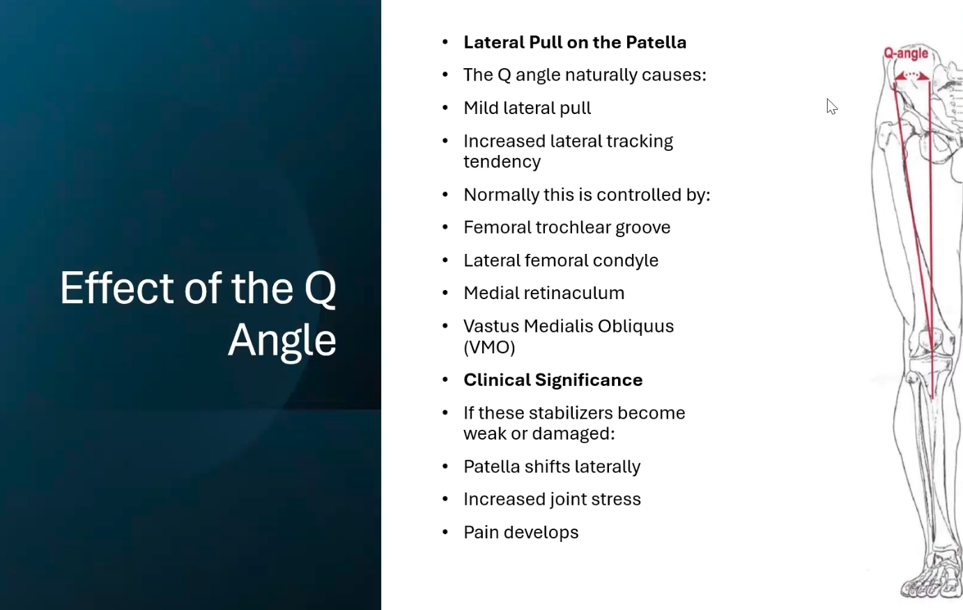

Slide 14
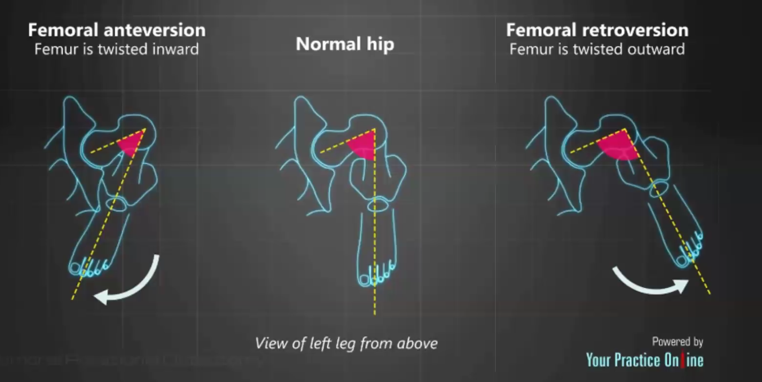

Slide 15
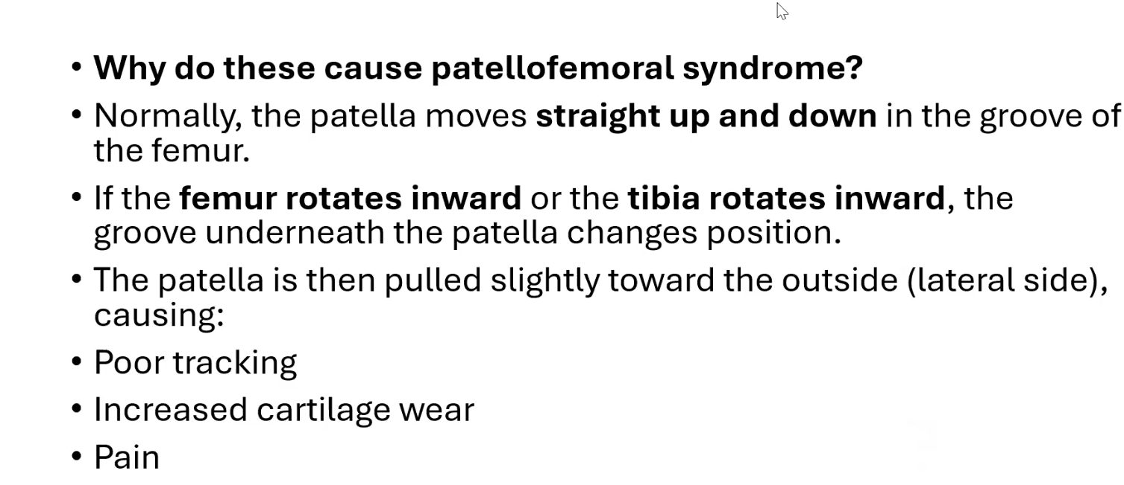

Slide 16
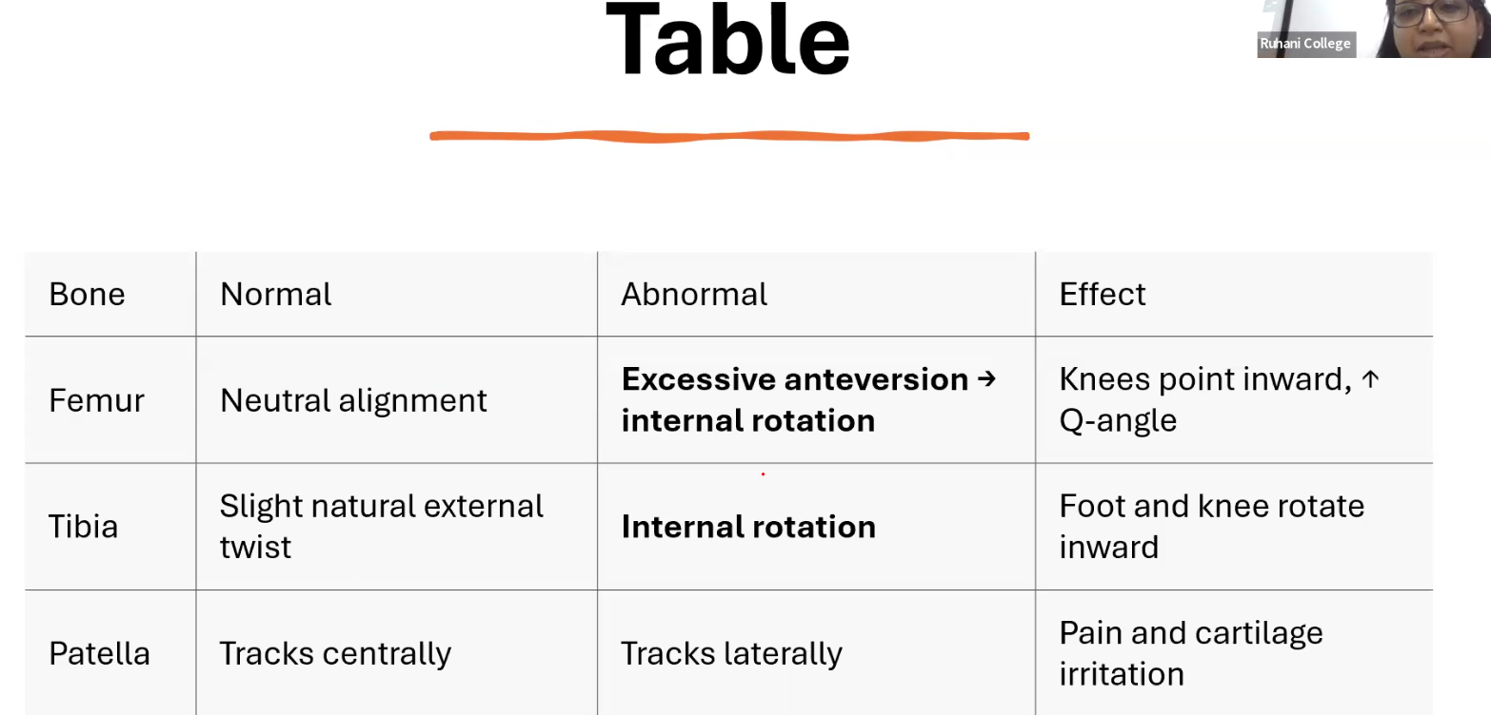

Slide 17
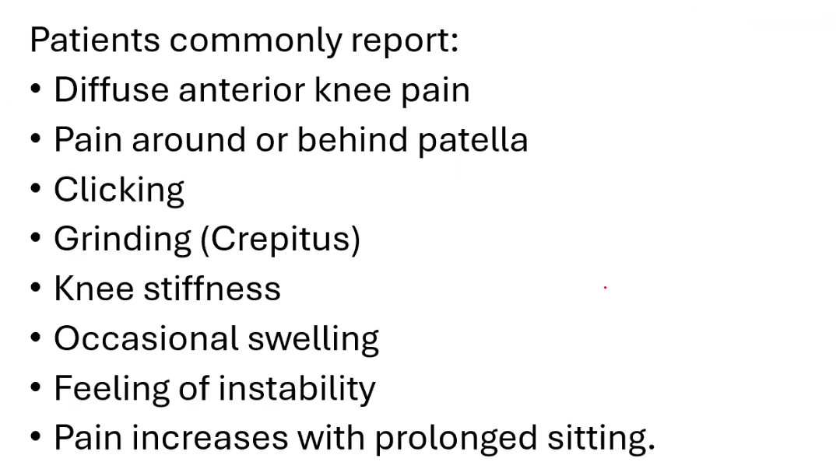
Symptoms

Slide 18
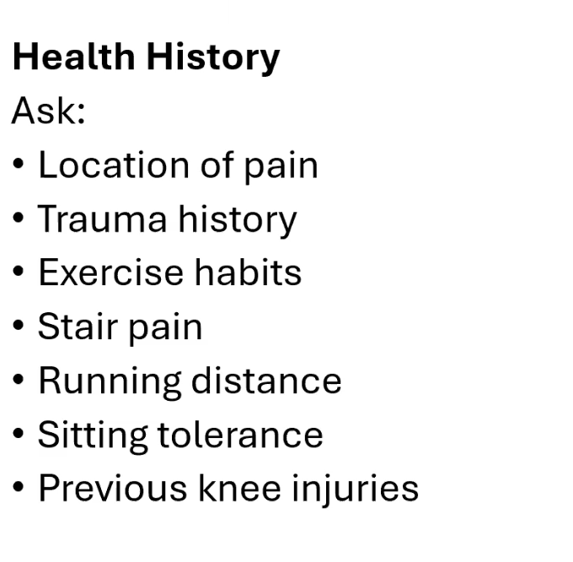
Assessment

Slide 19
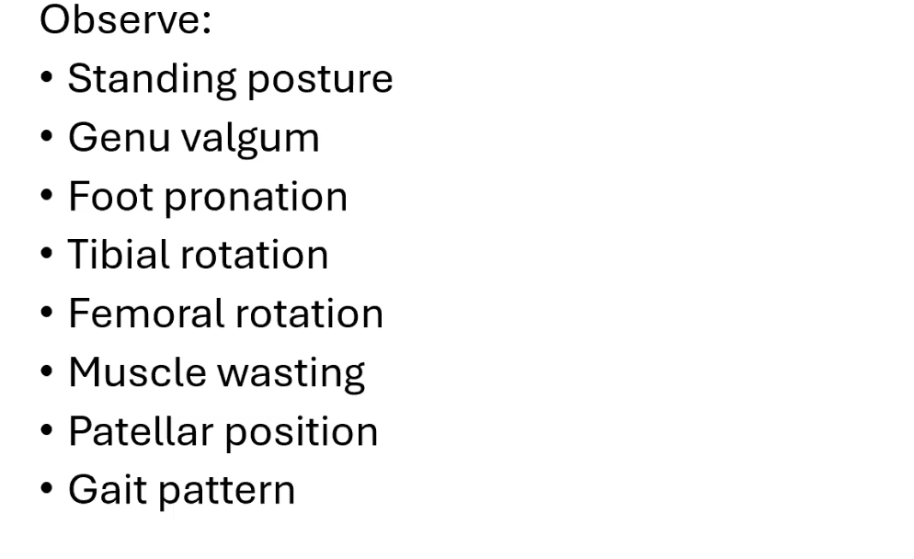
Observation

Slide 20
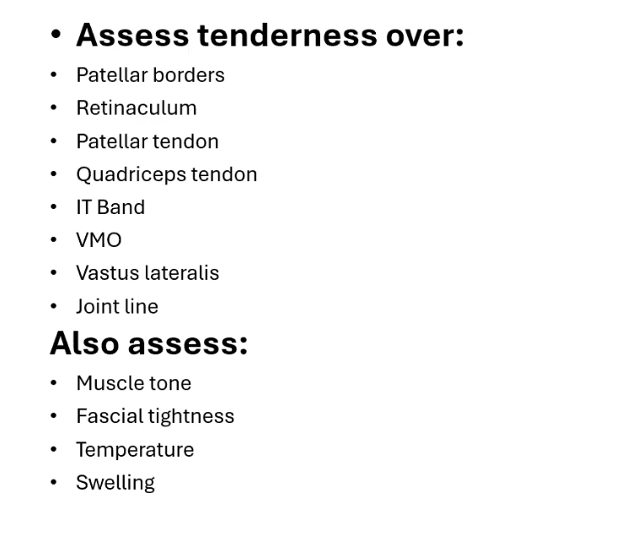
Palpation

Slide 21
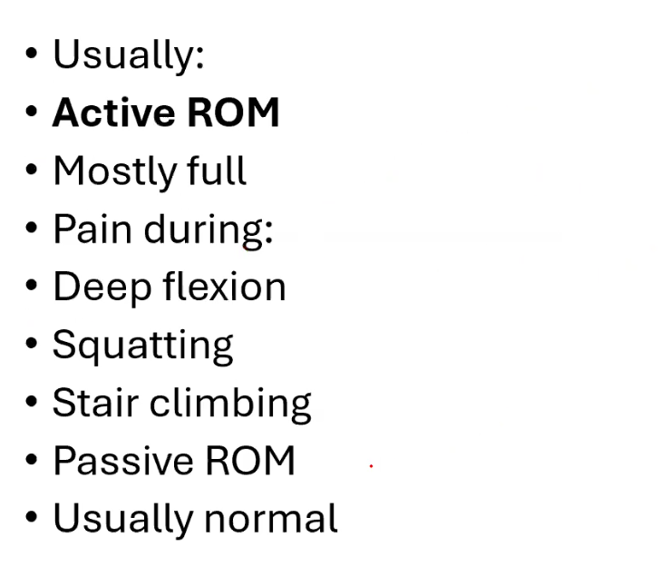
Range of Motion

Slide 22
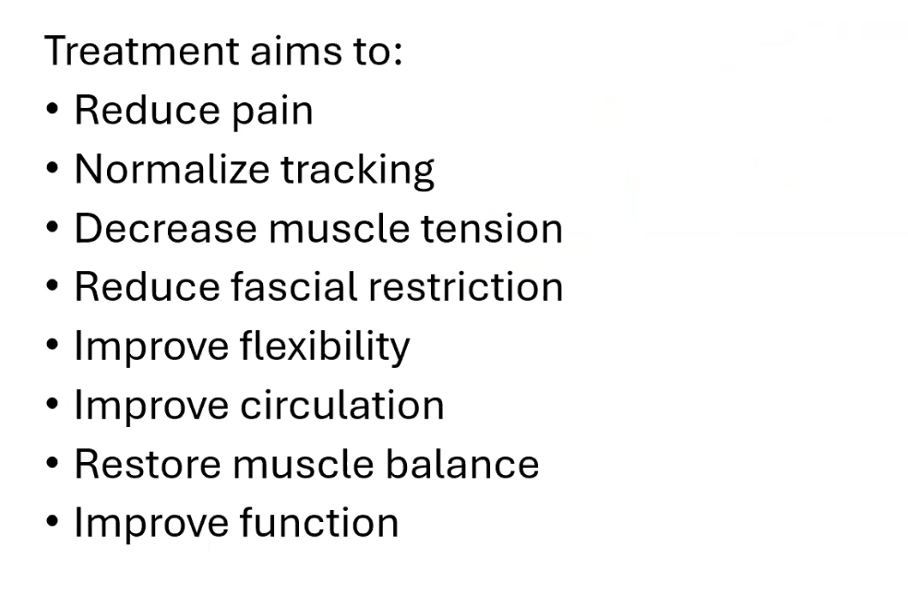
Massage Therapy Goals

Slide 23
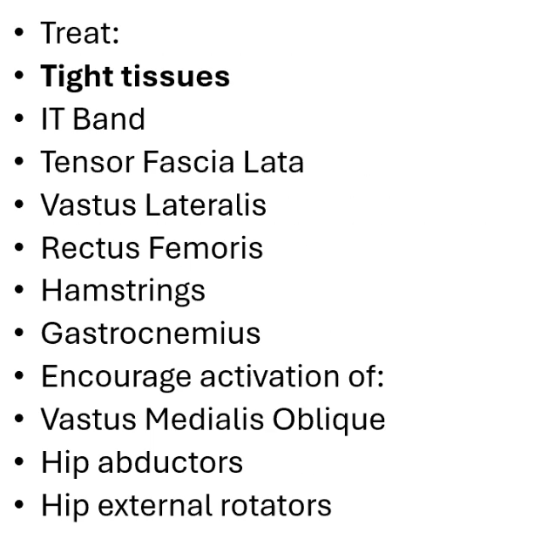
Treatment Plan

Slide 24

Contraindications

Slide 25
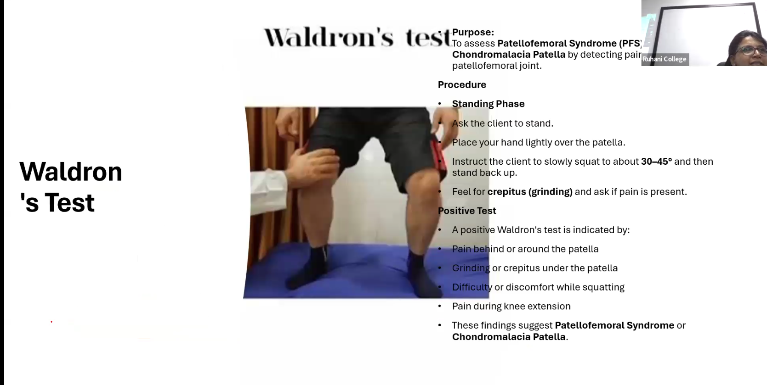

Slide 26
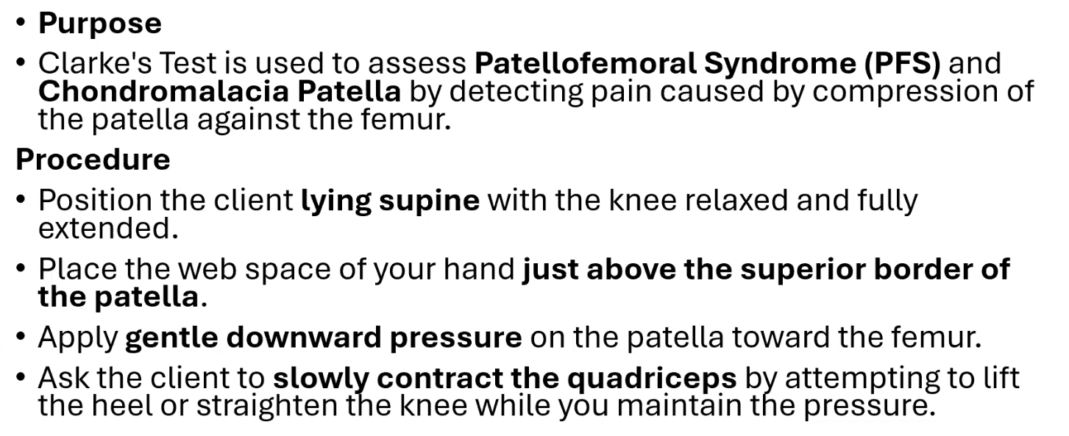
Clarke’s Test- (Patellar Grind Test)

Slide 27

McConnel’s Test

Slide 28
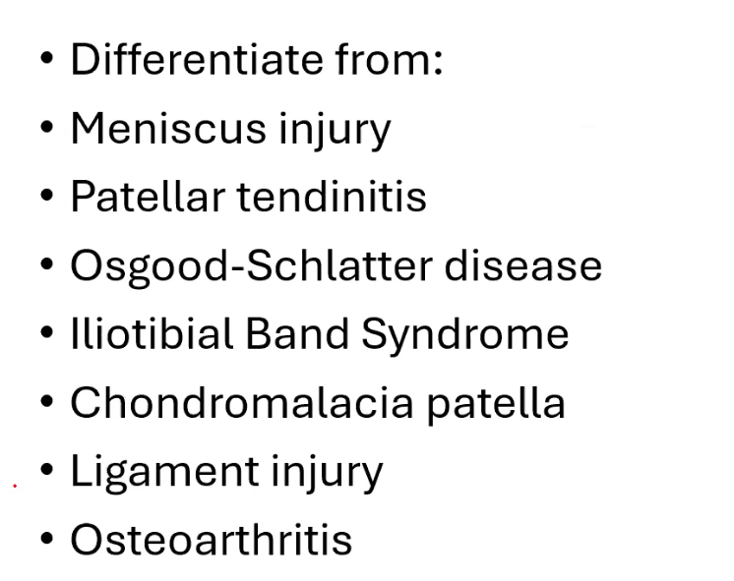
Differential Diagnosis

Slide 29
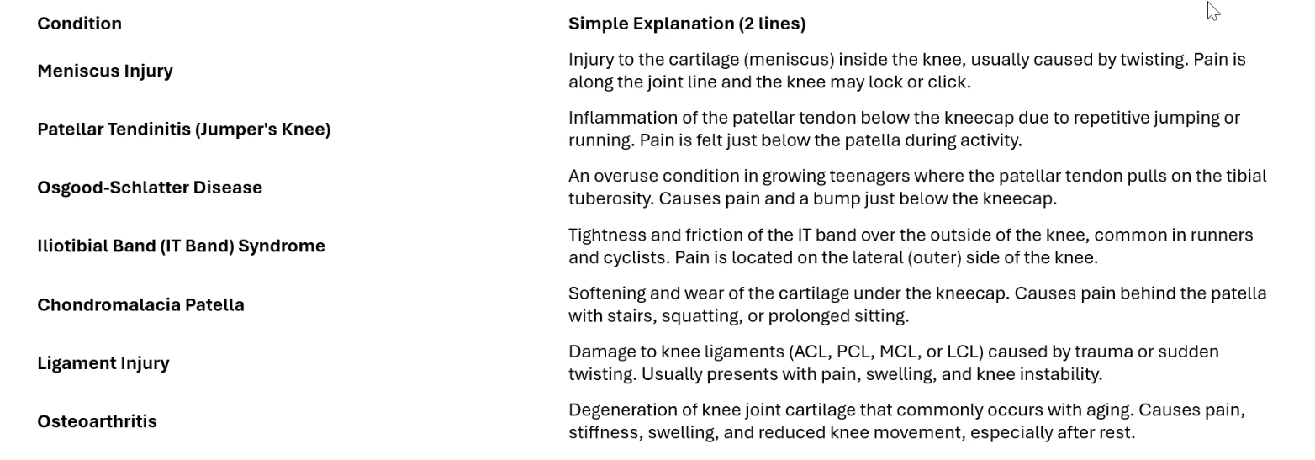
Differential Diagnosis of Patellofemoral Syndrome

Slide 30
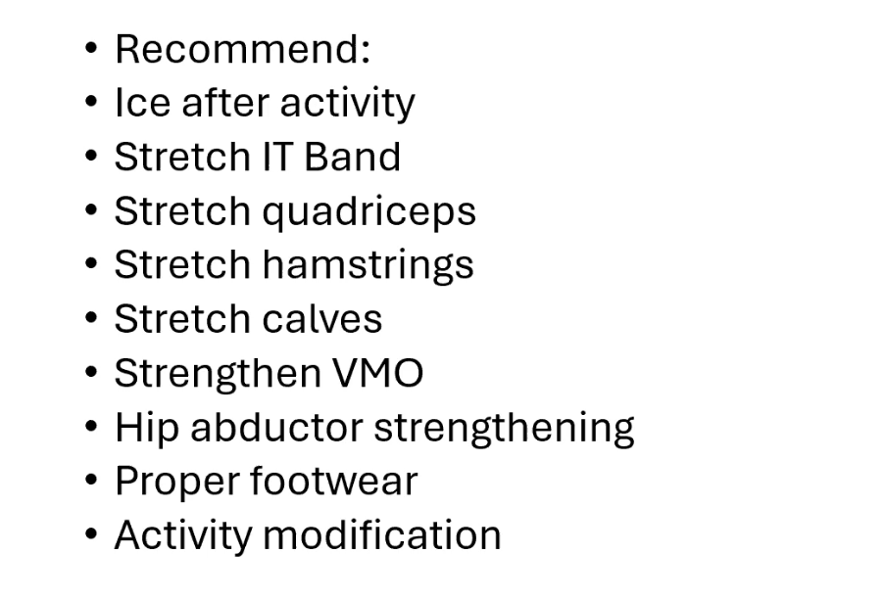
Self-Care

Slide 31
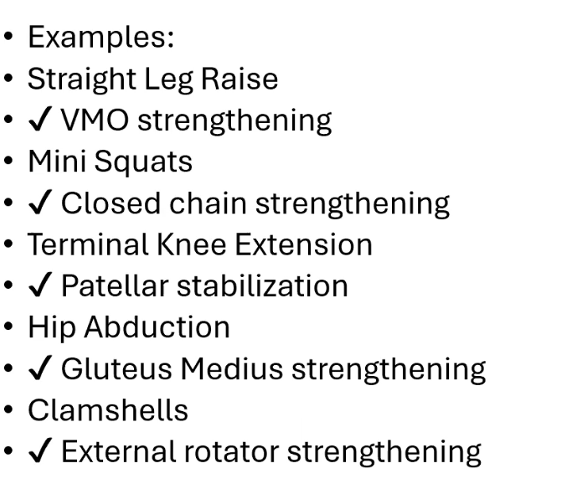
Home Exercise

Slide 32
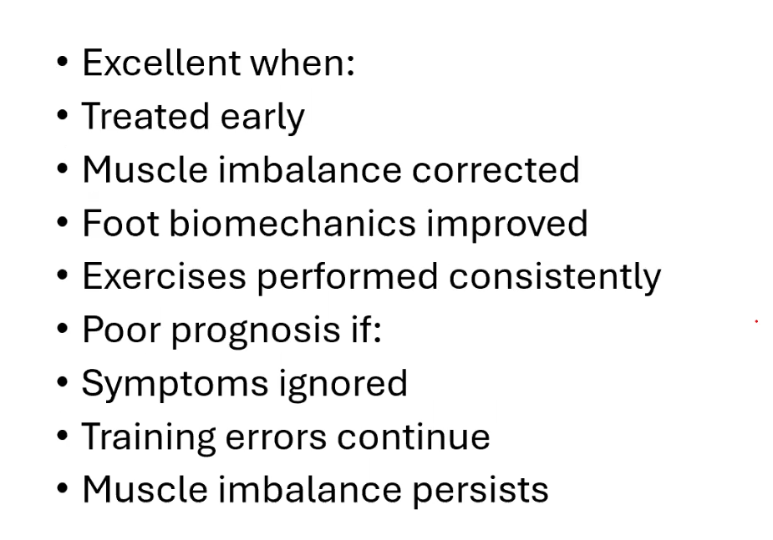
Prognosis

Slide 33
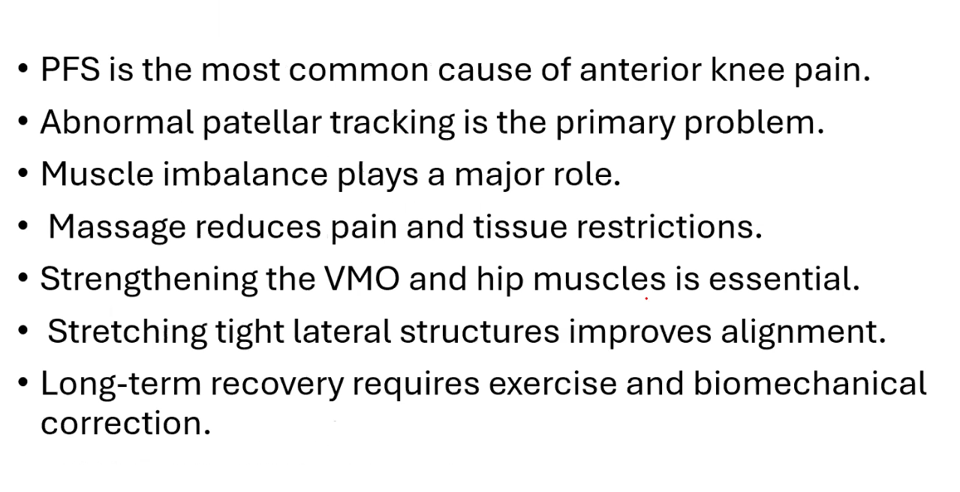
Key Take Home Points

