Slide 1
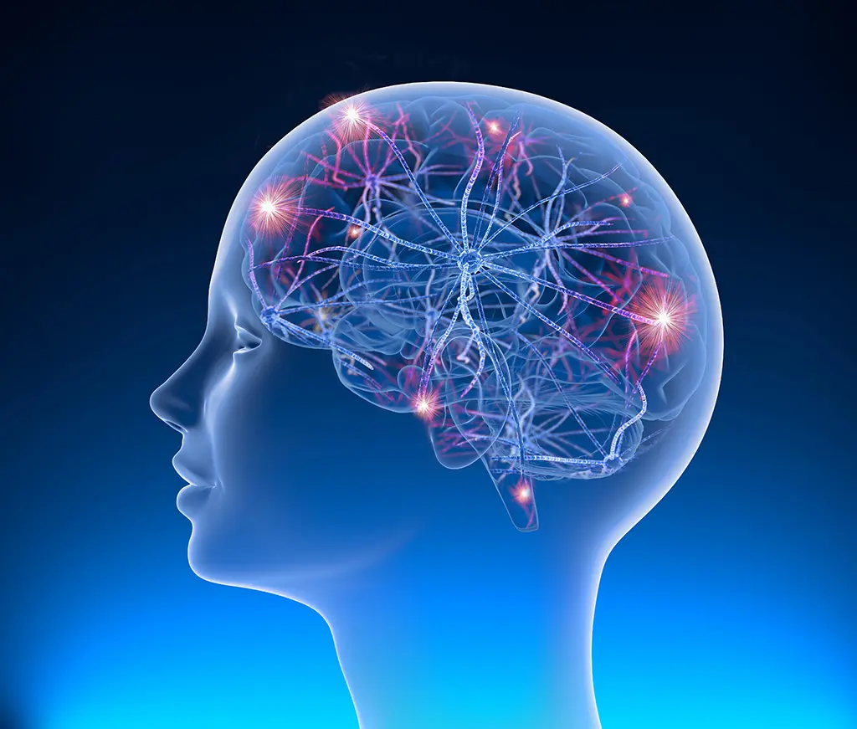
Neurology III-6
Seizures

Slide 2
Episodic Loss of Consciousness
Consciousness is lost when the function of both cerebral hemispheres or the brainstem reticular activating system is compromised. Episodic dysfunction of these anatomic regions produces transient, and often recurrent, loss of consciousness. There are two major causes of episodic loss of consciousness.
Seizures
Syncope

Slide 3
Approach to Diagnosis
Events at Onset of Spell
Prodromal Symptoms (Aura)
Posture When Loss of Consciousness Occurs
Relationship to Physical Exertion
Focal Symptoms

Slide 4
Events during the Spell
Tonic Stiffening and Clonic Movement
Flaccidity
Brief Stiffening or Jerking

Slide 5
Events after the Spell
Prompt Recovery of Consciousness
Brief Confusion
Prolonged Confusion
Tongue Biting
Urinary Incontinence

Slide 6
Seizures
A seizure is a transient disturbance of cerebral function caused by an abnormal neuronal discharge. Epilepsy, a group of disorders characterized by recurrent seizures, is a common cause of episodic loss of consciousness; the prevalence of epilepsy in the general population is about 1%, and the lifetime probability of a seizure is approximately 10%.
Etiology

Slide 7
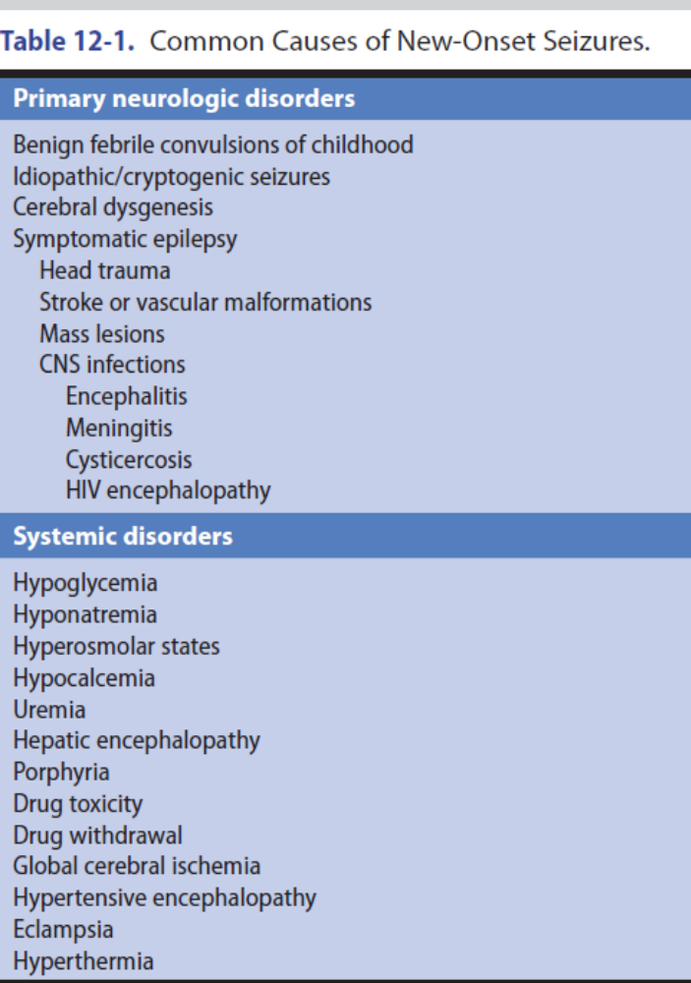

Slide 8
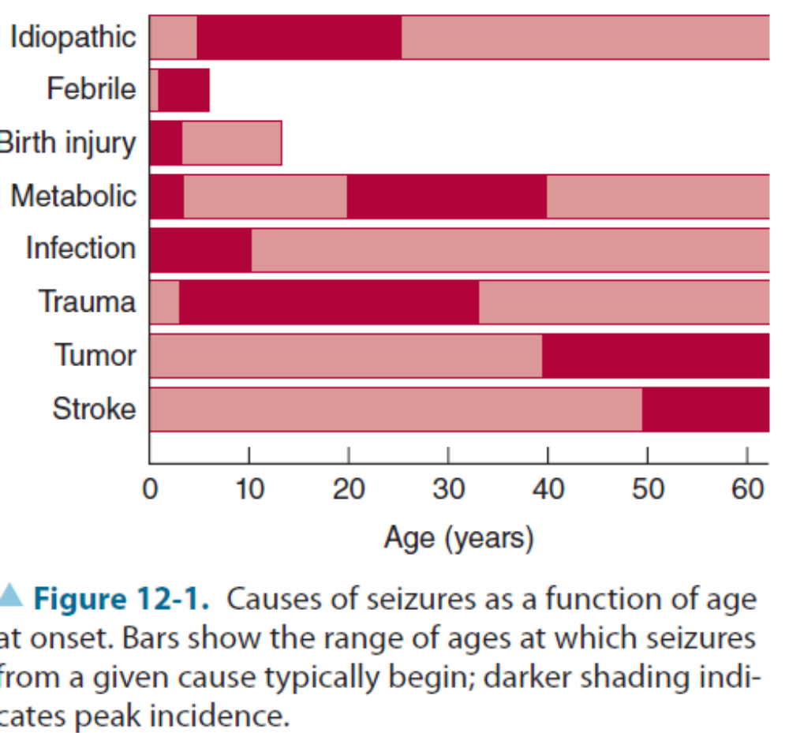

Slide 9
Primary Neurologic Disorders
Benign Febrile Convulsions
Idiopathic (Cryptogenic) Seizures
Head Trauma
Stroke
Mass Lesions
Meningitis or Encephalitis

Slide 10
Systemic Disorders
1. Hypoglycemia
2. Hyponatremia
3. Hyperosmolar states
4. Hypocalcemia
5. Uremia
6. Drug overdose and withdrawal

Slide 11
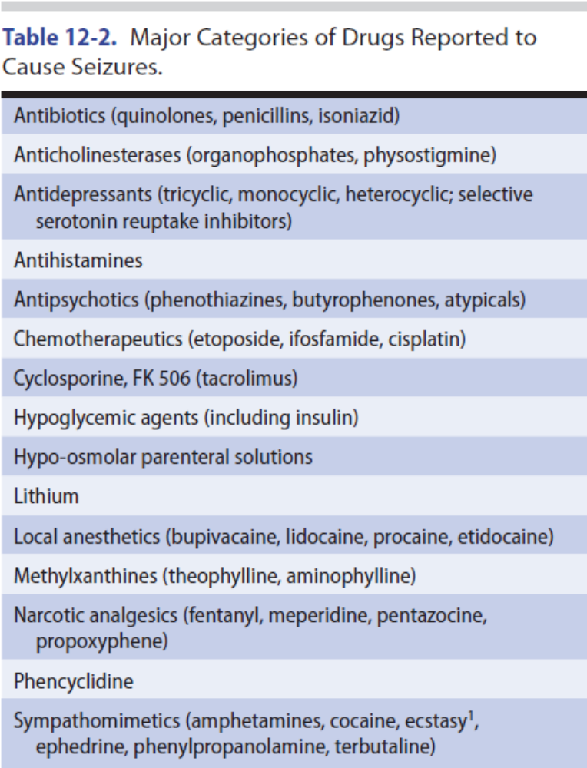

Slide 12
Nonepileptic Seizures
Attacks that resemble seizures (nonepileptic seizures or psychogenic seizures) may be manifestations of a psychiatric disturbance such as conversion disorder, somatization disorder, factitious disorder with physical symptoms, or malingering. Nonepileptic seizures usually can be distinguished both clinically and by the electroencephalogram (EEG) findings.

Slide 13
Classification
Generalized Seizures
Generalized Tonic–Clonic Seizures
1. Tonic phase
2. Clonic phase
3. Recovery
4. Status epilepticus

Slide 14
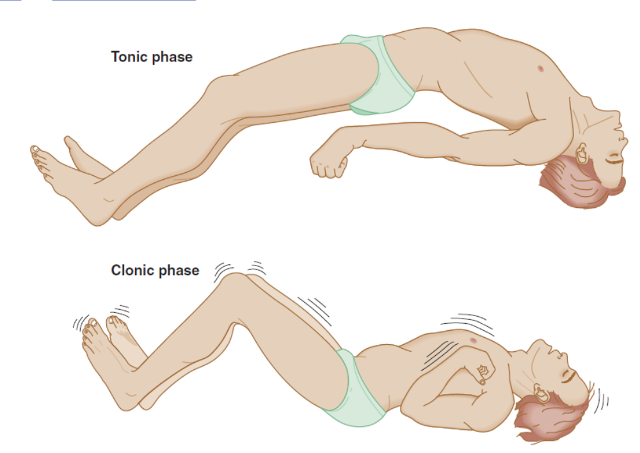

Slide 15
Absence (Petit Mal) Seizures
These are genetically transmitted seizures that always begin in childhood and rarely persist into adolescence. Genes linked to childhood absence epilepsy include the voltage-gated calcium channel and GABAA receptor subunits, malic enzyme 2, and inhibin alpha precursor. The spells are characterized by brief loss of consciousness (for 5-10 seconds) without loss of postural tone. Subtle motor manifestations, such as eye blinking or a slight head turning, are common. More complex automatic movements (automatisms) are uncommon. Full orientation is present immediately after seizure cessation.

Slide 16
Other Types of Generalized Seizures
1. Tonic seizures
2. Clonic seizures
3. Myoclonic seizures
4. Atonic seizures

