Slide 1
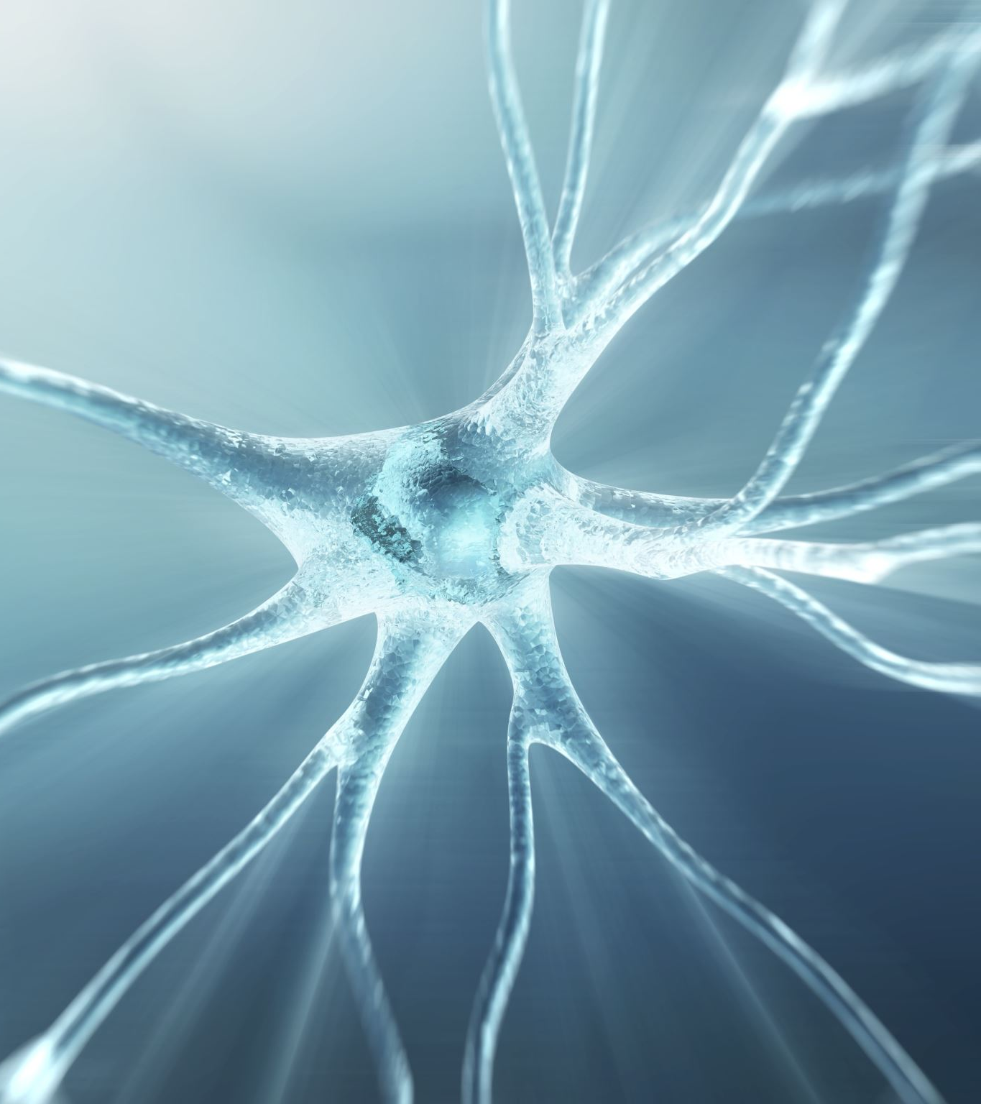
Neurology III-5
Movement Disorders 2

Slide 2
CLINICAL EVALUATION OF PATIENTS
HISTORY
AGE AT ONSET
MODE OF ONSET
COURSE
MEDICAL HISTORY
Drug History
General Medical History
Family History

Slide 3
Examination
Clinical examination indicates the nature of the abnormal movements, the extent of neurologic involvement, and the presence of coexisting disease; these in turn may suggest the diagnosis.
Focal motor or sensory deficits raise the possibility of a structural space-occupying lesion, as does papilledema. Kayser-Fleischer rings suggest Wilson disease. Signs of vascular, hepatic, or metabolic disease may suggest other causes for a movement disorder, such as acquired hepatocerebral degeneration or vasculitis.

Slide 4
Investigative Studies
BLOOD & URINE TESTS
ELECTROPHYSIOLOGIC TESTS
IMAGING
GENETIC STUDIES
PSYCHOLOGIC EVALUATION

Slide 5
Selected Movement Disorders
Familial or Essential Tremor
Parkinsonism
Huntington Disease
Wilson Disease
Gilles de la Tourette Syndrome
Restless Legs Syndrome

Slide 6
Familial or Essential Tremor
PATHOGENESIS
CLINICAL FINDINGS
TREATMENT

Slide 7
Parkinsonism
Parkinsonism occurs in all ethnic groups; it has a prevalence of 1 to 2 per 1,000 population, with an approximately equal sex distribution.
The disorder becomes increasingly common with advancing age. It is characterized by tremor, hypokinesia, rigidity, and abnormal gait and posture.
ETIOLOGY
Idiopathic
Encephalitis
Drug- or Toxin-Induced Parkinsonism/ Vascular Parkinsonism/ Post-traumatic Parkinsonism/ Familial & Genetic Parkinsonism

Slide 8
PATHOLOGY
PATHOGENESIS
CLINICAL FINDINGS
Tremor
Rigidity
Hypokinesia
Abnormal Gait & Posture
Other Motor Abnormalities
Nonmotor Manifestations

Slide 9
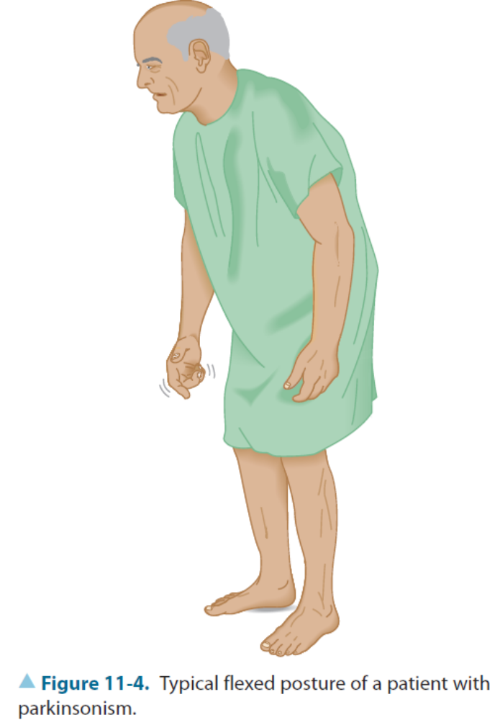

Slide 10
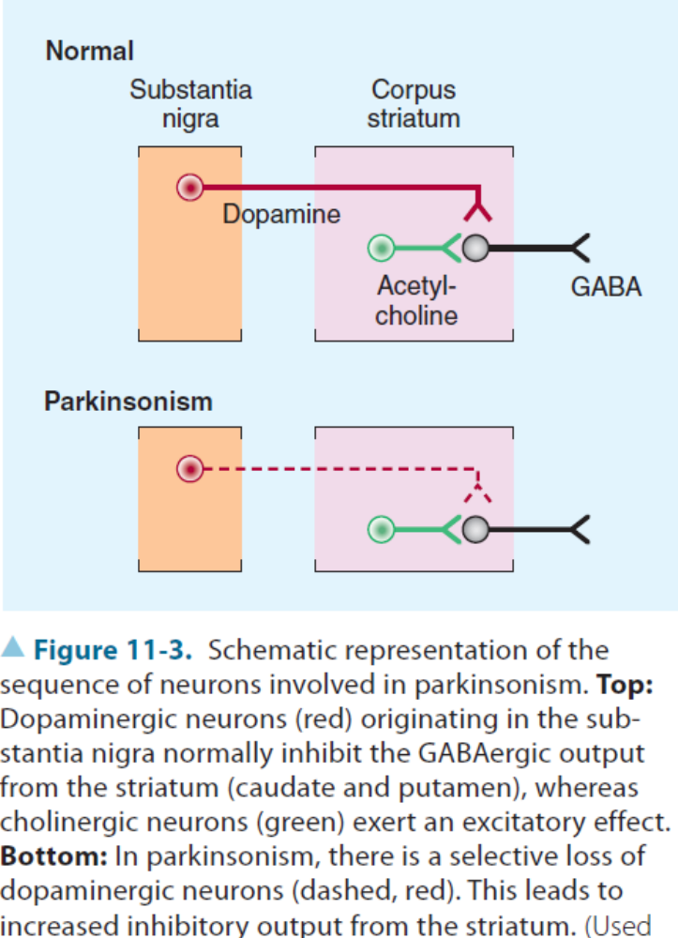

Slide 11
DIFFERENTIAL DIAGNOSIS
Depression
Essential (Benign Familial) Tremor
Parkinson-Plus Syndromes
Dystonia
Wilson Disease
Huntington Disease
Creutzfeldt-Jakob Disease
Normal Pressure Hydrocephalus

Slide 12
TREATMENT
Anticholinergic Drugs
Amantadine
Levodopa
Dopamine Agonists
Catechol-O-Methyltransferase Inhibitors
Monoamine Oxidase Inhibitors
Ablative Surgery
Deep Brain Stimulation

Slide 13
Huntington Disease
EPIDEMIOLOGY
GENETICS
PATHOLOGY
CLINICAL FINDINGS
TREATMENT & PROGNOSIS
PREVENTION

Slide 14
Wilson Disease
PATHOGENESIS
CLINICAL FINDINGS
INVESTIGATIVE STUDIES
TREATMENT

Slide 15
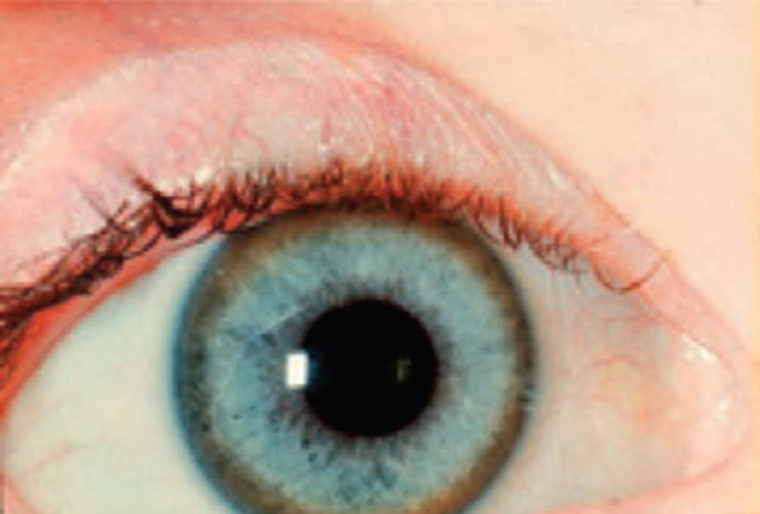
Kayser-Fleischer ring in Wilson disease.

Slide 16
Drug-Induced Movement Disorders
PARKINSONISM
ACUTE DYSTONIA
AKATHISIA
TARDIVE DYSKINESIA
Levodopa produces a wide variety of abnormal movements as a dose-related phenomenon in patients with parkinsonism. They can be reversed by withdrawing the medication or reducing the dose.

Slide 17
Gilles de la Tourette Syndrome
Gilles de la Tourette syndrome, characterized by chronic typically lifelong—multiple motor and verbal tics, is of unknown cause and does not relate to social class, ethnic group, perinatal abnormalities, birth trauma, or birth order.
PATHOGENESIS
CLINICAL FINDINGS
COMPLICATIONS
TREATMENT

Slide 18
Restless Legs Syndrome
Restless legs syndrome is characterized by an unpleasant creeping discomfort that is perceived as arising deep within the legs and occasionally in the arms as well. Symptoms tend to occur when patients are relaxed, especially while lying down or sitting, and lead to a need to move about. They are often particularly troublesome at night and may delay the onset of sleep.
Symptoms sometimes resolve after correction of coexisting iron-deficiency anemia, and they may respond to treatment with drugs such as dopamine agonists, levodopa, gabapentin, pregabalin, or opiates.

Slide 19
