Slide 1
Physical Assessment 8
Elbow Assessment

Slide 2
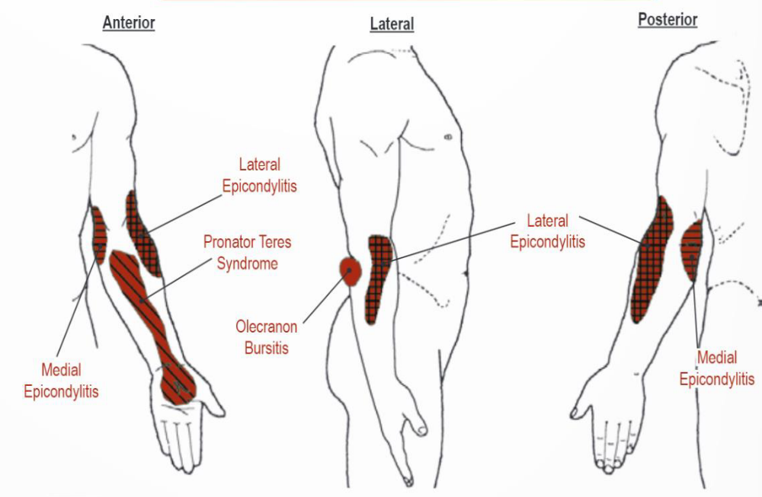
Elbow referral pain patterns

Slide 3
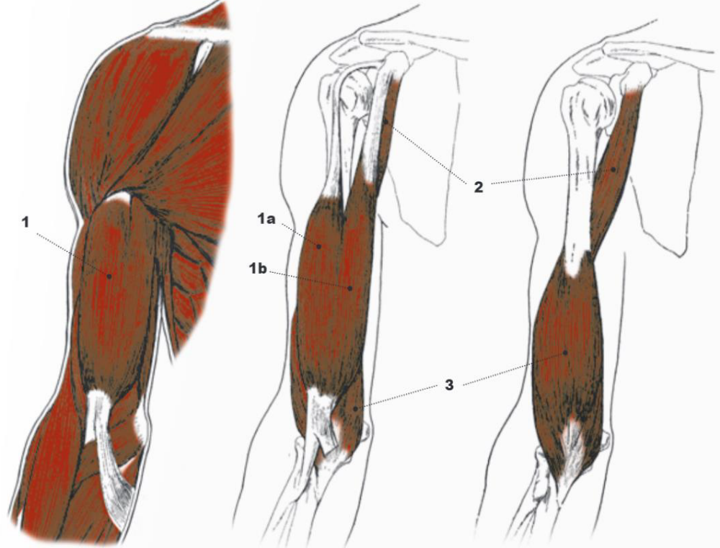
Arm muscle review

Slide 4
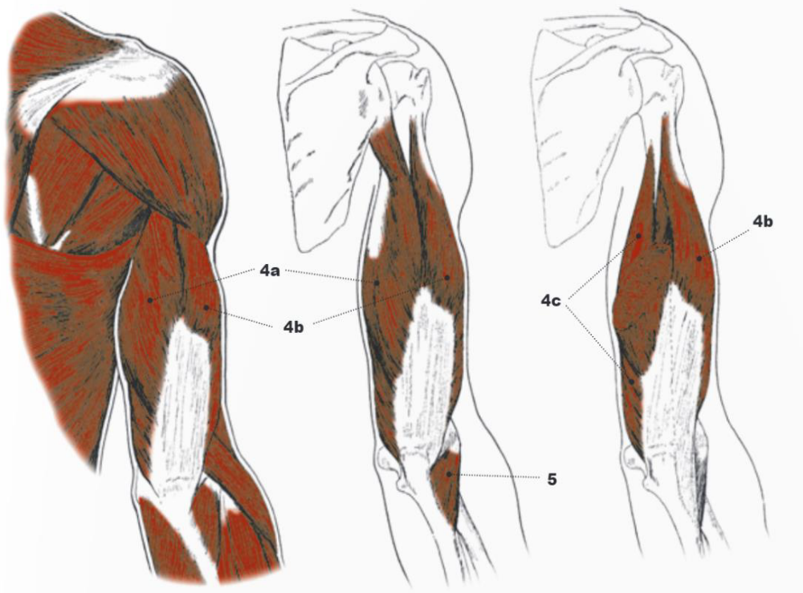
Arm muscle review

Slide 5
Elbow Exam Flow
History considerations screening
Inspection lateral epicondylitis
Fracture screen medial epicondylitis
Palpation pronator teres/ median nerve
Functional
AROM
PROM
Myotomes
Neurovascular screening
Orthopedic Tests

Slide 6

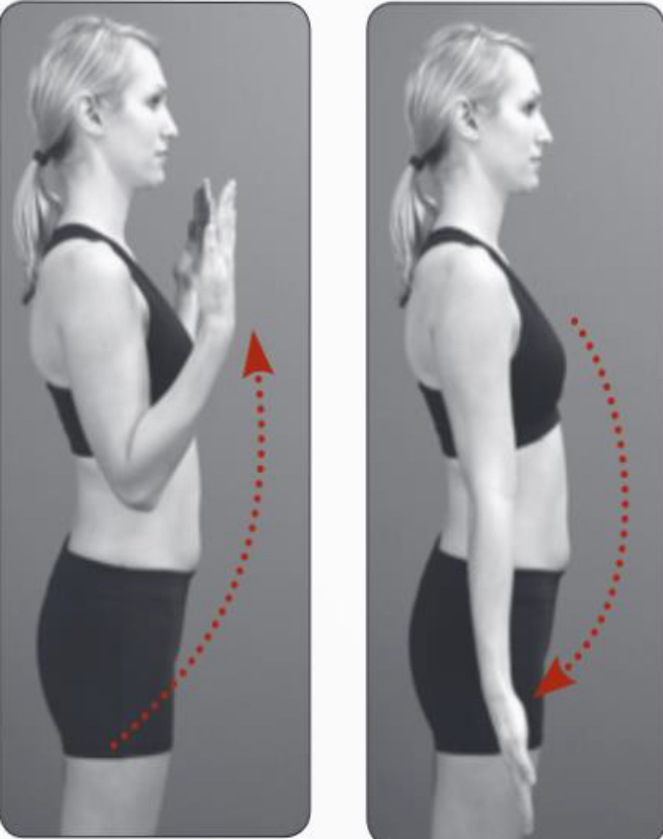
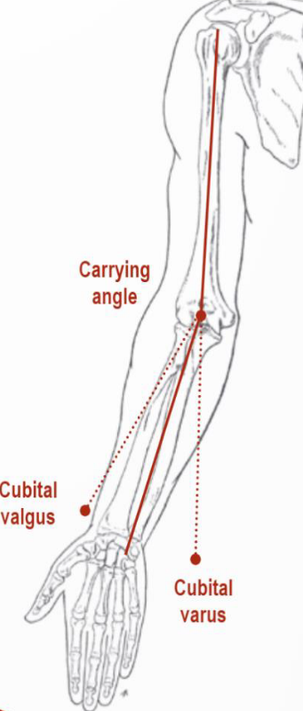
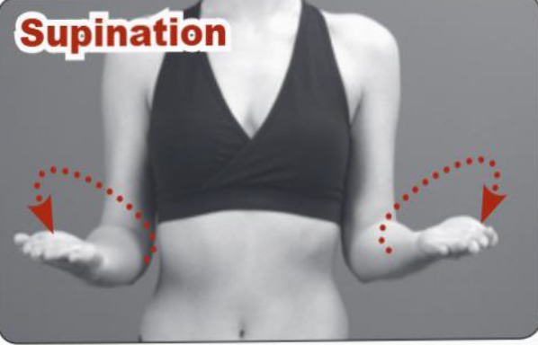
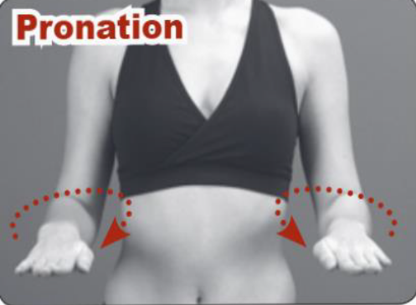
Elbow kinematic

Slide 7
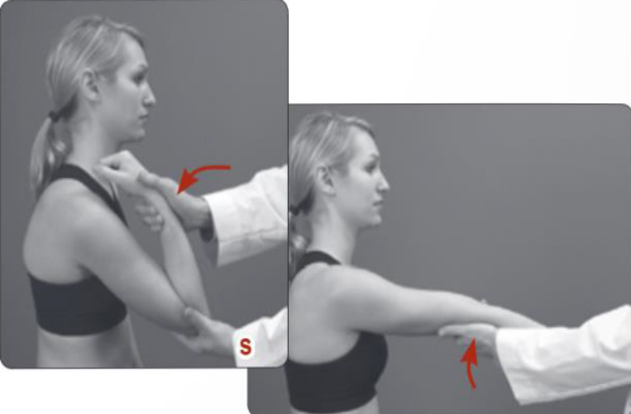
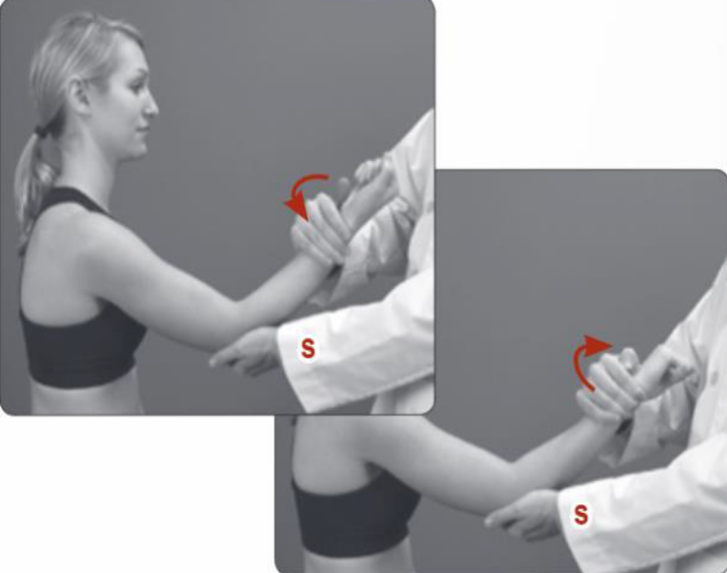
PROM

Slide 8
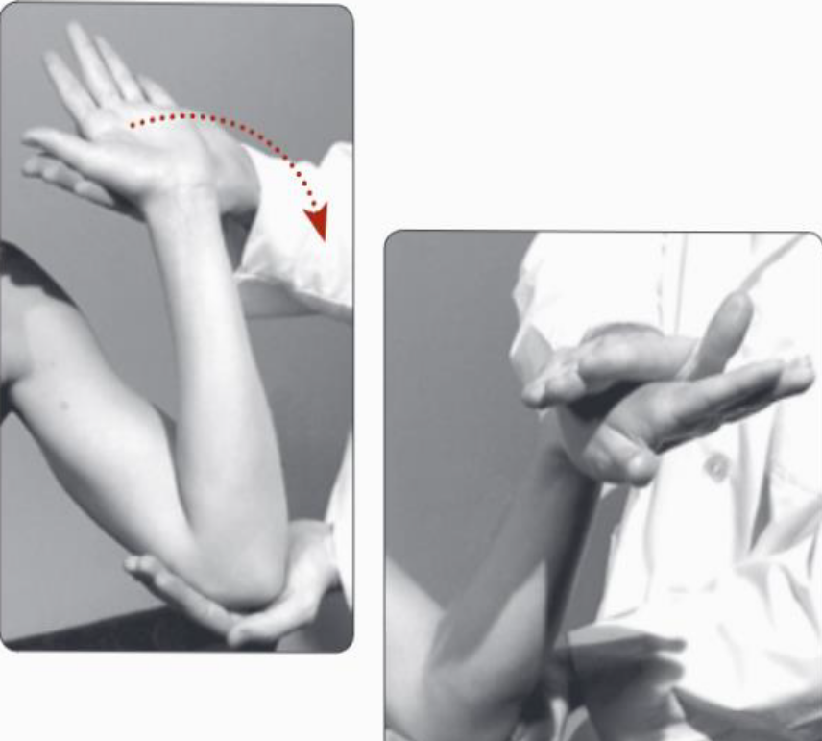
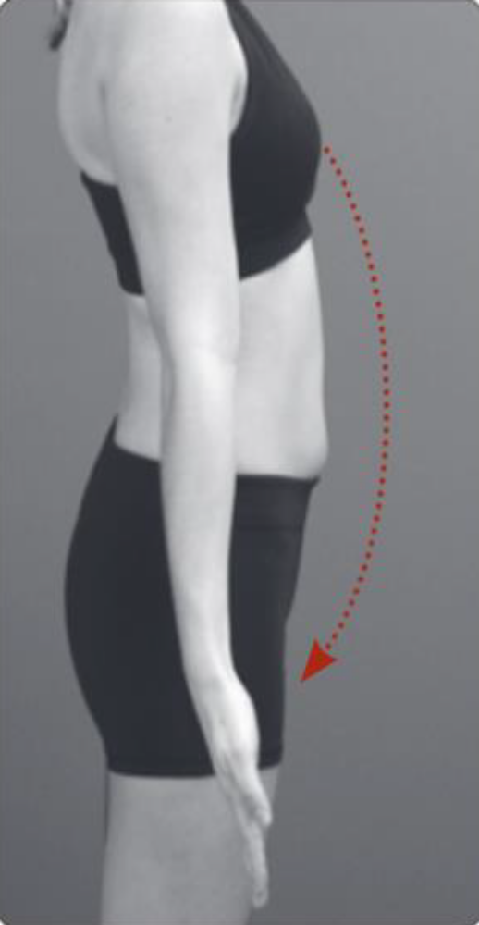

Orthopedic Tests

Slide 9
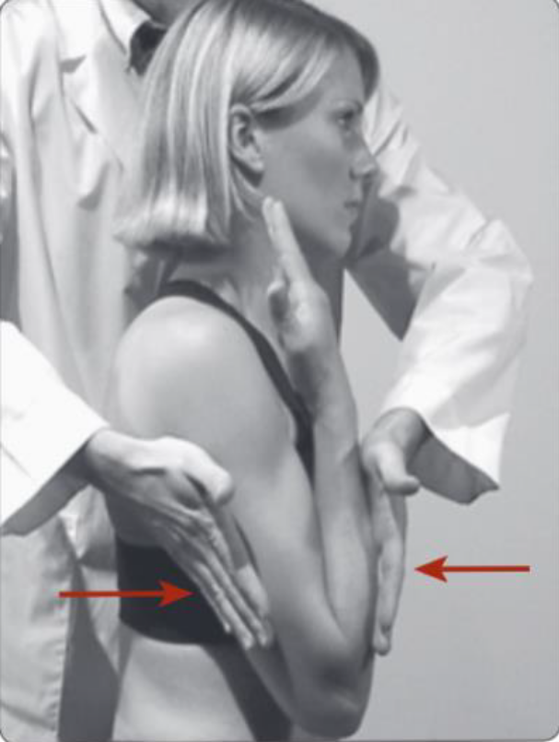
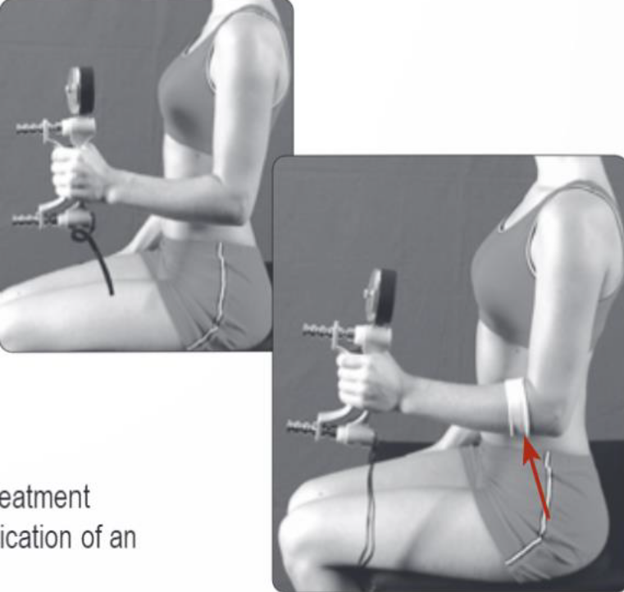


Orthopedic Tests

Slide 10
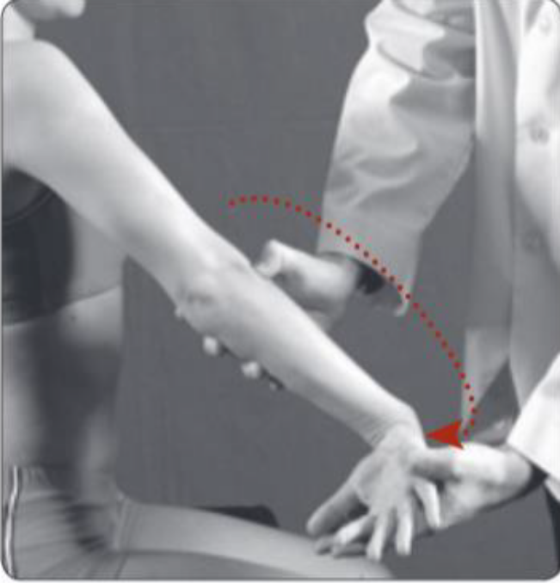



Orthopedic Tests

Slide 11
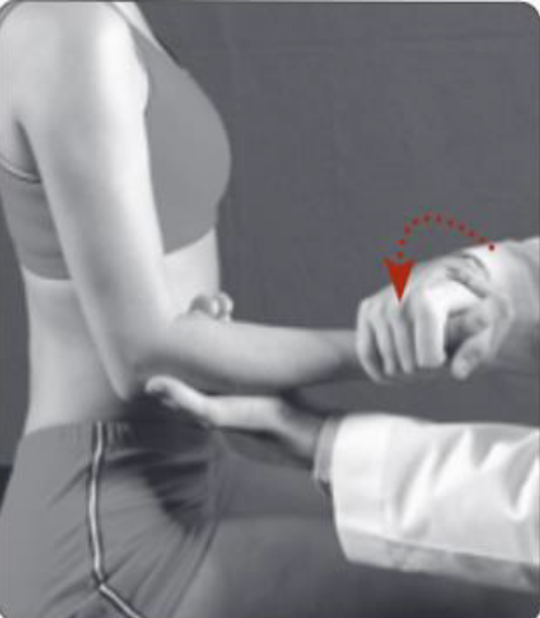
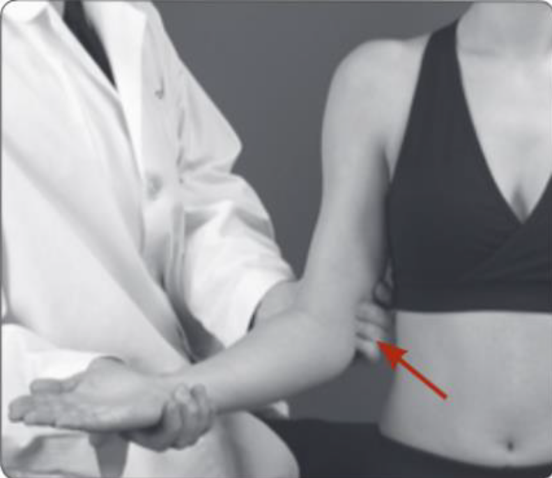

Orthopedic Tests

Slide 12
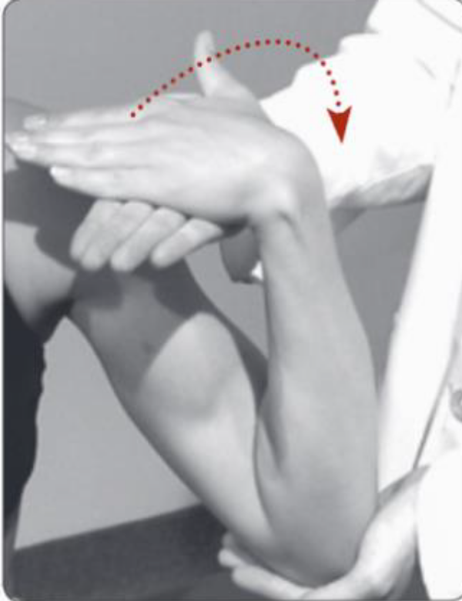
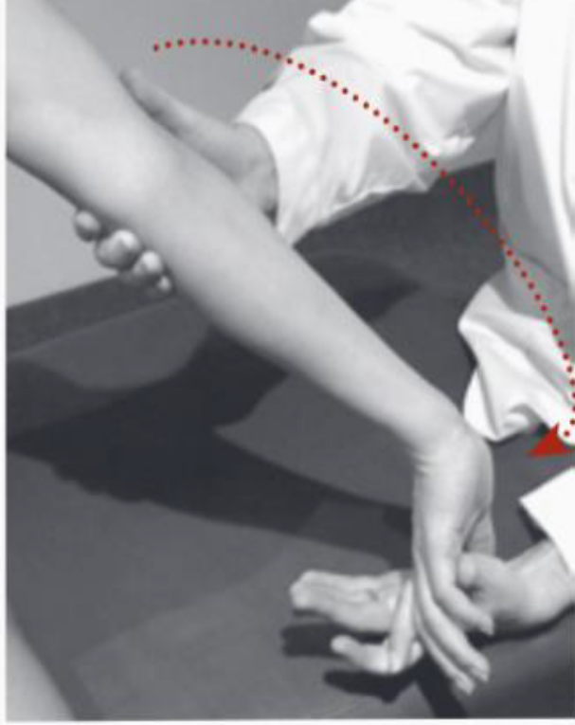


Orthopedic Tests

Slide 13
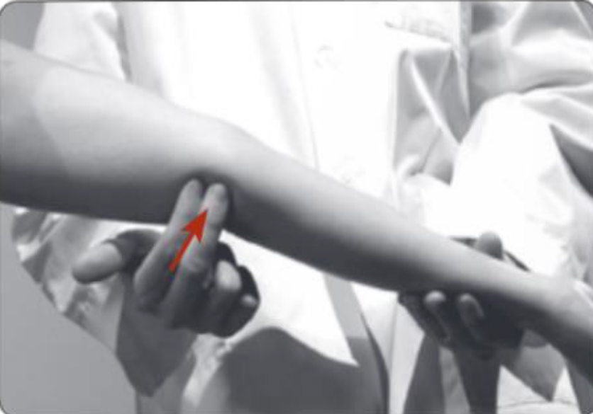

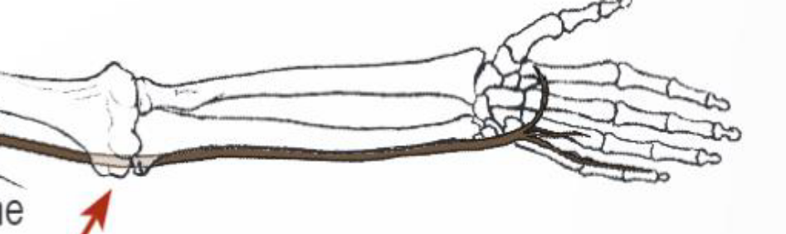
Orthopedic Tests

Slide 14
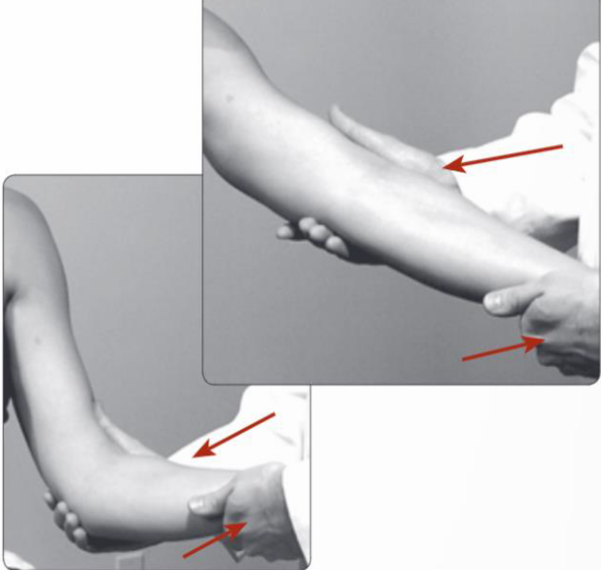
Orthopedic Tests

Slide 15
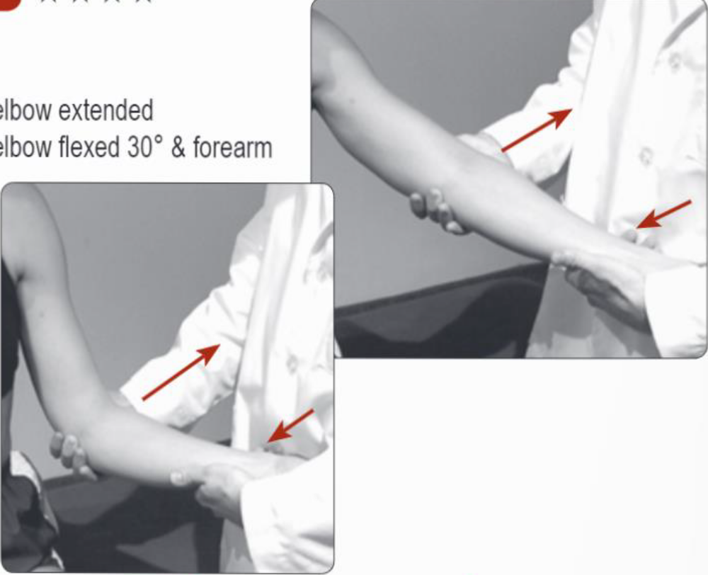
Orthopedic Tests

Slide 16
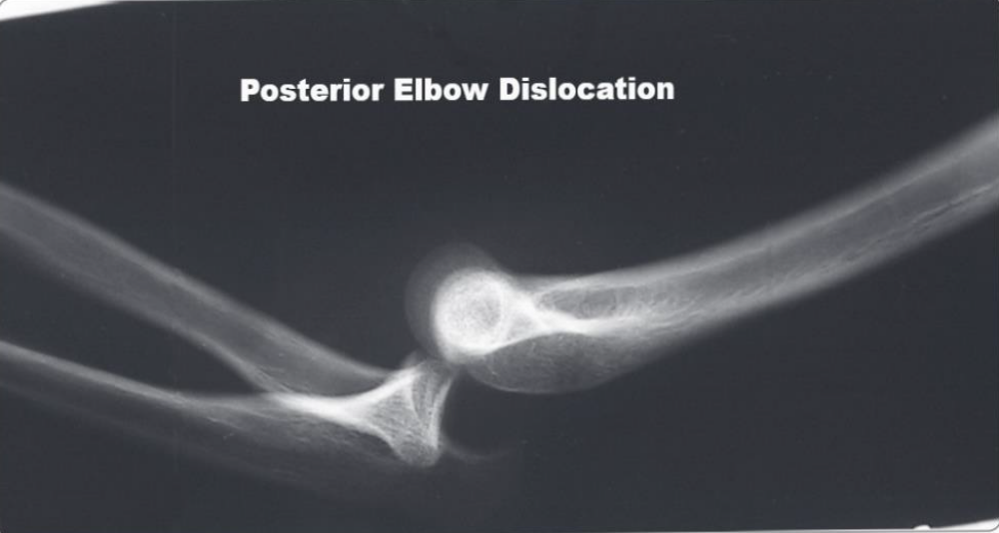
Elbow Dislocation

