Slide 1
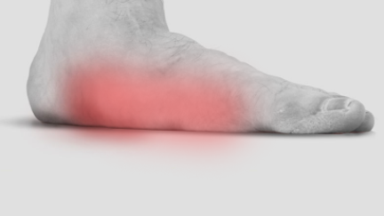
Pes Planus…
Pes cavus, hallux valgus

Slide 2
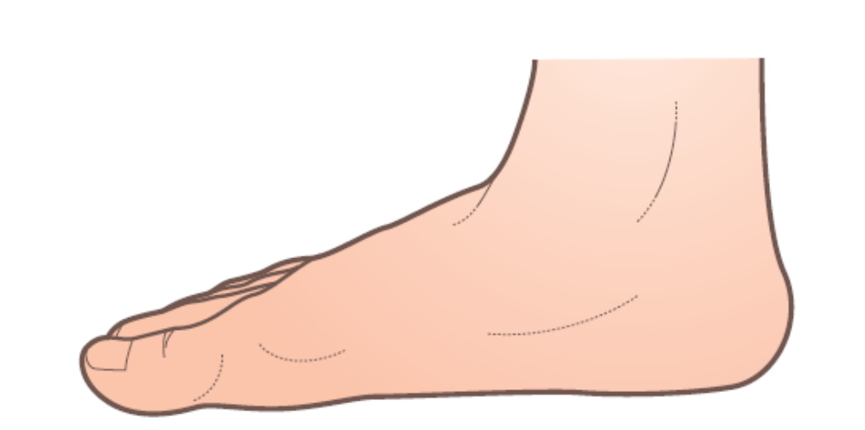

Description
Pes planus is a postural disorder of the foot more commonly known as flat foot. It results from a dropped or fallen longitudinal arch.
The primary function of the longitudinal arch is to aid in propulsion of the foot and shock absorption during foot strike. A detrimental effect of pes planus is that it decreases the shock-absorbing capability of the longitudinal arch. Pes planus results from weakness or laxity in those soft tissues that support the longitudinal arch including the tibialis posterior and intrinsic foot muscles, plantar fascia, tarsal, deltoid, and calcaneonavicular ligaments.

Slide 3
Of these, the tibialis posterior is considered the primary dynamic structural support for the arch. When other support tissues are weakened, even greater load is placed on the tibialis posterior to maintain the arch. Fatigue and dysfunction of the muscle is a common cause of pes planus and can lead to other problems such as shin splints, stress fractures, and plantar fasciitis.
The condition can appear earlier in life as a congenital deformity, but is often the result of age, increasing weight, and gradual loss of residual strength in the soft tissues that support the arch. Pes planus does not always lead to other disorders of the lower extremity. Many people have pes planus and experience no symptoms.

Slide 4
Treatment
Traditional approaches
Pes planus is most commonly treated with orthotics. The orthotic is designed to support the longitudinal arch and take stress off the soft tissues, such as the tibialis posterior. If the pes planus involves a severe case of bone deformity, surgery is sometimes used to correct the disorder.

Slide 5
Soft-tissue manipulation
General guidelines Pes planus results from weakening of structures that support the longitudinal arch. Massage reduces symptoms from the soft-tissue stress. However, massage treatment will not restore the arch to its proper form on its own. Some form of postural re-education is necessary; biomechanical interventions such as orthotics and strengthening and conditioning exercises in the foot are beneficial.

Slide 6
Suggested techniques and methods The techniques
listed in the descriptions under plantar fasciitis or medial tibial stress syndrome are helpful for reducing symptoms resulting from pes planus.
Rehabilitation protocol considerations
Massage treatment for pes planus is primarily for symptom management and not for corrective measures and can be performed at any time throughout the rehabilitation process.

Slide 7
The primary protocol consideration is for the practitioner to remember that soft-tissue therapy can change biomechanical relationships that are being addressed with other procedures, such as orthotics.
Cautions and contraindications
As long as working on the foot and leg region is appropriate there are no major cautions or contraindications for working on a client with pes planus

Slide 8
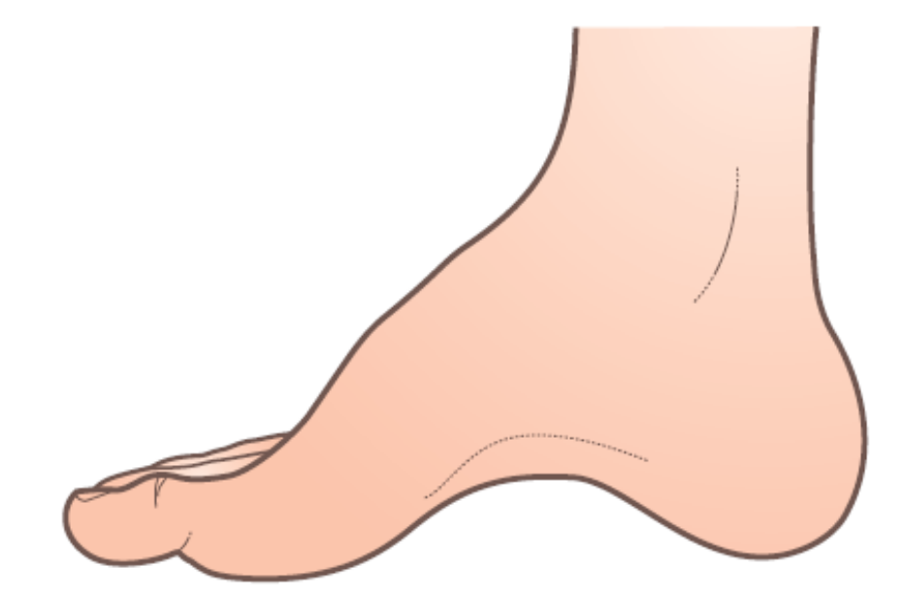

PES CAVUS
Description
Pes cavus is a postural disorder characterized by a high longitudinal arch in the foot that does not flatten with weight bearing. In pes cavus there is a shortening of soft tissues that support the longitudinal arch, such as the plantar fascia and tibialis posterior muscles. Bone deformities can also cause or result from this foot disorder.

Slide 9
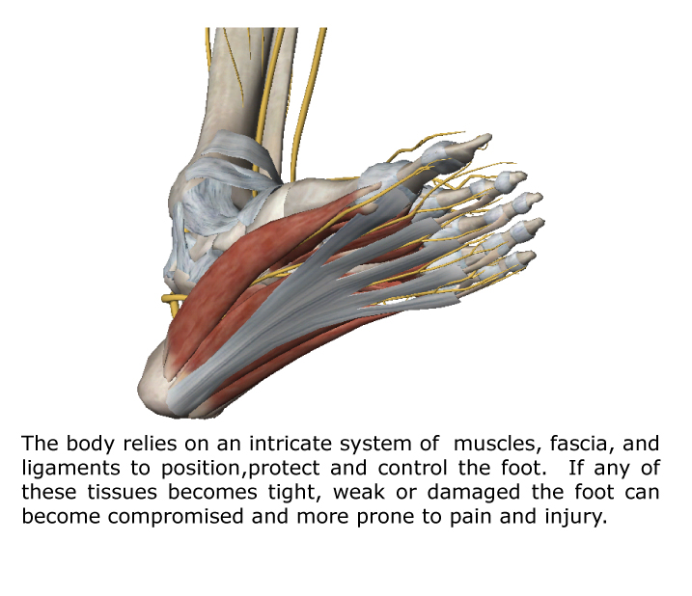
Intrinsic foot muscles, as well as the tibialis anterior and posterior, can be hypertonic and maintain the distorted position of the arch. The plantar fascia is in a shortened position causing increased tensile loads at its attachment points, especially at the anterior calcaneus. Due to the altered pull of muscular imbalance lateral foot pain is frequently reported in clients with pes cavus.

Slide 10
There are numerous causes of pes cavus. This postural disorder is often caused by neuromuscular disorders such as muscular dystrophy or Charcot–Marie–Tooth disease. The condition can also be congenital. It is normal to see an increased incidence of other foot, ankle, or leg disorders that the pes cavus has contributed to, such as metatarsal stress fractures, plantar fasciitis, or Morton’s neuroma. In some cases the condition results from traumatic injury that causes alterations in tarsal bone position.
Numerous biomechanical problems result from the high longitudinal arch. With increased arch height, there is greater weight-bearing pressure on the metatarsal heads. Increased pressure in this region can lead to Morton’s neuroma, metatarsal stress fractures, or other biomechanical distortions such as claw-toe deformity.

Slide 11
Treatment
Traditional approaches
If there is a progressive underlying disease or disorder that has produced the pes cavus, treatment options may be limited. In less severe cases orthotics can be helpful in correcting improperly distributed pressure levels on the foot. Physical therapy is used to stretch tight muscles and strengthen weak ones with the overall goal of addressing muscle imbalance to restore a proper arch. If the condition is severe, surgery may be necessary to correct the dysfunctional alignment. Surgical procedures may involve efforts to re-position bones or surgically release the plantar fascia, which has become shortened and fibrous.

Slide 12
Soft-tissue manipulation
General guidelines Pes cavus usually involves a combination of some leg and foot muscles that are tight, and others that have become weakened. Various conditioning activities will be necessary to strengthen the weakened muscles, but massage is a valuable treatment approach for addressing the hypertonic muscles. The exact pattern of muscle tightness and weakness can differ among clients, but these general guidelines can help in a majority of cases. There is usually greater weakness in the tibialis anterior and peroneus brevis muscles. These are the muscles that benefit from strengthening procedures. Tibialis posterior and peroneus longus tend more towards hypertonicity, so these muscles benefit from massage treatment.

Slide 13
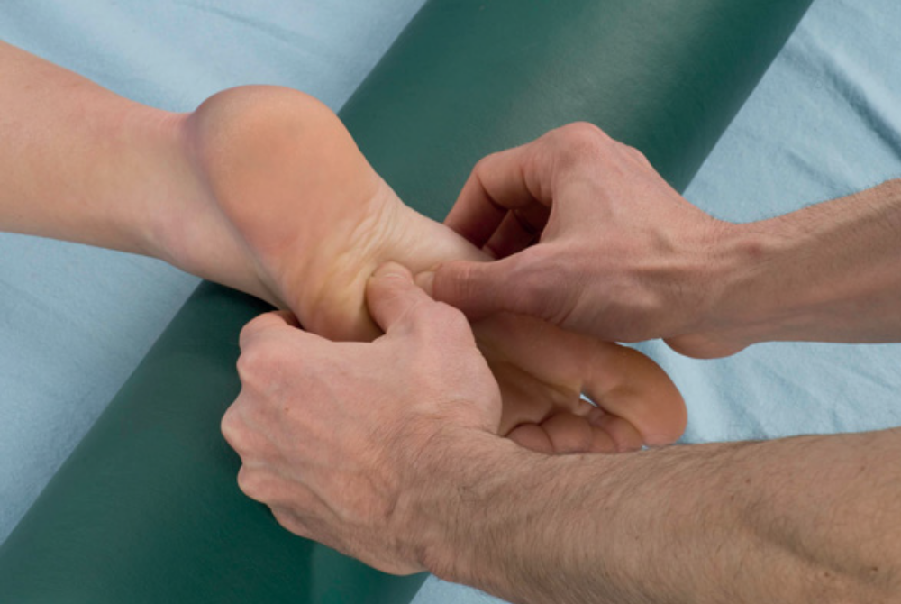
A. Longitudinal stripping to plantar surface of the foot Tension in soft tissues that shorten the arch is addressed with deep stripping techniques to the plantar surface of the foot. This technique is described in A under Plantar fasciitis and pictured here.

Slide 14
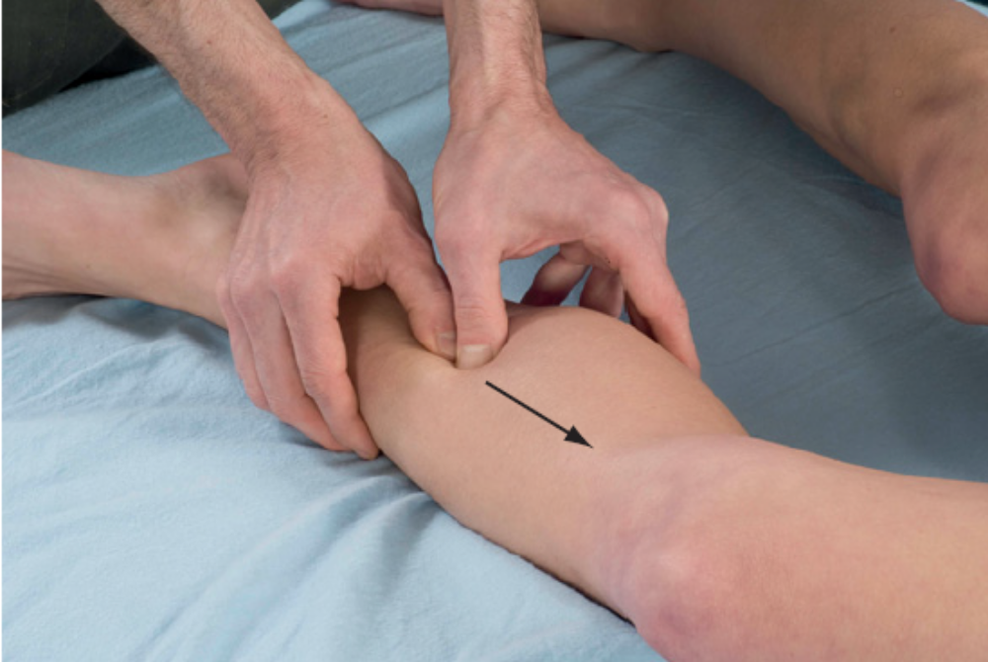
B. Deep stripping and active engagement techniques Reduction of muscle tension that leads to pes cavus is also achieved with active engagement techniques that focus on the tibialis posterior. These techniques are described in D and E under Plantar fasciitis and illustrated here.

Slide 15
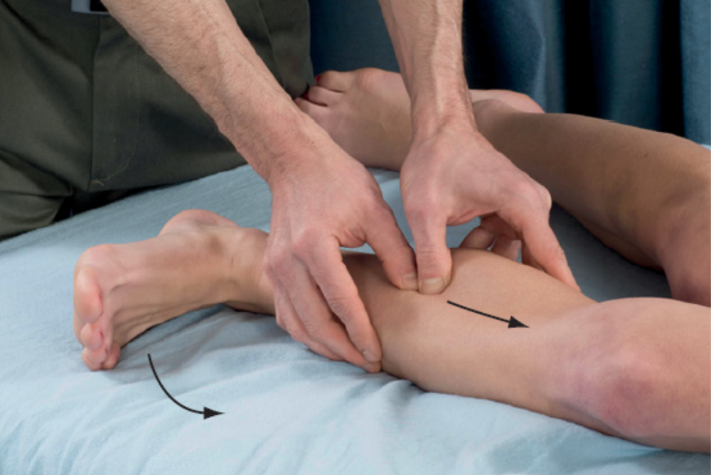


Slide 16
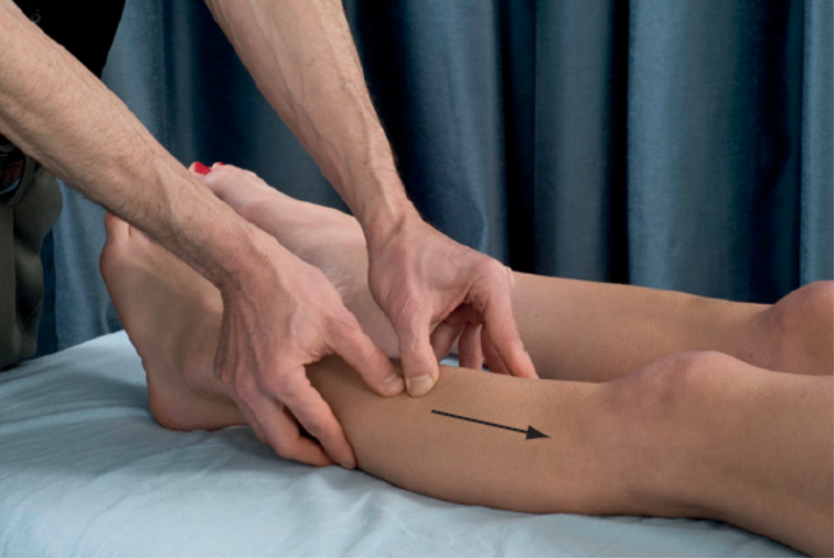
C. Deep stripping to peroneal muscles Peroneal muscles can aid in pulling the arch in a higher position. Stripping techniques that emphasize the peroneal muscles reduce tension on the arch. This technique is virtually the same as that described in B under Anterior compartment syndrome and pictured here. The only difference is emphasis of the stripping technique on the lateral region of the lower leg to address the peroneus longus and not as much on the anterior compartment.

Slide 17
Rehabilitation protocol considerations
If another health professional is treating the client for biomechanical distortions associated with the pes cavus condition, consider the impact of massage treatment on those other procedures and adjust treatment accordingly.
Cautions and contraindications It is generally safe to use soft-tissue therapy on a pes cavus condition as long as there are no other major contraindications that would be cause for concern. If the client’s pes cavus condition is the result of some neuromuscular disorder or systemic disease, consult with the client’s health care provider. It is unlikely that massage would have adverse effects on other treatments, but it is better to first clarify that before treatment.

Slide 18
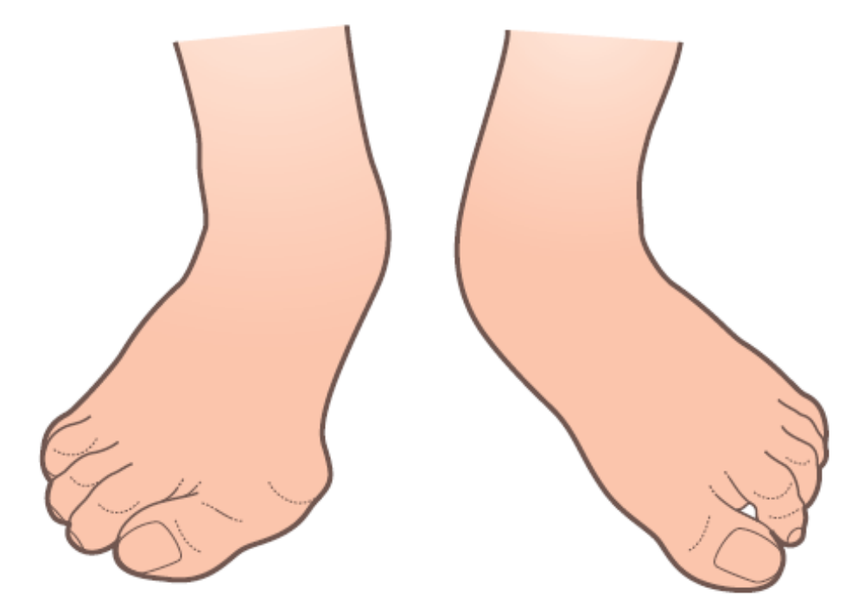

HALLUX VALGUS
Description
A valgus angulation is one in which the distal end of a bony segment deviates in a lateral direction. In this condition the distal end of the hallux is forced in a lateral direction. There are several factors that can cause a hallux valgus deformity including biomechanical, structural, or genetic disorders, lax ligaments, weak muscles, improper footwear, or abnormal bone structure. Wearing shoes with a narrow toe region is considered the primary cause of this disorder.

Slide 19
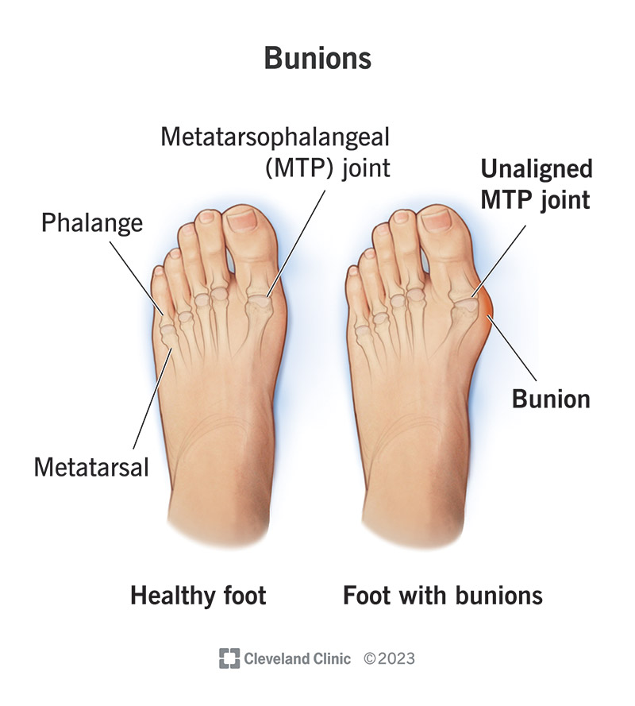
When the foot is in a shoe with a narrow toe region, the distal end of the hallux is forced toward the midline of the foot (a lateral direction in relation to the midline of the body). As the distal end of the hallux is pushed laterally (toward the foot’s midline), the proximal end pushes the first metatarsal head medially against the edge of the shoe, resulting in callus formation and subcutaneous inflammation. This callus formation is also called a bunion. Some sources call the hallux valgus deviation a bunion, so terminology is not always consistent in this condition.

Slide 20
A hallux valgus deformity can contribute to numerous lower extremity biomechanical problems. The hallux has a primary role in maintaining foot stability and absorbing forces during normal gait. When the distal hallux deviates laterally it is no longer able to carry out that crucial mechanical function. The loss of optimum foot mechanics from the hallux valgus deviation can lead to shin splints, myofascial trigger points, stress fractures, or overpronation. Some of these disorders can also create or increase a valgus deviation in the hallux. Overpronation, for example, puts a heavy biomechanical load on the distal hallux and metatarsophalangeal joint. If pronation is excessive, it can gradually force the distal hallux into its deviated position.

Slide 21
There is a noticeable gender difference in hallux valgus occurrence. It is far more common in women than in men. However, it is unclear if this difference is caused by structural or physiological differences or if it is caused by the different type of shoes worn by men and women.
There is a strong genetic pattern of hallux valgus occurrence. What is not clear is if the condition is more common within a family because of structural factors, sociological and cultural norms of particular shoes, or if there is just a genetic propensity for the condition that is exacerbated by outside factors. The condition does occur more commonly within families in the absence of particular shoes, indicating more important structural genetic factors.

Slide 22
Treatment
Traditional approaches
It is difficult to reverse a hallux valgus disorder because gradual pressure on the forefoot over time is responsible for the change in hallux angulation. In order to reverse the process it would be necessary to pull the distal hallux in the opposite direction (toward the medial side of the foot) for prolonged periods all day. In some cases there is inflammatory activity associated with the joint disorder. In those cases non-steroidal anti-inflammatory drugs (NSAIDS) or corticosteroid injections can be used to reduce inflammatory activity. Orthotics or pads inside the shoe are used to reduce pressure from the bunion at the metatarsal head on the side of the shoe.

Slide 23
If the condition is severe and other conservative methods are not adequate to address the disorder, surgery is an option. Surgery involves a release of soft-tissue restrictions around the joint as well as a procedure called an osteotomy, which involves cutting a portion of the bone to aid in realignment. Changing footwear is also an important part of treatment. It is not going to reverse the valgus drift of the hallux, but can sometimes prevent the condition from becoming worse.

Slide 24
Soft-tissue manipulation
General guidelines Massage can sometimes reduce foot pain and the discomfort that results from a hallux valgus deformity. The disorder cannot be reversed without more intensive interventions. Massage applications to the metatarsophalangeal joint can reduce fibrosity in that joint and make the joint more pliable. The hallux can then be stretched back toward its normal direction more easily. These techniques are helpful for encouraging motion in the intended direction of correction. However, lasting change is unlikely unless there is a constant force that pulls the hallux back into its normal alignment position for long periods every day.

Slide 25
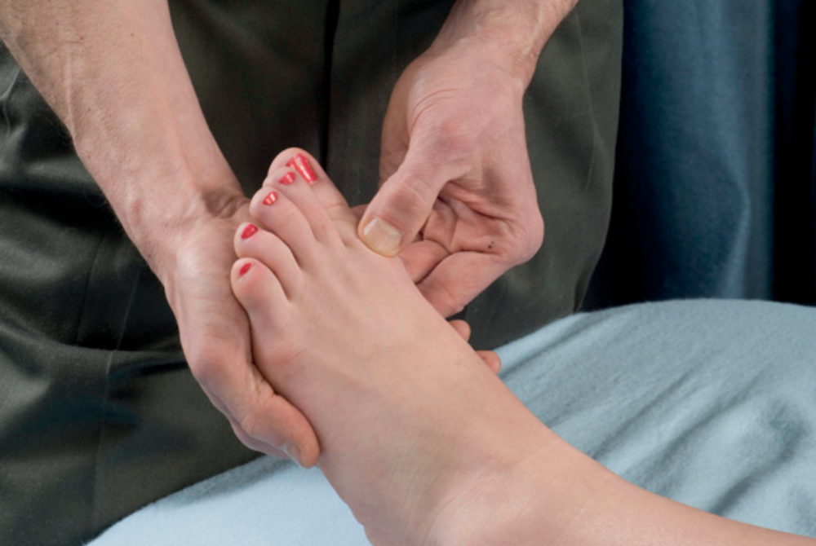
Suggested techniques and methods
A. Deep friction Mobility of joint tissue is enhanced with friction techniques to the metatarsophalangeal joint. Apply the deep friction treatments in multiple directions to the joint tissue to enhance mobility. Friction treatments can have longer duration than those that are used to treat scar tissue from torn muscles or tendons. Fibrous adhesion around the joint develops over time so longer and more aggressive bouts of friction are beneficial for joint mobilization.

Slide 26
B. Stretching of the hallux The position of the hallux can be altered somewhat by stretching the tissues that span the joint. After soft-tissue mobilization techniques such as the deep friction techniques mentioned in A (see above), pull the hallux back toward a position of proper alignment.
Fibrous scar tissue is likely contributing to holding the hallux in the deviated position. Long-duration stretches (at least 20 seconds) are most effective in flexibility enhancement for this fibrous tissue. This stretching method can enhance flexibility, but correction of this postural disorder is unlikely without something pulling the hallux back in a neutral position for long periods.

Slide 27
Rehabilitation protocol considerations
Hallux valgus deformities occur over a long period. Therapeutic interventions of short duration (such as a massage treatment) can reduce pain symptoms and encourage greater mobility, but are limited in their effectiveness in reversing the postural disorder.
A hallux valgus condition that is of recent onset is more likely to benefit from soft-tissue treatment than one developed over a long time.

Slide 28
Cautions and contraindications
Depending on the severity of the condition, callus formation (bunion) around the metatarsal head can be painful. Use caution with friction techniques in this area. The client’s pain tolerance is an appropriate guide. Massage can be used to improve mobility after surgical procedures, such as the metatarsal osteotomy. Wait an appropriate period after the surgery before attempting massage and consult with the surgeon about any necessary precautions for that client’s surgical procedure.

