Slide 1
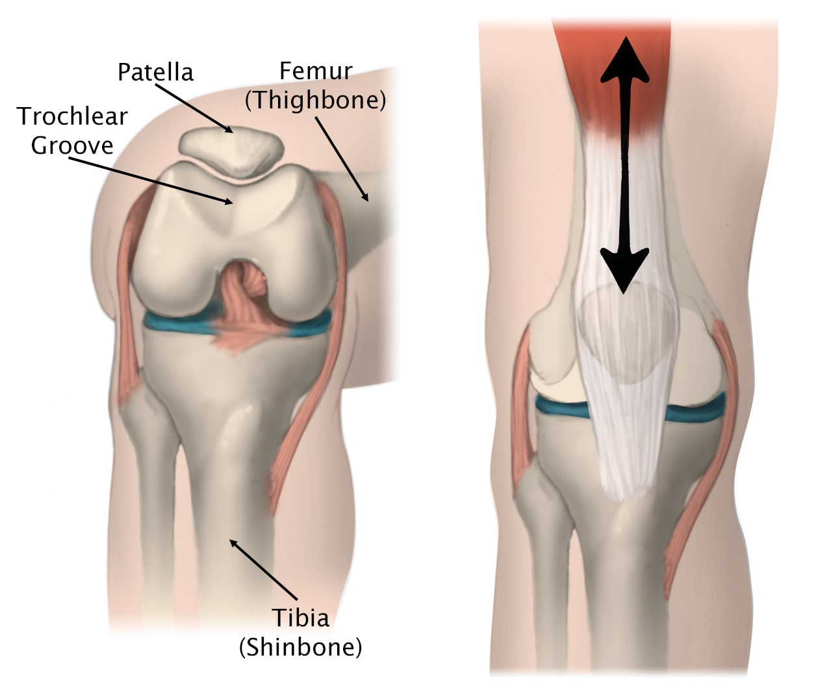
Patellofemoral Dysfunction
Anterior knee pain caused by abnormal motion of patella in trochlear groove

Slide 2
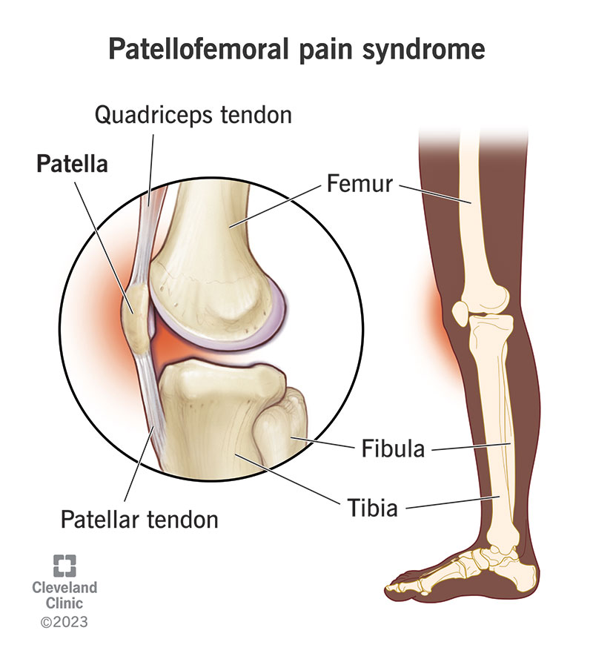
Dysfunction in the patellofemoral articulation can lead to a pain syndrome known as patellofemoral pain syndrome (PFPS) . This is anterior knee pain caused by abnormal motion of the patella in the trochlear groove, which results from biochemical and/or physical changes within the patellofemoral joint. The patellofemoral joint is one of the highest-loaded musculoskeletal components in the body and is therefore one of the most difficult areas in which to restore normal functionality after injury. Symptoms of patellofemoral problems can include:

Slide 3
Anterior knee pain exacerbated by squatting
Sitting for prolonged periods of time (movie theater sign)
Ascending or descending stairs
Point tenderness over the lateral facet of the patella
Crepitus
Possible catching or locking at the knee
A sensation of stiffness or swelling

Slide 4
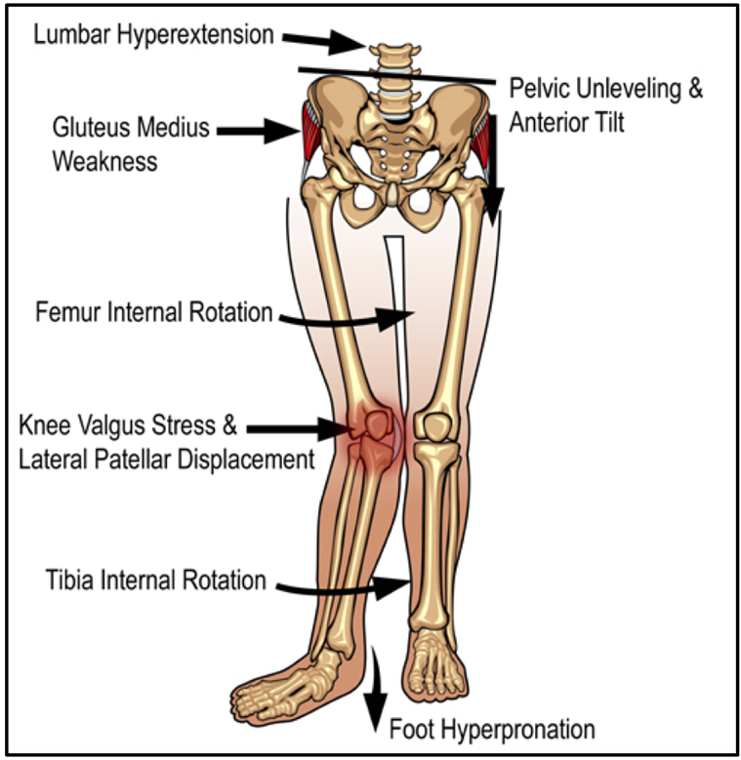
The dysfunction in the joint is a conglomeration of several factors that can result in a variety of conditions. These pathologies are often looked at as individual conditions but actually fall under this broader umbrella.

Slide 5
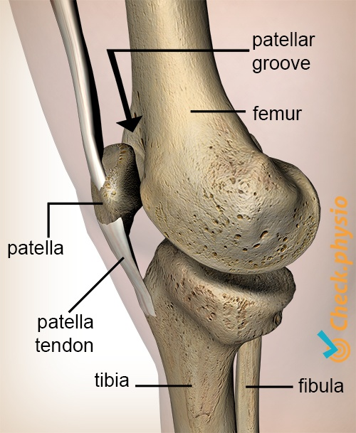
The patellofemoral articulation consists of the patella, the quadriceps and patellar tendons, and the four muscles of the quadriceps group. There are other soft tissue structures that help hold the patella in check, such as the medial and lateral retinacula and fibers from the iliotibial band. The articular side of the patella has various facets that contact the trochlear groove of the femur at different points during movement.

Slide 6
The patella’s job is to protect the anterior portion of the knee and absorb joint forces, as well as enhance the mechanical advantage of the extensor mechanism of the quadriceps. As the knee moves, the surface of contact between the patella and the trochlear groove of the femur constantly changes to optimize the efficiency of the lever by magnifying either force or displacement. As the knee flexes, the patella moves downward until, at 90°, only the top portion is in contact with the femur. This reverses during extension until, at 0°, there is no contact between the patella and the femur. On the surface, movement of the patella during flexion and extension seems simple; however, the stability of the patellofemoral joint occurs as a result of a complex interaction between a range of factors, both static and dynamic. Any disruption of these factors can result in a variety of pathologies that have plagued the medical community.

Slide 7
The misalignment of the patellofemoral joint may arise from anatomical factors that are outside the body’s control. The shape of the patella itself can affect its function: If the articular facets are misshapen or the patella is smaller or larger than normal, its mobility in the trochlear notch can be affected.
The depth of the trochlear groove can affect how the patella tracks: The shallower the groove, the less stable the patella, due to the lateral facet of the patella being poorly buttressed by the lateral face of the sulcus of the trochlear notch; hence, the greater the chance to have a tracking problem.

Slide 8
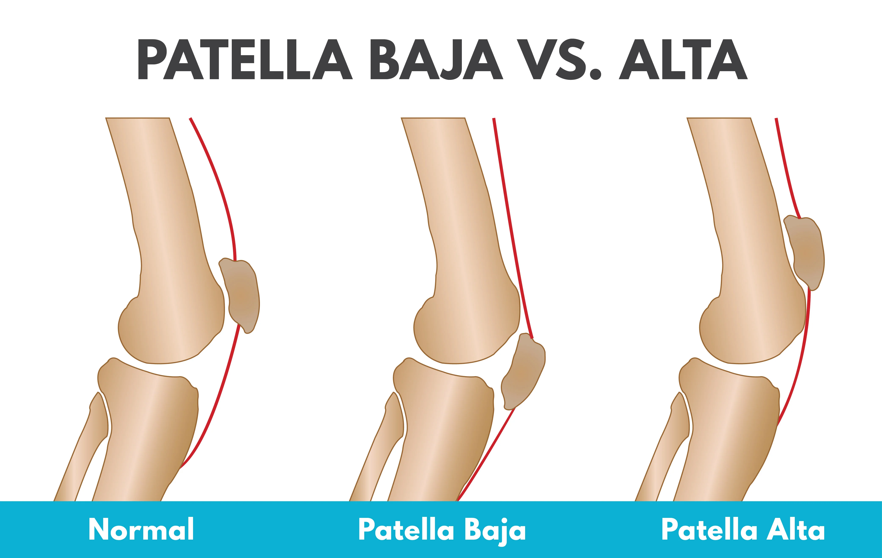
Soft tissue structures can affect the functioning of the joint, as well. Normally, the length of the patellar tendon should be as long as the long axis of the patella, resulting in the inferior pole of the patella lining up with the upper margins of the femoral trochlea. If the patellar tendon is longer than normal, the patella rides higher in the trochlea. This condition is known as patella alta.

Slide 9
Because the patella rides higher on the femur, it has a greater chance of mistracking. A quick way to check for patella alta is to have the client seated with the hip and knee at 90°. The patella should normally be perpendicular to the floor. In patella alta, however, it will be angled 45° to the floor. If there is an abnormally short tendon, the patella rides lower in the groove, resulting in a condition known as patella baja, which can also lead to instability of the patella in the groove. A tight lateral retinaculum, ITB, or vastus lateralis tendon will result in the lateral pull of the patella or the tilting up of the medial edge of the patella, thereby causing an uneven load distribution and excessive pressure on the lateral facet.

Slide 10
Imbalance in the musculature around the knee can cause the patella to track one way or the other. The vastus medialis has fibers in its distal end that attach to the superomedial aspect of the patella about one-third of the way down the patella at a 55° angle. This region of the muscle is known as the vastus medialis obliquus (VMO) and is arguably the most important muscle around the knee in regard to patellar mechanics. It is the only muscle that dynamically moves the patella medially and restrains the patella’s tendency to track laterally. In normal knees, the VMO should fi re at the same time or just before the vastus lateralis to maintain proper tracking; however, in abnormal knees, the VMO fi res late, a phenomenon that can be caused by pain or swelling. An accumulation of only 20 to 30 milliliters of excess fluid within the capsule can neurologically inhibit the VMO, compared to 50 to 60 milliliters of fluid for the rest of the extensor mechanism. The late fi ring of the vastus medialis allows the larger, stronger vastus lateralis to have a greater effect on the patella, pulling it laterally.

Slide 11
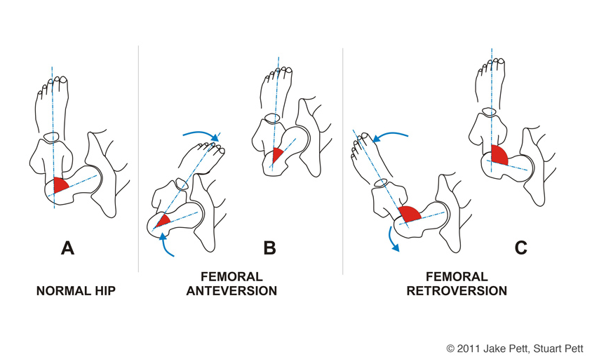
Another cause of patellofemoral dysfunction is the posture of various structures around the knee and at the hip. At the hip, anteversion will lead to an internal rotation of the femur, resulting in a misalignment known as squinting patella, which means that the patellas are oriented a if they were looking at each other even though the feet are pointed straight ahead. This misalignment can also come from an internally rotated femur or tibia and causes an increased valgus force at the knee, leading to lateraltracking tendencies.

Slide 12
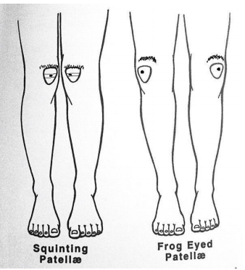
“Frog-eyed” patella is so-named because the patella are aligned as if they were looking away from each other. This originates from the hip as a result of retroversion or from an externally rotated femur or tibia. The orientation of the knee can also be a factor in misalignments. The presence of genu valgum, or “knock-knees,” can place excessive strain on the medial facet of the patella due to the increase in lateral forces created by the posture. Genu varus, or “bowlegged,” posture can increase the compressive forces on the lateral facet of the patella. Also, a difference in the length of the legs can cause an abnormal posture at the knee.

Slide 13
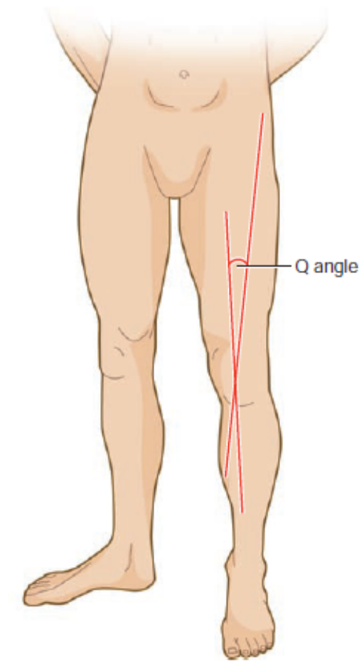
There are two types of leg-length discrepancies: true leg-length discrepancy and functional leg-length discrepancy: True shortening comes from an anatomical or structural change in the lower leg, which is either a congenital condition or the result of trauma. Functional shortening is typically a result of compensation for a posture, such as scoliosis or unilateral foot pronation. These differences in leg length cause abnormal rotations and postures in the hip and knee and can contribute to a variety of pathologies.

Slide 14
A measurement taken at the knee can help identify a tracking problem. The quadriceps angle (Q angle) is a measurement of the patellofemoral mechanics that is a reasonable estimate of the force between the quadriceps group and the patellar tendon. The angle is formed by the intersection of two lines. One line is drawn from the anterior superior iliac spine (ASIS) through the midpoint of the patella. The other line is drawn from the midpoint of the patella through the tibial tuberosity. The intersection of these lines forms the Q angle. A normal angle is 13° in men and 18° in women. One theory that seeks to explain this difference in angles between men and women suggests that it is because women have a wider pelvis than men; however, there is little evidence to support this. An angle of greater than 15° to 20° is thought to contribute to knee extensor mechanism dysfunction and is regarded as an anatomical risk factor in the development of lateral patella malpositioning.

Slide 15
Although the Q angle is an important factor in patellar mistracking, it is not the only factor. Numerous clients who have patellofemoral problems have normal Q angles, and some clients have angles that should cause dysfunction but do not. Discrepancies over what constitutes “normal” anatomy, as well as the accuracy of the measurements and the fact that the Q angle is a static measurement, demonstrate that patellofemoral functioning is based on a cluster of findings from a number of factors that contribute to the overall extensor mechanism.

Slide 16
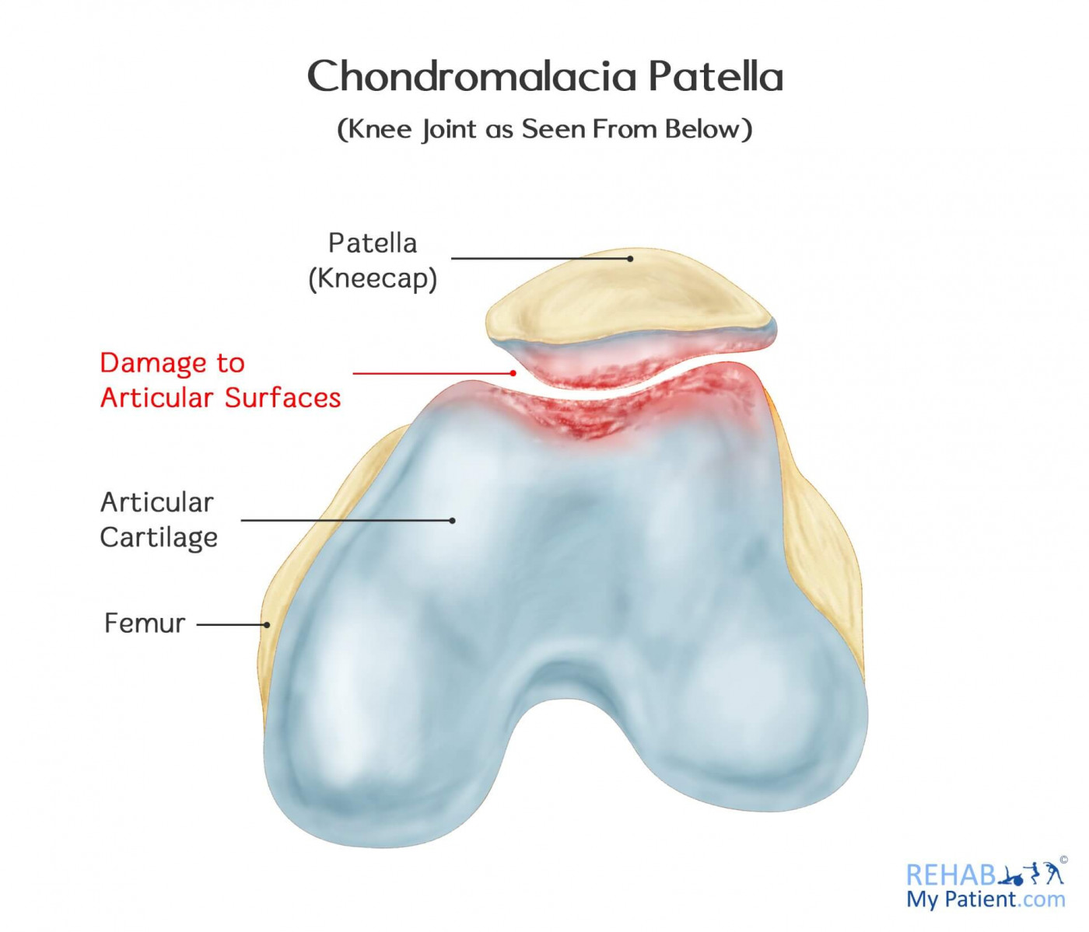
Chondromalacia patella and patellar tendonosis are two of the more common pathologies associated with patellofemoral dysfunction. Chondromalacia patella is the result of prolonged exposure to excessive compressive forces or abnormal shear forces due to patellar mistracking. These forces result in a softening and degeneration of the articular cartilage of the patella. Chondromalacia has four stages of progression:

Slide 17
Stage I: The cartilage softens.
Stage II: The cartilage starts to crack, and fissures develop.
Stage III: The cartilage is characterized by fibrillation, a fraying of the cartilage, which gives it an appearance similar to crabmeat.
Stage IV: The cartilage reveals defects so large that the subchondral bone is exposed. Even though there is a change in the tissue itself, it should not be looked at as a primary source of knee pain.

Slide 18
The articular cartilage is not innervated, so the presence of degeneration is confirmed only through arthroscopy. Pain may arise directly from other biomechanical factors and the irritation of the surrounding tissues. Patellar tendinosis is also associated with patellofemoral dysfunction. The term tendinosis was first used in the 1940s; its current use refers to tendon degeneration (or failed healing), with or without symptoms or histologic signs of inflammation. This condition commonly stems from an overuse of the patellar tendon, resulting in its acute version, patellar tendonitis. Over time, tendonitis becomes chronic, and a cycle of continued insults to the tendon with unsuccessful healing leads to the continued degeneration of the tissue.

Slide 19
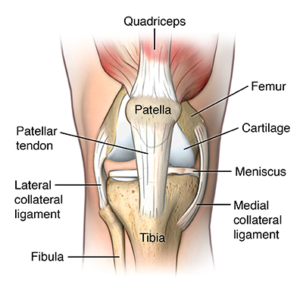
Patellar tendonosis is commonly referred to as “jumper’s knee” because of its associations with running and jumping. Pain initially occurs after activity at the inferior pole of the patella or the distal attachment of the tendon at the tibial tubercle. As the condition progresses, pain presents before activity, subsides after warm-up, and then returns following activity. Pain occurs while walking up or down stairs, with passive flexion beyond 120°, and during any resisted knee extension. The progression continues, and an increasing number of activities cause discomfort, eventually preventing the individual from participating at all.

Slide 20
Assessment
Patellofemoral dysfunction can result from a variety of factors acting together or individually. These factors can be static or dynamic and can involve more than one region of the body. It is important to conduct a thorough assessment of the area to ensure that all contributing factors are addressed. This section treats patellofemoral dysfunction as an umbrella pathology and addresses specifics for the two conditions discussed as necessary. Condition History Therapists should inquire about the following when taking the client’s history:

Slide 21
What was the mechanism of injury? Patellofemoral problems typically arise from chronic conditions with no memorable mechanism of injury; however, if a distinct event caused the injury, other structures may be involved, as well.
Are there any sounds associated with motion? Crepitus is a common symptom of patellofemoral problems, especially in chondromalacia. Audible popping or snapping sounds may indicate a more severe pathology.
Is there a history of knee injury? An acute injury that has occurred in the past can develop into patellofemoral problems.

Slide 22
Is there pain? If so, where? Patellofemoral pain is generally felt over the anterior knee. Patellar tendonitis presents with pain over the inferior pole of the patella.
When does the pain occur? Pain is often present after activity, while going up and down stairs, during movement that requires deep knee flexion, and after periods of prolonged sitting (movie theater sign).
Is there any locking, catching, or giving way? These are all common symptoms in patellofemoral conditions.

Slide 23
Visual Assessment The client must be appropriately dressed so that the therapist can observe the hips, feet, and knees. Begin by checking the entire knee complex for signs of swelling, discoloration, gross deformity, and evidence of past injury such as scars. The posture of the lower extremity should be observed from anterior and lateral views in both standing and sitting positions to assess any deviations. Anteriorly, have the client stand with the feet pointing straight forward. Check for any rotation of the femur on the tibia and note the angle between the femur and the tibia. Normally, the angle will range from 180° to 195°. An angle between the femur and the tibia of less than 180° is considered genu valgum or knock knees, and an angle greater than 195° is considered genu varum or bowlegs.

Slide 24
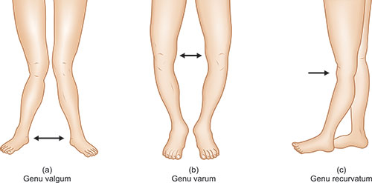
Observe patellar alignment from this position to note any abnormalities such as squinting or frog-eyed patella, described earlier. Have the client contract both quadriceps, and check for any deviations in patellar tracking and the symmetry of the muscles between sides.

Slide 25
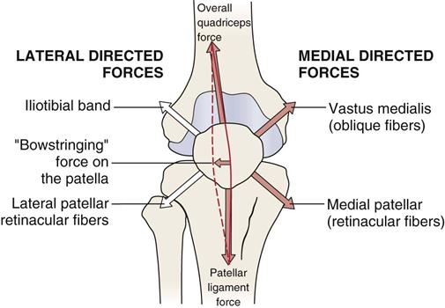
Observe the feet for pronation or supination. From the lateral view, note whether there is any hyperextension of the knee, known as genu recurvatum. In this position, patella alta is easily noted from the presence of something known as the “camel sign.” In patella alta, the patella rides higher in the trochlear groove, so the infrapatellar fat pad becomes more evident and a double hump is created.

Slide 26
Place the client in the seated position with the feet dangling off the table. Check anteriorly to see whether the tibial tubercles are directly below the inferior poles of the patellas. Excessive deviation can indicate a predisposition to tracking problems. The patellas should face forward and not demonstrate any displacement medially or laterally. From the side, assess the position of the patella for patella alta. In this position, the patella should be perpendicular to the floor. In patella alta, it will be at a 45° angle to the ground.
Palpation Check for the presence of swelling, point tenderness, deformity, spasm, crepitus, and temperature differences. Begin with the structures listed earlier and expand the area as necessary.

Slide 27
Orthopedic Tests Several physical assessments can help determine the presence of patellofemoral dysfunction. As discussed earlier, discrepancies in leg length are a component of patellofemoral dysfunction because they can affect the orientation of the knee during gait. There are two types of leg-length discrepancy: true and functional.
To determine a true leg-length discrepancy: Place the client in the supine position, and place the legs parallel to each other, 4 to 8 inches apart. Take a measurement from the ASIS to the medial malleolus on each leg and then compare the measurements. A difference of ½ to 1 inch is considered normal.

Slide 28
To determine a functional leg-length difference: Begin with the client in the same position, and measure from the umbilicus to the medial malleolus. This information is useful only when the results of the true leg-length test are negative.
The next assessment involves determining the mobility of the patella. With the client in the supine position, grasp the patella and move it medially. This will test the restrictions in the lateral restraints, such as the lateral retinaculum. Move the patella laterally. This will test restrictions in the medial restraints, such as the medial retinaculum. The patella should move about half its width medially and laterally. Any more motion in either direction is referred to as a hypermobile patella; less motion is a hypomobile patella.

Slide 29
Measure the Q angle, as described earlier, by drawing a line from the anterior superior iliac spine through the midpoint of the patella. Draw the other line from the midpoint of the patella through the tibial tuberosity; the angle is created by the intersection of the two lines. An angle of greater than 18° or fewer than 13° is considered abnormal and is a predisposing factor to patellar dysfunction.
There is no specific test for patellar tendonitis other than the presence of pain at the inferior pole of the patella on palpation; however, there are two tests specific to chondromalacia, as shown here:

Slide 30
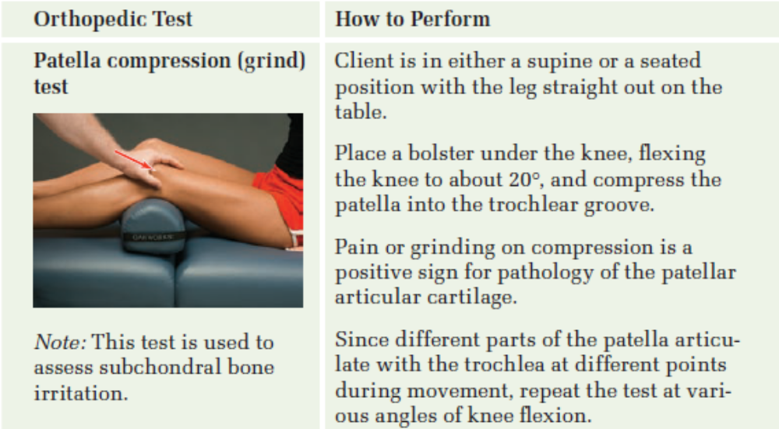

Slide 31
