Slide 1
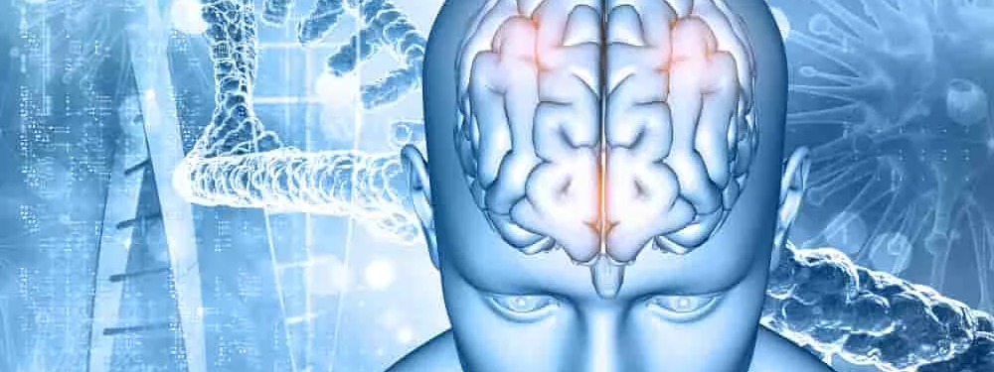
Neurology II-5
Motor Disorders 2

Slide 2
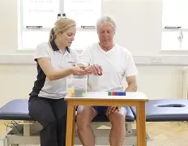
Clinical Localization of the Lesion
The findings on examination should indicate whether the motor deficit is due to an upper or lower motor neuron disturbance, impaired neuromuscular transmission, or a primary muscle disorder. With an upper or lower motor neuron disturbance, the clinical findings may also help to localize the lesion to a single level of the nervous system, thereby reducing the number of diagnostic possibilities.

Slide 3
Upper Motor Neuron Lesions
Signs
1. Weakness or paralysis
2. Spasticity
3. Increased tendon reflexes
4. Extensor plantar (Babinski) response
5. Loss of superficial abdominal reflexes
6. Little, if any, muscle atrophy

Slide 4
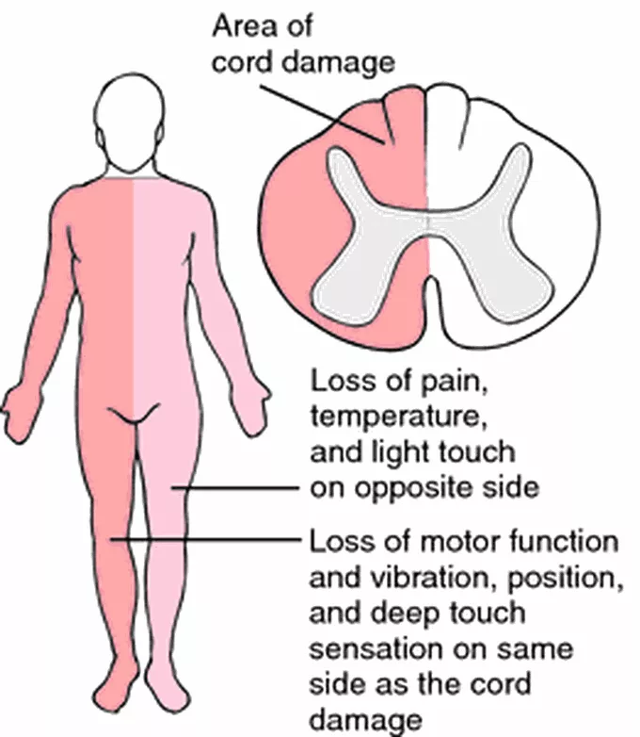
Localization of Underlying Lesion
Parasagittal
cerebral cortex
internal capsule
Brainstem
spinal cord (Brown-Séquard syndrome)
anterior horn cells

Slide 5
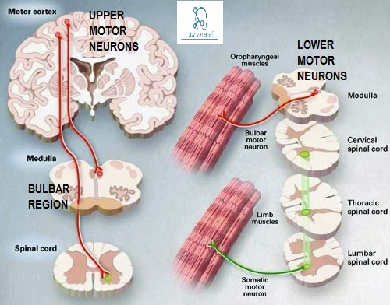
Lower Motor Neuron Lesions
Signs
1. Weakness or paralysis
2. Wasting and fasciculations of involved muscles
3. Hypotonia (flaccidity)
4. Loss of tendon reflexes when neurons subserving them
are affected
5. Normal abdominal and plantar reflexes

Slide 6
Localization of the Underlying Lesion
In distinguishing weakness from a segmental spinal cord, anterior horn cell, radicular (nerve root), plexus, or peripheral nerve lesion, the distribution of the motor deficit is important.

Slide 7
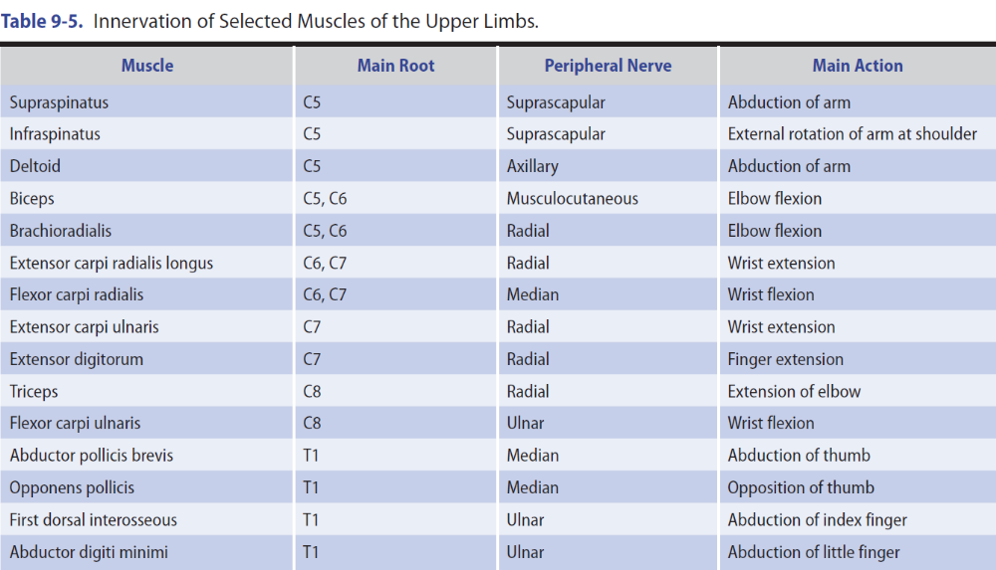

Slide 8
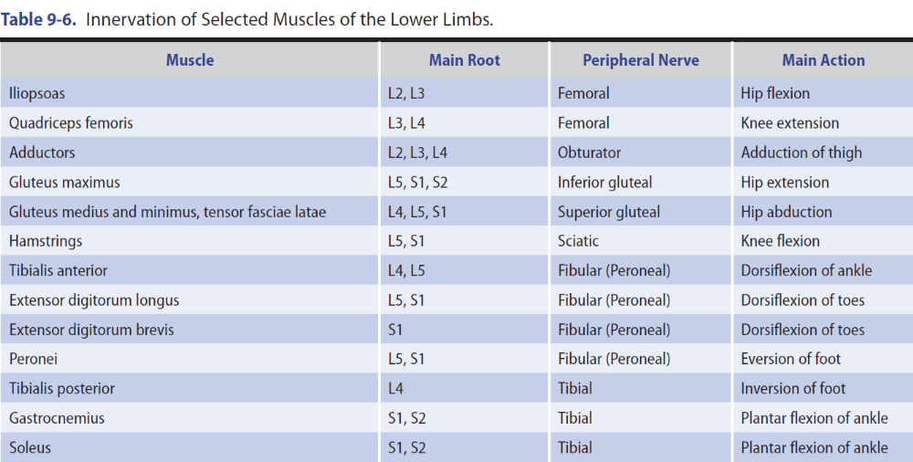

Slide 9
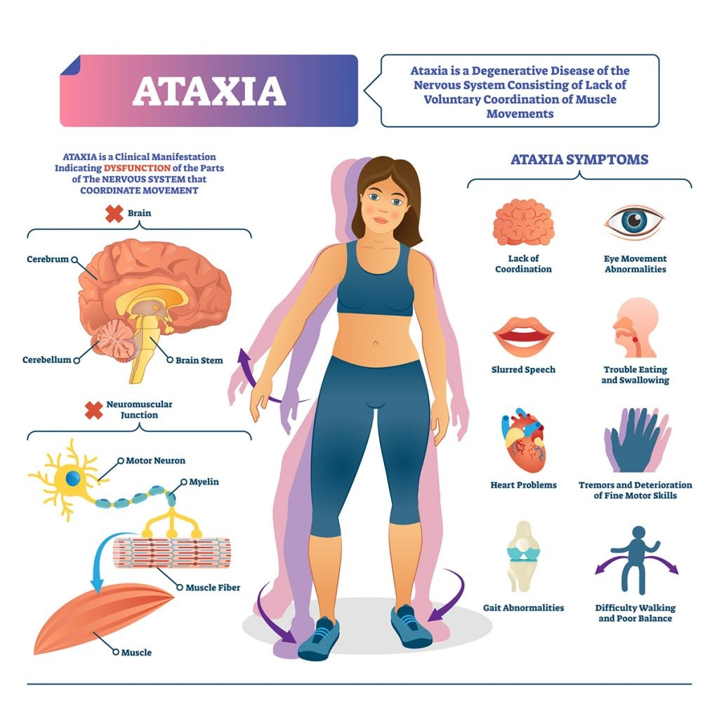
Cerebellar Lesions
Signs
1. Hypotonia.
2. Depressed or pendular tendon reflexes.
3. Ataxia
4. Gait disorder
5. Imbalance of station
6. Disturbances of eye movement—Jerk nystagmus
7. Disarthria

Slide 10
Neuromuscular Transmission
Disorders
Signs
1. Normal or reduced muscle tone.
2. Normal or depressed tendon and superficial reflexes.
3. No sensory changes.
4. Weakness, frequently involves the cranial muscles

Slide 11
Myopathic Disorders
Signs
1. Weakness, usually most marked proximally rather than distally.
2. No muscle wasting or depression of tendon reflexes, at least until an advanced stage of the disorder.
3. Normal abdominal and plantar reflexes.
4. No sensory loss or sphincter disturbances.

Slide 12
Investigative Studies
Investigative studies of patients with weakness from focal cerebral deficits are considered before, Investigative Studies. The investigations discussed here may be helpful in evaluating patients with weakness from other causes;

Slide 13
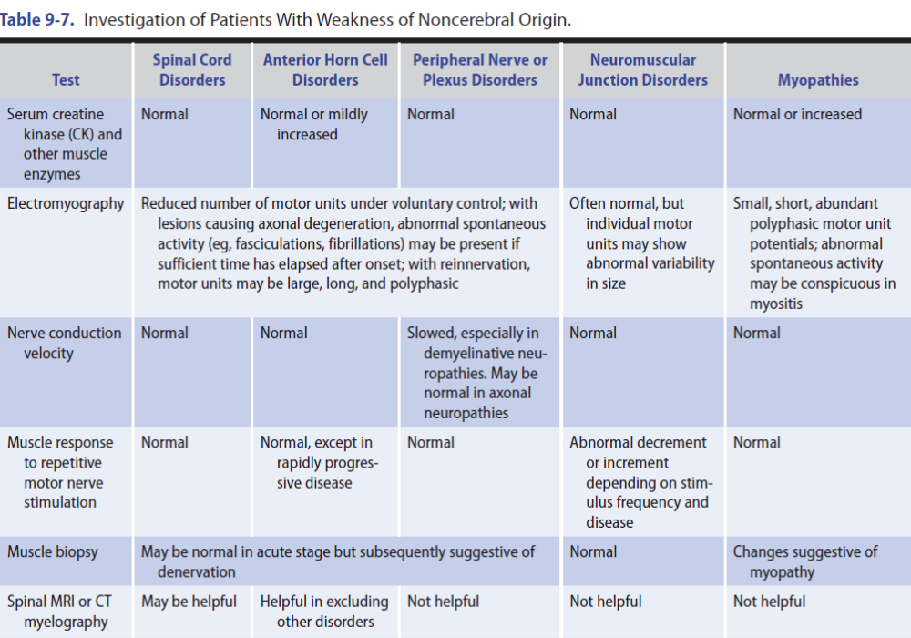

Slide 14
Imaging
Plain X-Rays of the Spine
CT Scan or MRI
Electrodiagnostic Studies
Serum Enzymes
Muscle Biopsy

Slide 15
Spinal Cord Disorders (Myelopathy)
Spinal cord disorders can lead to motor, sensory, or sphincter disturbances, or to some combination of these deficits. Depending on whether it is unilateral or bilateral, a lesion above C5 may cause an ipsilateral hemiparesis or quadriparesis.
Spasticity is a common accompaniment of upper motor neuron lesions and may be especially troublesome below the level of a myelopathy.

Slide 16
Traumatic Myelopathy
Clinical Findings
Total Cord Transection
“spinal shock”, spastic paraplegia or quadriplegia, Flexor or extensor spasms of the legs
Less Severe Injury
bibrachial paresis

Slide 17
Imaging
Plain radiographs will reveal misalignments, fractures, and soft tissue swelling, but CT scanning is more sensitive for detecting spinal fractures, especially in the cervical region, and also allows evaluation of the spinal cord.

Slide 18
Treatment
Immobilization, Decompression, & Stabilization
General Measures
Corticosteroids
Treatment of Painful Spasms
Skin Care
Bladder & Bowel Disorders
Experimental Therapeutics

Slide 19
Demyelinating Myelopathies
Multiple Sclerosis
Epidemiology
Pathology
Pathophysiology
Clinical Findings
Investigative Studies

Slide 20
Diagnosis
Treatment
Prognosis

Slide 21
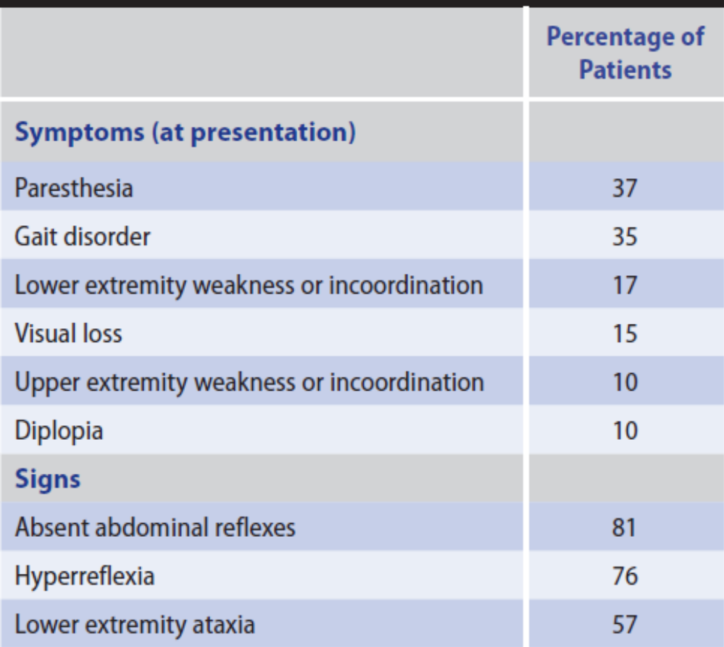
Symptoms and Signs of Multiple Sclerosis

Slide 22
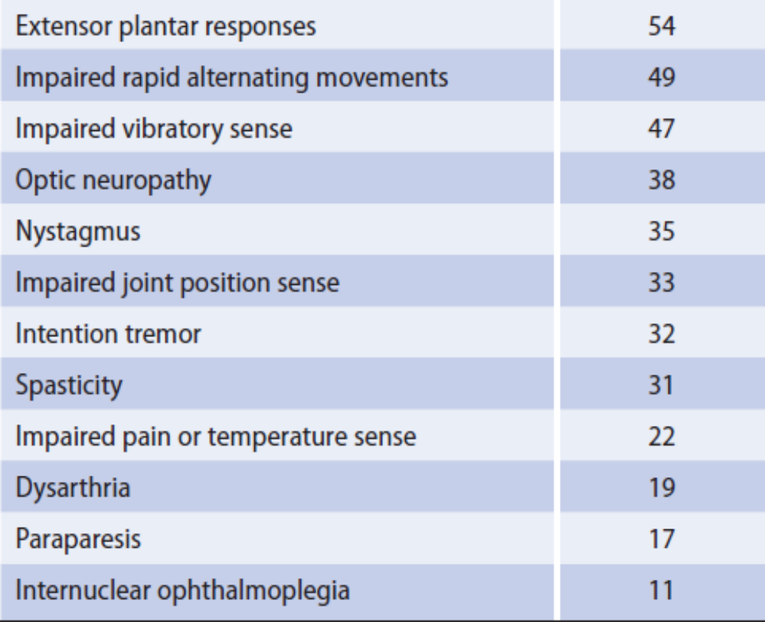
Symptoms and Signs of Multiple Sclerosis

Slide 23
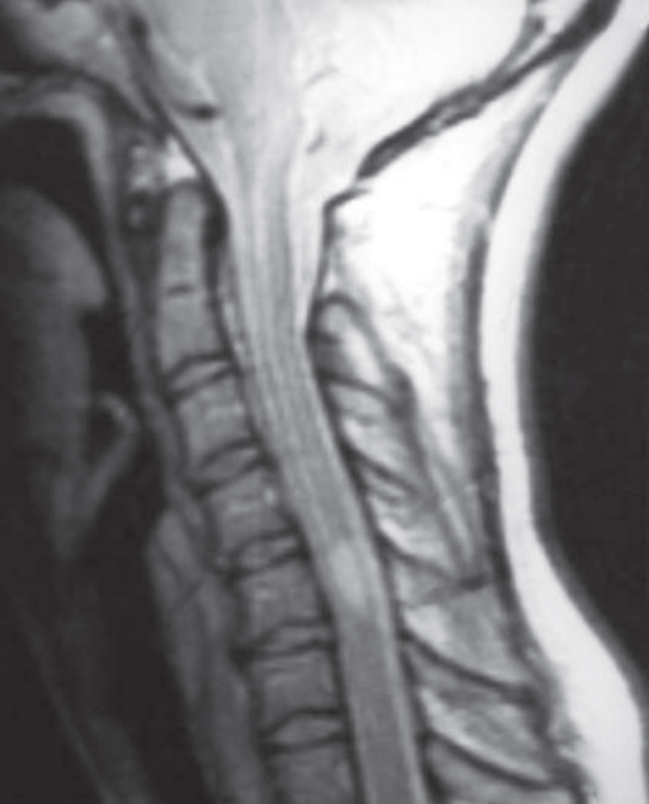
A mid-sagittal T2-weighted MRI of the cervical spinal cord in a young woman with multiple sclerosis. An abnormal region of high signal intensity (arrow) is seen.

Slide 24
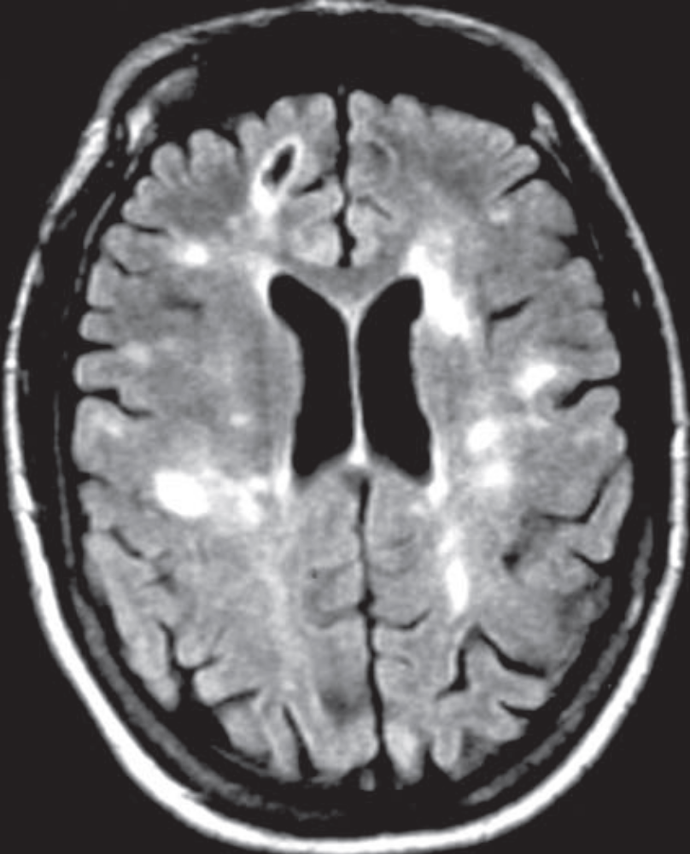
Axial T2-weighted MR brain image of a patient with multiple sclerosis showing multiple, primarily punctate, white matter plaques (arrows); note the typical location in the periventricular region (arrowheads).

