Slide 1
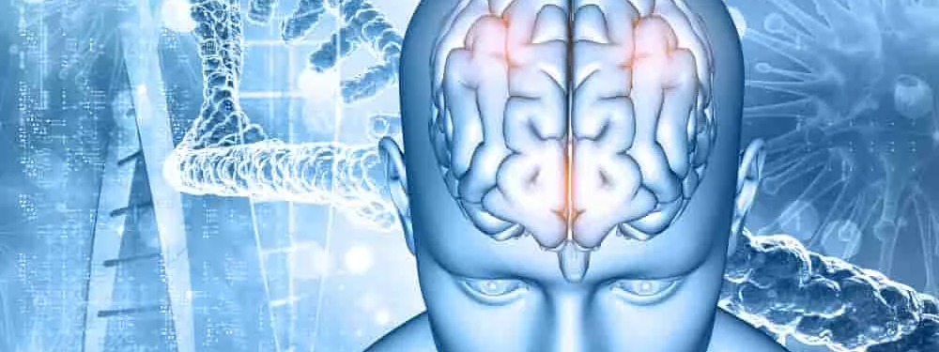
Neurology II-4
Motor Dysfunction

Slide 2
MOTOR DISORDERS
Normal motor function depends on the transmission of signals from the brain to the brainstem or spinal cord by upper motor neurons, and from there to skeletal muscle by lower motor neurons.

Slide 3
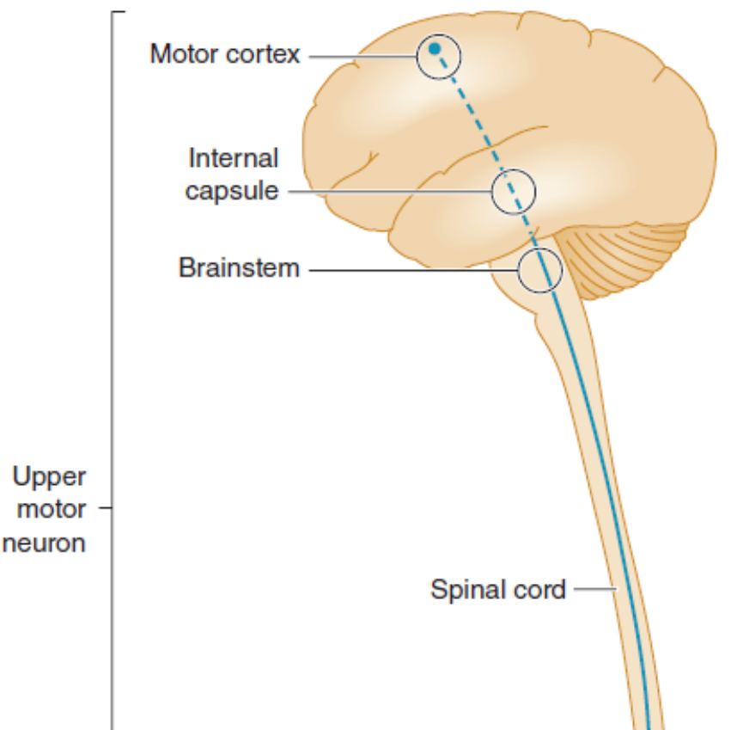
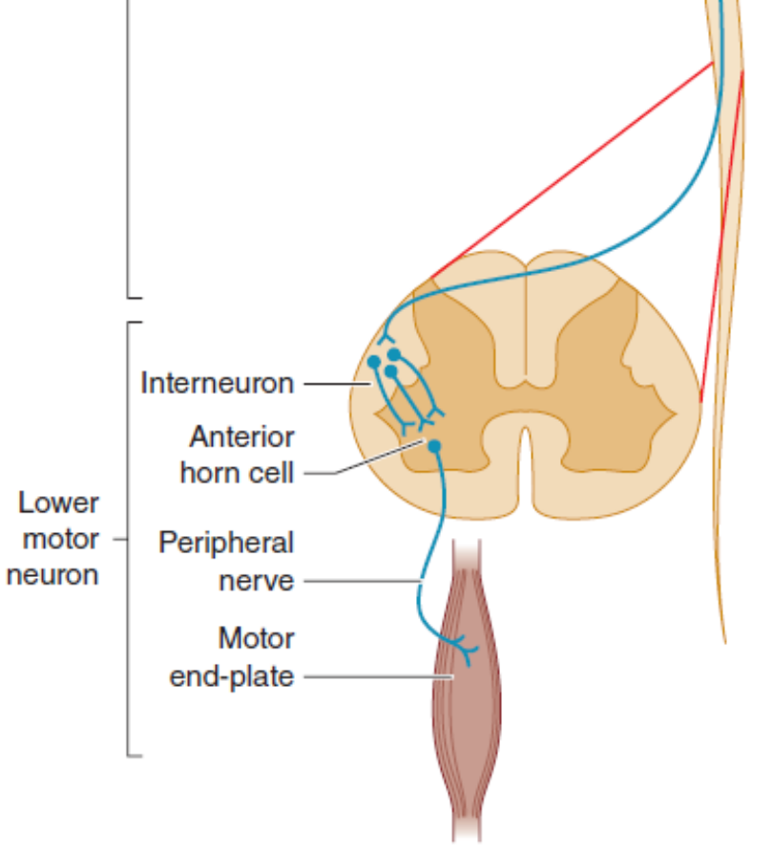
Anatomic basis of the upper motor neuron and lower motor neuron concepts.

Slide 4
History
Mode of Onset
Course
Distribution of Symptoms
Associated Symptoms
Severity of Symptoms

Slide 5
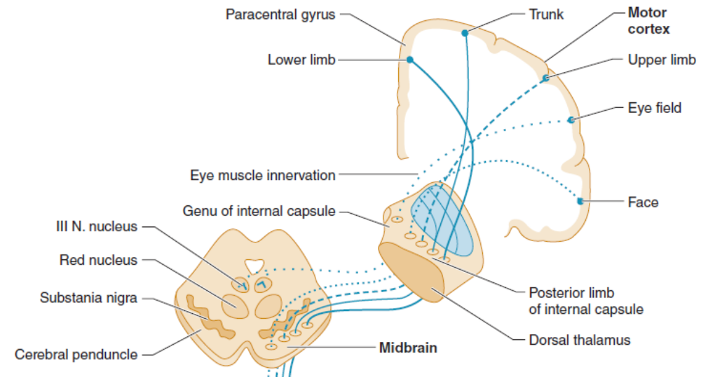
Upper motor neuron pathways.

Slide 6
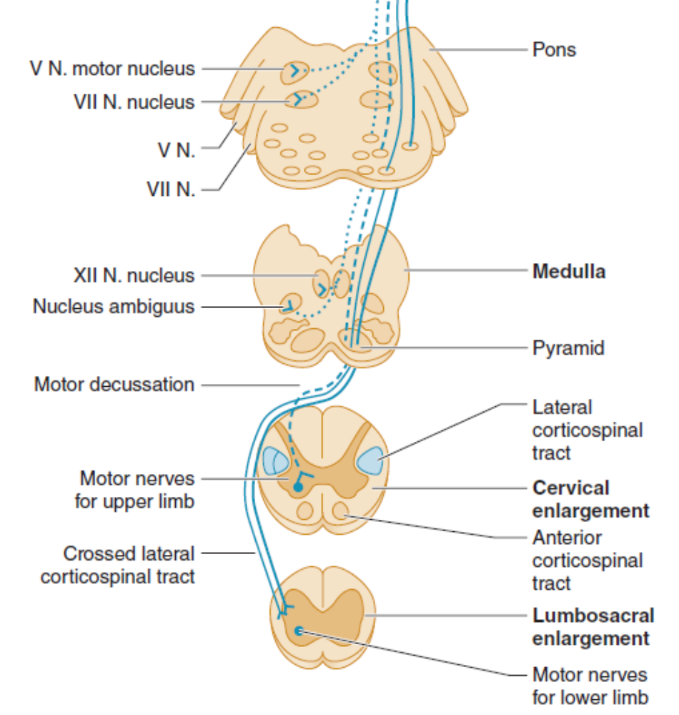
Upper motor neuron pathways. Tracts at bottom left are shown outside the cord for clarity only.

Slide 7
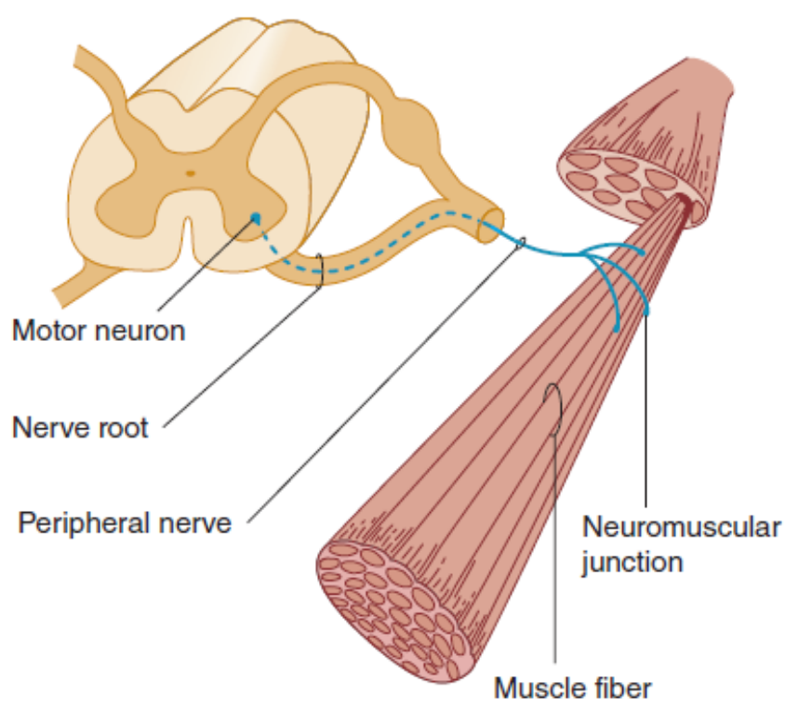
Anatomic components of the motor unit.

Slide 8
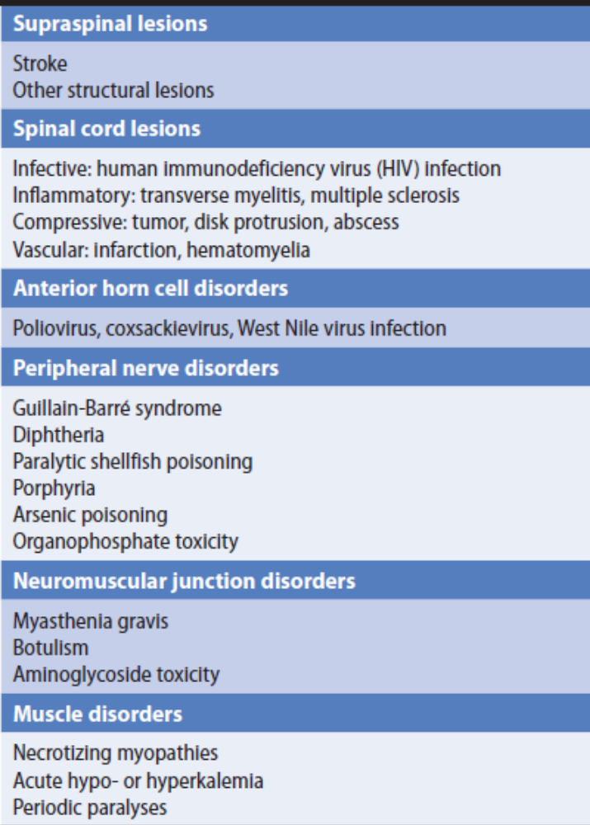
Some Causes of Weakness of Acute or Subacute Onset.

Slide 9
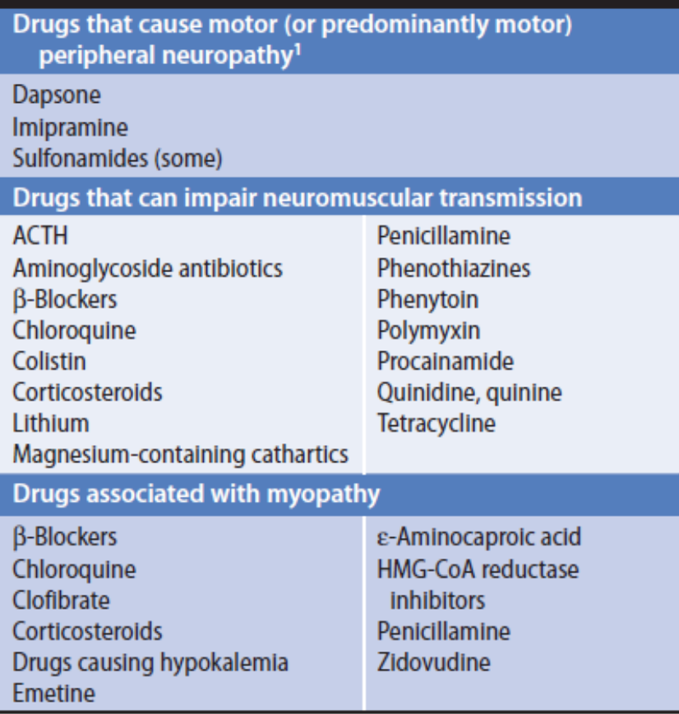
Motor Disorders Associated With Drugs.

Slide 10
Past Medical History
Developmental History
Family History

Slide 11
Neurologic Examination
Motor System
Muscle Appearance
Muscle Tone
Muscle Power

Slide 12
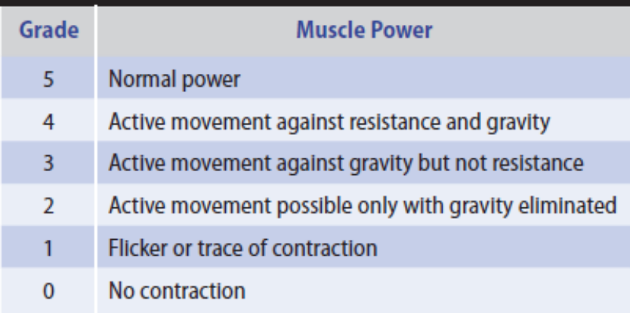
Grading of Muscle Power According to the System Suggested by the Medical Research Council.

Slide 13
Tendon Reflexes
Changes in the tendon (muscle stretch) reflexes may accompany disturbances in motor or sensory function and provide a guide to the cause of any motor deficit.
1. Areflexia
2. Hyperreflexia
3. Reflex asymmetry

Slide 14
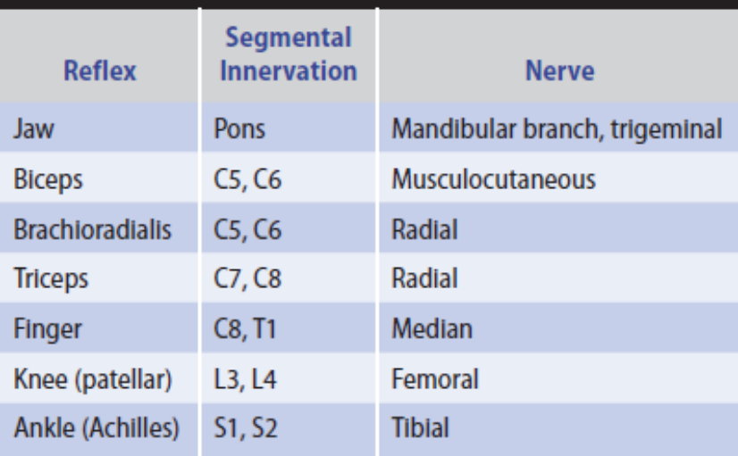
Tendon (Muscle Stretch) Reflexes

Slide 15
Coordination
The coordination of motor activity can be impaired by weakness, sensory disturbances, or cerebellar disease and requires careful evaluation.
Voluntary activity is observed with regard to its accuracy, velocity, range, and regularity, and the manner in which individual actions are integrated to produce a smooth complex movement.

Slide 16
Superficial Reflexes
1. The polysynaptic superficial abdominal reflexes
2. The cremasteric reflex
3. Stimulation of the lateral border of the foot ,The Babinski response

Slide 17
Gait
1. Apraxic gait
2. Corticospinal lesions
3. Frontal disorders
4. Extrapyramidal disorders
5. Cerebellar disorders
6. Vestibular disorders

Slide 18
7. Impaired sensation
8. Anterior horn cell, peripheral motor nerve, or skeletal muscle disorders
9. Unsteady or cautious gait in the elderly
10. Psychogenic gait disorder

