Slide 1

Neurology II-3
Vertigo, Ataxia

Slide 2
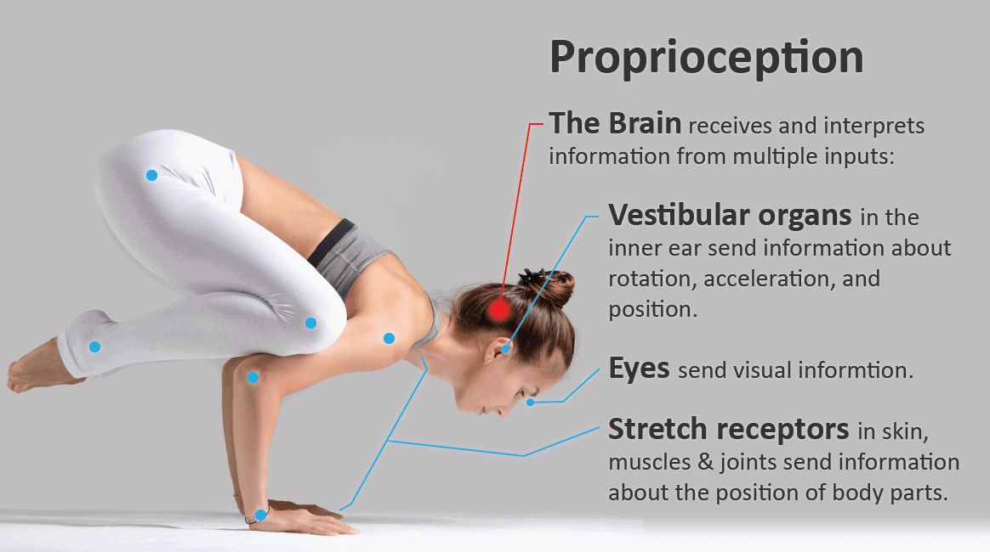
Equilibrium is the ability to maintain orientation of the body and its parts in relation to external space. It depends on continuous visual, labyrinthine, and proprioceptive somatosensory input and its integration in the brainstem and cerebellum.

Slide 3
VERTIGO
Vertigo is the illusion of movement of the body or the environment.
It may be associated with other symptoms, such as impulsion, oscillopsia, nausea, vomiting, or gait ataxia.
Vertigo must be distinguished from nonvertiginous dizziness, which includes sensations of light-headedness, faintness, or giddiness not associated with an illusion of movement.
The first step in the differential diagnosis of vertigo is to localize the pathologic process to the peripheral or central vestibular pathways.

Slide 4
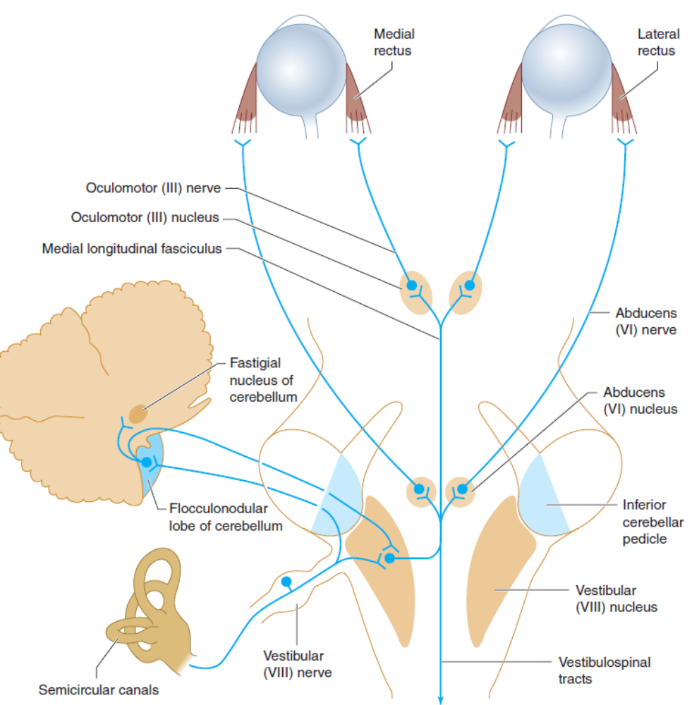
Peripheral and central vestibular pathways.

Slide 5
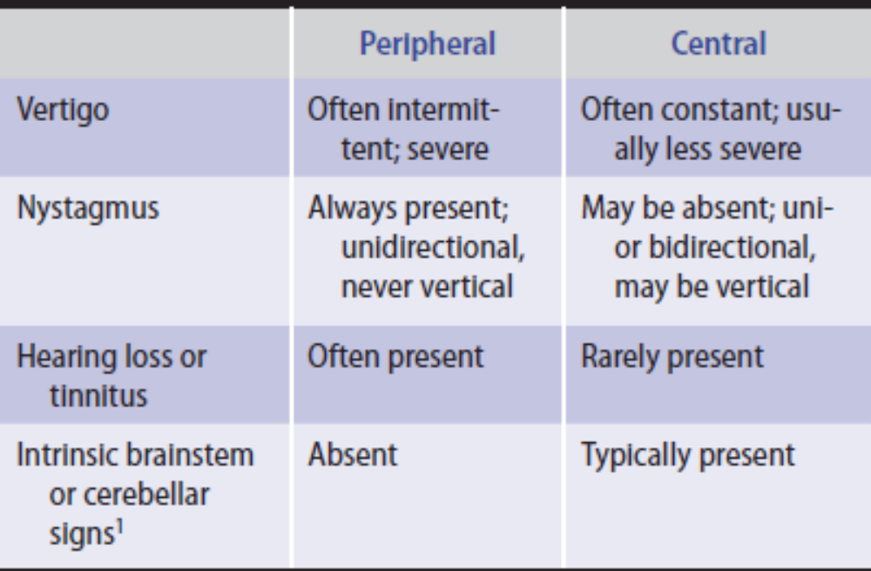
Characteristics of Peripheral and Central Vertigo.

Slide 6
PERIPHERAL VERTIGO
Peripheral vestibular lesions affect the labyrinth of the inner ear or the vestibular division of the vestibulocochlear(VIII) nerve. Vertigo from peripheral lesions tends to be intermittent, lasts for briefer periods, and produces more distress than vertigo of central origin.
Nystagmus
Hearing loss
Tinnitus

Slide 7
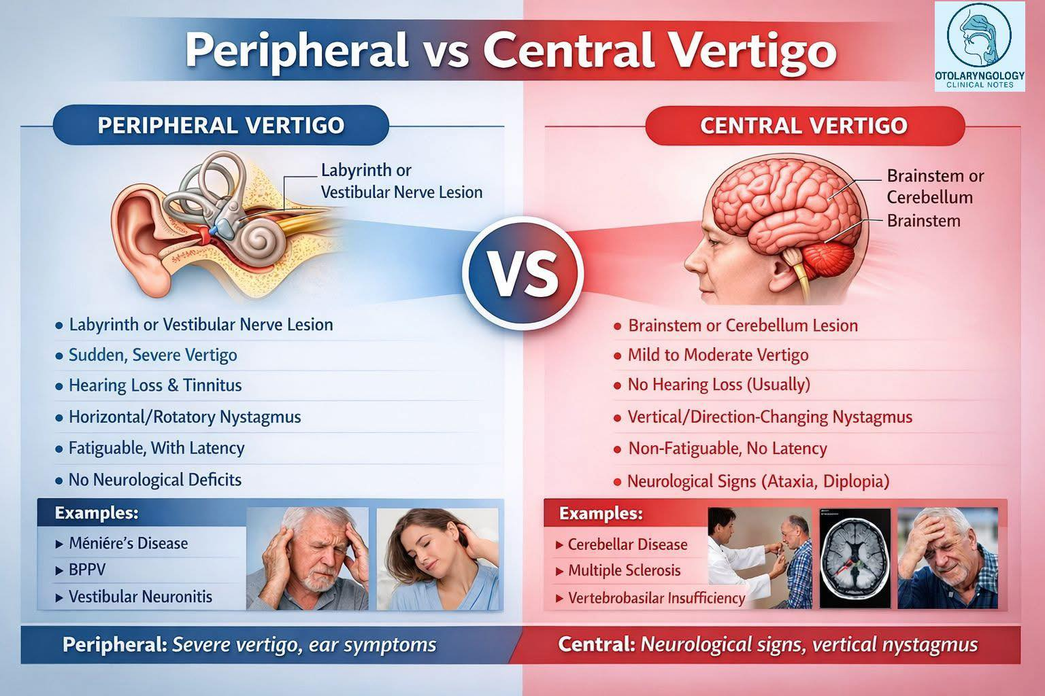

Slide 8
CENTRAL VERTIGO
Vertigo of central nervous system origin usually results from lesions that affect the brainstem vestibular nuclei or their connections.
Motor or sensory deficits
Hyperreflexia
Extensor plantar responses
Dysarthria
Limb ataxia

Slide 9
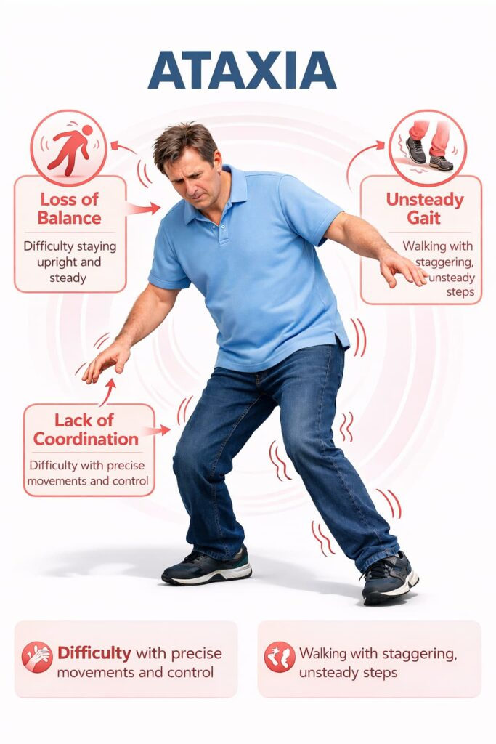
ATAXIA
Ataxia is incoordination or clumsiness of movement that is not the result of muscle weakness.
It can be caused by vestibular, cerebellar, or sensory (proprioceptive) disorders. Ataxia can affect eye movement, speech (producing dysarthria), individual limbs, the trunk, stance, or gait.

Slide 10
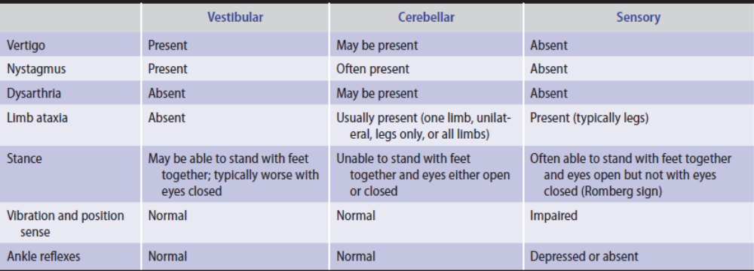
Characteristics of Vestibular, Cerebellar, and Sensory Ataxia.

Slide 11
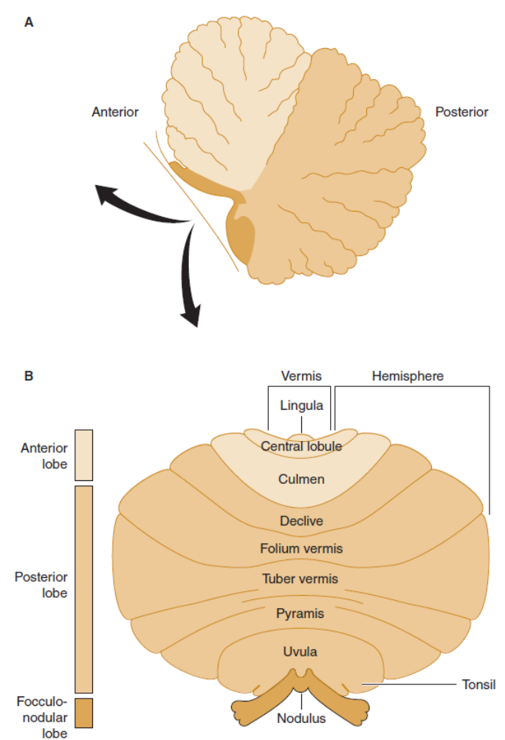
Anatomic divisions of the cerebellum in midsagittal view (A), or unfolded (arrows) and viewed from behind (B).

Slide 12
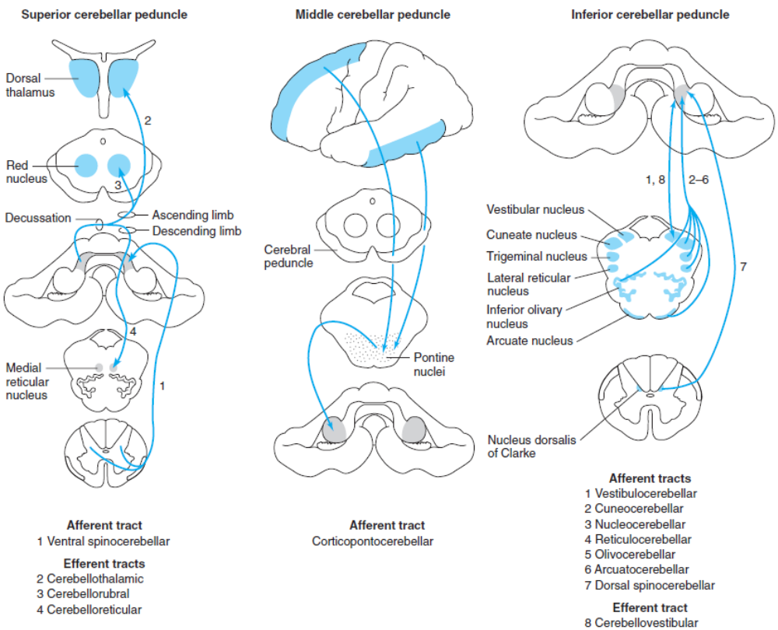
Cerebellar connections in the superior, middle, and inferior cerebellar peduncles.

Slide 13
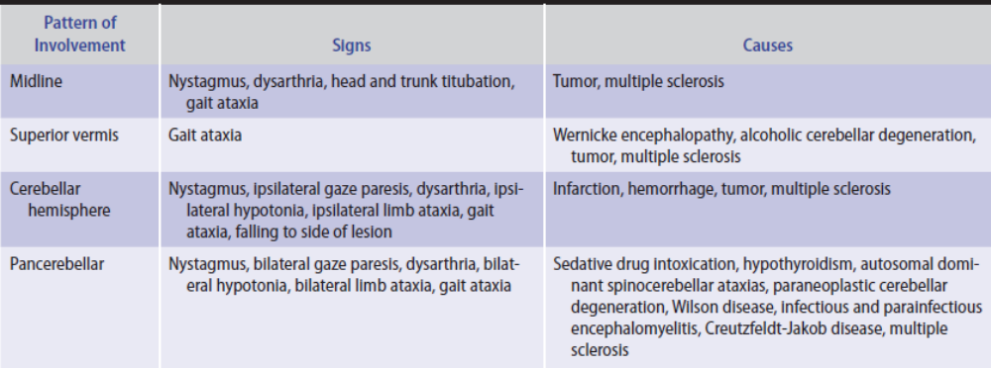
Clinical Patterns of Cerebellar Ataxia.

Slide 14
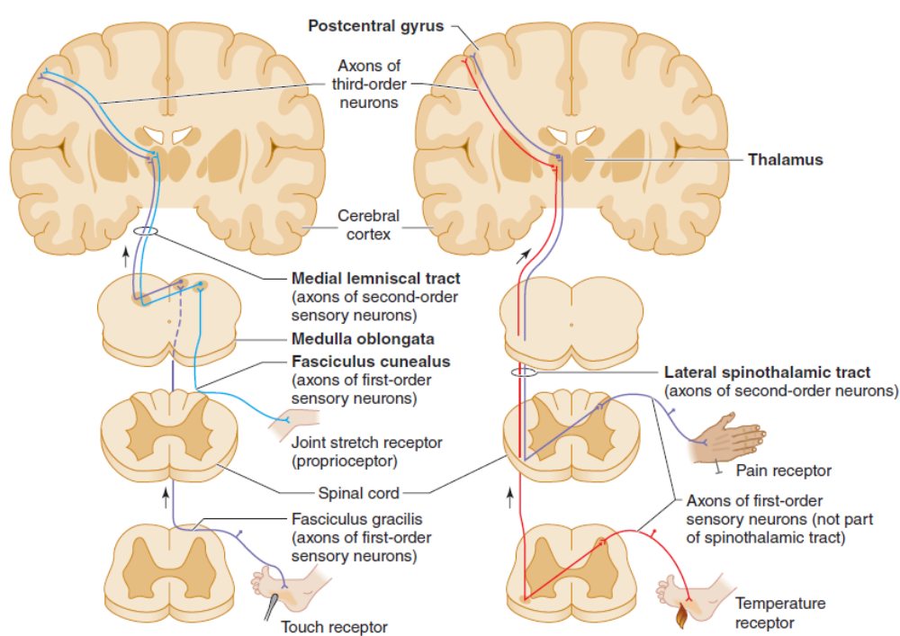
Pathways mediating proprioception (left, light blue) and other somatic sensory modalities (left and right).

Slide 15
HISTORY
SYMPTOMS & SIGNS
ONSET & TIME COURSE
MEDICAL HISTORY
FAMILY HISTORY

Slide 16
GENERAL PHYSICAL EXAMINATION
Orthostatic hypotension
Skin
Pigmented corneal
Skeletal abnormalities

Slide 17
NEUROLOGIC EXAMINATION
MENTAL STATUS EXAMINATION
STANCE & GAIT
CRANIAL NERVES
MOTOR SYSTEM
SENSORY SYSTEM
REFLEXES

Slide 18
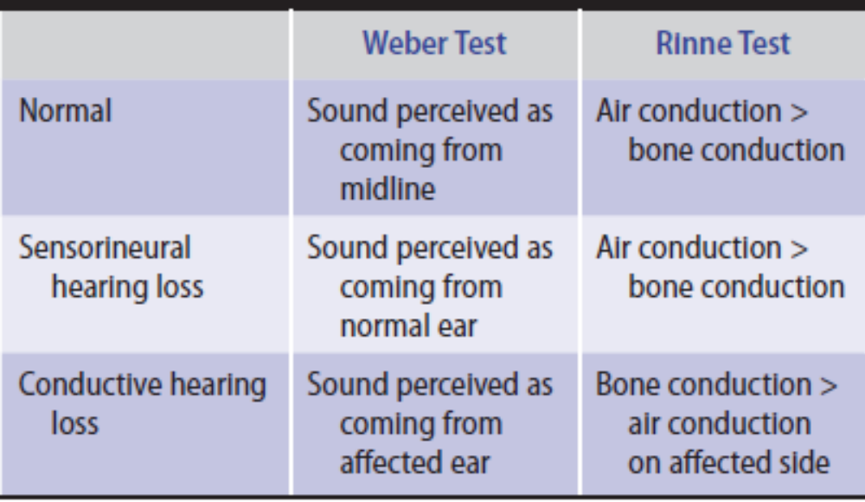
Assessment of Hearing Loss.

Slide 19
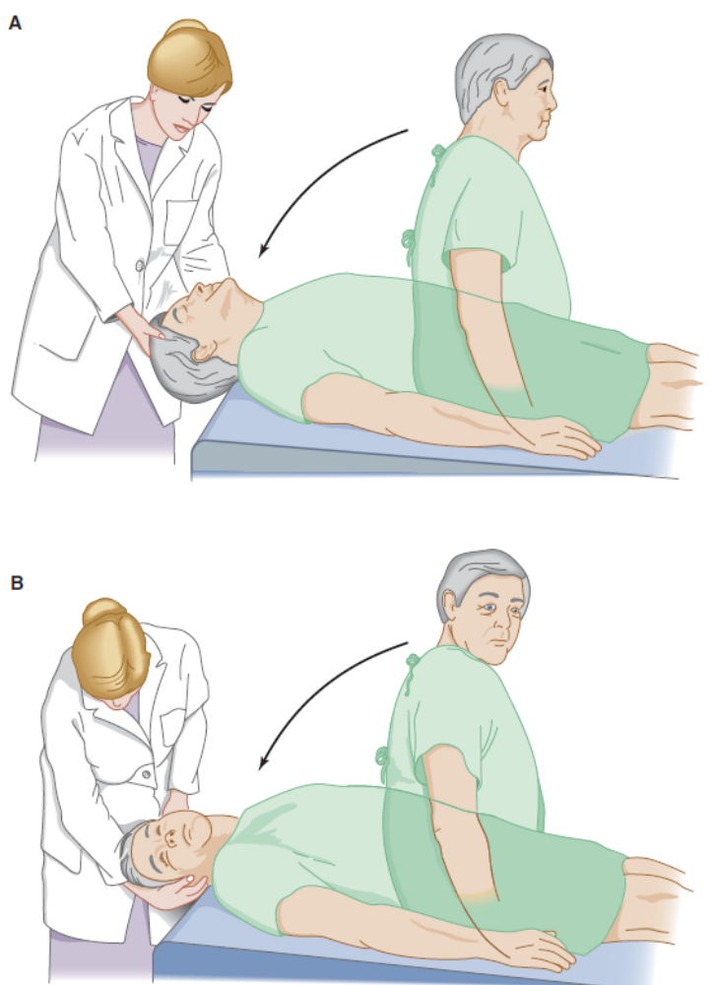
Test for positional vertigo and nystagmus. The patient is seated on a table with the head and eyes directed forward (A) and is then quickly lowered to a supine position with the head over the table edge, 45 degrees below horizontal. The patient’s eyes are then observed for nystagmus, and the patient is asked to report any vertigo.
The test is repeated with the patient’s head and eyes turned 45 degrees to the right (B), and again with the head and eyes turned 45 degrees to the left (not shown).

Slide 20
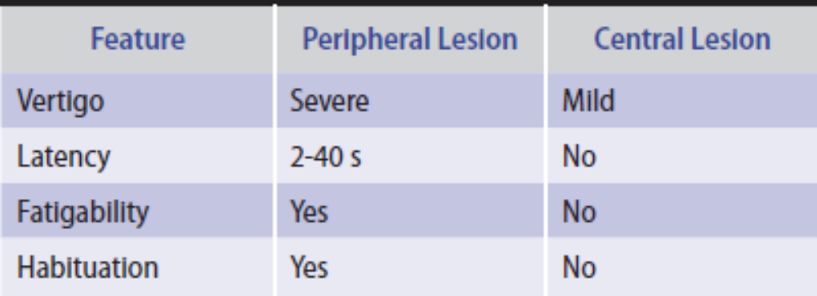
Characteristics of Positional Nystagmus.

Slide 21
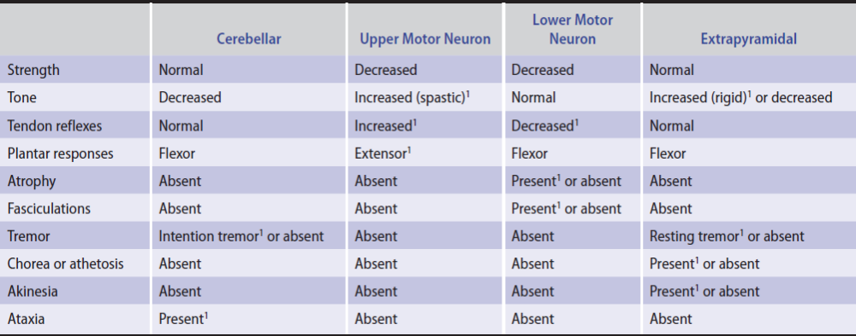
Clinical Features Distinguishing Cerebellar from Other Motor Systems Disorders.

Slide 22
INVESTIGATIVE STUDIES
BLOOD TESTS
CEREBROSPINAL FLUID
BRAIN IMAGING
EVOKED POTENTIALS
CHEST X-RAY & ECHOCARDIOGRAPHY
AUDIOMETRY
ELECTRONYSTAGMOGRAPHY

Slide 23
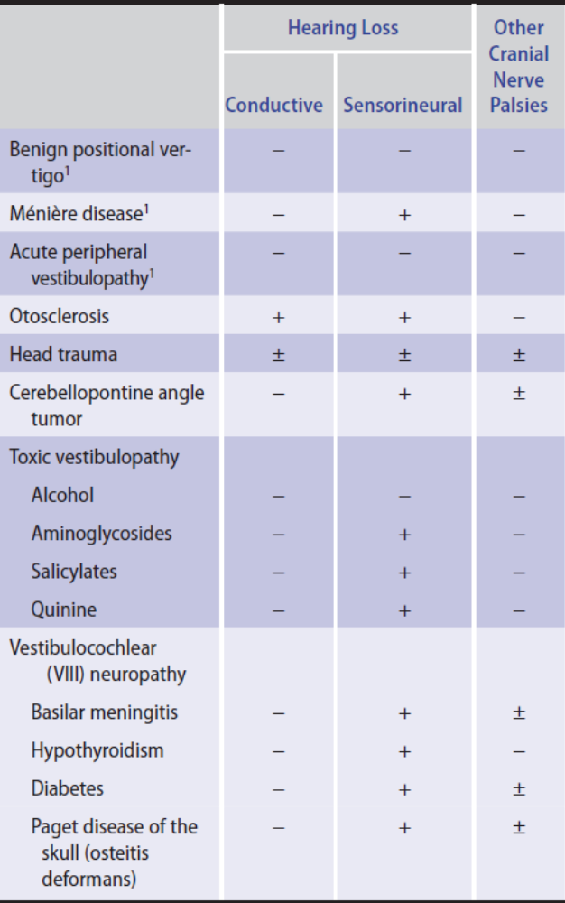
Differential Diagnosis of Peripheral Vestibular Disorders.

Slide 24
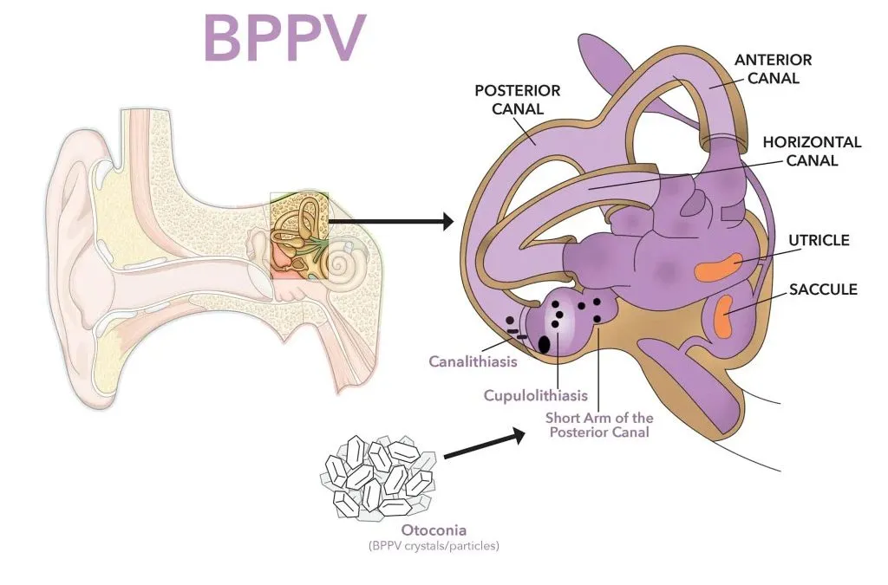
BENIGN POSITIONAL VERTIGO
PATHOGENESIS
CLINICAL FINDINGS
TREATMENT

Slide 25
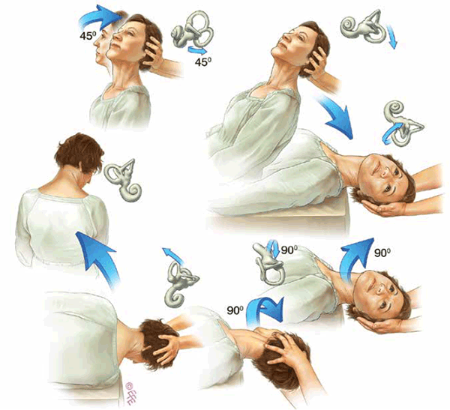
repositioning (Epley) maneuvers

