Slide 1

Neurology II-2
Dementia

Slide 2
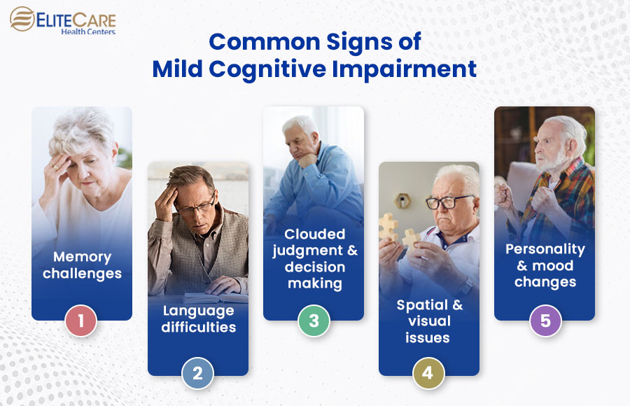
Dementia is an acquired, generalized, and usually progressive impairment of cognitive function.
Normal aging may be associated with minor alterations in neurologic function and with neuroanatomic changes, such as enlargement of cerebral ventricles and cortical sulci seen on computed tomography (CT) or magnetic resonance imaging (MRI) scans.
Mild cognitive impairment (MCI

Slide 3
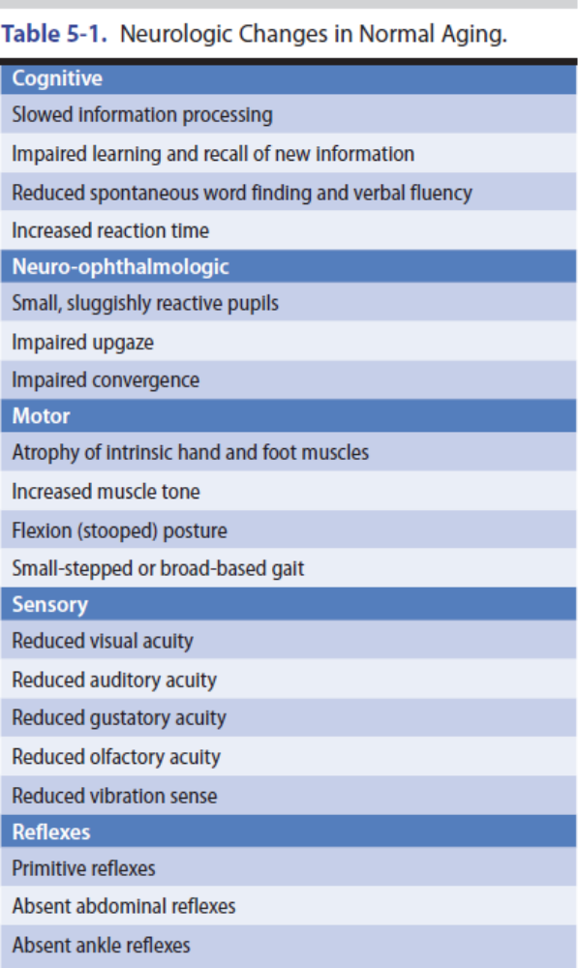
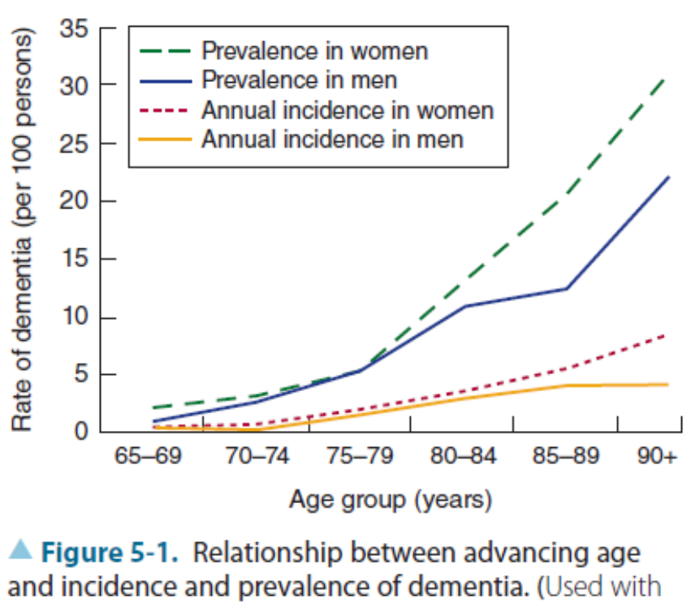

Slide 4
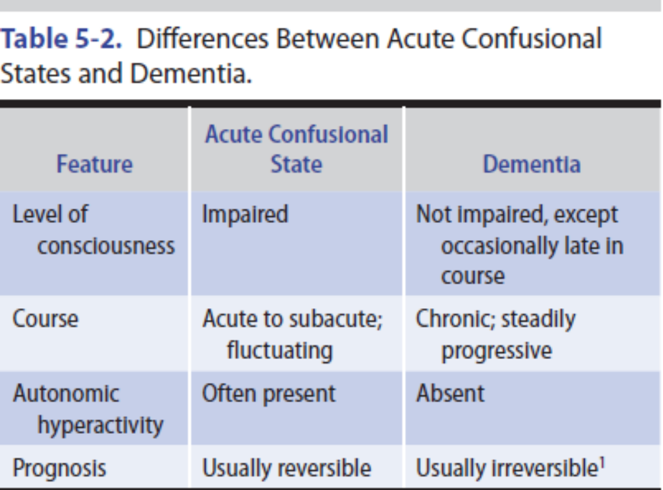

Slide 5
HISTORY
Because dementia implies deterioration in cognitive ability, it is important to establish that the patient’s level of functioning has declined.
Course of deterioration; associated symptoms such as headache, gait disturbance, or incontinence; family history.
Medical illnesses; and the use of alcohol and therapeutic or recreational drugs

Slide 6
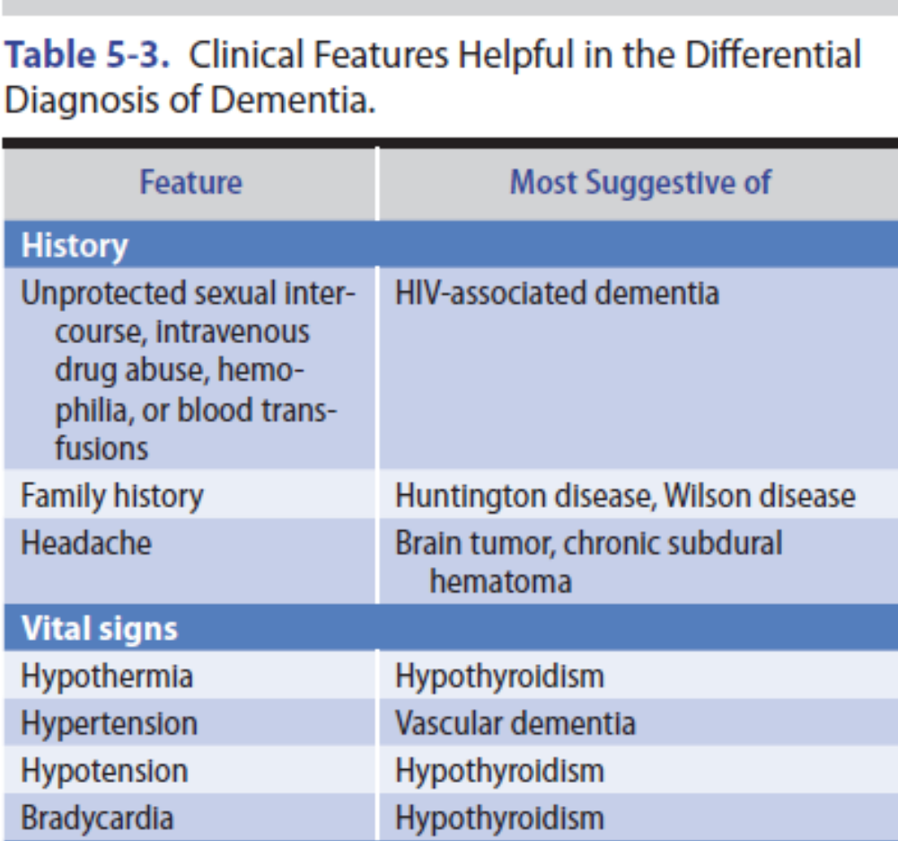

Slide 7
GENERAL PHYSICAL EXAMINATION
Meningismus, Jaundice, Kayser–Fleischer rings

Slide 8
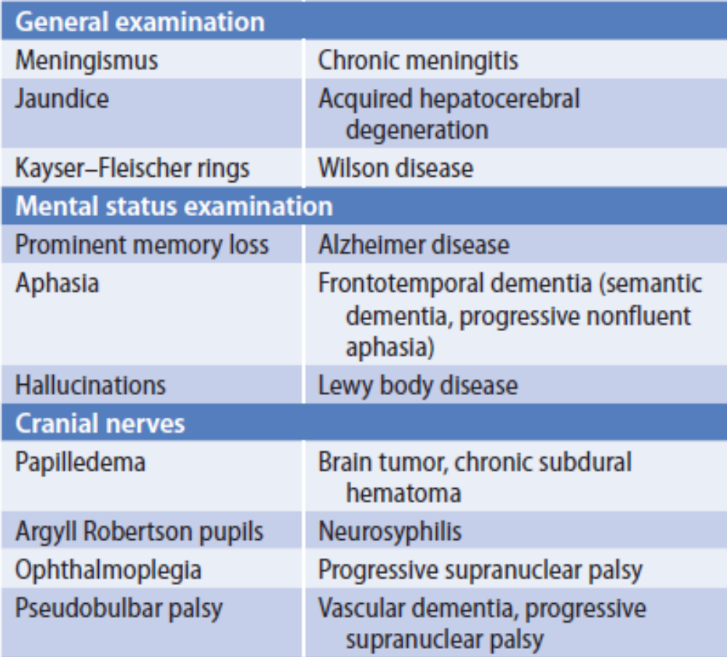

Slide 9
MENTAL STATUS EXAMINATION
The mental status examination helps to determine whether the level or the content of consciousness is impaired and whether cognitive dysfunction is global or circumscribed.
These include memory, language, parietal lobe functions (pictorial construction, right–left discrimination, localization of objects in space), and frontal lobe or diffuse cerebral cortical functions (judgment, abstraction, thought content, the ability to perform previously learned acts).

Slide 10
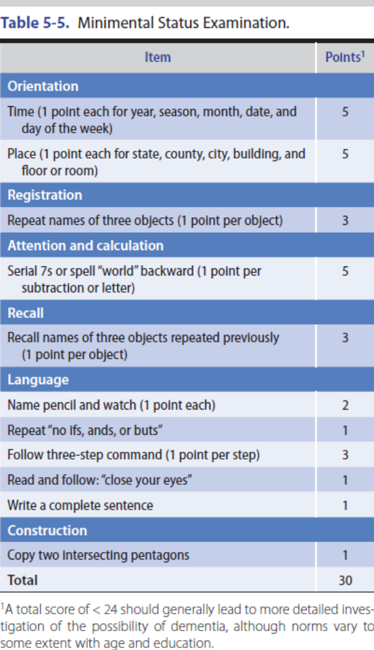

Slide 11
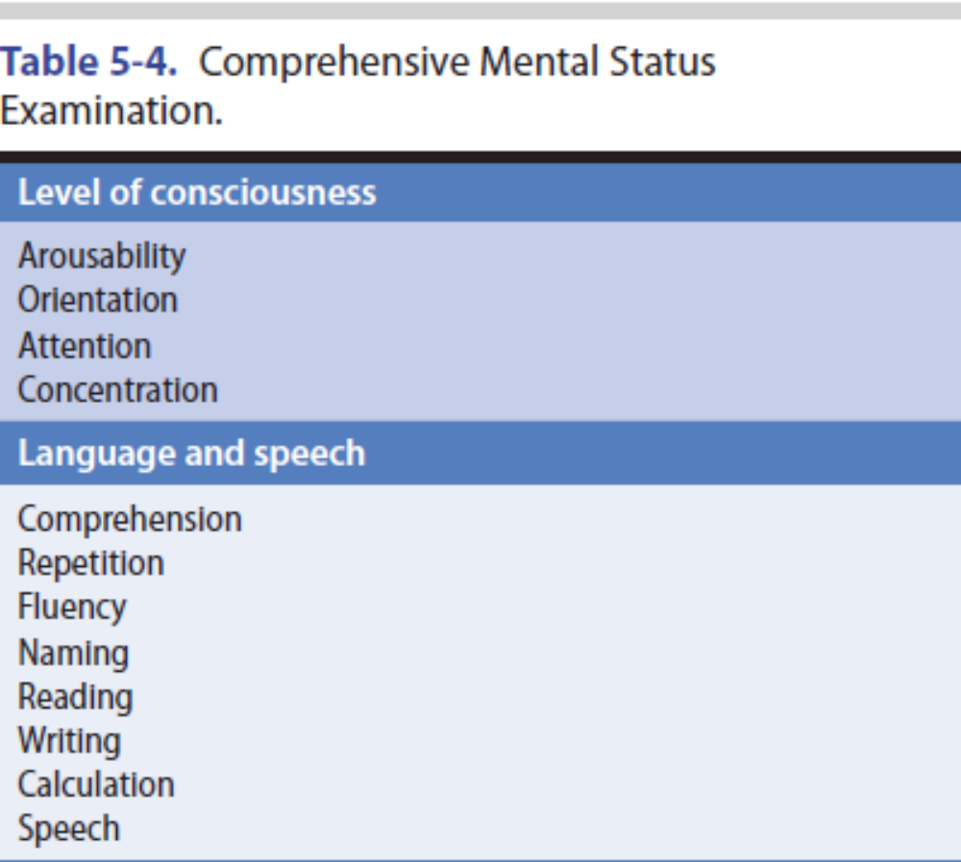

Slide 12
NEUROLOGIC EXAMINATION
Certain disorders that produce dementia also affect vision, coordination, or motor or sensory function. Detecting such associated neurologic abnormalities can help to establish an etiologic diagnosis.

Slide 13
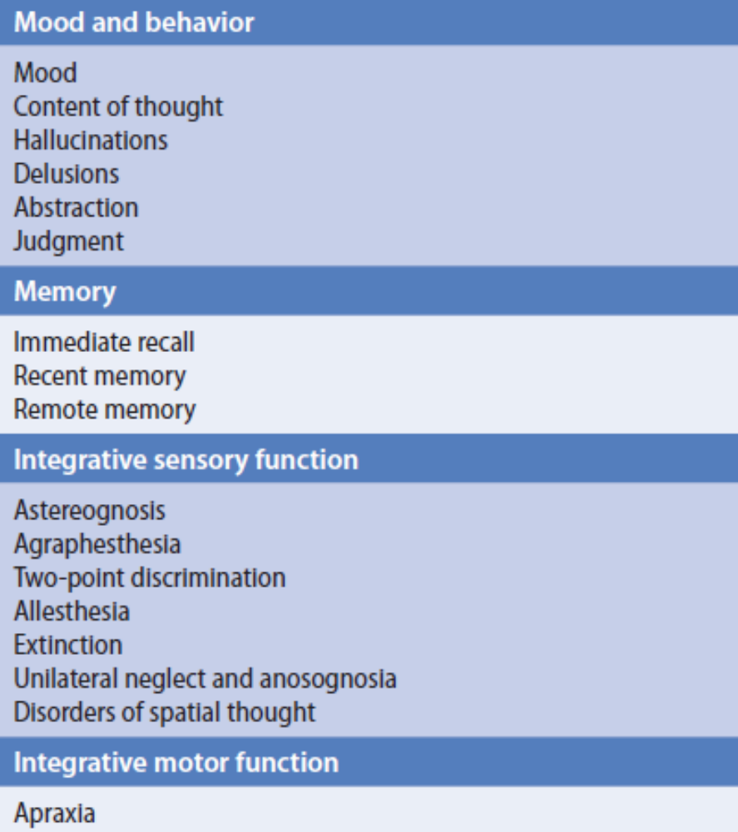

Slide 14
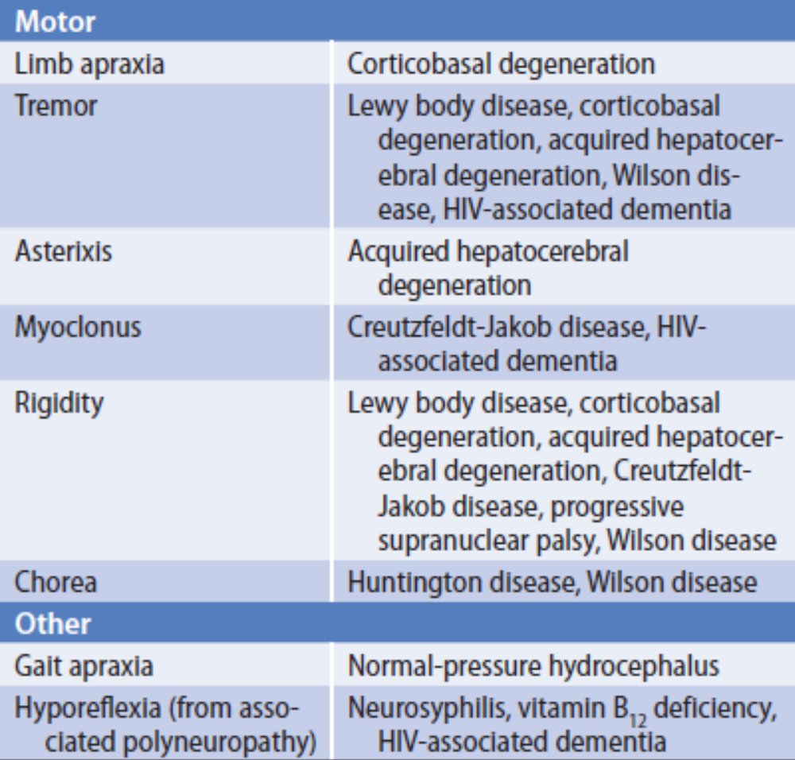

Slide 15
LABORATORY INVESTIGATIONS
Laboratory studies that can help to identify the cause of dementia are listed here:

Slide 16
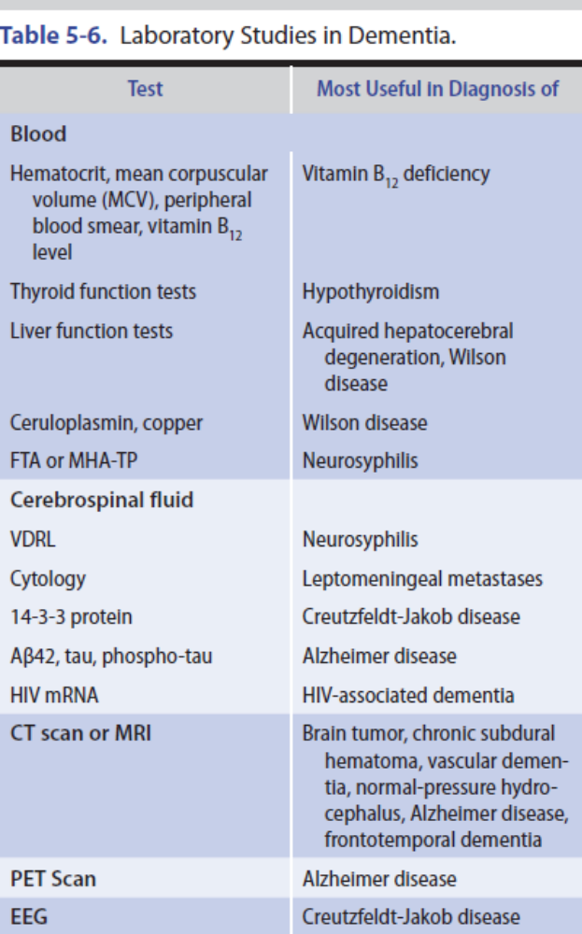

Slide 17
DIFFERENTIAL DIAGNOSIS
A wide variety of diseases can produce dementia, but only a few do so commonly. In its most typical presentation— with gradual cognitive decline in an elderly (≥65 years) patient—the most common causes of dementia are Alzheimer disease, vascular (formerly “multi-infarct”) dementia, frontotemporal dementia, Lewy body disease, and Parkinson disease.

Slide 18
ALZHEIMER DISEASE
Alzheimer disease is the most common cause of dementia, accounting in whole or part for an estimated 60% to 70% of cases.
Alzheimer disease is defined by characteristic histopathologic features, especially neuritic (senile) plaques and neurofibrillary tangles.

Slide 19
Risk Factors
The factors most conclusively associated with increased risk for Alzheimer disease are increasing age, female sex, and APOE4 genotype.
Definitive evidence that the risk of Alzheimer disease can be reduced by diet, drugs, or lifestyle changes is lacking.
However, cognitive engagement, physical activity, a low-fat and vegetable-rich diet, and light to moderate alcohol intake are all supported by some data.

Slide 20
Clinical Findings
1. Early manifestations—The term mild cognitive impairment (MCI) is sometimes used to describe the early phase of cognitive decline observed in patients who later receive a diagnosis of Alzheimer disease.
2. Late manifestations—In the late stages, previously preserved social graces are lost, and psychiatric symptoms, including psychosis with paranoia, hallucinations, or delusions, may be prominent.

Slide 21
Investigative Studies
Laboratory investigations can exclude other disorders,including reversible or otherwise treatable conditions.
Cognitive testing may also be useful in helping to distinguish between Alzheimer disease and other causes of dementia.
In patients with Alzheimer disease, the CT scan or MRI often shows cortical (especially medial temporal lobe) atrophy and enlarged ventricles, but such changes are nonspecific.

Slide 22
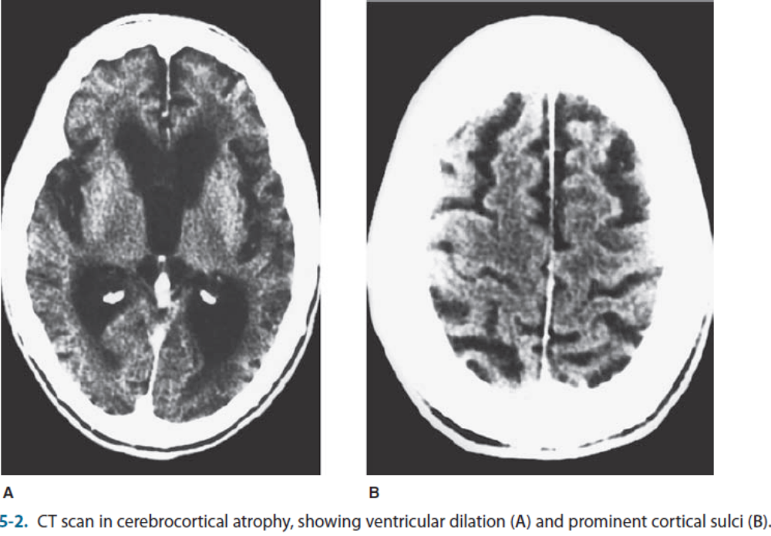

Slide 23
Differential Diagnosis
Early Alzheimer disease may resemble depression or pure memory disorders such as the Korsakoff amnestic syndrome. More advanced Alzheimer disease must be distinguished from Lewy body dementia, vascular dementia, Creutzfeldt-Jakob disease, and other dementing disorders.

Slide 24
Treatment
No currently available treatment has been shown to reverse existing deficits or to arrest disease progression.
However, memantine, an NMDA-type glutamate receptor antagonist drug, may produce modest improvement in patients with moderate or severe Alzheimer disease.
Cholinergic replacement therapy has also been used for symptomatic treatment of cognitive dysfunction.
Antipsychotic drugs, antidepressants, and anxiolytics may be useful in controlling behavioral disturbances associated with Alzheimer disease.

Slide 25
Prognosis
Early in the course of the disease, patients can usually remain at home and continue social, recreational, and limited professional activities.
Patients in advanced stages of the disease may require care in a nursing facility and the use of psychoactive medications. These patients must be protected and prevented from injuring themselves and their families by injudicious actions or decisions.
Death from inanition or infection generally occurs 5 to 10 years after the first symptoms.

