Slide 1
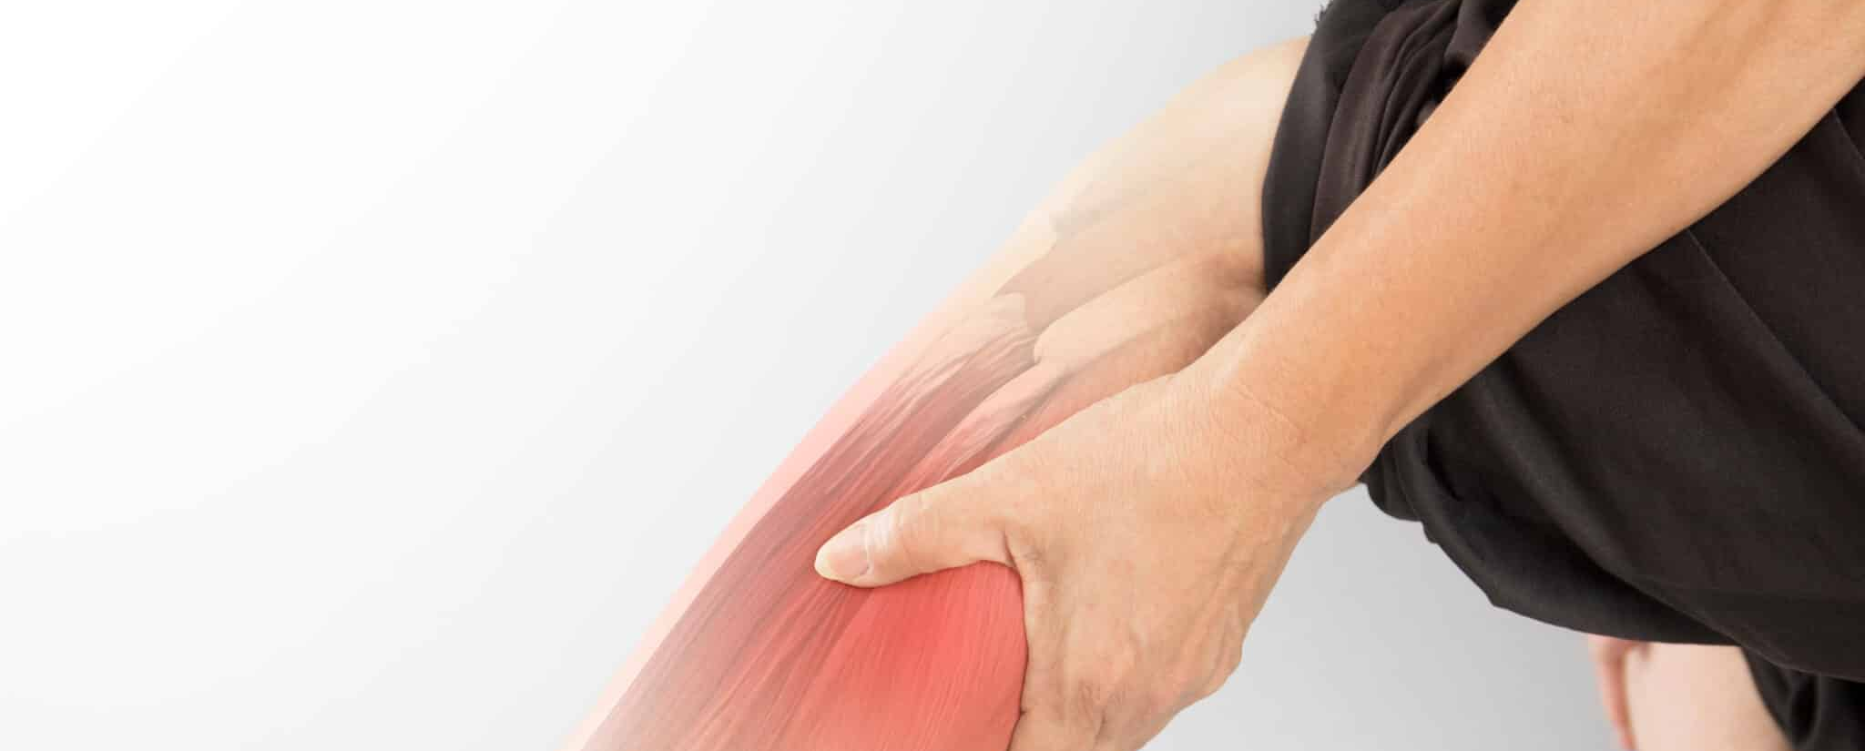
Muscle Spasm
Definition: An involuntary contraction of a voluntary skeletal muscle.

Slide 2
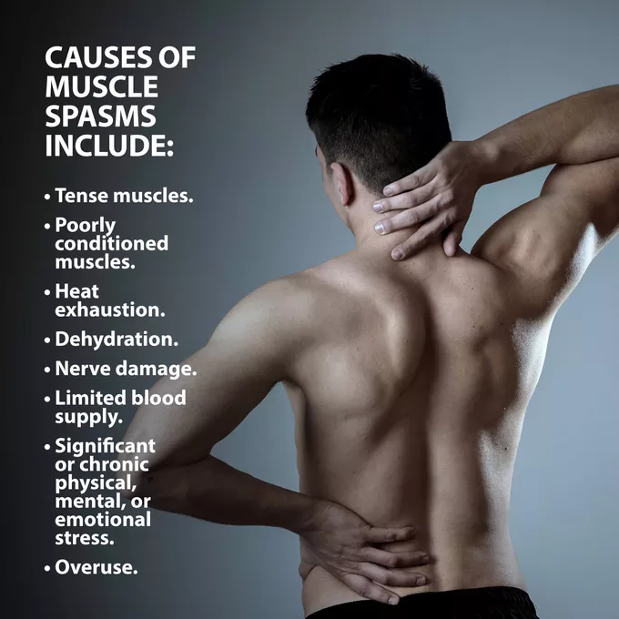
GENERAL INFORMATION
• Caused by trauma, muscle overuse, emotional stress, chilled muscles, prolonged immobilization, ischemia (temporary lack of oxygen in localized tissue), dehydration, or insufficient calcium, sodium, magnesium, potassium, or vitamin D
• Muscles commonly affected: gastrocnemius, soleus, hamstrings, deep back muscles (especially the erector spinae complex), and sternocleidomastoid (SCM)

Slide 3
PATHOPHYSIOLOGY
A review of normal muscle anatomy and physiology will help clarify the pathophysiology of a muscle spasm. Muscle tissue is one of the most sanguineous (well vascularized) tissues in the body. In order to function quickly and efficiently on both gross and fine motor levels, a muscle must receive a constant flow of fresh blood from and release metabolic waste into the bloodstream. As muscles move, Golgi tendon organs (GTOs; nerve receptors located in tendons) signal the brain about the extent a muscle can stretch before injury will occur. The vigilant GTOs constantly fire signals during normal muscle activity and will produce sudden and severe pain if an overly zealous exerciser, for example, stretches too far and thereby possibly risks snapping a tendon off a bone. When a tendon is injured or inflamed, the GTOs “ register their objections” by firing continuous pain signals in order to prevent the person from continuing offending activity.

Slide 4
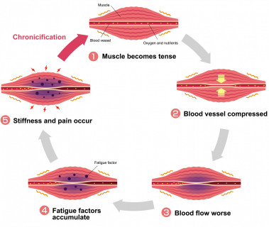
Conversely, immobilized muscle produces its own set of painful signals. Local ischemia, which accompanies immobilization, leads to metabolite buildup, causing pain and further muscle immobilizing, thereby continuing the pain-spasm-pain cycle. There is no diagnostic test for identifying a muscle spasm. The clinician palpates for the presence of tightened, painful muscles and will take an oral history of recent activity, lack of activity, or the presence of recent trauma or disease.

Slide 5
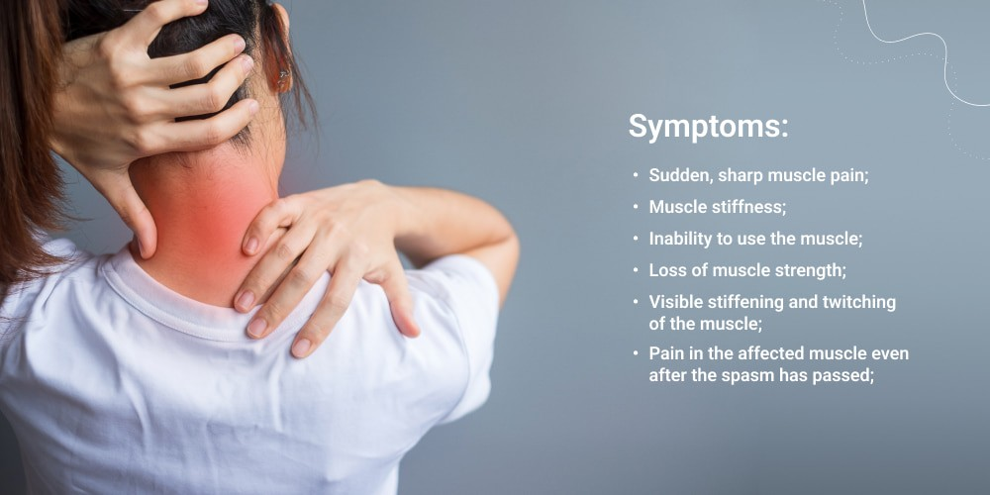
OVERALL SIGNS AND SYMPTOMS
• Temporary skeletal muscle pain, spasm, and/or cramping
• Temporary decreased range of motion (ROM) secondary to muscle shortening and pain
• Unusually firm, hard, and/or congested muscle tissue

Slide 6
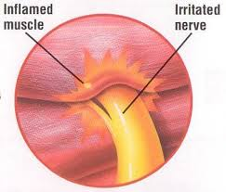
SIGNS AND SYMPTOMS MASSAGE THERAPY CAN ADDRESS
• The pain-spasm-pain cycle is effectively broken with skilled therapeutic massage.
• ROM is increased with passive techniques applied to the post-spasm muscle and proximal joint.
• Accumulated toxins can be hastened out of the muscle and sent into circulation with the use of several massage modalities.

Slide 7
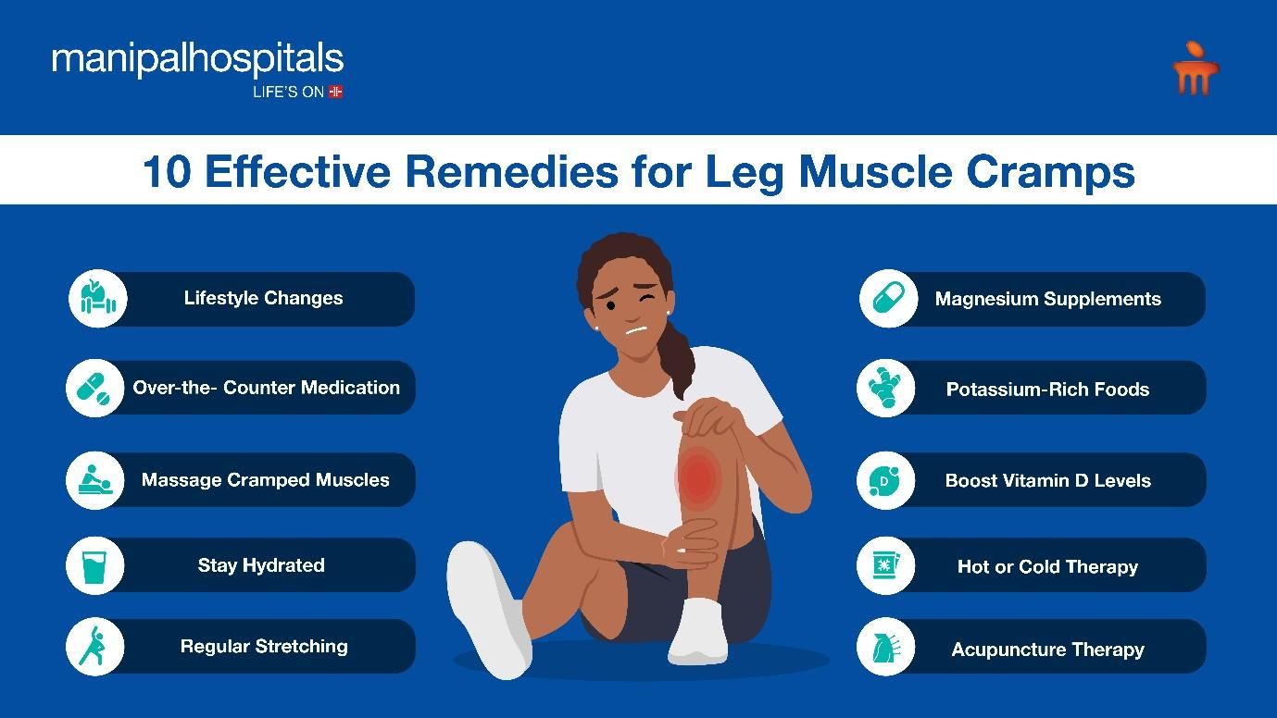
TREATMENT OPTIONS
Rest, ice, and nonsteroidal anti-inflammatory drugs (NSAIDs) or muscle relaxants are suggested during the first 3 days if muscle spasms occur secondary to trauma. Rest, heat, NSAIDs, and, more rarely, muscle relaxants are suggested for chronic or infrequent muscle spasms that result from minor injury, exercise, or immobilization. When a spasm results from exercise dehydration, water and sports drinks are suggested before, during, and after activity. Spasms occurring secondary to metabolic imbalance or circulatory diseases often do not resolve until the primary condition is addressed.

Slide 8
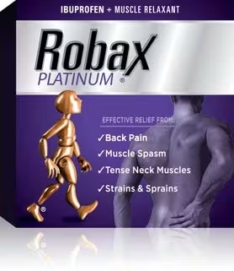
Common Medications
• NSAIDs, such as ibuprofen (Motrin, Advil)
• Skeletal muscle relaxant, such as cyclobenzaprine hydrochloride (Flexeril)

Slide 9
MASSAGE THERAPIST ASSESSMENT
The client experiencing a muscle spasm may present after unusual or excessive physical activity, such as shoveling after the first snowstorm of the year, or because of one sudden, unusual awkward movement, such as jerking to catch something. Before proceeding with the treatment of a seemingly innocuous muscle spasm, however, the therapist must be assured that no underlying metabolic pathology exists. In addition, a therapist should not treat muscle spasm secondary to recent injury or trauma. Before continuing in the safe treatment of a muscle spasm, the therapist can:

Slide 10
• Ask the client about the specific, suspected origin of the muscle spasm.
• Ask him to clearly identify the exact location of the spasm.
• Find out whether he experiences chronic spasms or if this is an unusual occurrence.
• Ask how he normally treats the spasm.
• Ask if he is diabetic, dehydrated, experiencing unusual stress, or is a smoker.

Slide 11
• Ask if he is seeing a physician, chiropractor, or physical therapist for his spasms or for any medical condition.
• Palpate the muscle belly to determine the character of the spasm. Is it accompanied by heat, coolness, or increased hypertonicity?
• Ask the client to demonstrate his ROM at the affected limb.

Slide 12
THERAPEUTIC GOALS
Reasonable goals for treating muscle spasm include softening hypertonic muscles, quieting the firing GTOs, removing accumulated metabolic waste, increasing circulation to the affected muscle, enhancing the healing process, and relieving the pain.

Slide 13
MASSAGE SESSION FREQUENCY
• Ideally: 60-minute sessions once a day until the painful spasm is under control
• Preventive: 60-minute sessions once a week if the client is sedentary

Slide 14
MASSAGE PROTOCOL
Once you have determined that it is safe to proceed, your approach to a spasming muscle should be gentle but firm, and your protocol will have a definite beginning, middle and end. Haphazard work will produce unnecessary pain and may injure the client.
Your first task is the application of ice for an acute spasm (if it occurred within the last 3 days) or heat (if the spasm is chronic or if it occurred longer than 3 days ago). You must attempt to break the pain-spasm-pain cycle and use the gate control theory of pain to your advantage. Use frequent deep-breathing techniques to help relax your client and bring oxygen to the blood-starved muscles. You’ll “slay the dragon” while the ice or heat begins to work, and then gently perform techniques that will bring blood to the muscle belly and quiet the GTOs. Take your time and don’t overwork the muscle set; start at the tendon sites, not on the muscle belly; be sure to work on surrounding and antagonist muscles and not solely on the painful muscle.

Slide 15
Passive ROM and deep vibratory techniques—both highly effective and necessary components of this protocol—should not be performed until well after you are sure the spasm has quieted. Even then, you may find that as you attempt to reposition the client, or as he gets off the table at the end of the session, the muscle may re-spasm. These repeated spasm cycles will quiet with rest, heat or ice, anti inflammatories, and time.
The following protocol is based on the treatment of nontraumatic back muscle spasms resulting from snow shoveling.

Slide 16
Getting Started
Try to gather information from a telephone intake before your client arrives to ensure that you can safely treat him. Once you determine it is safe to proceed, have ice and hot packs ready.
This protocol focuses on treating the rhomboids, so the client will probably be positioned prone for an extended period. Allow him to move his head from side to side, and shift positions frequently so he does not lay prone for 60 minutes. This sustained position is usually not well-tolerated and can produce sinus congestion and headache. The side-lying position can be a helpful alternative.

Slide 17
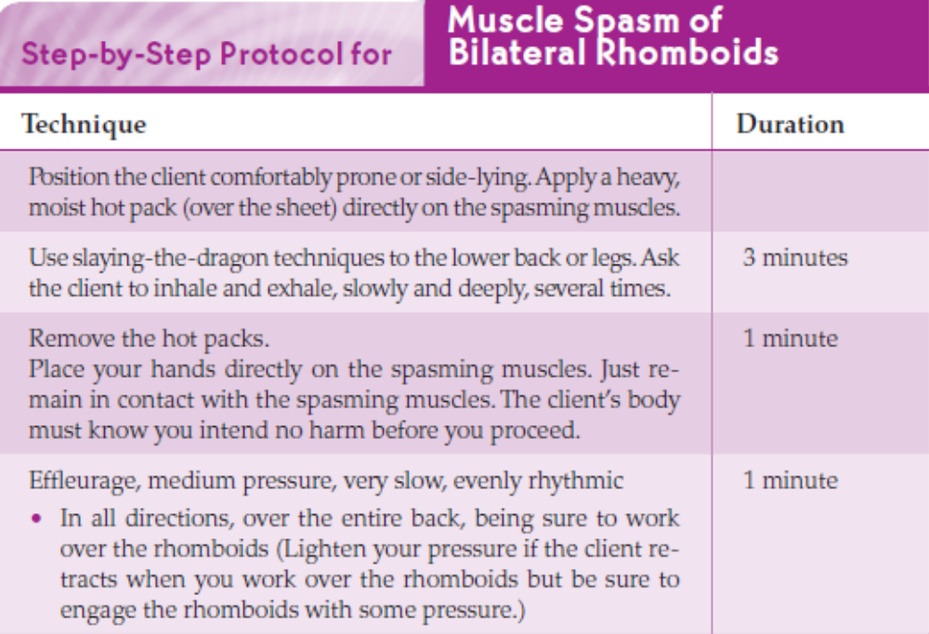

Slide 18
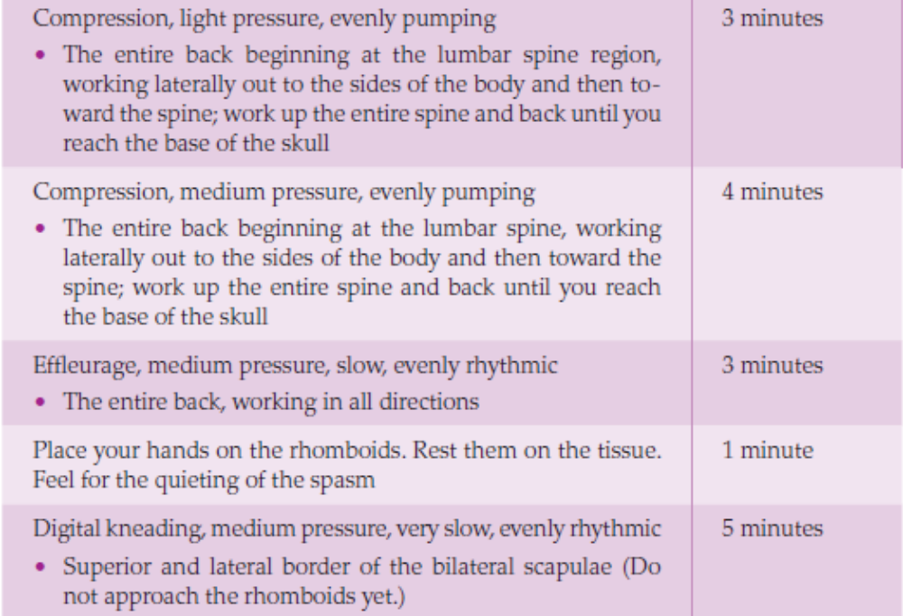

Slide 19
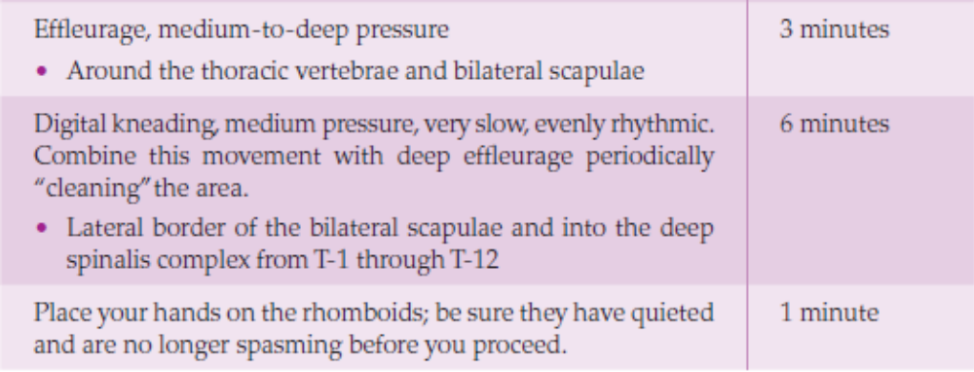
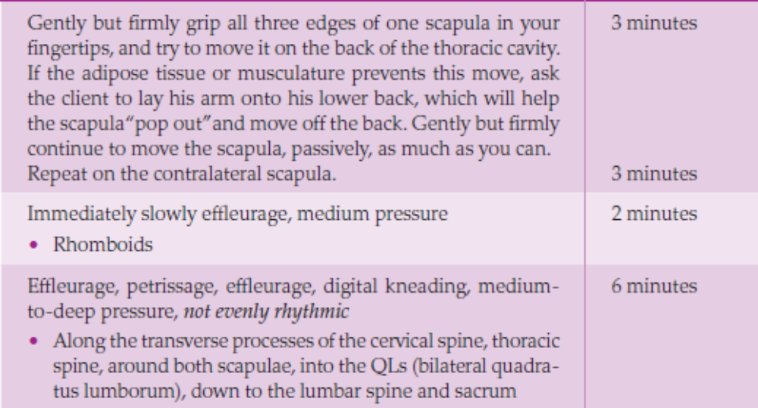

Slide 20
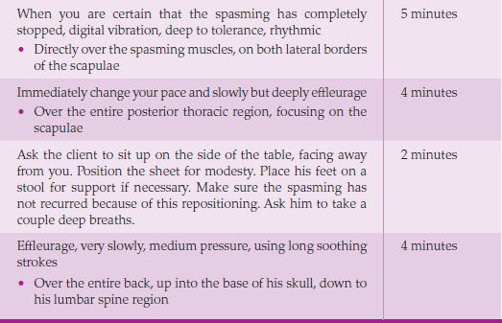

Slide 21
HOMEWORK
Your client’s healing is only possible if he continues to attend to his muscle spasm after he leaves your table. Appropriate homework assignments are determined by the client’s acute or chronic symptoms.
Acute Muscle Spasm
• Place an ice pack or bag of frozen vegetables on your spasming muscle for 5–10 minutes every hour. Repeat frequently.
• Find the end of your muscle, the place where it attaches to your bone. Deeply massage into this area. Don’t cause further pain and don’t massage directly on the painful muscle.

Slide 22
• Slowly and carefully perform ROM exercises without placing the muscle into even the slightest stretch.
• Call your physician to determine if you should be taking NSAIDs, or if she wants to prescribe a short-term muscle relaxant. Don’t drive if you’re taking
muscle relaxants.
• Return for another massage session as soon as your schedule allows.
• Rest.

Slide 23
Non-Acute Muscle Spasm
• Apply a moist hot pack directly onto the affected muscle; leave it on for as long as it’s comfortable.
• Find the end of your muscle, the place where it attaches to your bone. Deeply massage this area, but don’t cause further pain.
• Find the exact affected muscle. Massage into the muscle belly. Start superficially, working progressively deeper. Do not cause pain.

Slide 24
• Perform slow, careful ROM exercises, moving your joint until you can’t move any farther; hold this stretch for about 20 seconds and then release. Don’t bounce. Repeat several times.
• If you are exercising, be sure to drink plenty of water for adequate hydration.
• Stretch before and after your regular workout.
• Rest.

Slide 25
Contraindications and Cautions
• Gastrocnemius cramps are often associated with third trimester pregnancy. The cause is thought to be either vitamin insufficiency or spinal disc involvement secondary to the baby’s placement against the spine. Since pregnant women are also at risk for lower extremity blood pooling and blood clots, it is best to get a physician’s clearance before treating muscle spasms in a pregnant client. • A unilateral dull, aching, sometimes cramping sensation in the gastrocnemius (or any muscle) accompanied by heat, redness, slight swelling, pain, and localized tenderness are dangerous signs and symptoms of a potentially lethal deep vein thrombosis (DVT). Never massage a muscle that feels unilaterally warm, appears reddened, is even mildly swollen, and is uncomfortably tender to the touch. The client should see a physician before you proceed.

Slide 26
• Diabetic patients often suffer from chronic Arteriosclerotic vascular disorders, which cause leg pain and cramping. Be sure to get a clearance from the client’s physician before proceeding with deep work.
• Chronic smokers ten have circulatory disorders that can inflame vessels. Be sure to get a physician’s clearance before performing deep work on a chronic smoker. • Women who take birth control pills are at increased risk for DVT. • Never massage a set of muscles that are splinting or guarding after trauma or injury. Immediately refer the client to a physician.
• Do not stretch or work deeply into a spasming muscle until it has completely relaxed.
• Do not apply heat to a muscle spasm that occurred as a result of injury or trauma.

