Slide 1

Massage Techniques 9C
Muscles of medial thigh

Slide 2
Muscles of the medial thigh (hip adductors)
Overview
Although we associate the hip adductors chiefly with adduction of the hip, they contribute to flexion, extension, rotation, and stability of the hip in complex ways in standing, walking, climbing stairs, and other activities involving the legs. In your assessment of the client's gait, observe the medial thigh closely for any anomalies such as twitches or catches in the motion of the thigh.

Slide 3
Palpation
The superior attachments of these muscles follow the pubis from the symphysis all the way to the ischial tuberosity. Adductor longus attaches at and to the side of the pubic symphysis. Adductor brevis attaches lateral t it, and pectineus to the lateral end of the pubic ramus. Behind these are gracilis and then adductor magnus, which attach to the ischiopubic ramus and the ischial tuberosity. Although it is difficult for the most part to distinguish the attachments, they can be easily palpated and followed from the pubic symphysis to the ischial tuberosity.

Slide 4
The most distinctive attachment to the pubis is that of adductor magnus with gracilis; it is a distinctively large tendon. The inferior attachments are difficult to palpate except for adductor magnus, which attaches to the adductor tubercle of the femur, and gracilis, which attaches just below the tibial tuberosity. Their architectures are all convergent.

Slide 5
Adductor Magnus ad-DUCK-ter MAG-nus
Etymology Latin ad, toward + ducere, pull + magnus, large
Overview
The superior part of adductor magnus (Fig. 9-24) is called adductor minimus.
Attachments
Superiorly, to the ischial tuberosity and ischiopubic ramus
Inferiorly, to the linea aspera and adductor tubercle of the femur
Action. Adducts and extends hip
Referral Areas. To the medial aspect of the thigh
Other Muscles to Examine. Other hip adductors

Slide 6
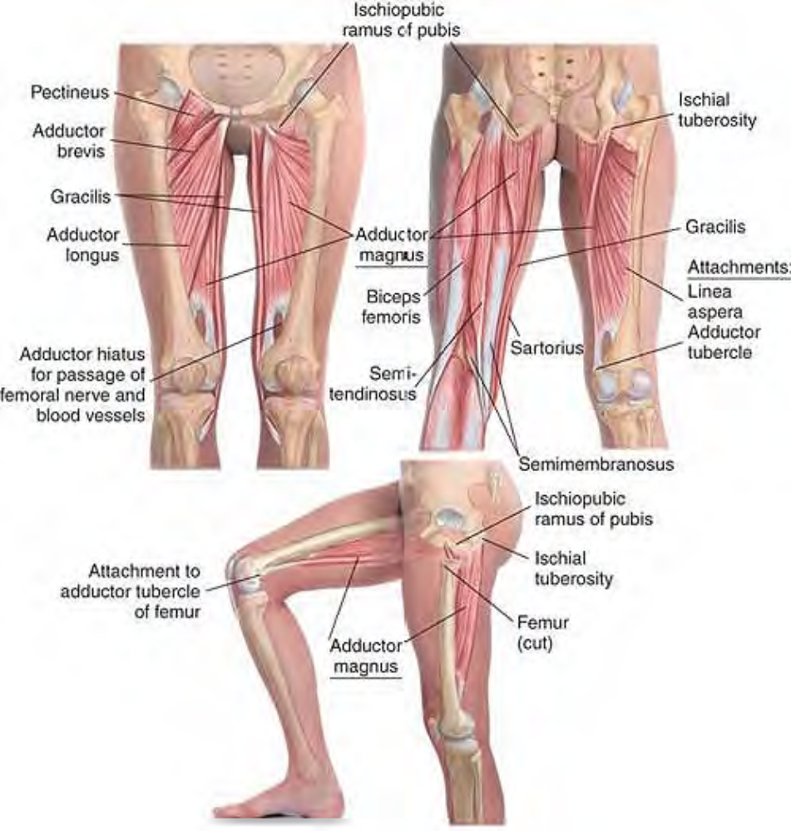
Anatomy of adductor magnus

Slide 7
Adductor Longus ad-DUCK-ter LONG-gus
Etymology Latin ad, toward + ducere, pull + longus, long
Attachments
Superiorly, symphysis and crest of pubis (Fig. 9-25)
Inferiorly, to the middle third of medial lip of linea aspera
Action. Adducts hip
Referral Areas. To the medial aspect of the thigh
Other Muscles to Examine. Other hip adductors

Slide 8
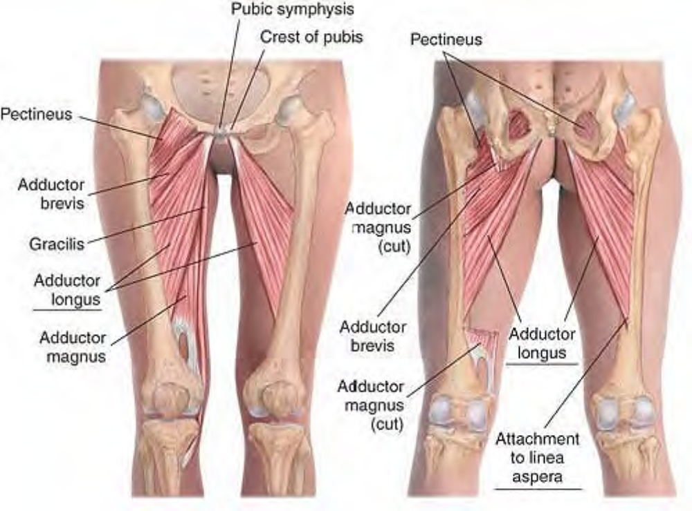
Anatomy of adductor longus

Slide 9
Adductor Brevis ad-DUCK-ter BREV-is
Etymology Latin ad, toward + ducere, pull + brevis, short
Attachments
Superiorly, to the inferior ramus of the pubis (Fig. 9-26)
Inferiorly, to the upper third of medial lip of linea aspera
Action. Adducts hip
Referral Areas. To the medial aspect of the thigh
Other Muscles to Examine. Other hip adductors

Slide 10
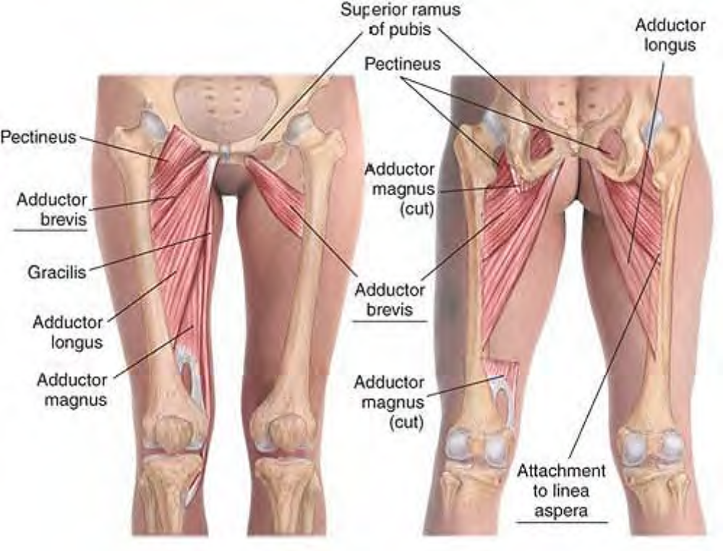
Anatomy of adductor brevis

Slide 11
Pectineus peck-TIN-ee-us
Etymology Latin pecten, comb
Overview
Pectineus is named for its attachment to the pecten, a sharp ridge on the superior pubic ramus.
Attachments
Superiorly, to the crest of the pubis
Inferiorly, to the pectineal line of femur between the lesser trochanter and the linea aspera
Action. Adducts and assists in flexion of hip
Referral Areas. To the medial aspect of the thigh
Other Muscles to Examine. Other hip adductors

Slide 12
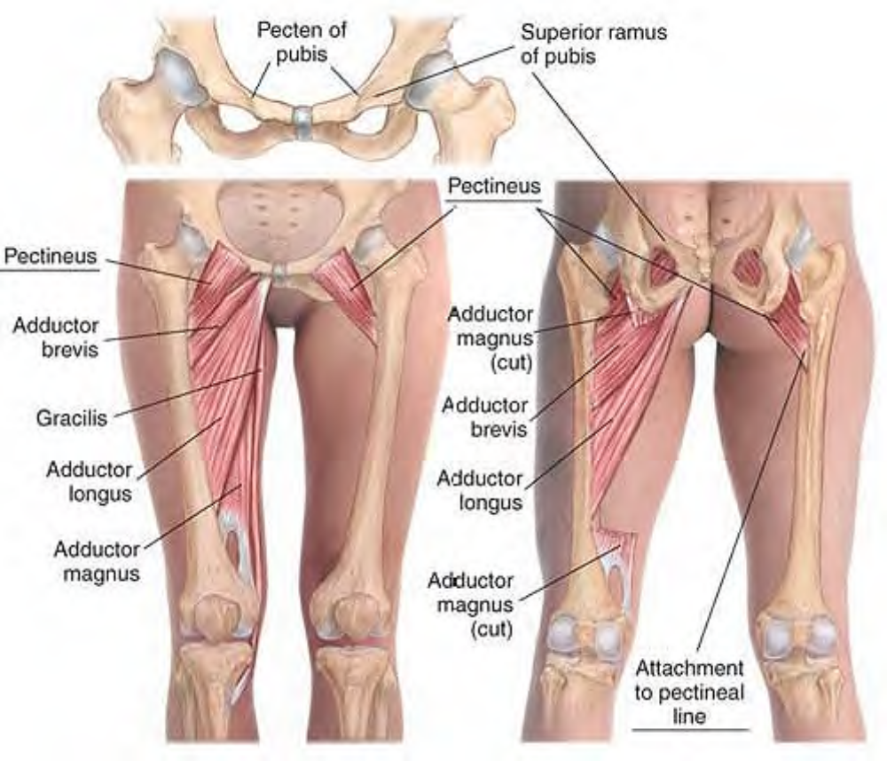
Anatomy of pectineus

Slide 13
Gracilis GRASS-ill-iss, gra-SILL-iss
Etymology Latin gracilis, slender
Attachments
Superiorly, to the body and inferior ramus of the pubis near the symphysis
Inferiorly, to the medial shaft of the tibia below the tibial tuberosity
Action. Adducts the hip, flexes the knee, rotates the flexed knee medially
Referral Areas. To the medial aspect of the thigh
Other Muscles to Examine. Other hip adductors

Slide 14
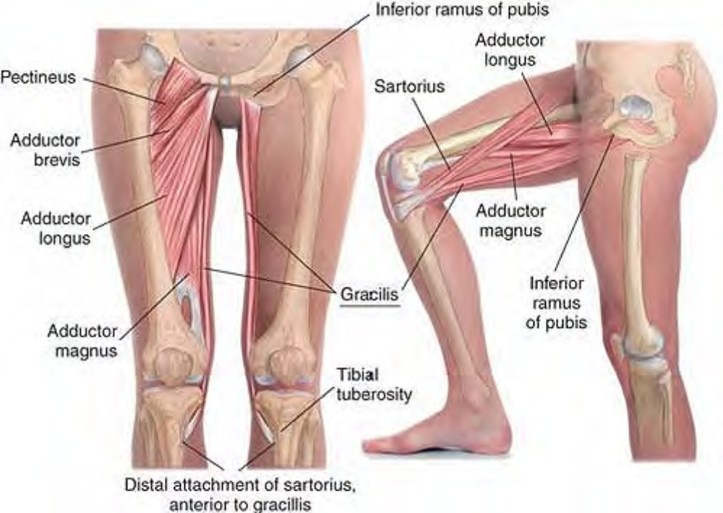
Anatomy of gracilis

Slide 15
Manual Therapy for the Hip Adductors
Note: Some clients may be more comfortable keeping underwear on for work on the hip adductors.
Compression of the Adductor Attachments
The client lies supine. The therapist stands beside the client at the knee. Place your thumb on the lateral edge of the pubic crest on the attachment of pectineus. Press firmly into the tissue, looking for tender spots. Hold for release. Shift the thumb inferiorly and posteriorly along the pubic crest, compressing each adductor attachment.

Slide 16
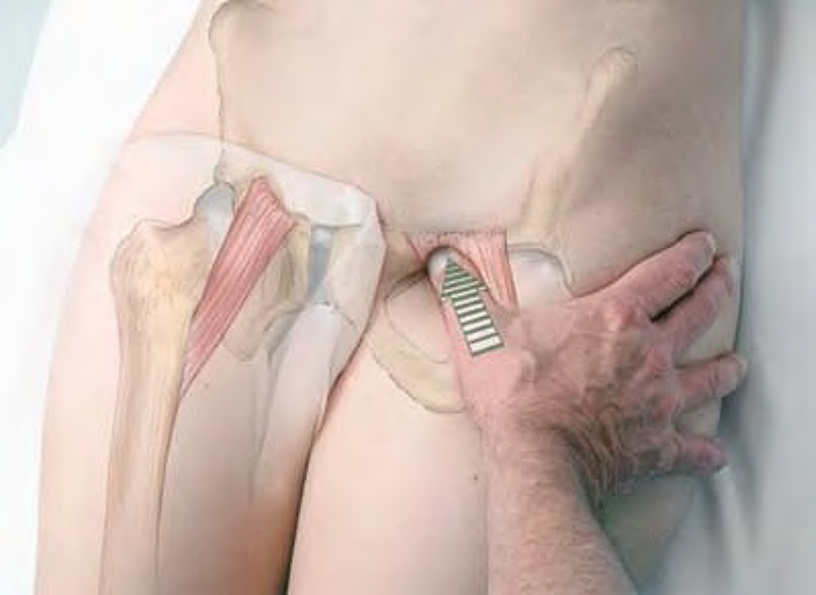
Compression of attachment of pectineus

Slide 17
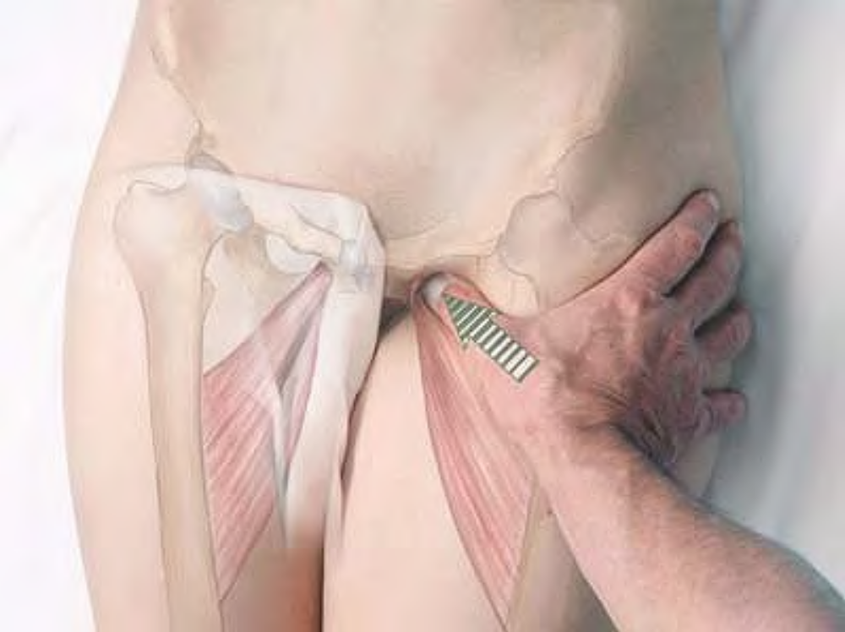
Compression of attachment of adductor brevis

Slide 18
Repeat this procedure until you reach the attachment of adductor magnus.
This technique may also be performed with the hip abducted and externally rotated and the knee partially flexed, and may also be performed with the fingertips.

Slide 19
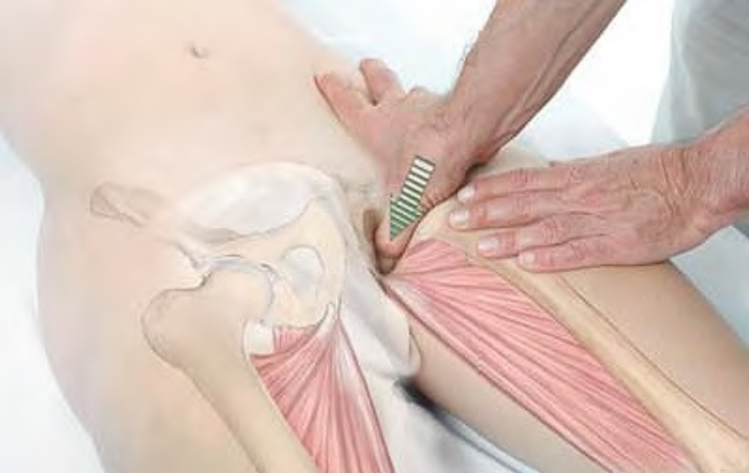
Compression of attachment of adductor magnus with thumb

Slide 20
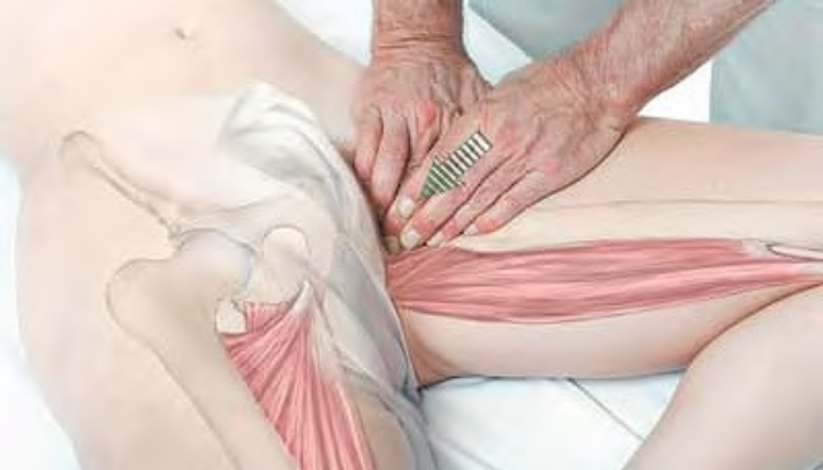
Compression of attachment of adductor magnus with fingertips, hip abducted and rotated

Slide 21
Stripping and compression of the Hip Adductors
The client lies supine, either with the leg straight and the hip slightly abducted, or with the hip abducted and externally rotated and the knee partially flexed. The therapist stands beside the client at the knees. Place the fingertips or thumb(s) just above the medial epicondyle of the femur.
Pressing firmly into the tissue, glide the fingertips along the adductors to the anterior aspect of the pubic arch.
Beginning at the same spot, repeat this procedure, ending each time more posteriorly along the pubis.
You may also perform compression against the femur along each hip adductor in the same position, using the thumbs.

Slide 22
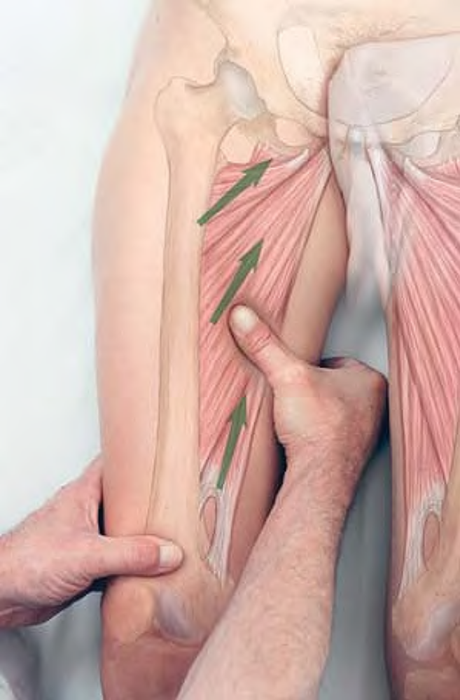
Stripping of adductor magnus and longus with thumb, client supine, leg straight, hip slightly abducted

Slide 23
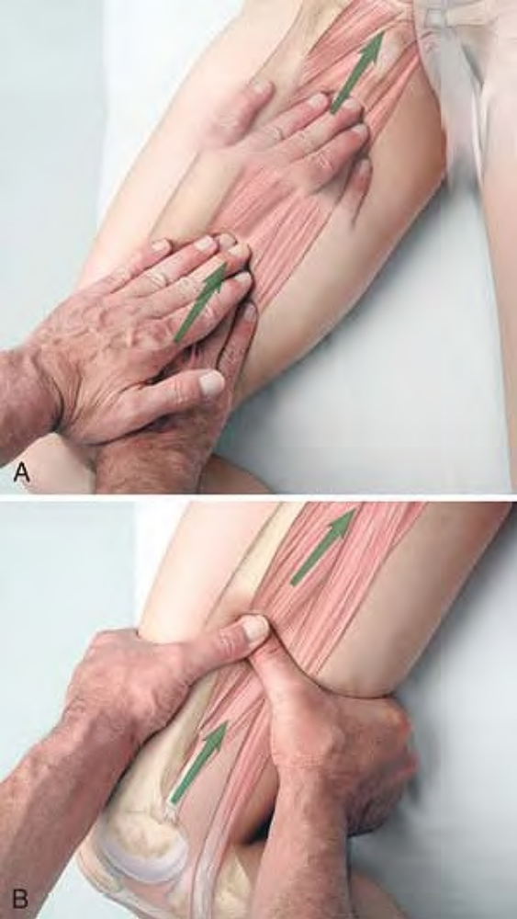
Stripping of adductor magnus and gracilis, client supine, hip abducted and externally rotated, hip and knee flexed: (A) with fingertips, (B) with thumb

Slide 24
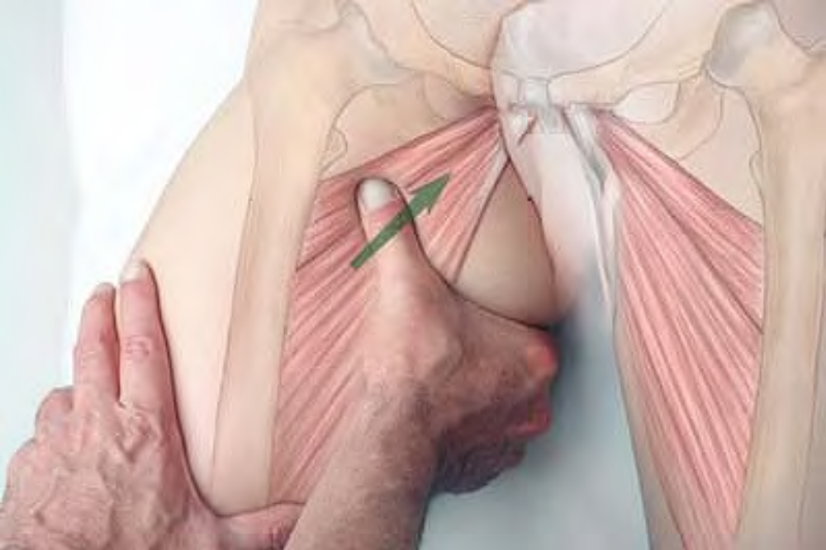
Stripping of adductor brevis and longus with thumb, client supine, hip abducted and externally rotated, hip and knee flexed

Slide 25
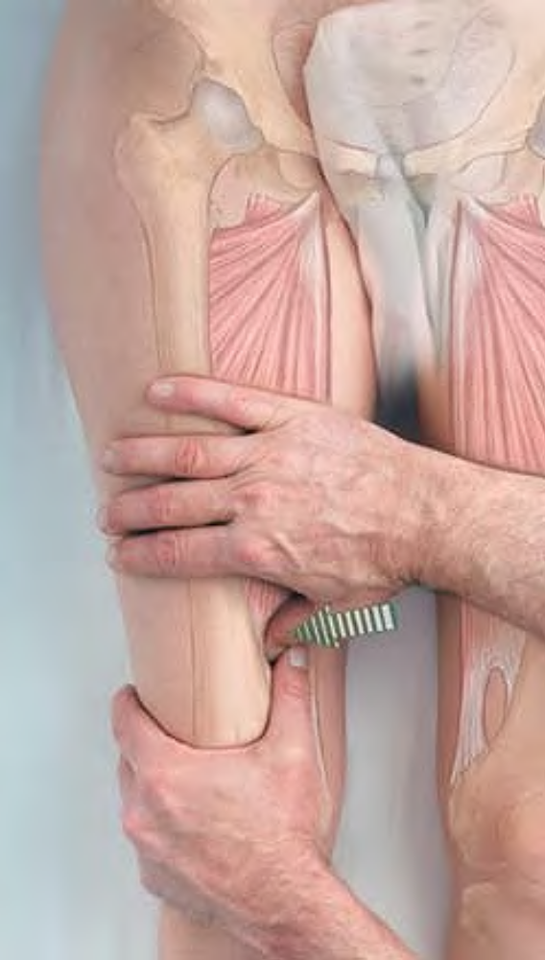
Compression of adductor magnus with thumb, leg straight

Slide 26
Both of these procedures may also be performed with the client lying on her side, with either the lower leg straight and the upper leg flexed at the hip and the knee, or with the upper leg straight and the lower leg flexed at the hip and the knee. However, in these positions it is not possible to work close to the attachments without contacting the genitals.

Slide 27
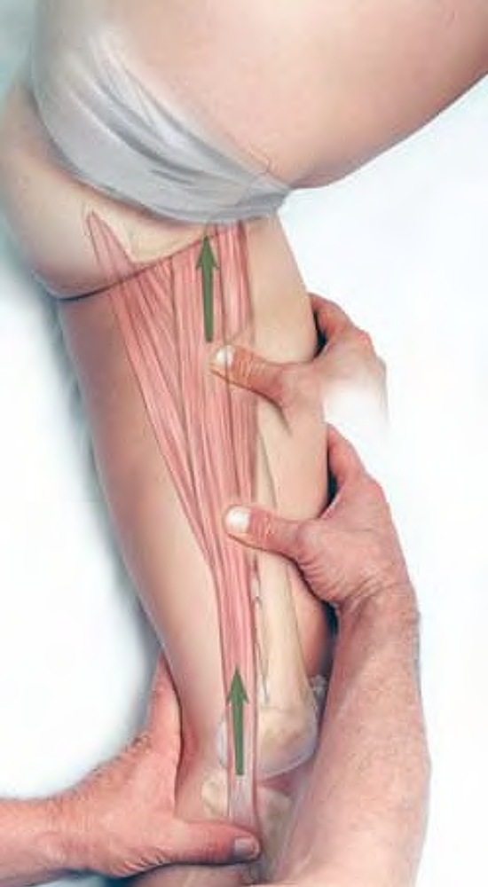
Stripping of adductors with client side-lying, lower leg straight

Slide 28
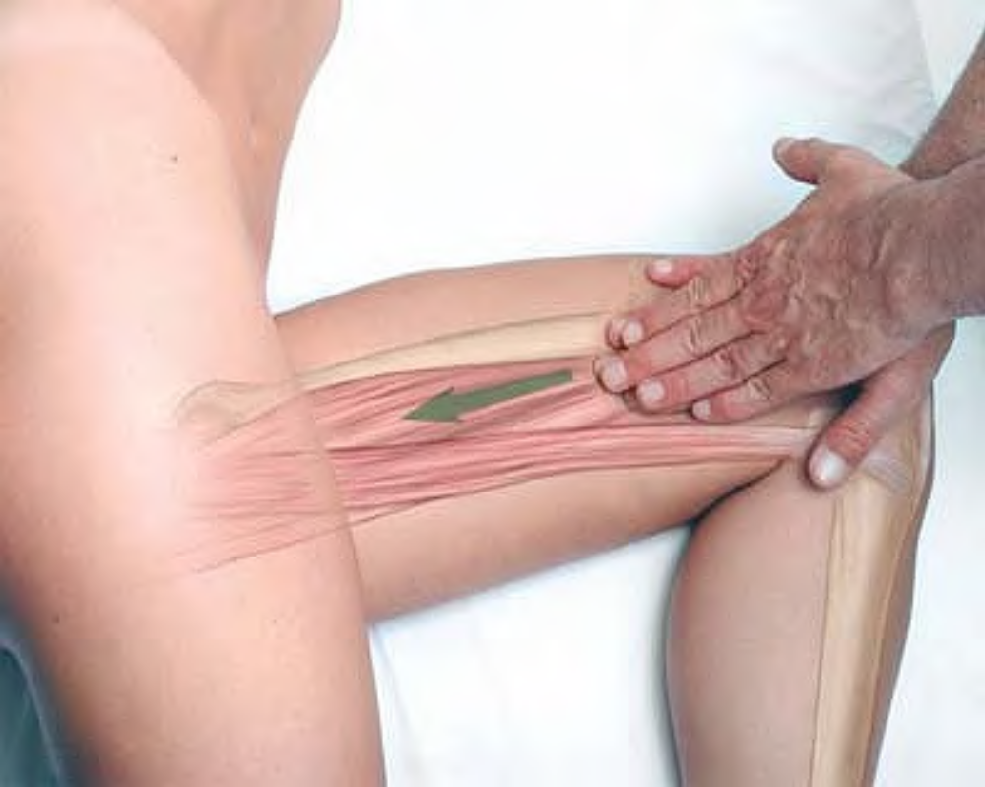
Stripping of adductors with client side-lying, upper leg straight

