Slide 1
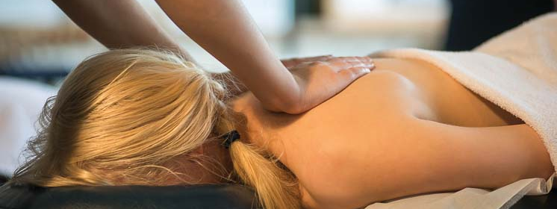
Massage Techniques 9B
Muscles of the Posterior Thigh (Hamstrings)

Slide 2
Muscles of the Posterior Thigh (Hamstrings)
Overview
From the word ham, denoting the buttock and back of the thigh, hamstrings is an old term for the muscles of the posterior thigh, comprising the long head of biceps, the semitendinosus, and the semimembranosus muscles. Note that these muscles cross both the hip and knee joints and are therefore important in both movement and stabilization of these joints.

Slide 3
Semitendinosus SEM-i-ten-di-NO-sus
Etymology Latin semi, half + tendinosus, tendinous
Attachments. Superiorly, to the ischial tuberosity. Inferiorly, to the medial surface of the superior fourth of the shaft of the tibia
Palpation. The hamstrings, like quadriceps femoris, are easy to palpate but difficult to distinguish. Biceps femoris can be followed on the lateral side to its attachment to the head of the fibula. Semimembranosus can be followed to its attachment to the medial condyle of the tibia. Semitendi-nosus is difficult to distinguish at its inferior attachment to the tibia. The superior heads of the hamstrings can be felt underneath the ischial tuberosity. Biceps femoris and semimembranosus are bipennate; semitendinosus is unipennate.
Action. Extends hip; flexes knee and rotates it medially when flexed
Referral Areas. Over the back of the leg from the buttock to the mid-calf

Slide 4
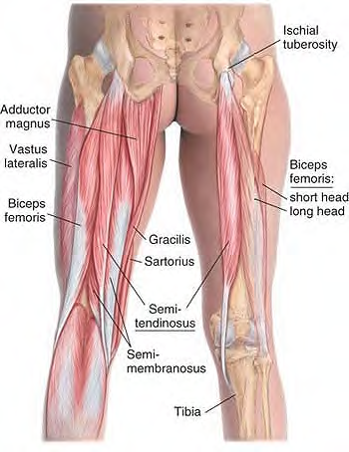
Anatomy of semitendinosus

Slide 5
Semimembranosus SEM-i-mem-bra-NO-sus
Etymology Latin semi, half + membranosus, membranous
Attachments. Superiorly, to the ischial tuberosity. Inferiorly, to the posterior aspect of the medial condyle of the tibia
Palpation. See semitendinosus
Action. Flexes knee and rotates knee medially when flexed; contributes to the stability of extended knee by making capsule of knee joint tense; extends hip
Referral Areas. Over the back of the leg from the buttock to the mid-calf

Slide 6
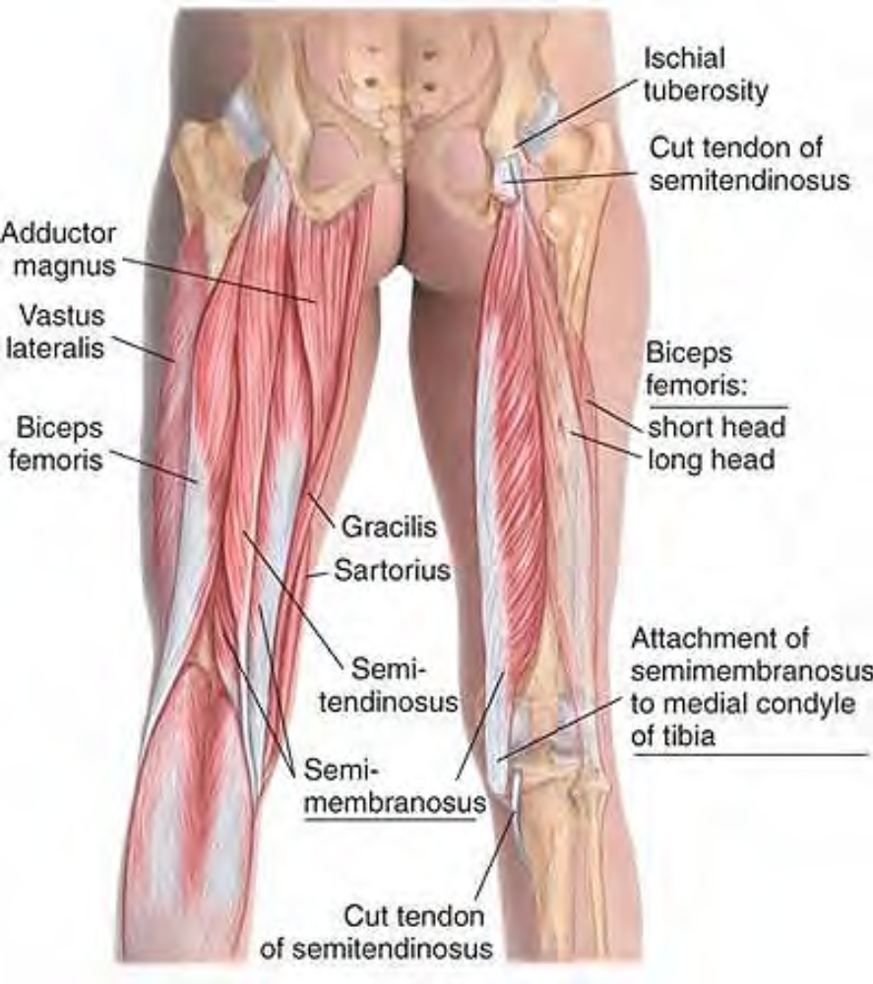
Anatomy of semimembranosus

Slide 7
Biceps Femoris BUY-seps fe-MORE-is
Etymology Latin biceps, two-headed + femoris, of the femur
Attachments. Superiorly, the long head to the ischial tuberosity, the short head to the lower half of the lateral lip of linea aspera. Inferiorly, to the head of the fibula
Palpation. See semitendinosus
Action. Flexes knee and rotates flexed knee laterally; long head extends hip
Referral Areas. Over the back of the leg from the buttock to the mid-calf

Slide 8
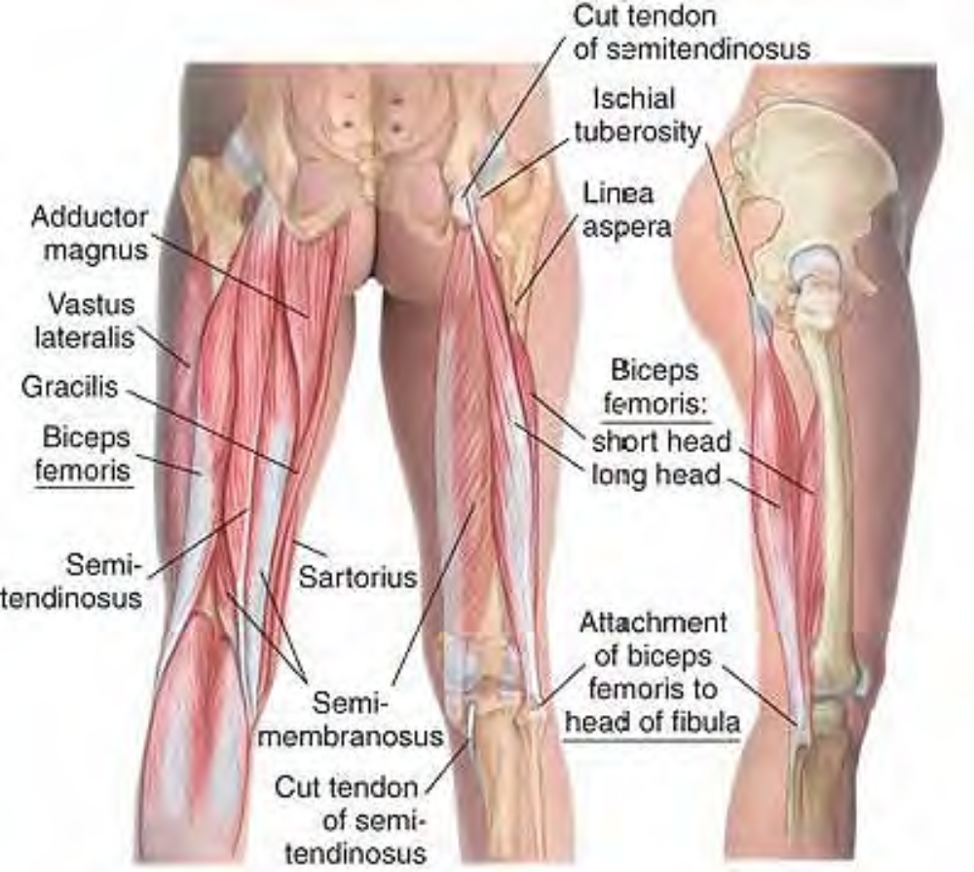
Anatomy of biceps femoris

Slide 9
Manual Therapy for Hamstrings
Stripping. The client lies prone. The therapist stands beside the client at the calves. Place the fingertips, heel of the hand, forearm, or knuckles on the medial aspect of the hamstrings just superior to the knee.
Pressing firmly into the tissue, slide along the muscle to its attachment on the ischial tuberosity.
Beginning in the center, repeat this procedure.
Repeat the same procedure on the lateral aspect.
Caution. At the beginning of the above procedure, avoid pressure into the popliteal space behind the knee.

Slide 10
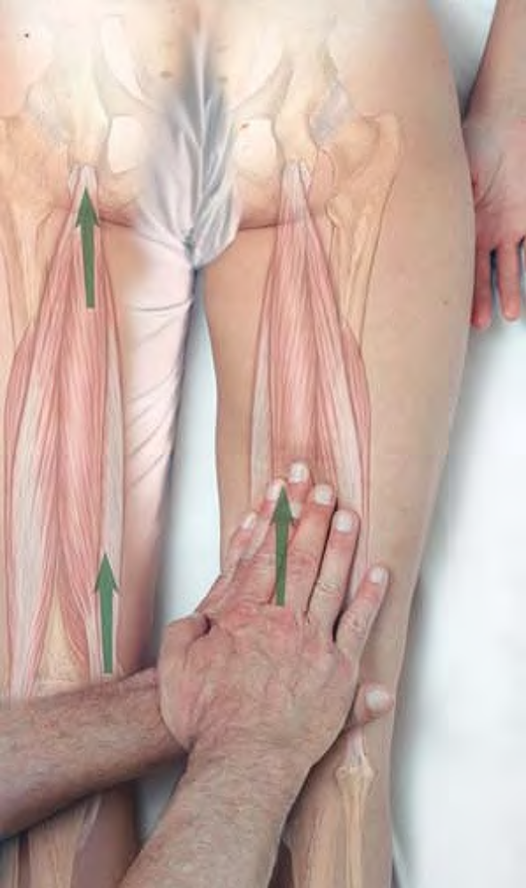
Stripping of medial hamstrings with the fingertips

Slide 11
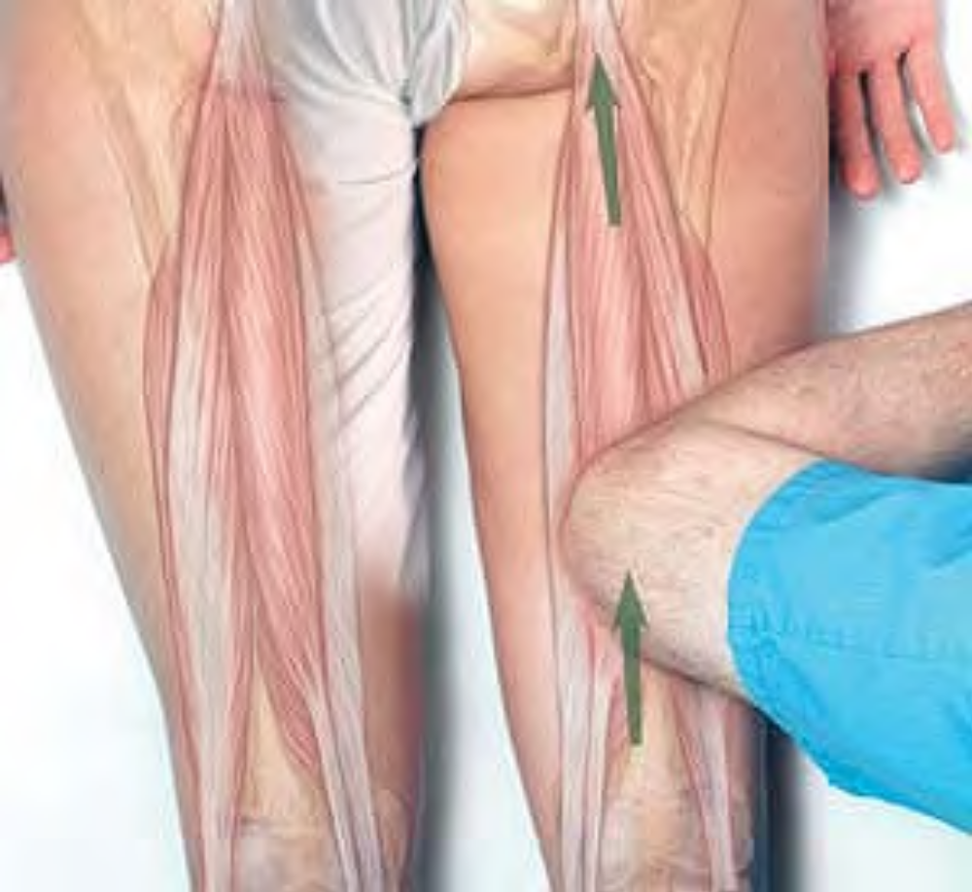
Stripping of hamstrings with the forearm

Slide 12
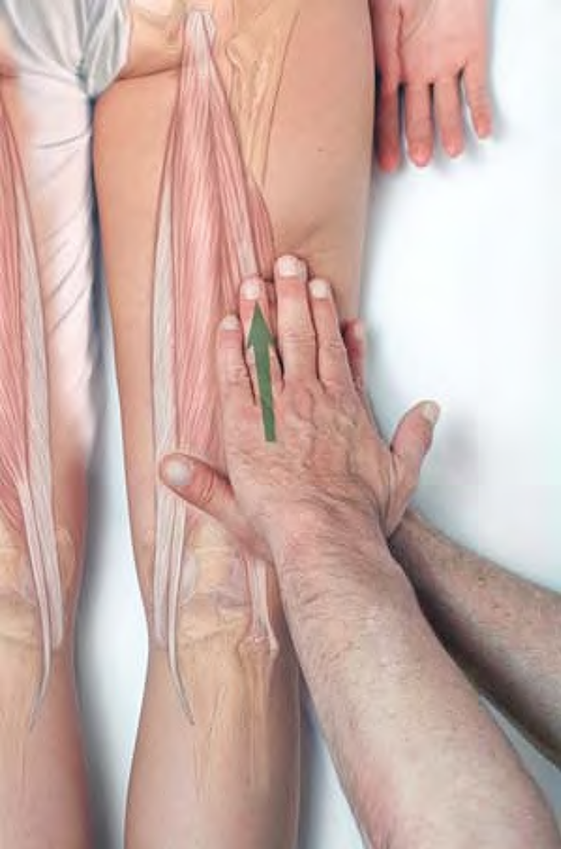
Stripping of lateral hamstrings with the fingertips

Slide 13
Compression and Cross-fiber Friction
Place the thumbs on the attachment of the hamstrings to the ischial tuberosity.
Press superiorly into the tissue and hold for release. Alternatively, move the thumbs from side to side until you feel a softening and relaxation in the tissue.

Slide 14
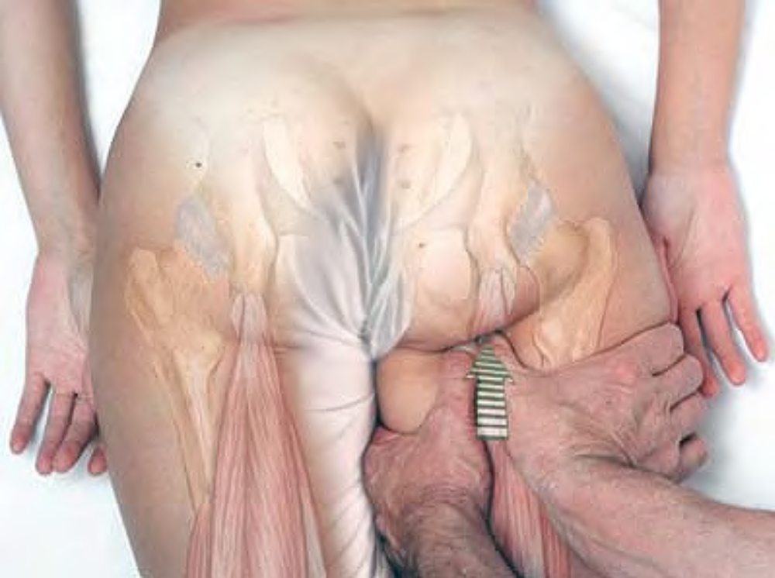
Compression of hamstring attachments against the ischial tuberosity

Slide 15
The Lateral Thigh:
Tensor Fasciae Latae and the Iliotibial Band
Overview
The iliotibial band is a fibrous reinforcement (thickening) of the fascia lata (the deep fascia of the thigh) on the lateral surface of the thigh, extending from the crest of the ilium to the lateral condyle of the tibia. Tensor fasciae latae attaches to it and tenses the deep fascia. Together they serve as a flexor, abductor, and medial rotator of the hip. Tensor fasciae latae and gluteus maximus are the two muscles that insert on and control the iliotibial band.

Slide 16
Tensor Fasciae Latae and the Iliotibial Band (ITB)
Attachments. Superiorly (tensor fasciae latae), to the anterior superior iliac spine and the adjacent lateral and posterior surface of the ilium. Inferiorly, to the iliotibial band of fascia lata, which attaches to the lateral condyle of the tibia.
Palpation. Tensor fasciae latae can be palpated just below the anterior superior iliac spine, moving posteriorly into the iliotibial band (ITB). The ITB can be followed from there, and from gluteus maximus, down the side of the thigh to the lateral condyle of the tibia. Its architecture is parallel.
Action. Tenses fascia lata; flexes, abducts and medially rotates hip; also contributes to the lateral stability of the knee.
Referral Areas. To the lateral aspect of the thigh.

Slide 17
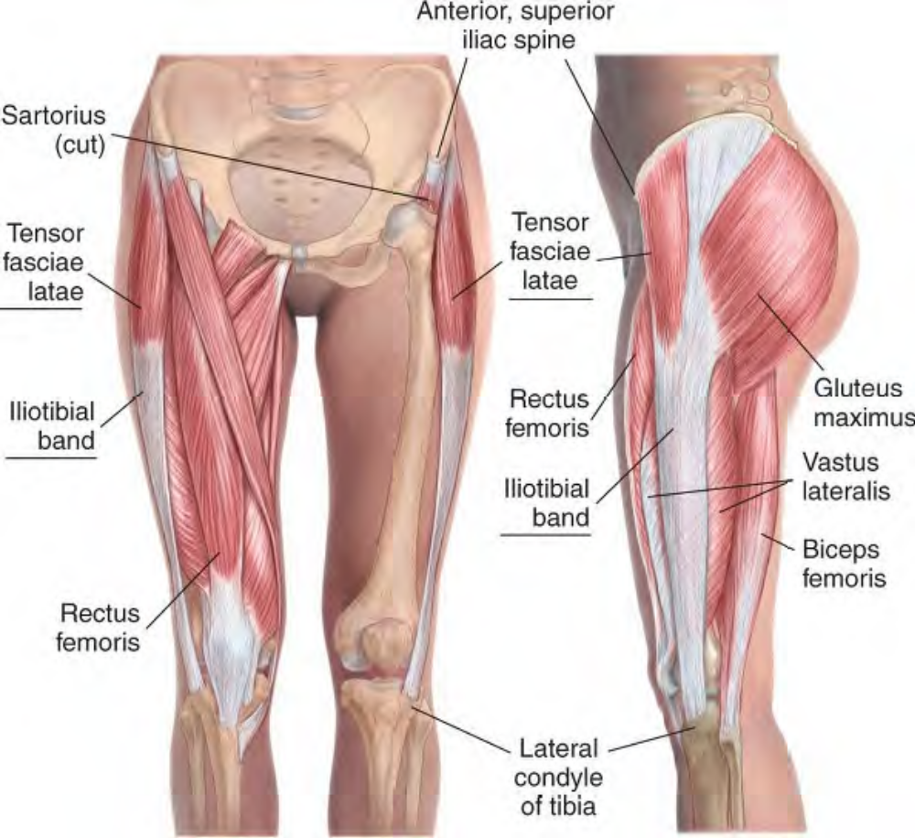
Anatomy of tensor fasciae latae and the iliotibial band

Slide 18
Manual Therapy for Tensor Fasciae Latae
Compression
The client lies supine. The therapist stands beside the client at the knee.
Place the fingertips on the tensor fasciae latae between the greater trochanter and the crest of the ilium.
Press firmly into the tissue, searching for tender areas. Hold for release

Slide 19
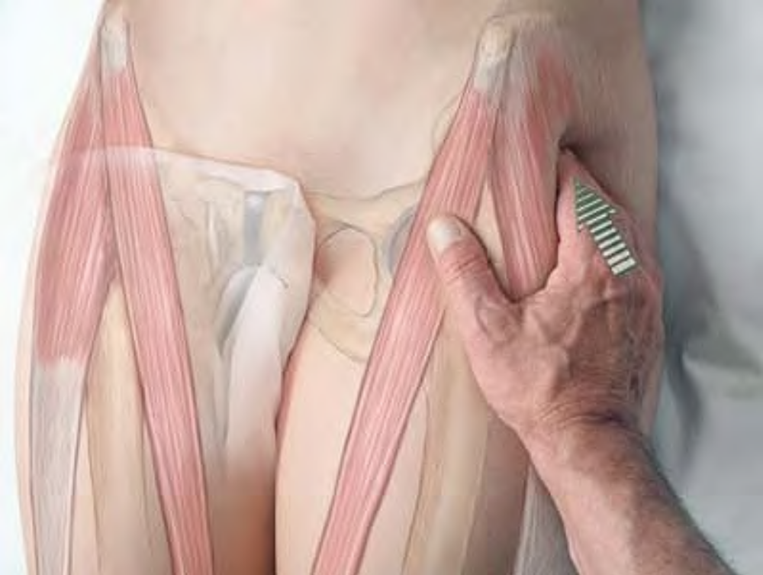
Compression of tensor fasciae latae with the fingertips

Slide 20
Stripping
The client lies supine.
The therapist stands beside the client at the chest.
Place the fingertips, thumb, or knuckles on the tensor fasciae latae just below the iliac crest.
Pressing firmly into the tissue, glide along the muscle past the greater trochanter.
Continue the stroke with the next technique for the ITB.

Slide 21
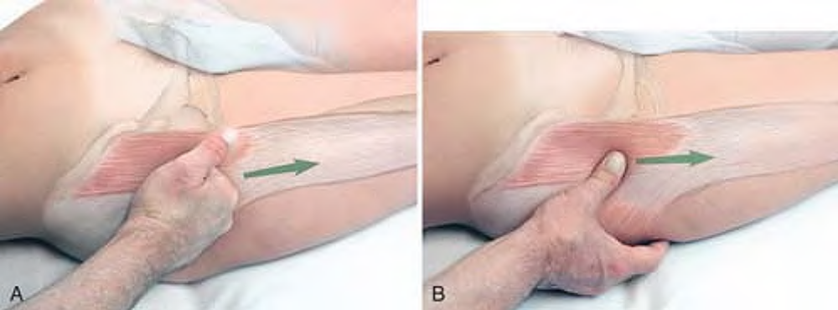
Stripping of tensor fasciae latae with the knuckles (A) and the thumb (B)

Slide 22
Manual Therapy for the Iliotibial Band (ITB)
Stripping
The client lies supine.
The therapist stands beside the client at the waist.
Place the heel of the hand or knuckles on the ITB just below the greater trochanter.
Pressing firmly into the tissue, glide along the muscle to the lateral condyle of the tibia

Slide 23
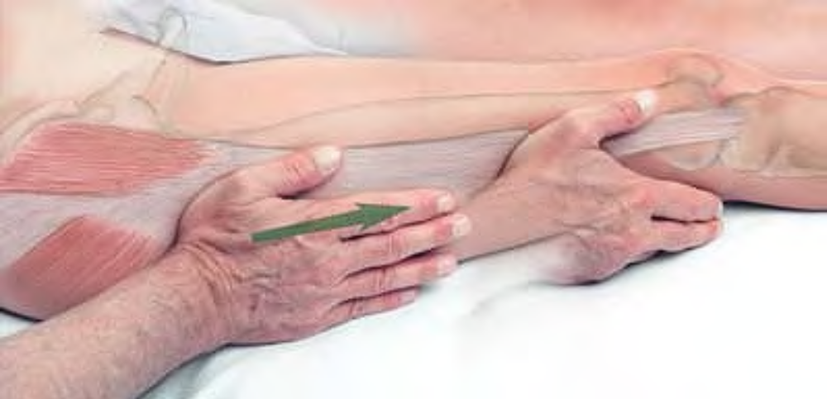
Stripping of iliotibial band with client supine

Slide 24
Stripping
The client lies on her or his side, with the lower leg straight, and the upper leg flexed at the hip and the knee. The therapist stands behind the client at the pelvis.
Place the heel of the hand or knuckles on the ITB just below the greater trochanter.
Pressing firmly into the tissue, slide along the muscle to the lateral condyle of the tibia

Slide 25
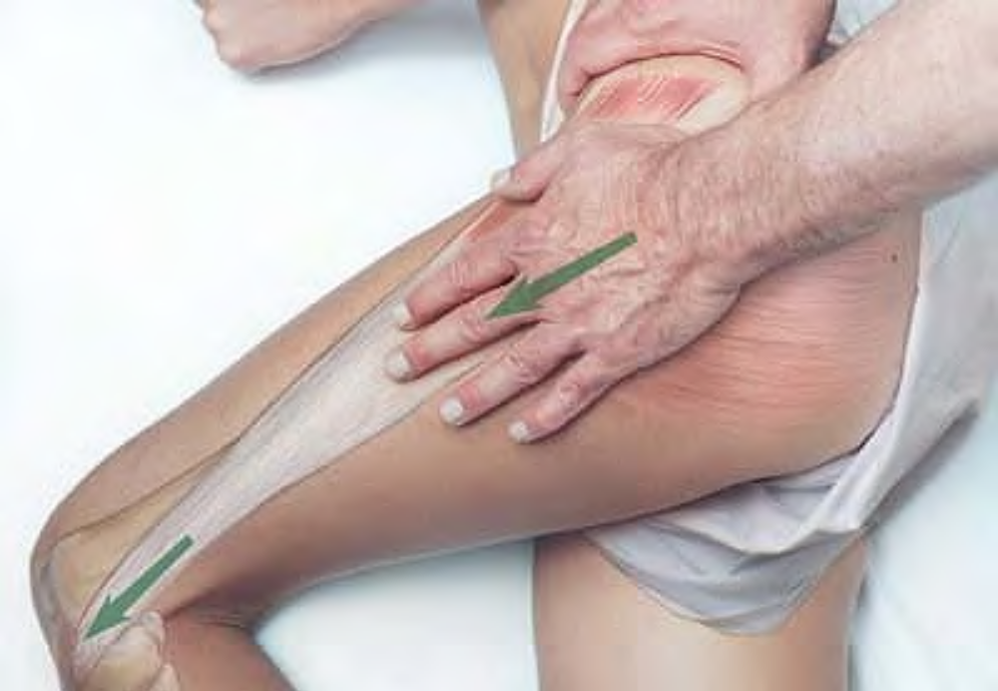
Stripping of iliotibial band with client sidelying

