Slide 1
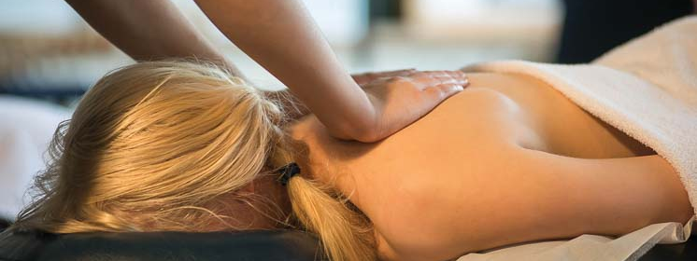
Massage Techniques 9A
The Thigh

Slide 2
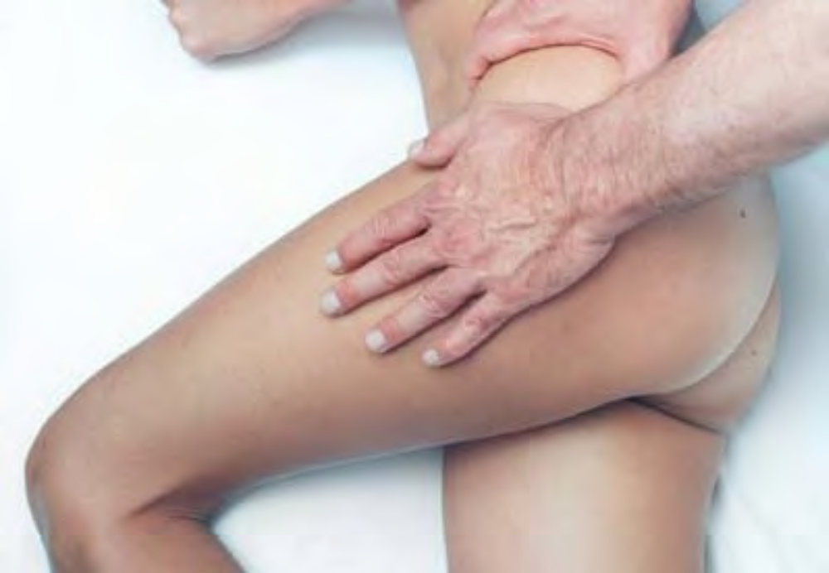
The Thigh

Slide 3
Overview of the Region
The powerful muscles of the thigh can be divided into four basic groups: anterior (quadriceps and sartorius), posterior (hamstrings), lateral (tensor fasciae latae and iliotibial band), and medial (hip adductors). Although some pain in the thigh is referred from superior muscles in and around the pelvis and from the lower leg, pain may also originate in the thigh muscles themselves.
The muscles of the thigh are one of the principal contributors to knee pain, as their primary function is to move and stabilize the knee joint. Their importance in maintaining posture is considerable, both in their control of the knee and in the influence of rectus femoris and the hip adductors on the position of the pelvis. Rectus femoris attaches at the ASIS, and adductor longus, adductor brevis, pectineus, and gracilis all have attachments to various anterior aspects of the pubis. Therefore, all these muscles can contribute to an anterior pelvic rotation.

Slide 4
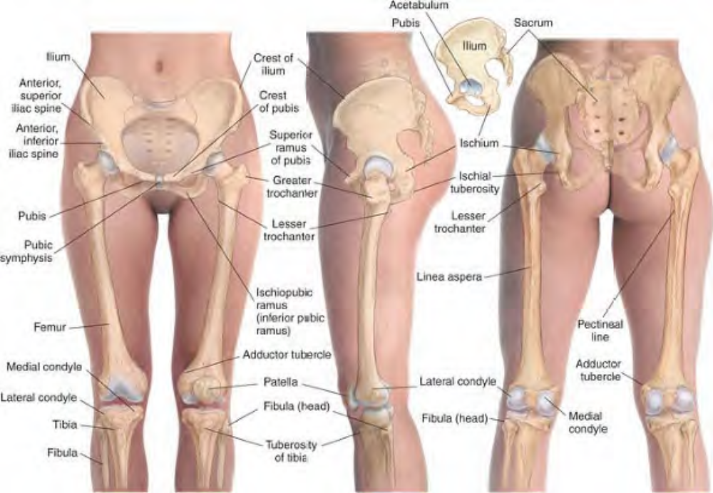
Skeletal features of the thigh

Slide 5
The hamstrings, on the other hand, attach to the ischial tuberosity and can pull the pelvis into posterior rotation. When we say that quadriceps and hamstrings are antagonists, we usually think of their opposing functions in flexing and extending the knee, but they are also antagonists in the positioning of the pelvis.

Slide 6
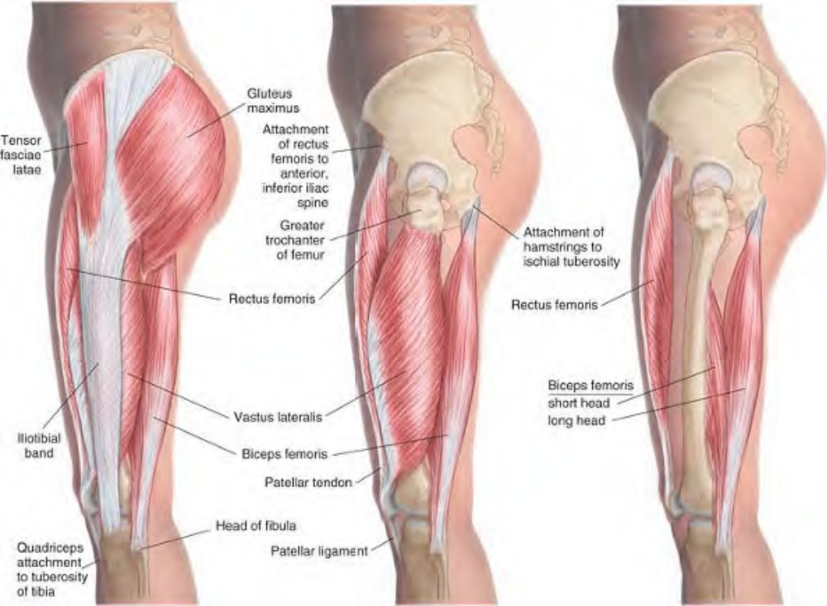
Muscles of the thigh, lateral view

Slide 7
The relative tension of the muscles of the thigh also determines the position of the head of the femur in the acetabulum, and thus the position and movement of the femur in standing and walking. In addition, since the muscles of the quadriceps group attach to the tibia via a common tendon enclosing the patella, these muscles determine the position of the patella. Together, the quadriceps and hamstrings dictate the position and balance of stress in the knee joint.
Careful observation of the gait of the client in the initial examination will reveal much information about the muscles of the thigh, because they affect the position and movement of the hips and knees throughout the gait cycle.
Note that the connective tissue structure attaching quadriceps to the tibia and enclosing the patella is generally referred to as the patellar tendon above the patella and as the patellar ligament below the patella.

Slide 8
Caution
Be familiar with the femoral triangle, a triangular space at the upper part of the thigh, bounded by sartorius laterally, ad-ductor longus medially, and the inguinal ligament superiorly (see Plate 9-2). Deep to these muscles it is bounded laterally by iliopsoas and medially by pectineus. The femoral triangle contains the femoral vessels and the branches of the femoral nerve. When working on the anterior and medial thigh, take care not to exert pressure on these structures.

Slide 9
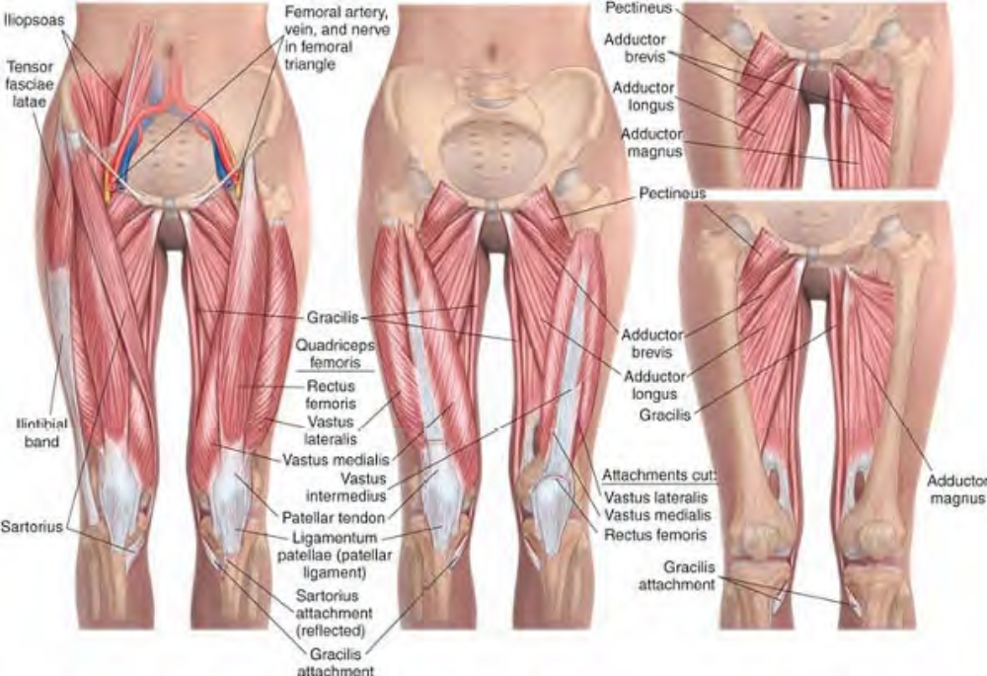
Muscles of the thigh, anterior view

Slide 10
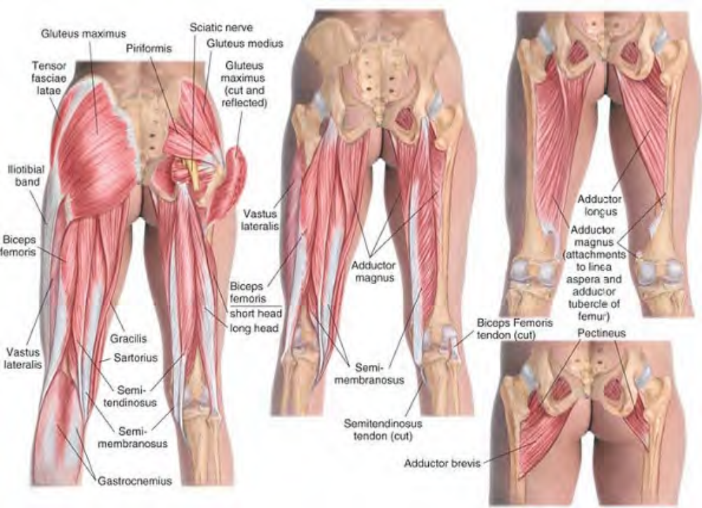
Muscles of the thigh, posterior view

Slide 11
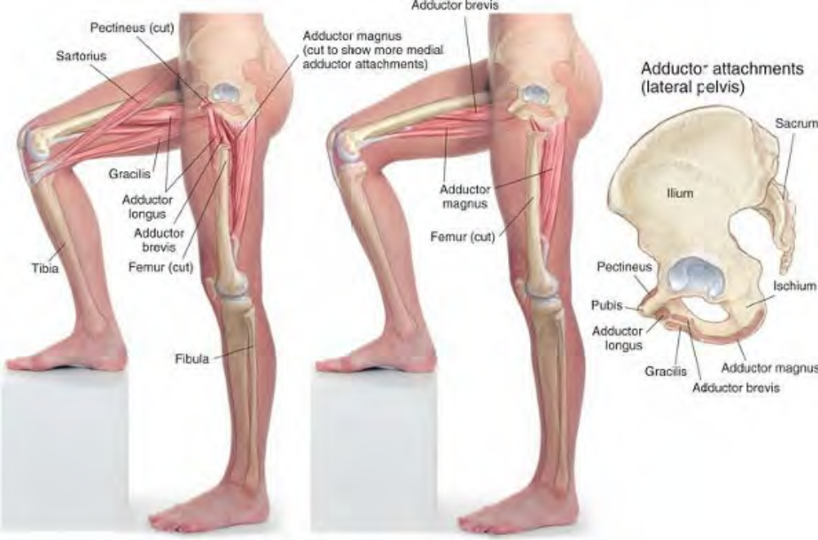
Adductors of the hip, medial and lateral views

Slide 12
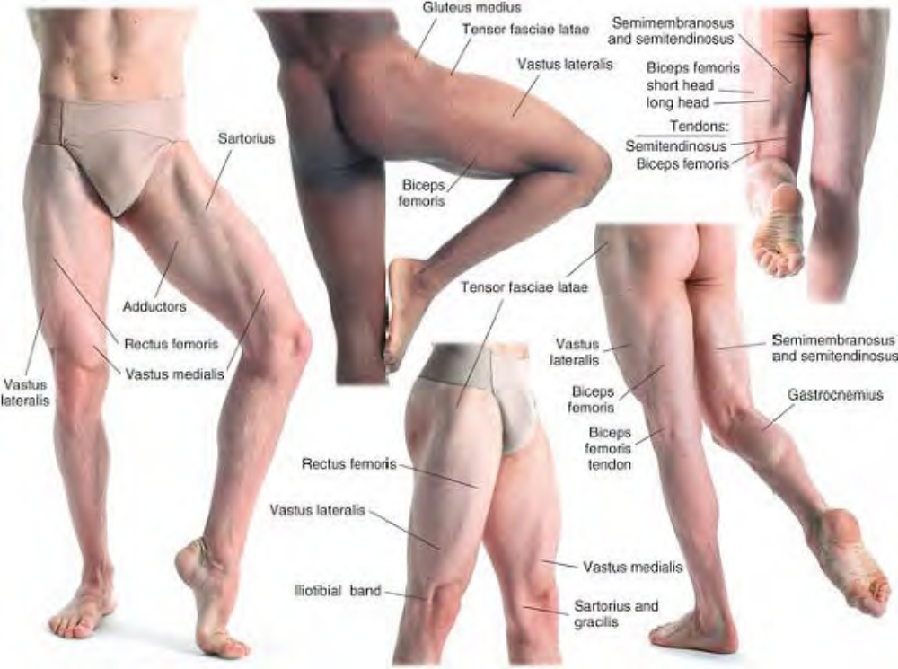
Surface anatomy of the thigh

Slide 13
Muscles of the Anterior Thigh
Quadriceps Femoris
Comment. Three of the muscles (the vasti) of the quadriceps group cross only the knee joint, while one (rectus femoris) crosses both the hip and the knee joint. All have a common inferior attachment via the patellar tendon.
Attachments. Inferiorly, by four heads: rectus femoris, vastus lateralis, vastus intermedius, and vastus medialis to the patella, and thence by ligamentum patellae (patellar ligament) to the tibial tuberosity; vastus medialis also to the medial condyle of the tibia. Superiorly, as follows:
Rectus femoris: to the anterior inferior spine of ilium and upper margin of acetabulum. Vastus lateralis: to the lateral lip of the linea aspera as far as the greater trochanter. Vastus medialis: to the medial lip of the linea aspera. Vastus intermedius: to the upper three-fourths of the anterior surface of the shaft of the femur

Slide 14
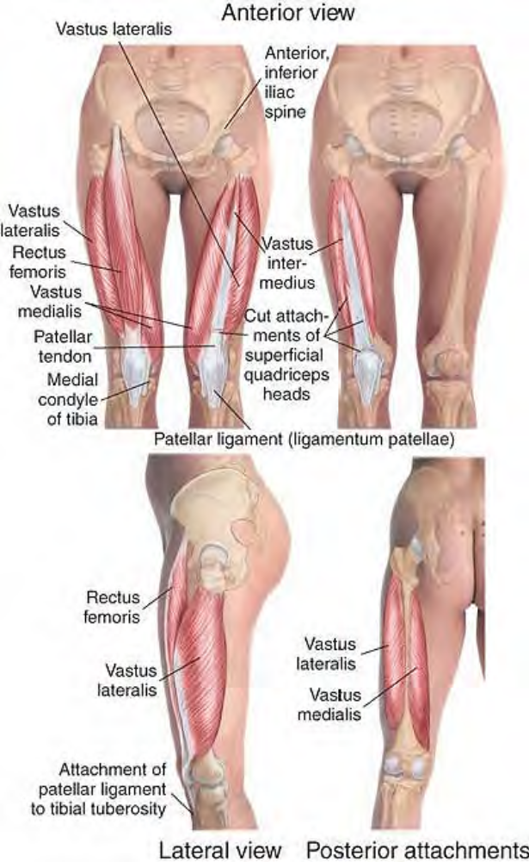
Anatomy of quadriceps femoris

Slide 15
Palpation. Palpation is easy, but distinguishing the muscles very challenging. All are easily palpated at the attachment to the superior patella. Rectus femoris (architecture bipennate) can be followed up to its superior attachment just below the anterior superior iliac spine. Vastus lateralis and medialis (architecture unipennate) can be followed to their superior attachments to the femur laterally and medially. Vastus intermedius is not palpable.
Action. Extends the knee; flexes the hip by the action of rectus femoris
Referral Areas. Vastus medialis and intermedius: to the anterior thigh and the knee. Vastus lateralis: to the lateral thigh and the knee

Slide 16
Manual Therapy
Stripping. The client lies supine. The therapist stands beside the client at the lower legs. Place the heel of the hand, the thumb, or the fingertips on the quadriceps tendon where it attaches to the patella on the medial side.
Pressing firmly into the tissue, slide along vastus medialis to its attachment on the upper femur.
Beginning again at the kneecap in the center, repeat this procedure, continuing the stroke along rectus femoris to its attachment at the ASIS. Repeat the same procedure laterally on vastus lateralis.
Note: Vastus intermedius lies deep to the other quadriceps muscles and is therefore treated through them.

Slide 17
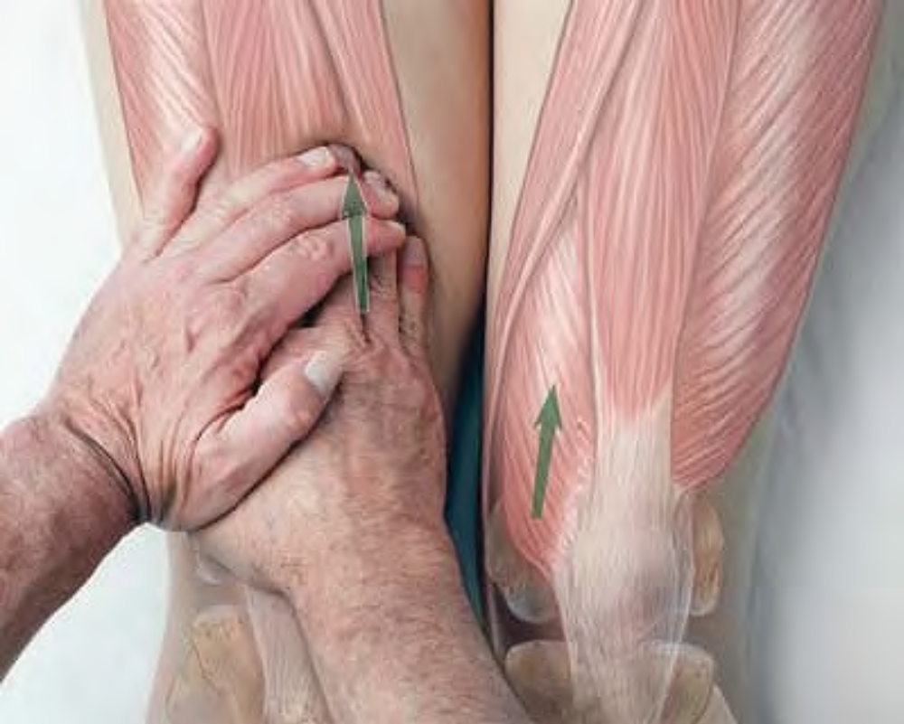
Stripping of vastus medialis with the fingertips

Slide 18
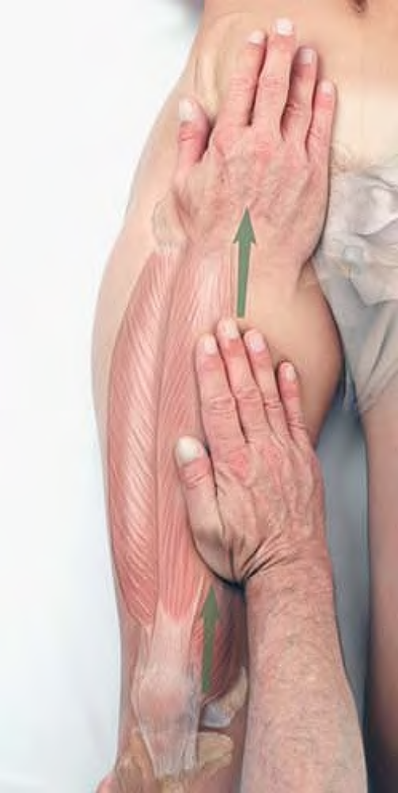
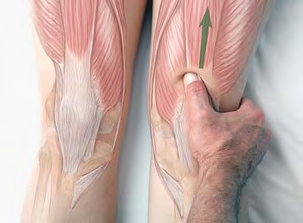
Stripping of vastus medialis
Stripping of rectus femoris with the thumb

Slide 19
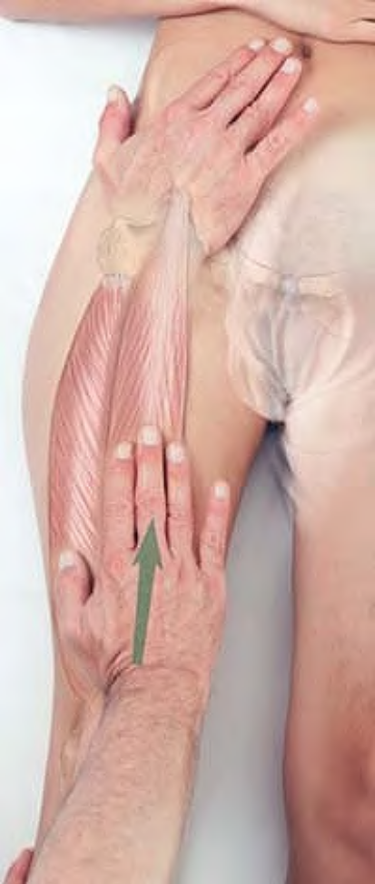
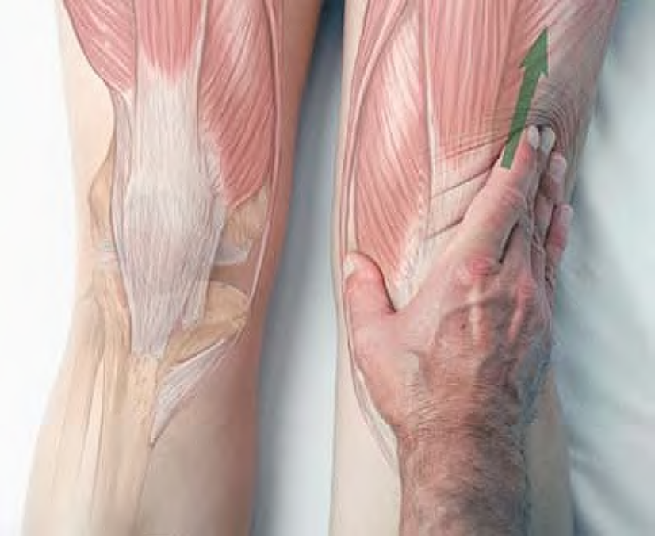
Stripping of rectus femoris
Stripping of vastus lateralis with the fingertips

Slide 20
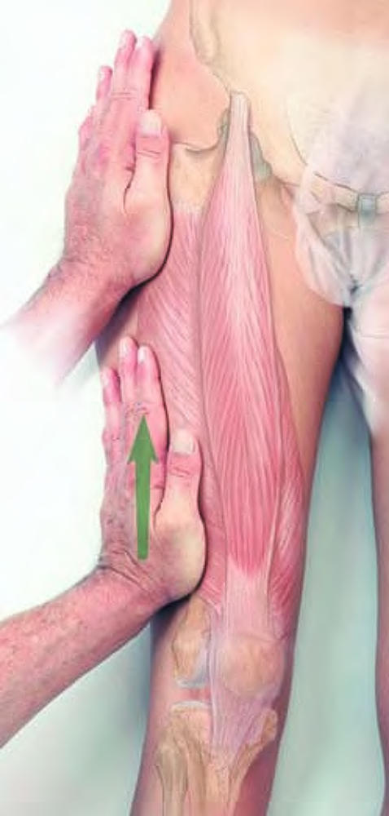
Stripping of vastus lateralis

Slide 21
Cross-fiber Friction for the Patellar Tendon and Ligament
The client lies supine. The therapist stands beside the client at the legs. Place the thumb on the patellar tendon (superior to the patella).
Press firmly into the tissue, and move the thumb back and forth across the tendon until you feel a softening and relaxation in the tissue.
Repeat this procedure on the patellar ligament (inferior to the patella).

Slide 22
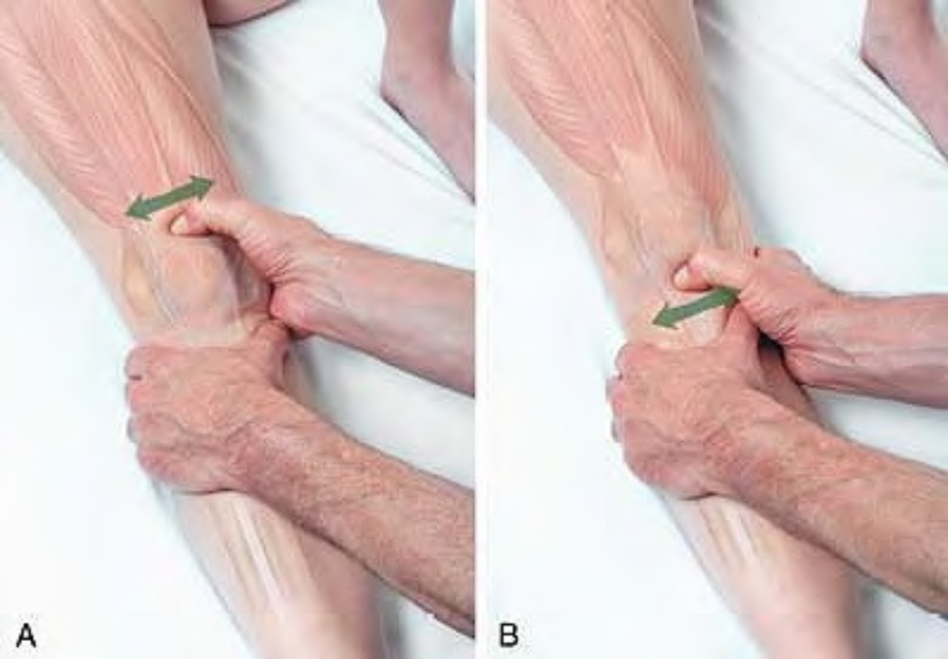
Cross-fiber friction of the patellar tendon (A) and ligament (B)

Slide 23
Cross-fiber Friction on Deep Surface of Patella
With one hand, displace the patella away from yourself. Place the fingertips of the other hand under the patella. Pressing upward into the patella, move your fingertips back and forth until you feel a softening and relaxation in the tissue.
Repeat the procedure medially.
Caution. The above procedure should not be performed on a client who has had recent knee surgery, or is scheduled for such surgery. If a client has had knee surgery in the past, or complains of knee pain, question the client thoroughly before proceeding. When in doubt, have the client obtain permission from her or his physician before proceeding.

Slide 24
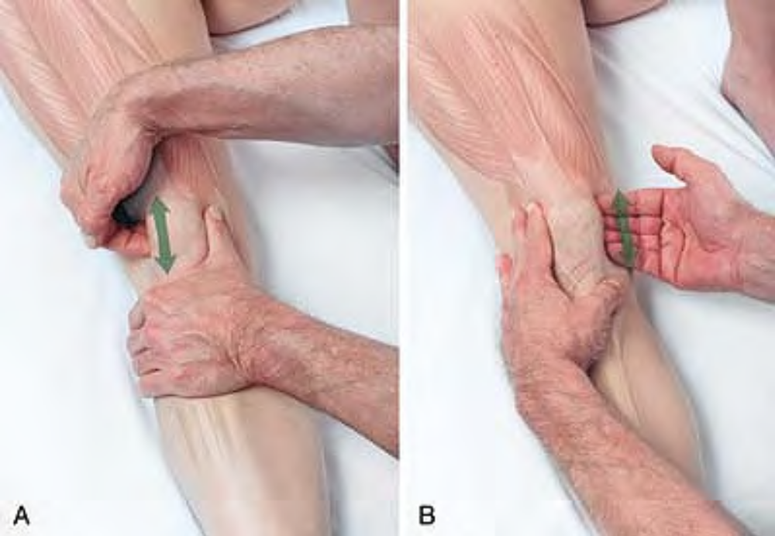
Cross-fiber friction underneath the patella laterally (A) and medially (B)

Slide 25
Sartorius sar-TORE-ee-us
Etymology Latin sartor, tailor (from the cross-legged position)
Overview. A tight sartorius muscle will often interfere with the stretching of piriformis. If you attempt to stretch piriformis and the client reports feeling the stretch in the anterior thigh, release sartorius before proceeding.
Attachments. Superiorly, to the anterior superior iliac spine. Inferiorly, to the medial border of the tuberosity of the tibia
Palpation. Sartorius, although superficial, is very difficult to palpate except on those who have developed it to an unusual degree (i.e., bodybuilders). Its architecture is parallel.
Action. Flexes hip and knee, rotates knee medially and hip laterally

Slide 26
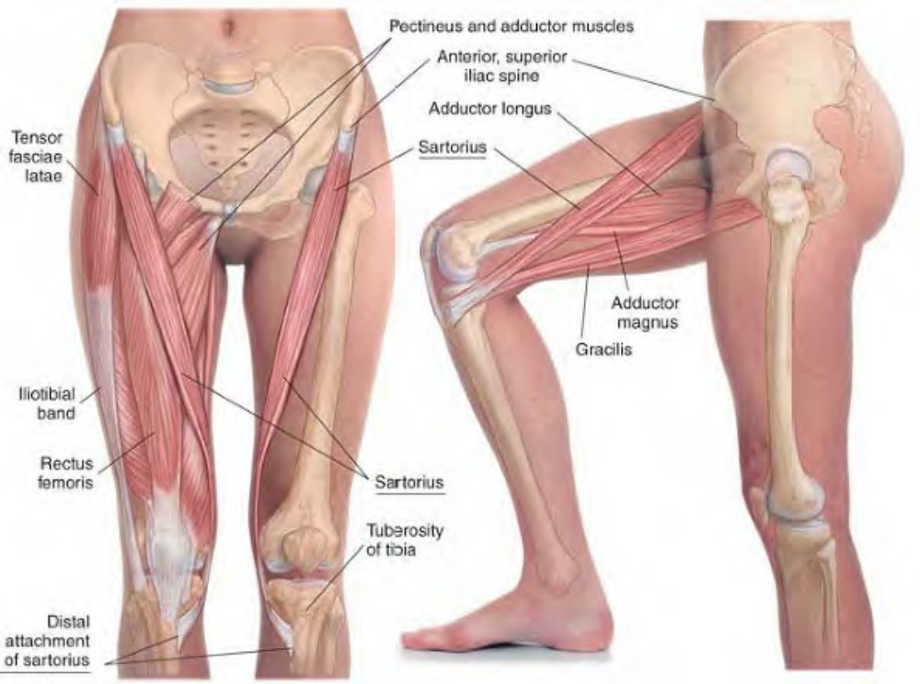
Anatomy of sartorius

Slide 27
Manual Therapy
Stripping. The client lies supine. The therapist stands beside the client at the legs.
Place the heel of the hand, thumb, or fingertips on the medial thigh just superior to the patella.
Pressing firmly into the tissue, slide the fingertips diagonally along the muscle across the quadriceps to its attachment on the ASIS.

Slide 28
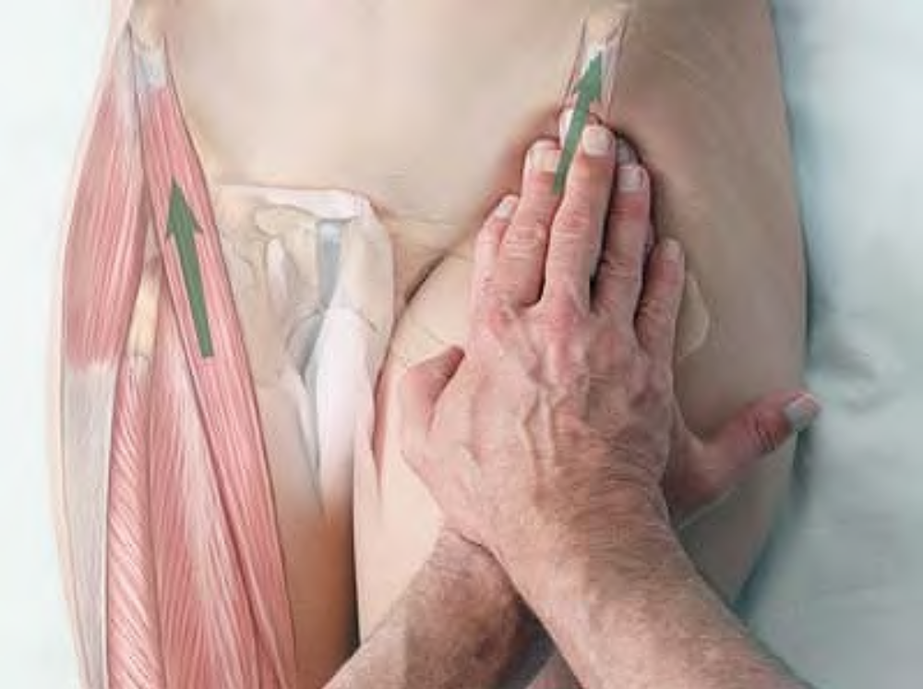
Stripping of sartorius with the fingertips

