Slide 1
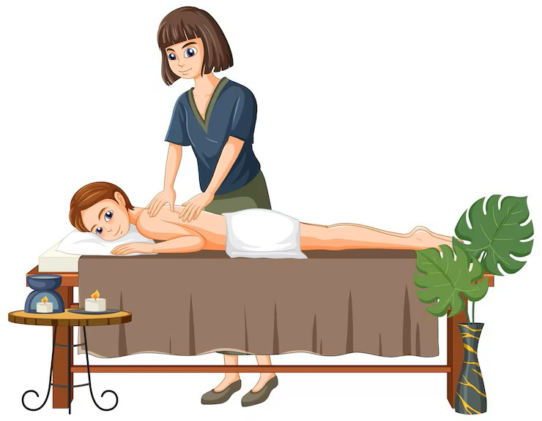
Massage Techniques 8B
Muscles of Pelvic Floor

Slide 2
Muscles of the Pelvic Floor
Overview. The pelvic floor might more usefully be called the pelvic hammock, both for psychological reasons (a hammock sounds softer than a floor) and descriptive reasons. These muscles form a supportive hammock for the pelvic organs, secured to the coccyx behind, the pubis in front, the ischial tuberosities on either side, as well as to various connective tissue structures in between. The muscle group has openings to admit the rectum, the vagina, and the urethra, and parts of it serve as sphincters for these passages. It is common for people to hold tension in the pelvic floor muscles along with the buttock muscles, and this tension can affect the pelvic organs and cause discomfort in such activities as bowel movements and sexual intercourse.

Slide 3
Some examination and treatment of these muscles can be carried out externally, working between the buttocks and on the perineum, but a thorough and effective treatment will often require internal work through the rectum. Internal examination and treatment of the pelvic floor muscles is an advanced, specialized technique that is beyond the scope of this book. For external work between the buttocks or on the perineum, the client may lie prone, preferably with a pillow or bolster under the hips.

Slide 4
Coccygeus cock-SIDGE-us
Etymology Latin, relating to the coccyx, from Greek kokkyx, cuckoo, coccyx
Attachments. Inferiorly, to the spine of the ischium and the sacrospinous ligament Superiorly, to the sides of the lower part of the sacrum and the upper part of the coccyx
Palpation. The superior attachments can be palpated externally on either side of the coccyx. The muscle can be palpated internally with the index finger from the coccyx moving inferiorly and laterally. Its architecture is convergent.
Action. Assists in the support of the pelvic floor, especially when intra-abdominal pressures increase. Wagging of tail (flexion of coccyx).
Referral Areas. To the lower sacrum, the coccyx, and the surrounding area (medial aspect of the buttocks)
Manual Therapy. See below.

Slide 5
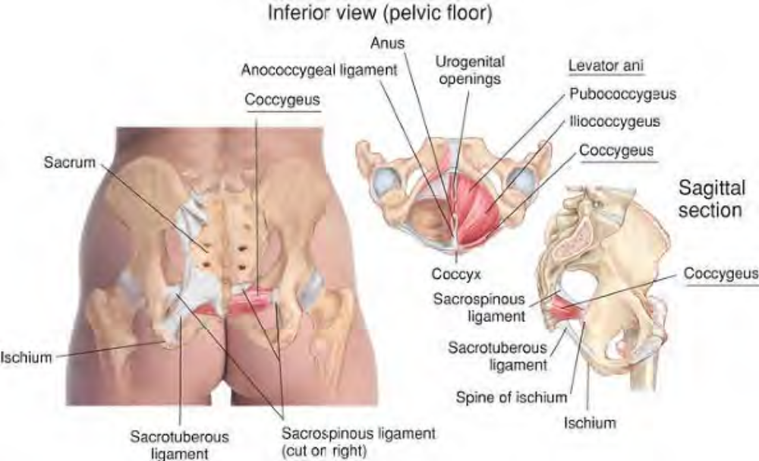
Anatomy of coccygeus

Slide 6
Levator ani le-VAY-ter AYN-eye
Etymology Latin levator, raiser + ani, of the anus
Overview. Levator ani is comprised of the pubococcygeus, iliococcygeus, and puborectalis muscles, forming the pelvic diaphragm.
Attachments. Anteriorly, to the posterior body of the pubis, the tendinous arch of the obturator fascia, and the spine of the ischium. Posteriorly, to the anococcygeal ligament, the sides of the lower part of the sacrum and of the coccyx
Palpation. Can only be palpated internally. Action. Resists prolapsing forces and draws the anus upward following defecation; helps support the pelvic viscera.
Referral Area. To the lower sacrum, the coccyx, and the surrounding area (medial aspect of the buttocks).

Slide 7
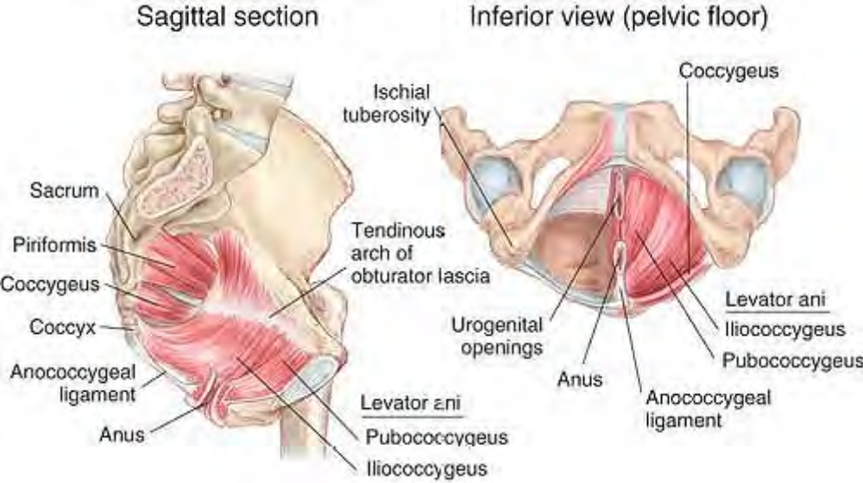
Anatomy of levator ani

Slide 8
Manual Therapy
Levator ani cannot be externally treated effectively. Manual Therapy for the Pelvic Floor Muscles and Obturator Internus
Compression
The client lies prone. A pillow may be placed under the client's pelvis. The therapist stands beside the client at the hip. Place the palm of the gloved hand nearest the client on the opposite buttock, inserting the thumb between the buttocks to rest on the inferior end of the coccyx externally. Press firmly under the coccyx, then into the tissue on either side of the coccyx, looking for tender spots. Hold for release.

Slide 9
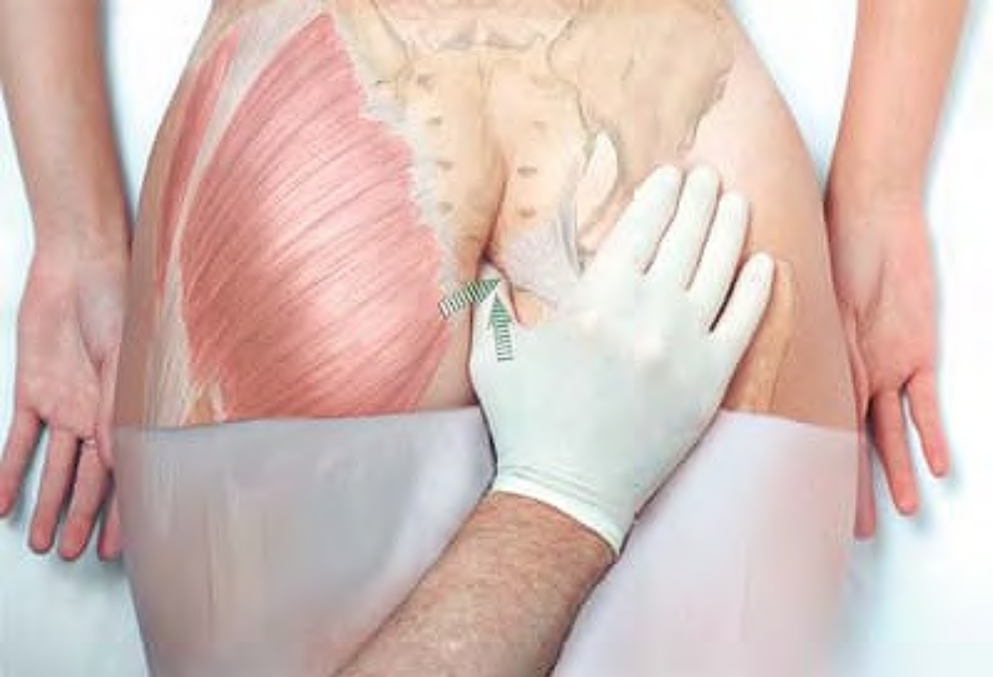
External examination under the coccyx

Slide 10
Repeat this procedure, shifting the thumb in an inferior direction, exploring the pelvic floor muscles and the inner aspect of gluteus maximus.
At the level of the obturator foramen, press into the foramen to explore obturator internus, holding for release as necessary.

Slide 11
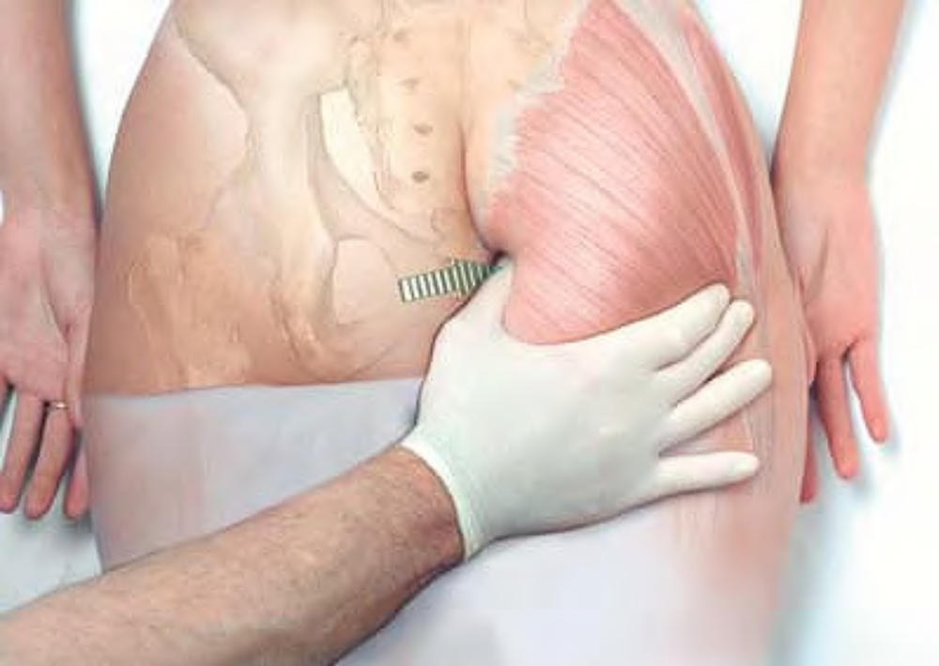
External examination and treatment between the buttocks

Slide 12
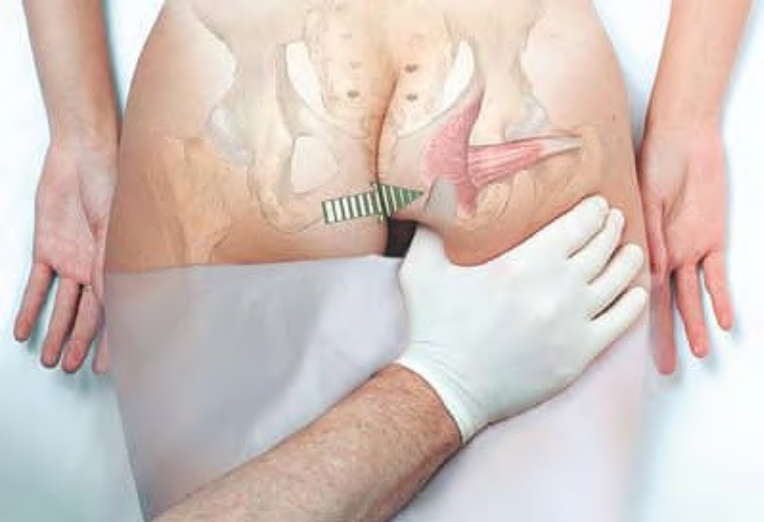
Compression of obturator internus

Slide 13
Gluteal Muscles
Overview
Since gluteus maximus covers gluteus medius and much of gluteus minimus, much of the work on the buttock applies to all three muscles, especially over the lateral aspect. The only distinction lies in the intention and depth of the work. Therapy of the gluteal muscles will be found after descriptions of all the individual muscles.

Slide 14
Gluteus Maximus GLUE-tee-us MAX-im-us
Etymology Latin gluteus, buttock muscle + maximus, largest
Overview. Gluteus maximus is the powerful climbing muscle, antagonist to iliopsoas. It is very commonly involved in low back pain.
Attachments. Superiorly, to the ilium behind the posterior gluteal line, to the posterior surface of the sacrum and coccyx, and to the sacrotuberous ligament Inferiorly, to the iliotibial band of the fascia lata (superficial three-quarters) and to the gluteal tuberosity (posterolateral proximal one-quarter) of the femur.
Palpation. Discernible over most of the buttock, moving downward diagonally to the iliotibial band. Medial edge is discernible between the buttocks. Architecture is convergent, and fibers are primarily diagonal. Action. Extends the thigh, especially from a flexed position, as in climbing stairs or rising from a sitting position. Referral Areas. To the entire buttock and into the upper posterior thigh

Slide 15
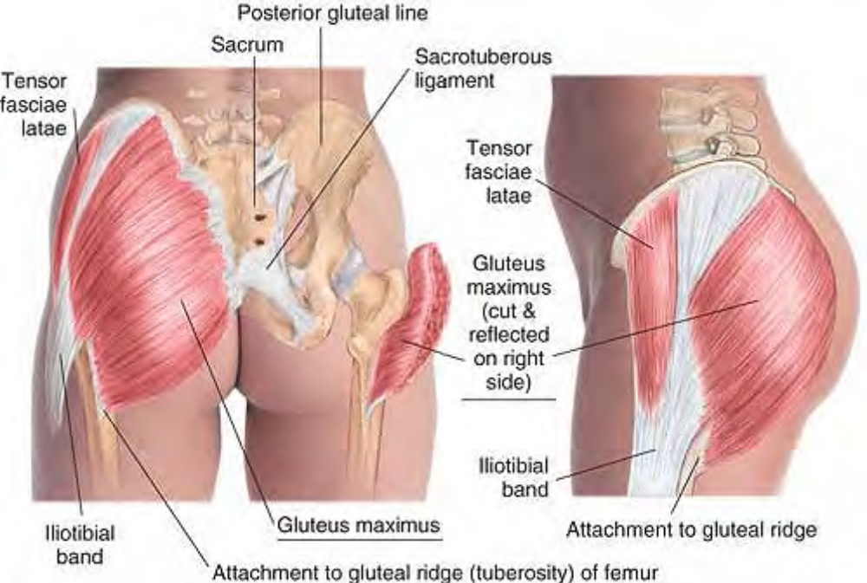
Anatomy of gluteus maximus

Slide 16
Gluteus Medius
Overview. Gluteus medius, with gluteus minimus, is a powerful abductor of the hip. It is very commonly involved in low back pain.
Attachments. Superiorly, to the ilium between the anterior and posterior gluteal lines Inferiorly, to the lateral surface of the greater trochanter
Palpation. Discernible only on the lateral and superior aspect of the buttock. Architecture is convergent, and fibers are diagonal.
Action. Abducts and contributes to rotation of the thigh; stabilizes the pelvis in walking
Referral Areas. Over the buttock, Over the sacrum, Into the medial lumbar region, Into the upper posterior thigh

Slide 17
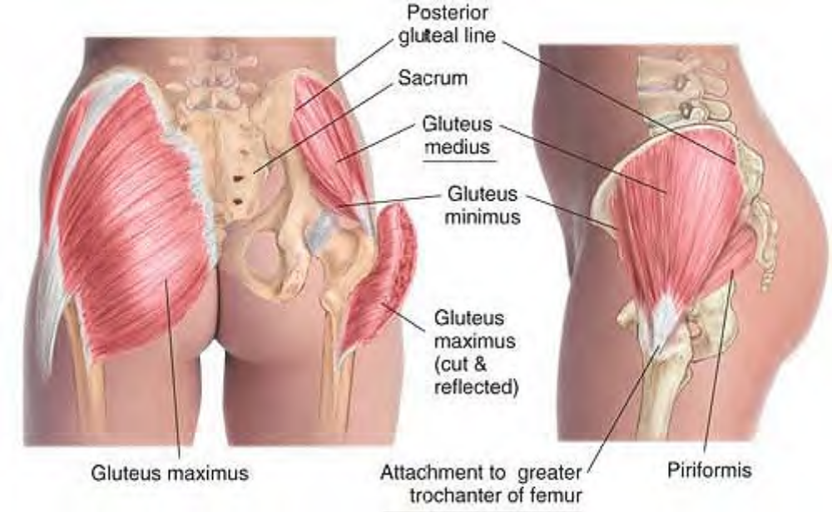
Anatomy of gluteus medius

Slide 18
Gluteus Minimus
Overview. Gluteus minimus, with gluteus medius, is a powerful abductor of the hip. It has a far-ranging pain referral pattern, and is commonly involved in hip and leg pain.
Attachments. Superiorly, to the ilium between the anterior and inferior gluteal lines. Inferiorly, to the greater trochanter of the femur
Palpation. Discernible on the lateral aspect of the buttock between gluteus medius and tensor fasciae latae. Architecture is convergent.
Action. Abducts and medially rotates the thigh
Referral Areas. Over the buttock and lateral hip, Over the posterior thigh, Over the posterior calf, Over the lateral thigh, Over the lateral calf to the ankle

Slide 19
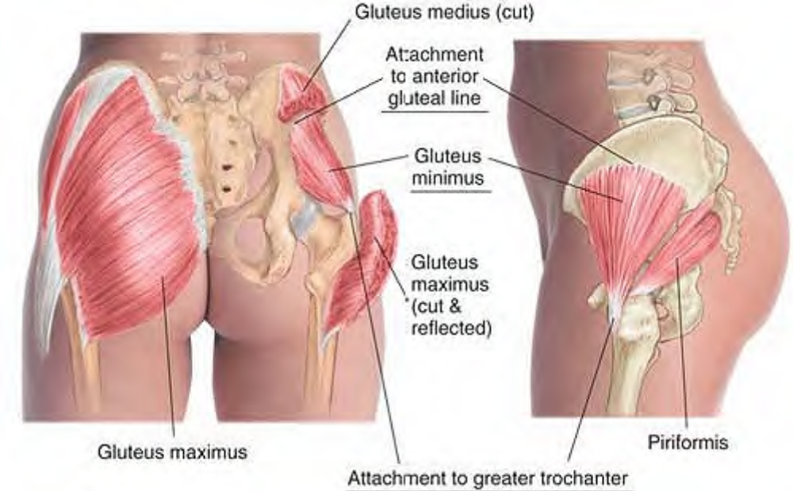
Anatomy of gluteus minimus

Slide 20
Note: For working the medial aspect of gluteus maximus, use the technique for external work between the buttocks described under Pelvic Floor Muscles and Obturator Internus above
Manual Therapy for the Gluteal Muscles
Myofascial Stretch. The client lies prone. The therapist stands beside the client at the waist, facing the client. Place the palm of your cephalad hand on the upper aspect of the client's near buttock, the fingers pointing inferiorly. Cross the caudad hand over, placing it on the client's waist at the iliac crest. Lean into the hands to push them apart, pressing firmly into the tissue. Hold this stretch until you feel the underlying fascia release.

Slide 21
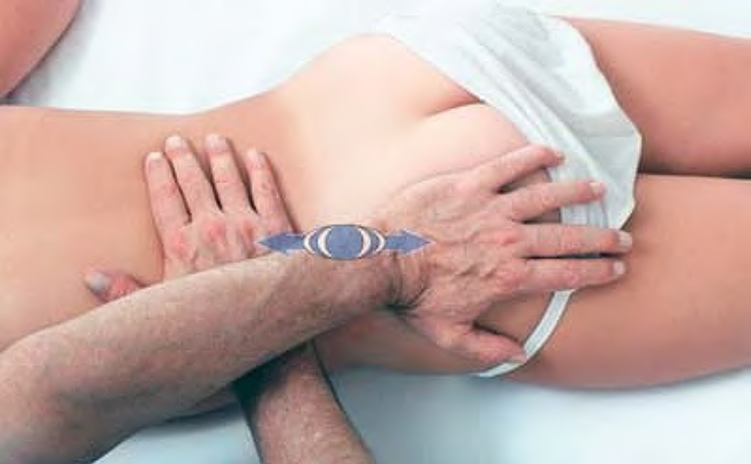
Myofascial release on gluteal region

Slide 22
Stripping. The client lies prone. The therapist stands beside the client at the level of the chest. Place the palm of the hand on the buttock just above the iliac crest and lateral to the sacrum, the thumb pointing inferiorly. Pressing firmly into the tissue with the heel of the hand, slide the hand along the muscle to its most inferior aspect.
Beginning just lateral to the previous spot, repeat this procedure until the entire buttock has been covered, including the attachment of gluteus maximus to the iliotibial band, and gluteus minimus along the side of the hip.
The same procedure may be carried out with the knuckles, the fingertips, or the supported thumb.

Slide 23
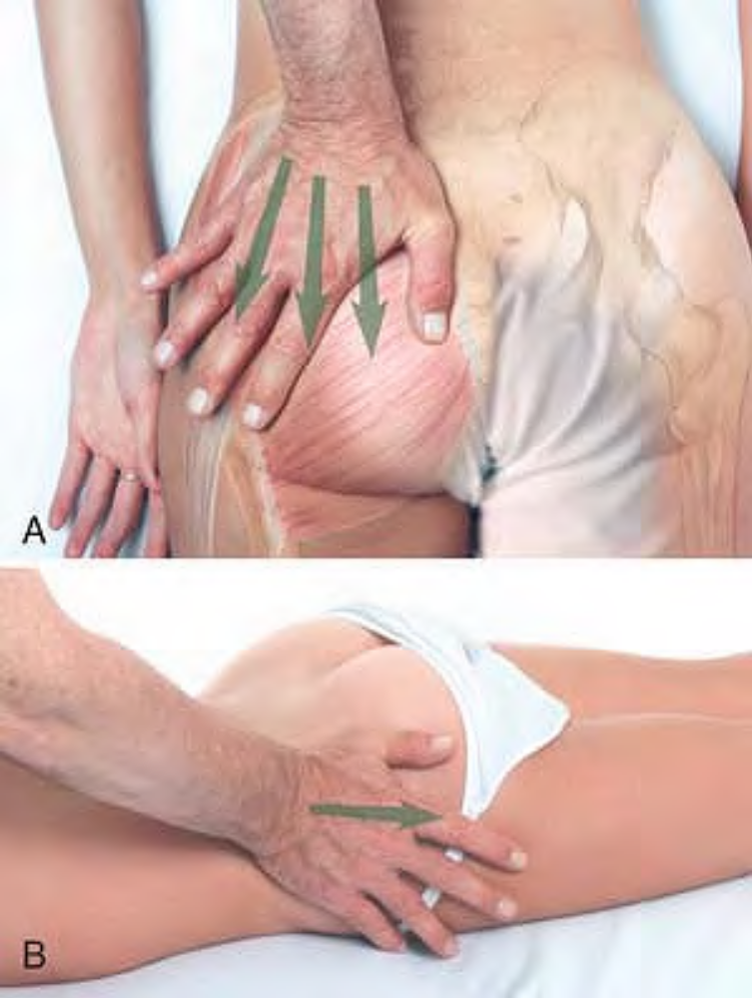
Stripping of gluteal muscles with the heel of the hand: A, beginning stroke; B, ending stroke

Slide 24
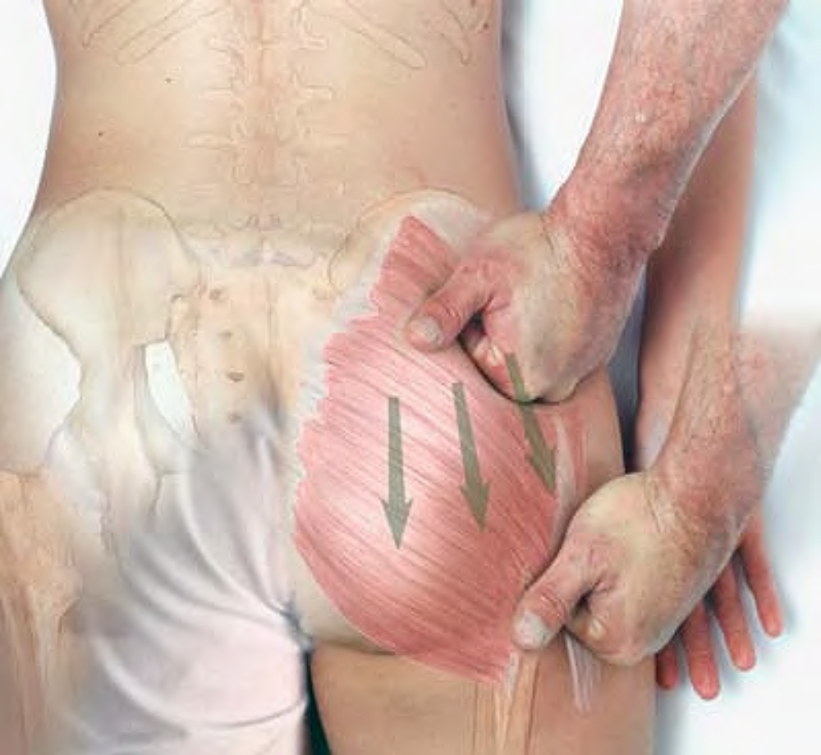
Stripping of gluteal muscles with the knuckles

Slide 25
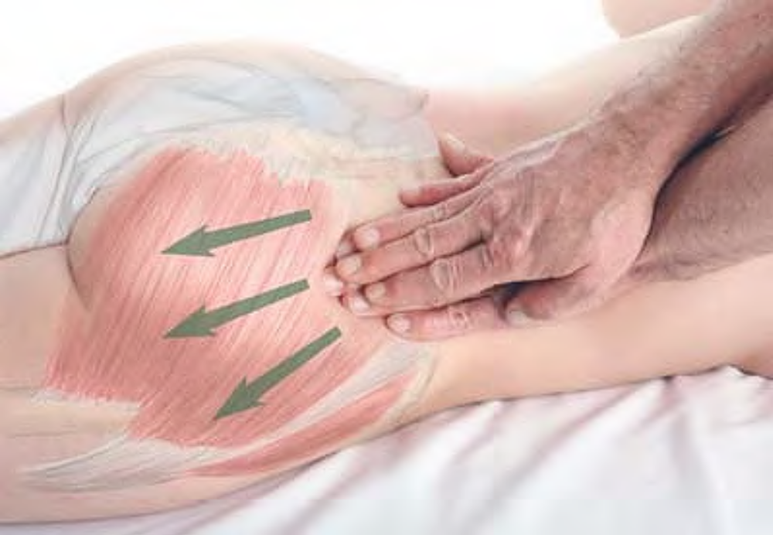
Stripping of gluteal muscles with the fingertips

Slide 26
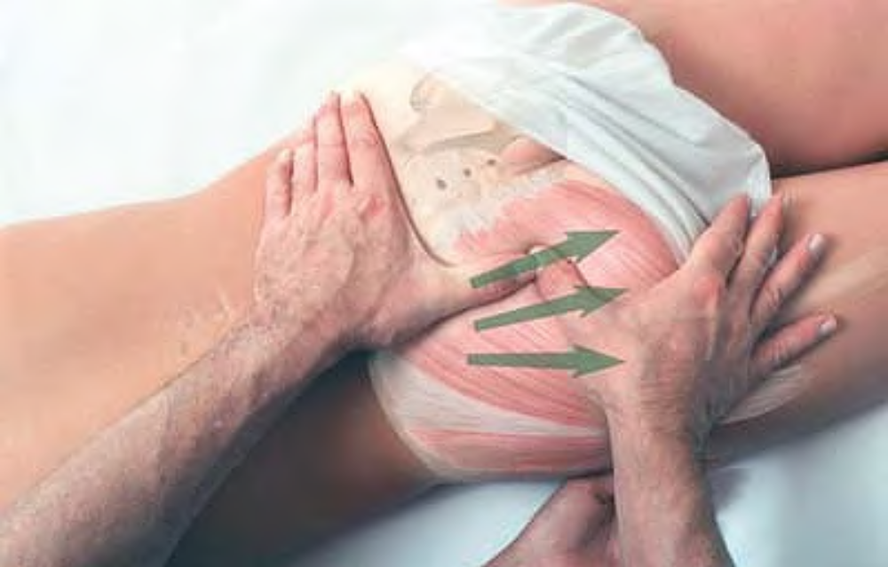
Stripping of gluteal muscles with the thumb

Slide 27
Stripping
The client lies on her/his side, with the lower leg straight and the upper leg flexed at the hip and knee. The therapist stands beside the client at the waist. Place the supported thumb on the superior lateral aspect of the buttock at the iliac crest. Pressing firmly into the tissue, slide the thumbs inferiorly along the muscle to its attachments on the greater trochanter.

Slide 28
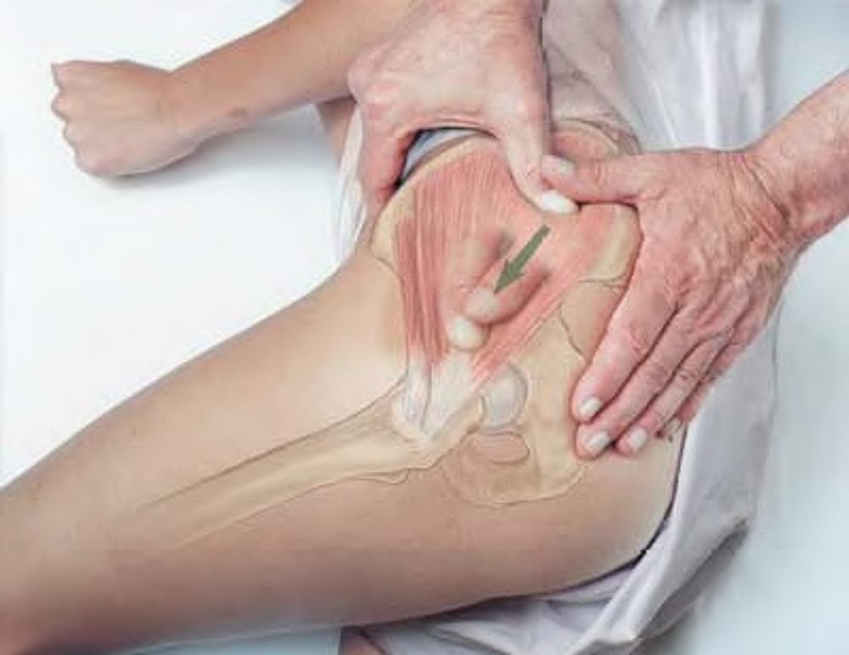
Stripping of gluteal muscles in side-lying position

Slide 29
Compression
The client lies prone. The therapist stands beside the client at the client's waist. Place the supported thumb on the lateral aspect of the buttock just inferior to the iliac crest. Press firmly into the tissue, moving your thumb back and forth, to search for tender areas. Hold for release. Explore the gluteal muscles in this way over the entire buttock.

Slide 30
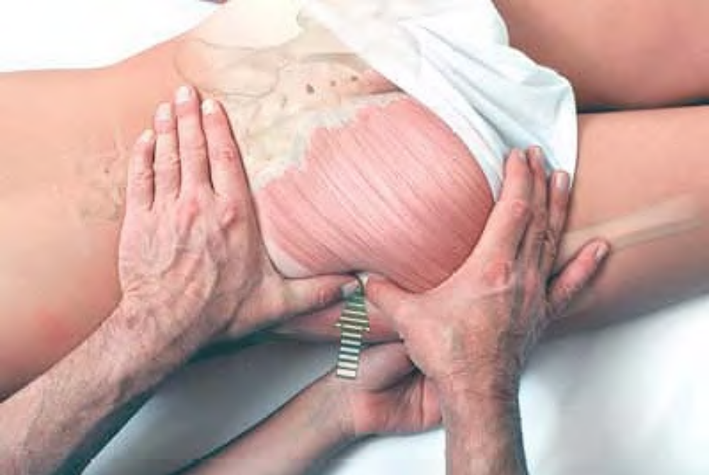
Examination and compression of gluteal muscles

Slide 31
Reversing Anterior Pelvic Rotation
These procedures should be performed after working all the muscles affecting anterior pelvic rotation (quadratus lumborum, gluteal muscles, latissimus dorsi, iliopsoas, rectus femoris, hip adductors).
Prone Position
The client lies prone. The therapist stands beside the client at the client's waist. Place one hand on the buttock at the iliac crest, the fingers pointing inferiorly. Place the other hand under the ilium with the fingertips on the anterior superior iliac spine (ASIS). Simultaneously pull the ASIS in a superior direction while pushing the iliac crest in an inferior direction.

Slide 32
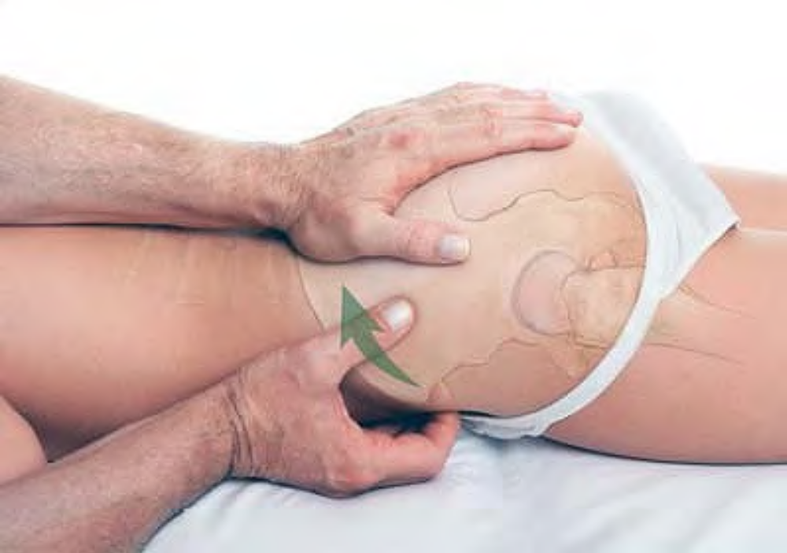
Reversing anterior pelvic rotation in prone position

Slide 33
Supine Position
The client lies supine, with the leg flexed at the hip and the knee. The therapist stands beside the client's leg, facing the head. Wrapping the arm nearest the client around the client's leg, place your shoulder firmly just below the knee and the heel of your hand on the ASIS. Place your far hand underneath the client's buttock, with the fingertips resting on the iliac crest. Ask the client to resist you with 20% of her/his strength as you simultaneously press the leg to the client’s chest, push superiorly against the ASIS, and pull inferiorly on the buttock and iliac crest.

Slide 34
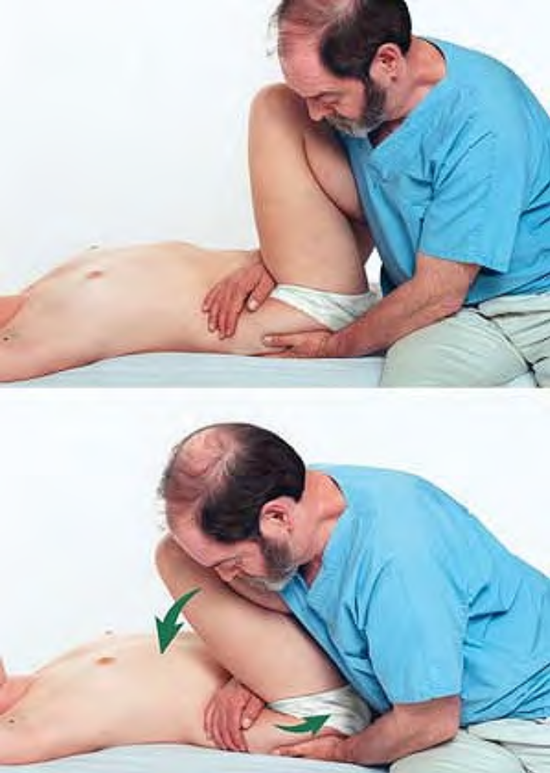
Reversing anterior pelvic rotation in supine position

Slide 35
Piriformis PEER-re-FORM-is
Etymology Latin pirum, pear + forma, form
Overview. Piriformis is a primary lateral rotator of the hip, as well as a principal stabilizer of the hip joint. It has profound clinical significance. The sciatic nerve may pass under, over, or even through (or partially through) piriformis, depending on the individual. Therefore, a tightened piriformis may cause pain not only through its own referral patterns, but also by entrapment of the sciatic nerve. This entrapment is called piriformis syndrome. Piriformis problems are common in ballet dancers because of the constant demand for (lateral rotation of the hip) in ballet. It is also very common in general because of its role in stabilizing the hip.
Attachments. Medially and superiorly, to the margins of the anterior pelvic sacral foramina and the greater sciatic notch of the ilium Laterally and inferiorly, to the upper border of greater trochanter.

Slide 36
Palpation. Palpable only if pathologically hypercontracted, through gluteus maximus on a line between the lower sacrum and the greater trochanter. Superior attachment is discernible intra-anally underneath the lower sacrum. Architecture is convergent. Action. Rotates thigh laterally; assists in abduction of flexed hip; stabilizes hip joint
Referral Areas. Over the buttock (especially the lateral border of the sacrum and the inferolateral aspect of the buttock) Into the posterior thigh. By entrapment of the sciatic nerve, over the entire posterior leg to the foot, and into the low back, hip, groin, perineum, and rectum

Slide 37
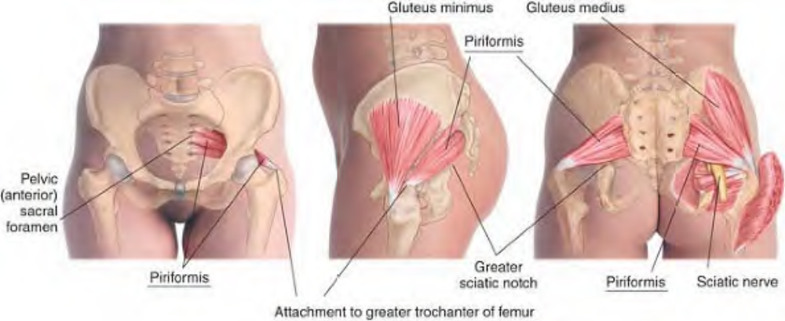
Anatomy of piriformis

Slide 38
Manual Therapy
Compression. The client lies prone. The therapist stands beside the client's hip. Place the thumb or supported thumb on the midpoint between the greater trochanter and the sacrum.

Slide 39
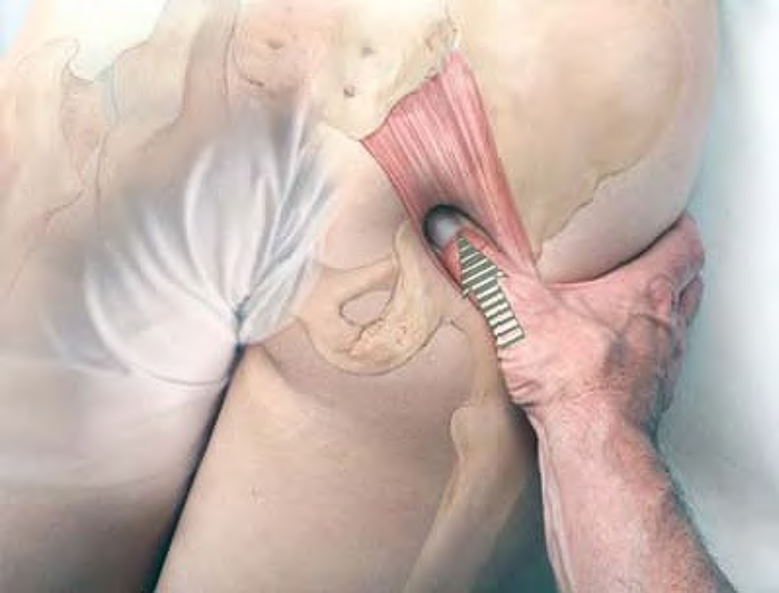
Compression of piriformis with supported thumb

Slide 40
Press firmly into the tissue, looking for tender areas. Hold for release. Explore the entire muscle in this manner, from the sacral border to the attachment on the greater trochanter.
Compression with Stretch. The client lies prone. The therapist stands at the client's hip. Place the knuckles of one hand on the buttock just medial to the greater trochanter, pressing firmly in a medial and anterior direction. With the other hand, grasp the client's ankle and flex the knee to 90º. Still holding the knuckles firmly against piriformis, pull the client's foot toward yourself, rotating the hip medially.

Slide 41
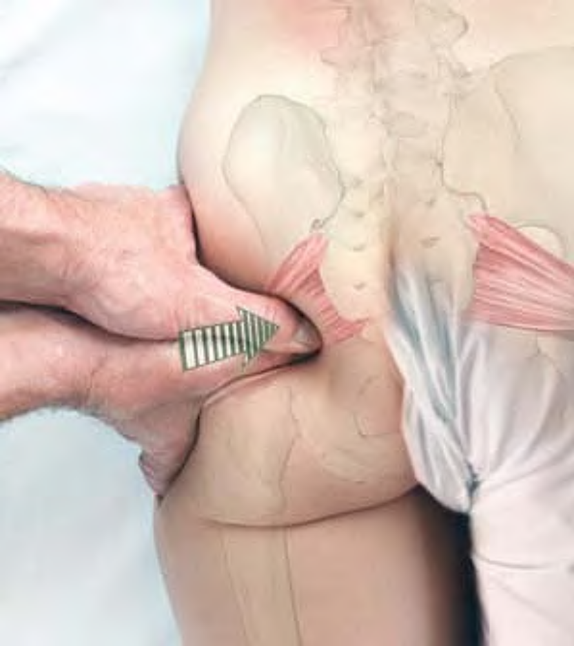
Compression of piriformis with supported thumb

Slide 42
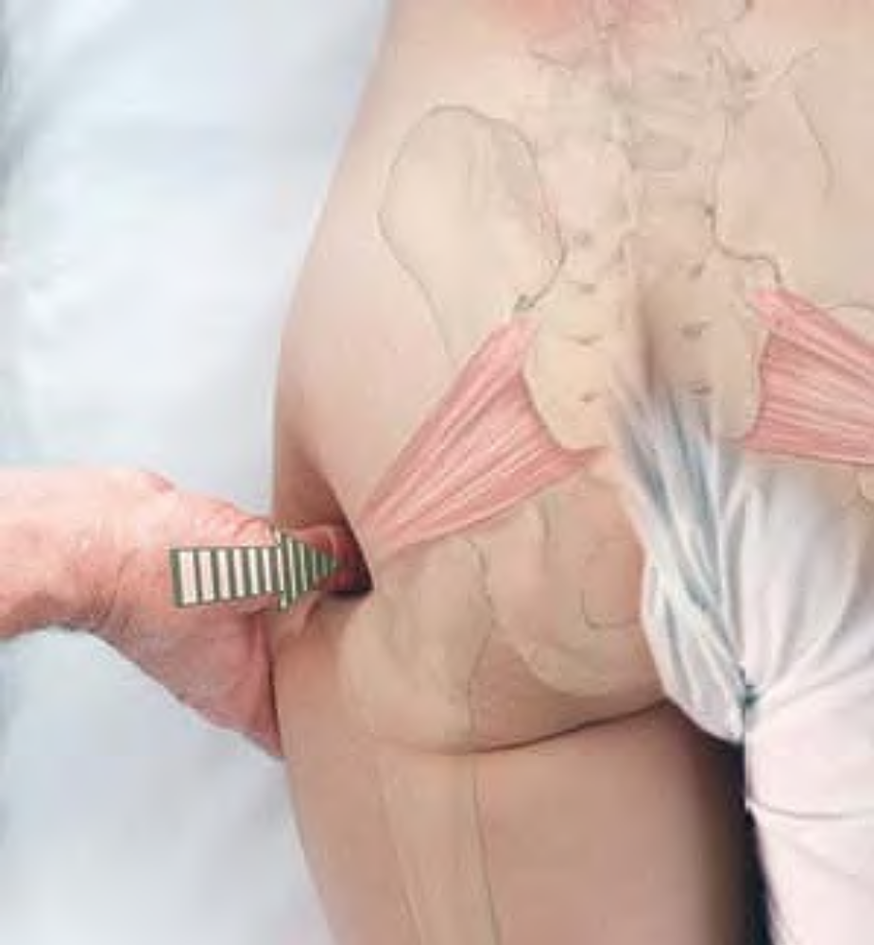
Compression of piriformis attachment at greater trochanter

Slide 43
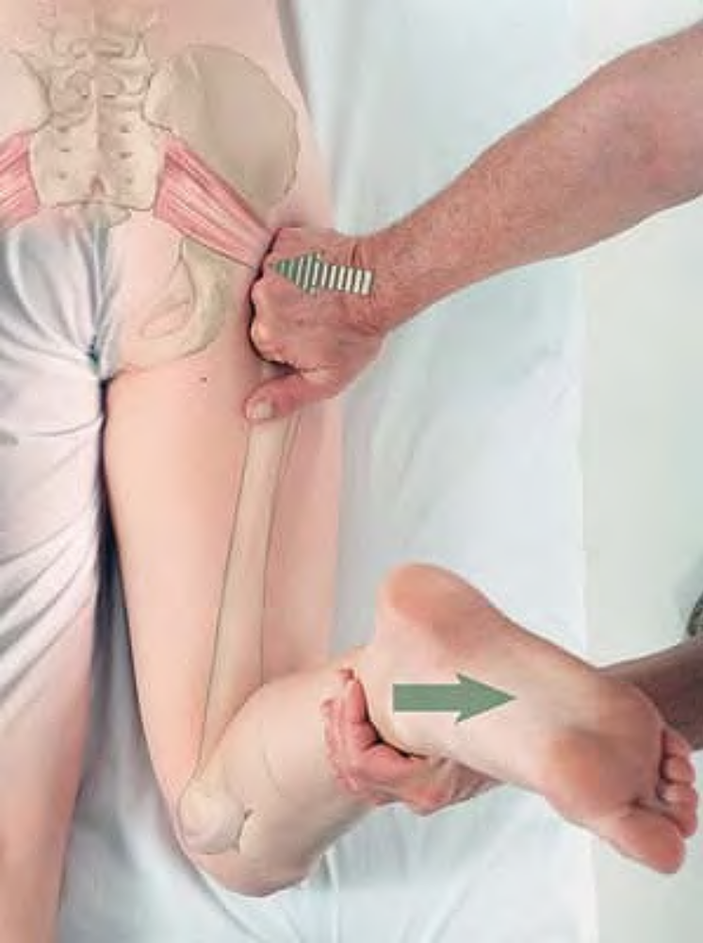
Passive stretch of piriformis

Slide 44
Superior Gemellus sue-PEER-ee-or je-MELL-us
Etymology Latin superior, higher + gemellus, diminutive of geminus, twin
Overview. Superior gemellus has no clinical significance separate from piriformis.
Attachments. Medially, to the ischial spine and margin of the lesser sciatic notch. Laterally, to the medial surface of the greater trochanter via the tendon of obturator internus
Palpation. Not palpable
Action. Rotates thigh laterally; stabilizes the hip joint
Referral Areas. Not applicable

Slide 45
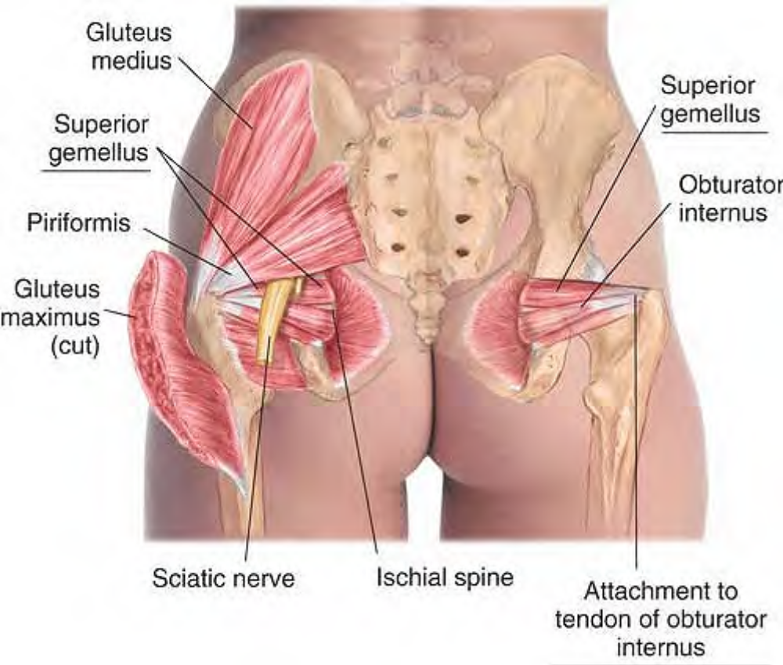
Anatomy of superior gemellus

Slide 46
Inferior Gemellus in-FEER-ee-or je-MELL-us
Etymology Latin inferior, lower + gemellus, diminutive of geminus, twin
Overview. Inferior gemellus has no clinical significance separate from piriformis.
Attachments. Medially, to the ischial tuberosity. Laterally, to the medial surface of the greater trochanter via the tendon of obturator internus
Palpation. Not palpable
Action. Rotates thigh laterally
Referral Areas. Not applicable

Slide 47
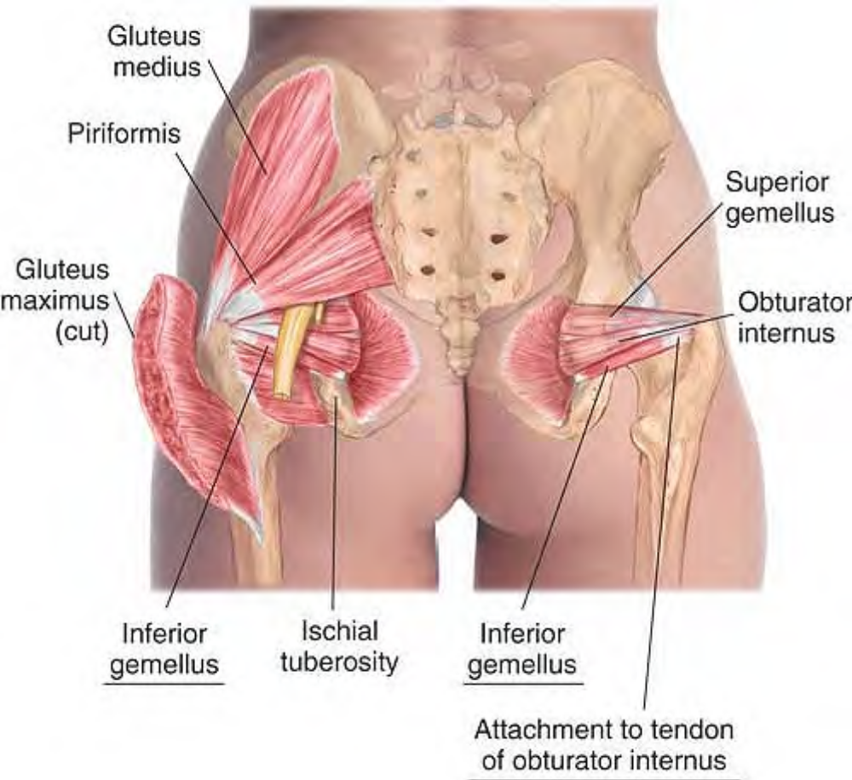
Anatomy of inferior gemellus

Slide 48
Obturator Internus AHB-tu-ray-ter in-TURN-us
Etymology Latin obturator, that which occludes or stops up + internus, internal
Overview. Obturator internus has much the same referral pattern as levator ani and coccygeus, discussed above.
Attachments. Medially, to the pelvic surface of the obturator membrane and margin of obturator foramen. Laterally, through the lesser sciatic notch, turning 90Âº to insert into the medial surface of the greater trochanter
Palpation. Discernible with the thumb between the buttocks pressing into the obturator foramen. Architecture is convergent as a whole.
Action. Rotates thigh laterally; stabilizes the hip joint
Referral Areas. To the lower sacrum and coccyx, Into the posterior upper thigh

Slide 49
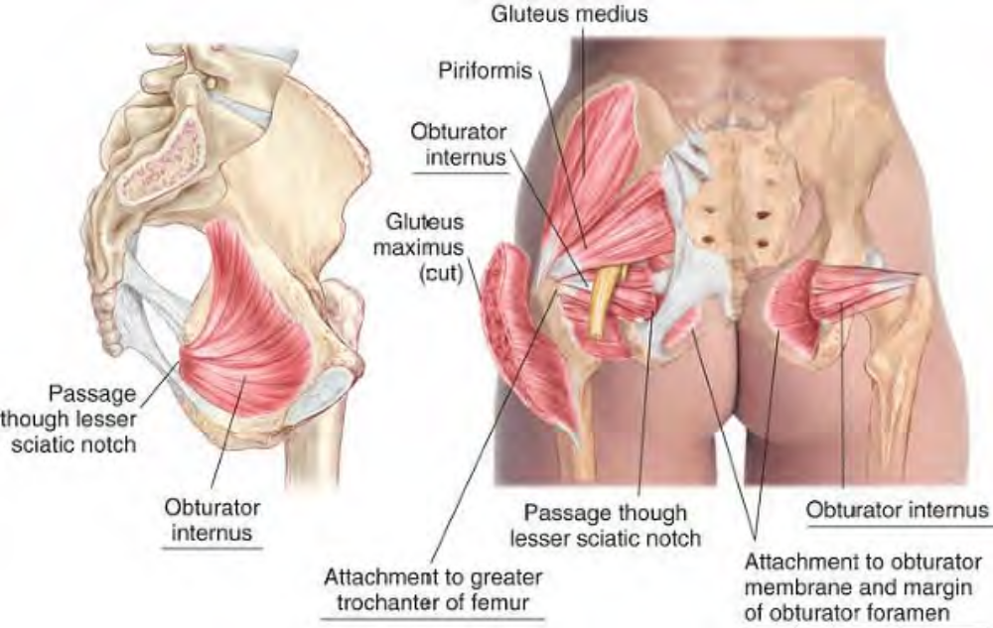
Anatomy of obturator internus

Slide 50
Obturator Externus AHB-tu-ray-ter ex-TURN-us
Etymology Latin obturator, that which occludes or stops up + externus, external
Overview. Obturator externus may, with quadratus femoris, cause tenderness just medial to the lower aspect of the greater trochanter. This muscle may be palpated deeply in the groin between pectineus and adductor brevis.
Attachments. Medially, to the lower half of margin of obturator foramen and adjacent part of external surface of obturator membrane. Laterally, to the trochanteric fossa of greater trochanter
Palpation. Not palpable
Action. Rotates thigh laterally; stabilizes the hip joint
Referral Areas. Just medial to the lower aspect of the greater trochanter

Slide 51
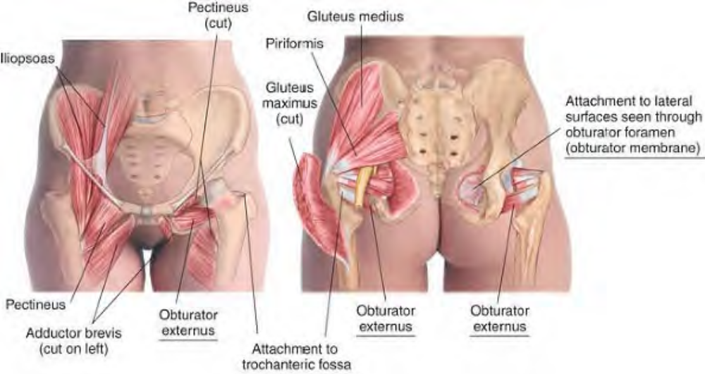
Anatomy of obturator externus

Slide 52
Manual Therapy
Compression. The client lies supine. The therapist stands at the client's knee. Using the thumb, locate pectineus and adductor brevis. Press firmly and deeply into the tissue between pectineus and adductor brevis exploring for tenderness. Hold for release.

Slide 53
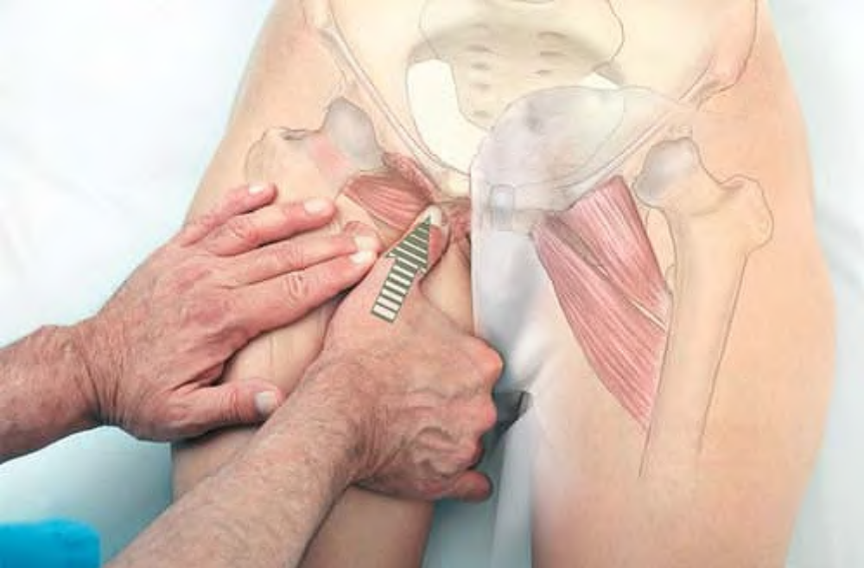
Compression of obturator externus through the groin

Slide 54
Quadratus Femoris kwa-DRAY-tus FEM-or-is
Etymology Latin quadratus, four-sided + femoris, of the femur (thigh bone)
Overview. Quadratus femoris may, with obturator externus, cause tenderness just medial to the lower aspect of the greater trochanter.
Attachments. Medially, to the lateral border of tuberosity of ischium. Laterally, to the intertrochanteric crest
Palpation. Palpable just posterior and medial to the greater trochanter. Architecture is parallel.
Action. Rotates thigh laterally
Referral Areas. With obturator externus, just medial to the lower aspect of the greater trochanter

Slide 55
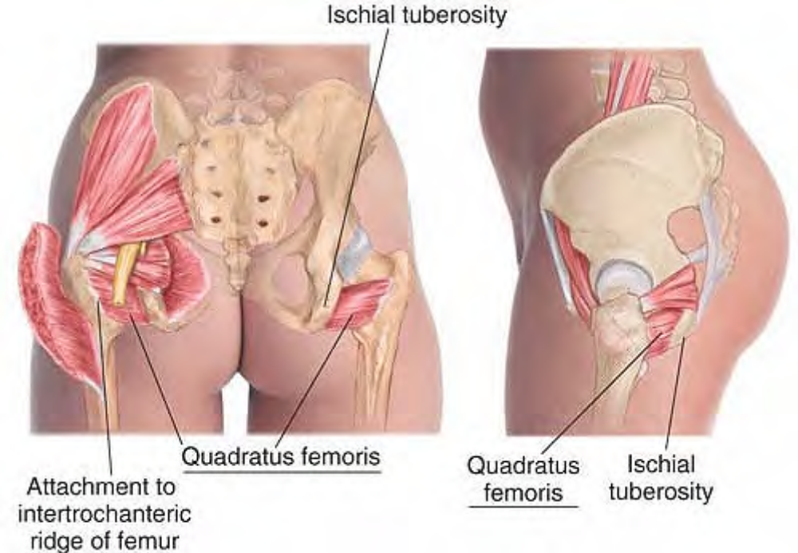
Anatomy of quadratus femoris

Slide 56
Manual Therapy
Compression. The client lies prone. The therapist stands at the client's knee. Place the thumb at the crease of the buttock between the ischial tuberosity and the greater trochanter. Press firmly in a superior direction, exploring for tender areas. Hold for release.

Slide 57
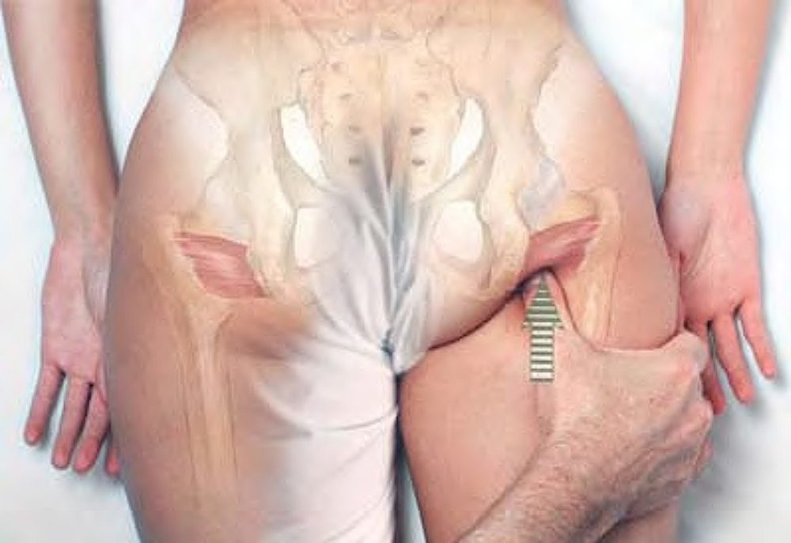
Compression of quadratus femoris

