Slide 1
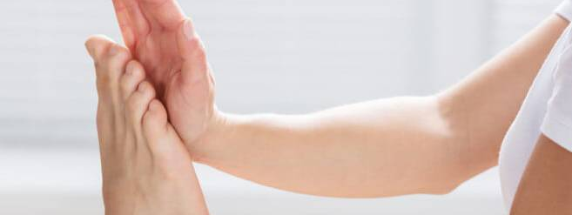
Massage Techniques 10C
Posterior leg muscles

Slide 2
Popliteus pop-LIT-ee-us
Etymology Latin poples, poplit-, the ham of the knee
Attachments
Proximally, to the lateral condyle of the femur (Fig. 10-22)
Distally, to the posterior surface of the tibia above the soleal line
Palpation. Not discernible
Action. Unlocks the knee to permit flexion
Referral Areas. To the posterior knee, toward the medial side.

Slide 3
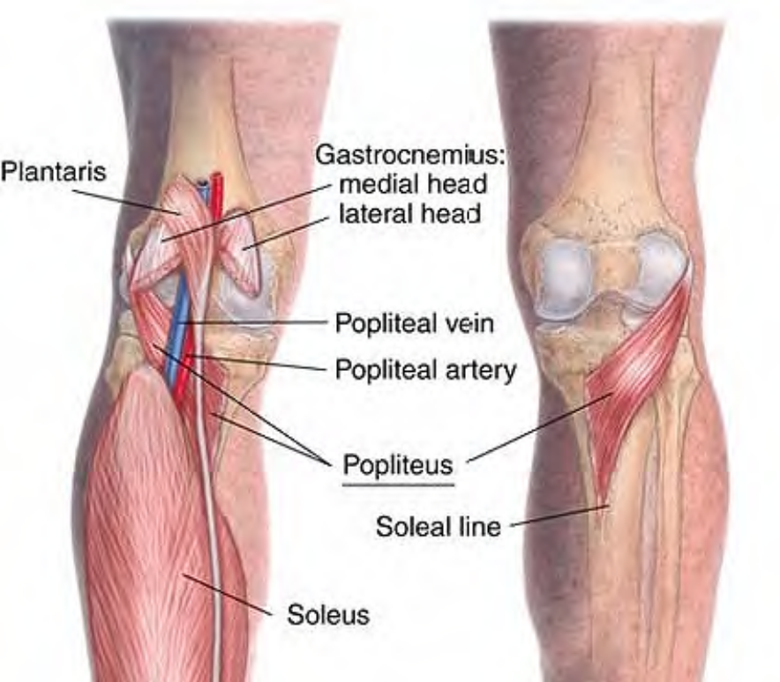
Anatomy of popliteus

Slide 4
Manual Therapy
Compression. The client lies on the unaffected side, with the knee to be treated flexed slightly. The therapist stands at the client's knees. Place the hand nearest the client on the posterior aspect of the knee, the thumb placed distal to the knee toward the medial side, pressing the gastrocnemius laterally to gain access to popliteus. Press firmly into the tissue, searching for tender spots. Hold for release.
Caution! Avoid pressure on the popliteal artery and tibial nerve, which run along the midline of the knee.

Slide 5
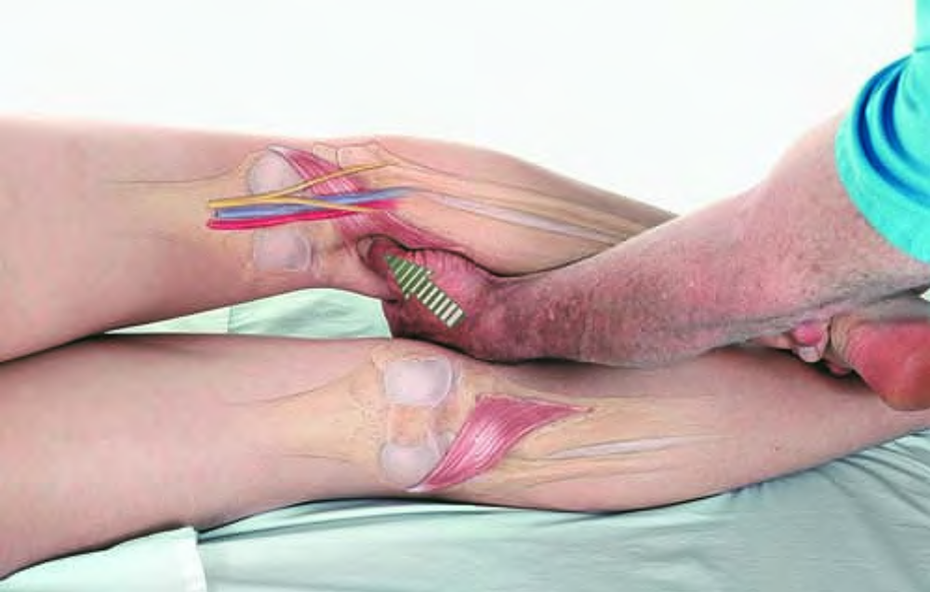
Compression of popliteus trigger point

Slide 6
Gastrocnemius GAS-trock-NEEM-ee-us
Etymology Greek gastroknemia, calf of the leg, from gaster (gastr-), belly, + kneme
Comment. Note that gastrocnemius crosses both the knee and ankle joints, while soleus crosses only the ankle joint. Therefore, while soleus can be stretched with the knee flexed, gastrocnemius can only be stretched with the knee straight.
Attachments. Superiorly, by two heads (lateral and medial) from the lateral and medial condyles of the femur Inferiorly, with soleus by the Achilles tendon into the inferior half of the posterior surface of the calcaneus.
Palpation. Easily palpable from Achilles tendon up to the division high on the calf, then on either side of the calf across the knee joint inside the hamstring tendons. Architecture as a whole is bipennate.
Action. Plantar flexion of foot.

Slide 7
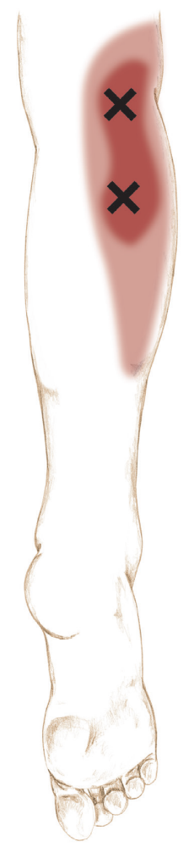
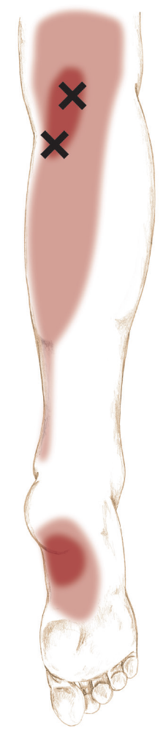
Referral Areas
Over the bellies of the muscle
To the medial surface of the ankle
To the longitudinal arch (medial surface of the plantar foot)

Slide 8
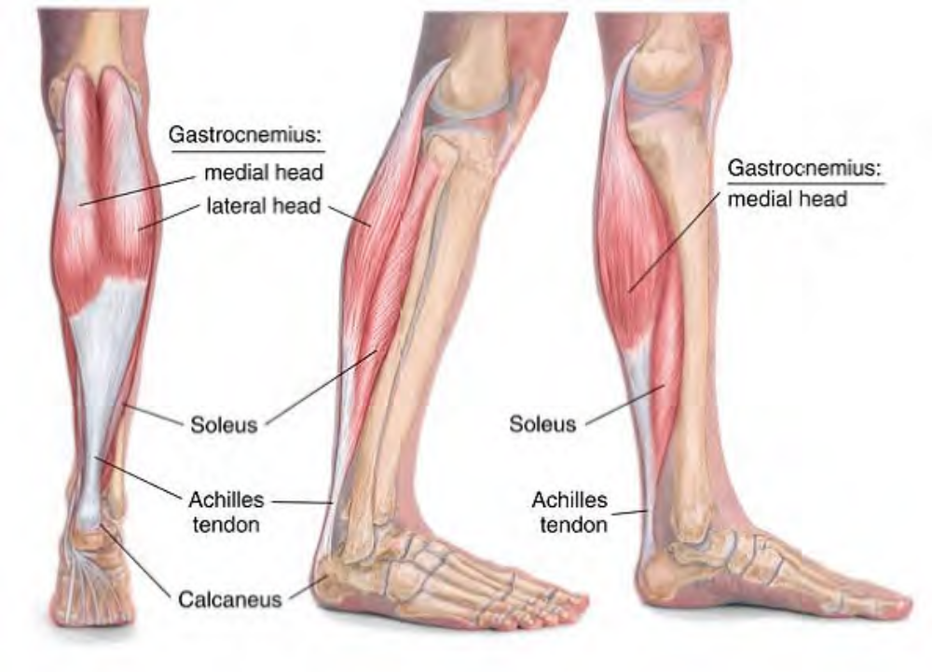
Anatomy of gastrocnemius

Slide 9
Soleus SO-lee-us
Etymology Latin solea, a sandal, sole of the foot (of animals), from solum, bottom
Comment. A soleus trigger point is one of the most common causes of pain in the heel.
Attachments. Superiorly, to the posterior surface of the head and superior third of the shaft of the fibula, the soleal line and middle third of the medial margin of the tibia, and a tendinous arch passing between the tibia and the fibula over the popliteal vessels.
Inferiorly, with gastrocnemius by the Achilles tendon into the tuberosity of the calcaneus
Palpation. Not directly palpable
Action. Plantar flexion of foot

Slide 10
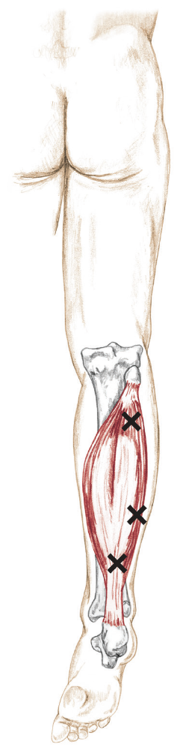
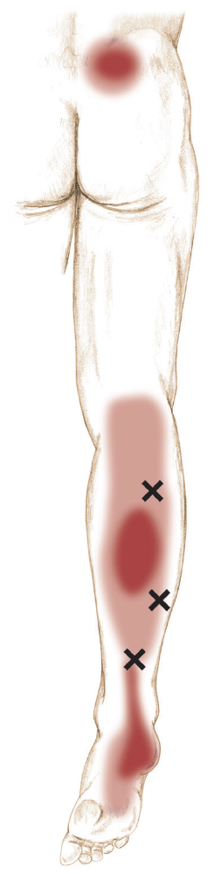
Referral Areas. Over the Achilles tendon to the plantar surface of the heel

Slide 11
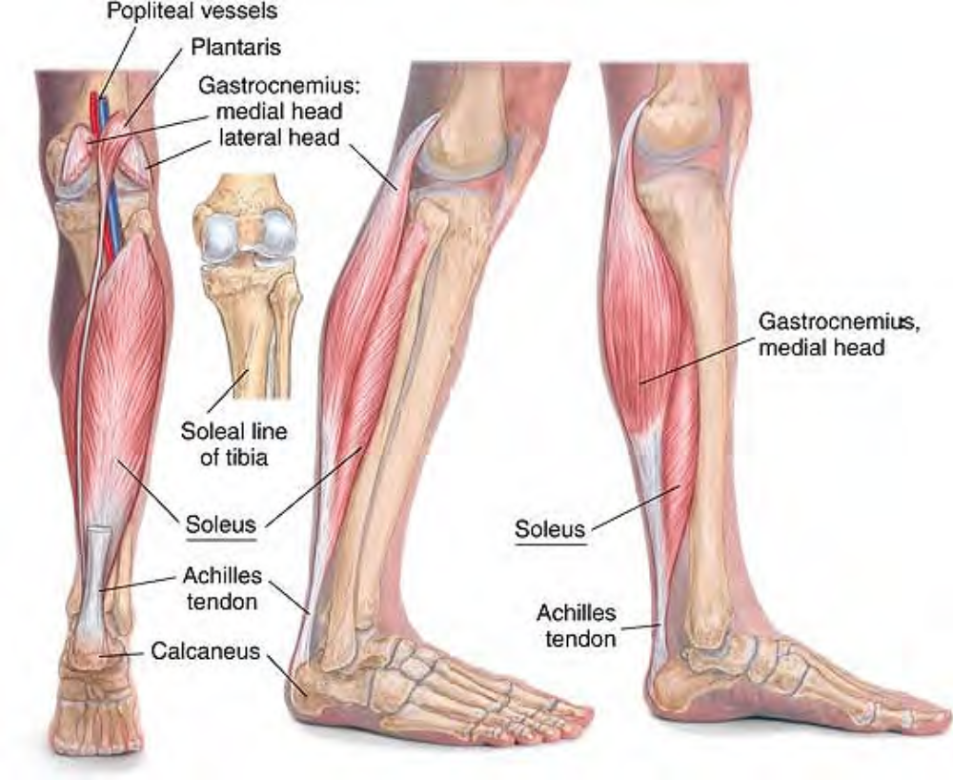
Anatomy of soleus

Slide 12
Manual Therapy
Compression. The client lies prone. The therapist stands at the client's feet. Place the hand on the soleus, the thumb pressing into the muscle proximal to the ankle about a third of the way to the knee.
Press firmly into the tissue, searching for tender spots. Hold for release.

Slide 13
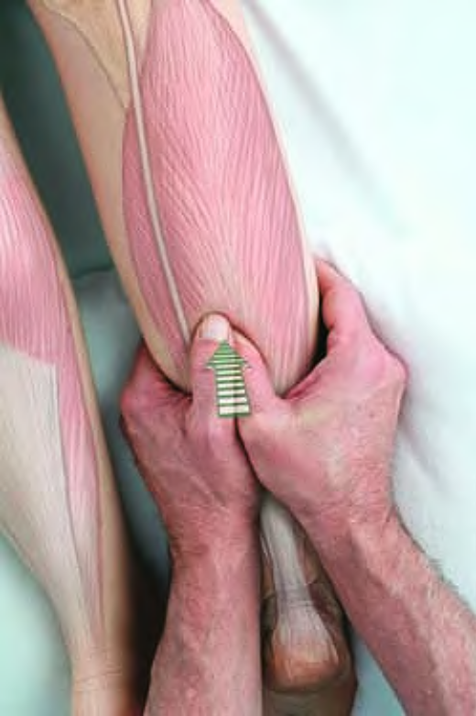
Compression of soleus trigger point

Slide 14
Stretch of Soleus
Holding the client's leg in one hand, grasp the foot with the other hand and slowly dorsiflex it.
Comment
See also Manual Therapy of the Calf Muscles, below.

Slide 15
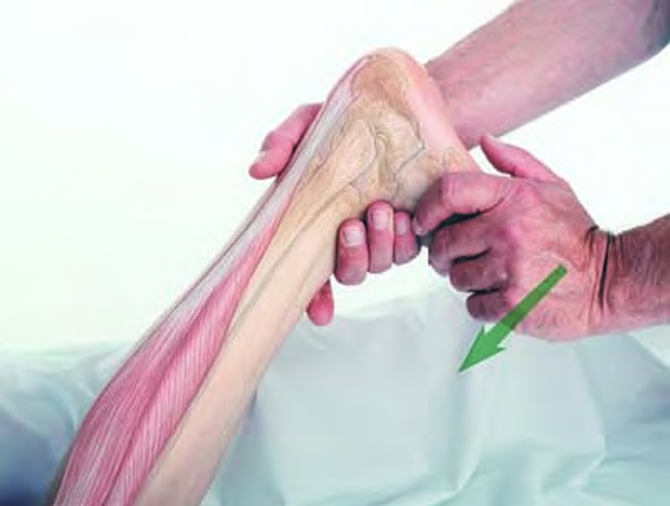
Stretch of soleus

Slide 16
Plantaris plan-TARE-is
Etymology Latin plantaris, plantar (relating to the sole of the foot)
Attachments. Proximally, to the lateral supracondylar ridge of the femur
Distally, by a long tendon to the medial margin of the Achilles tendon and deep fascia of the ankle
Palpation. Not directly palpable
Action. Assists in plantar flexion of the foot
Referral Areas. To the posterior knee and the upper calf

Slide 17
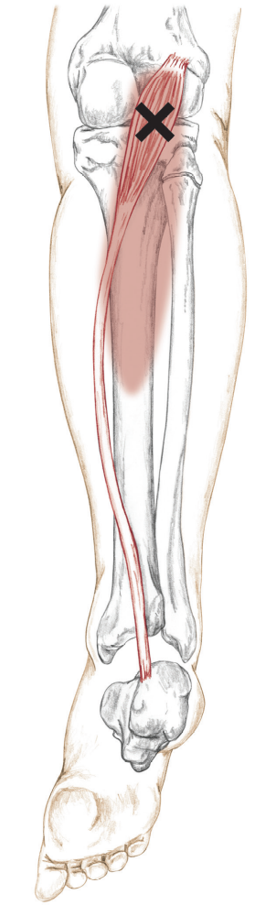
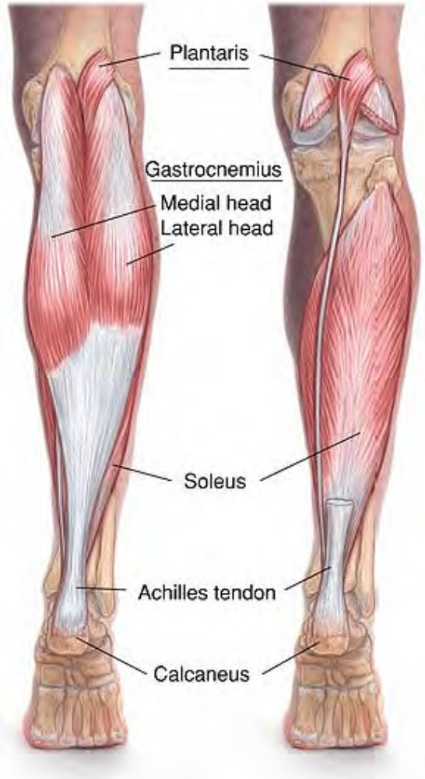
Posterior view of right leg, foot plantar flexed

Slide 18
Tibialis Posterior tib-ee-AL-is pos-TEER-ee-or
Etymology Latin tibialis, of the tibia + posterior, back
Attachments. Proximally, to the soleal line and posterior surface of the tibia, the head and shaft of the fibula between
the medial crest and interosseous border, and the posterior surface of the interosseous membrane
Distally, to the navicular; three cuneiform; cuboid; and second, third, and fourth metatarsal bones
Palpation. Not directly palpable
Action. Plantar flexion and inversion of foot

Slide 19
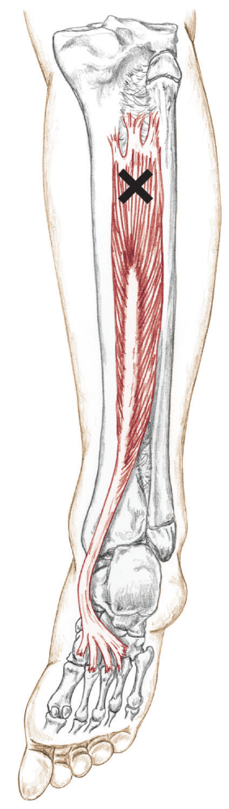
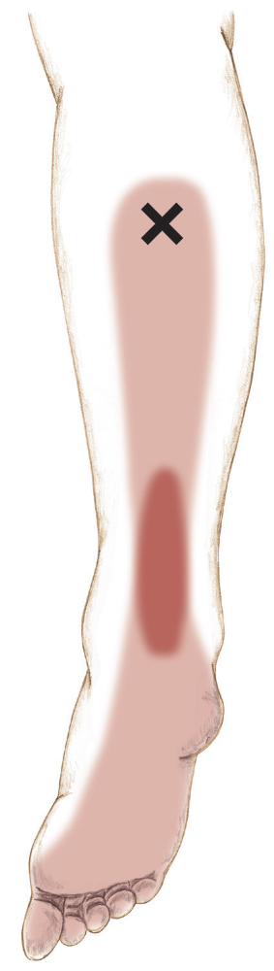
Referral Areas
Primarily, to the Achilles tendon, Secondarily, to the surface of the calf, and the plantar surface of the heel and foot

Slide 20
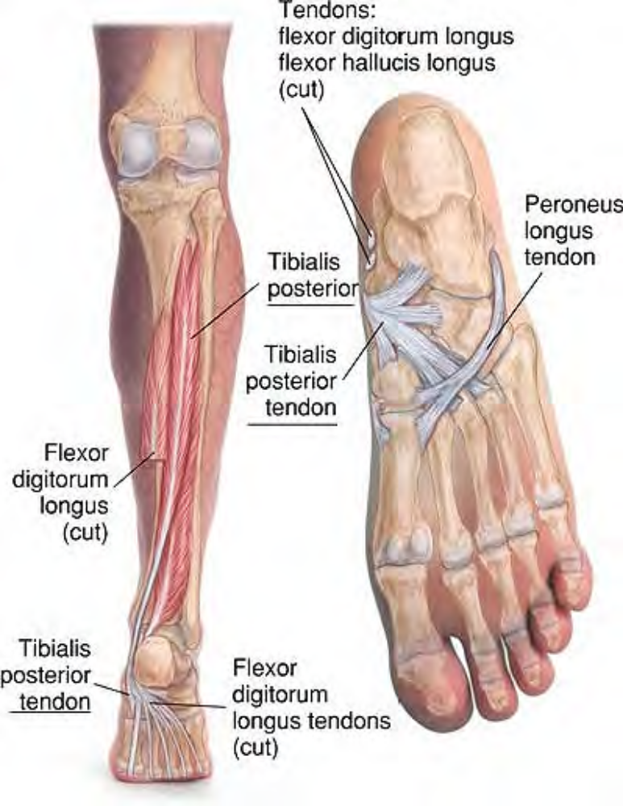
Anatomy of tibialis posterior

Slide 21
Flexor Digitorum Longus
Etymology Latin flexor, flexor + digitorum, of the digits + longus, long
Attachments
Proximally, to the middle third of the posterior surface of the tibia. Distally, by four tendons, perforating those of the flexor brevis, into the bases of the distal phalanges of the four lateral toes
Palpation. Not directly palpable
Action. Flexes second to fifth toes

Slide 22
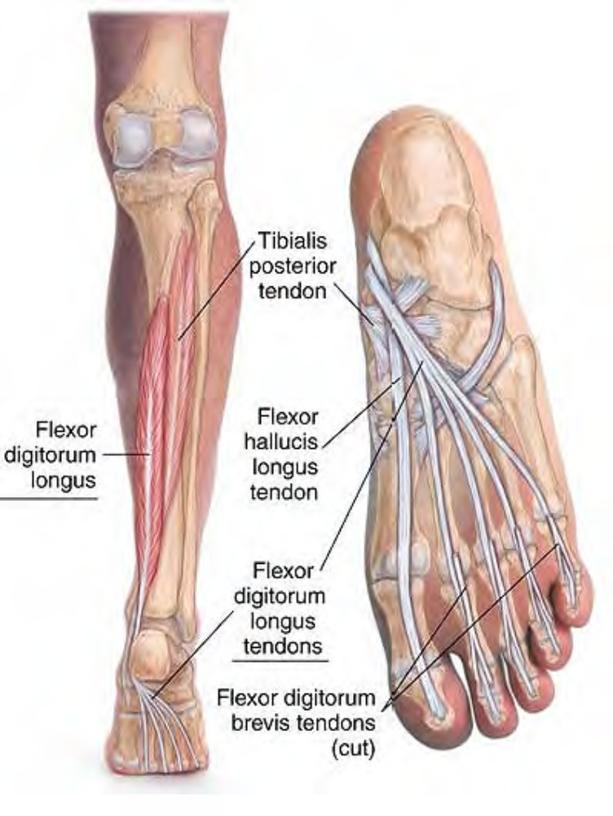
Anatomy of flexor digitorum longus

Slide 23
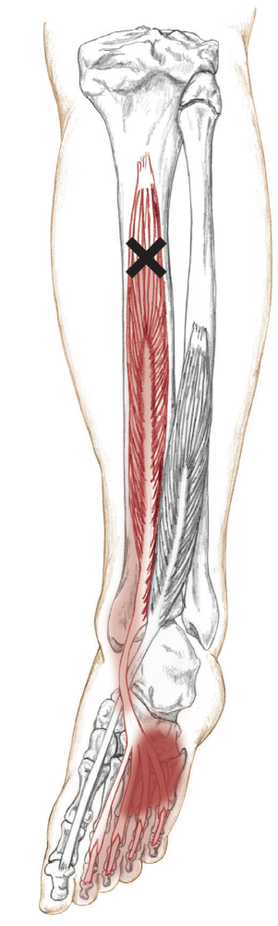
Referral Areas. To the medial surface of the calf, To the central plantar surface of the foot
Other Muscles to Examine. Other calf muscles Other muscles of the plantar foot
Manual Therapy. See Manual Therapy of the Calf Muscles, below.

Slide 24
Etymology Latin flexor, flexor + hallucis (from hallux, great toe), of the great toe + longus, long

Slide 25
Flexor Hallucis Longus
Attachments
Proximally, to the lower two-thirds of the posterior surface of the fibula. Distally, to the base of the distal phalanx of the great toe
Palpation. Not directly palpable
Action. Flexes great toe

Slide 26
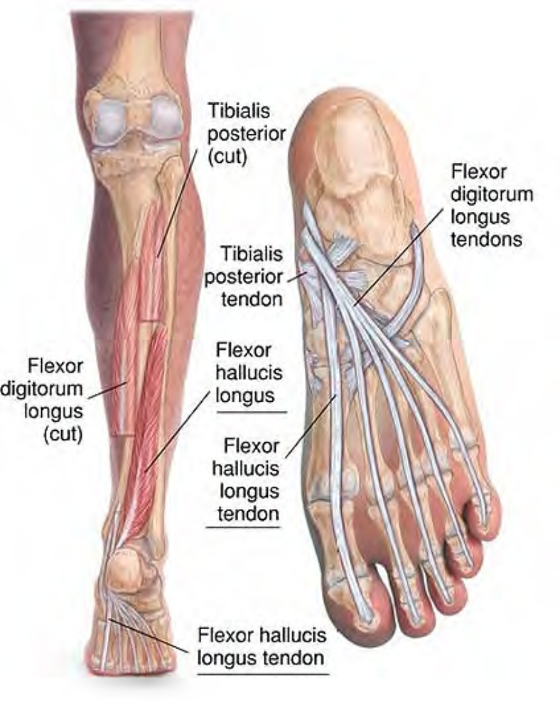
Anatomy of flexor hallucis longus

Slide 27
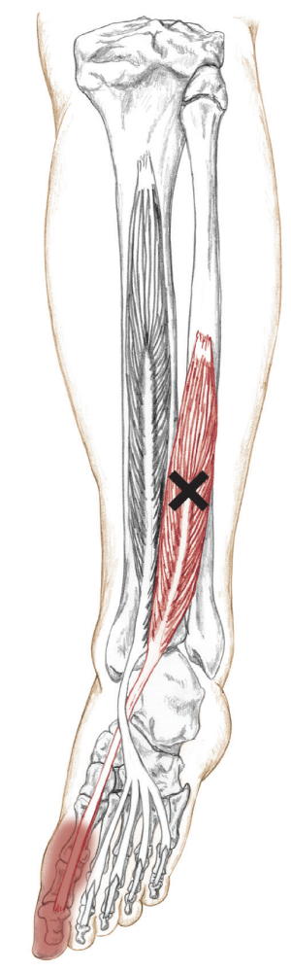
Referral Areas. To the ball of the foot and the great toe
Other Muscles to Examine. Flexor hallucis brevis
Manual Therapy. See Manual Therapy of the Calf Muscles, below.

Slide 28
Manual Therapy of the Calf Muscles
When treating the calf muscles with the client prone, avoid excessive plantar flexion of the ankle by placing the ankles on a pillow or bolster or have the client lie with the feet off the end of the table.
Stripping. The client lies prone. The therapist stands at the client's feet. Place the heel of the hand on the calf at the proximal end of the Achilles tendon, starting on the lateral side. Pressing firmly into the tissue, slide the heel of the hand along the muscle to the knee. Repeat this procedure on the posterior calf. Repeat this procedure on the medial calf.

Slide 29
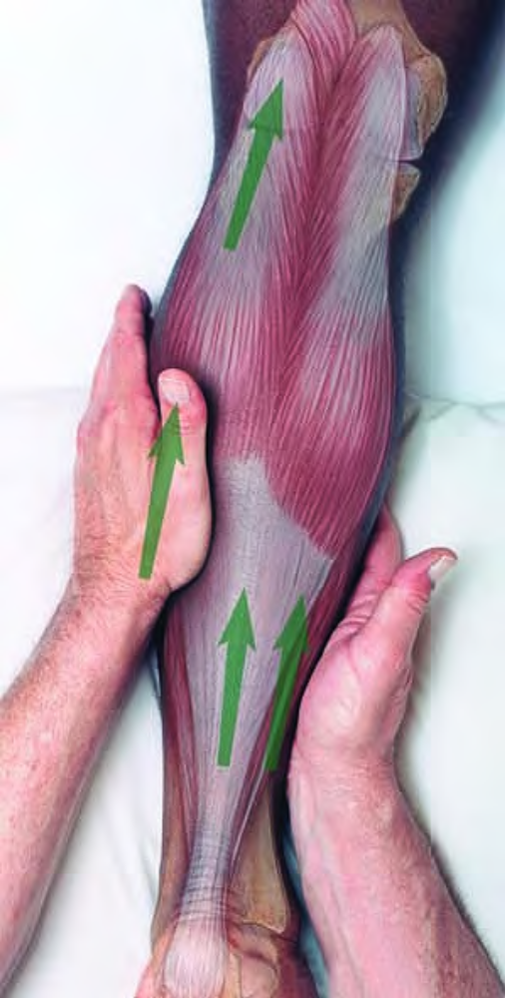
Stripping of calf muscles with the heel of the hand

Slide 30
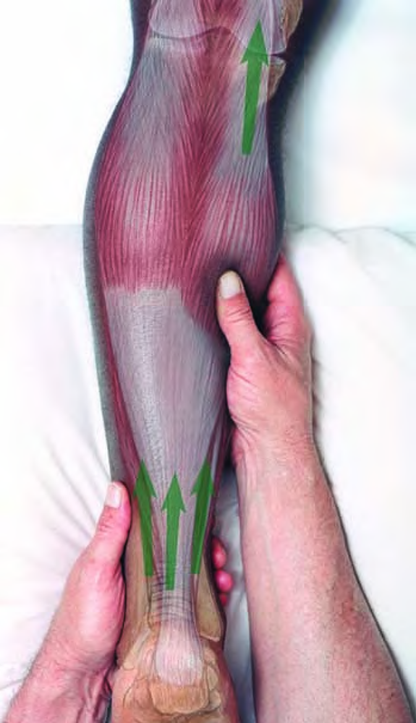
Stripping of calf muscles with the thumb

Slide 31
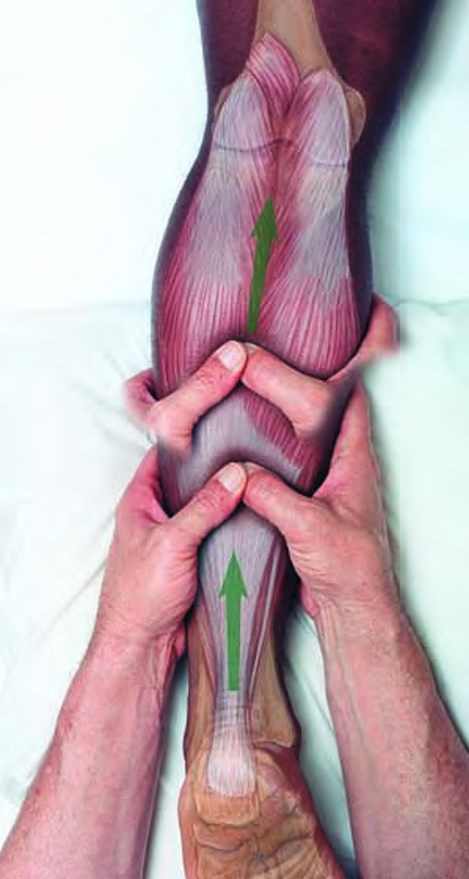
Stripping of calf muscles with the supported thumb

