Slide 1
Upper Limb SOT
&
Dupuytren’s Contracture
Dr Manju Setia Khowal
RMT, BAMS

Slide 2
Supraspinatus tendinitis is a common cause of shoulder pain, especially with overhead activity. It involves inflammation or irritation of the supraspinatus tendon (part of the rotator cuff).

Slide 3
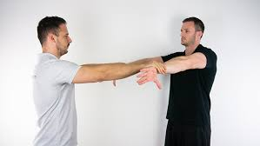
Supraspinatus pathology
Empty Can Test (Jobe’s Test)
Purpose: Assess supraspinatus muscle/tendon
Procedure:
Patient abducts shoulder to 90° in scapular plane (~30° forward)
Internally rotate (thumb pointing down – “empty can”)
Therapist applies downward resistance
Positive Sign:
Pain or weakness → suggests supraspinatus tendinitis or tear

Slide 4
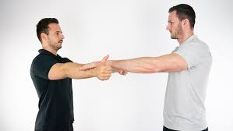
Full Can Test
Purpose: Safer alternative to Empty Can
Procedure:
Same position but thumb pointing up
Apply downward resistance
Positive Sign:
Pain/weakness → supraspinatus pathology

Slide 5
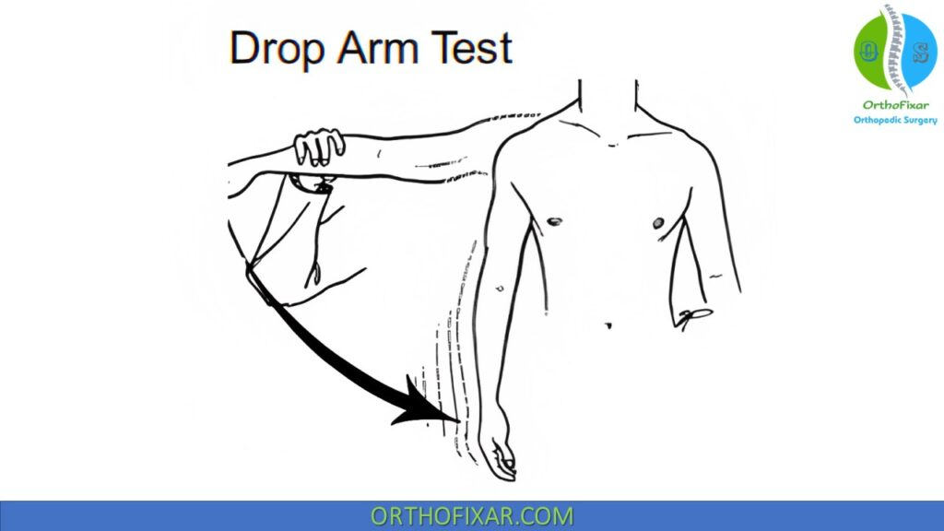
Drop Arm Test
Purpose: Detect supraspinatus tear (more severe cases)
Procedure:
Passively abduct arm to 90–120°
Ask patient to slowly lower it
Positive Sign:
Arm drops suddenly or severe pain → rotator cuff tear

Slide 6
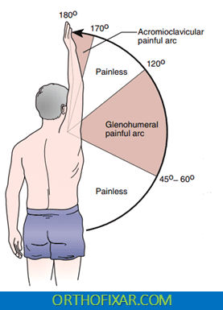
Painful Arc Test
The Painful Arc Test is used to assess supraspinatus tendinitis and subacromial impingement.
Procedure:
Patient actively abducts arm
Positive Sign:
Pain between 60°–120° → supraspinatus impingement/tendinitis

Slide 7
Painful Arc Test
Range | Finding | Likely Condition
0°–60° | Pain | Severe rotator cuff issue like Severe rotator cuff injury Acute inflammation Possible calcific tendinitis
60°–120° | Pain | Supraspinatus tendinitis / impingement
160°–180° | Pain | AC joint pathology

Slide 8
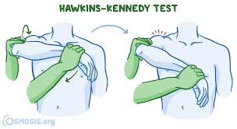
Hawkins–Kennedy Test
Purpose: Subacromial impingement (supraspinatus involvement)
Procedure:
Flex shoulder to 90°
Elbow flexed 90°
Internally rotate shoulder
Positive Sign:
Pain → impingement of supraspinatus tendon

Slide 9
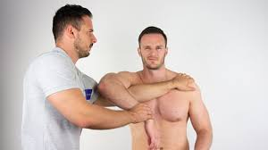
Hawkins–Kennedy Test

Slide 10
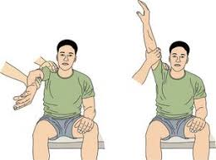
Neer’s Impingement Test
Purpose: Subacromial impingement
Procedure:
Passively internal rotation & flex arm overhead while stabilizing scapula
Positive Sign:
Pain → supraspinatus tendon impingement

Slide 11
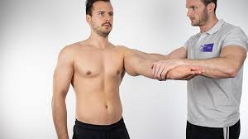
Speed’s Test:
Purpose: Detect biceps tendinitis (long head)
Procedure:
Patient flexes shoulder to 90°, elbow extended, forearm supinated (palm up)
Therapist applies downward resistance
Positive Sign:
Pain in bicipital groove → biceps tendinitis

Slide 12

Yergason’s Test
Purpose: Assess biceps tendon stability + tendinitis
Procedure:
Elbow flexed to 90°, forearm pronated
Patient tries to supinate + externally rotate against resistance
Therapist palpates bicipital groove
Positive Sign:
Pain or Popping →
  Pain: biceps tendinitis
  Popping: transverse humeral ligament instability

Slide 13
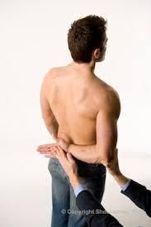
Lift-Off Test (Gerber’s Test)
Most specific for subscapularis
Purpose: Assess subscapularis strength
Procedure:
Patient places hand on lower back (lumbar spine)
Asked to lift hand away from back
Positive Sign:
Inability to lift hand OR weakness/pain
Indicates subscapularis tear or tendinitis

Slide 14
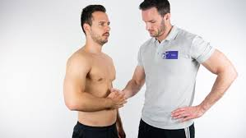
Belly Press Test
Purpose: Alternative when patient cannot perform lift-off
Procedure:
Patient presses palm against abdomen
Try to keep elbow forward
Positive Sign:
Elbow drops backward
Wrist flexes to compensate
Indicates subscapularis weakness

Slide 15
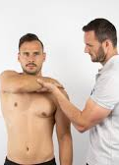
Bear Hug Test
Purpose: Detect partial tears (more sensitive)
Procedure:
Patient places hand on opposite shoulder
Therapist tries to lift hand away
Patient resists
Positive Sign:
Weakness or inability to maintain position
Indicates subscapularis tear

Slide 16
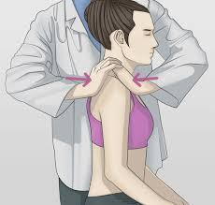
AC Shear / Compression Test (Acromioclavicular Joint)
This test is used to check problems in the acromioclavicular (AC) joint like sprain, separation, or arthritis.
How to Perform
Patient sitting or standing
Therapist places:
  One hand on front of shoulder (clavicle)
  Other hand on back of shoulder (scapula)
Then squeeze both hands together
This compresses the AC joint
Positive Sign
Pain at top of shoulder (AC joint area)
Sometimes reproduction of familiar pain
Indicates:
AC joint sprain
AC joint arthritis
AC joint separation

Slide 17
Medial Epicondylitis (Golfer’s Elbow)
Inflammation of common flexor tendon
Pain on medial elbow
Caused by repetitive wrist flexion & pronation

Slide 18
Muscles Involved (Medial)
Flexor carpi radialis
Flexor carpi ulnaris
Palmaris longus
Pronator teres

Slide 19
Signs & Symptoms (Medial)
Medial elbow pain
Pain with gripping
Tenderness at medial epicondyle
Weak wrist flexion

Slide 20

Reverse Cozen’s Test (for Medial Epicondylitis)
Purpose
To identify Medial Epicondylitis
Procedure
Patient seated
Elbow slightly flexed or extended
Forearm supinated
Ask patient to flex wrist against resistance
Positive Sign
Pain at medial epicondyle
Interpretation
Indicates flexor tendon involvement
Common in overuse injuries (gripping, manual work)

Slide 21
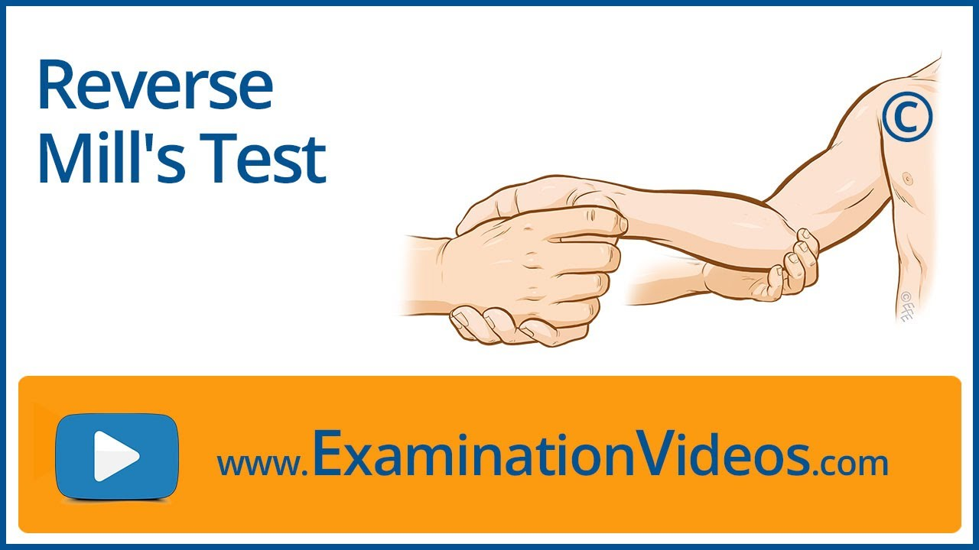
Reverse Mill’s Test (Passive Stretch Test for Medial Epicondylitis)
Purpose
To stretch wrist flexors and reproduce pain
Procedure
Elbow extended
Forearm supinated
Therapist passively moves wrist into: Extension + supination
Positive Sign
Pain at medial epicondyle
Interpretation
Confirms tightness or irritation of flexor group
Helps differentiate from nerve-related pain

Slide 22
SOT-Golfer’s Elbow
Test | Type | Action | Positive
Reverse Cozen’s | Active (resisted) | Wrist flexion | Medial pain
Reverse Mill’s | Passive stretch | Wrist extension | Medial pain

Slide 23
Lateral Epicondylitis (Tennis Elbow)
Overuse of extensor tendon
ECRB commonly involved
Pain on lateral elbow
Repetitive wrist extension

Slide 24
Muscles Involved (Lateral)
Extensor carpi radialis brevis
Extensor digitorum
Extensor carpi ulnaris

Slide 25
Signs & Symptoms (Lateral)
Lateral elbow pain
Pain with wrist extension
Reduced grip strength
Tenderness at lateral epicondyle

Slide 26
Special Tests (Lateral)
Cozen’s Test: Pain on resisted wrist extension
Mill’s Test: Pain on passive stretch
Maudsley’s Test: Pain on middle finger extension

Slide 27
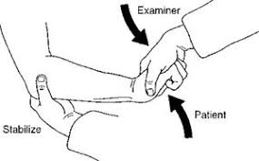
Cozen’s Test
Purpose
To detect extensor tendon involvement (especially ECRB)
Procedure
Patient seated
Elbow slightly flexed (~90°)
Forearm pronated
Patient makes a fist
Ask patient to extend wrist against resistance
Positive Sign
Sudden pain at lateral epicondyle
Interpretation
Indicates active contraction irritation of wrist extensors

Slide 28
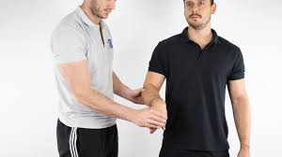
Mill’s Test
Purpose
To stretch the extensor muscles
Procedure
Patient seated
Therapist palpates lateral epicondyle
Passively move:
  Elbow → extension
  Forearm → pronation
  Wrist → flexion
Positive Sign
Pain at lateral epicondyle
Interpretation
Indicates tightness or inflammation
of extensors

Slide 29
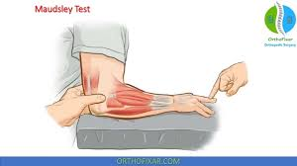
Maudsley’s Test (Middle Finger Test)
Purpose
To isolate extensor digitorum
Procedure
Patient extends middle finger
Therapist applies downward resistance
Positive Sign
Pain at lateral epicondyle
Interpretation
Suggests ECRB / extensor digitorum involvement

Slide 30
SOT- Tennis Elbow
Test | Type | Movement | What it stresses
Cozen’s | Active (resisted) | Wrist extension | Extensor contraction
Mill’s | Passive | Wrist flexion stretch | Extensor stretch
Maudsley | Active (resisted) | Middle finger extension | Extensor digitorum

Slide 31
Treatment
Myofascial release
Deep friction
Trigger points
Stretching & strengthening

Slide 32
Home Care
Ice therapy
Activity modification
Bracing
Exercises

Slide 33
Varus & Valgus Stress Tests
These tests assess the collateral ligaments of the elbow joint:
Varus Stress Test → Lateral (Radial) Collateral Ligament (LCL)
Valgus Stress Test → Medial (Ulnar) Collateral Ligament (UCL)

Slide 34
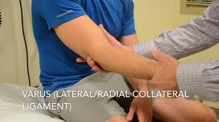
Varus Stress Test (Elbow)
Purpose
To assess integrity of the Lateral Collateral Ligament (LCL)
Procedure
Patient seated or supine
Elbow slightly flexed (20–30°) → unlocks joint
Therapist stabilizes distal humerus
Apply varus force (push forearm medially, creating outward stress at elbow)
Think: Distal forearm goes inward → stress on lateral side
Positive Sign
Pain on lateral elbow
Excessive joint laxity (compared to other side)
Indicates
LCL sprain or tear
Posterolateral instability

Slide 35
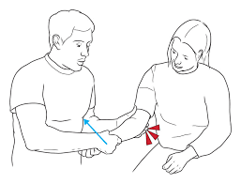
Valgus Stress Test (Elbow)
Purpose
To assess integrity of the Ulnar Collateral Ligament (UCL)
Procedure
Elbow slightly flexed (20–30°)
Stabilize humerus
Apply valgus force (push forearm laterally, creating inward stress at elbow)
Think: Distal forearm goes outward → stress on medial side
Positive Sign
Pain on medial elbow
Excessive laxity
Indicates
UCL sprain or tear
Common in throwing athletes

Slide 36
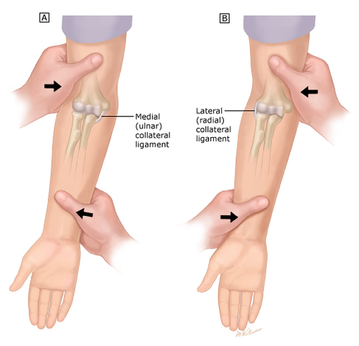

Slide 37
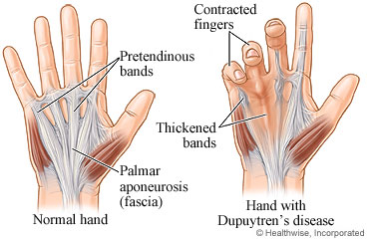
Dupuytren’s Contracture
Contracture of palmar fascia
Leads to finger flexion deformity
Commonly affects MCP & IP joints of 4th & 5th digits

Slide 38
Anatomy
Palmar fascia: dense connective tissue
Fibers: longitudinal, transverse, vertical
Provides grip stability

Slide 39
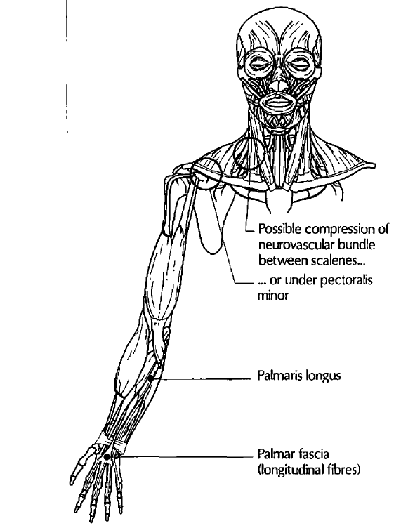
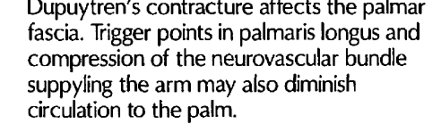

Slide 40
Etiology
Idiopathic
Genetic factors
Associated with diabetes, epilepsy, alcoholism
More common in males

Slide 41
Pathophysiology
Nodules form
Fibrous bands develop
Leads to progressive flexion contracture

Slide 42
Symptoms
Palmar nodules
Skin dimpling
Finger flexion
Reduced circulation

Slide 43
Functional Limits
Difficulty extending fingers
Weak grip
Reduced hand function

Slide 44
Assessment
Observation: deformity
Palpation: nodules, thick fascia
ROM limitations
The severity of the condition is measured with a degrees of Dupuytren's contracture test. A positive Adson's test, costoclavicular syndrome test or Wright’s hyperabduction test indicates the presence of thoracic outlet syndrome,which could be a contributing factor.

Slide 45
Treatment Goals
Reduce restriction
Improve ROM
Enhance circulation

Slide 46
Treatment Plan
Myofascial release
Friction techniques
Passive stretching
Increase circulation
Hydrotherapy is a pre-treatment application of wax (using a Paraffin wax bath) applied to the affected hand to soften the fascia. The hand is then wrapped in plastic wrap and a towel to retain the heat. Contrast is used after the treatment to increase local circulation.

Slide 47
ROM Techniques
Passive extension
Gradual progression
Joint stabilization

Slide 48
Prognosis
Better early stage
Limited in chronic cases
Recurrence possible
Surgery:
Fasciotomy
Post-op rehab needed

Slide 49
Key Points
Early treatment important
Focus on fascia
Improve circulation & function

Slide 50
DeQuervain's tenosynovitis
Inflammation of tendons in the first dorsal compartment
Involves:
Abductor Pollicis Longus (APL)
Extensor Pollicis Brevis (EPB)
Causes pain on thumb side of wrist

Slide 51
Anatomy
Tendons pass through a fibrous sheath near radial styloid
Responsible for:
Thumb abduction
Thumb extension
Friction occurs within the sheath →inflammation
Causes:
Activities requiring repetitive thumb use, typing,gripping
Repetitive radial and ulnar deviation
forceful gripping cause this condition, such as factory work,
massage therapy and racquet sports

Slide 52
Symptoms:
Pain is located one centimetre proximal to the radial styloid process.
Pain with gripping / pinching
Difficulty lifting objects
Functional Limitations:
Pain while holding objects
Difficulty opening jars
Weak grip strength
Limited thumb movement

Slide 53
Finkelstein’s Test:DeQuervain's tenosynovitis
To determine the presence of deQuervain's tenosynovitis:
Place the client in a seated position.
Instruct the client to make a fist of the affected hand, with the thumb firmly held in flexion inside the flexed fingers.
Stabilize the arm proximal to the client's wrist with one hand.
With the other hand, ulnarly deviate the wrist.
Pain along the abductor pollicis longus and extensor pollicis brevis tendons at the wrist is positive for tenosynovitis.
Because this test can be painful even if tendinitis is not present, perform the test
bilaterally, comparing affected and unaffected sides.
A variation:
Instruct the client to actively ulnarly deviate the wrist, keeping the thumb and fingers
flexed in a fist as in the first version of the test.
Pain along the tendon sheath is a positive result.

Slide 54

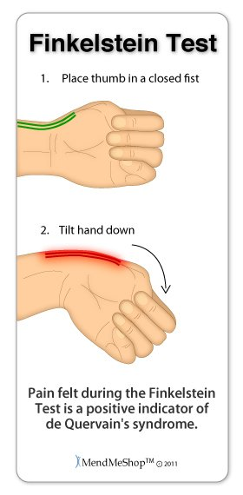

Slide 55
Thoracic Outlet Syndrome (TOS)
Dr Manju Setia Khowal
RMT, BAMS

Slide 56
ULTT 1
ULTT 1 (Upper Limb Tension Test 1) is a neurodynamic test mainly used to assess the median nerve and its pathway
Purpose
Evaluate neural tension / mobility
Identify nerve irritation or compression
Commonly used in:
  Cervical radiculopathy
  Carpal Tunnel Syndrome
  Thoracic outlet issues

Slide 57
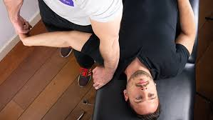
Patient Position
Supine (lying on back)
No pillow (cervical spine neutral)
Steps
Scapular depression (stabilize shoulder)
Shoulder abduction (~90–110°)
Forearm supination
Wrist & finger extension
Shoulder external rotation
Elbow extension
Cervical side flexion (away/toward for sensitization)

Slide 58
Positive Test
Reproduction of symptoms:
  Pain
  Tingling
  Numbness along median nerve distribution
Symptoms change with neck side bending
  ↑ symptoms → neural involvement likely

Slide 59
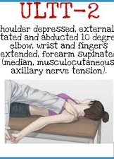
ULTT 2
Purpose: To assess the median nerve, Axillary nerve, Musculocutaneous nerve as the source of the client's painful shoulder or arm
Performing the Test:
Test Position: The client is in a supine position
- Depress the client's shoulder and abduct the humerus to 10 degrees. - Slowly extend the wrist and fingers.
- Fully supinate the forearm and extend the elbow. Tissue tightness in the shoulder or elbow, or tingling in the fingers is a normal response.
Result:
- A positive test is reproduction of the client's symptoms.

Slide 60
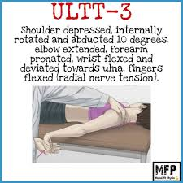
ULTT 3
Test Sequence:
Scapular depression
Shoulder abduction (10–30°)
Elbow extension
Medial (internal) rotation of shoulder
Forearm pronation
Wrist flexion + ulnar deviation
Finger flexion

Slide 61
Add contralateral cervical side bending
↑ symptoms → neural involvement
Ipsilateral side bending → ↓ symptoms
Positive Test
Reproduction of:
  Pain/tingling along:
    Lateral arm
    Posterior forearm
    Dorsum of hand
Difference compared to opposite side

Slide 62
ULTT 4
The ULTT (Upper Limb Tension Test) for the ulnar nerve—often called ULTT 4 or the ulnar nerve bias test
Purpose
To evaluate neural tension of the ulnar nerve
Helps in conditions like:
  Cubital tunnel syndrome
  Ulnar nerve entrapment
  Cervical radiculopathy (C8–T1)

Slide 63
Patient Position
Supine (lying on back)
No pillow or minimal support under head
Arms relaxed initially

Slide 64
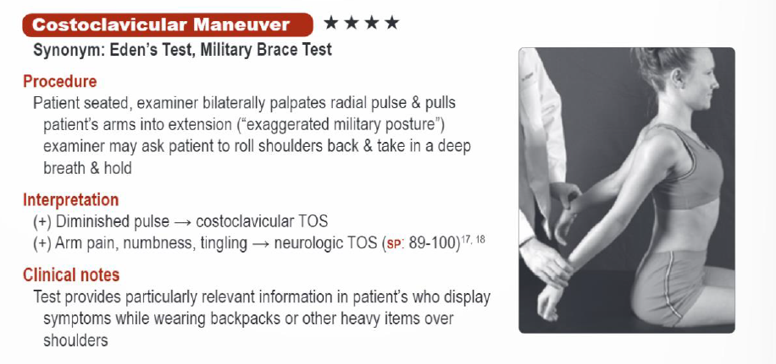
Costoclavicular: SOT

Slide 65
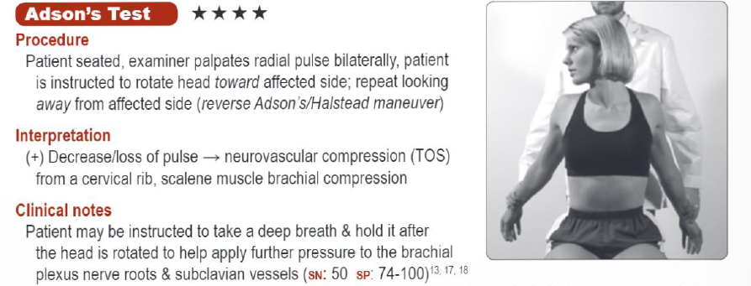
Anterior Scalene Syndrome: SOT

Slide 66
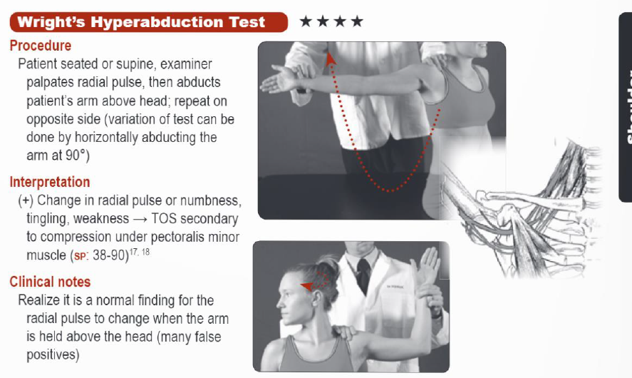
Pectoralis Minor Syndrome: SOT

Slide 67
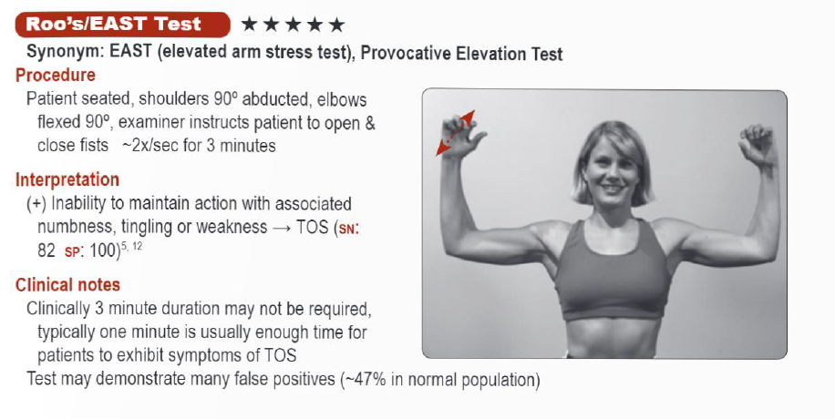
TOS

