Slide 1
Ulnar Nerve
Dr Manju Setia
RMT, BAMS

Slide 2
The ulnar nerve arises from the medial cord of the brachial plexus (C8–T1).
It is responsible for:
Fine motor control of the hand
Sensation to medial 1½ fingers
Highly vulnerable at:
Elbow (cubital tunnel)
Wrist (Guyon’s canal)

Slide 3
Anatomy Overview
Course of Ulnar Nerve
Origin: Medial cord (C8–T1)
Travels:
  Medial arm → posterior to medial epicondyle
  Through cubital tunnel
  Enters forearm → passes into hand via Guyon’s canal
Guyon’s canal: At the wrist, the ulnar nerve travels over the flexor retinaculum (carpal tunnel), between the pisiform, and the hook of the hamate bone and beneath the volar carpal ligament andthe palmaris brevis muscle.
This passage is also called Guyon's canal or the ulnar tunnel; it is another site for compression of the nerve.

Slide 4
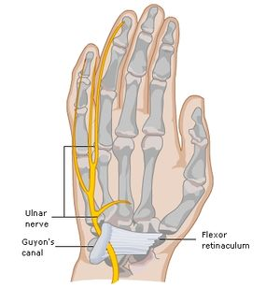
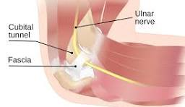
At Guyon’s Canal, the ulnar nerve divides into superficial and deep divisions.
The superficial branch is primarily sensory and the deep branch is primarily motor.

Slide 5
Muscles Innervated by the Ulnar Nerve
Motor supply:Forearm:
Flexor carpi ulnaris
flexor digitorum profundus (ulnar & medial half) innervation is shared with the median
nerve
Hypothenar muscles:
Abductor digiti minimi
Flexor digiti minimi
Opponens digiti minimi
Third and fourth lumbricals
palmar and dorsal interossei
Thenar Eminence:
Adductor pollicis
Flexor pollicis brevis (deep head); innervation is shared with the median nerve

Slide 6
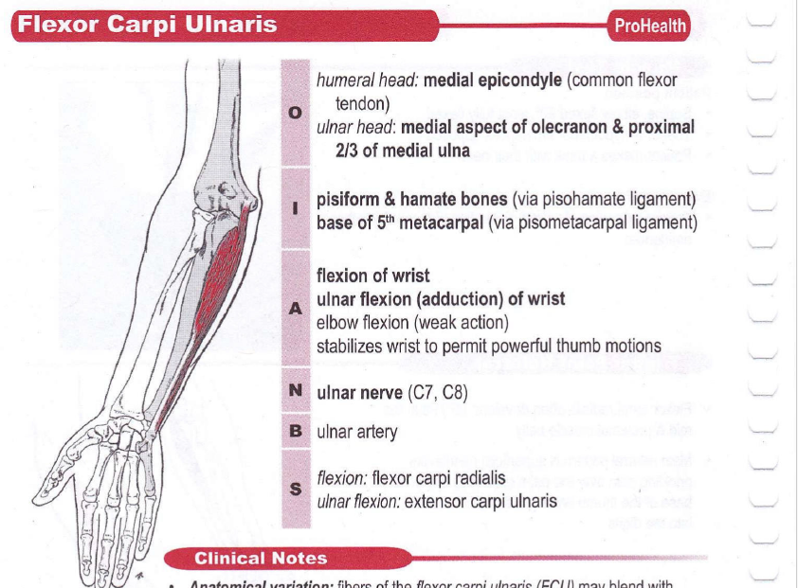

Slide 7
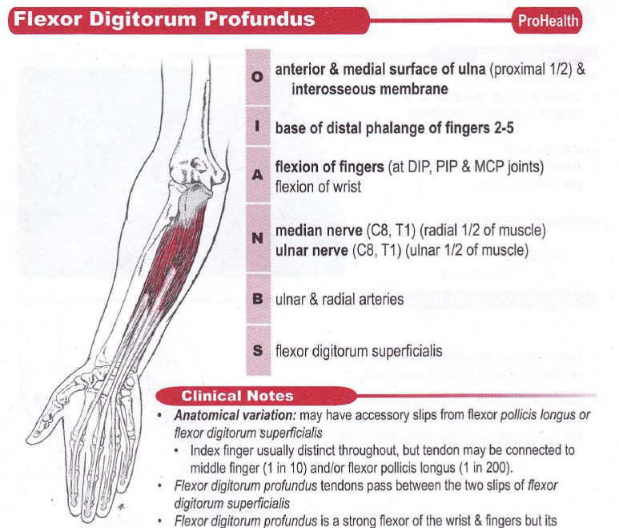

Slide 8
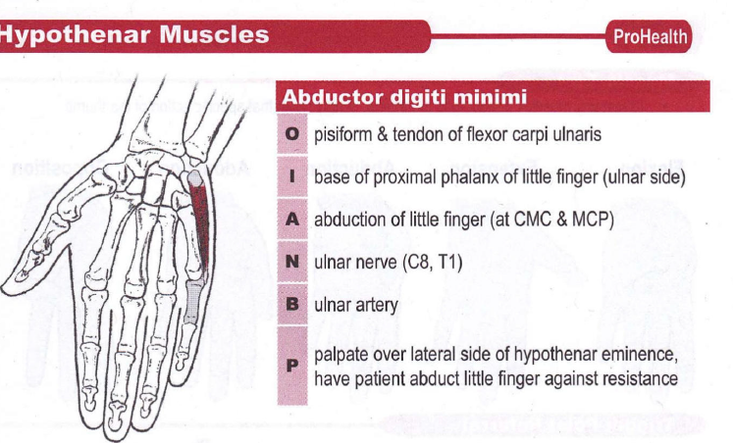

Slide 9
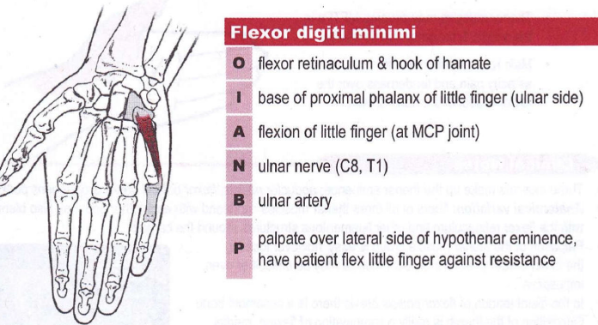

Slide 10
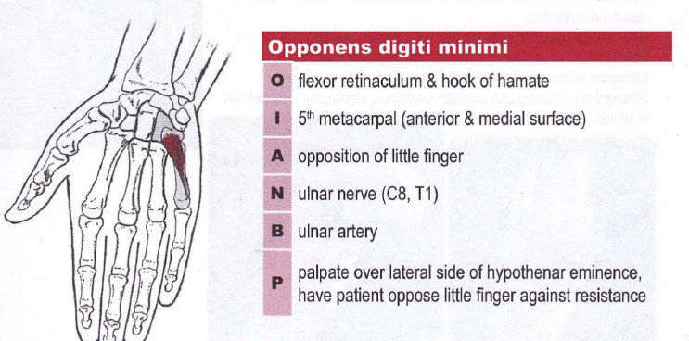

Slide 11
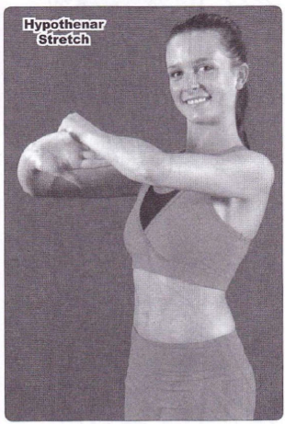
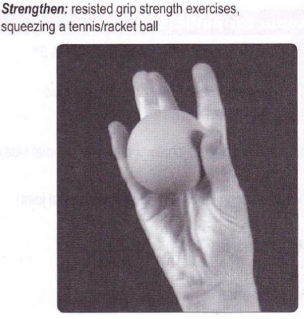

Slide 12
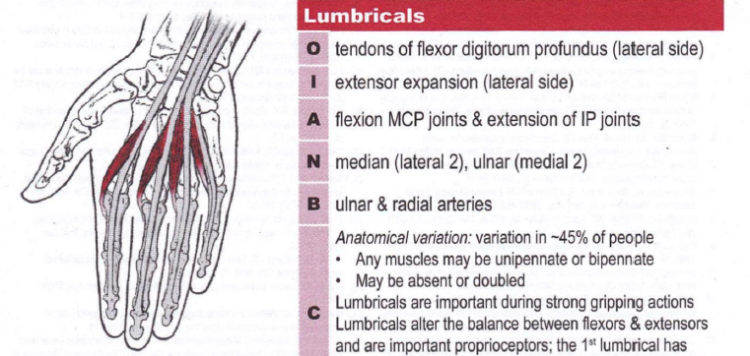

Slide 13
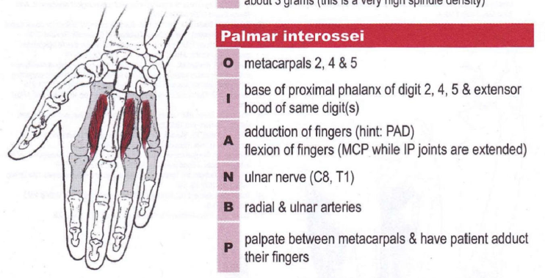

Slide 14
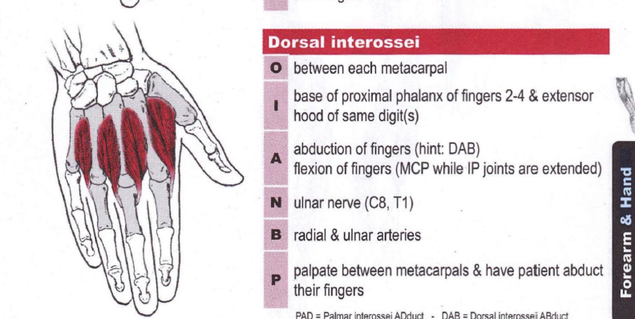

Slide 15
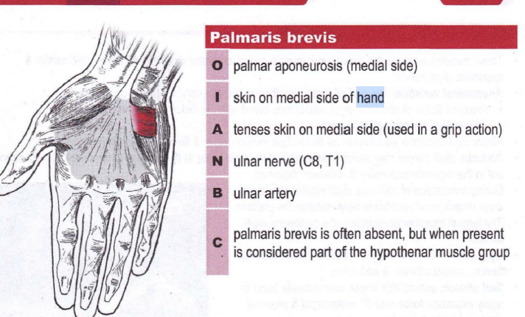

Slide 16
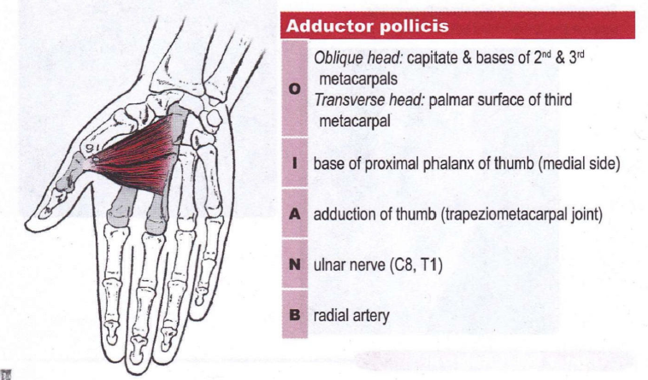

Slide 17
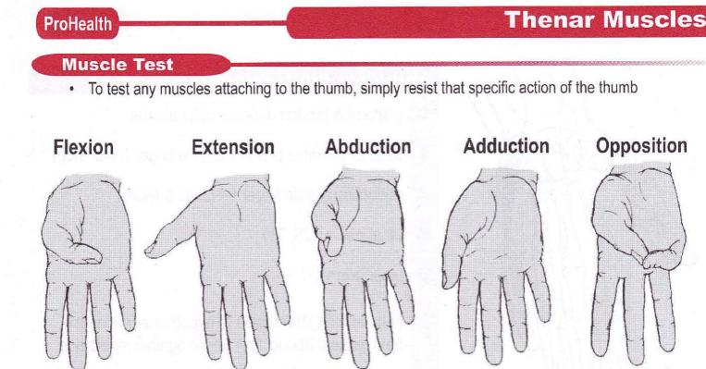

Slide 18
Sensory Supply
Medial 1½ fingers (little finger + half of ring finger)
Medial palm and dorsum

Slide 19
Common Sites of Lesion
1. Elbow (Cubital Tunnel Syndrome)
Causes:
  Prolonged elbow flexion
  Leaning on elbow
  Trauma or fracture
2. Wrist (Guyon’s Canal Syndrome)
Causes:
  Cyclists (“handlebar palsy”)
  Ganglion cyst
  Repetitive wrist pressure

Slide 20
Causes
Trauma (fracture of medial epicondyle)
dislocation of the elbow
Post-surgical complication such as unrelieved pressure from the arm hanging over
the edge of a table or the arm positioned improperly while under anesthesia
Direct trauma such as a contusion or laceration at the wrist or hand; this injury is often in combination with a median nerve lesion.
Chronic compression from resting the elbow on a hard surface, from wearing a
too-tight wrist band or handcuff or from bicycling
Repetitive strain :causing excessive stress such as pitching a ball or repeated flexion
and extension with machine work.
Arthritis
Space-occupying lesions (tumors, cysts)

Slide 21
Symptoms
Motor Deficits
Weak grip strength
Loss of finger abduction/adduction
Difficulty with fine motor skills
Sensory Deficits
Numbness/tingling:
  Little finger
  Medial half of ring finger
Muscle wasting is most remarkable at the hypothenar eminence
Altered sensation, anhidrosis (diminished or absent sweating) may occur.

Slide 22
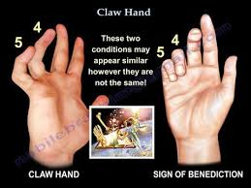
Characteristic Deformities
Claw Hand Deformity
Seen especially in distal lesion
Features:
  Hyperextension at MCP joints
  Flexion at IP joints (4th & 5th digits)
Reason:
Loss of interossei and lumbricals → imbalance between flexors and extensors

Slide 23
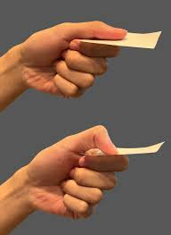
Clinical Signs
Froment's sign is positive with an ulnar nerve lesion. The client attempts to maintain a firm grip on an object held between the thumb and index finger.
This is impossible with:
loss of the adductor pollicis function. The flexor pollicis longus (innervated by the median nerve) is recruited in order to hold the object better. This results in flexion at the terminal phalanx

Slide 24
Differences Based on Lesion Level
High Lesion (Elbow)
Less clawing (ulnar paradox)
Loss of:
  FDP (ring & little finger)
  FCU
Low Lesion (Wrist)
More pronounced clawing
Forearm muscles spared
Ulnar Paradox:
Higher lesion → less visible deformity

Slide 25
Functional Limitations
Difficulty:
  Gripping objects
  Writing
  Opening jars
  Finger coordination tasks
Palpation Findings
Tenderness:
  Behind medial epicondyle
  Guyon’s canal (wrist)
Possible nerve thickening

Slide 26
Special Tests
Tinel’s Sign (Ulnar Nerve)
Tap over cubital tunnel
Positive → tingling in ulnar distribution
Elbow Flexion Test
Hold elbow in flexion
Reproduces symptoms

Slide 27
Management
Conservative Treatment
Activity modification
Splinting (especially at night)
Physiotherapy:
  Nerve gliding exercises
Ergonomic correction
Medical
Anti-inflammatory medications
Corticosteroid injections (select cases)
Surgical
Decompression
Ulnar nerve transposition

Slide 28
The ULTT (Upper Limb Tension Test) for the ulnar nerve—often called ULTT3 or the ulnar nerve bias test
Purpose
To evaluate neural tension of the ulnar nerve
Helps in conditions like:
  Cubital tunnel syndrome
  Ulnar nerve entrapment
  Cervical radiculopathy (C8–T1)

Slide 29
Patient Position
Supine (lying on back)
No pillow or minimal support under head
Arms relaxed initially

Slide 30
Test Procedure (Step-by-Step)
Scapular Depression
  Stabilize and depress the shoulder
Shoulder Abduction
  Abduct shoulder to ~90–110°
Shoulder External Rotation
  Fully externally rotate the shoulder
Forearm Pronation
  Pronate the forearm
Wrist & Finger Extension
  Extend wrist and fingers
Elbow Flexion
  Flex the elbow fully
Final Sensitizer
  Add contralateral cervical side flexion (away from tested side) to increase tension
  Ipsilateral side flexion reduces symptoms

Slide 31
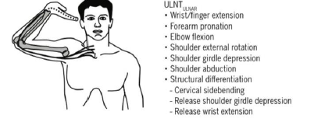

Slide 32
Positive Test
Reproduction of:
  Tingling, numbness, or pain along ulnar distribution:
    Medial forearm
    Little finger & half of ring finger
Symptoms change with neck side bending

Slide 33


