Slide 1
Thoracic Outlet Syndrome (TOS)
Dr Manju Setia Khowal
RMT, BAMS

Slide 2
Thoracic outlet syndrome (TOS) is a condition that involves the:
compression of the brachial plexus and its accompanying artery between the anterior and middle scalene muscles (anterior scalene syndrome)
or between the coracoid process and the pectoralis minor muscle (pectoralis minor syndrome)
or between the clavicle and the first rib (costoclavicular syndrome).

Slide 3
Structures Involved
Brachial plexus (C5–T1)
Subclavian artery & vein
Lymphatic vessels
Supplies entire upper limb
Types of TOS
Neurogenic (most common)
Vascular
Mixed

Slide 4
TOS:Causes
Causes :
internal (bony callus, cervical rib) or external compression (crutches);
prolonged poor positioning; poor posture, such as hyperkyphosis and scoliosis, muscle hypertonicity and trigger points;
systemic immune or metabolic disorders, such as rheumatoid arthritis, diabetes and hypothyroidism;
trauma with inflammation and subsequent scarring as with, for example, whiplash;
joint subluxation of the cervical spine;
pregnancy, which causes a combination of increased fluid retention and posturalchanges.

Slide 5
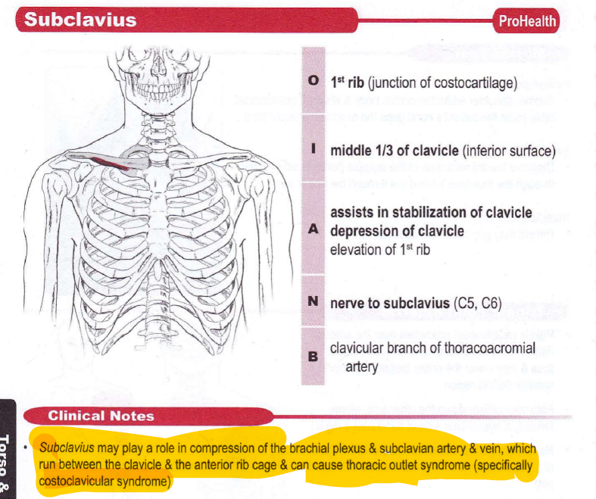

Slide 6
Costoclavicular Syndrome
Costoclavicular Syndrome is a specific type of Thoracic Outlet Syndrome (TOS) where compression happens in the costoclavicular space.
What is Costoclavicular Syndrome?
Compression of:
  Brachial plexus
  Subclavian artery & vein
Occurs between the clavicle and first rib
This space narrows when shoulders are pulled down/back or with poor posture.

Slide 7
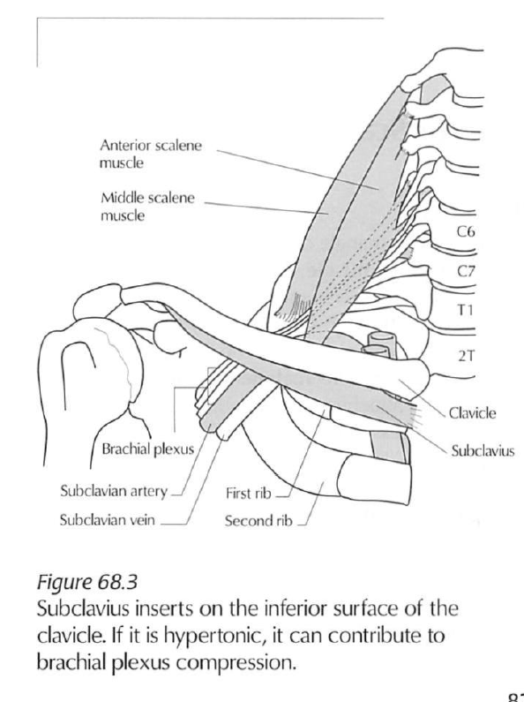

Slide 8
Causes: Costoclavicular Syndrome
Drooping shoulders (common in tall/thin individuals)
Carrying heavy backpacks or bags
Poor posture (military posture or slouching)
Clavicle fracture or deformity
Tight subclavius
Pathophysiology
Narrowing of costoclavicular space → compression of neurovascular bundle
Leads to:
  Nerve ischemia → paresthesia
  Vascular compromise → circulation issues

Slide 9
Symptoms:
Neurological
Numbness & tingling in arm/hand
Weak grip
Pain in shoulder, arm, forearm
Vascular
Cold hand
Pallor or cyanosis (Cyanosis is a clinical sign where the skin, lips, or nails turn bluish due to low oxygen levels in the blood)
Swelling (especially hand)

Slide 10
Aggravating Positions
Carrying weight (bags, groceries)
Shoulder retraction (military posture)
Prolonged downward pull on shoulders

Slide 11
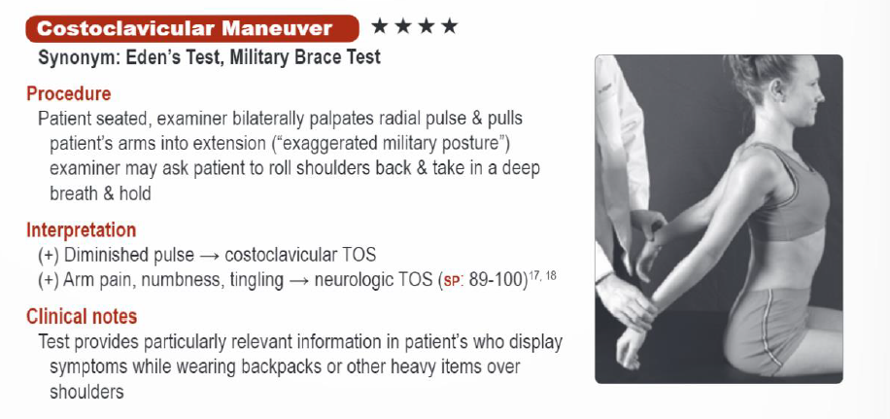
Costoclavicular: SOT

Slide 12
Cervical Rib in Thoracic Outlet Syndrome (TOS)
What is a Cervical Rib?
An extra rib arising from C7 vertebra
Congenital (present since birth)
Can be:
  Fully formed rib
  Fibrous band (incomplete rib)
Not everyone with a cervical rib has symptoms—but it can predispose to TOS
How it Causes TOS
The cervical rib reduces space in the thoracic outlet
Compresses:
  Brachial plexus → neurogenic symptoms
  Subclavian artery → vascular symptoms
Compression usually occurs in the interscalene triangle

Slide 13
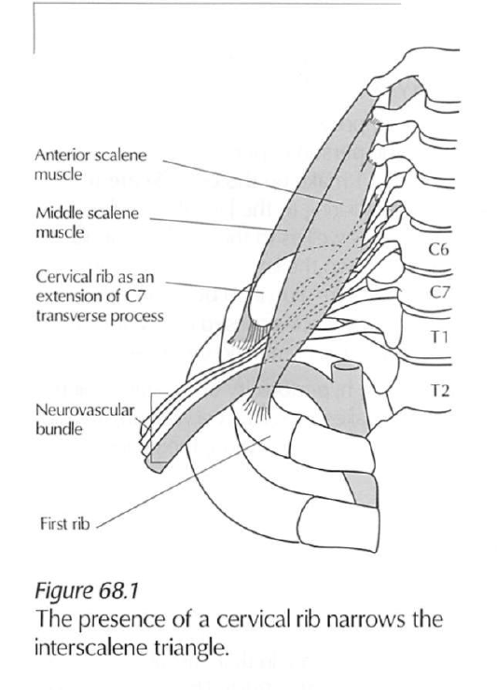
Such ribs are identified by X-ray andthrough palpation, at the level of the clavicle, as a bulge in the space between the anterior and middle scalenes.

Slide 14
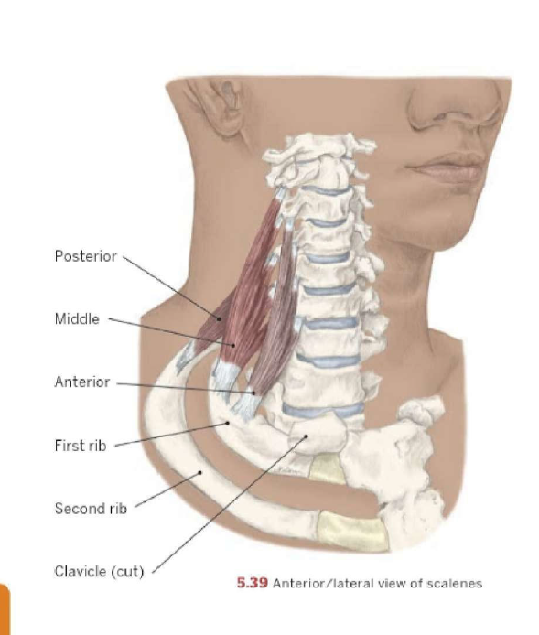
scalenes

Slide 15
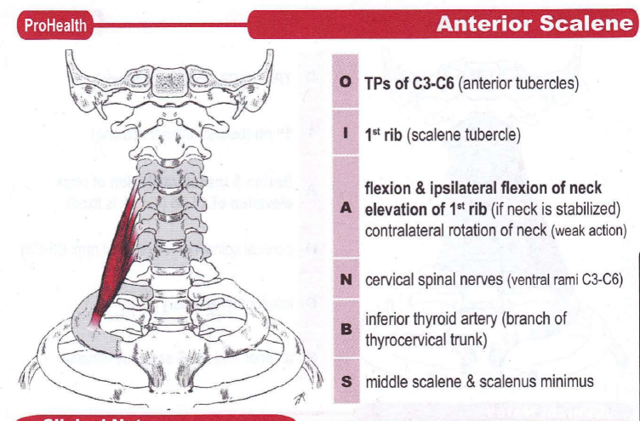

Slide 16
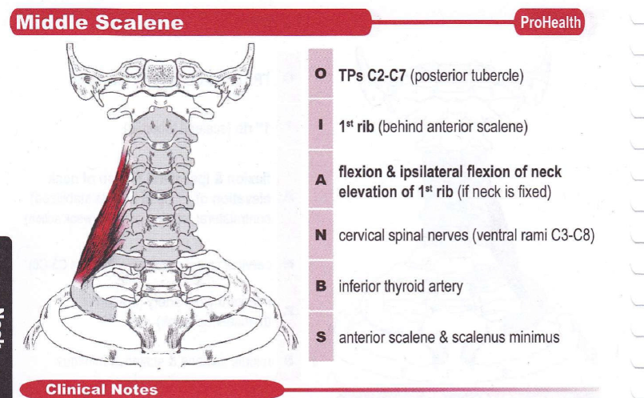

Slide 17
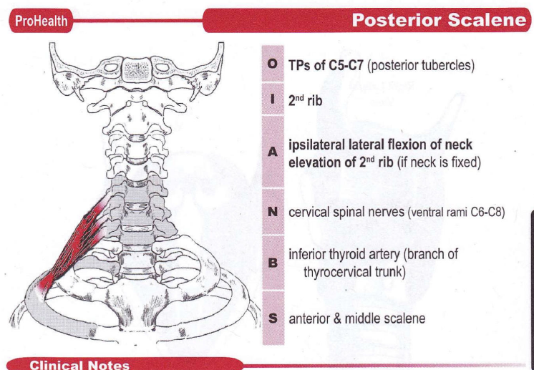

Slide 18
Anterior Scalene Syndrome
A common subtype of Thoracic Outlet Syndrome (TOS) where compression occurs in the interscalene triangle.
What is it?
Compression of:
  Brachial plexus (especially C8–T1)
  Subclavian artery
Caused by tight or hypertrophied anterior scalene muscle

Slide 19
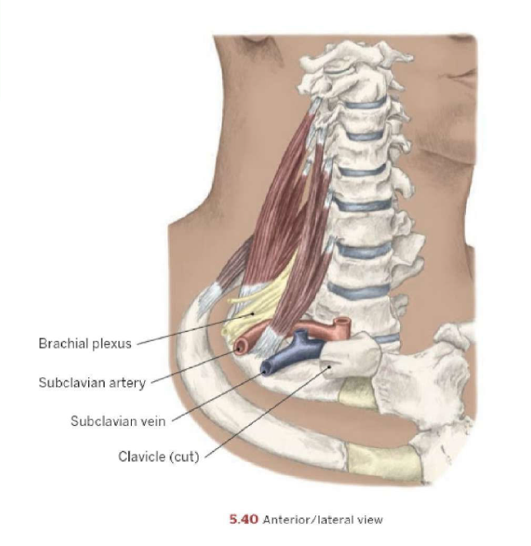

Slide 20
Interscalene Triangle (Important Anatomy)
Boundaries:
Anterior → Anterior scalene
Posterior → Middle scalene
Inferior → First rib
Structures passing through:
Brachial plexus
Subclavian artery
Subclavian vein does NOT pass here

Slide 21
Causes
Scalene muscle tightness or spasm
Poor posture (forward head)
Whiplash injury
Repetitive neck strain
Accessory breathing (overuse of scalenes)
Pathophysiology
Tight anterior scalene → narrows interscalene space
Leads to:
  Nerve compression → neurological symptoms
  Arterial compression → vascular symptoms

Slide 22
Symptoms
Neurological (most common)
Numbness & tingling
Pain radiating from neck → arm → hand
Weak grip
Ulnar distribution symptoms (ring & little finger)
Vascular (less common)
Coldness
Pallor or cyanosis
Reduced pulse

Slide 23
Aggravating Factors
Neck rotation (especially toward affected side)
Deep breathing
Overhead activities
Carrying weight
ROM Findings
Pain with:
  Neck rotation
  Lateral flexion

Slide 24
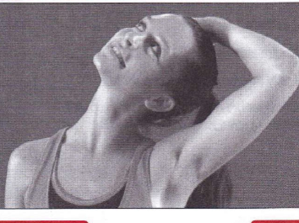
Anterior Scalene Stretch

Slide 25
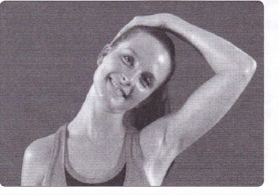
Middle scalene stretch

Slide 26
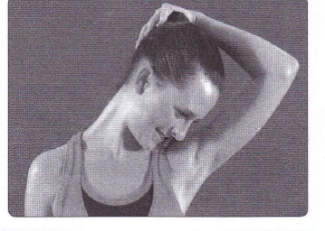
Posterior Scalene Stretch

Slide 27
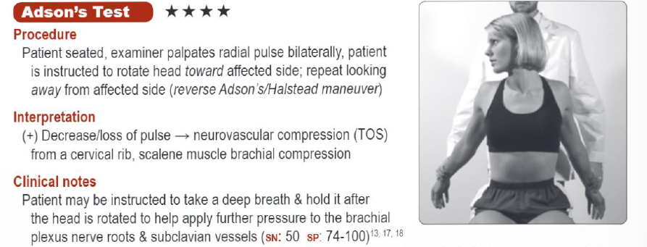
Anterior Scalene Syndrome: SOT

Slide 28
Stretching (Very Important)
Scalene stretch:
  Side bend away
  Slight extension
  Gentle rotation
Postural Correction
Correct forward head posture
Improve breathing pattern (diaphragmatic breathing)
Avoid accessory muscle overuse

Slide 29
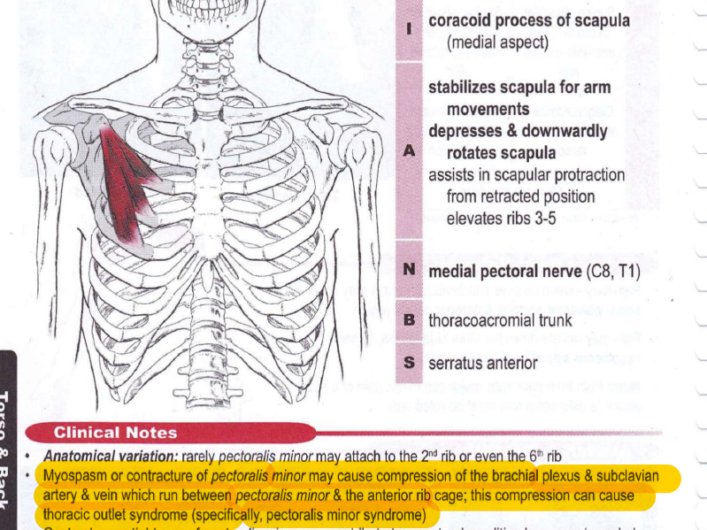

Slide 30
Pectoralis Minor Syndrome
A subtype of Thoracic Outlet Syndrome (TOS) where compression occurs below the coracoid process, in the subpectoral space.
What is it?
Compression of:
  Brachial plexus
  Axillary artery & vein
Caused by tight/shortened pectoralis minor muscle
Anatomy
Pectoralis minor attaches:
  From ribs 3–5
  To coracoid process of scapula
Compression occurs under this muscle when it is tight

Slide 31
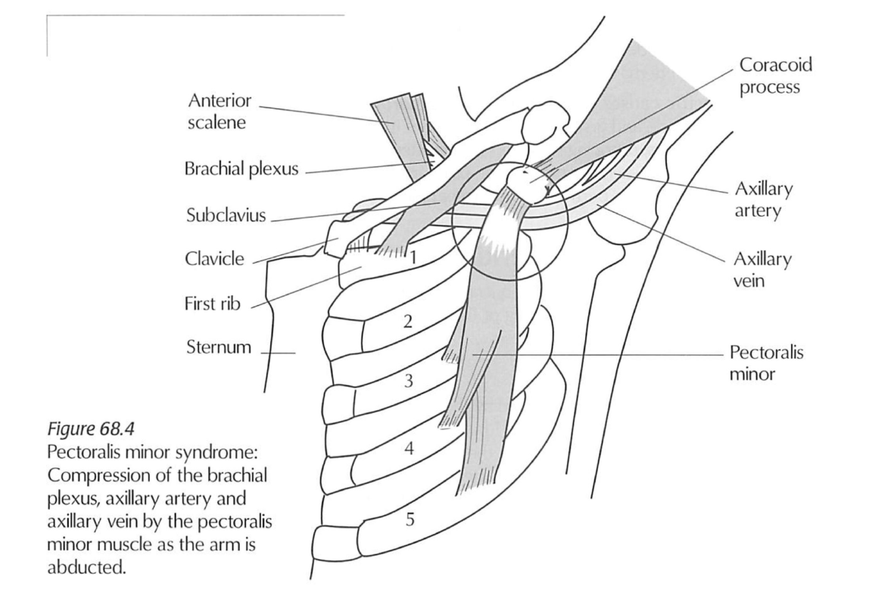

Slide 32
Pectoralis Minor Syndrome
Causes
Rounded shoulder posture
Prolonged desk work
Repetitive overhead activity
Sports (swimming, throwing)
Emotional stress → chest tightness

Slide 33
Pathophysiology
Tight pec minor → pulls scapula anterior & inferior
Narrows subpectoral space → compresses neurovascular bundle
Symptoms:
Neurological
Numbness & tingling in arm/hand
Pain in anterior shoulder & chest
Weakness in arm
Vascular
Coldness
Swelling in hand
Possible cyanosis

Slide 34
Aggravating Factors
Overhead arm position
Prolonged forward shoulder posture
Sleeping with arms overhead
Assessment
Postural Findings
Rounded shoulders
Protracted scapula
Increased thoracic kyphosis

Slide 35
Palpation
Tight, tender pectoralis minor
Trigger points referring to chest/arm
ROM Findings
Restricted shoulder abduction
Pain with overhead movement

Slide 36
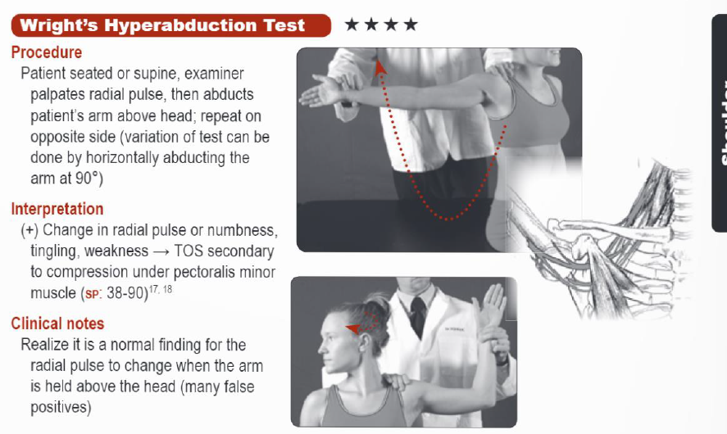
Pectoralis Minor Syndrome: SOT

Slide 37
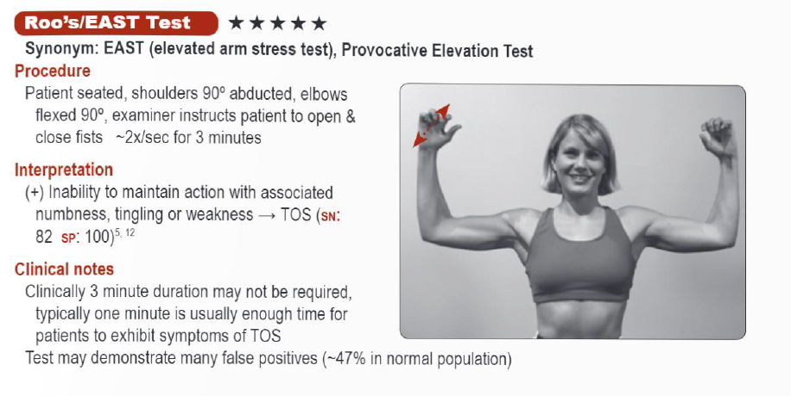
TOS

Slide 38
Subjective Assessment
Ask about:
Numbness / tingling (“hand asleep”)
Pain location & intensity
Aggravating / relieving factors
Posture (sleeping, work)
History of trauma

Slide 39
Postural Assessment
Look for:
Forward head posture
Drooping shoulders
Hyperkyphosis
Scoliosis
Observation
Weak grip
Muscle wasting
Edema or color changes

Slide 40
Palpation
Trigger points
  Scalenes
  pec minor
  subclavius
Fascial restriction (neck & chest)
Cool Hand
ROM Findings:
Reduced neck & shoulder ROM
Pain with
  Rotation
  Lateral Flexion

Slide 41
Differential Diagnosis
Carpal tunnel
Cervical radiculopathy
Raynaud’s

Slide 42
Treatment Principles
Relieve compression
Treat cause, not symptoms
Focus on:
  Soft tissue
  Posture

Slide 43
Treatment Goals
Decrease compression
Reduce muscle hypertonicity
Improve circulation
Decrease edema
Improve posture

Slide 44
General Approach
Treat neck & shoulder girdle
Address:
  Primary muscles
  Compensatory patterns

Slide 45
Key Muscles
Scalenes
Pectoralis minor
Subclavius
Trapezius
Latissimus dorsi
Serratus anterior

Slide 46
Techniques
Effleurage
Trigger point therapy
Fascial work
Muscle stripping
Joint mobilization

Slide 47
Specific Techniques
Scalene stripping
Pec minor release
Subclavius release

Slide 48
Positioning
Supine/prone
Towel support
Arm elevation

Slide 49
Hydrotherapy
Heat for relaxation
Cold for swelling
Contrast baths→ circulation improvement

Slide 50
Precautions
Avoid aggressive techniques with:
  Cervical rib
  RA
  Degenerative disc disease
Modify pressure in fragile tissue

Slide 51
Self Care
Posture correction
Stretching
Strengthening

Slide 52
ULTT 1
ULTT 1 (Upper Limb Tension Test 1) is a neurodynamic test mainly used to assess the median nerve and its pathway
Purpose
Evaluate neural tension / mobility
Identify nerve irritation or compression
Commonly used in:
  Cervical radiculopathy
  Carpal Tunnel Syndrome
  Thoracic outlet issues

Slide 53
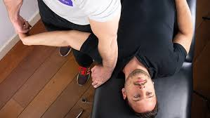
Patient Position
Supine (lying on back)
No pillow (cervical spine neutral)
Steps
Scapular depression (stabilize shoulder)
Shoulder abduction (~90–110°)
Forearm supination
Wrist & finger extension
Shoulder external rotation
Elbow extension
Cervical side flexion (away/toward for sensitization)

Slide 54
Positive Test
Reproduction of symptoms:
  Pain
  Tingling
  Numbness along median nerve distribution
Symptoms change with neck side bending
  ↑ symptoms → neural involvement likely

Slide 55
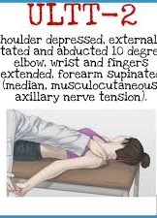
ULTT 2
Purpose: To assess the median nerve, Axillary nerve, Musculocutaneous nerve as the source of the client's painful shoulder or arm
Performing the Test:
Test Position: The client is in a supine position
- Depress the client's shoulder and abduct the humerus to 10 degrees. - Slowly extend the wrist and fingers.
- Fully supinate the forearm and extend the elbow. Tissue tightness in the shoulder or elbow, or tingling in the fingers is a normal response.
Result:
- A positive test is reproduction of the client's symptoms.

Slide 56
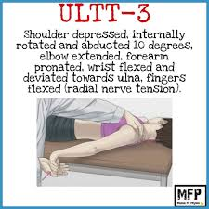
ULTT 3
Test Sequence:
Scapular depression
Shoulder abduction (10–30°)
Elbow extension
Medial (internal) rotation of shoulder
Forearm pronation
Wrist flexion + ulnar deviation
Finger flexion

Slide 57
Add contralateral cervical side bending
↑ symptoms → neural involvement
Ipsilateral side bending → ↓ symptoms
Positive Test
Reproduction of:
  Pain/tingling along:
    Lateral arm
    Posterior forearm
    Dorsum of hand
Difference compared to opposite side

Slide 58
ULTT 4
The ULTT (Upper Limb Tension Test) for the ulnar nerve—often called ULTT 4 or the ulnar nerve bias test
Purpose
To evaluate neural tension of the ulnar nerve
Helps in conditions like:
  Cubital tunnel syndrome
  Ulnar nerve entrapment
  Cervical radiculopathy (C8–T1)

Slide 59
Patient Position
Supine (lying on back)
No pillow or minimal support under head
Arms relaxed initially

Slide 60
Test Procedure (Step-by-Step)
Scapular Depression
  Stabilize and depress the shoulder
Shoulder Abduction
  Abduct shoulder to ~90–110°
Shoulder External Rotation
  Fully externally rotate the shoulder
Forearm Pronation
  Pronate the forearm
Wrist & Finger Extension
  Extend wrist and fingers
Elbow Flexion
  Flex the elbow fully
Final Sensitizer
  Add contralateral cervical side flexion (away from tested side) to increase tension
  Ipsilateral side flexion reduces symptoms

Slide 61
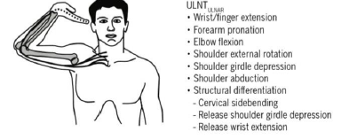

Slide 62
Positive Test
Reproduction of:
  Tingling, numbness, or pain along ulnar distribution:
    Medial forearm
    Little finger & half of ring finger
Symptoms change with neck side bending

Slide 63
