Slide 1
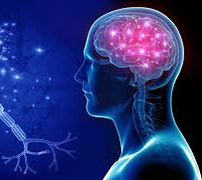
Neurology II
Headaches

Slide 2
Pathophysiology of Headache &
Facial Pain
Headache is caused by traction, displacement, inflammation, or distention of the pain-sensitive structures in the head or neck.
A. Pain-Sensitive Structures Within the Cranial Vault
B. Extracranial Pain-Sensitive Structures
Radiation or Projection of Pain
trigeminal (V) nerve
glossopharyngeal (IX) and vagus (X) nerves
upper cervical (C2-C3) nerves

Slide 3
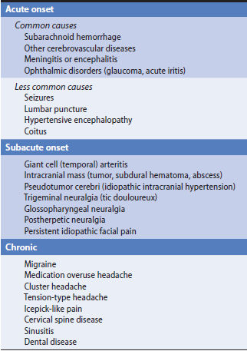
Causes of Headache and Facial Pain.

Slide 4
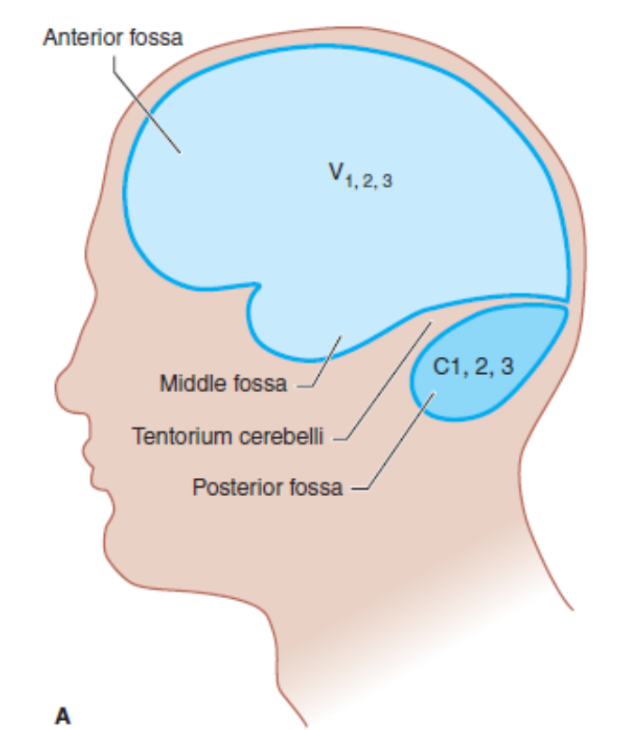
Innervation of pain-sensitive intracranial compartments (A) and corresponding extracranial sites of pain radiation

Slide 5
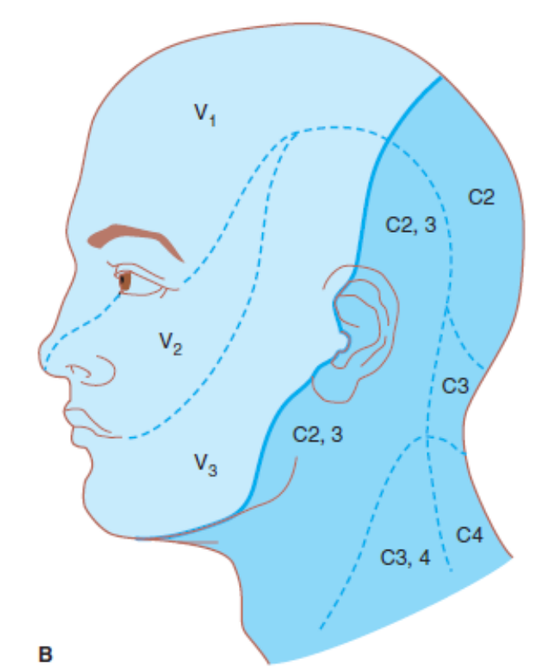
(B). The trigeminal (V) nerve, especially its ophthalmic (V1) division, innervates the anterior and middle cranial fossae; lesions in these areas can produce frontal headache. The upper cervical nerve roots (especially C2) innervate the posterior fossa; lesions here can cause occipital headache.

Slide 6
History
Acute Headache & Facial Pain
Subacute Headache & Facial Pain
Chronic Headache & Facial Pain
Precipitating Factors
Prodromal Symptoms (Auras )
Characteristics of Pain

Slide 7
Location of Pain
Unilateral, Ocular, Paranasal, Local, Bandlike, Trigeminal (V1), (V2), (V3), Pharynx, Ext meatus
Associated Symptoms
Weight loss, fever, dyspnea, visual findings, nausea, photophobia, myalgia, TIA, rhinorrhea
Other Features of Headache
Temporal pattern of headache, relieving, exacerbating conditions

Slide 8
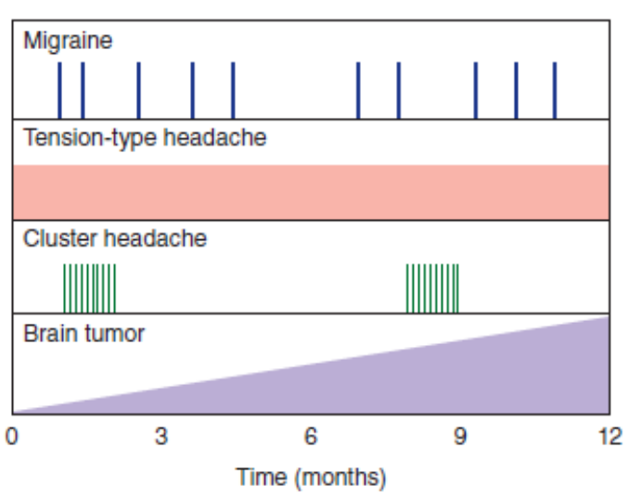
Temporal patterns of headache. Migraine headache is episodic and may occur at varying intervals. Tension-type headache may be present every day. Cluster headache occurs in bouts separated by symptom-free periods. Headache caused by brain tumor often increases in severity with time.

Slide 9
Physical Examination
Vital signs
General physical examination: weight, skin, face & head, neck, heart & lungs
Neurologic examination: mental status, cranial nerves, motor, sensory,

Slide 10
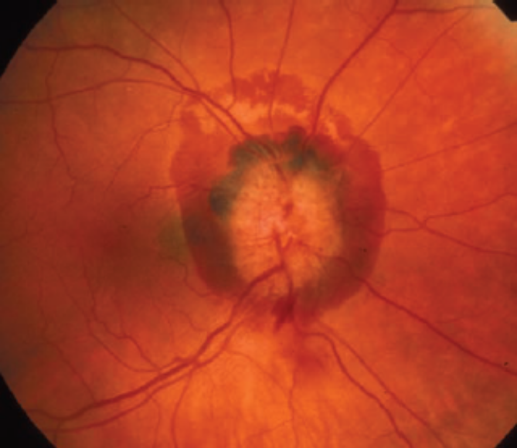
Disc edema and a large peripapillary subhyaloid hemorrhage in the right eye of a patient with aneurysmal rupture and subarachnoid hemorrhage.

Slide 11
Acute Headache
Subarachnoid Hemorrhage
Pathology
Pathophysiology
Clinical findings
Differential diagnosis
Complication
Treatment
Prognosis

Slide 12
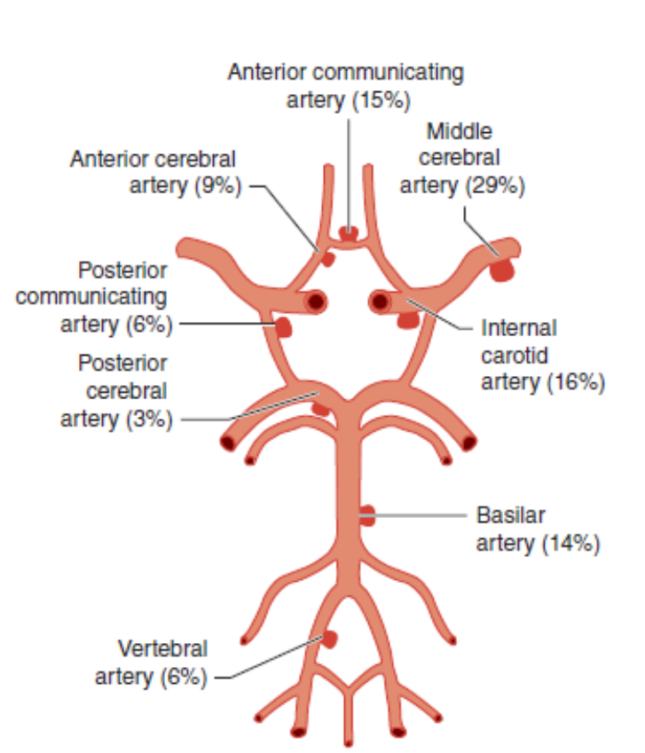
Frequency distribution of intracranial aneurysms.

Slide 13
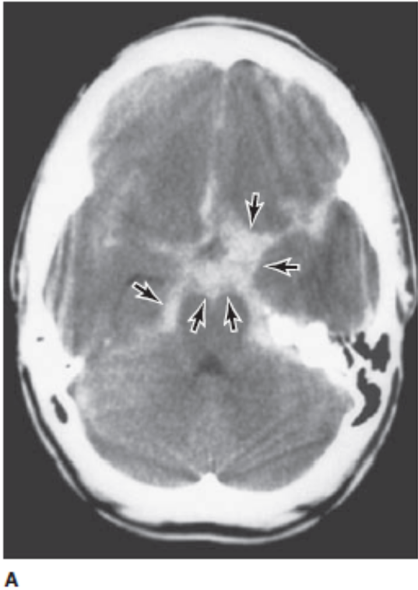
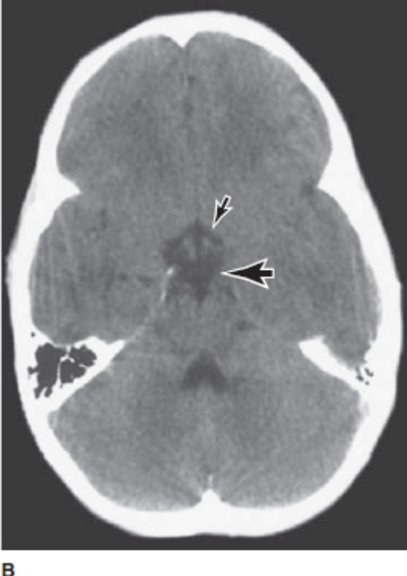
(A) Nonenhanced brain CT scan from a patient with an acute aneurysmal subarachnoid hemorrhage. Areas of high density (arrows) represent blood in the subarachnoid space at the base of the brain (most aneurysms occur in this region about the circle of Willis. (B) A normal nonenhanced brain CT scan of the same region. Interpeduncular cistern, large arrow; suprasellar cistern, small arrow.

Slide 14
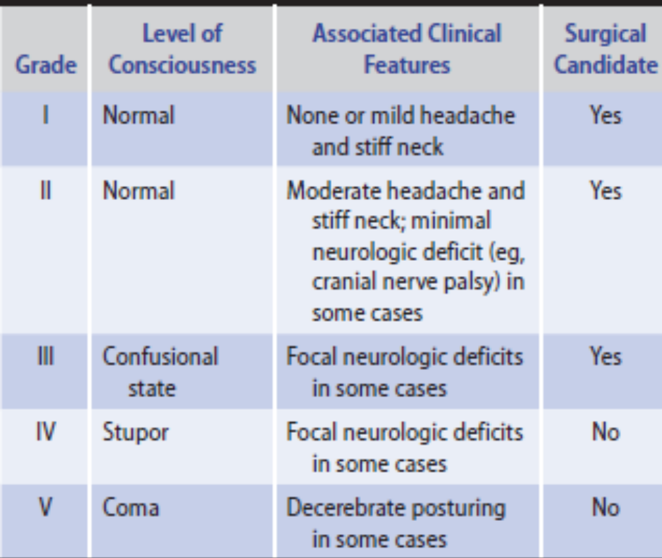
Clinical Grading of Patients With Aneurysmal Subarachnoid Hemorrhage.

Slide 15
Other Cerebrovascular Disorders
Intracerebral Hemorrhage
Cerebral Ischemia
Headache occurs at onset of stroke or TIA in one-third of patients and may persist for hours to several days.
Headaches associated with ischemic stroke are typically mild to moderate in intensity, and non throbbing in character.
Headache associated with cerebral infarction may require analgesics for symptomatic relief.

Slide 16
Meningitis or Encephalitis
Headache is a prominent feature of inflammation of the brain (encephalitis) or its meningeal coverings (meningitis) caused by bacterial, viral, or other infections.
The headache is commonly throbbing in character, bilateral, and occipital or nuchal in location.
Mental status abnormalities accompany most cases of bacterial but few cases of aseptic meningitis.
The diagnosis of bacterial meningitis is suggested by a CSF examination.

Slide 17
Brain Abscess
Headache is the most frequent presentation but the classic triad of headache with fever and focal neurologic signs occurs in less than 20%.
MRI and CT scanning differentiate abscess from primary or metastatic cancers.

Slide 18
Other Causes of Acute Headache
Seizures
Lumbar Puncture
Hypertensive Encephalopathy
Coitus
Ophthalmic Disorders

Slide 19
Subacute Headache
Giant cell arteritis
Intracranial mass
Idiopathic intracranial hypertension

Slide 20
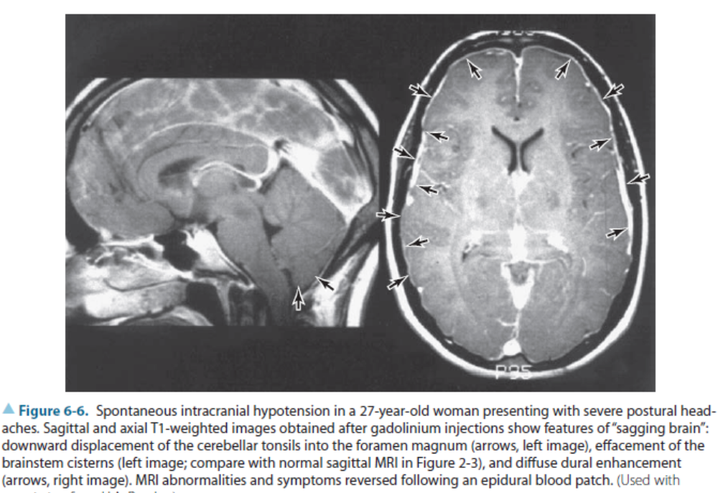

Slide 21
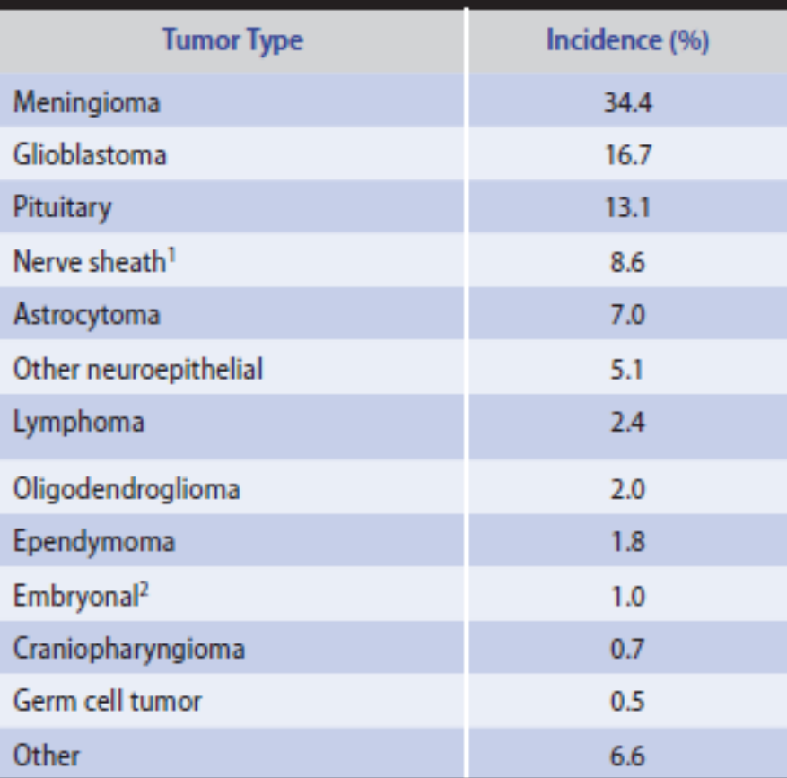

Slide 22
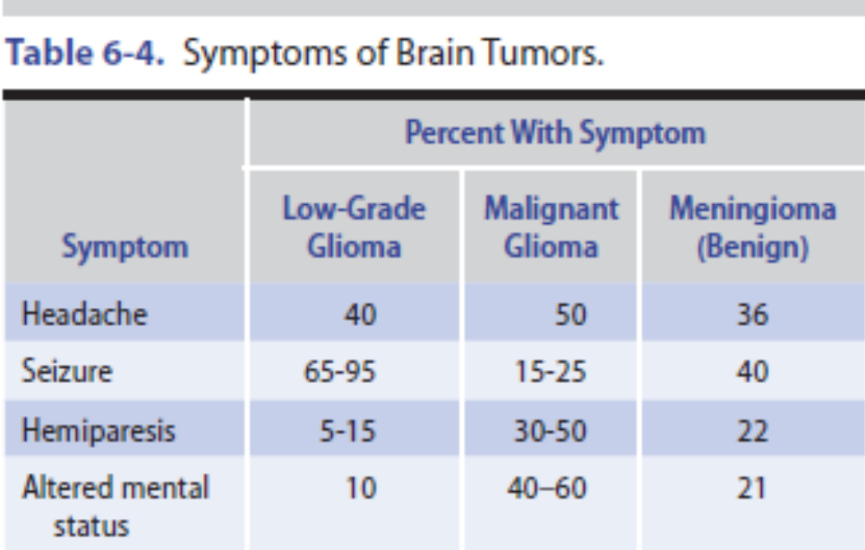

Slide 23
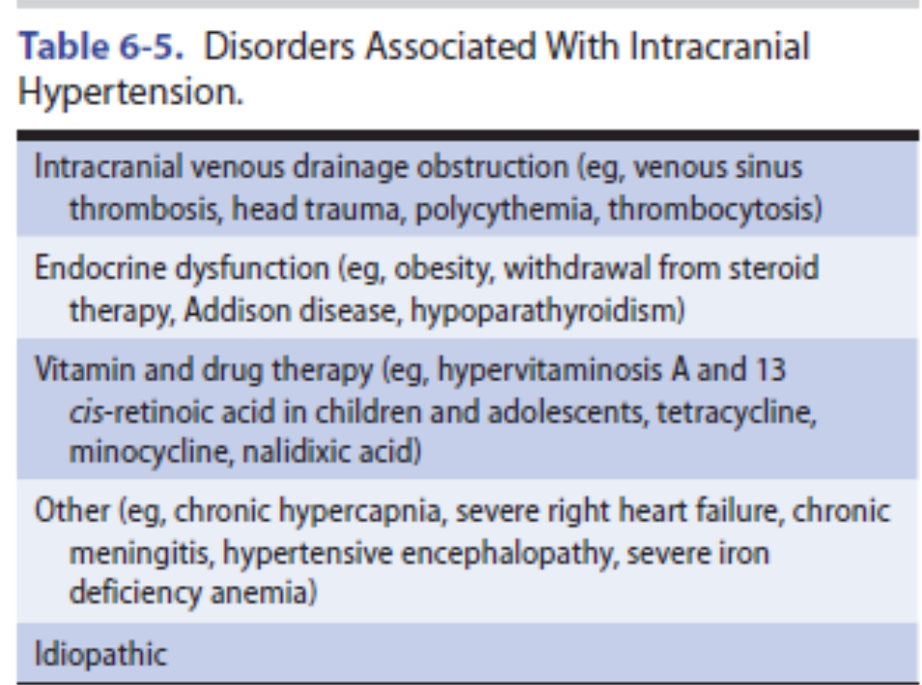

Slide 24
Trigeminal Neuralgia
Trigeminal neuralgia (tic douloureux) is a facial pain syndrome that develops in middle to late life and is more common in women than men. In many instances, the trigeminal (V) nerve roots are close to a vascular structure, and microvascular compression followed by demyelination of the nerve is believed to cause the disorder.

Slide 25
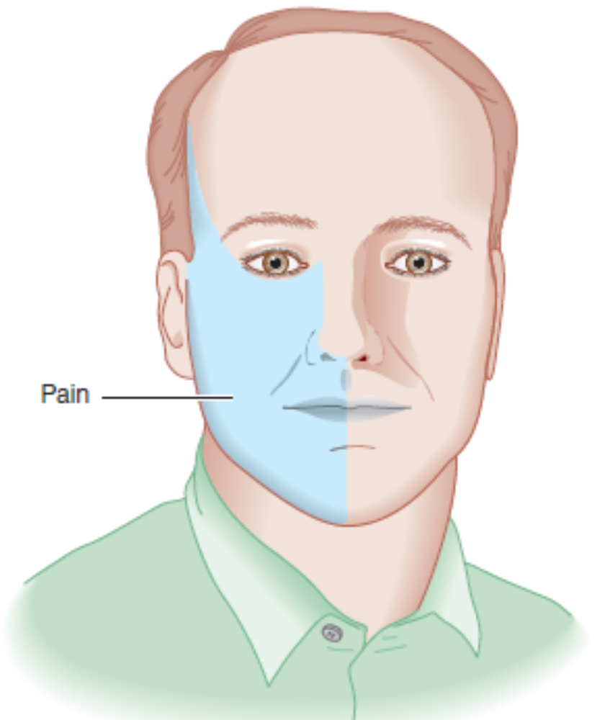
Distribution of symptoms in trigeminal neuralgia.

Slide 26
Postherpetic Neuralgia
Reactivation of varicella-zoster virus in the trigeminal, or ganglion causes herpes zoster (shingles), a vesicular skin eruption in the distribution of the trigeminal (V) nerve accompanied by pain and tenderness.

Slide 27
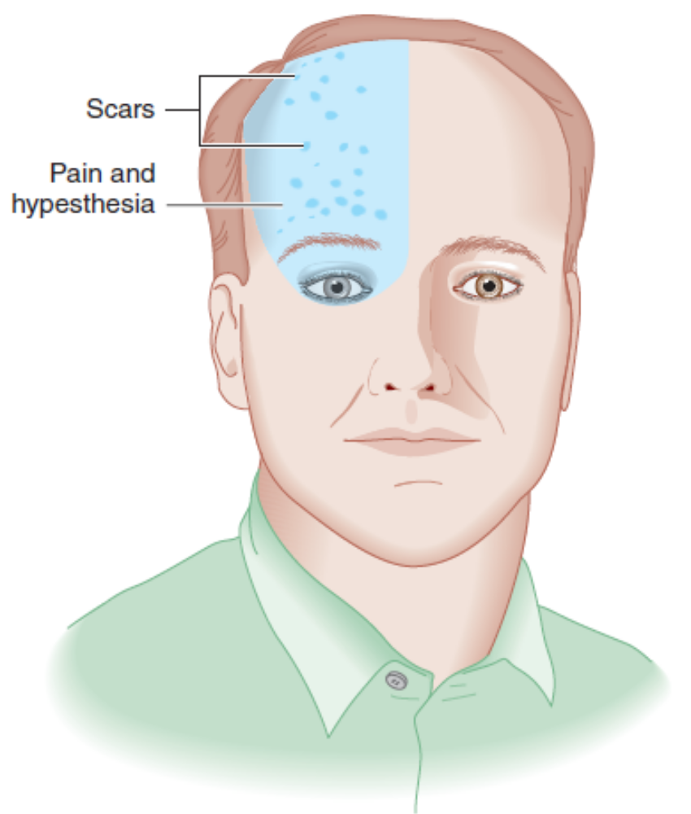
Distribution of symptoms and signs in postherpetic neuralgia.

Slide 28
Chronic Headache
Migraine
Genetics
Structural features
Pathogenesis
Clinical findings
Classic migraine
Common migraine
Chronic migraine and medication overuse

Slide 29
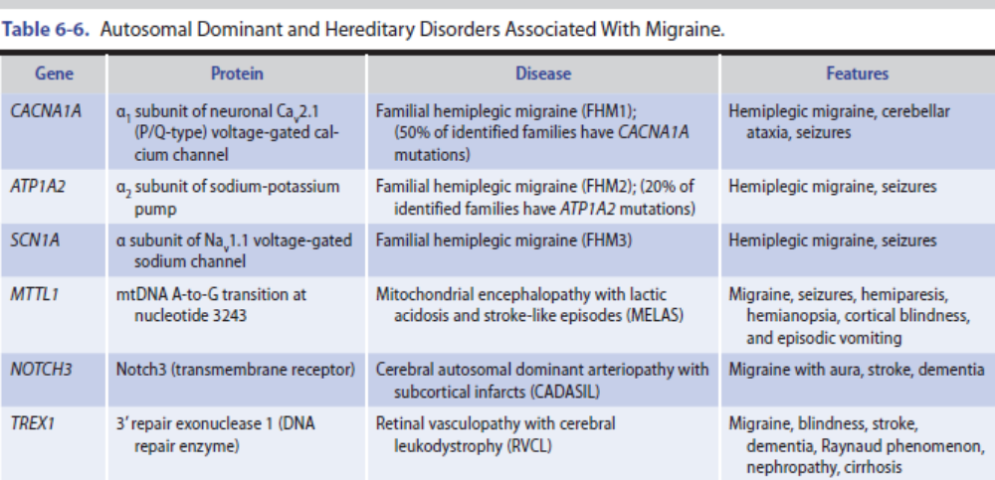

Slide 30
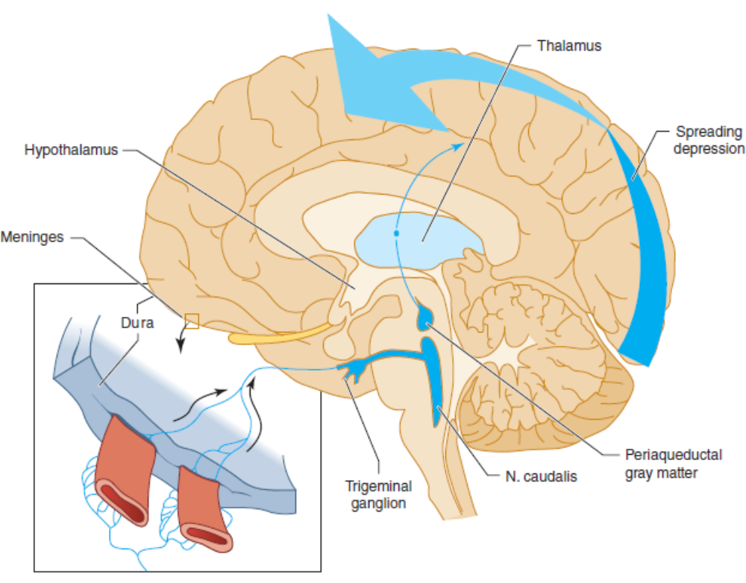

Slide 31
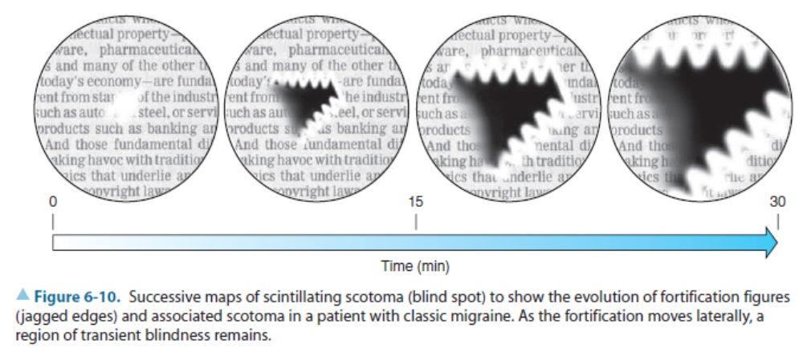

Slide 32
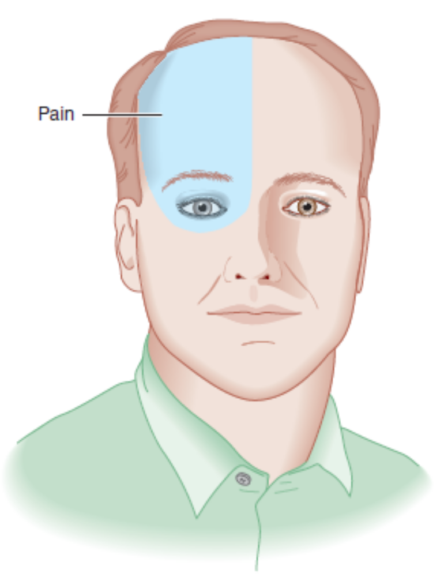

Slide 33
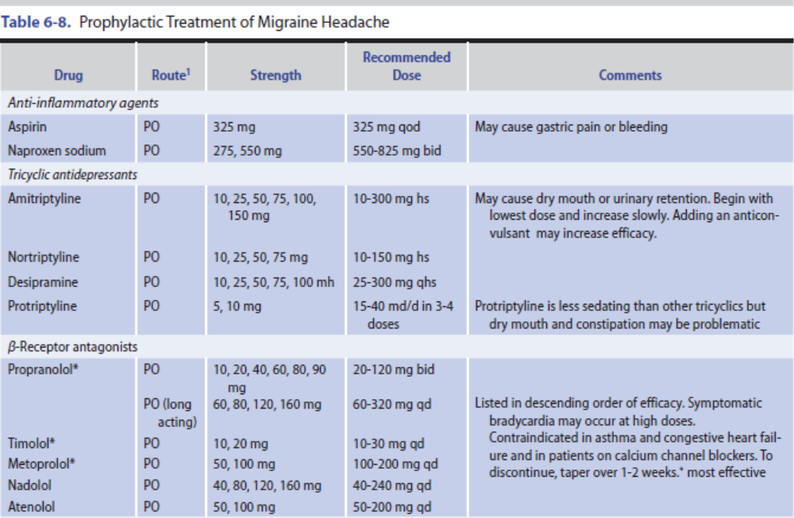

Slide 34
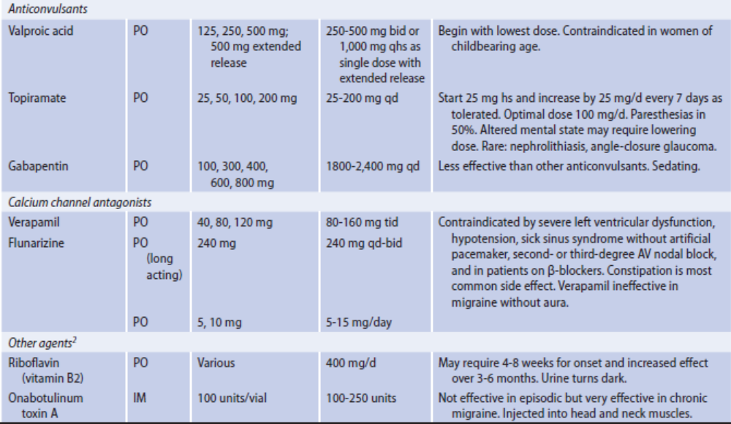

Slide 35
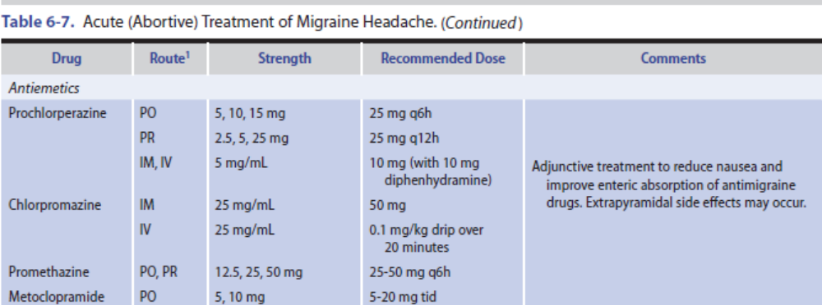

Slide 36
Migraine
Precipitating factors
Treatment

Slide 37
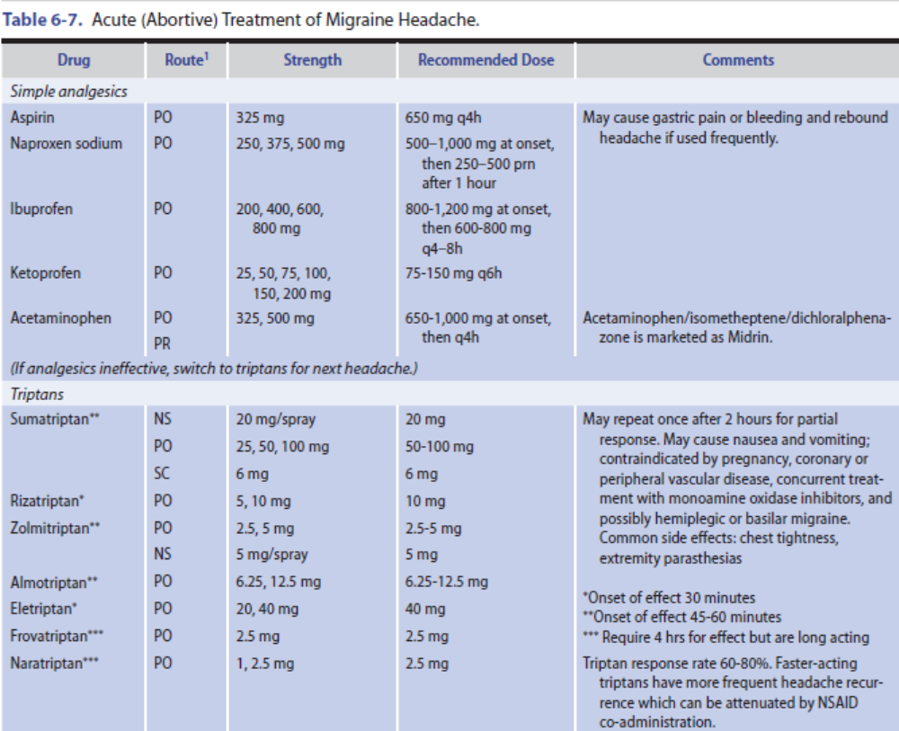

Slide 38
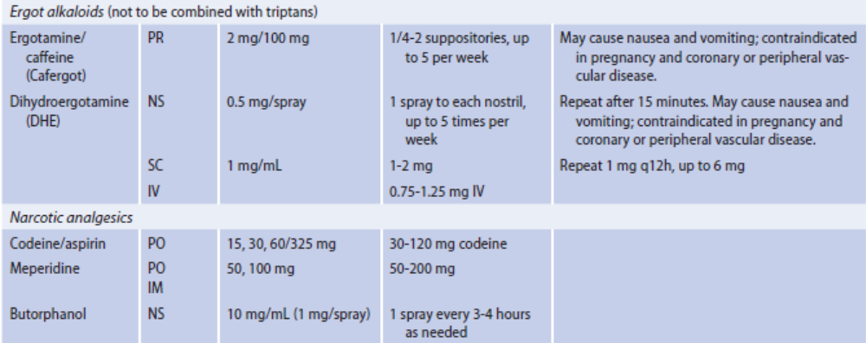

Slide 39
Cluster Headache
Cluster headache presents as clusters of brief, very severe, unilateral, constant, nonthrobbing headaches that last from 15 minutes to 3 hours.
Clinical findings
Treatment

Slide 40
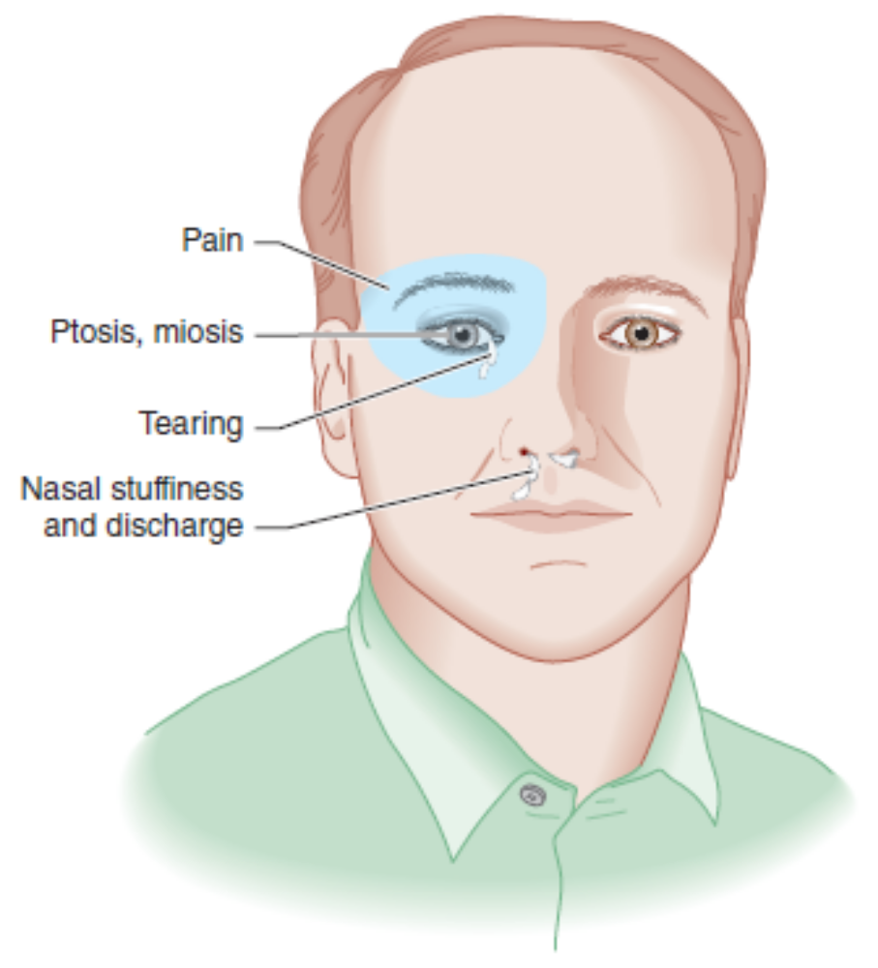

Slide 41
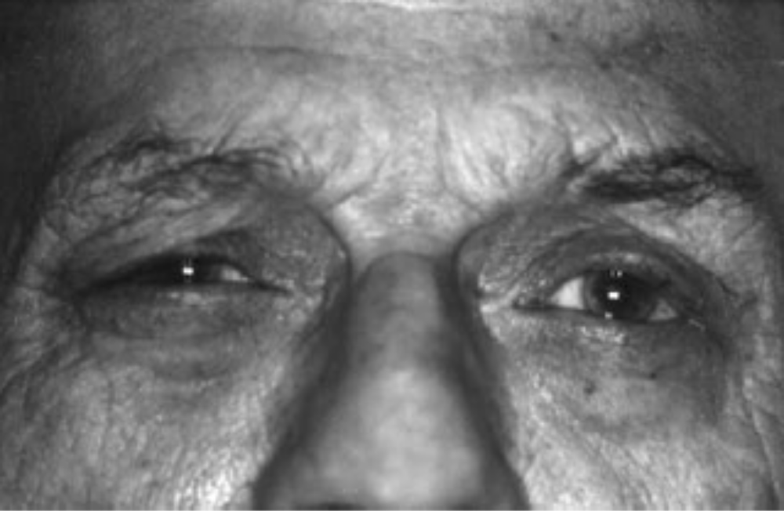

Slide 42
Tension-Type Headache
Tension-type headache is the term used to describe chronic or recurrent headache of inapparent cause that lack features of migraine or other headache syndromes.
In its classic form, tension-type headache is a chronic disorder that begins after age 20 years.
Women are more commonly affected than men.
Drugs used in the treatment of tension-type headache include many of the same agents used for migraine.

Slide 43
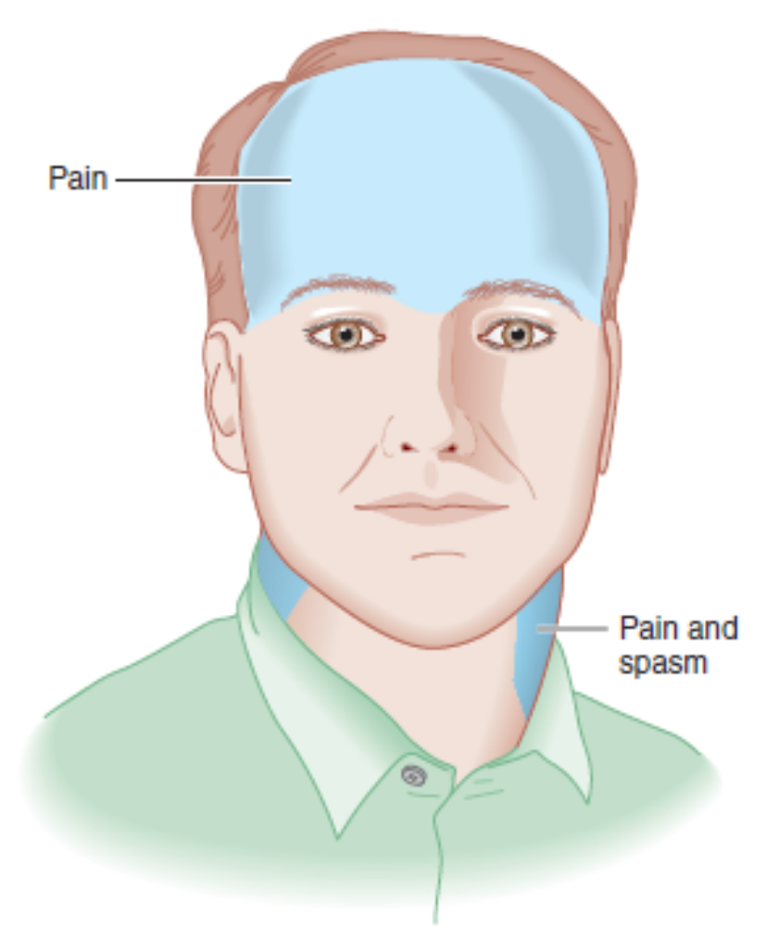

Slide 44
Icepick-Like Pain
Cervical spine disease
Sinusitis
Dental disease

