Slide 1

Neurology 6
Meningitis, head trauma

Slide 2
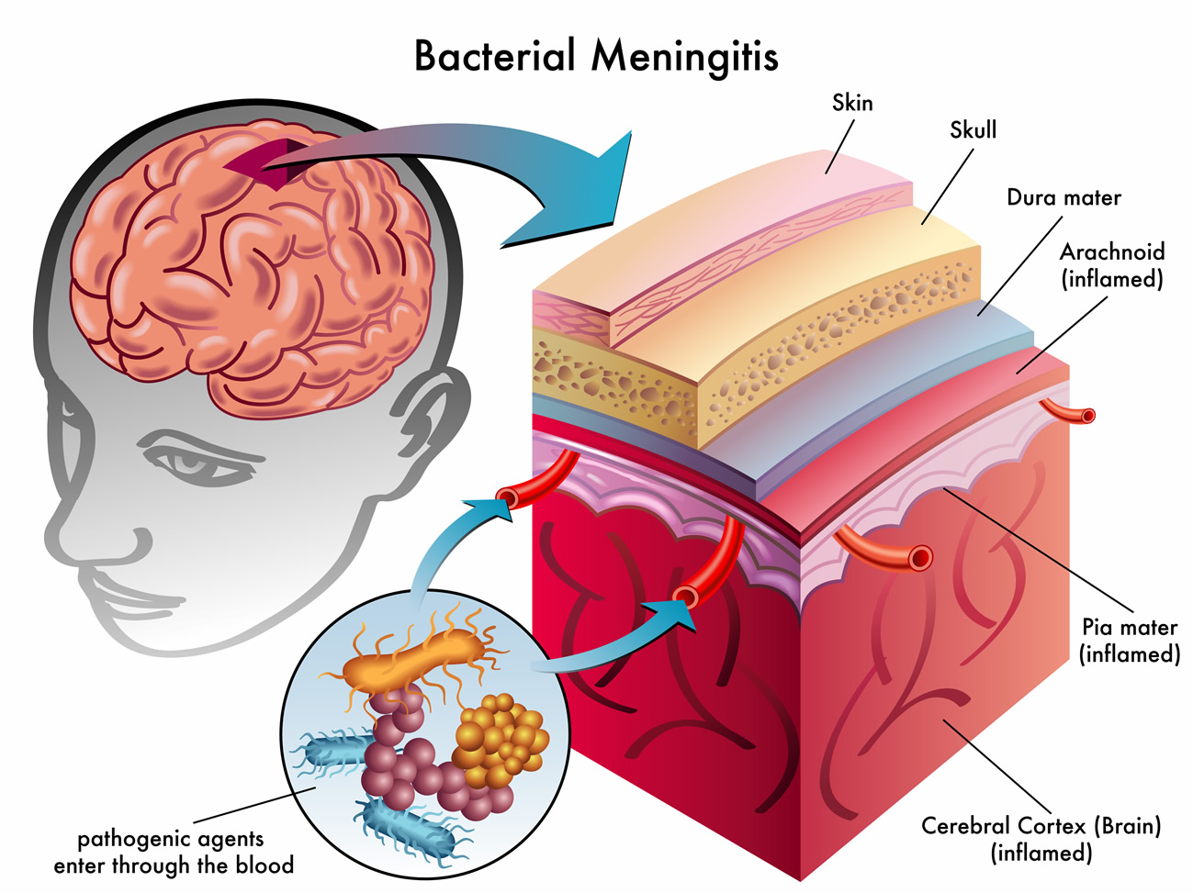
BACTERIAL MENINGITIS
Bacterial meningitis is a leading cause of acute confusional states and one in which early diagnosis is crucial to a good outcome. Predisposing conditions include systemic (especially respiratory) or parameningeal infection, head trauma, anatomic meningeal defects, prior neurosurgery, cancer, alcoholism, and immunodeficiency states.

Slide 3
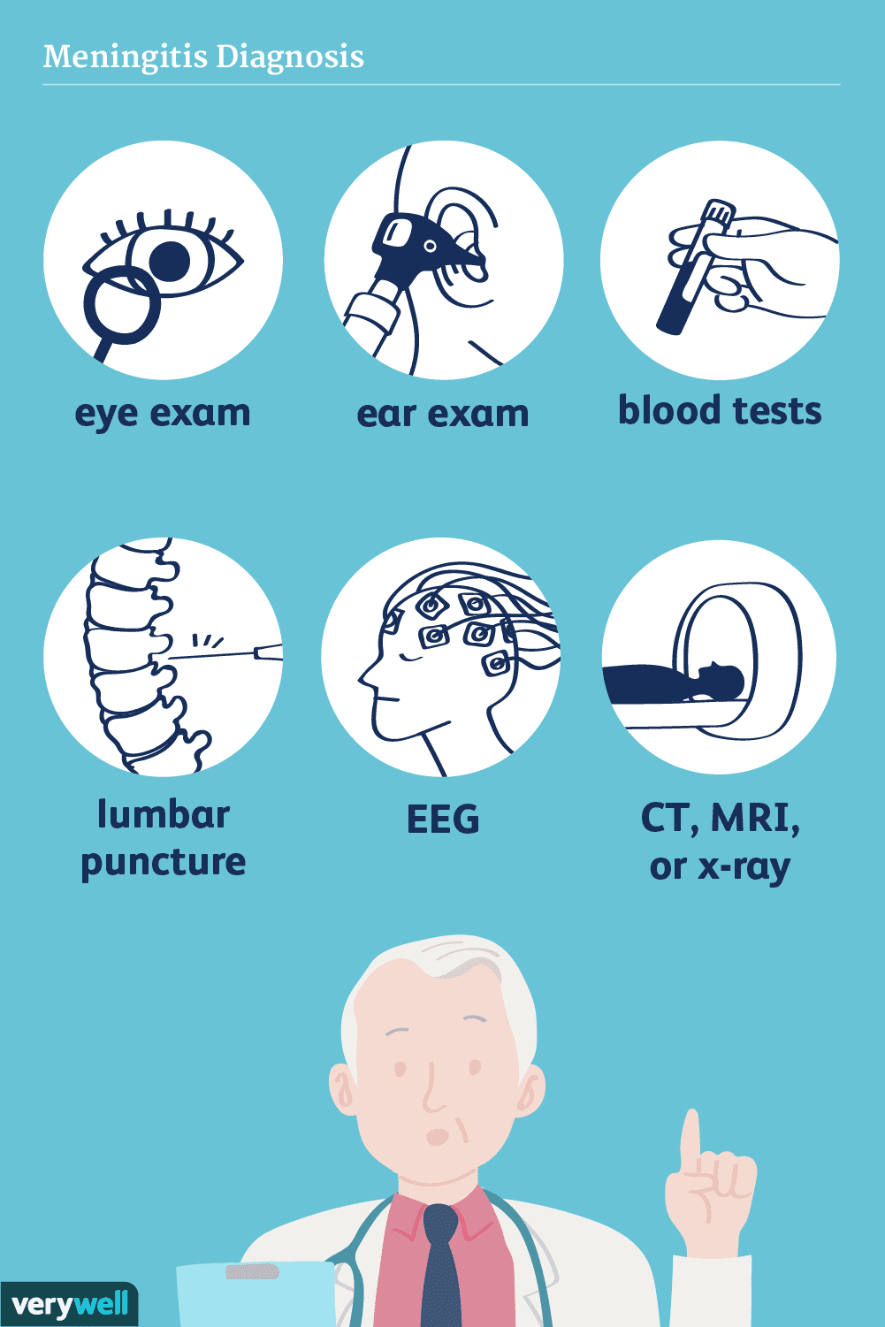
Pathogenesis & Pathology
Bacteria typically gain access to the CNS by colonizing the mucous membranes of the nasopharynx, leading to local tissue invasion, bacteremia, and hematogenous seeding of the subarachnoid space.
- Direct spread
- Low level antibodies
- Inflammatory response
- Streptococcus, Hemophilus, Neisseria meningitidis

Slide 4
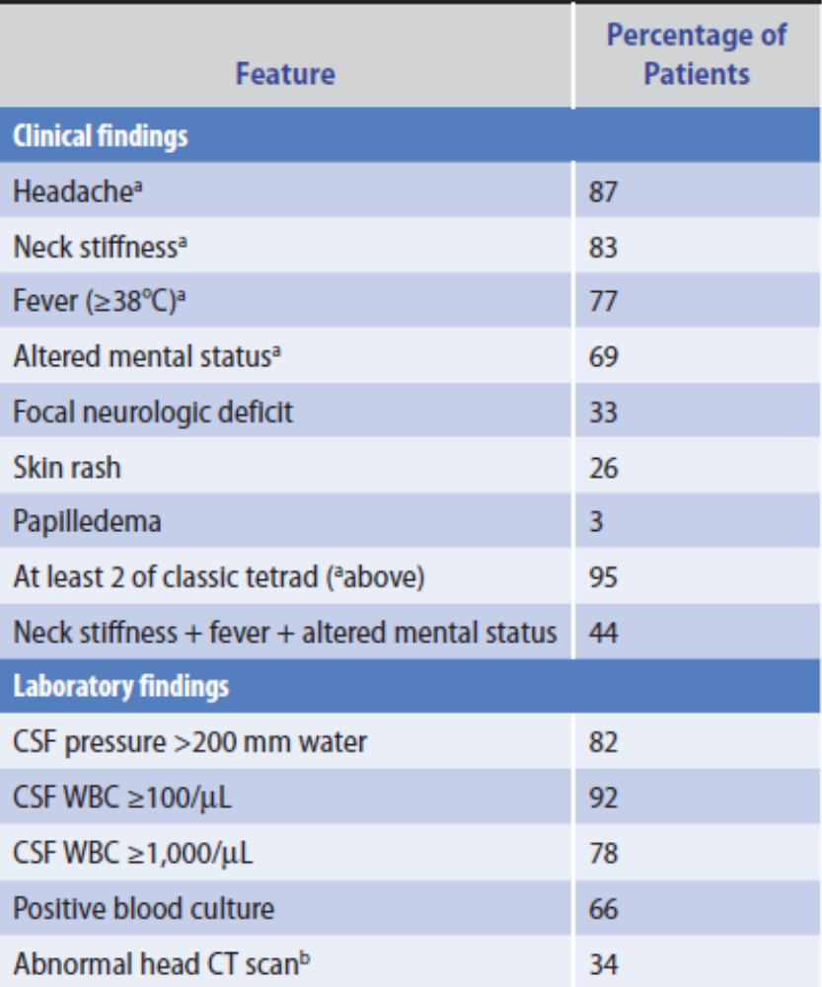
Clinical Findings
At presentation, most patients have had symptoms for 1 to 7 days. These include fever, confusion, vomiting, headache, and neck stiffness, but the full syndrome is not usually present.

Slide 5
Laboratory Findings
Peripheral blood may show polymorphonuclear leukocytosis from systemic infection or leukopenia caused by immunosuppression. The causative organism can be cultured from the blood in approximately two-thirds of cases. Images of the chest, sinuses, or mastoid bones may indicate a primary site of infection. A brain CT or MRI scan may show contrast enhancement of the cerebral convexities, the base of the brain, or the ventricular ependyma. The EEG is usually diffusely slow.

Slide 6
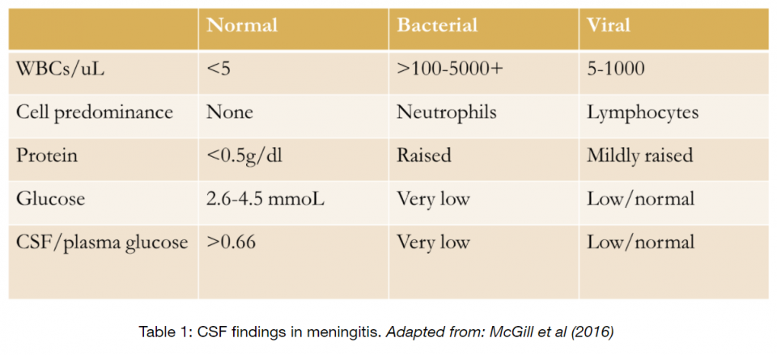

Slide 7
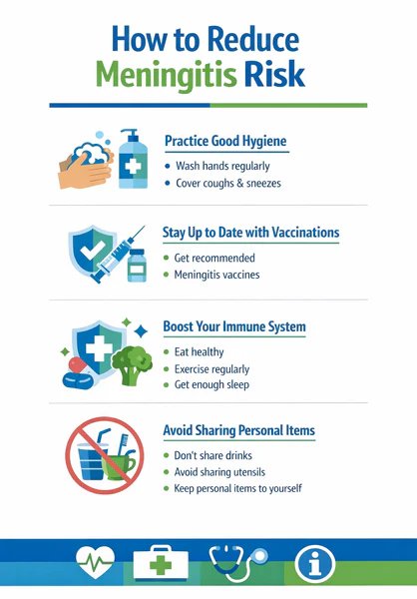
Differential Diagnosis
Signs of meningeal irritation may also be seen with nonbacterial meningitis and subarachnoid hemorrhage.
Prevention
Vaccines are available for three bacteria that can cause meningitis: H. influenzae type b, N. meningitidis, and S. pneumoniae.

Slide 8
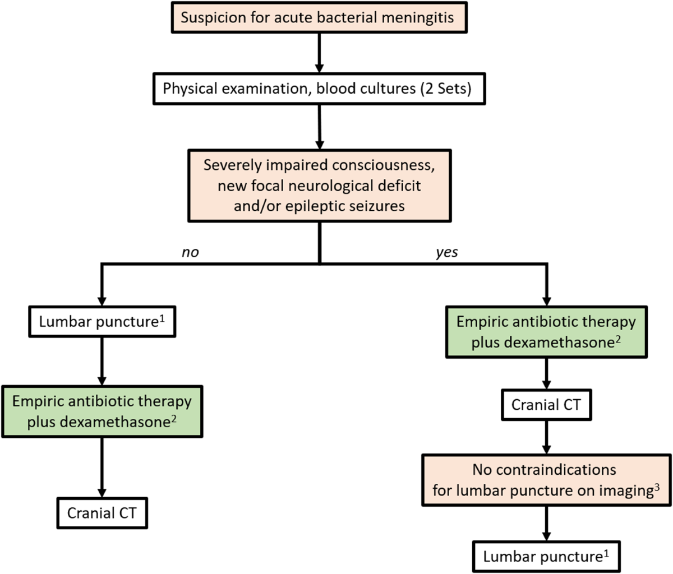
Treatment
Unless the physical examination shows focal neurologic abnormalities or papilledema, suggesting a mass lesion, lumbar puncture should be performed immediately; if the CSF is not clear and colorless, antibiotic treatment is started without delay.

Slide 9
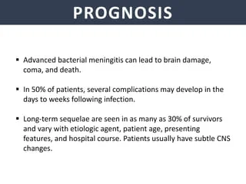
Prognosis
Complications of bacterial meningitis include headache, seizures, hydrocephalus, syndrome of inappropriate secretion of antidiuretic hormone (SIADH), residual neurologic deficits (including cognitive disturbances and cranial— especially VIII—nerve abnormalities), and death.

Slide 10
TUBERCULOUS MENINGITIS
Tuberculous meningitis must be considered in patients who present with a confusional state, especially if there is a history of pulmonary tuberculosis, alcoholism, corticosteroid treatment, HIV infection, or other conditions associated with impaired immune responses.
Tuberculous meningitis usually results from reactivation of latent infection with Mycobacterium tuberculosis. Primary infection, typically acquired by inhaling bacillus-containing droplets, may be associated with metastatic dissemination of blood-borne bacilli from the lungs to the meninges and the surface of the brain.
Symptoms usually at include headache, fever, neck stiffness, vomiting, and lethargy or confusion. Fever, signs of meningeal irritation, and a confusional state are the most common findings on physical examination, but all may be absent.

Slide 11
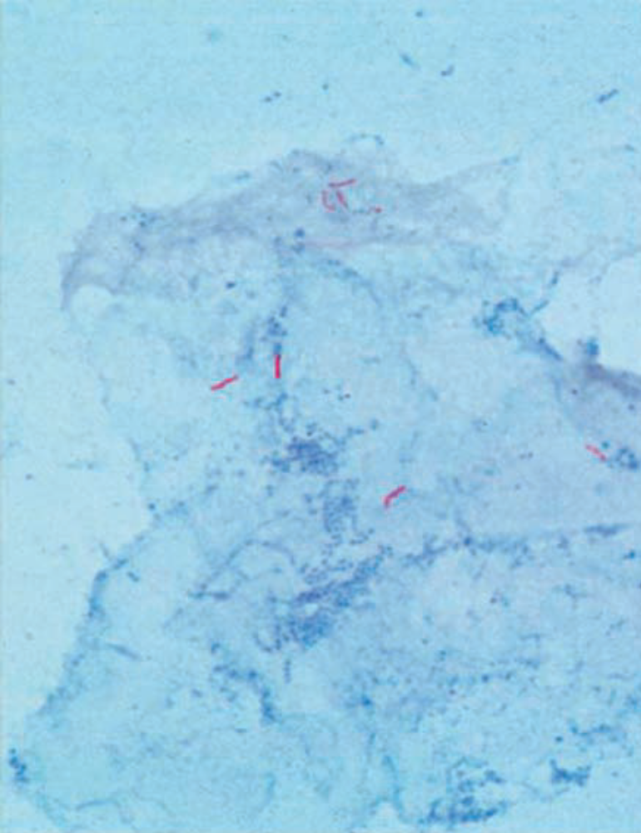
Only one-half to two-thirds of patients show a positive skin test for tuberculosis or evidence of active or healed tubercular infection on chest x-ray; chest CT is more sensitive. The diagnosis is established by CSF analysis.
Treatment should be started as early as possible; it should not be withheld while awaiting culture results. The decision to treat is based on the CSF findings described previously; lymphocytic pleocytosis and decreased glucose are particularly suggestive, even if AFB smears are negative.

Slide 12
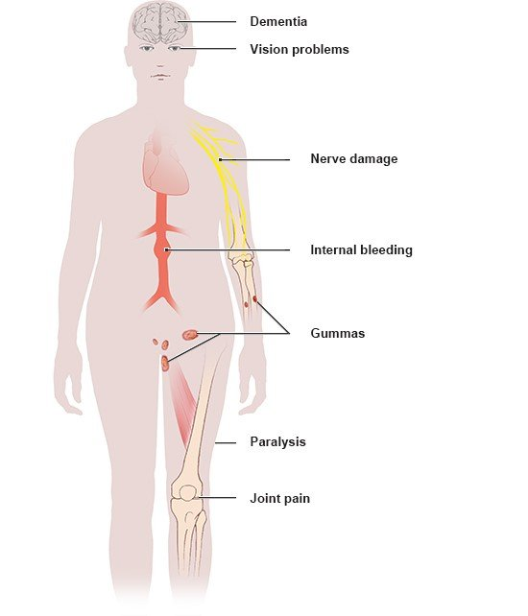
SYPHILITIC MENINGITIS
Acute or subacute syphilitic meningitis usually occurs within 2 years after primary syphilitic infection. It is most common in young adults, affects men more often than women, and requires prompt treatment to prevent the irreversible manifestations of tertiary neurosyphilis.
Physical examination may show signs of meningeal irritation, confusion or delirium, papilledema, hemiparesis, and aphasia. The diagnosis is established by CSF findings.

Slide 13
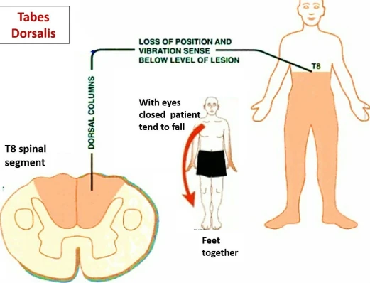
Treatment
Acute syphilitic meningitis is usually a self-limited disorder, but treatment is required to avoid more advanced vascular and parenchymatous neurosyphilis (tabes dorsalis, general paresis, optic neuritis, myelitis). Treatment is with aqueous penicillin G 2 to 4 × 106 units intravenously every 4 hours for 10 to 14 days. For penicillin-allergic patients, ceftriaxone 2 g intravenously daily for 14 days or doxycycline 200 mg orally twice daily for 21 to 28 days can be substituted.

Slide 14
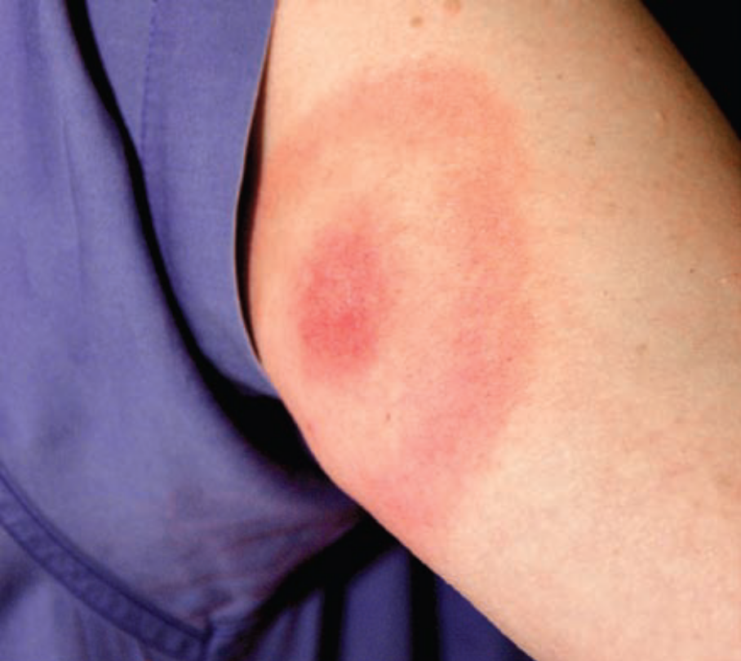
LYME DISEASE
Lyme disease is a tick-borne disorder due to infection with the spirochete Borrelia burgdorferi. Most cases occur during the summer. Primary infection may be manifested by an expanding erythematous annular skin lesion (erythema migrans).
Less distinctive symptoms include fatigue, headache, fever, neck stiffness, joint or muscle pain, anorexia, sore throat, and nausea. Neurologic involvement may be delayed for up to 10 weeks and is characterized by meningitis or meningoencephalitis.

Slide 15
Lyme meningitis produces prominent headache accompanied by signs of meningeal irritation, photophobia, pain when moving the eyes, nausea, and vomiting. Definitive diagnosis is usually made by serologic testing for B. burgdorferi.
Treatment
Preventive measures include avoiding tick-infested areas and using insect repellents and protective clothing when avoidance is impossible. Treatment of Lyme disease with neurologic involvement is with intravenously administered ceftriaxone (2 g/d), cefotaxime (2 g three times daily), or penicillin (20-24 × 106 units/d) for 2 to 4 weeks.

Slide 16
VIRAL MENINGITIS & ENCEPHALITIS
Viral infections of the meninges (meningitis) or brain parenchyma (encephalitis) often present as acute confusional states. The most common causative agents are listed here. Viral infections can affect the CNS in three ways— hematogenous dissemination of a systemic viral infection (eg, arthropod-borne viruses), neuronal spread of the virus by axonal transport (eg, herpes simplex, rabies), and autoimmune postinfectious demyelination (eg, varicella, influenza).

Slide 17
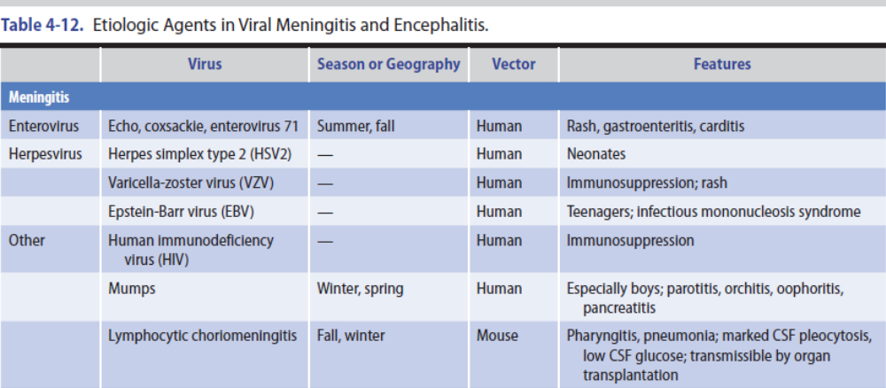

Slide 18
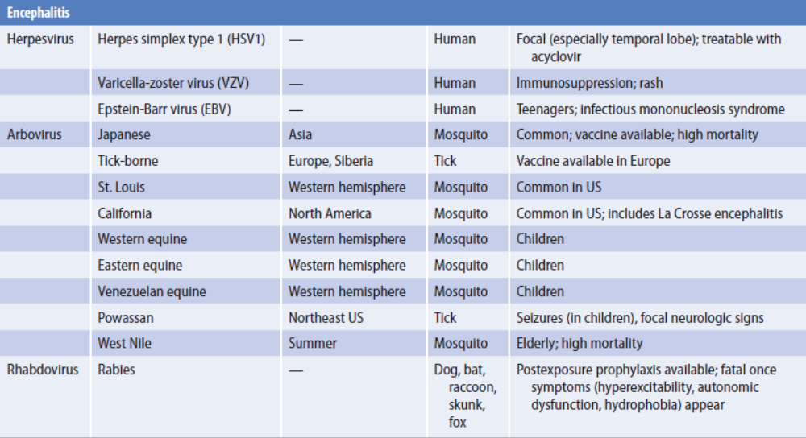

Slide 19
Clinical manifestations of viral meningitis include fever, headache, neck stiffness, photophobia, pain with eye movement, and mild impairment of consciousness. Patients usually do not appear as ill as those with bacterial meningitis.
CSF analysis is the most important laboratory test. CSF pressure is normal or increased, and a lymphocytic or monocytic pleocytosis is present. The patient can be treated for bacterial meningitis until the results of CSF cultures are known, or treatment can be withheld and lumbar puncture repeated in 6 to 12 hours. If the meningitis is viral in origin, the second sample should show a mononuclear cell pleocytosis.
No specific treatment is available for most causes of viral meningitis or encephalitis. Exceptions include herpes simplex (discussed in the next section); varicella zoster, which respond to drugs.

Slide 20
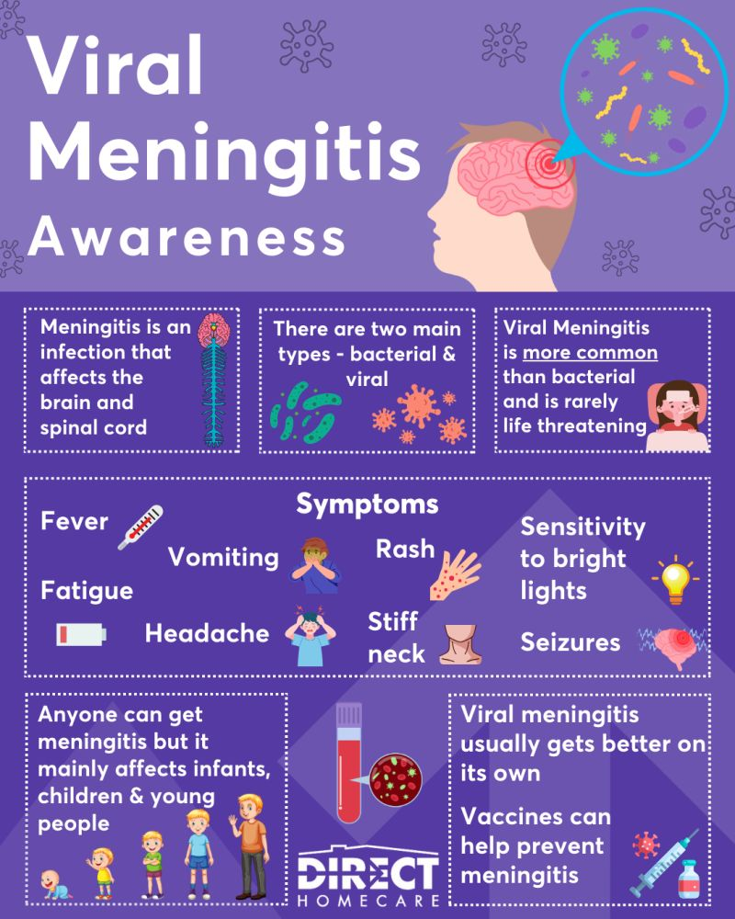
Symptoms of viral meningitis usually resolve spontaneously within 2 weeks regardless of the causative agent, although residual deficits may be seen. The outcome of viral encephalitis varies with the specific virus—for example, eastern equine and HSV infections are associated with severe morbidity and high mortality rates.

Slide 21
HERPES SIMPLEX VIRUS (HSV)
ENCEPHALITIS
HSV type 1 (oral herpes) is the most common cause of sporadic fatal encephalitis in the United States. Approximately one-half of cases involve patients older than 50 years of age. The virus migrates along nerve axons to sensory ganglia, where it persists in a latent form and may be subsequently reactivated.
The clinical syndrome may include headache, stiff neck, vomiting, behavioral disorders, memory loss, anosmia, aphasia, hemiparesis, and focal or generalized seizures.
The CSF in HSV type 1 encephalitis most often shows increased pressure, lymphocytic or mixed, mild protein elevation, and normal glucose. The virus generally cannot be isolated from the CSF, but can be detected by the polymerase chain reaction and serologic testing.

Slide 22
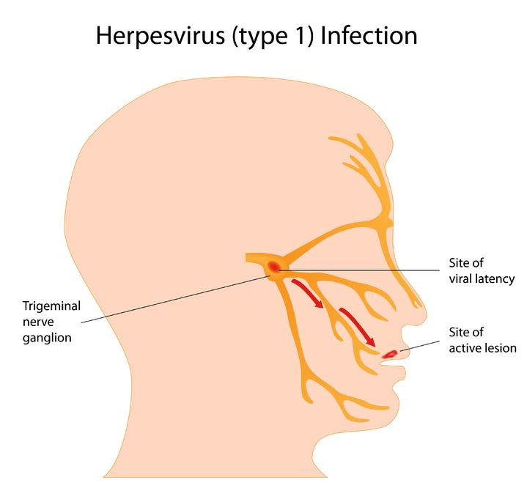
However, because treatment is most effective when begun early and is comparatively safe, the most common approach is to treat patients with acyclovir, given intravenously.
Patients younger than age 30 and those who are only lethargic at the onset of treatment are more likely to survive than are older or comatose patients.

Slide 23
HUMAN IMMUNODEFICIENCY VIRUS
INFECTION
Acquired immune deficiency syndrome (AIDS) is caused by human immunodeficiency virus type 1 (HIV-1) and is characterized by opportunistic infections, malignant neoplasms (typically non-Hodgkin lymphoma or Kaposi sarcoma), and a variety of neurologic disturbances. Transmission occurs through sexual activity or transfer of virus-contaminated blood or blood products, such as by intravenous drug users who share needles.
A. HIV-1 Meningitis
B. Cryptococcal Meningitis
C. Cerebral Toxoplasmosis
D. Cytomegalovirus Encephalitis

Slide 24
FUNGAL MENINGITIS
In a small fraction of patients with systemic fungal infections (mycoses), fungi invade the CNS to produce meningitis or focal intraparenchymal lesions.
Fungi reach the CNS by hematogenous spread from the lungs, heart, gastrointestinal or genitourinary tract, or skin, or by direct expansion. Neurologic examination may show signs of meningeal irritation, a confusional state, papilledema, visual loss, ptosis, exophthalmos, ocular or other cranial nerve palsies, and focal neurologic abnormalities such as hemiparesis.
CSF pressure may be normal or elevated. The fluid is usually clear, but may be viscous in the presence of numerous cryptococci. Lymphocytic pleocytosis of up to 1,000 cells/mL is common, but a normal cell count or polymorphonuclear pleocytosis can be seen in early fungal meningitis and in immunosuppressed patients.

Slide 25
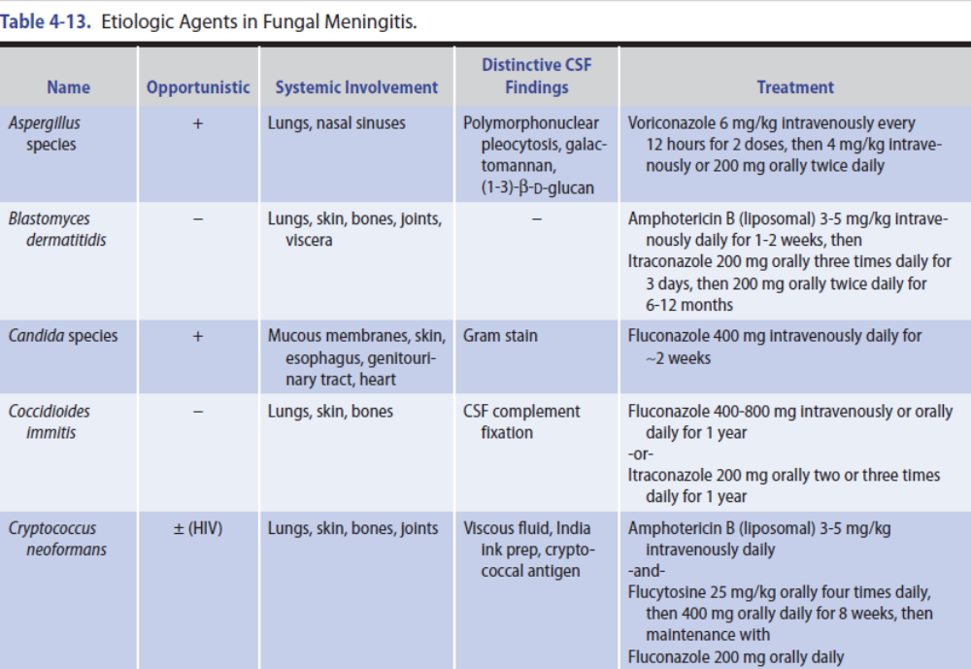

Slide 26
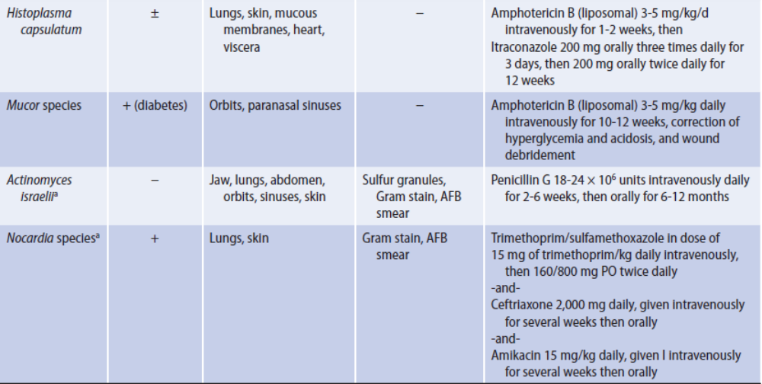

Slide 27
PARASITIC INFECTIONS
Protozoal, helminthic, and rickettsial infections may cause CNS disease, particularly in immunosuppressed patients (including those with HIV infection), and in certain regions of the world.
A. Malaria
B. Toxoplasmosis
C. Primary Amebic Meningoencephalitis
D. Granulomatous Amebic Encephalitis
E. Cysticercosis

Slide 28
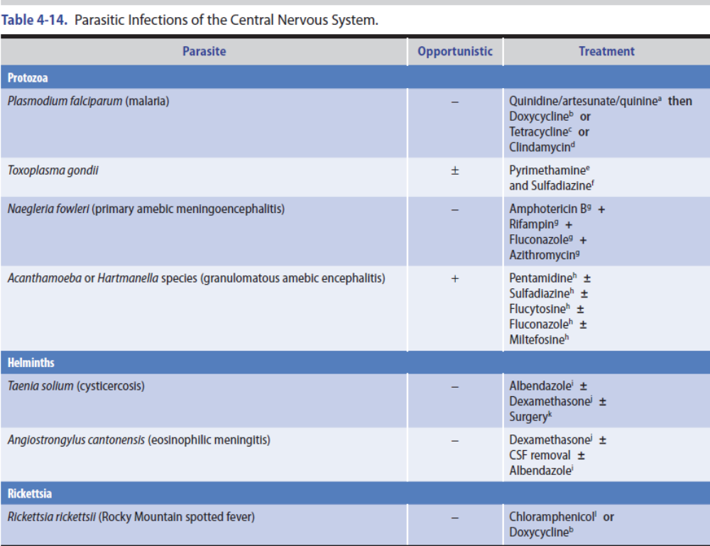

Slide 29
HEAD TRAUMA
Concussion is a syndrome that follows head trauma and is characterized by transient confusion, memory impairment, or incoordination.
Other symptoms, which include headache, fatigue, irritability, dizziness, nausea, vomiting, blurred vision, and imbalance, tend to resolve after 1 to 2 days but may persist for weeks to months (postconcussion syndrome).
Because a concussion may increase the risk of subsequent concussion, athletes who sustain a concussion while playing sports should delay their return to play until postconcussive symptoms have resolved and they have gradually resumed normal activity over about 1 week.

Slide 30
SEIZURES
Generalized tonic-clonic (grand mal) seizures are typically followed by a transient confusional state (postictal state) that resolves within 1 to 2 hours.
Complex partial (temporal lobe or psychomotor) seizures, now often called focal seizures with dyscognitive features, produce alterations in consciousness characterized by confusion or other cognitive, affective, psychomotor, or psychosensory symptoms.

