Slide 1

Neurology 5
Confusional states

Slide 2
A confusional state, sometimes referred to as encephalopathy or delirium, is a state in which the level of consciousness is depressed, but to a lesser extent than in coma (unarousable unresponsiveness; Coma). In confusional states, responses to stimulation are at least semi-purposeful, whereas in coma, patients fail to respond to even painful stimulation or do so only in reflex fashion. Thus the difference between a confusional state and coma is largely one of degree, and the causes overlap extensively.

Slide 3

APPROACH TO DIAGNOSIS
History
General physical examination
Neurologic examination
Laboratory examination

Slide 4
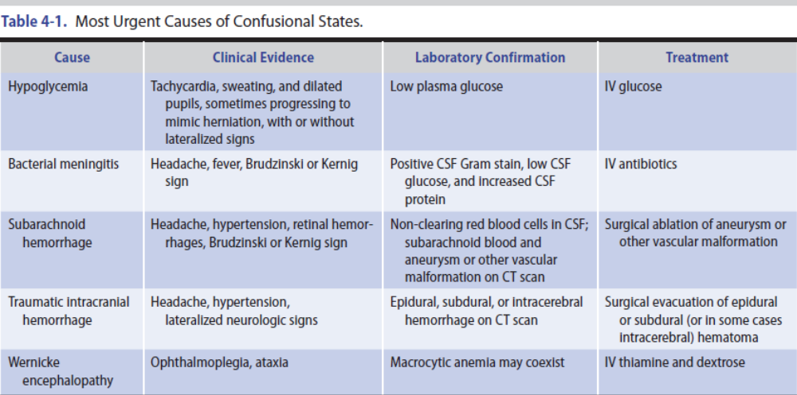

Slide 5
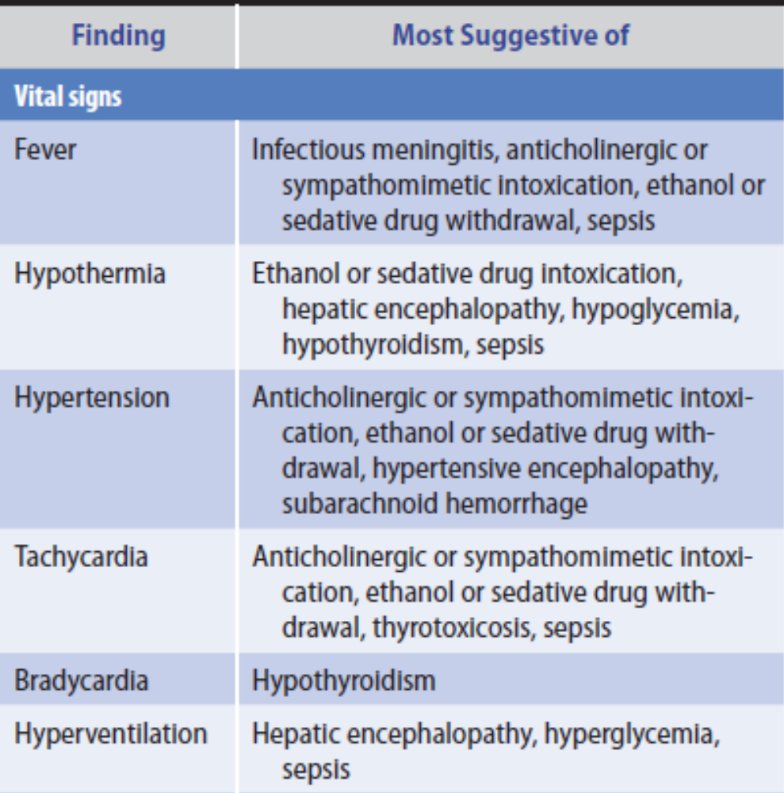
General Physical Examination inConfusional States.

Slide 6
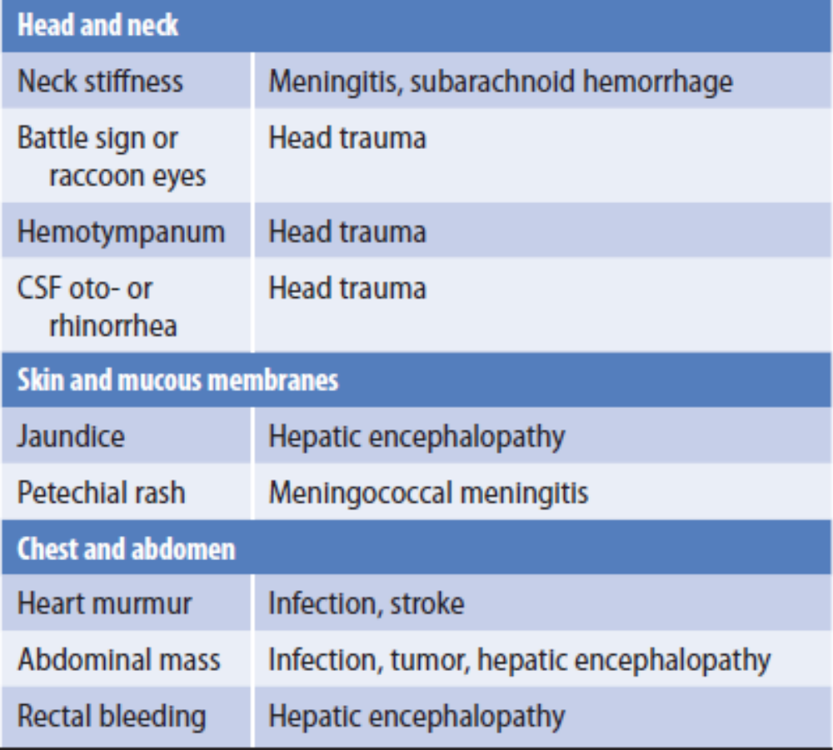
General Physical Examination in Confusional States.

Slide 7
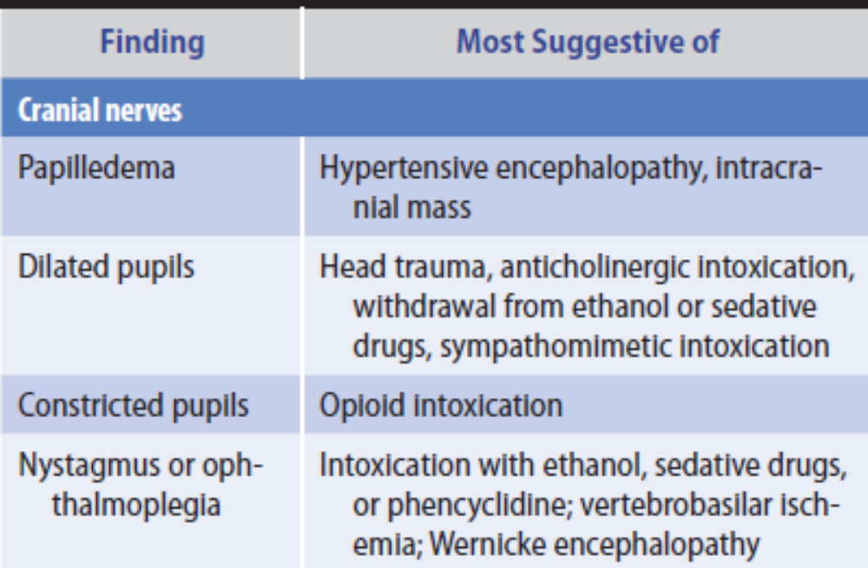
Neurologic Examination in Confusional States.

Slide 8
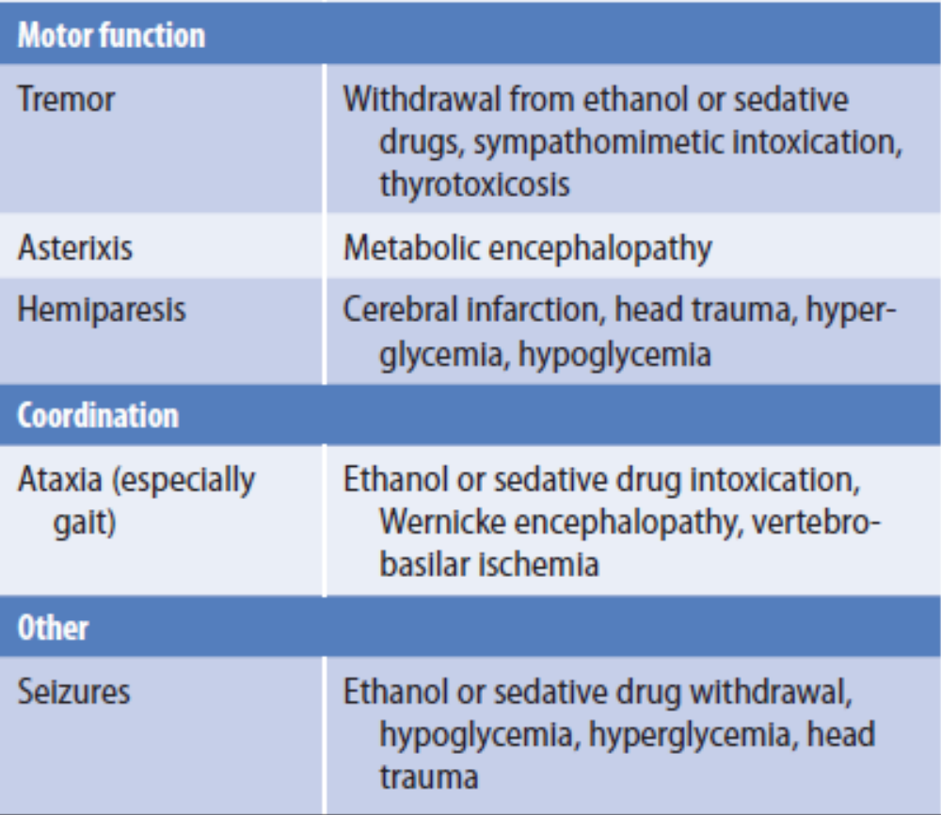
Neurologic Examination in Confusional States.

Slide 9
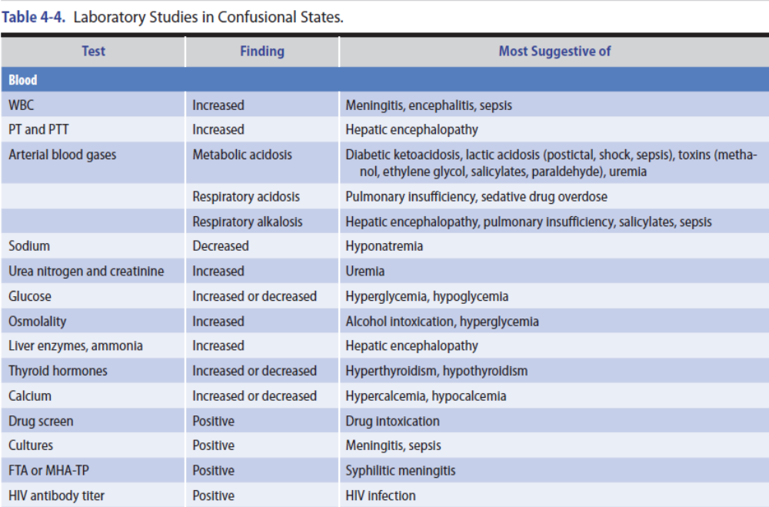

Slide 10
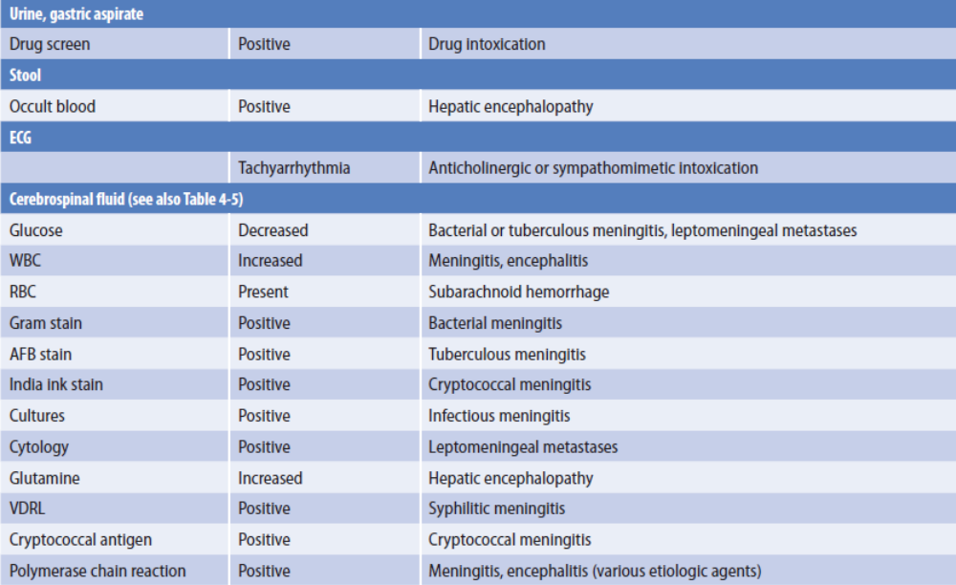

Slide 11
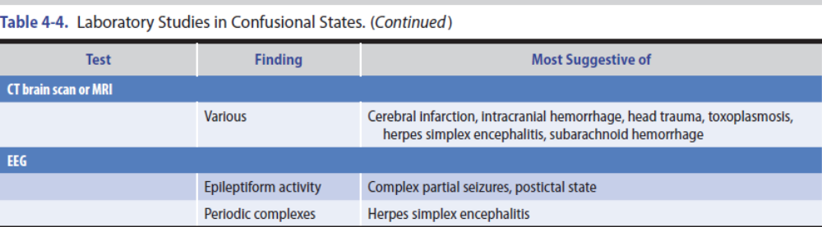

Slide 12
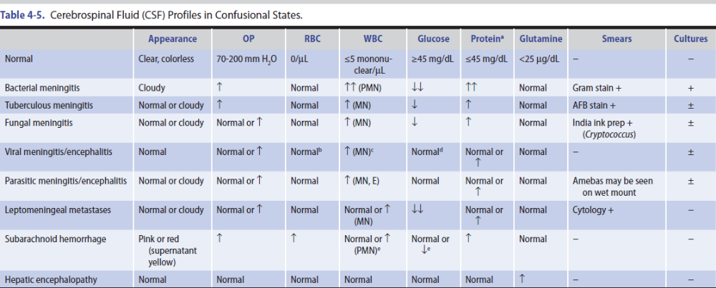

Slide 13
CAUSES OF CONFUSIONAL STATES
Drugs
Alcohol intoxication
Alcohol withdrawal
Hallucinations
Seizures
Delirium tremens

Slide 14

Sedative drug intoxication
Sedative drug withdrawal
Opiates
Anticholinergics

Slide 15

Sympathomimetics
Hallucinogens
Inhalants

Slide 16
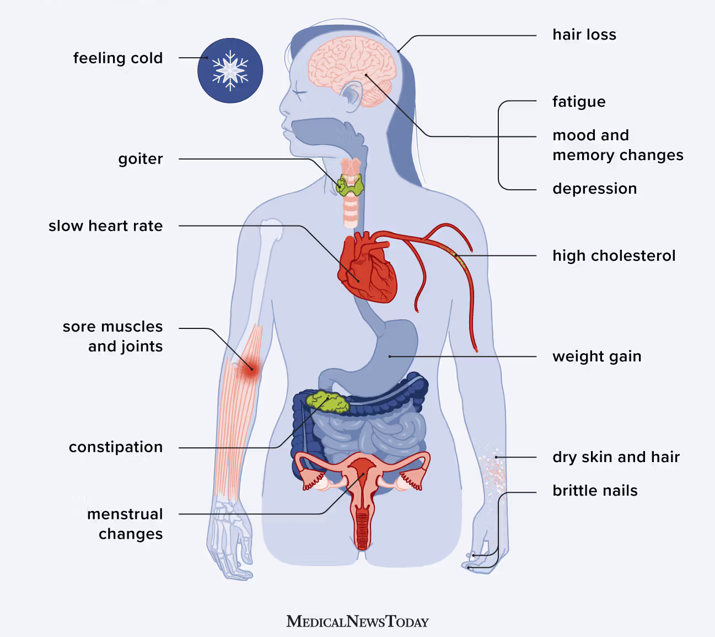
Endocrine Disorders
Hypothyroidism

Slide 17
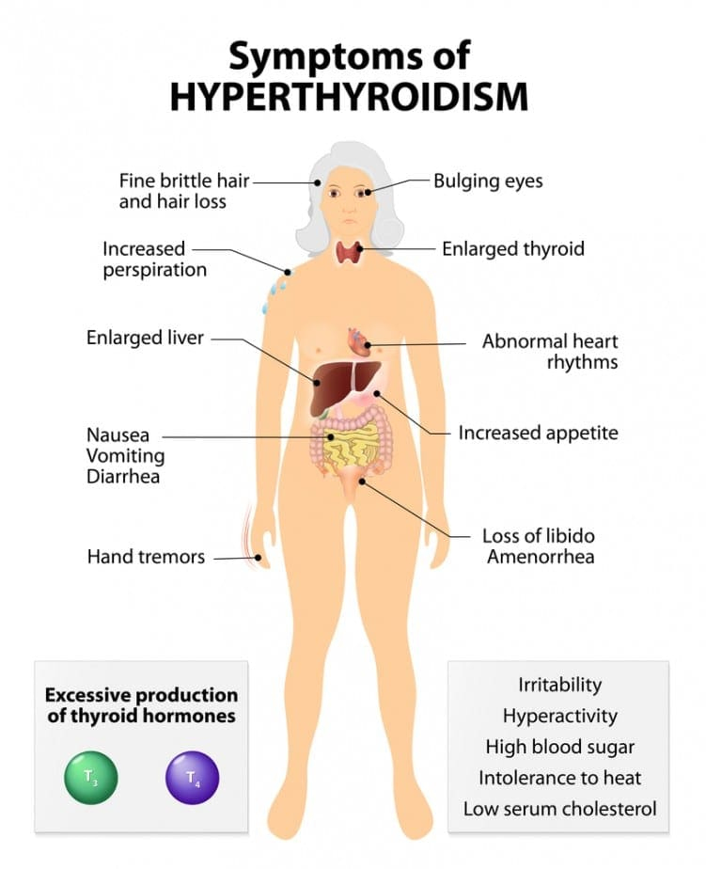
Hyperthyroidism

Slide 18
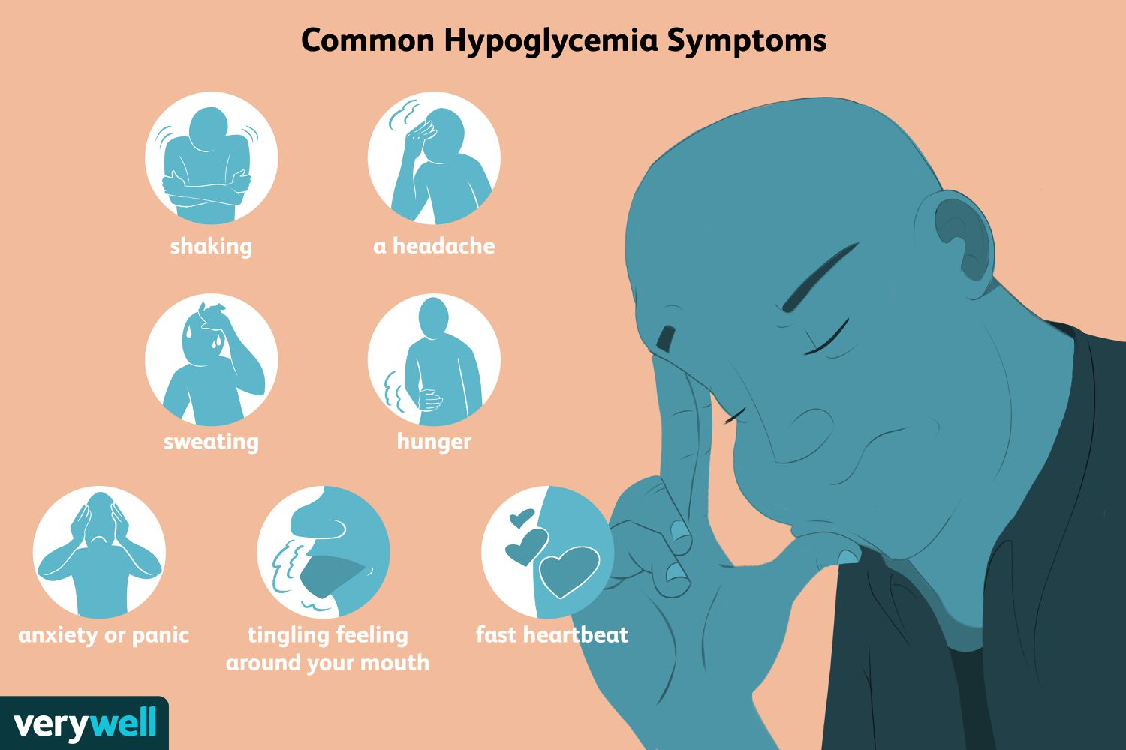
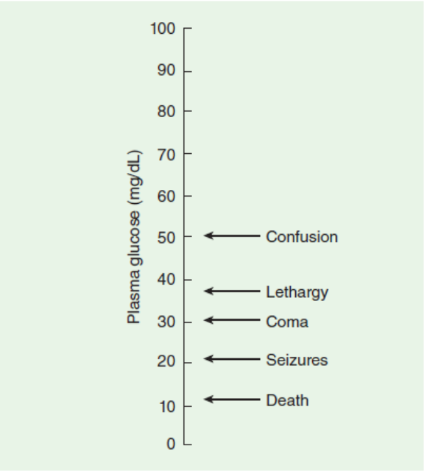
Hypoglycemia

Slide 19
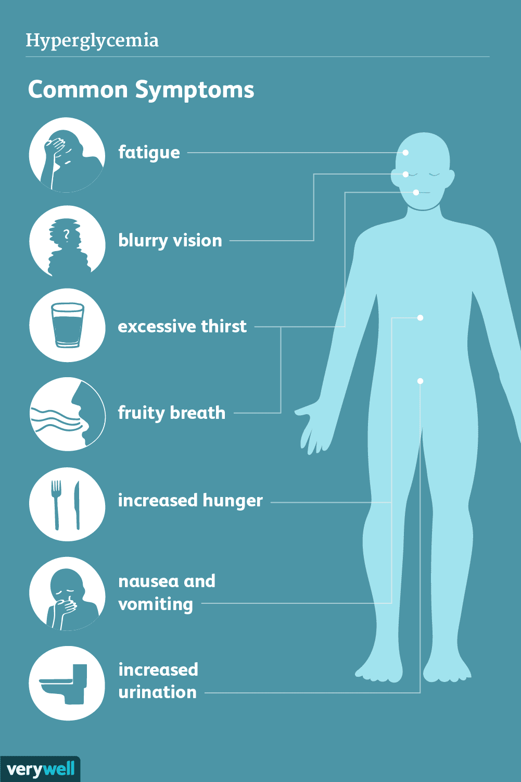
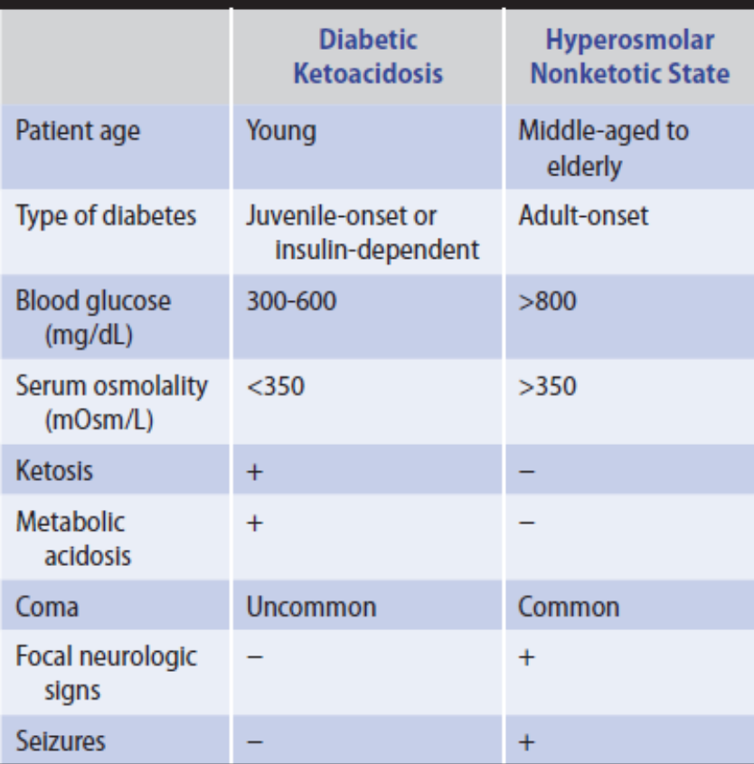
Hyperglycemia

Slide 20
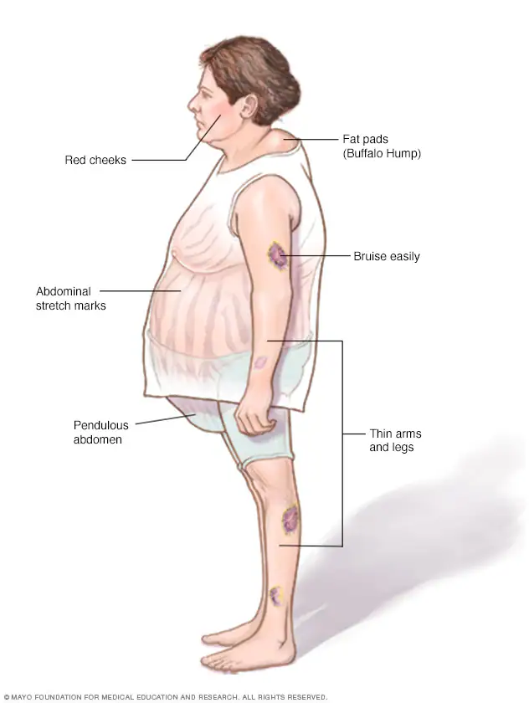
Hypoadrenalism
Hyperadrenalism

Slide 21
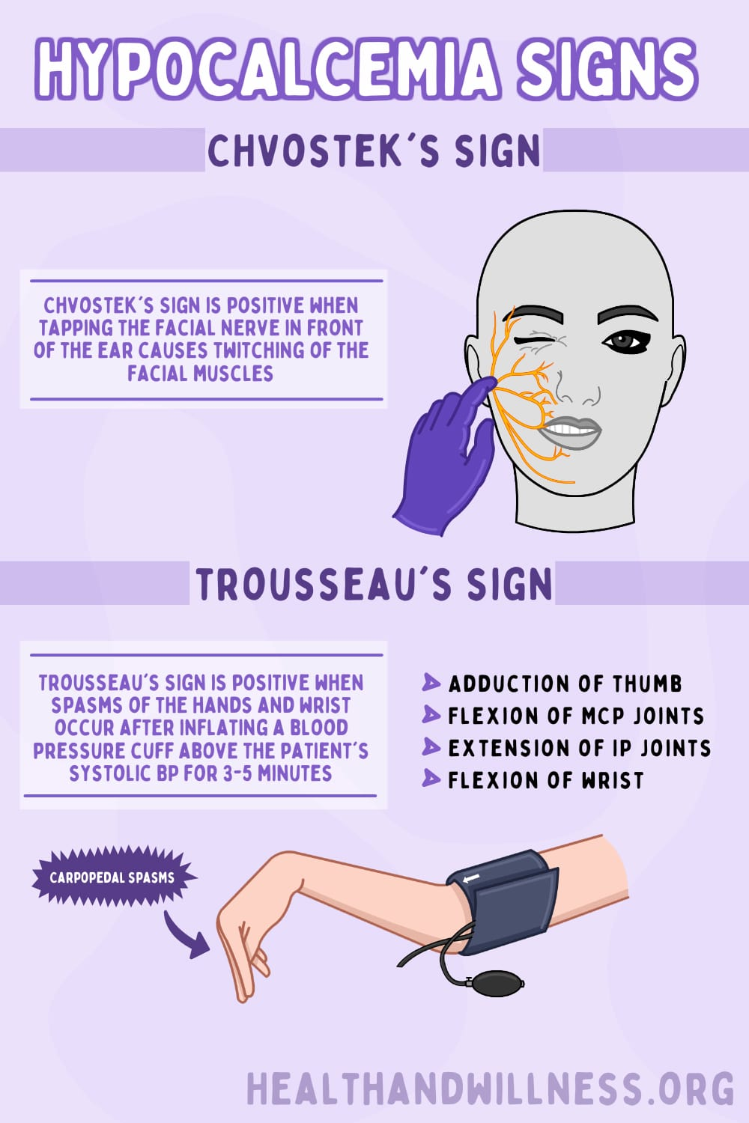
Electrolyte Disorders
Hyponatremia
Hypercalcemia
Hypocalcemia

Slide 22

Nutritional Disorders
Wernicke encephalopathy

Slide 23

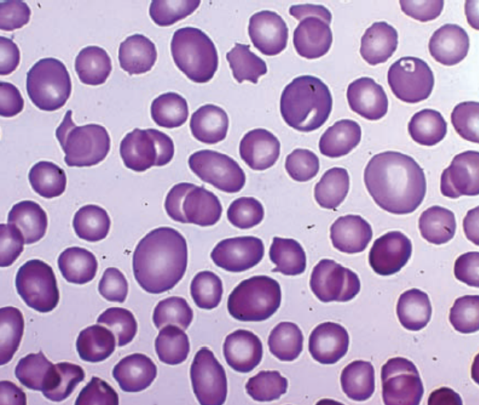
Vitamin B12 deficiency

Slide 24
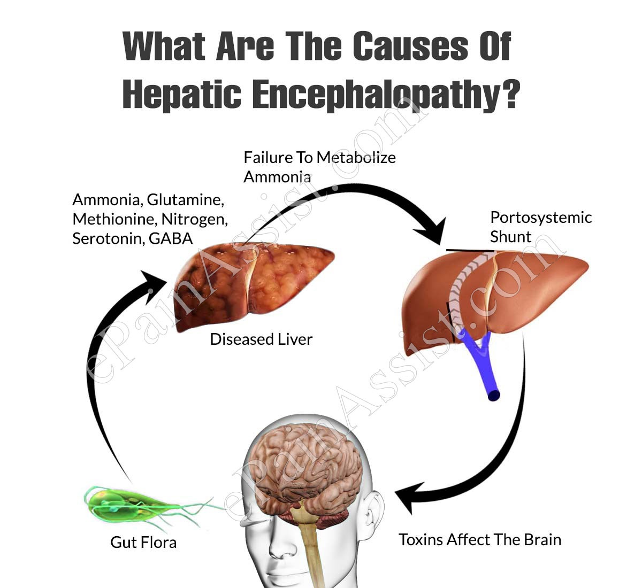
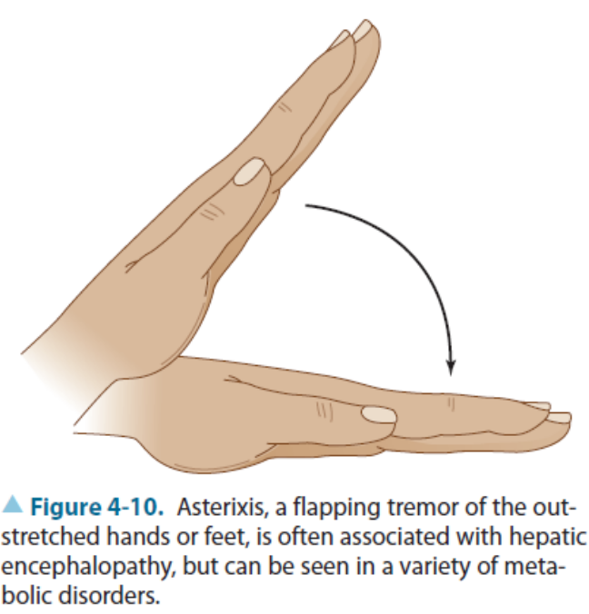
Organ Failure Systems
Hepatic Encephalopathy

Slide 25
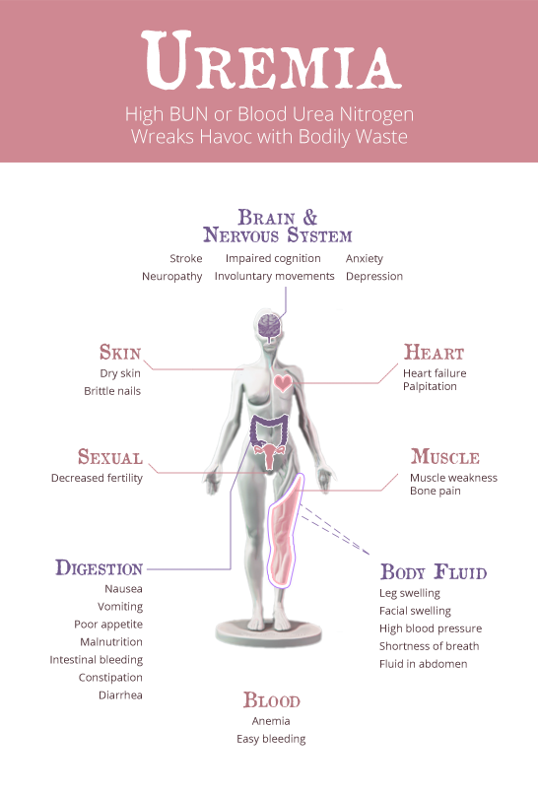
Uremia
Respiratory Encephalopathy
Organ transplantation

