Slide 1
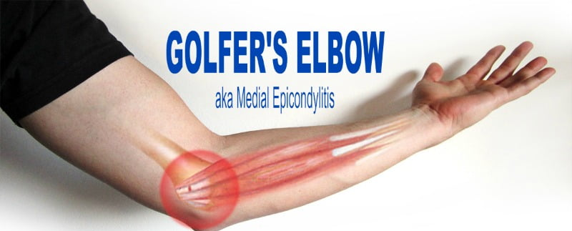
Medial Epicondylitis
Advanced massage Treatment

Slide 2
Background
Far less common than lateral epicondylitis, medial epicondylitis is also an overuse injury of the wrist and forearm, involving primarily the pronator teres and the flexor carpi radialis. Its symptoms are similar to those of its lateral counterpart and include:
•Pain and tenderness over medial epicondyle
•Pain and tenderness just distal along the tendinous origin of the flexor-pronator Origins
•Swelling •Discoloration
•Point tenderness over the humeroulnar joint
•Increased pain with resisted wrist flexion, pronation, and valgus stress at 30° of flexion

Slide 3
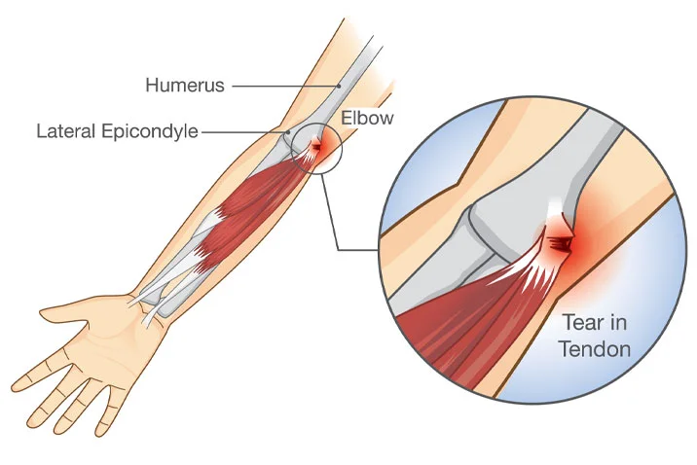
In addition to the flexor carpi radialis and pronator teres, other affected tissues can include the flexor carpi ulnaris and palmaris longus origin tendons. Medial epicondylitis arises from repeated flexion and pronation combined with a repeated valgus force on the elbow. There are several pathologies that are associated and often coexist with medial epicondylitis, including ulnar collateral ligament sprains, ulnar neuropathy, and medial elbow intra-articular damage. To ensure that proper treatment is administered, it is necessary to rule out the presence of other conditions via a thorough history and assessment.

Slide 4
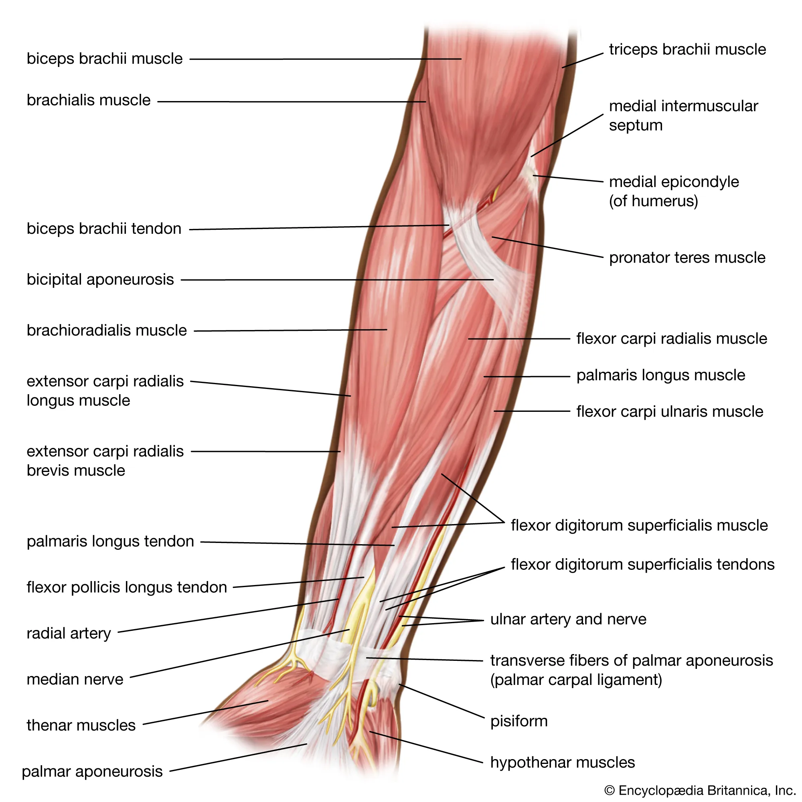
Assessment
Since medial epicondylitis can arise from and coexist with a variety of other elbow pathologies, assessment should include additional regions as necessary.
Condition History; Therapists should inquire about the following while taking the client’s history:

Slide 5
Question
Significance
What was the mechanism of injury?
Is there any noise, weakness, or change in sensation that accompanies the condition?
Are there any repetitive movements involved?
How long has the client had the problem?
Helps determine whether the conditionis chronic or acute.
Helps identify structures that may be involved.
Helps determine the etiology of the condition.
Helps determine whether the condition is chronic.

Slide 6
Helps identify structures that may be involved.
Helps identify structures that may be involved.
Helps determine where the dysfunction is.
New activities can lead to pathologies.
This will determine whether there is nerve involvement.
What is the pain like? What are its boundaries? If it radiates, is it worse at night?
Are there any specific motions that increase or decrease the pain?
Are there any limitations in motion?
What are the client’s normal activities?
Is there any numbness or tingling?

Slide 7
Visual Assessment The visual assessment for medial epicondylitis is essentially the same as that for lateral epicondylitis. Compare both arms for symmetry. Include associated areas such as the neck and shoulder in case there are pain referral issues. Place the arms in the anatomical position to observe the carrying angle, which is created by the long axis of the humerus and the long axis of the ulna. The normal carrying angle is 5° to 10° in adult males and 10° to 15° in adult females. Cubital valgus is present if the angle is greater than 15°; cubital varus is present if the angle is less than 5°. An exaggerated cubital varus that has resulted from trauma to the distal humerus is referred to as a gunstock deformity; therefore, check for obvious deformity, swelling, and bruising.

Slide 8
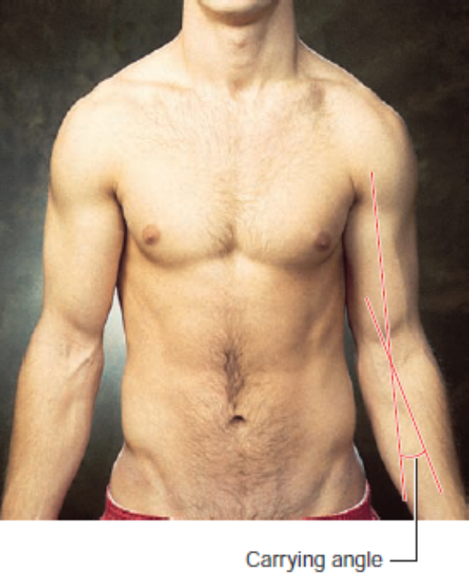
Observe both flexed elbows to see the alignment of the olecranon relative to the epicondyles of the humerus. Normally, the three structures form an isosceles triangle when flexed and form a straight line when extended. Finally, bilaterally compare the cubital fossa for swelling and the entire region for symmetry, as the dominant side may be slightly larger due to muscle hypertrophy.

Slide 9
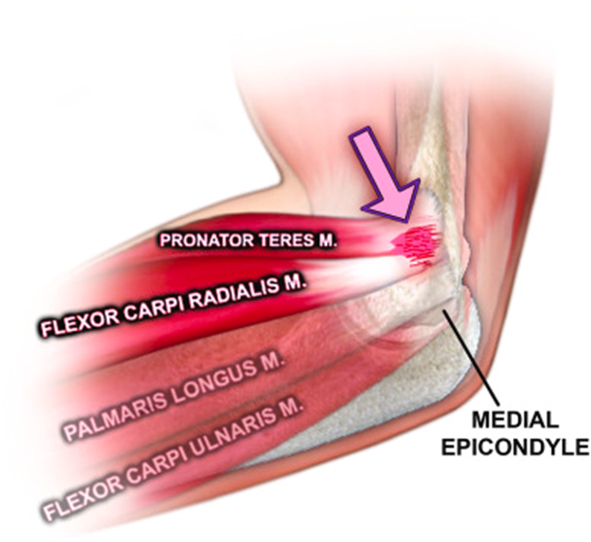
Palpation Start at the distal humerus and work distally onto the proximal forearm, palpating the structures listed earlier in the chapter. Expand the palpation to related areas to determine the presence of swelling, temperature differences, deformity, point tenderness, and muscle spasm.
Orthopedic Tests The orthopedic test for medial epicondylitis is the medial epicondylitis test, or golfer’s elbow test, and it has two methods: a passive technique and an active technique. Here is lists both methods and explains how to perform them:

Slide 10
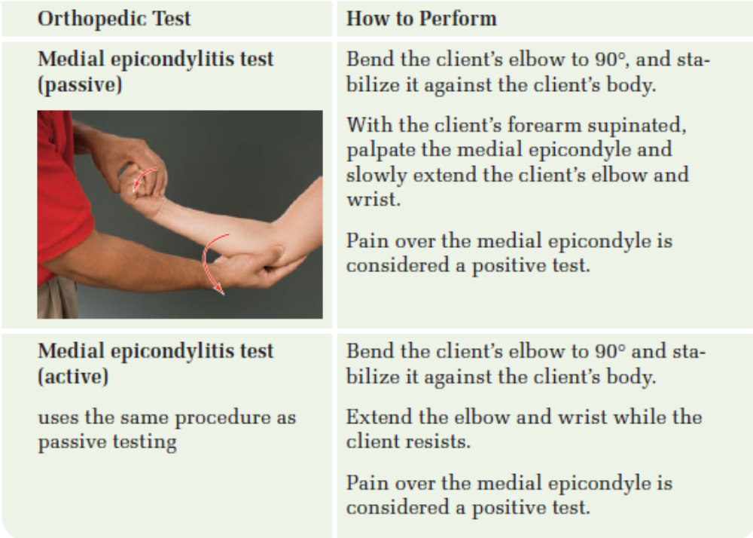

Slide 11
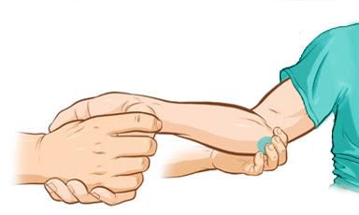

Slide 12
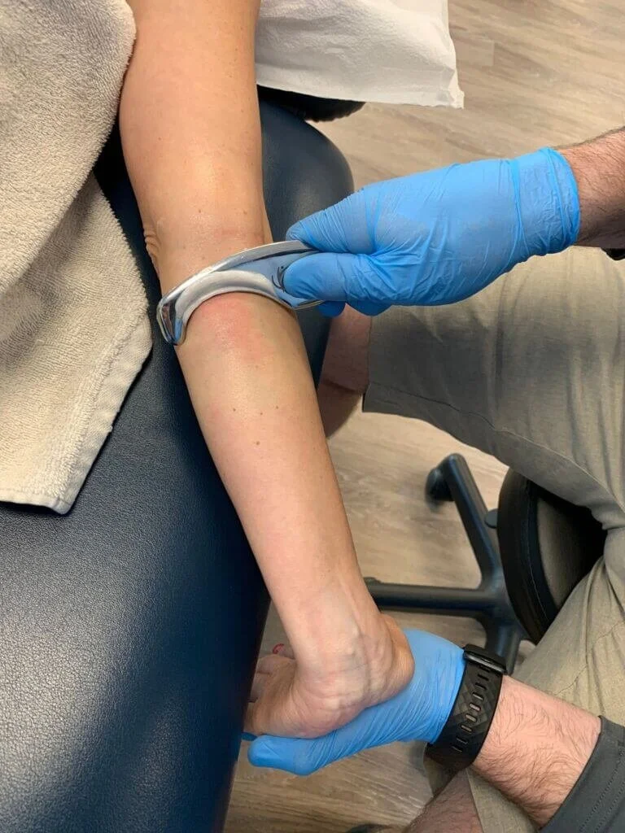
Soft Tissue Treatment
The primary mechanism of this injury is an overuse condition. Because of the nature of overuse injuries, soft tissue work is very beneficial. Focus on removing restrictions in the tissue to relieve stress on the area. Consider the state of the injury and treat any related dysfunctions.

Slide 13
Connective Tissue The nature of repetitive motion injuries includes a cyclical pattern of inflammation and the formation of scar tissue. Connective tissue work is beneficial for removing restrictions that have formed as a result of the scarring. The wrist flexors tend to be larger in comparison to the extensors—a result of being used more frequently. Since they are larger and stronger, they may develop adhesive restrictions in addition to scarring. Even if there is no current injury, connective tissue work to this area can be beneficial as a maintenance technique.

Slide 14
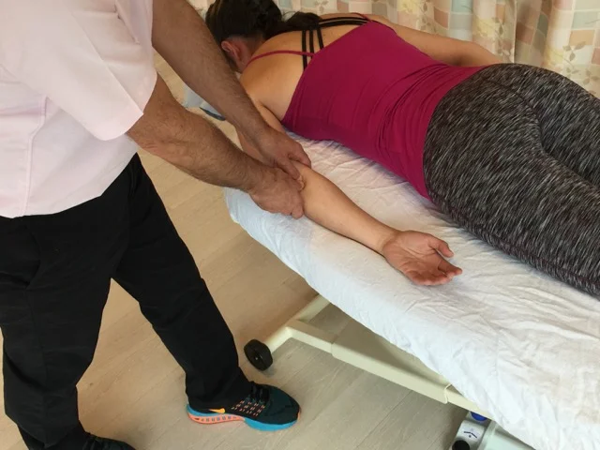
Prone Position Medial epicondylitis is best treated with the client in the prone position. If the client has no restrictions, begin by hanging the forearm off the side of the table, with the upper arm remaining on the table. Treating the muscles of the upper arm also positively affects the forearm muscles:
1. Assess the superficial connective tissue vertically, horizontally, and at various angles to determine the restrictions. Once located, move into the restrictions by directing the stroke along the restrictions until they release.

Slide 15
2. Internally and externally rotate the arm to address the entire muscle. Passive and active movements are effective and easy to apply in this position using the techniques described in the previous section. The most effective stroke that incorporates active movement is perpendicular compressive effleurage during elbow extension.
3. Once the superficial tissues have been released, move into defining the three heads of the triceps brachii, taking care to remove any restrictions between the triceps and the posterior deltoid.

Slide 16
4. Place the forearm back on the table, and assess the superficial connective tissue in various directions as described previously. When moving into the deeper layers, focus on separating out the individual wrist flexors using parallel thumb stripping with active movement. Move the hand off the table to enable full range of motion at the wrist. While the client extends the wrist, strip out the wrist flexors.
Pay special attention to the flexor retinaculum to release any restrictions, using the treatments described for lateral epicondylitis.

Slide 17
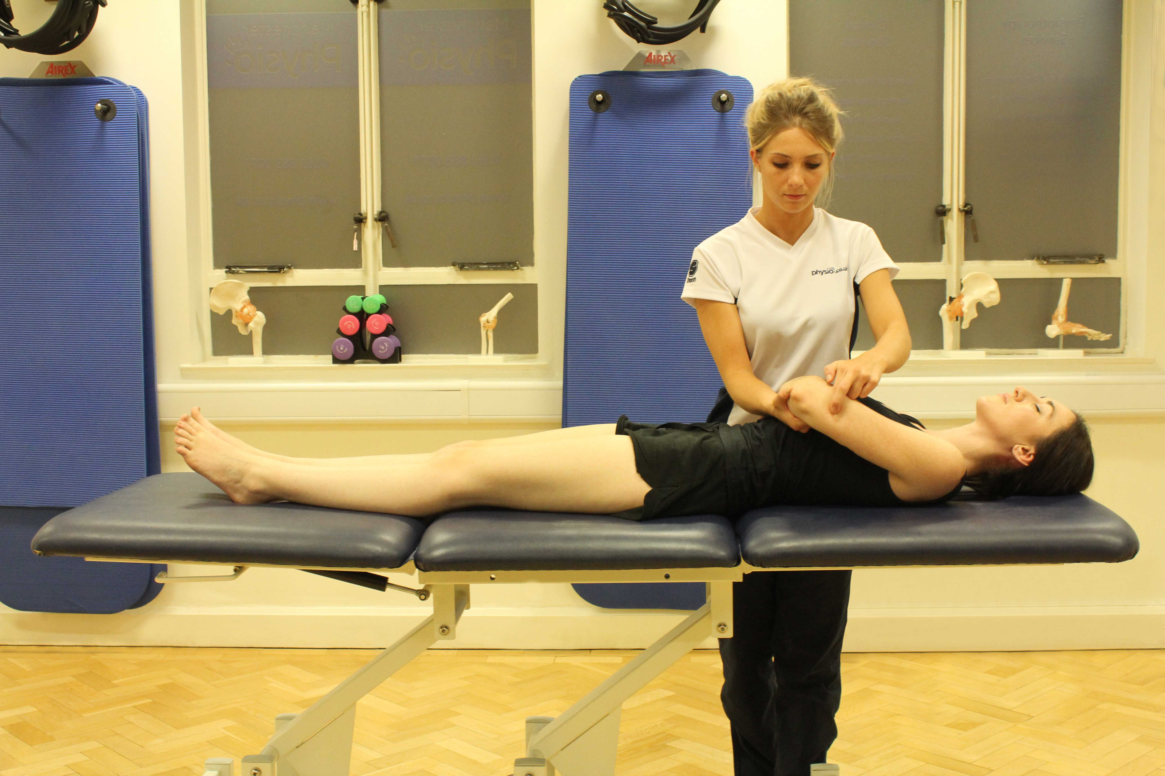
Supine Position Although the wrist extensors are not directly related to this condition, it is important to address them so that any imbalances between the groups are removed.
1. Begin by assessing the superficial tissue of the humerus. Release any restrictions in the biceps brachii, and identify each head as you move into the deeper layers.

Slide 18
2. Remove any restrictions between the biceps and the brachialis by flexing the elbow to create slack in the biceps and moving it aside in order to identify the border between the two muscles.
3. Move into the forearm by pronating it and placing it on the table. Assess the superficial tissue and address it as necessary. Identify the brachioradialis, as it is a common source of dysfunction. Strip out each wrist extensor to remove any restrictions. Be sure to address the extensor retinaculum.

Slide 19
Side-Lying Position There is no clinical advantage to placing the client in this position, unless the client specifically requests it or it is warranted by other factors.
Tissue Inconsistencies Trigger points in this area can be debilitating and can mimic other conditions; therefore, addressing them is vital. Investigate the muscles of the upper arm for trigger points, as well, since they function at the elbow. Additionally, focus on the wrist flexors, using the information discussed earlier in the chapter to help identify the location of the points. Expand the treatment areas to include the entire forearm as necessary.

Slide 20
Muscle Concerns
Treatment should focus on removing pressure on the medial epicondyle and restoring balance to the forearm. Utilize the same strokes as those described for treating lateral epicondylitis. Movement can also be easily incorporated when treating this region.
Prone Position Treatment for medial epicondylitis is similar to treatment for lateral epicondylitis. To address the triceps, hang the arm off the table and place it face up. Petrissage, perpendicular compressive effleurage, and parallel thumb stripping work well at treating the triceps and will help remove any overall tension in the area.

Slide 21
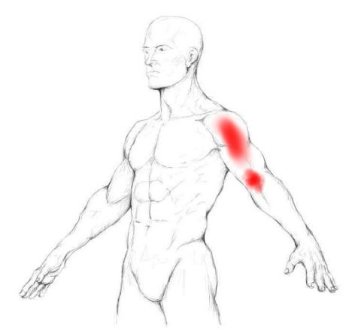
To treat the forearm in this position, place it on the table so that the ventral surface is face up. Once the superficial tissue has been released, using the forearm to administer a stroke from the elbow toward the wrist is effective. Be sure to stay within the client’s comfort level, especially as you move closer to the wrist. Apply a finishing stroke from the wrist to the elbow to ensure the return of circulation to the heart. Securing the hand and performing deep thumb-stripping strokes to the flexors is also effective in this position.

Slide 22
Supine Position The techniques described to treat lateral epicondylitis can also be applied here. One effective technique is to “milk” the forearm. Bend the client’s elbow, and hold the hand to control the arm. Perform alternating effleurage strokes from the wrist to the elbow, grasping the entire forearm. Apply more pressure with the thumb over the desired muscle to affect specific muscles. From here, separate out the brachioradialis by running one thumb down each side of the muscle.
Side-Lying Position There is no clinical advantage to placing the client in this position, unless the client specifically requests it or it is warranted by other factors.

Slide 23
Stretching
The forearm is usually a chronically tight region of the body because of excessive use during daily activities, and stretching the entire region is beneficial regardless of the condition. To begin, perform the stretches that were discussed for lateral epicondylitis.
Wrist Flexors Three stretches specific to the wrist flexors have a direct effect on medial epicondylitis. Perform them with the client in the seated position. Place the client’s arm on the table, and stabilize the forearm.

Slide 24
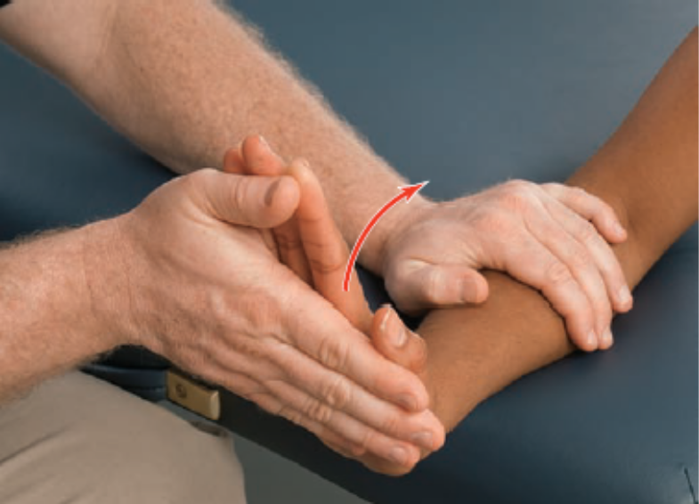
1. For the first stretch, have the client exhale and extend the wrist as far as possible, keeping the forearm pronated. Once the client reaches the end of the range, assist in the same direction by placing the therapist’s hand on the palmar surface of the client’s hand and the entire length of the fingers, keeping them straight. Return to the starting position, and repeat for one to two sets of 10 repetitions.

Slide 25
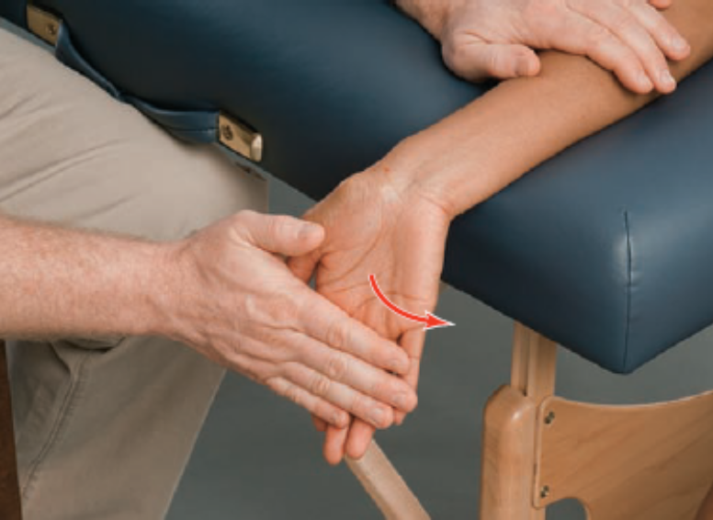
2. The next stretch addresses the same muscles but at the proximal attachments. Position the client as described above but with the forearm supinated. While exhaling, the client should extend the wrist toward the floor until he or she reaches the end of the range. At the end of the movement, assist in the same direction by placing the therapist’s hand on the palmar surface of the client’s hand and the entire length of the fingers. Release the stretch, and repeat for one to two sets of 10 repetitions.

Slide 26
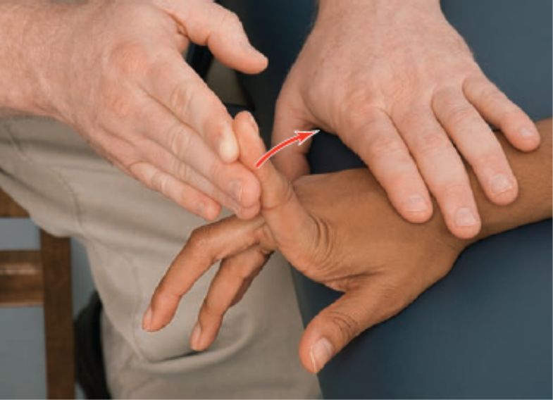
3. For the final stretch, position the client as described above but with the forearm pronated. Secure the client’s hand, and allow movement of only one finger at a time. While exhaling, the client should extend one finger until the end range. Assist at the end of the range in the same direction. If the client can move to 90°, place the wrist in slight extension to achieve a greater stretch, and repeat. Perform one to three sets of 10 repetitions per finger.

