Slide 1
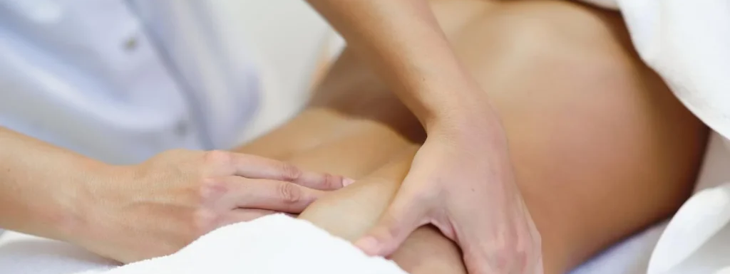
Massage Techniques 8A
The Pelvis

Slide 2
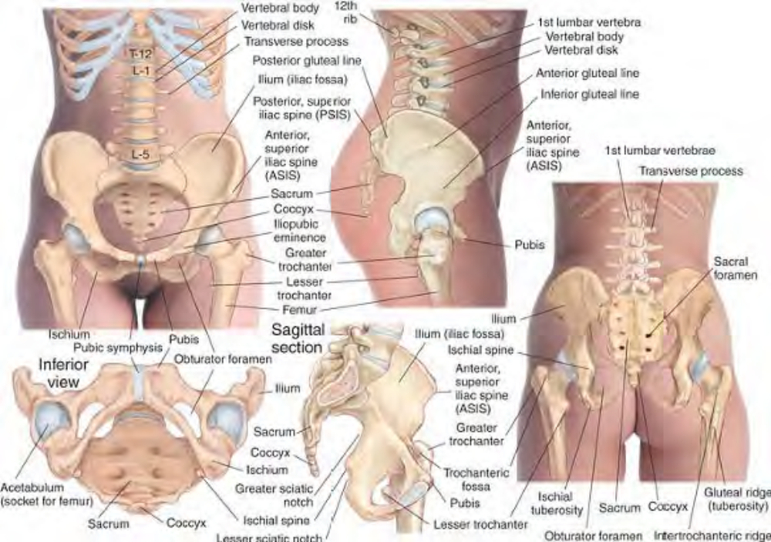
Skeletal features of the pelvic region

Slide 3
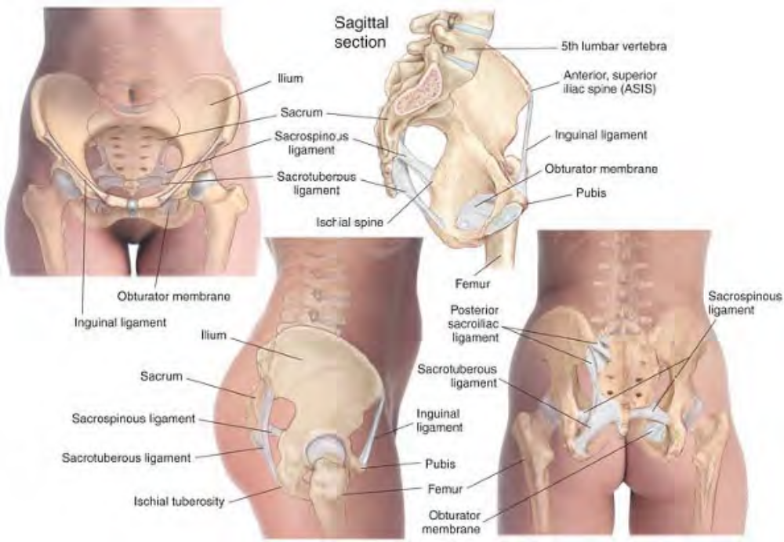
Ligaments of the pelvic region

Slide 4
Overview of the Region
The structural, functional, and emotional importance of the human pelvis cannot be overemphasized. The pelvis balances the torso and its appendages on the legs. It is the container, support, and protector of the abdominal and pelvic organs, especially the organs of reproduction and elimination. It is therefore a very personal and intimate area. Its position and freedom of movement are of principal importance in postural alignment.
Although we tend to think of the pelvis as a single entity, it is actually composed of two halves, or hemipelves, connected posteriorly at the sacroiliac joints and anteriorly at the symphysis pubis. The pelvis as a whole can be rotated forward or backward or tilted to either side. Each hemipelvis, however, can have a greater or lesser anterior or posterior rotation in relation to the other, resulting in what is called a torqued pelvis.

Slide 5
Since each hemipelvis is the site of one acetabulum, in which the head of the femur rests, the position of the hemipelvis will affect the position of the hip joint and its corresponding leg. The anterior or posterior rotation of the pelvis as a whole will also affect the normal curve of the lumbar spine, which in turn will affect the carriage of the entire upper body.
A lateral tilt in the pelvis, determined by the relative positions of the two sacroiliac joints, will result in an uneven distribution of the body weight on the legs, and will require a compensatory shifting of the rib cage and its attached structures. Any combination of tilt or rotation in the frontal or sagittal planes and torque of the hemipelves will result in a postural misalignment that is likely to cause a wide variety of myofascial problems in both the lower extremities and the entire upper body. In addition to postural issues, tightness or trigger points in the muscles of the pelvis can interfere with reproductive or eliminatory functions and can refer pain into the viscera.

Slide 6
The muscles of the pelvis should always be considered and addressed in any interview and examination. Because of the intimate nature of the pelvic region, it is necessary to approach examination and treatment with a great deal of sensitivity to the client's feelings and concerns with regard to privacy and modesty. Examination and treatment should be carried out only with informed consent.

Slide 7
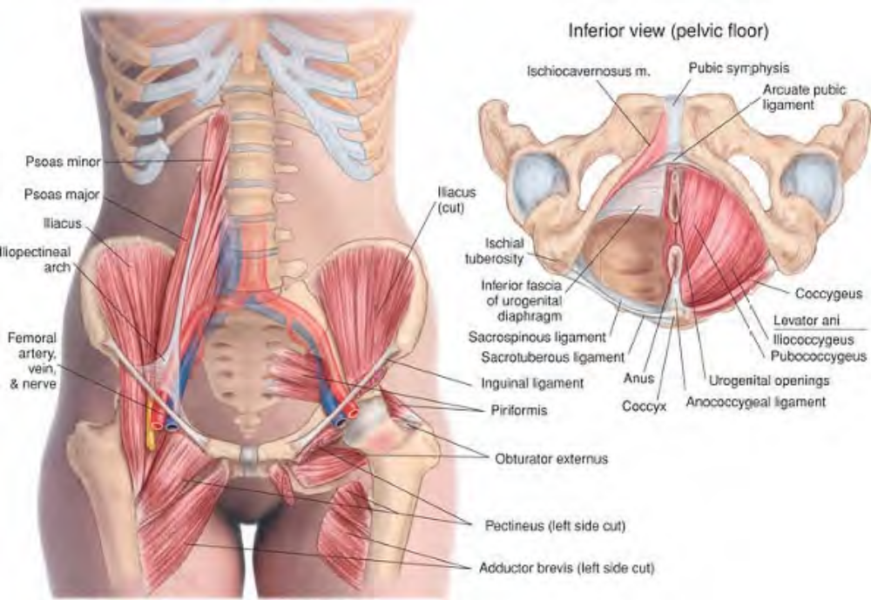
Muscles of the anterior pelvis and pelvic floor

Slide 8
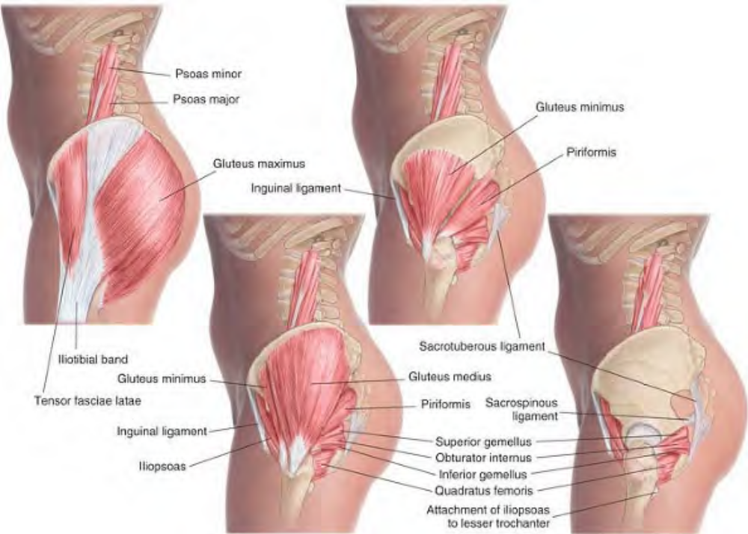
Muscles of the pelvis, lateral view

Slide 9
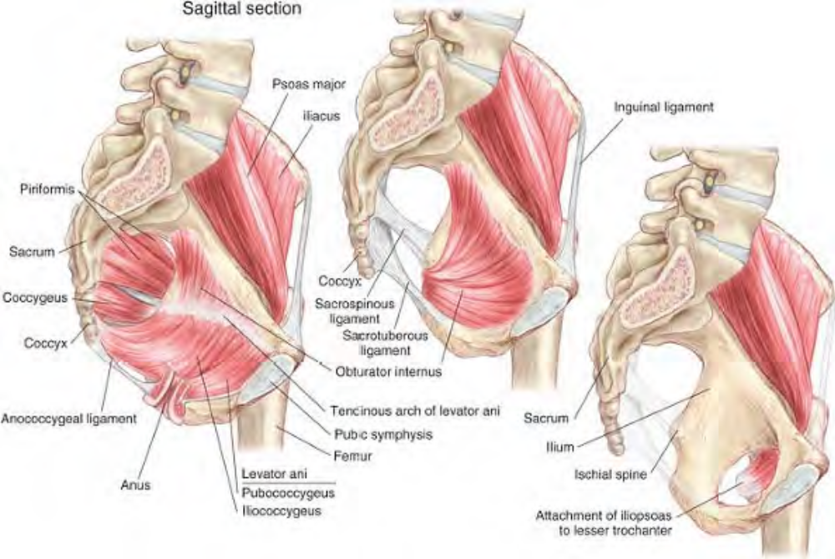
Muscles of the pelvis, sagittal section

Slide 10
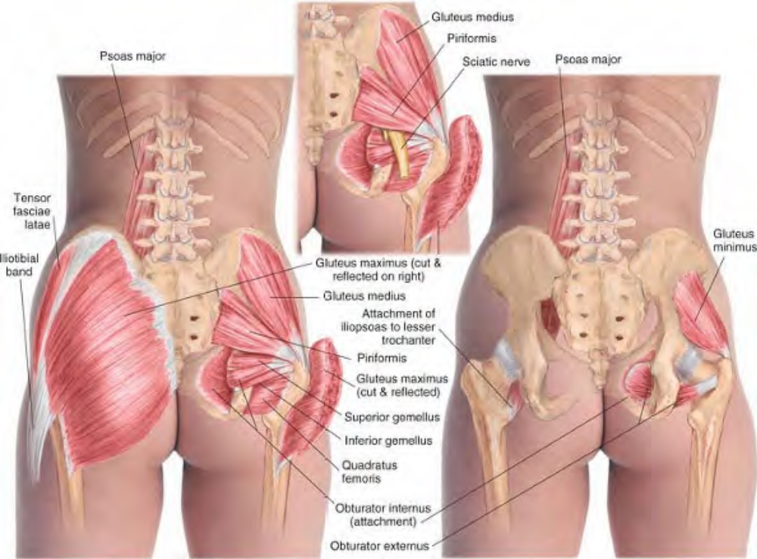
Muscles of the pelvis, posterior view

Slide 11
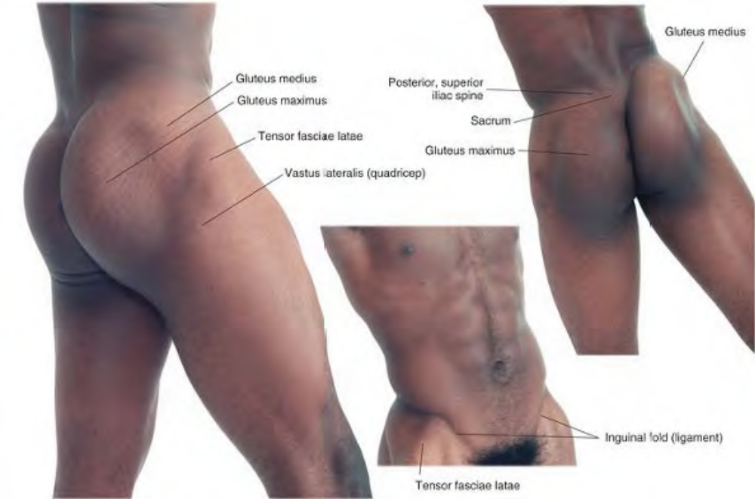
Surface anatomy of the pelvic region

Slide 12
Psoas Major (Iliopsoas) SO-az MAY-jer
Etymology Greek psoa, the muscles of the loins + Latin major, larger
Overview
Psoas major, which joins iliacus at the groin to form iliopsoas, is one of the most important muscles in the body, not only for its primary function as hip flexor, but also for its postural and clinical significance. In four-legged domestic animals, iliopsoas has little challenging work to do, since it has no real postural function and acts only to swing the hind leg forward in walking. For this reason, it tends to be a tender cut of meat: it is the tenderloin or filet, the source of the filet mignon. In humans, the story is altogether different: since we walk upright, much greater muscular effort is required to flex the hip and lift the leg. In addition, psoas plays a major role in determining the positioning of the pelvis and low back in relation to each other.

Slide 13
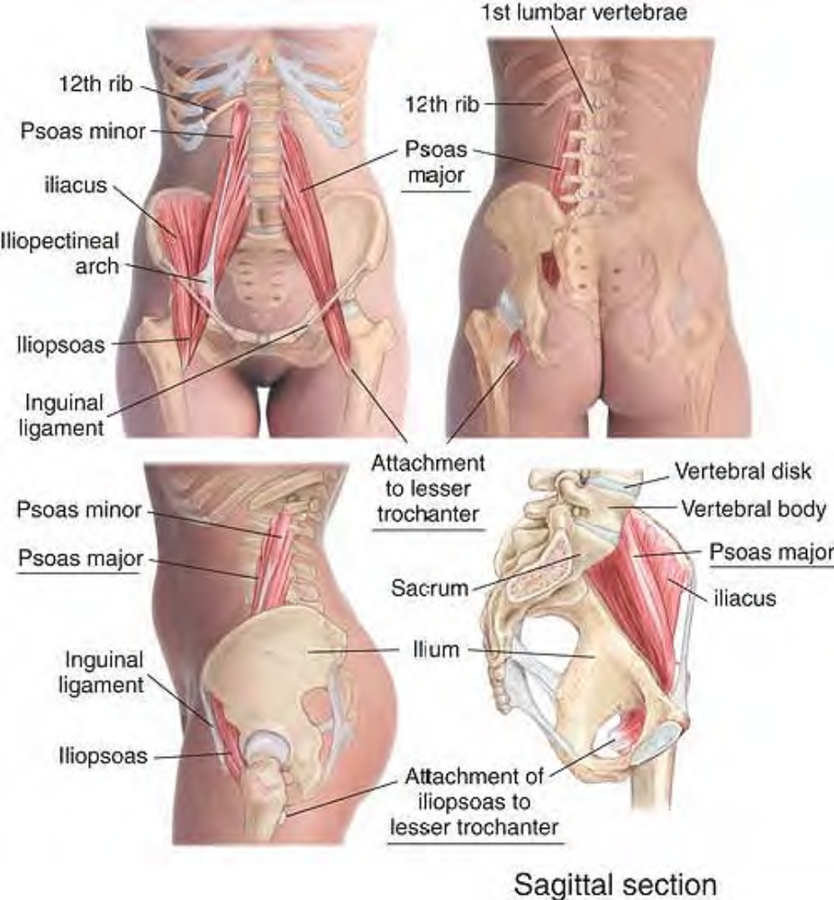
Anatomy of psoas major

Slide 14
During gestation, the hips of the fetus remain fully flexed most of the time. If you observe human babies, you will notice that they do not lie flat the hips tend to stay partially flexed. In fact, a baby does not usually attain full extension of the hips until she begins to walk. This full extension is necessary for a relaxed and comfortable upright posture. Children spend a great deal of time sitting, either in class at school, or at home studying or watching television. Most adults spend even more time in this position at desks or computers or, again, in front of the television. Iliopsoas, therefore, spends a lot of time shortened and very little time stretched.
Psoas attaches to the lumbar vertebrae and passes downward through the abdominal cavity to the groin, where it merges with iliacus and passes over the anterior rim of the ilium, then obliquely in a posterior and inferior direction to attach to the lesser trochanter of the femur.

Slide 15
In this way, it uses the anterior rim of the ilium as a pulley, exerting an inferior and posterior force against it. Thus, by pulling forward on the lumbar spine and pressing downward and backward on the anterior inferior ilium, it rotates the pelvis forward and draws the lumbar curve into lordosis. This effect can easily be seen in children, who tend to have this rotation and lordosis to a pronounced degree, and it is quite common for this postural tendency to persist into adulthood to a lesser, but still measurable, extent. One result of an anterior pelvic rotation is to shift the weight of the contents of the abdominal cavity forward, causing the abdomen to protrude. In addition, this rotation moves the hip joint posteriorly, placing strain on the muscles controlling the knees and ankles. An exaggerated lumbar lordosis requires compensatory positioning of all the structures superior to it.

Slide 16
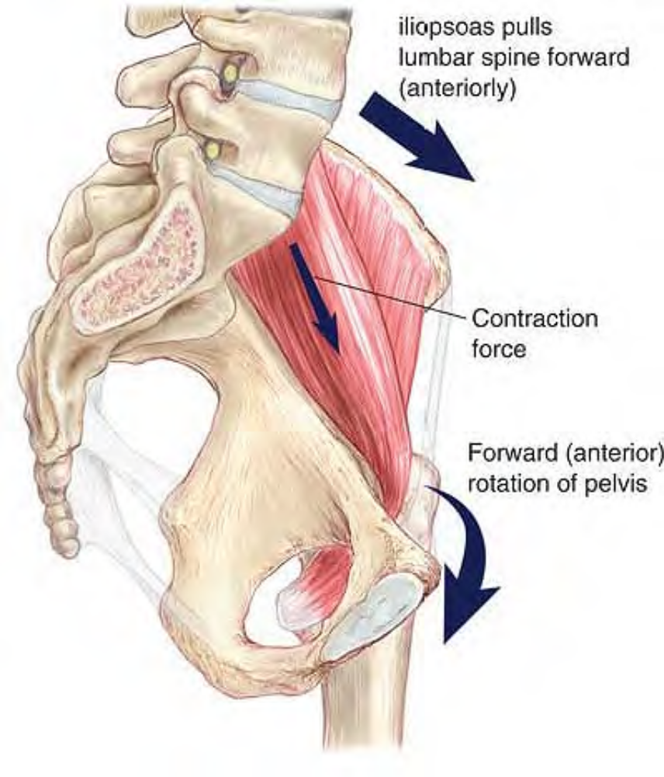
Influence of psoas major on anterior pelvic rotation

Slide 17
The clinical significance of psoas is both indirect and direct: indirect, in the postural influences described above, and direct, by referring pain into the low back, abdomen, groin, and upper thigh. The pain referral patterns of psoas can include the viscera. In this way, psoas problems can mimic pain from visceral causes.
Attachments. Superiorly, to the vertebral bodies and intervertebral disks of the twelfth thoracic to the fifth lumbar, and to the transverse processes of the lumbar vertebrae. Inferiorly, with the iliacus muscle to the lesser trochanter of the femur.

Slide 18
Palpation. Belly is discernible with the fingertips just below and two to three inches to either side of the umbilicus by having the client raise the corresponding leg. Lower psoas is discernible in the groin below the inguinal ligament just medial to the iliopubic eminence. Architecture is parallel, and fibers run vertically except where they pass over the pelvic rim.
Action. Flexes the hip; is a major postural muscle
Referral Areas. To the medial lumbar region. To the abdomen from the epigastrium to the groin. To the anterior thigh from the groin halfway to the knee

Slide 19
Manual Therapy
Compression. The client lies supine, with the hip and knee on the side to be treated flexed about 45’. The therapist stands beside the client, at the client's hip. Place the fingertips of the hand nearest the client on the near side of the abdomen, a few inches inferior and lateral to the navel. Press firmly and slowly into the abdomen, moving the fingertips in a circular fashion to nudge the viscera out of the way.
When you encounter the psoas, press into the muscle searching for tender areas. Hold for release. Move the hand caudally so that the fingertips are just inferior to the previous spot

Slide 20
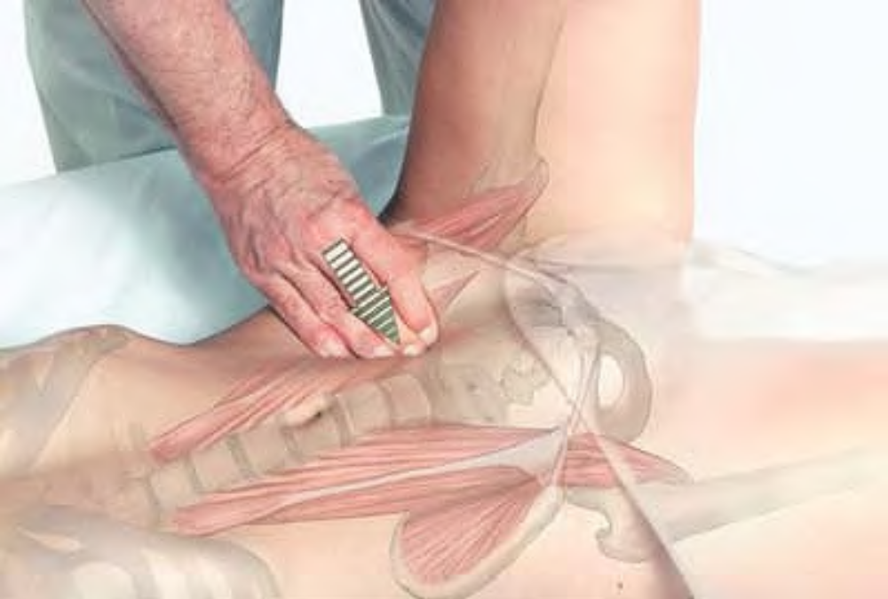
Position of hand for work on psoas major

Slide 21
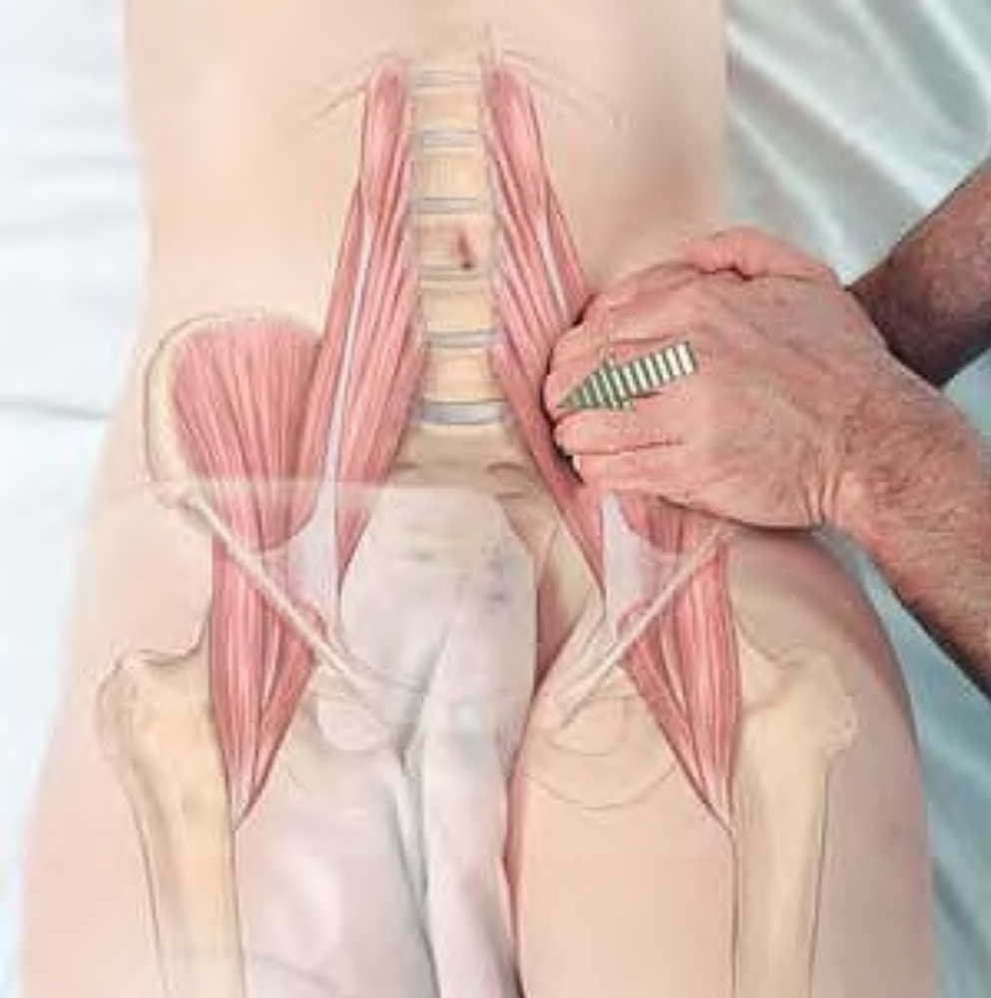
Compression of psoas major

Slide 22
. Repeat this procedure until you reach the inguinal ligament. Repeat at the groin below the inguinal ligament (the circular motion is not necessary here). This work on psoas may also be done from the opposite side of the client, with the client in a sitting position, or standing bent over the table.
Compression of the Inferior Attachment. The client lies supine. The therapist stands beside the client at the client's knees. Place the supported thumb on the anterior thigh, about two inches below the groin, medial to the rectus femoris. Press firmly into the tissue, looking for the attachment to the lesser trochanter. If tender, hold for release.

Slide 23
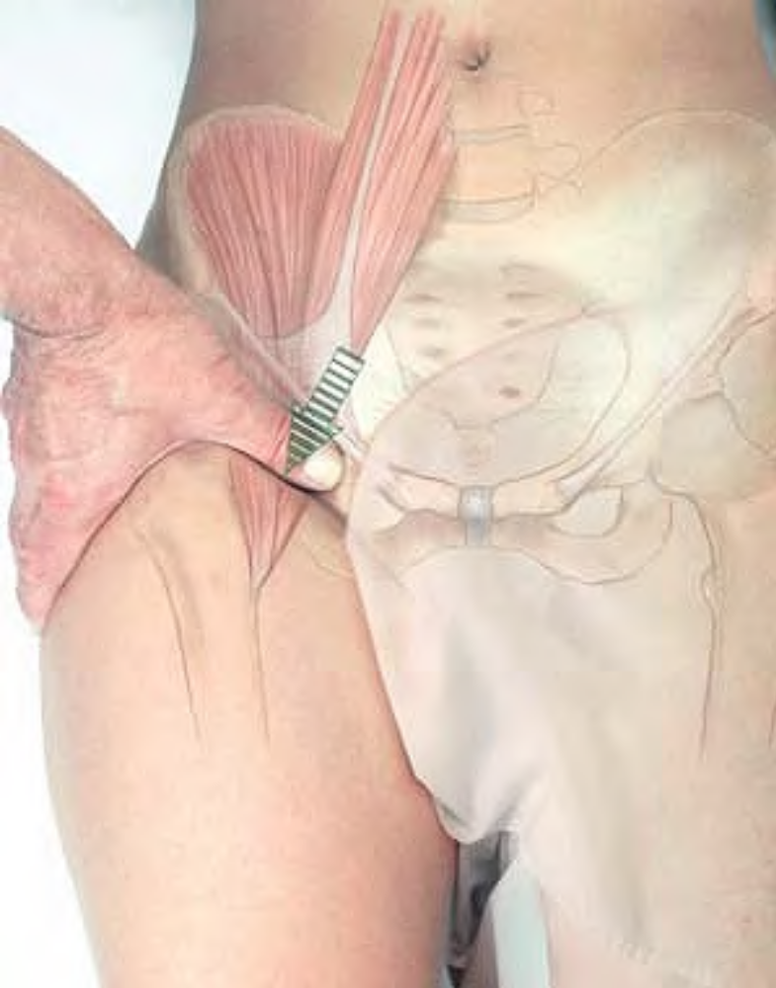
Compression of iliopsoas below the inguinal ligament

Slide 24
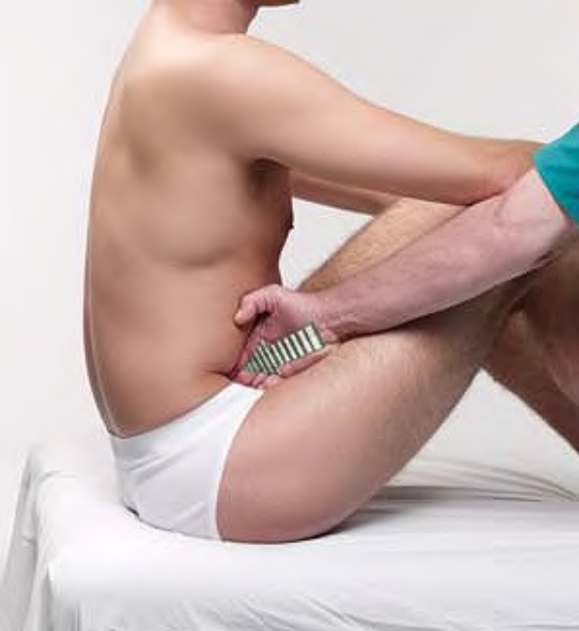
Compression of psoas major with client in sitting position

Slide 25
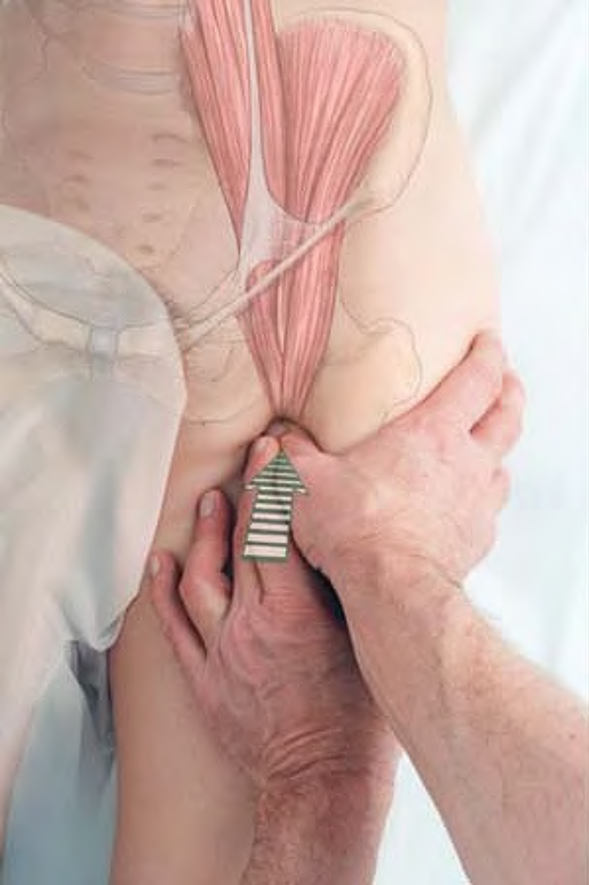
Compression of attachment of psoas major to lesser trochanter

Slide 26
Iliacus il-lee-ACK-us, il-EYE-a-cus
Etymology Relating to the ilium: Latin ilium, flank, groin
Overview. See discussion of psoas, above.
Attachments. Superiorly, to the iliac fossa. Inferiorly, to the tendon of psoas, the anterior surface of lesser trochanter, and the capsule of the hip joint
Palpation. Can be discerned with the fingertips curled over the ilium. The architecture is convergent.
Action. Flexes the hip
Referral Areas. See psoas, above

Slide 27
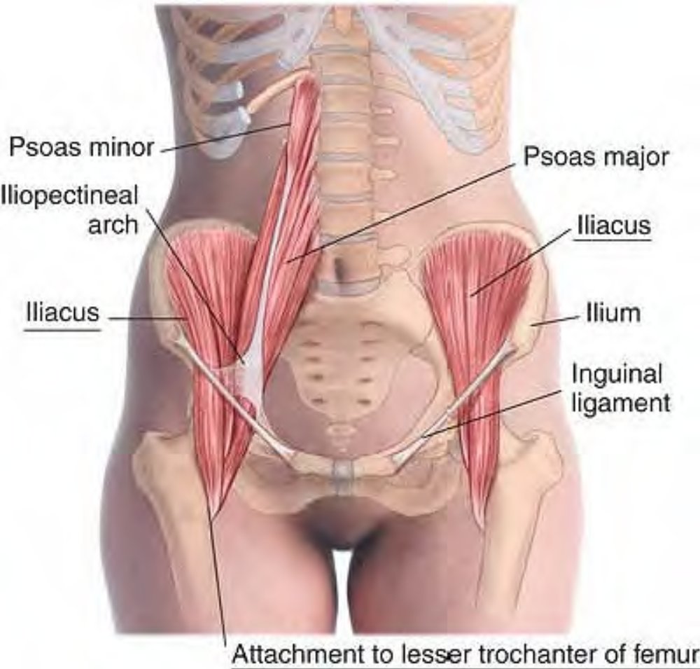
Anatomy of iliacus

Slide 28
Manual Therapy
Stripping and Cross-fiber Stroking. The client lies supine. The therapist stands beside the client at the hip. Place the fingertips just medial to the ilium. Pressing firmly into the tissue, move the fingertips back and forth and rotate the hand from side to side to slide the fingertips across the muscle (Fig. A).This procedure may also be carried out with the supported thumb (B), or with the client prone and the hand underneath the pelvis (Fig. C).

Slide 29
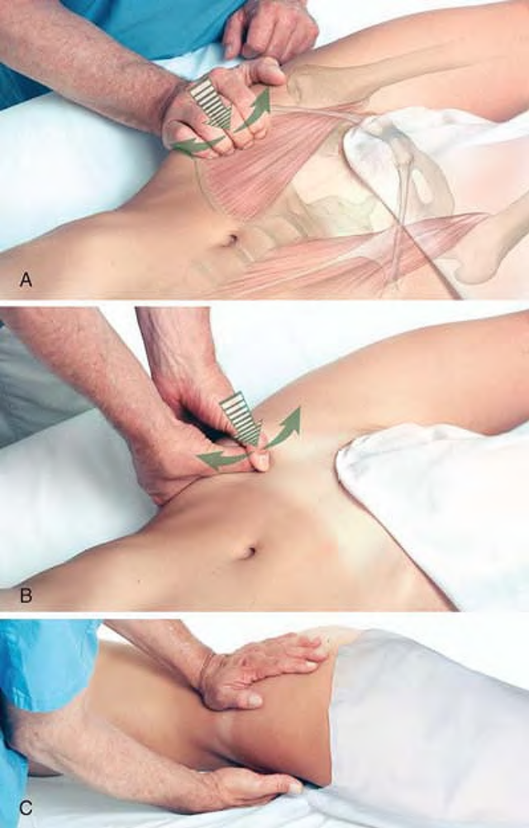
Stripping and cross-fiber stroking of iliacus with fingertips (A), supported thumb (B), and from underneath the client (C)

Slide 30
Psoas Minor SO-az MY-ner
Etymology Greek psoa, the muscles of the loins + Latin minor, smaller
Overview. Psoas minor is absent in approximately 40% of the population, and in some people may be present on one side only. It has no recorded clinical significance.
Attachments. Superiorly to the bodies of the twelfth thoracic and first lumbar vertebrae and the disk between them Inferiorly, to the iliopubic eminence via the iliopectineal arch (iliac fascia).
Palpation. Not palpable
Action. Assists in
Referral Areas. Not applicable
Manual Therapy. Not applicable

Slide 31
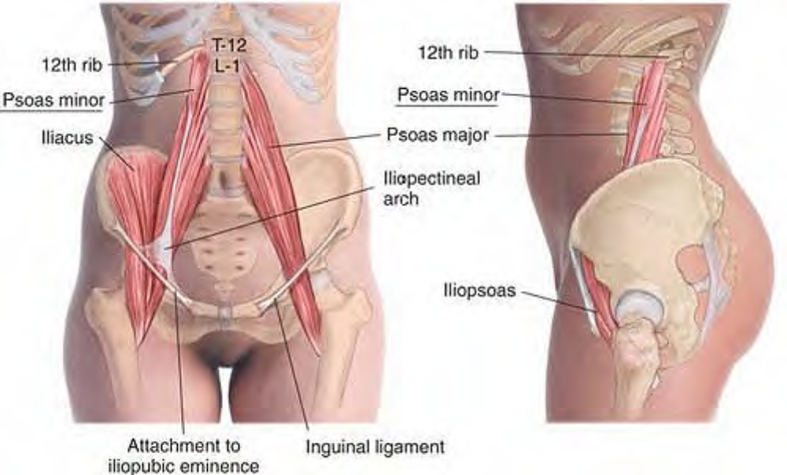
Anatomy of psoas minor

