Slide 1
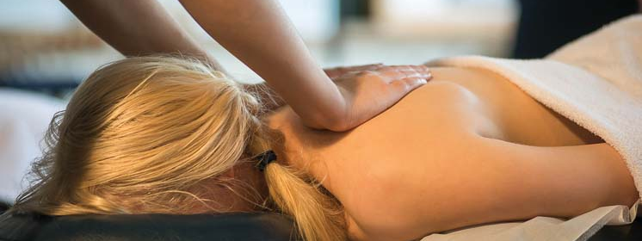
Massage Techniques 7B
Muscles of lower back

Slide 2
Quadratus Lumborum kwa-DRAY-tus lum-BOR-um
Etymology Latin quadratus, four-sided + lumborum, of the loins
Comment
When cinematographers have to shoot a scene in which the camera is moving around, either on someone's back or on a truck, they use a device called Steadicam to prevent the movement of the carrier being transferred to the camera. The same coordination between our upper and lower bodies is needed when we perform complex actions with our eyes and hands while running or riding on horseback, or keep our feet and legs steady while performing actions with our arms. In addition to its responsibility for side-bending, quadratus lumborum performs this service. For this reason, you will often find quadratus lumborum problems in horseback riders, kayakers, golfers, and anyone whose activities involve separation of movement between the upper and lower body.

Slide 3
Quadratus lumborum is not an easy muscle to access manually, as it lies deep to the lumbar paraspinal muscles (erector spinae) and the thick layers of fascia and aponeurotic tissue of the lumbar region. It can be approached obliquely with the elbow just adjacent to the lumbar paraspinal muscles or laterally with the fingers or thumbs.
Attachments. Inferiorly, to the iliac crest, iliolumbar ligament, and transverse processes of the lower lumbar vertebrae Superiorly, to the twelfth rib and transverse processes of the upper lumbar vertebrae
Palpation. Can be palpated with thumb or fingertips from the side underneath the paraspinal muscles and lumbar aponeurosis between the last rib and the iliac crest. The fibers are oblique, the upper fibers from lateral to medial, lower fibers medial to lateral, and the architecture is parallel.

Slide 4
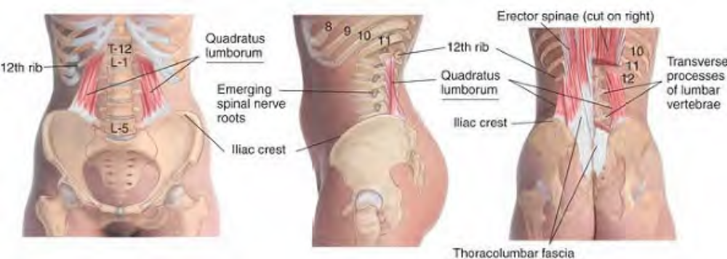
Anatomy of quadratus lumborum

Slide 5
Actions. Lateral flexion of the spine (unilaterally) Extension of the spine (bilaterally) Stabilization of the lumbar spine
Referral Areas. Into the buttock Over the hip Down the back of the leg Over the iliac crest Into the groin and sometimes the testicle Into the lower lateral quadrant of the abdomen
Other Muscles to Examine. Iliopsoas. Lumbar paraspinal muscles. Gluteal muscles. Piriformis and other deep lateral rotators.Rectus abdominis and pyramidalis
Caution. In working in a superior direction on quadratus lumborum, do not place excessive pressure on the last rib. It is joined only to T12 and can be broken with pressure.

Slide 6
Manual Therapy
Myofascial Stretch
The client lies prone. The therapist stands beside the client at the waist. Place the hand nearest the client's head flat on the lumbar area lateral to the vertebrae with the fingers over the iliac crest just lateral to the sacrum.
Crossing the other hand over or under the first, place it flat on the thoracic area over the lowest three or four ribs. Let your hands sink into the tissue until you feel contact with the superficial fascia. Press the hands in opposite directions, with enough downward pressure to engage and stretch the superficial fascia. Hold until you feel significant release in the fascia. Shift both hands laterally (toward yourself) by one hand's width and repeat the technique.

Slide 7
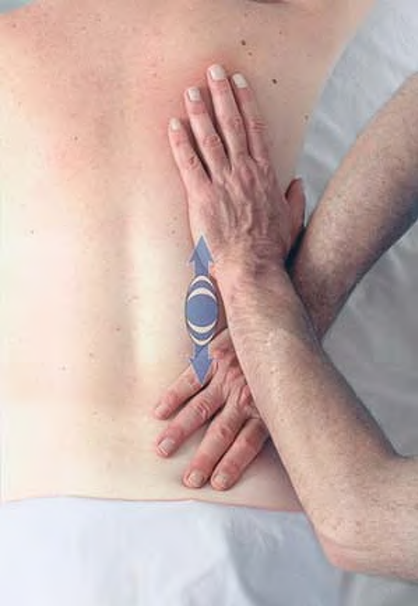
Myofascial stretch of low back

Slide 8
Compression
The client lies prone or on one side. The therapist stands beside the client at the waist.
Grasp the client's waist laterally, with either the thumb (Figs. A) or the fingertips (Fig. B) pressing under the erector spinae bundle into quadratus lumborum. Press firmly into the muscle, looking for tender spots, which may range from the attachments to the ilium to the attachments to the last rib. Hold for release.

Slide 9
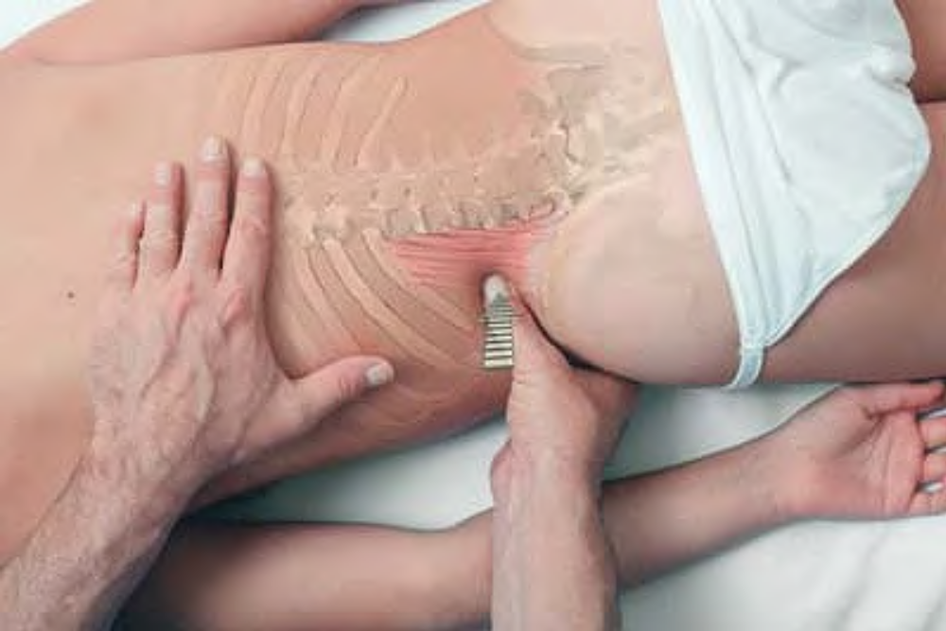
Compression of quadratus lumborum with the thumb, client prone

Slide 10
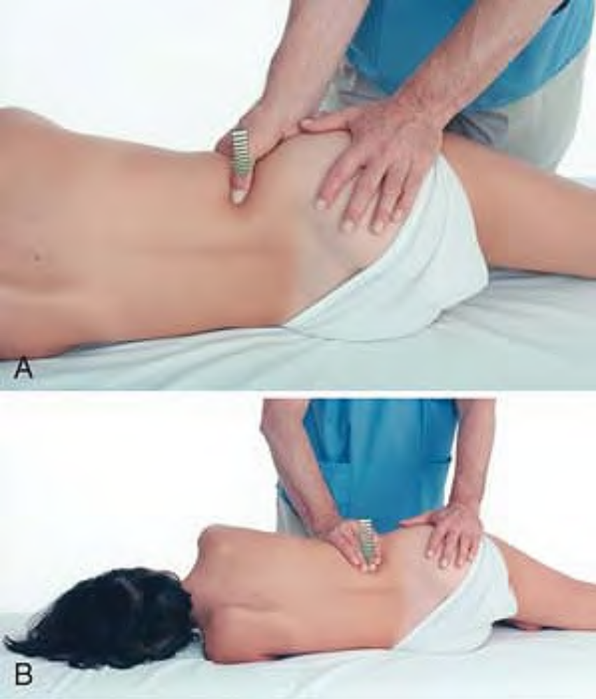
Compression of quadratus lumborum with the client sidelying, using the thumb (A) or fingertips (B)

Slide 11
Compression
The client lies prone. The therapist stands beside the client at the waist. Place the elbow just lateral to the erector spinae bundle. Press firmly into the tissue, obliquely in a deep and medial direction. Hold for release. Repeat this procedure, first pressing superiorly toward the muscle's attachment to the last rib (Fig. A), then inferiorly toward the muscle's attachment to the ilium (Fig. B).

Slide 12
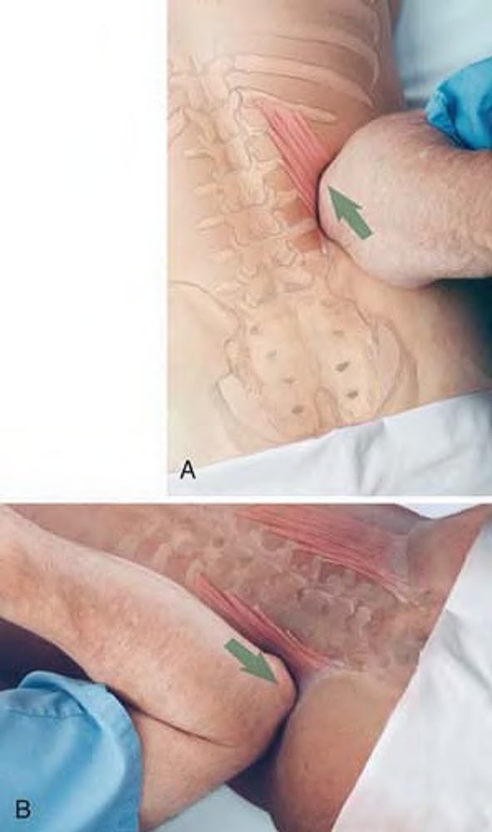
Compression of quadratus lumborum with the elbow superiorly (A) and inferiorly (B), client sidelying

Slide 13
Stretch
The client lies prone. The therapist stands beside the client at the waist. Place the heel of the hand just lateral to the erector spinae bundle on the opposite side of the client’s body, between the ilium and the last rib. Pressing deeply toward the table, let the heel of your hand slide slowly away from you compressing all the muscles between the pelvis and the last rib, until your hand comes off the client’s side.

Slide 14
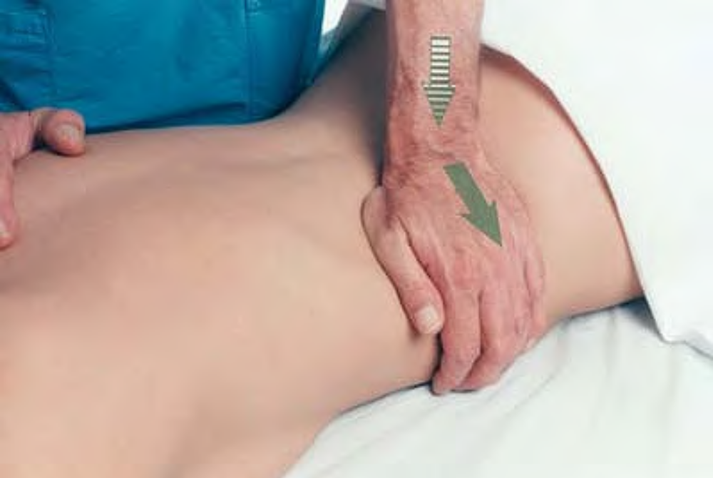
Stretch of quadratus lumborum with the hand

