Slide 1
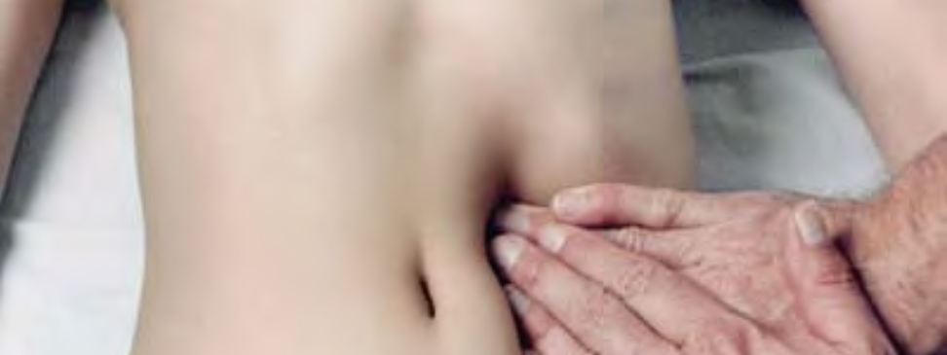
Massage Techniques 7A
Low back and Abdomen

Slide 2
Overview of the Region
The waist, which includes the low back (lumbar region) and middle abdomen, is a very vulnerable area because of its lack of bony armor and support. Above, the torso and spine are stabilized and the internal organs protected by the rib cage. Below, the pelvis provides stability and protection. In between, however, our need for flexibility and mobility require a space with very little support or protection. The muscles of this region, therefore, have a lot of work to do and are easily stressed or injured. Their primary actions are movement of the upper body in relation to the lower and vice versa: anterior flexion, lateral flexion, and rotation of the torso. Trigger points in these muscles refer to an extensive territory: upward into the back and chest; inward into the viscera; and downward into the buttocks, lower abdomen, groin, genitals, and legs.

Slide 3
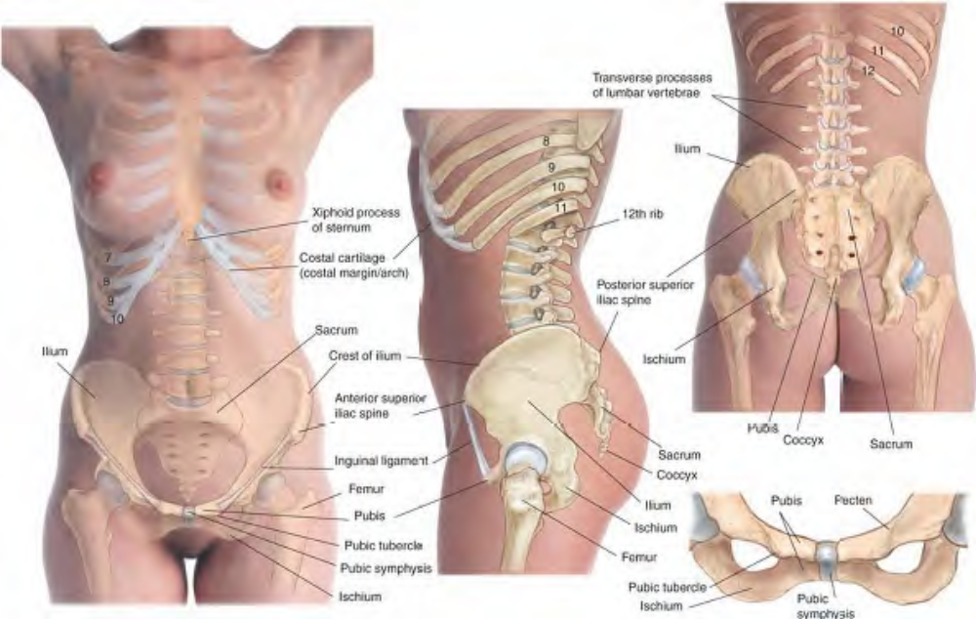
Skeletal features of the abdominal region and lower back

Slide 4
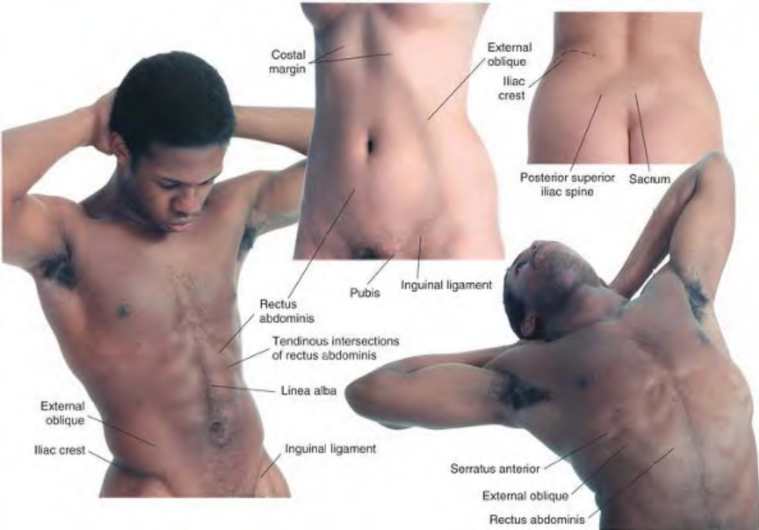
Surface anatomy of the abdomen and lower back

Slide 5
Muscles of the Abdomen
Comment
These muscles form the wall of the abdomen, and include rectus abdominis, transversus abdominis, and the external and internal oblique muscles. Aside from their various primary functions, all of these muscles assist in forced exhalation through compression of the abdominal cavity. They are extremely important clinically, as trigger points in these muscles can refer pain into the viscera and even cause visceral problems (somatovisceral disease). Likewise, visceral disorders can cause pain in the abdominal musculature that can persist even after the disorder is resolved. They can also refer pain into the low back. It is helpful to do some preparatory work on the abdomen prior to deeper manual therapy on specific muscles in order to stimulate local blood flow and relax the superficial musculature. This work may include general massage techniques such as effleurage as well as myofascial stretching.

Slide 6
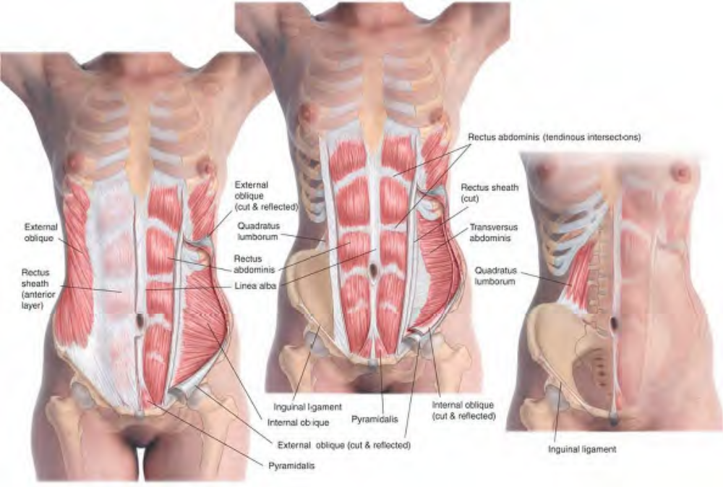
Muscles of the anterior abdomen

Slide 7
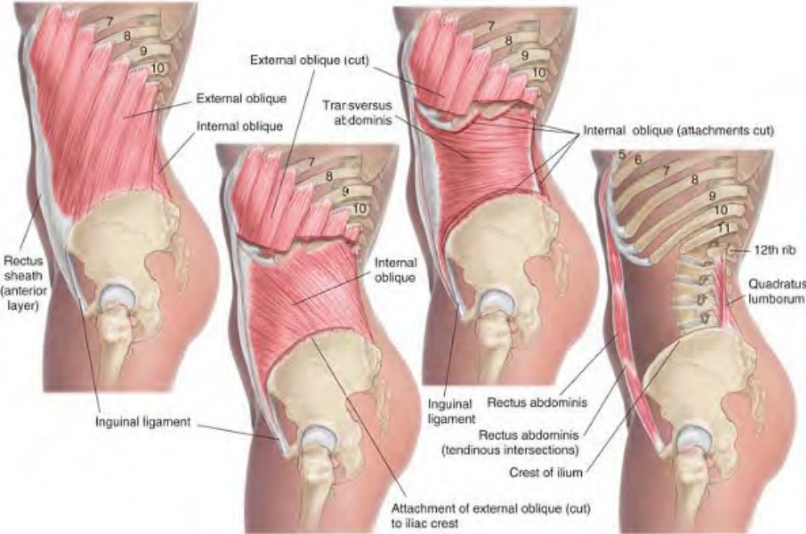
Abdominal and lower back muscles, lateral view

Slide 8
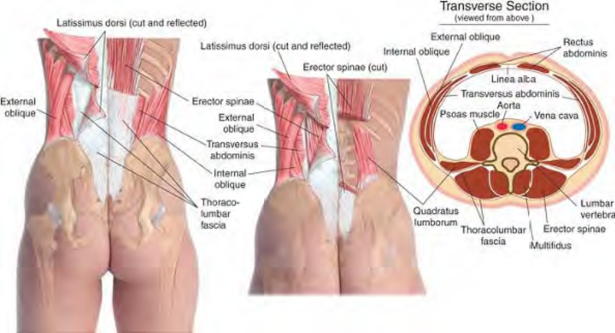
Muscles of the lower back

Slide 9
Manual Therapy for the Abdomen
Myofascial Stretching
The client lies supine. The therapist stands beside the client at the hips. Place one hand flat on the upper abdomen on the near side of the client, the fingers resting just inferior to the rib cage Cross the other hand over the first and place it on the lower abdomen on the far side of the client, the fingers over the ASIS (anterior superior iliac spine). Let the hands sink into the tissue until they engage the superficial fascia of the abdomen. Press the hands apart without allowing them to glide on the skin. Hold for release. Repeat on the opposite side.

Slide 10
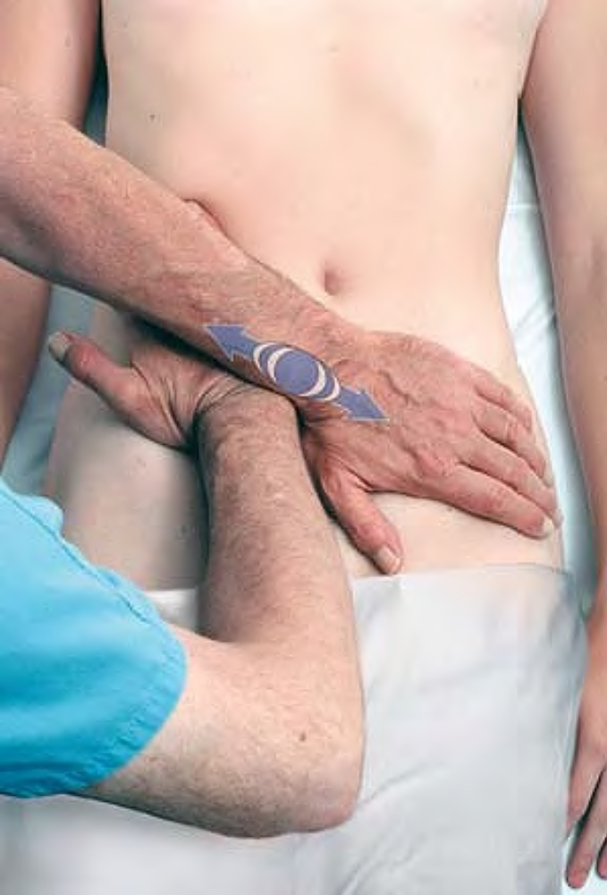
Myofascial stretch of abdomen

Slide 11
Rectus Abdominis REK-tus ab-DAHM-in-iss
The lumbar/abdominal muscles constitute one of the muscle groups chiefly implicated in complaints of low back pain. The others are the buttock muscles, pelvic floor muscles, and iliopsoas, all of which are addressed later.
Etymology. Latin rectus, straight, upright + abdominis, of the abdomen
Comment. Rectus abdominis is composed of a series of muscle bodies separated by tendinous intersections and divided in the center by the linea alba (Latin linea, line + alba, white). This muscle connects the anterior thorax (rib cage) to the anterior pelvis (pubis). It flexes the spine and resists extension of the spine.
Attachments. Inferiorly, to the crest and symphysis of the pubis. Superiorly, to the xiphoid process and fifth to seventh costal cartilages

Slide 12
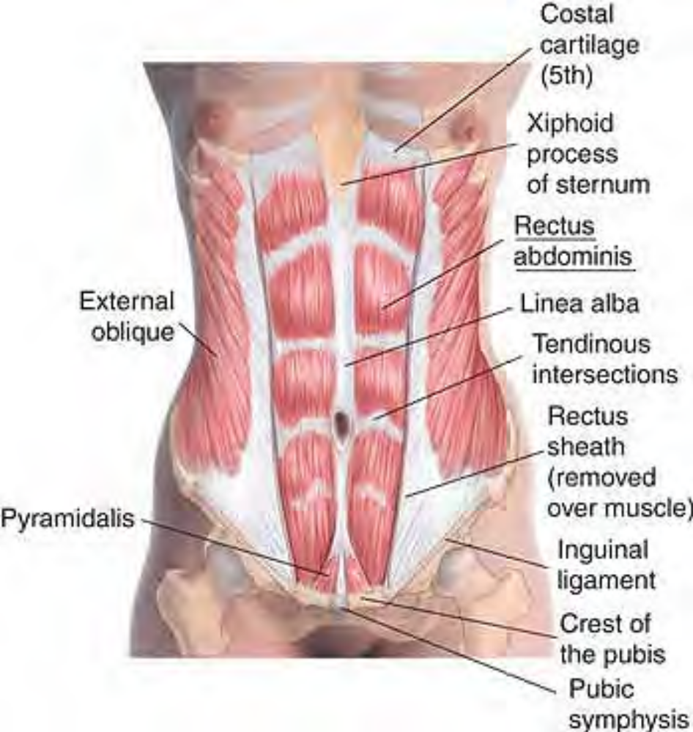
Anatomy of rectus abdominis

Slide 13
Palpation. Discernible at the pubis; discernible at the edges with the fingertips from the pubis to the rib cage, although difficult to distinguish in obese clients. Its architecture is parallel, and the fibers are superior-inferior.
Action. Flexes the lumbar vertebral column Draws the thorax inferiorly toward the pubis
Referral Areas. Over the abdomen from the xiphoid process to the pubis Across the back just below the scapulae; the region around the xiphoid process (epigastrium, precordium) Across the top of the buttocks (iliac crest) and sacrum Into the lower lateral quadrant of the abdomen Mid-abdomen just inferior to umbilicus (Also, abdominal fullness, dysmenorrhea).

Slide 14
Manual Therapy
Stripping (1)
The client lies supine. The therapist stands beside the client at the hip. Place the fingertips on one side of the rectus just superior to the pubis. Pressing firmly into the tissue, slide the fingertips superiorly along the muscle to its attachments on the Ribs. Repeat the same procedure on the other side.

Slide 15
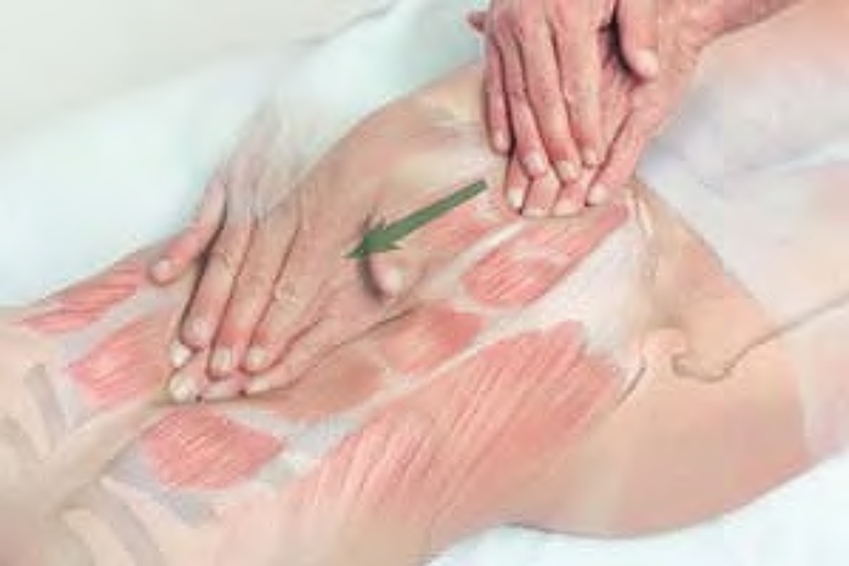
Stripping of rectus abdominis

Slide 16
Stripping (2)
The client lies supine. The therapist stands beside the client at the waist. Place the fingertips on the lateral border of the rectus just above the pubis. Pressing firmly into the tissue, rotate the hand so that the fingertips move superiorly along the edge of the muscle.
Beginning just superior to the previous spot, repeat this procedure all the way along the muscle to the rib cage. Repeat the same procedure on the other side.

Slide 17
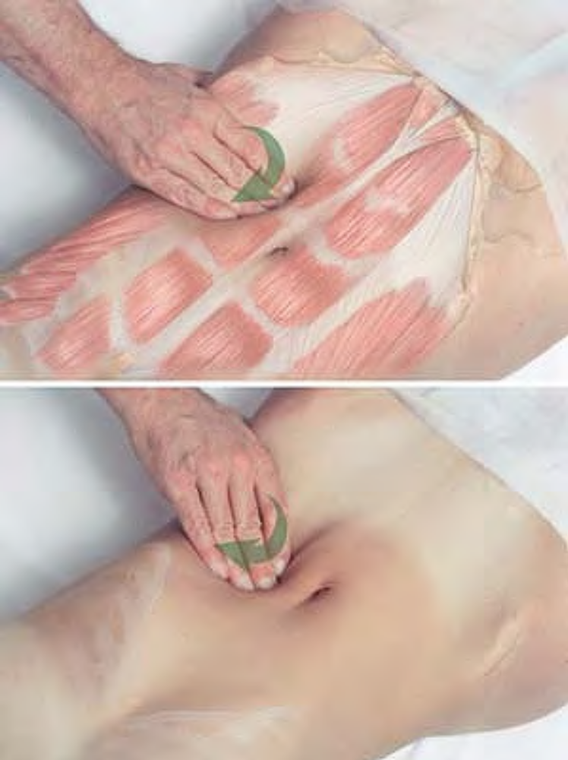
Stripping of lateral border of rectus abdominis

Slide 18
Stripping (3)
The client lies supine. The therapist stands beside the client at the hip. Place the fingertips (Fig. A) or supported thumb (Fig. B) on the lateral border of the rectus just above the pubis. Pressing firmly into the tissue, slide the fingertips or thumb along the muscle to its attachments on the rib cage.
Repeat the same procedure on the other side.

Slide 19
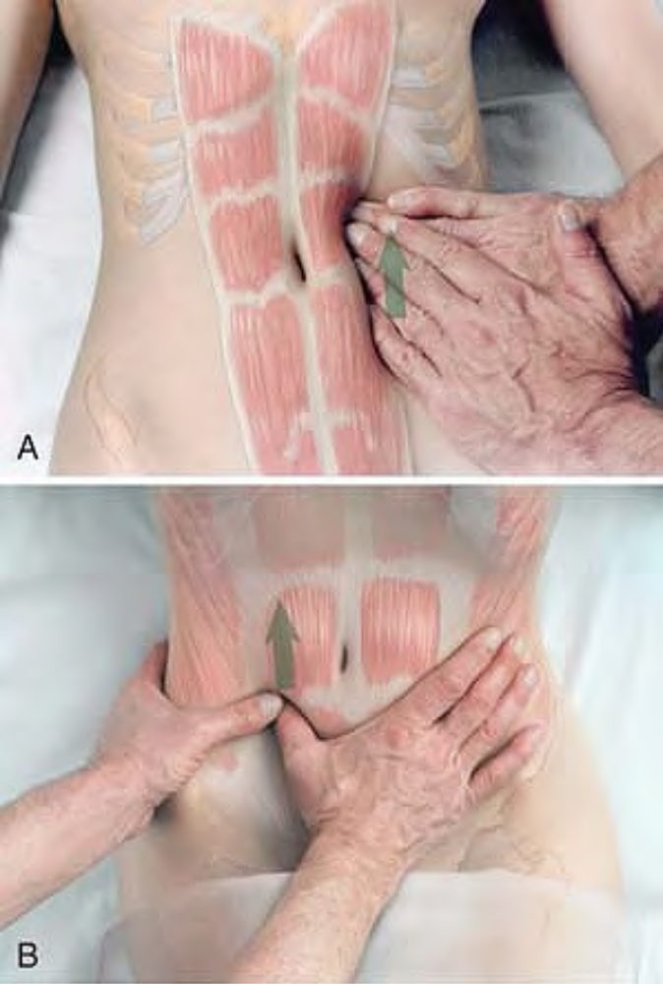
Stripping of lateral border of rectus abdominis with fingertips (A) or supported thumb (B)

Slide 20
Compression
The client lies supine. The therapist stands beside the client at the chest. Place the supported thumb at the attachment of the rectus to the pubis at the side nearest you. Press the muscle firmly against the bone, looking for tender spots. Hold for release. Move the hand medially to the next spot and repeat until you reach the linea alba at the center.
Repeat this procedure on the other side.

Slide 21
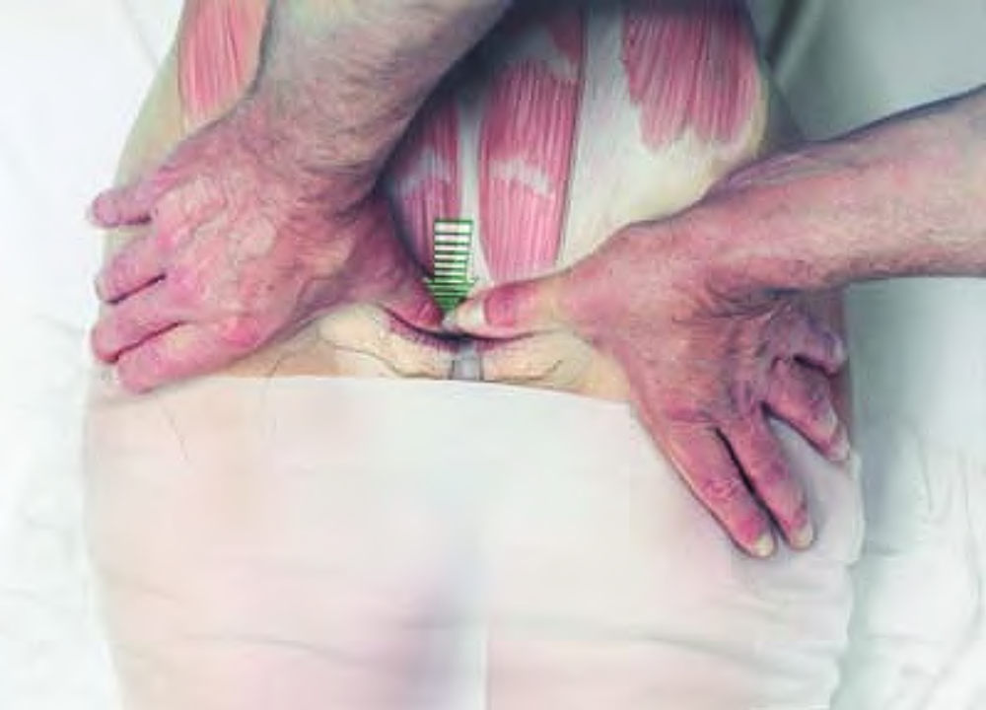
Compression of rectus abdominis attachments at the pubis

Slide 22
Cross-fiber Stroking
The client lies supine. The therapist stands beside the client at the waist. Place the tip of the thumb on rectus abdominis at the linea alba (center line) just superior to the pubic symphysis, with the fingertips resting on the abdomen laterally. Pressing firmly into the tissue, slide the tip of the thumb laterally toward the fingertips. Beginning just superior to the previous point, repeat this procedure. Repeat the same procedure, continuing along the rectus until you reach the rib cage.
Repeat this procedure on the other side.

Slide 23
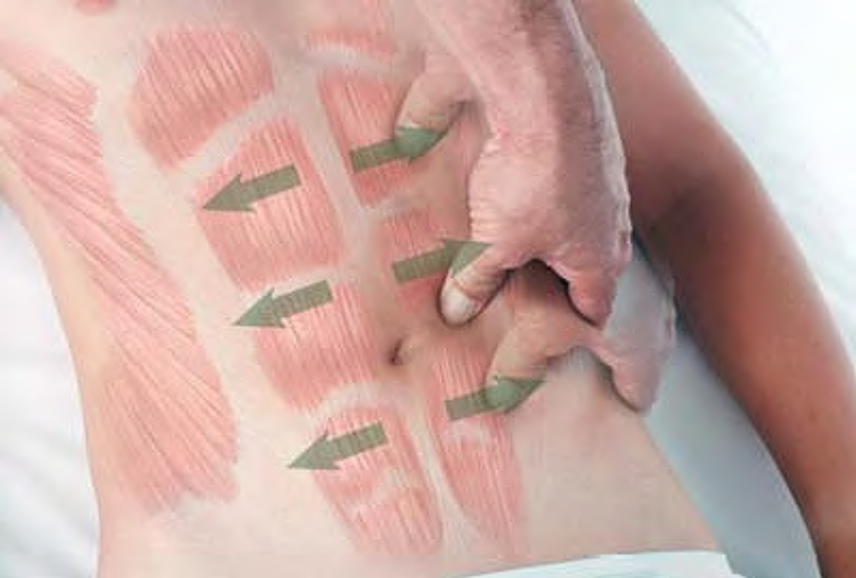
Cross-fiber stroking of rectus abdominis

Slide 24
Pyramidalis pi-RAM-I-DAL-iss
Etymology Latin pyramidalis, shaped like a pyramid
Comment. Pyramidalis very commonly occurs on one side only, and may be absent in many people. It may harbor a trigger point at its attachment to the pubis.
Attachments. Inferiorly, to the crest of the pubis. Superiorly, to the lower portion of the linea alba.
Palpation. Not normally distinguishable from rectus abdominis.
Action. Tenses the linea alba.
Referral Areas. To its attachment to the pubis. Along the midline to the umbilicus

Slide 25
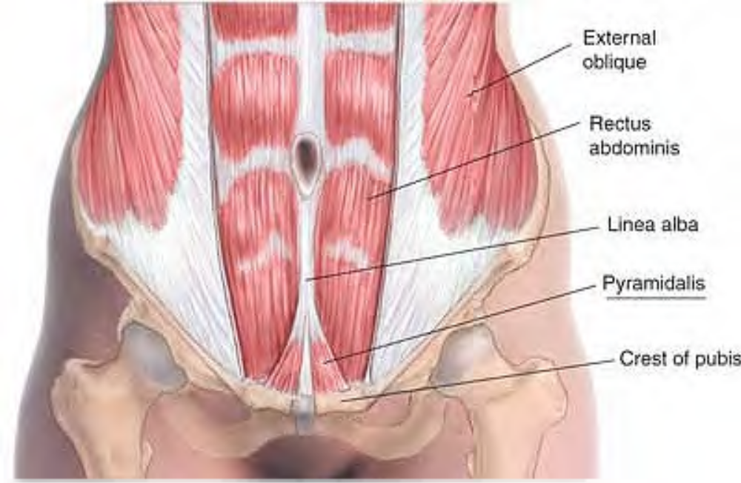
Anatomy of pyramidalis

Slide 26
Other Muscles to Examine. Rectus abdominis. Iliopsoas. Abdominal obliques
Manual Therapy.
Compression. The client lies supine. The therapist stands beside the client at the hip. Place the thumb on pyramidalis, just superior and lateral to the symphysis pubis. Press firmly into the tissue, examining for tenderness. Hold for release.
Repeat this procedure on the other side.

Slide 27
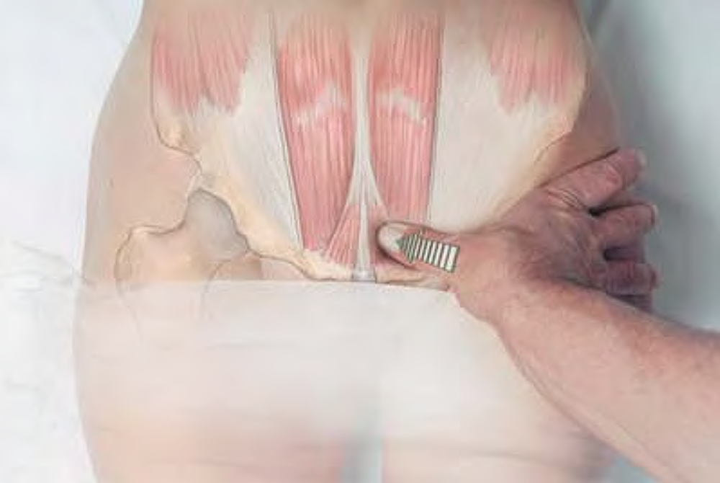
Compression of pyramidalis

Slide 28
Abdominal Obliques oh-BLEEKS
Etymology Latin obliquus, slanting, diagonal
Comment
The external and internal abdominal obliques run in the same respective directions as the external and internal intercostals. A good way to remember their directions is to place one hand on the opposite side of the abdomen with your fingers pointing diagonally downward, then place the other hand on top of it pointing perpendicularly. The top hand represents the externals, the bottom hand the internals.

Slide 29
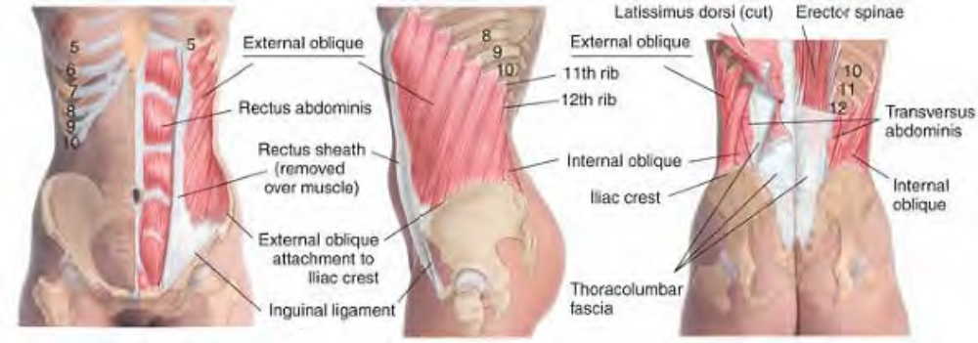
Anatomy of external oblique

Slide 30
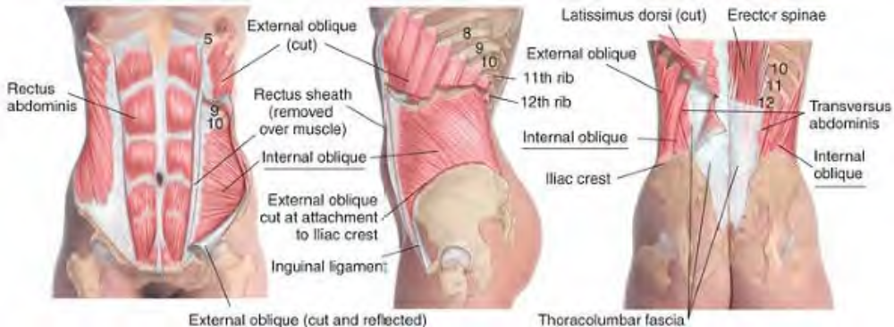
Anatomy of internal oblique

Slide 31
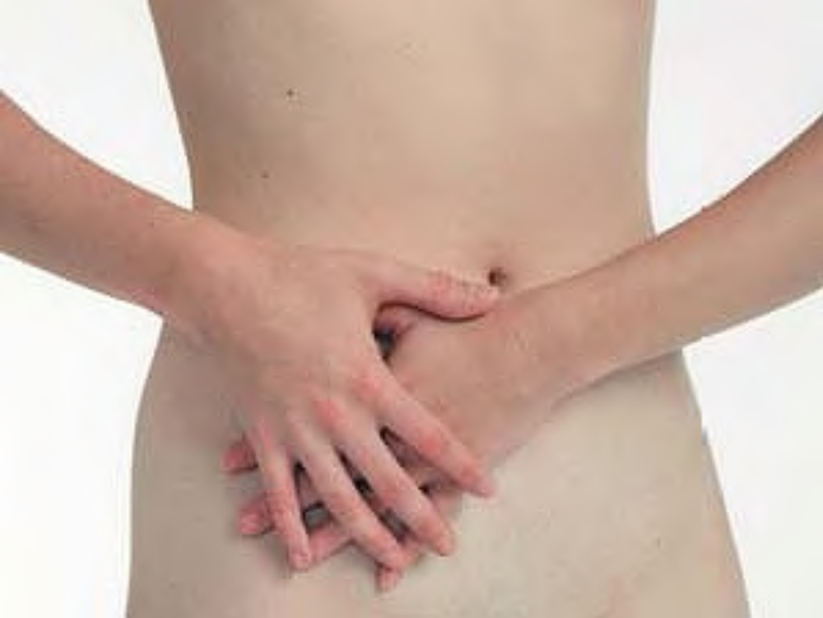
Mnemonic hand position for direction of external and internal obliques (top hand, external; bottom hand, internal)

Slide 32
Actions. Bilaterally, increase intra-abdominal pressure and flex the spine. Unilaterally, assist in lateral flexion and rotation of the spine.
Referral Areas. To the epigastric region (below the xiphoid process between the costal arches), over the lower chest, and diagonally below the costal arch. The lower lateral quadrant of the abdomen, into the groin and the testicle, up over the abdomen to the pubis, the umbilicus, and the costal arch
Other Muscles to Examine. Rectus abdominis. Iliopsoas. Quadratus lumborum

Slide 33
Manual Therapy
Stripping
The client lies prone. The therapist stands beside the client at the chest. Place the hand between the client's abdomen and the table with the palm on the abdomen and the fingertips just superior to the pubis at the attachment of the inguinal ligament. Pressing firmly upward into the tissue, slide the fingertips superolaterally along the muscle to the rib cage. (NOTE: the client is shown standing in the photograph for illustration of the procedure.) Beginning at the same spot, repeat this procedure at a more oblique angle until the whole surface of the abdomen has been treated.
Repeat the same procedure on the other side.

Slide 34
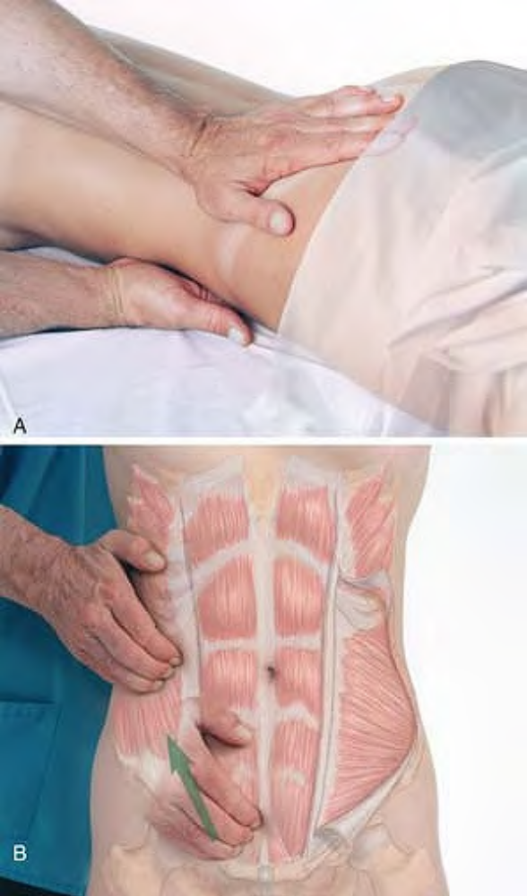
Client prone (A) for stripping of obliques with fingertips (Draping option 7) (B) position for demonstration as if prone

Slide 35
Transversus Abdominis trans-VERS-us ab-DOM-in-iss
Etymology Latin trans, across + versus, turned
Comment. Transversus abdominis lies deep to the other abdominal muscles. There is no separate manual treatment for it that is appropriate to this text.
Attachments. Laterally, to the seventh to twelfth costal cartilages (interdigitating with fibers of the diaphragm), lumbar fascia, iliac crest, and inguinal ligament.Medially, to the xiphoid cartilage and linea alba and, through the conjoint tendon, to the pubic tubercle and pecten.
Palpation. Not palpable.
Action. Compresses the abdomen
Referral Areas. Along and between the anterior costal margins
Manual Therapy. Not applicable.

Slide 36
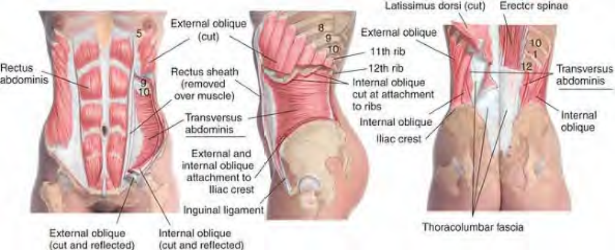
Anatomy of transversus abdominis

