Slide 1
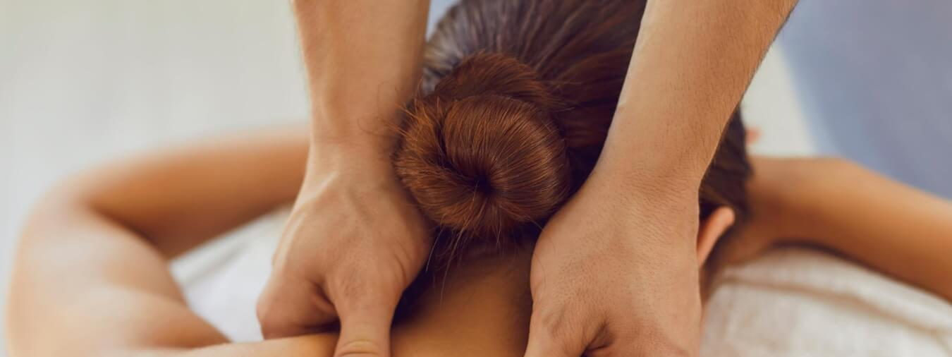
Massage Techniques 6B
The Deep muscles of vertebral column

Slide 2
Multifidus (plural Multifidi) mul-TIFF-I-duss
Etymology Latin multi, many + fidus, divided, thus â€oedivided into many segments
Comment
This group of muscles is located all along the vertebral column, from the cervical region to the base of the spine. The lower segments of multifidus that reach from the sacrum to the lumbar vertebrae are very strong and prominent, resembling the stays on the mast of a sailboat. In fact multifidus is one of the strongest muscles in the body. You will frequently find tenderness over the sacrum in clients with low back pain.

Slide 3
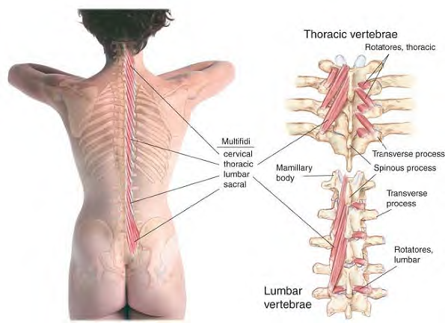
Anatomy of multifidi

Slide 4
Attachments. Inferiorly, from the sacrum and the sacroiliac ligament, mamillary proces-ses of the lumbar vertebrae, transverse processes of thoracic vertebrae, and articular processes of last four cervical vertebrae. Superiorly, into the spinous processes of all the vertebrae up to and including the axis
Palpation. Discernible between the transverse processes of the vertebrae, but most easily on the sacrum. Architecture is parallel, and fibers are parallel to the muscle. Action. Extends, rotates, and stabilizes the vertebral column.
Referral Areas. Between the vertebral column and the medial border of the scapula The region just lateral to T12 and L1, and over the lumbar region; upper lateral quadrant of the abdomen Over the sacrum, into the buttock along the gluteal cleft, into the posterior thigh below the buttock; lower lateral quadrant of the abdomen Around the coccyx.

Slide 5
Manual Therapy
Stripping
The client lies prone. The therapist stands at the client's side at the chest, facing caudad. Place the fingertips or thumb, supported or unsupported, at the superior aspect of the sacrum just lateral to the spinal column, pointing caudad (inferiorly). Pressing firmly into the tissue, glide the thumb or fingertips caudad as far as the inferior aspect of the sacrum.
Repeat this technique on the other side.

Slide 6
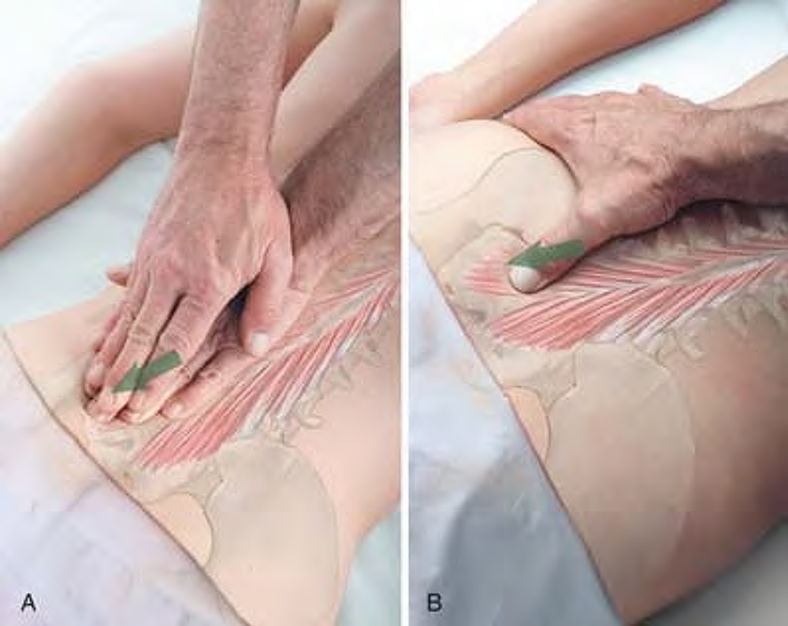
Stripping of multifidus at inferior attachments with fingertips (A) and thumb (B)

Slide 7
Rotatores RO-ta-TOR-ace
Etymology Latin rotatores, rotators
Comment
Rotatores are the deepest of the three layers of transversospinalis muscles, chiefly developed in the thoracic region. Because they have a very high density of muscle spindles, they probably function as organs of proprioception. Their motor function appears to be in fine adjustments rather than gross movements of the spine.

Slide 8
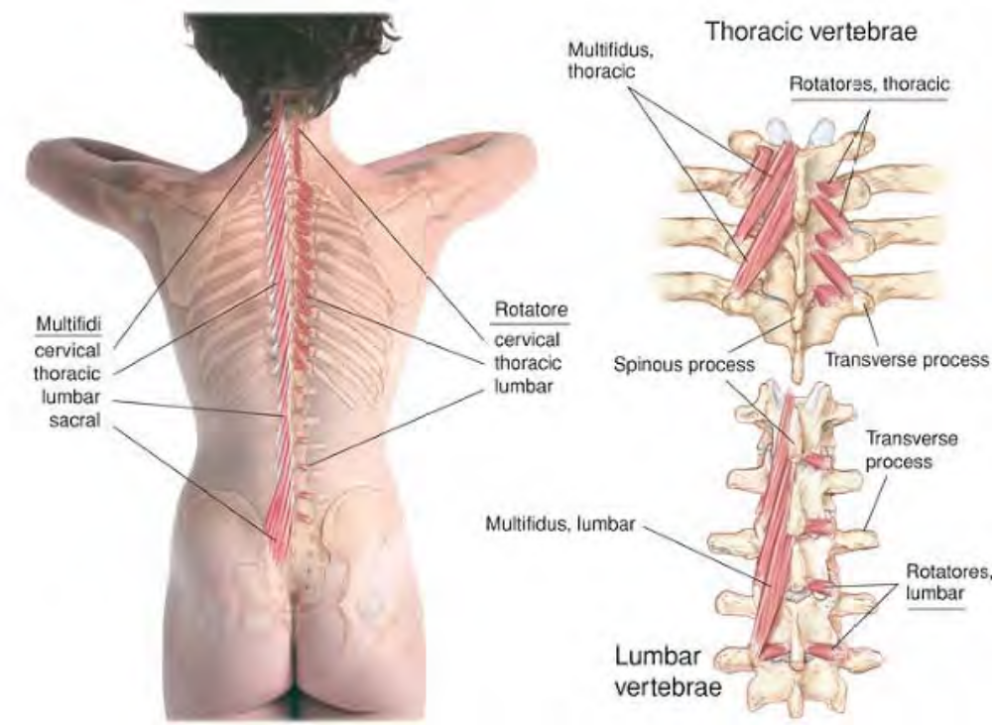
Anatomy of rotatores

Slide 9
Attachments. Inferiorly, from the transverse process of one vertebra. Superiorly, into the root of the spinous process of the next two or three vertebrae above
Palpation. Discernible between the transverse processes of the vertebrae. Architecture is parallel, and fibers are parallel to the muscle.
Action. Bilaterally, extension of the spine Unilaterally, rotation of the vertebrae Proprioception.
Referral Areas. Along the midline of the spine
Other Muscles to Examine. Other superficial and deep paraspinal muscles

Slide 10
Manual Therapy for Multifidi and Rotatores
Cross-fiber Stroking. The client lies prone. The therapist stands at the client's side, beginning at the waist. Place the thumb or fingertip (supported or unsupported) on the space between the spinous process of L5 and the sacrum. Press laterally (away from yourself) and diagonally caudad, pushing the superficial muscles out of the way to reach the intrinsic muscles. If the client reports tenderness, hold for release. Shifting cephalad, repeat this technique between each two spinous processes as far as the space between T12 and L1. Beginning with the space between T11 and T12, perform the same technique gliding the thumb into the space between the ribs.
Repeat this technique as far as C7.
From C7 to the cranial base, use your unsupported thumb.

Slide 11
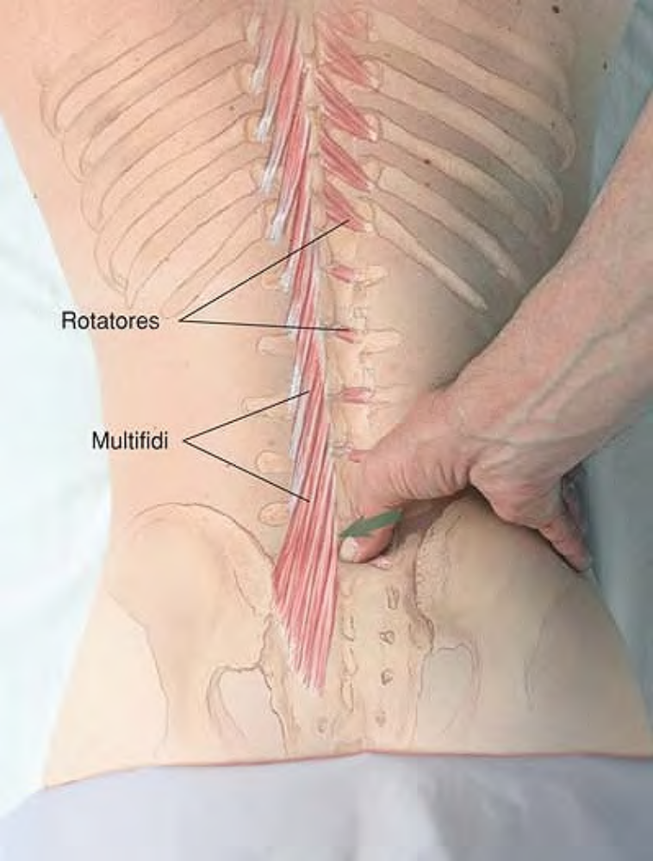
Cross-fiber stroking of rotatores in lumbar region using thumb

Slide 12
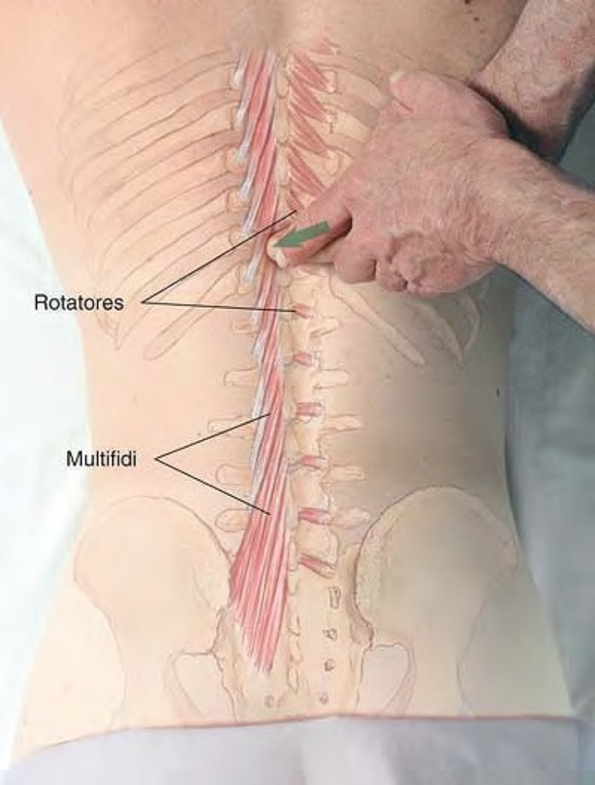
Cross-fiber stroking of rotatores in thoracic region using support fingertips

Slide 13
Caution
Use this technique with great care in the cervical region, and only after other work has been performed in that area as described in Chapter 3 to release the more superficial posterior neck muscles.
This technique is contraindicated in any area of the spine where there is diagnosed or suspected spinal pathology.
When using this technique, get regular feedback from the client regarding any local or referred pain or other sensation.

