Slide 1
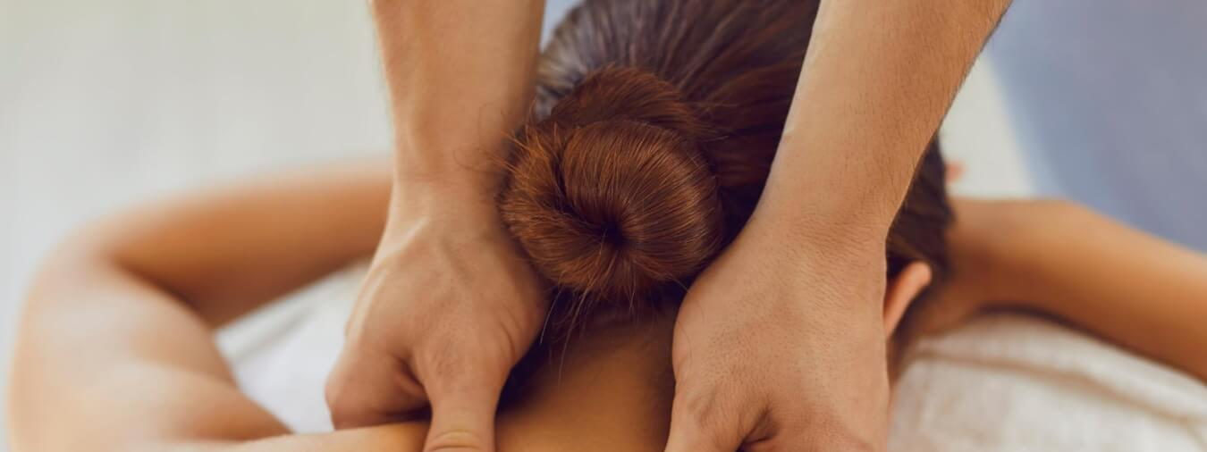
Massage Techniques 6
The Vertebral Column

Slide 2
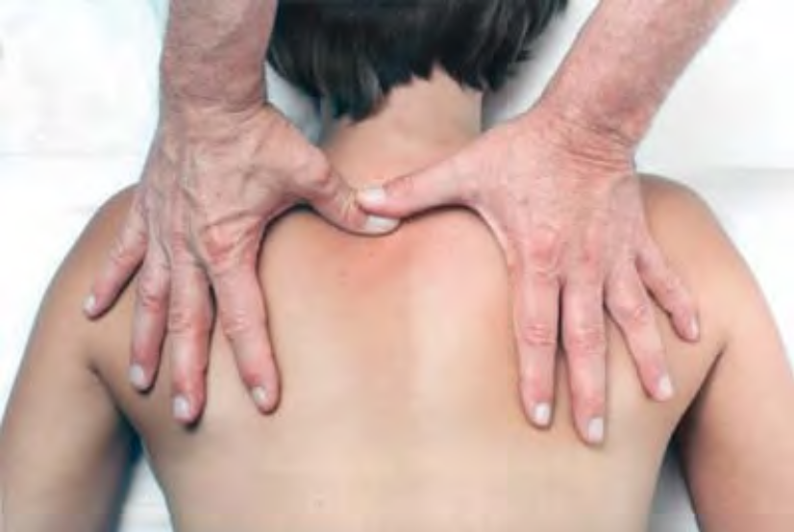
The Vertebral Column
The spinal column is a long bunch of bones.
The head sits on the top, and you sit on the bottom.

Slide 3
Overview of the Region
The vertebral column, or spine, is divided into five regions:
The cervical spine, with seven vertebrae (C1 through C7)
The thoracic spine, with twelve vertebrae and attached ribs (T1 through T12)
The lumbar spine, with five vertebrae (L1 through L5)
The sacrum, with five fused vertebrae. The coccyx, usually consisting of four vertebrae
Though similar in basic structure and function, the vertebrae vary considerably in size and shape in the different regions, the cervical vertebrae being the smallest and the lumbar vertebrae being the largest.

Slide 4
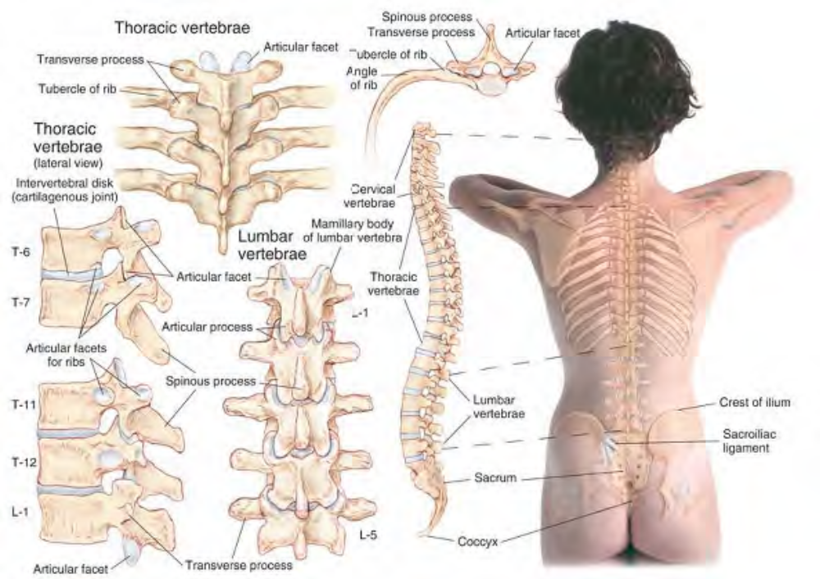
Skeletal features of the back

Slide 5
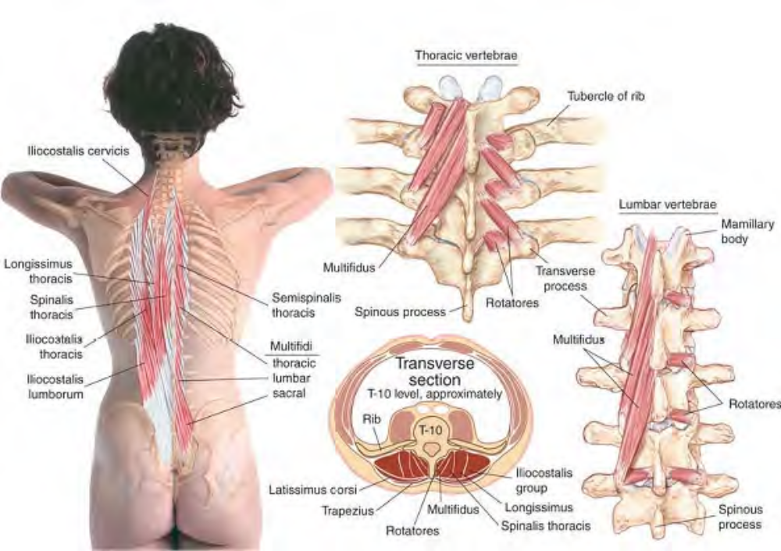
Muscles of the back

Slide 6
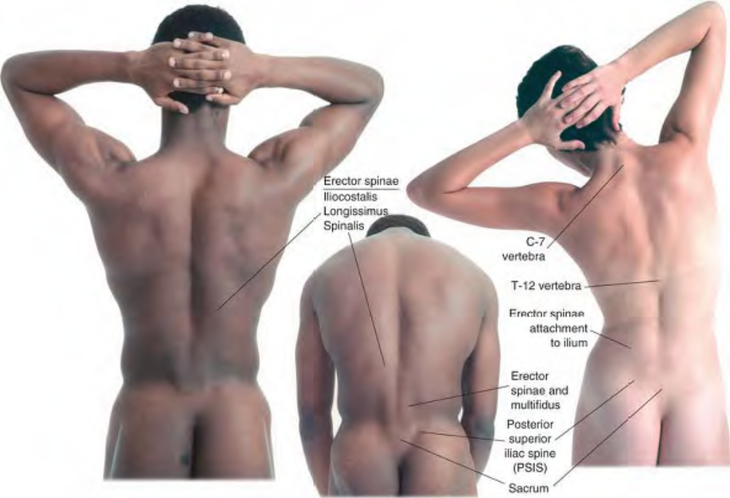

Slide 7
At birth the spine has a single posterior curvature forming the typical • shape of the newborn infant. As the child begins to hold the head erect, sit up, and learn to stand, additional spinal curvatures develop. The five regions of the adult spine include four normal curvatures. The cervical and lumbar regions have an anterior curvature while the thoracic, sacral, and coccygeal regions retain their original posterior curvature. Excessive increases or decreases in these curves (kyphosis, lordosis) threaten postural integrity, and their restoration and maintenance is one of the aims of posturally oriented bodywork.
There are two types of joints between most of the vertebrae of the spine: Cartilaginous joints between the broad vertebral body of adjoining vertebrae, comprised of fibrocartilage surrounding a gel-filled disk that supports most of the weight Synovial facet joints between articular processes that guide most of the movement.

Slide 8
There are two facet joints on each side, articulating with the facets of the two adjoining vertebrae. In addition, the thoracic vertebrae also articulate with the ribs and accordingly have facets for those joints. These joints and the variations in shape between vertebrae of different regions determine the type and range of movement of the spine. These movements are:
Anterior flexion
Lateral flexion (sometimes called lateral bending)
Extension (and hyperextension)
Rotation

Slide 9
The cervical region is the only one capable of the full range of spinal movement. All other regions are limited in one or more movements. The spinous processes of the thoracic vertebrae are angled sharply in an inferior direction and prevent hyperextension of this region in most individuals. The planes of the articular facets of the lumbar region are nearly vertical and thus limit rotation.
Since the vertebrae are usually fused in the sacrum and coccyx by eighteen to thirty years of age (and for all practical purposes much earlier), there is no movement possible within those regions, although they do move relative to adjoining regions. Note that the coccyx is joined to the sacrum by ligaments, and can move in relation to it in response to pressure.

Slide 10
Comment
The directional terms cephalad• (toward the head) and caudad• (toward the tail, i.e., coccyx) are
used in this lecture.
Etymology Greek kephal, head, Latin cauda, tail
It is helpful to do some general work on the back before treating specific areas in order to stimulate local blood
flow and relax the superficial musculature. This may include effleurage, petrissage, kneading, and percussion, but
be careful not to use excessive lubrication, as it will hinder work in specific areas afterwards. One helpful technique
for preparatory treatment of the back is myofascial stretching.

Slide 11
Manual Therapy
Myofascial Stretching for the Back
The client lies prone. The therapist stands beside the client at the torso. Place the hand nearest the client's head flat on the lumbar area lateral to the vertebrae with the fingers over the iliac crest just lateral to the sacrum. Crossing the other hand over or under the first, place it flat on the thoracic area over the lowest three or four ribs. Let your hands sink into the tissue until you feel contact with the superficial fascia. Press the hands in opposite directions, with enough downward pressure to engage and stretch the superficial fascia .

Slide 12
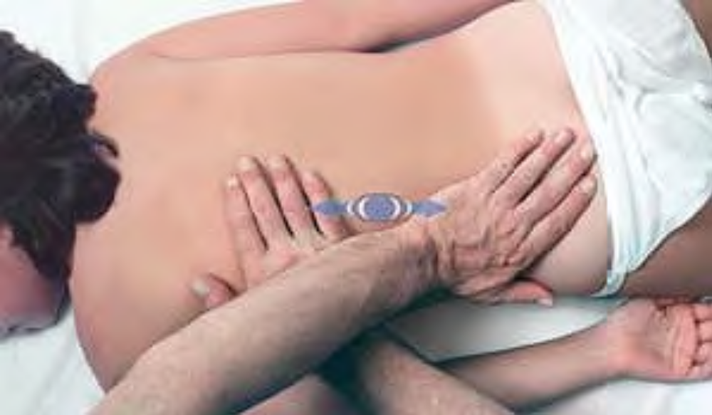
Myofascial stretch for the back

Slide 13
Hold until you feel significant release in the fascia.
Shift both hands laterally (toward yourself) by one hand's width and repeat the technique.
Shift the hands cephalad, so that the caudad hand rests on the lower three or four ribs and the cephalad
hand rests on the third through the sixth ribs, both hands just lateral to the vertebrae.
Repeat the technique.
Repeat the technique at this level shifting the hands laterally.
Repeat the entire procedure on the opposite side.

Slide 14
The Superficial Paraspinal Muscles
We need to keep two facts in mind when viewing the vertebral column in the context of the whole body:
The center of gravity of the body is in the pelvic region, well forward of the spine.
As we noted before, the entire arm and shoulder structure is attached to the skeleton by only one joint, the sternoclavicular joint, also well forward of the spine.

Slide 15
The implication of these two facts is that the spine and the muscles that attach to it must maintain the integrity of the posture against a strong anterior pull. Because of the location of our eyes and the construction of our shoulders and arms, virtually everything that we human beings do requires us to move our heads, arms, and torsos forward, down, and inward. It is the task of the superficial muscles of the vertebral column (along with the muscles of the low back) to counterbalance us in such activities. Poor posture” that is, posture in which the head is carried forward of the sagittal midline, the shoulders are medially rotated, and the anterior intercostal and abdominal muscles are habitually shortened” places a severe strain on the superficial muscles of the spine and posterior neck, resulting in the development of active trigger points and pain. Although, according to David G. Simons, MD, there are no hard scientific data as to when and how latent MTrPs [myofascial trigger points] Start, we do know that by correcting the postural problem the MTrP either clears up or is much more treatable.

Slide 16
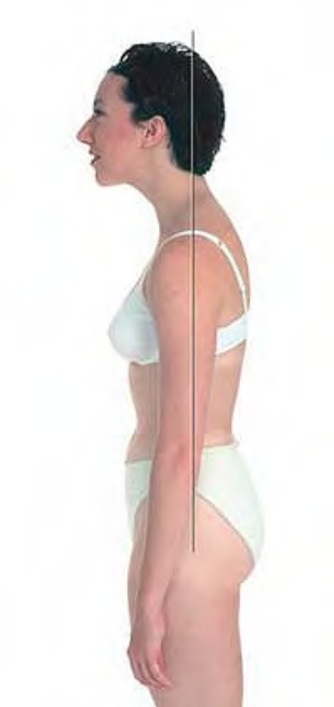
Posture with head forward and shoulders medially rotated

Slide 17
Erector Spinae
Etymology Latin erector, straightener + spinae, of the spine
Comment
Erector spinae is a collective term for the group of muscles that extend and maintain the balance of the vertebral column and the rib cage. They also contract strongly in coughing and in straining during bowel movements.
These muscles originate from the sacrum, ilium, and the processes of the lumbar vertebrae. They are divided into three groups: iliocostalis, longissimus, and spinalis. Their branches attach to the vertebrae and ribs at ascending levels.

Slide 18
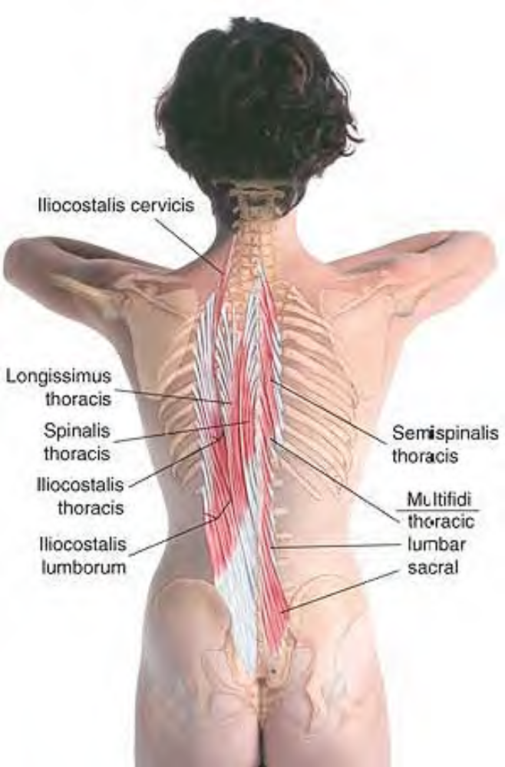
Anatomy of the erector spinae muscles

Slide 19
The Iliocostalis Group
The iliocostalis group represents the most lateral column of the erector spinae. It is comprised of three divisions: iliocostalis lumborum, iliocostalis thoracis, and iliocostalis cervicis.
Etymology Latin ilio-, relating to the ilium + costalis, relating to the ribs (costa, rib) + lumborum, of the loins
Attachments. Inferiorly, from sacrum and ilium Superiorly, to the inferior borders of the lower six ribs
Palpation. Discernible if pathologically hypercontracted, by cross-fiber stroking. Archi-tecture is parallel, and fibers are parallel to the muscle. Action. Extends, laterally flexes, and rotates lumbar vertebrae
Referral Areas. Over the lumbar region into the center of the buttock

Slide 20
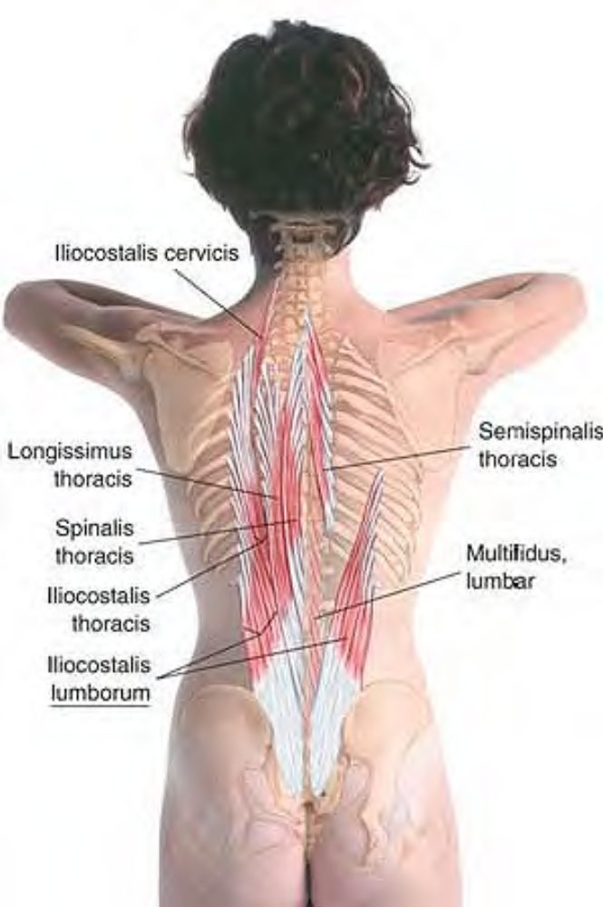
Anatomy of iliocostalis lumborum

Slide 21
Manual Therapy
Stripping
The client lies prone. The therapist stands beside the client at the torso. Place the knuckles on the muscles at the waist of the client just lateral to the lumbar vertebrae. Pressing firmly into the tissue, slide the knuckles inferiorly over the sacrum to its base.
Repeat the procedure on the opposite side.

Slide 22
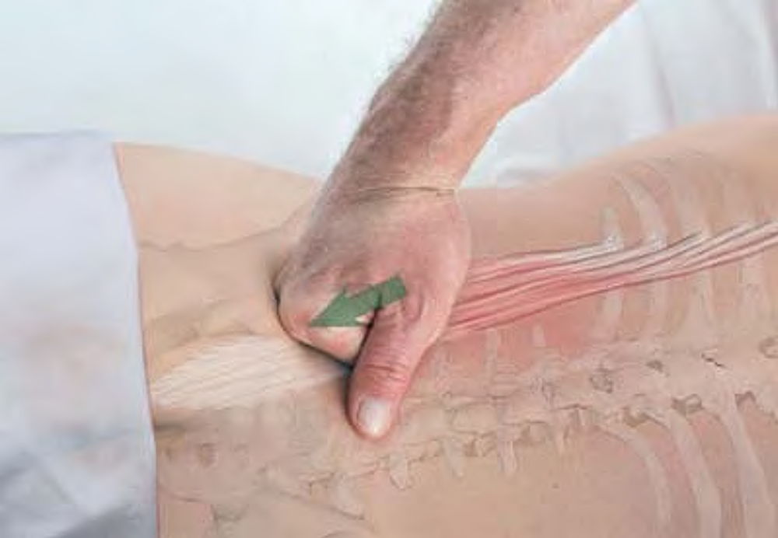
Stripping of origins of iliocostalis lumborum

Slide 23
Iliocostalis Thoracis ILL-ee-oh-kos-TAL-is THOR-as-iss
Etymology Latin ilio-, relating to the ilium + costalis, relating to the ribs (costa, rib) + thoracis, of the chest
Comment
Because of our extensive use of our arms and hands, our need to look down at what our hands are doing, and the prevalence of poor posture, iliocostalis thoracis frequently develops painful trigger point activity in branches of the muscle that extend under the scapulae. This area just inferior and medial to the scapula is one of the most common areas in need of trigger point release. Pain here often accompanies pain in the muscles of the shoulders.

Slide 24
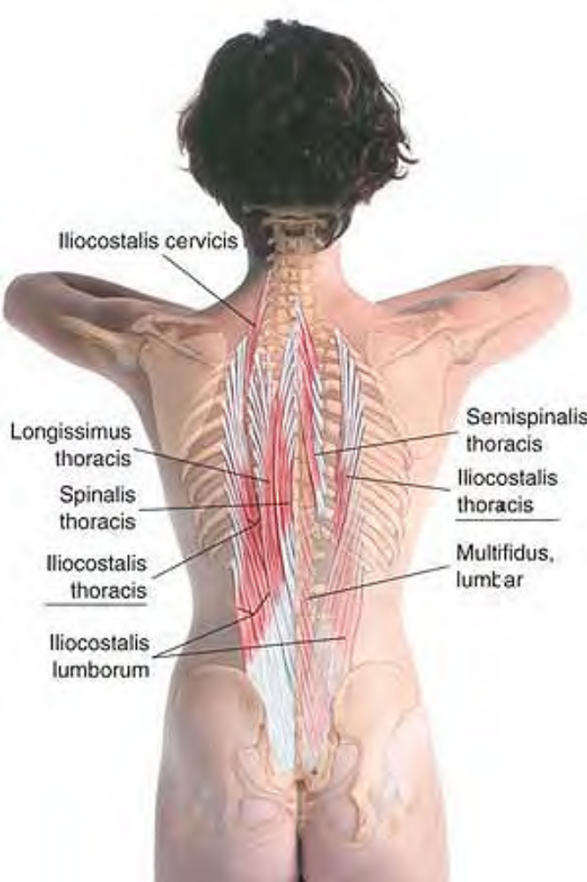
Anatomy of iliocostalis thoracis

Slide 25
Attachments. Inferiorly, to the medial side of the inferior borders of the lower six ribs Superiorly, to the inferior borders of the upper six ribs
Palpation. Discernible if pathologically hypercontracted, by cross-fiber stroking, particularly in the area of the inferior angle of the scapula. Architecture is parallel, and fibers are parallel to the muscle.
Action. Extends, laterally flexes, and rotates thoracic vertebrae
Referral Areas. Inferior angle of the scapula, inside the medial border of the scapula to the superior angle; anterior chest over the angle of the sternum and the costal arch Over the lumbar region, into the lateral inferior thoracic region, up across the scapula; lower ipsilateral quadrant of the abdomen

Slide 26
Manual Therapy
Stripping
The client lies prone. The therapist stands beside the client at the head. Palpate for a distinct muscular band running diagonally in a superolateral direction under the inferomedial border of the scapula. Explore this band just inferior to the scapula for tenderness. Place the supported thumb on the tender spot and press firmly into the tissue. Glide the thumb diagonally along the muscle to the erector bundle. Beginning at the same spot, repeat this procedure two or three times.

Slide 27
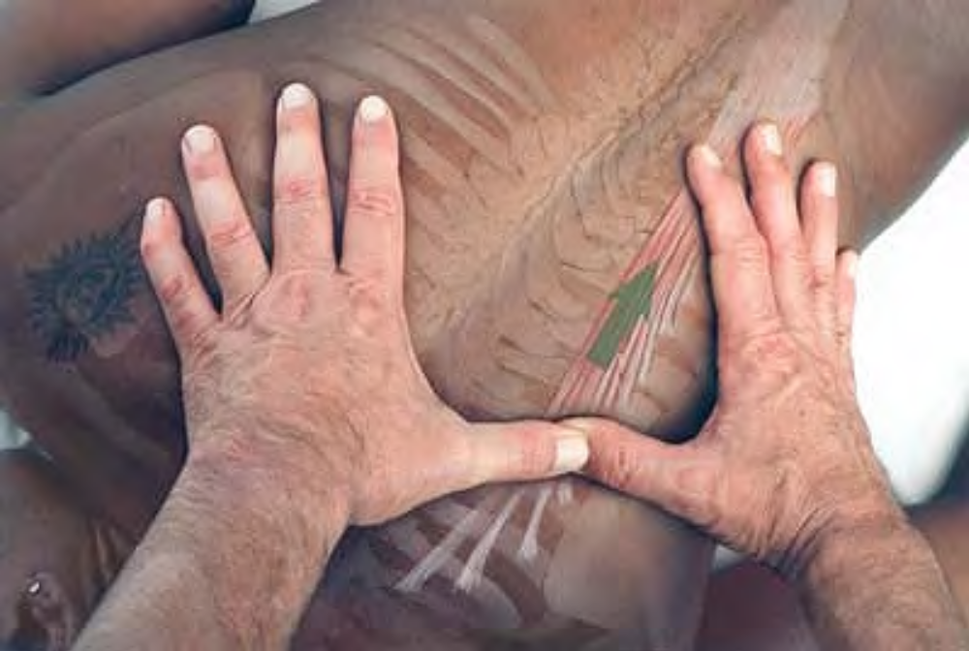
Stripping of iliocostalis thoracis with supported thumb

Slide 28
Cross-fiber Stroking. The client lies prone. The therapist stands beside the client at the head. Place the hand or the knuckles on the upper back medial to the superior angle of the scapula. Pressing firmly into the tissue with the heel of your hand or your knuckles, slide your hand diagonally along the medial border of the scapula past the inferior angle. Beginning at the same spot, repeat this procedure two or three times.
Cross-fiber Friction. The client lies prone. The therapist stands beside the client at the head. Place the fingertips or the knuckles next to the muscular band at the inferomedial border of the scapula. Move the fingertips or knuckles back and forth across the band at a rate of about twice per second. Continue until you feel release in the tissue.

Slide 29
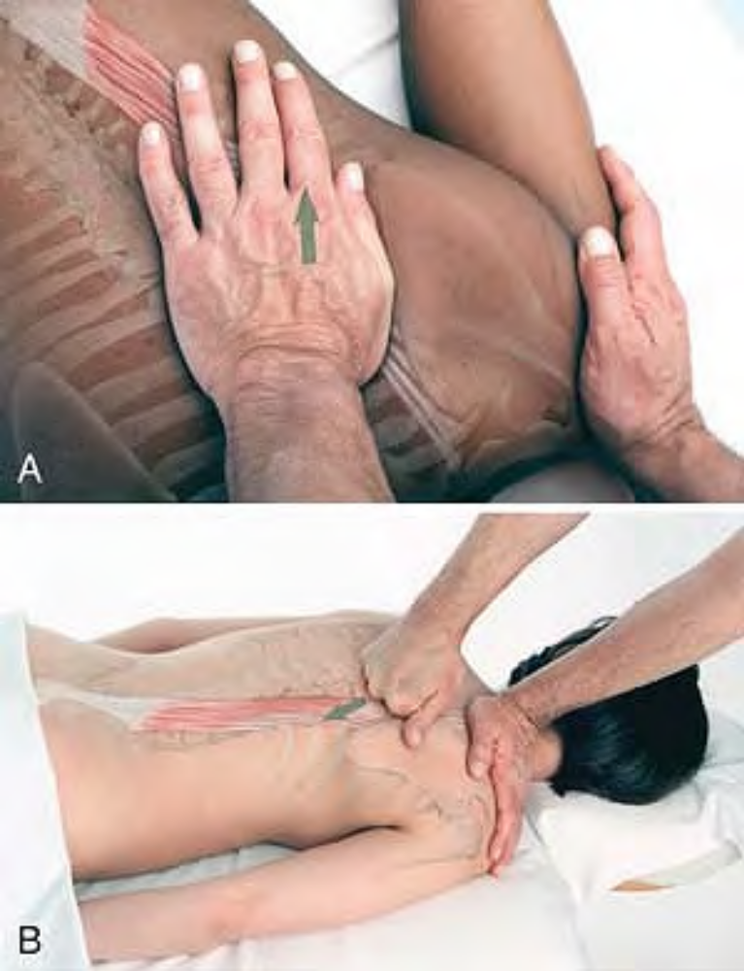
Cross-fiber stroking of iliocostalis thoracis with heel of hand (A) or knuckles (B)

Slide 30
Iliocostalis Cervicis ILL-ee-oh-kos-TAL-is SERV-iss-iss
Etymology Latin ilio-, relating to the ilium + costalis, relating to the ribs (costa, rib) + cervicis, of the neck
Attachments. Inferiorly, to the superior borders of the upper six ribs. Superiorly, to the transverse processes of the middle cervical vertebrae
Palpation. Discernable if pathologically hypercontracted, by cross-fiber stroking. Archi-tecture is parallel, and fibers are parallel to the muscle. Action. Extends, laterally flexes, and rotates cervical vertebrae
Comment. No trigger points have been recorded for this muscle; it is included here for completeness.

Slide 31
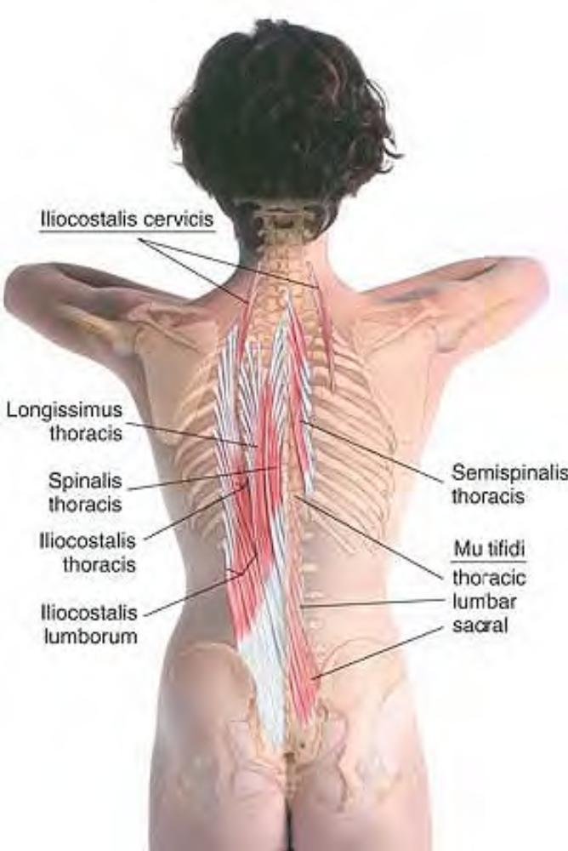
Anatomy of iliocostalis cervicis

Slide 32
Longissimus Thoracis long-GISS-i-mus THOR-as-iss
Etymology Latin, longissimus, longest + thoracis, of the chest
Attachments. Inferiorly, to the transverse processes of the lumbar vertebrae. Superiorly, to the tips of the transverse processes of all thoracic vertebrae and the last nine or ten ribs between their tubercles and angles
Palpation. Discernible if pathologically hypercontracted, by cross-fiber stroking. Archi-tecture is parallel, and fibers are parallel to the muscle. Action. Extends vertebral column
Referral Areas. Over the lumbar region into the superior aspect of the buttock; over the buttock to the inferior aspect

Slide 33
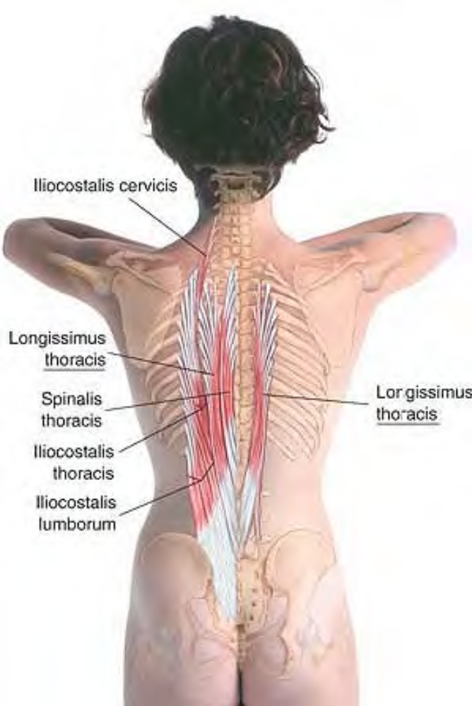
Anatomy of longissimus thoracis

Slide 34
Spinalis Thoracis spin-AL-iss THOR-as-iss
Etymology Latin spinalis, relating to the spine
Attachments. Inferiorly, to the spinous processes of the upper lumbar and two lower thoracic vertebrae. Superiorly, to the spinous processes of middle and upper thoracic vertebrae
Palpation. Discernible if pathologically hypercontracted, by cross-fiber stroking. Archi-tecture is parallel, and fibers are parallel to the muscle.
Action. Supports and extends the vertebral column
Referral Areas. None recorded

Slide 35
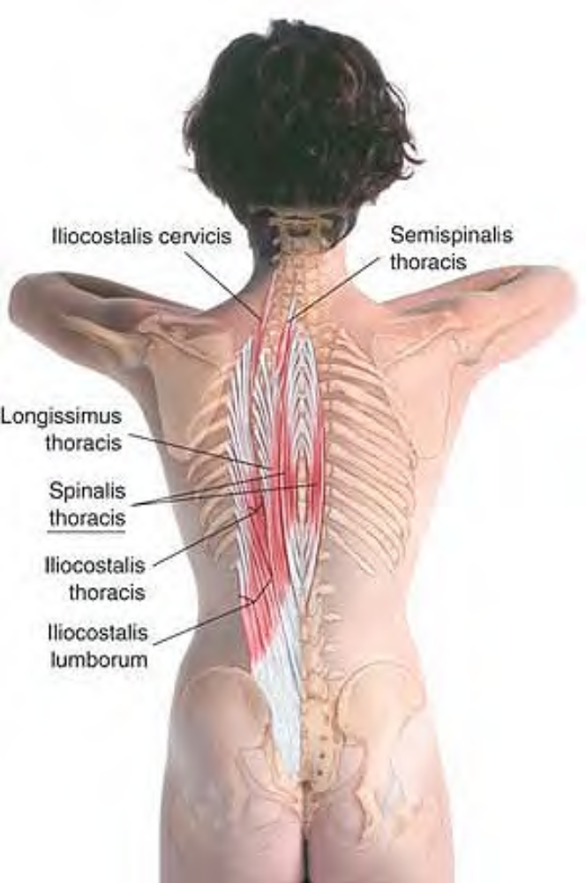
Anatomy of spinalis thoracis

Slide 36
Semispinalis Thoracis SEM-i-spin-AL-iss THOR-as-iss
Etymology Latin semi, half + spinalis, relating to the spine + thoracis, of the chest
Attachments. Inferiorly, to the transverse processes of the fifth to eleventh thoracic vertebrae. Superiorly, to the spinous processes of the first four thoracic and fifth and seventh cervical vertebrae.
Palpation. Architecture is parallel, and fibers are parallel to the muscle. Discernible if pathologically hypercontracted, by cross-fiber stroking.
Action. Extends vertebral column.
Referral Areas. None recorded

Slide 37
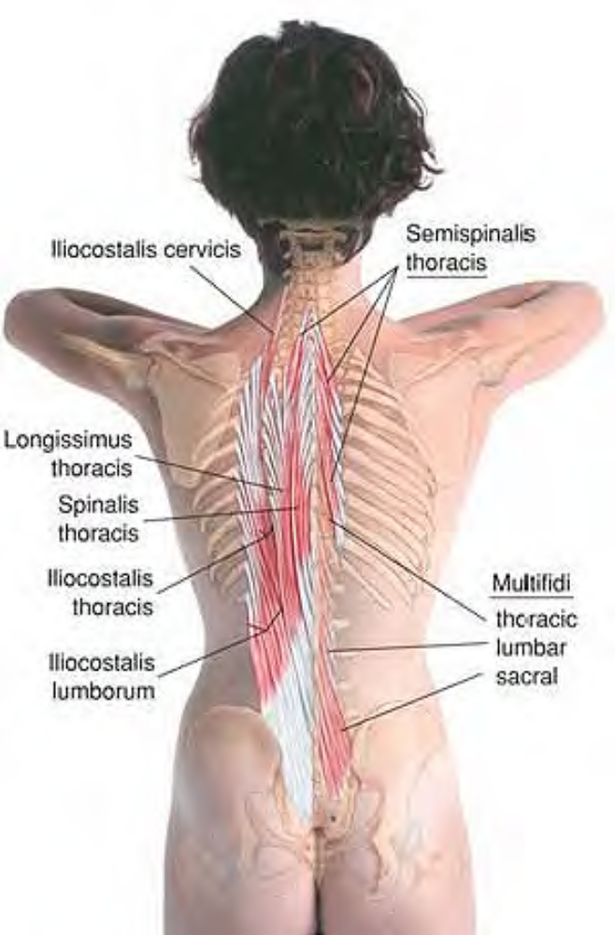
Anatomy of semispinalis thoracis

Slide 38
Manual Therapy for the Erector Spinae
Because the erector spinae muscles are gathered together in a paraspinal bundle, they can most easily be treated as a group. Stripping massage may be applied in either a caudad or cephalad direction. It is helpful to do both, as different trigger points may be accessed in each direction. You may use the hand, thumb, knuckles, fingertips, or elbow.

Slide 39
Stripping
The client lies prone.
The therapist stands beside the client at either the head or shoulder (to work in a caudad direction) or at the hips (to work in a cephalad direction).
Place the heel of the hand, the supported fingertips, the supported thumbs, the knuckles, or the elbow on the muscle bundle near C7 (to work caudad) or at the sacrum (to work cephalad).
Pressing firmly into the tissue, slide the body part you are using along the entire length of the muscle bundle.

Slide 40
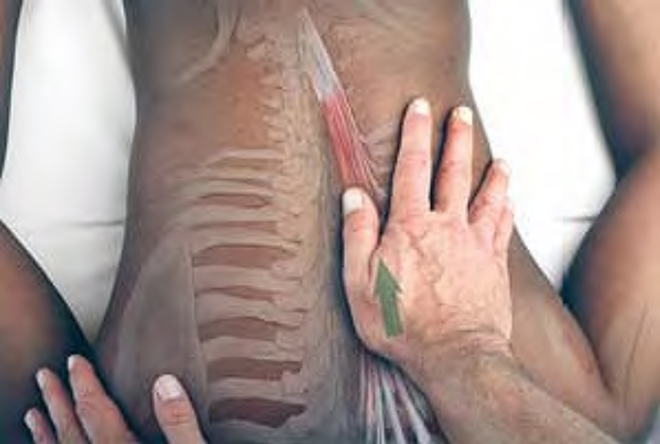
Stripping of erector spinae bundle with heel of hand (longissimus is shown)

Slide 41
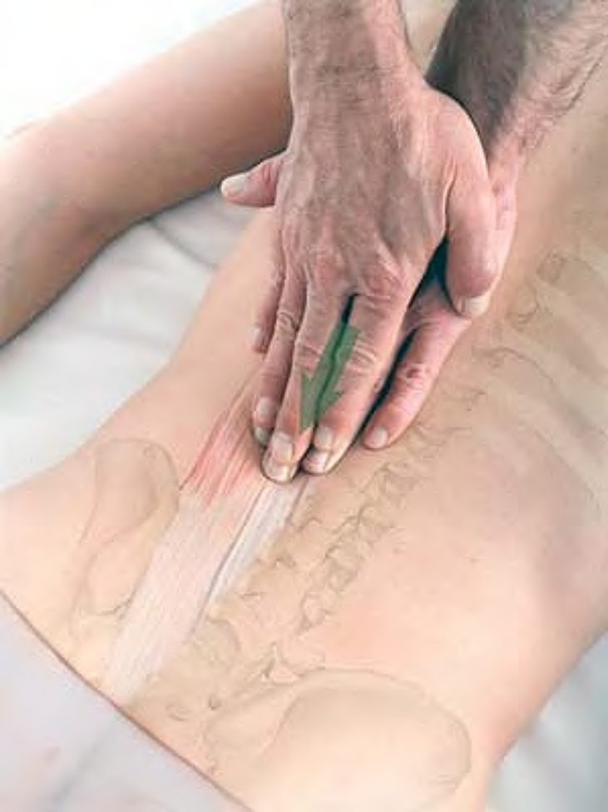
Stripping of erector spinae bundle with supported fingertips (longissimus is shown)

Slide 42
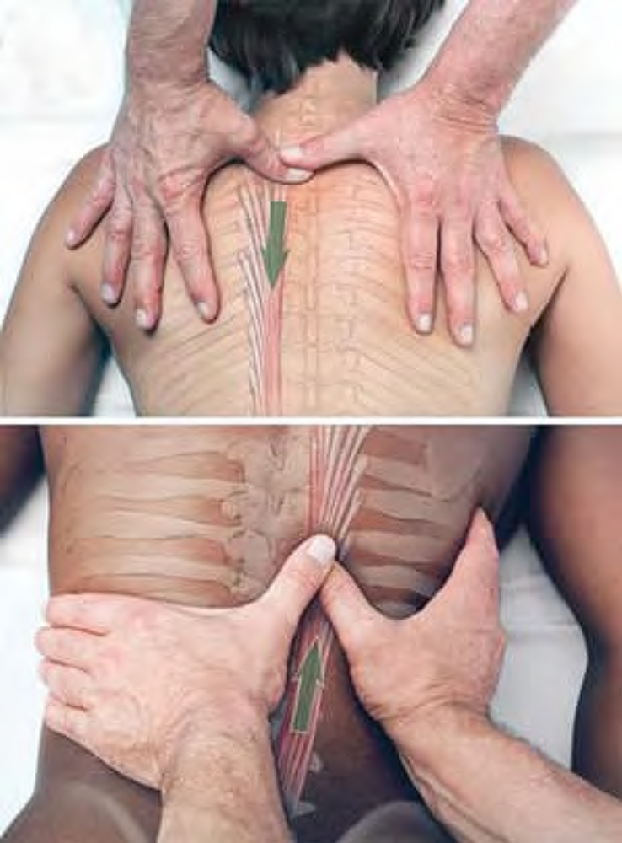
Stripping of erector spinae bundle with supported thumb both caudad and cephalad, showing
longissimus. (A) starting position stripping caudad, (B) midway position stripping cephalad

Slide 43
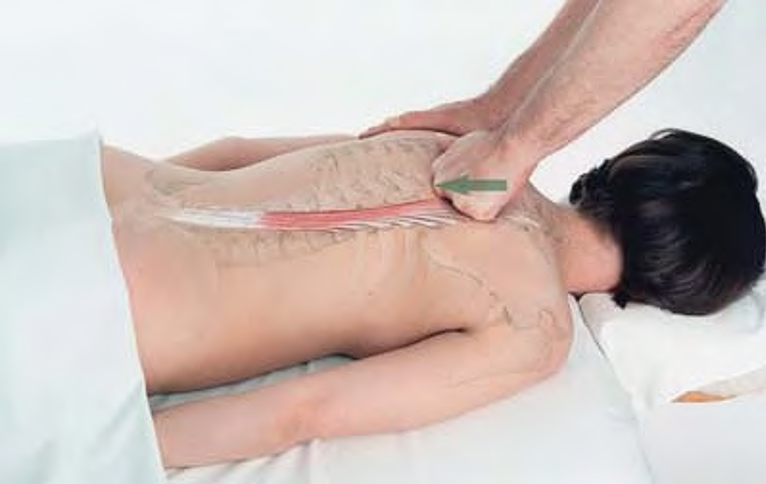
Stripping of erector spinae bundle with knuckles, showing longissimus

Slide 44
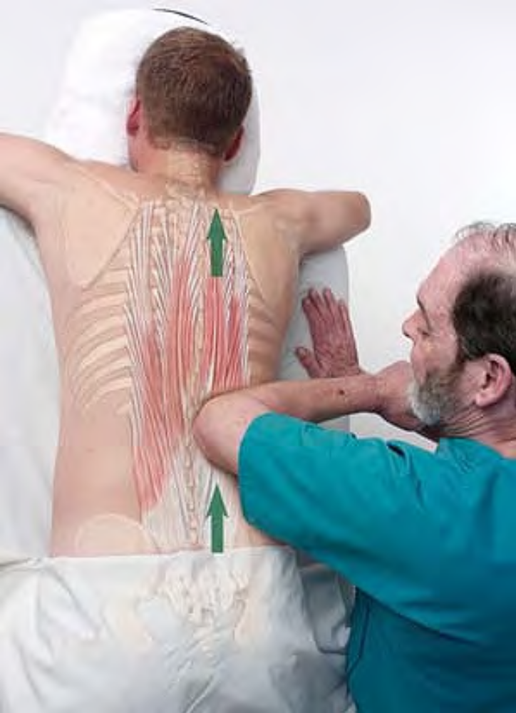
Stripping of erector spinae bundle with elbow, showing longissimus.

