Slide 1
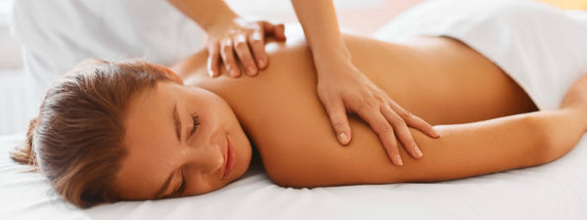
Massage Techniques 5C
Muscles in the Hand

Slide 2
Muscles in the Hand
Muscles of the Thumb
One of the distinguishing characteristics of homo sapiens is the opposable thumb, and we use it intensively, as every massage therapist certainly knows. Soreness, tender points, and trigger points in the thumb muscles due to overuse are quite common. Pain in the thumb area can also be a symptom of carpal tunnel syndrome, so careful examination and thorough treatment of both the thumb muscles and the muscles of the forearm are important. The principal muscles of the thumb (abductor pollicis and opponens pollicis) comprise the thenar eminence, commonly called the ball of the thumb, the thick, muscular bundle of muscles at the base of the thumb just distal to the wrist.

Slide 3
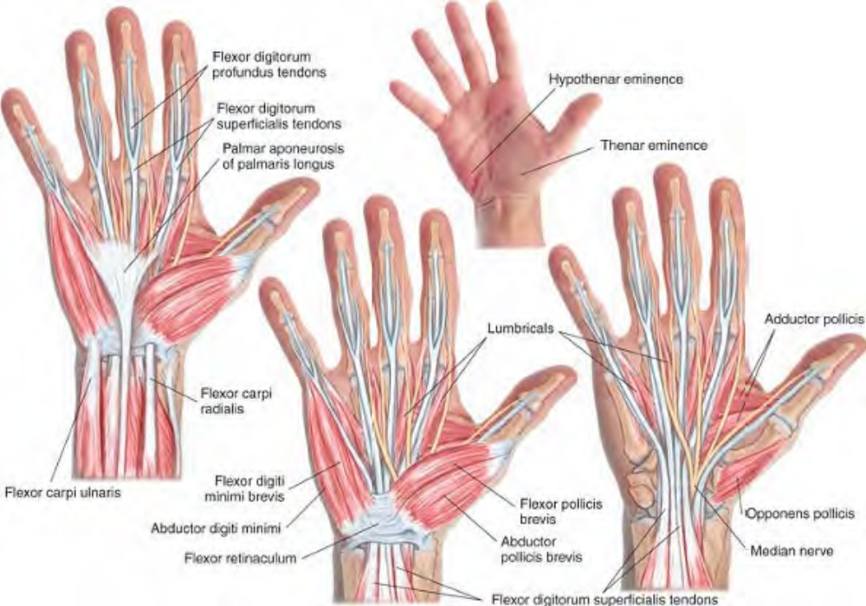
Superficial muscles of the palmar (anterior) hand

Slide 4
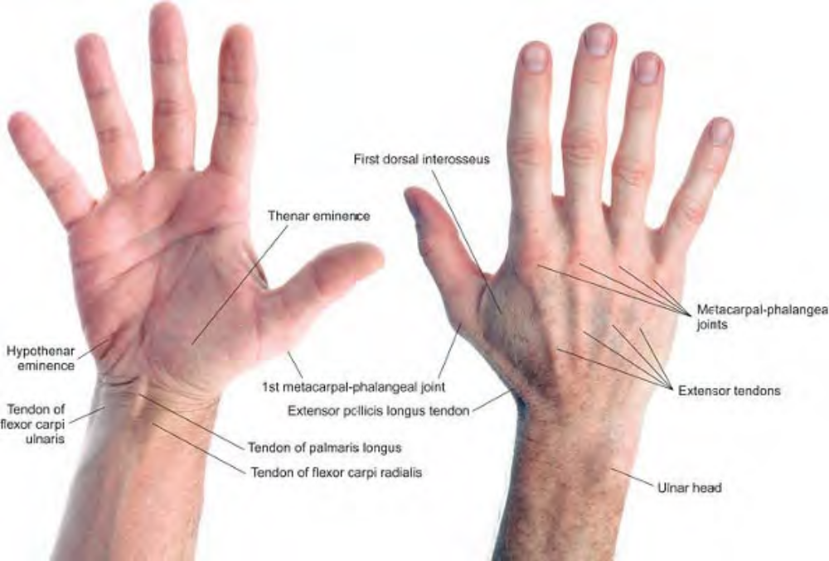
Surface anatomy of the hand

Slide 5
Adductor Pollicis
Etymology Latin adductor (ad, to or toward + ducere, to lead), that which draws toward + pollex, thumb
Attachments. By two heads: The transverse head from the shaft of the third metacarpal. The oblique head from the front of the base of the second metacarpal, the trapezoid and capitate bones Both heads to the ulnar side of base of proximal phalanx of thumb
Palpation. Palpable distal to the thenar eminence; architecture is slightly convergent, and fibers are parallel to the muscle.
Action. Adducts thumb at carpometacarpal joint
Referral Areas. The base of the thumb on both the palmar and dorsal sides

Slide 6
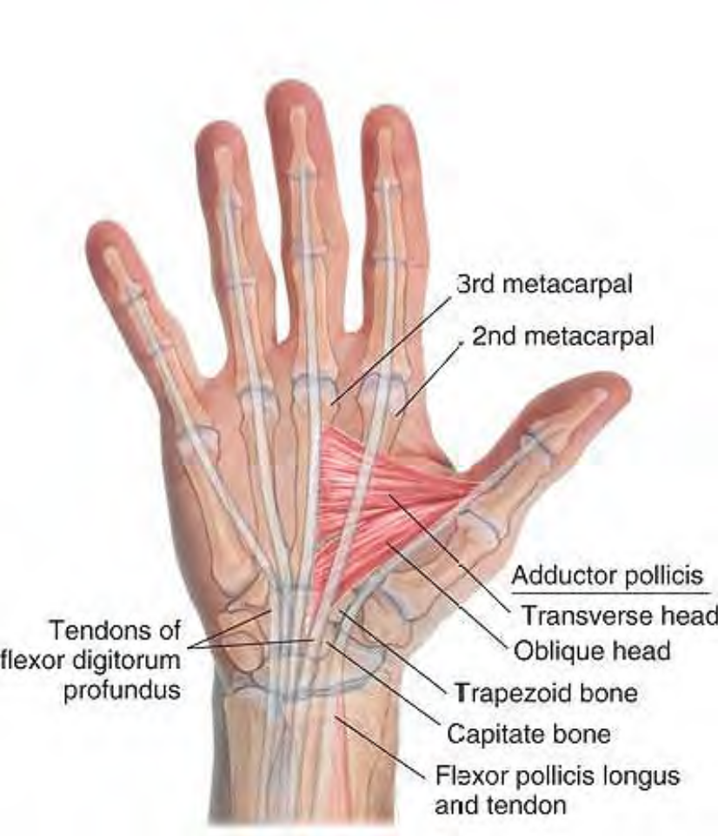
Anatomy of adductor pollicis

Slide 7
Flexor Pollicis Brevis
Etymology Latin flexor, bender + pollicis, of the thumb + brevis, short
Attachments. Proximally, superficial portion to the trapezium and the flexor retinaculum of the wrist, deep portion from ulnar side of first metacarpal bone. Distally, to the base of the proximal phalanx of the thumb
Palpation. Palpable as the most distal muscle in the thenar eminence. Architecture is parallel, and fibers are parallel to the muscle.
Action. Flexes proximal phalanx of thumb
Referral Areas. Not applicable
Other Muscles to Examine. Not applicable

Slide 8
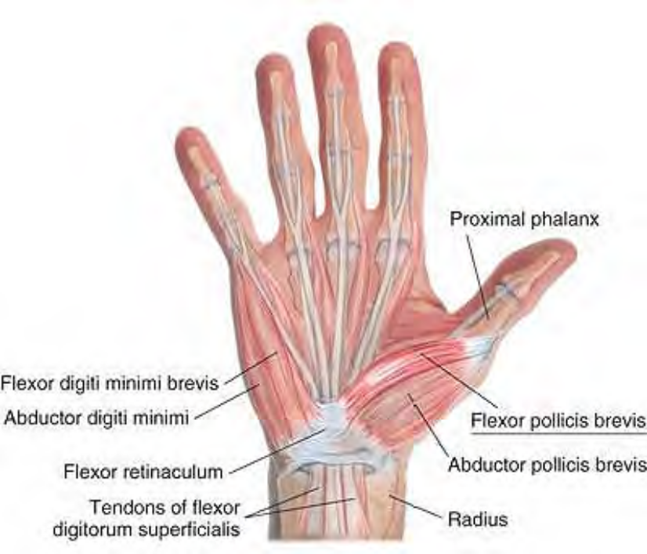
Anatomy of flexor pollicis brevis

Slide 9
Abductor Pollicis Brevis
Etymology Latin abductor (ab, from + ducere, to lead), that which draws away from + pollex, thumb
Attachments. Proximally, to the tubercle of the trapezium and flexor retinaculum. Distally, to the base of the radial side of the proximal phalanx of the thumb
Palpation. Palpable as the central muscle in the thenar eminence. Architecture is con-vergent, and fibers are parallel to the muscle.
Action. Abducts thumb at the carpometacarpal joint
Referral Areas. None

Slide 10
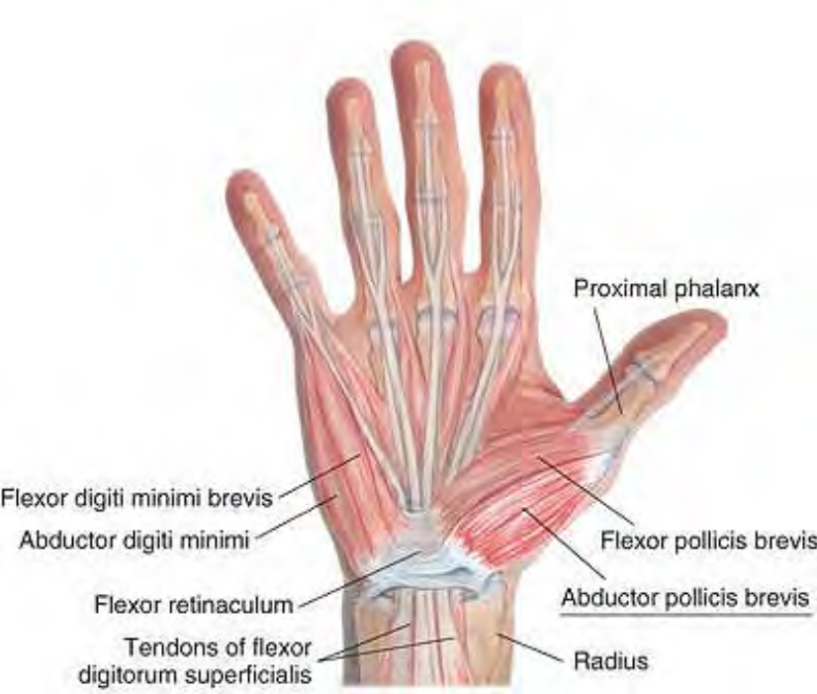
Anatomy of abductor pollicis brevis

Slide 11
Opponens Pollicis
Etymology Latin opponere, to place against, oppose
Attachments. Proximally, to the ridge of the trapezium and flexor retinaculum. Distally, to the radial side of the full length of the shaft of the first metacarpal bone
Palpation. Palpable as the most proximal muscle in the thenar eminence. Architecture is convergent, and fibers are parallel to the muscle.
Action. Puts the thumb in opposition to the other fingers by drawing the base of the thumb toward the palm at the carpometacarpal joint
Referral Areas. Lateral surface of thumb, wrist at the head of the radius

Slide 12
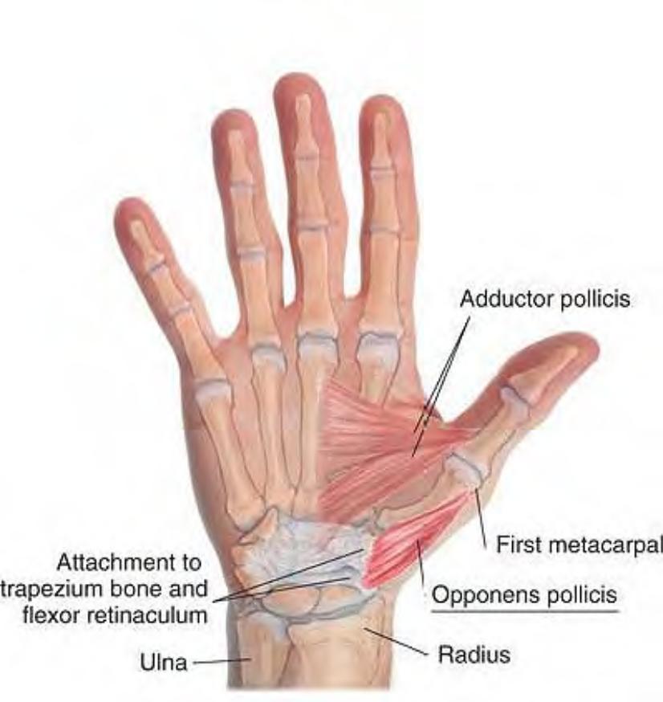
Anatomy of opponens pollicis

Slide 13
Manual Therapy for the Palmar Thumb Muscles
Trigger Point Compression. Holding the client's hand with the palm up, use the other thumb to search for a trigger point on the thenar eminence near the base. Compress with the thumb and hold for release.
Stripping. The client may be in any position that gives easy access to the palm of the hand. Holding the hand firmly with the palm facing you, place your supported or unsupported thumb at the base of the thenar eminence. Pressing firmly, slide your thumb radially to the first carpophalangeal joint. Repeat this procedure on a line just distal and parallel to the first. Continue until the whole thenar eminence has been treated.

Slide 14
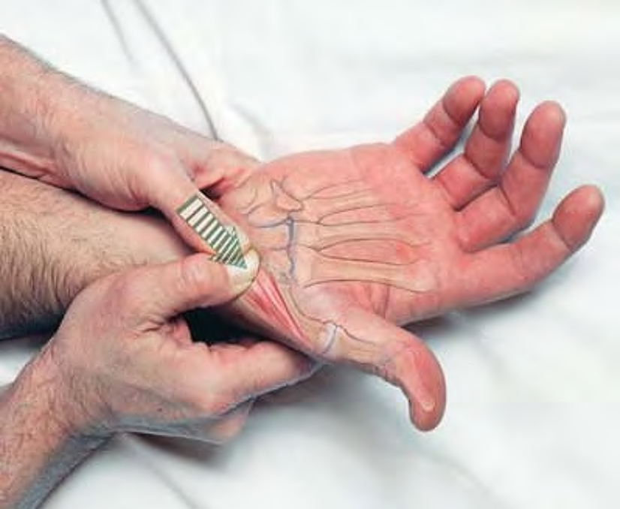
Compression of trigger point in opponens pollicis

Slide 15
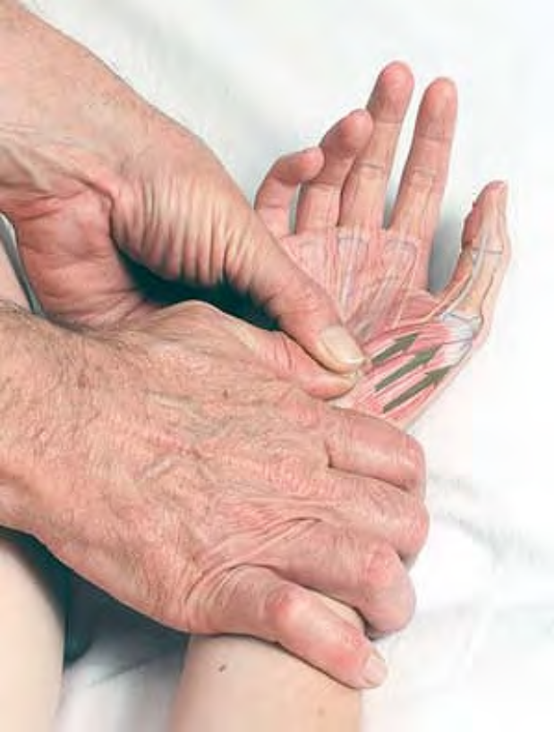
Stripping massage of the thenar eminence beginning at opponens pollicis (with supported thumb)

Slide 16
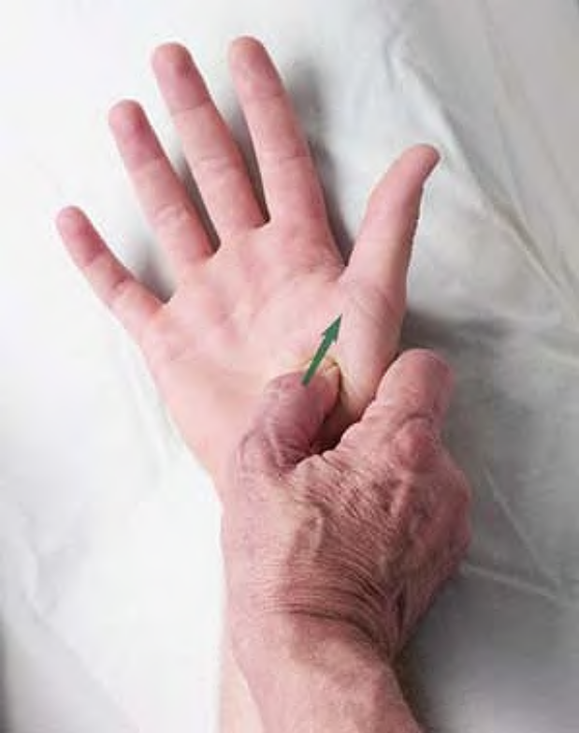
Stripping massage of the muscles of the thenar eminence (with unsupported thumb)

Slide 17
Interosseus Muscles of the Hand
Etymology Latin inter, between + os, bone
Overview. The palmar interosseous muscles adduct the fingers toward the midline, the dorsal interosseous muscles abduct the fingers from the midline.
Attachments. Dorsal interosseous muscles (four) :
Proximally, to the sides of adjacent metacarpal bones. Distally, to the base of the proximal phalanges and extensor expansion, first on radial side of second digit, sec-ond on radial side of third digit, third on ulnar side of third digit, fourth on ulnar side of fourth digit

Slide 18
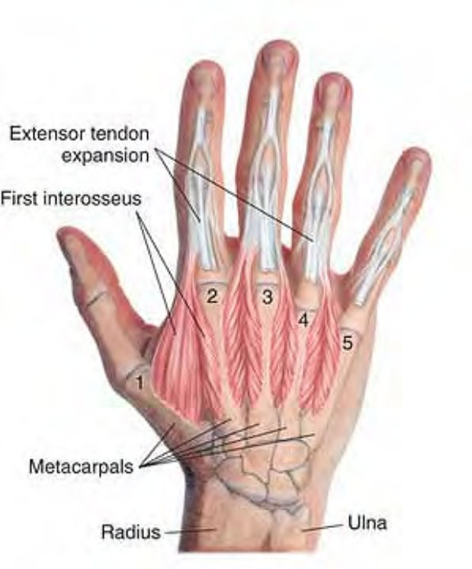
Anatomy of the dorsal interosseous muscles

Slide 19
Palmar interosseous muscles (three):
Proximally, to the palmar surface of second, fourth, and fifth metacarpal bones. Distally, the first palmar interosseous muscle into the base of the ulnar side of the second digit, the second and third palmar interosseous muscles into radial sides of fourth and fifth digits.
Palpation. Palpable between the metacarpals on the front and back of the hand. Architecture varies from unipennate to bipennate, and fibers are parallel to the muscle.
Actions.Dorsal: abduct second and third digits from the axis of the third digit and adduct third and fourth digits Palmar: adduct second, fourth, and fifth digits toward axis of the third digit

Slide 20
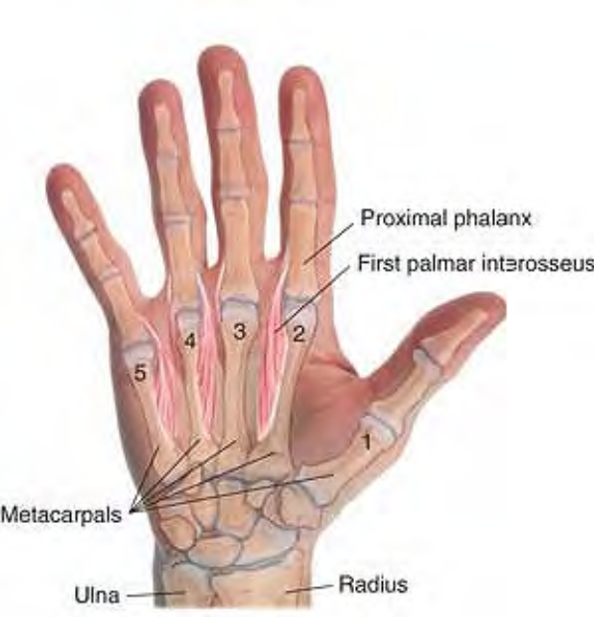
Anatomy of the palmar interosseous muscles

Slide 21
Manual Therapy of Palmar Interosseous Muscles of the Hand
Stripping. The client lies supine. (The client may also be seated, or in any position that makes the palmar aspect of the hand accessible.) The therapist stands beside the client at the shoulder. Place the thumb on the palm of the hand between the 1st and 2nd metacarpophalangeal joints. Pressing firmly into the tissue, slide the thumb distally between the first and second fingers to the thenar eminence. Repeat this procedure between each pair of metacarpals, shifting the thumb ulnarly, until the entire hand has been treated.

Slide 22
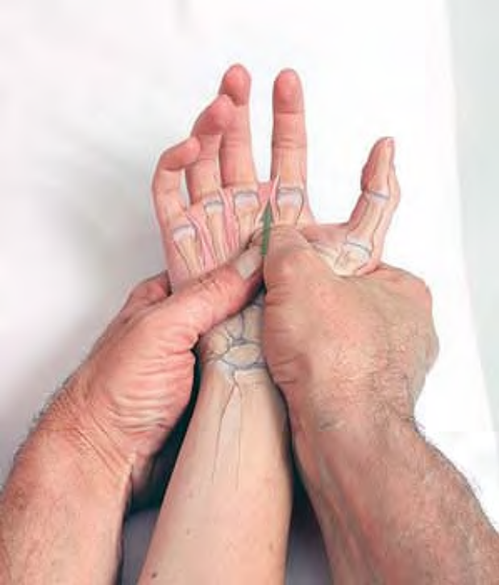
Stripping massage of palmar interosseous muscles between 2nd and 3rd metacarpals

Slide 23
Manual Therapy of Dorsal Interosseous Muscles of the Hand
Stripping. The client lies supine. (The client may also be seated, or in any position that allows access to the dorsal aspect of the hand.) The therapist stands beside the client at the hips. Hold and stabilize the client's hand with your non-treating hand. Place the thumb on the dorsal aspect of the hand between the 1st and 2nd metacarpals (i.e., between the thumb and forefinger) just next to the metacarpophalangeal joint. Pressing firmly into the tissue, slide the thumb proximally between the thumb and forefinger to the end of the tissue. Repeat this procedure between each pair of metacarpals until the entire hand has been treated.

Slide 24
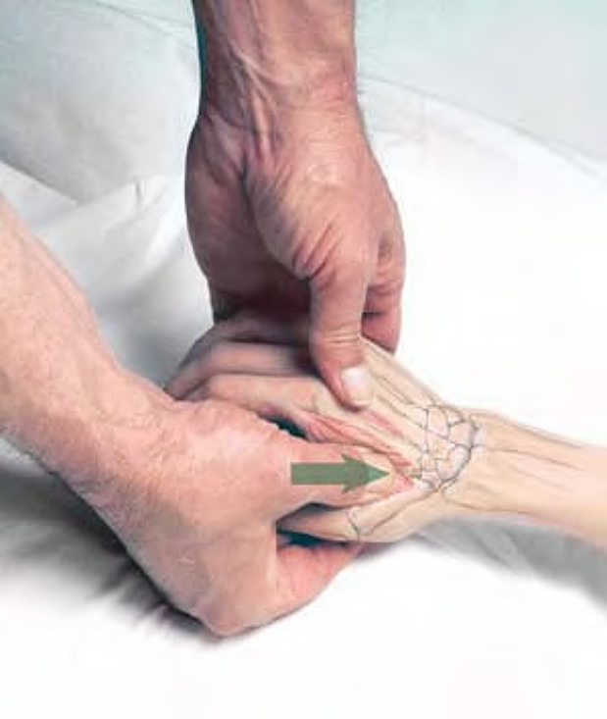
Stripping massage of first dorsal interosseous muscle

Slide 25
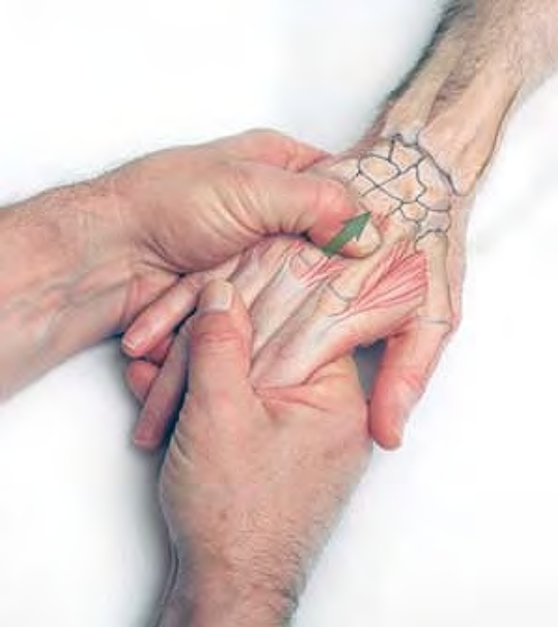
Stripping massage of dorsal interosseous muscles

Slide 26
Lumbrical Muscles of the Hand
Etymology Latin lumbricus, earthworm. The lumbricals work with the interossei in refining actions of the fingers, particularly in strong grasping. They are unusual in that they attach only to tendons, rather than bones.
Attachments. Proximally: The two lateral (radial): from the radial side of the tendons of the flexor digitorum profundus going to the second and third digits The two medial (ulnar): from the adjacent sides of the second and third, and third and fourth tendons Distally: To the radial side of extensor tendon on dorsum of each of the four fingers at the proximal phalanges
Palpation. Neither palpable nor discernible. Action. Flex metacarpophalangeal joint and extend the proximal and distal interphalangeal joint. Referral Areas. No specific trigger points have been documented in the lumbrical muscles. They are included here for completeness.

Slide 27
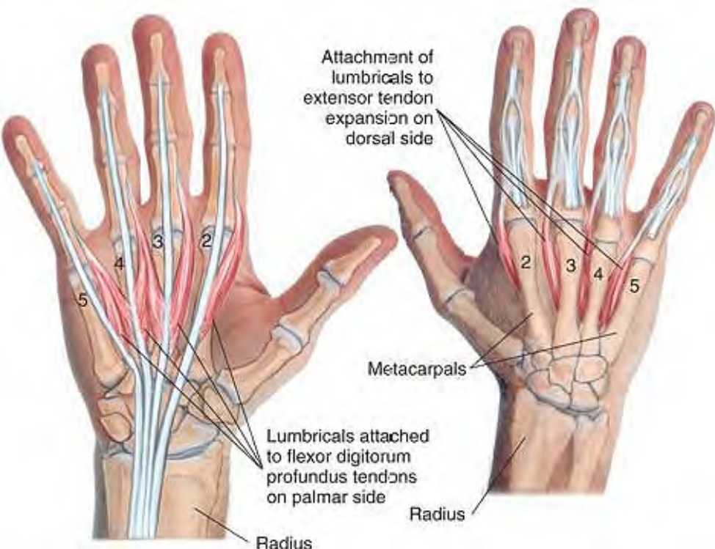
Anatomy of lumbricals

Slide 28
Flexor Digiti Minimi Brevis
Etymology Latin flexor, flexor + digiti, of the finger + minimi, smallest + brevis, short
Attachments. Proximally, to the hamulus of the hamate bone. Distally, to the ulnar side of the proximal 5th phalanx
Palpation. Palpable on the palm between the hamate and the base of the fifth digit. Architecture is parallel, and fibers are parallel to the muscle.
Action. Flexes the proximal phalanx of the fifth digit
Referral Areas. No trigger points have been documented for this muscle.

Slide 29
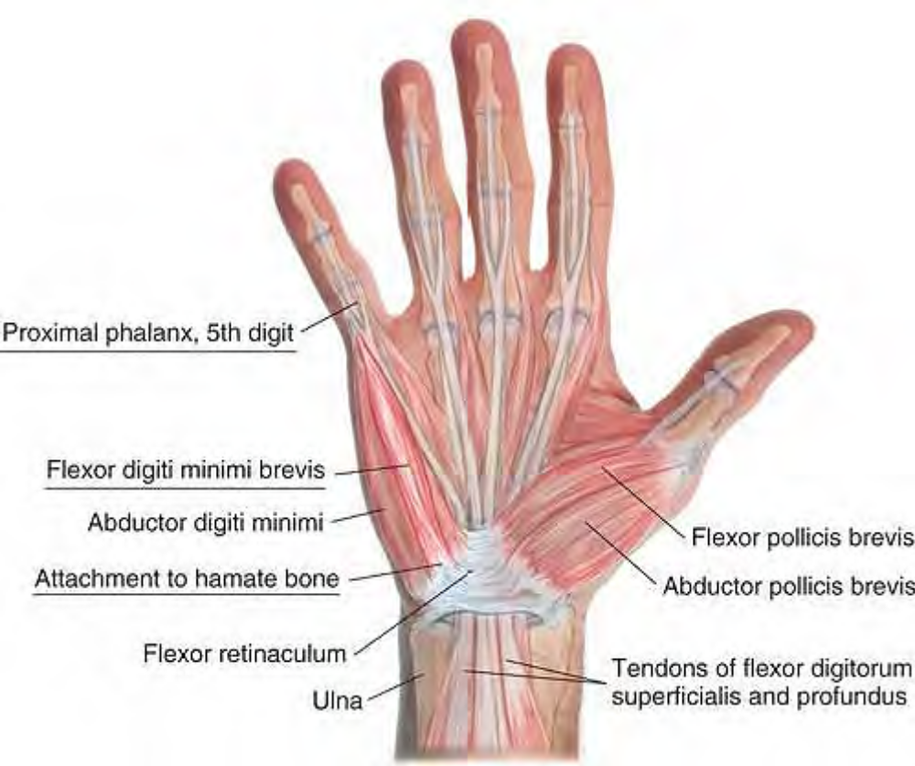
Anatomy of flexor digiti minimi brevis

Slide 30
Abductor Digiti Minimi
Etymology Latin abductor (ab, away from + ducere, to lead), that which draws away + digiti, of the finger + minimi, smallest
Overview. If there were a sixth digit, abductor digiti minimi would be half of its dorsal interosseous muscle. It typically develops a trigger point at the center of the belly, palpable on the dorsal side.
Attachments. Proximally, to the pisiform bone and pisohamate ligament. Distally, to the ulnar side of the base of the proximal 5th phalanx
Palpation. Palpable on the ulnar edge of the hand. Architecture is parallel, and fibers are parallel to the muscle.
Action. Abducts proximal phalanx of and flexes the fifth digit
Referral Areas. Lateral and dorsal aspects of the little finger

Slide 31
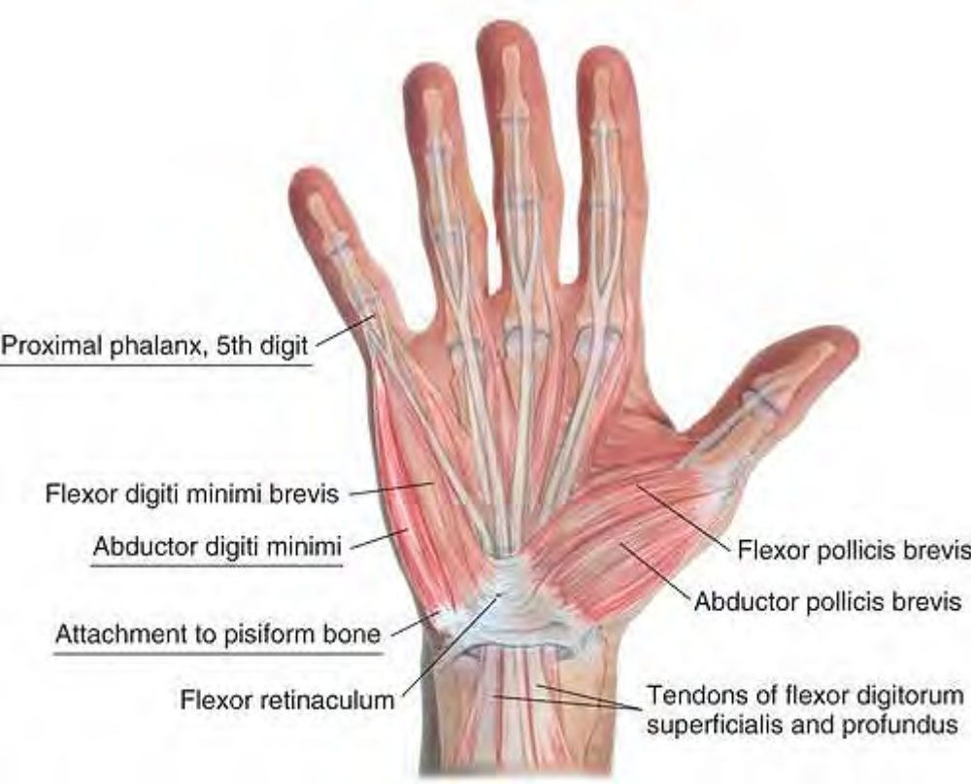
Anatomy of abductor digiti minimi

Slide 32
Manual Therapy
Pincer Compression. The client is in any position that allows access to the ulnar edge of the hand. With the non-treating hand, hold and stabilize the client's hand. Using the thumb and index finger, explore the dorsal aspect of abductor digiti minimi looking for tender spots.
Hold for release.

Slide 33
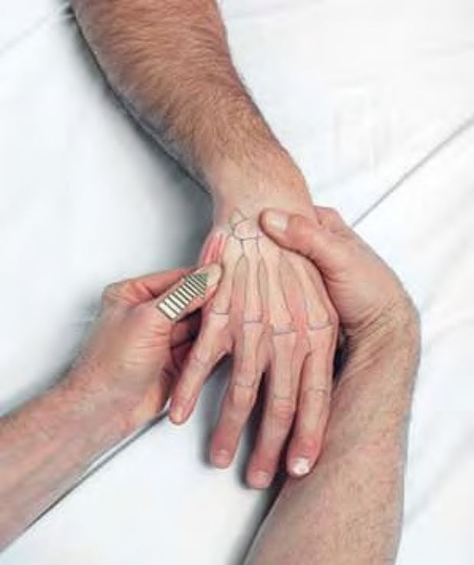
Pincer compression of trigger point in abductor digiti minimi

Slide 34
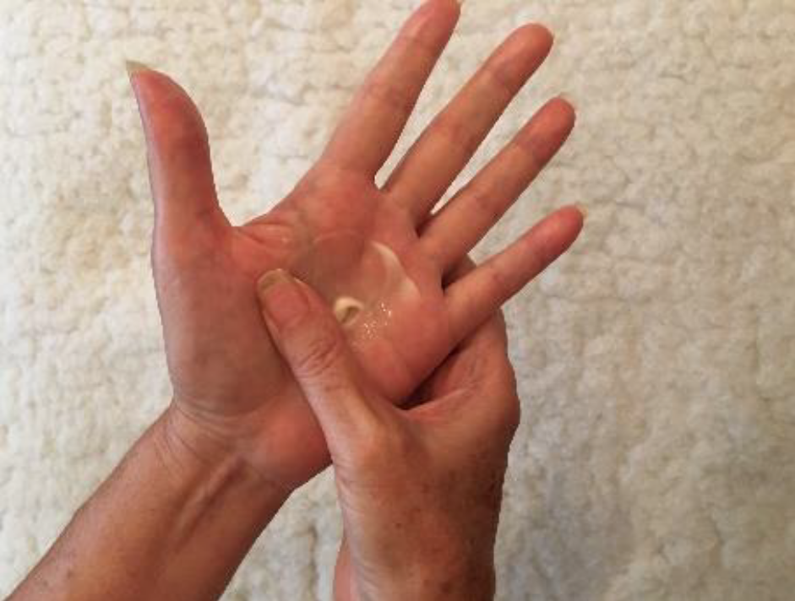
8 Steps To Pain-Free Hands
With “Hands-On Self-Massage”
1. Take a small dab of your favorite cream with two fingers and rub your hands together, spreading it on the palms and outside of your hands.

Slide 35
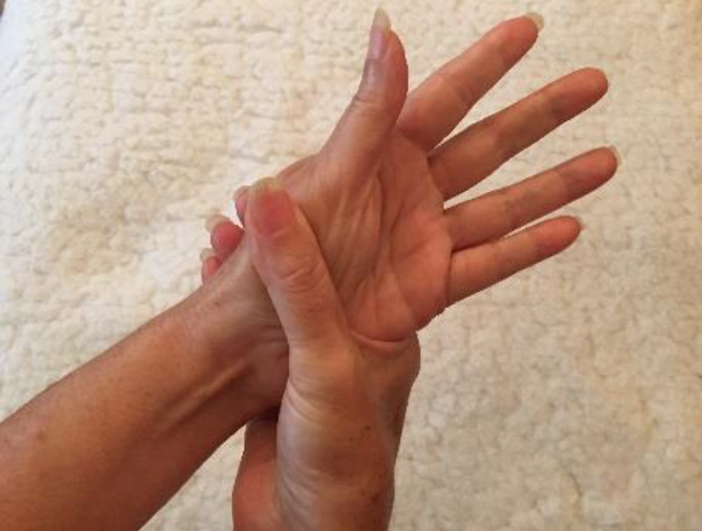
2. Open the thumb and index finger of the massaging hand and hug your wrist.
* Allow the other fingers to fall relaxed next to the index finger.
* Gently pull your non-massaging hand through your fingers and thumb, twisting the hand inside towards and away from the massaging hand as you go.
*Use the massaging hand to wring your non- massaging hand.
* Exhale and feel the healing heat generated by the friction of your hands rubbing together.

Slide 36
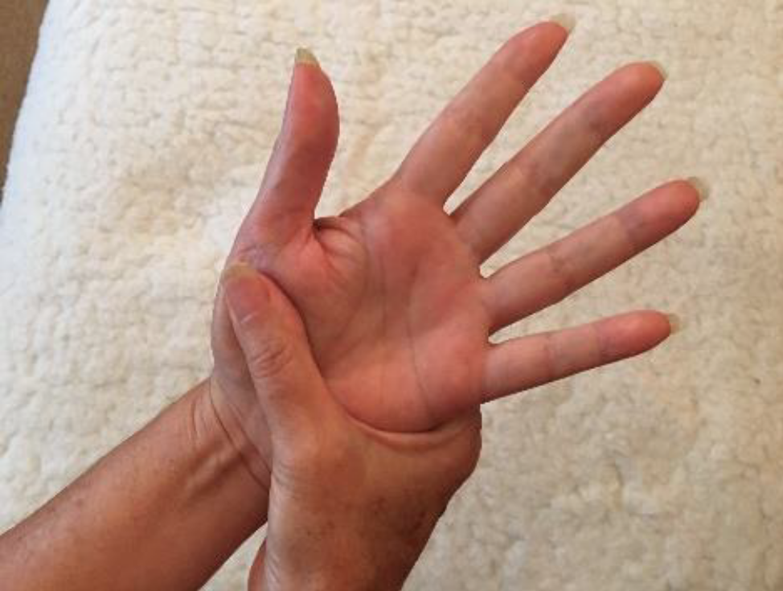
3. Place one hand in the palm of your other hand and place the thumb of the bottom hand on the palm of the top hand.
* Using your thumb, rub the fleshy part of your palm as deeply as feels good to you, in short strokes from the wrist to the base of your thumb.
* Coordinate your exhalation with the movements of your thumb.
* Exhale and allow breath to enter your body.
* Let the rhythm of your breathing move you deeper into relaxation.

Slide 37
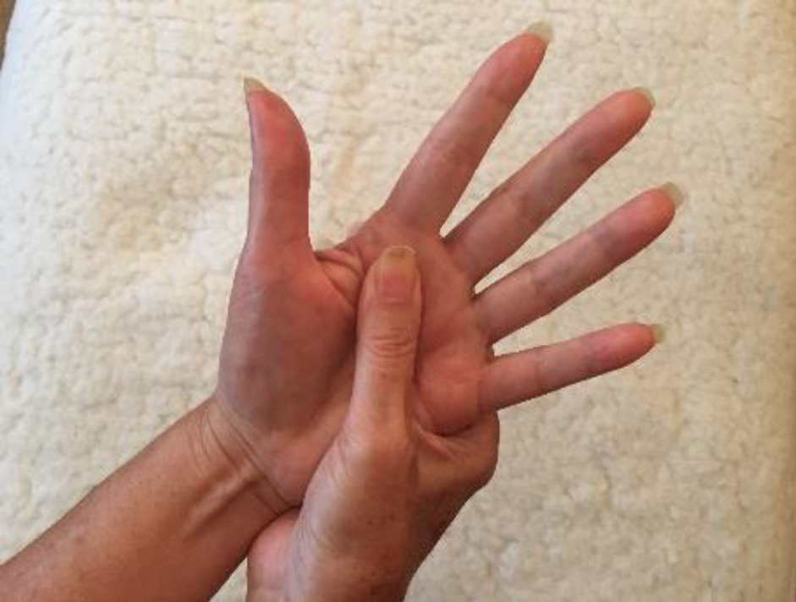
4. Using the same short stroke gesture, rub the bones in your hands.
* After rubbing each bone, rub them all in a circular motion, including each of the knuckles.
* Change the direction of your circular strokes as you go.
* Exhale and feel your hands and fingers releasing all the tension held within.

Slide 38
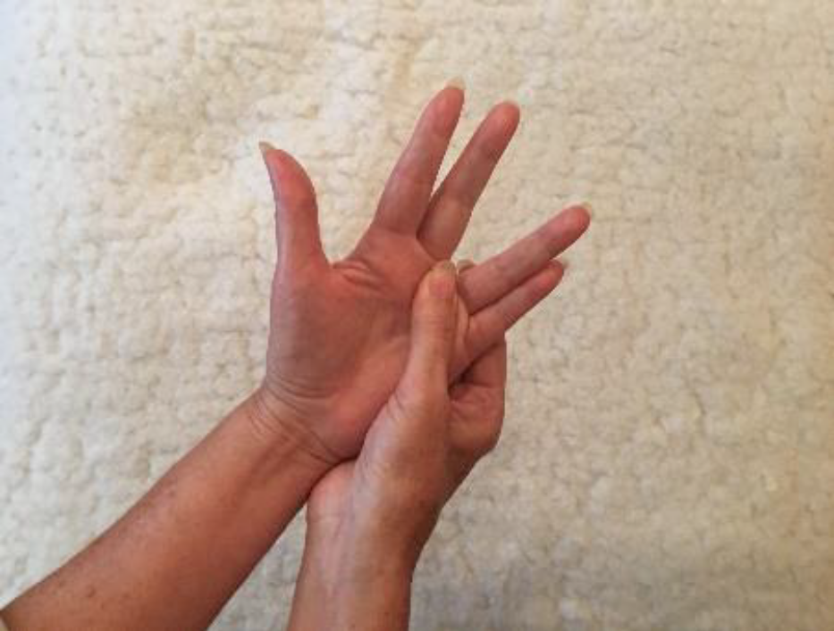
5. Rub the spaces between the bones of your hand.
* Starting from the middle of your palm, follow the crevices of your hand all the way up to the spaces between your fingers.
* Find or continue a rhythm with your exhalation and breathing.
* Make sure the breath enters your body slowly and in a relaxed way.

Slide 39
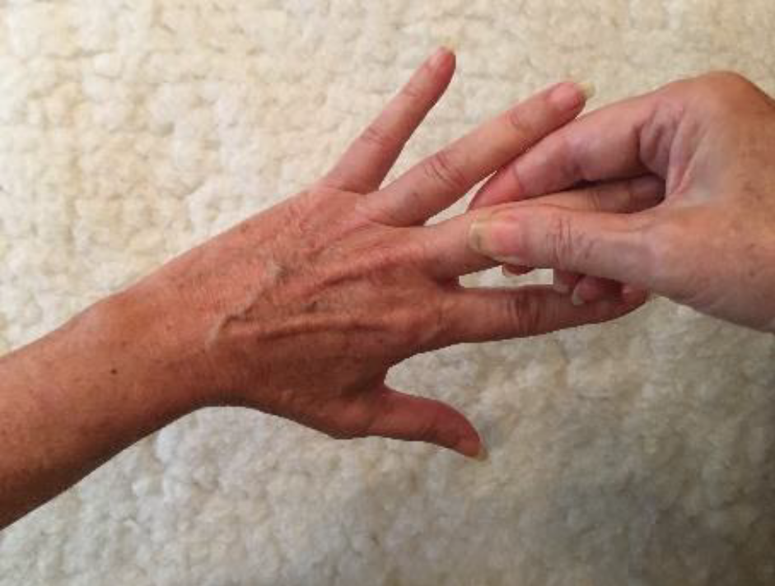
6. One by one, squeeze the sides of your fingers and slowly rub from where they meet the palm of your hand all the way to the tip of each finger.
* Observe your breath. Is it deep or shallow? Feel your rib cage rise and fall.
SAY: With each and every day I have more and more control in my life. Consistency and steady improvement is more important than perfection.

Slide 40
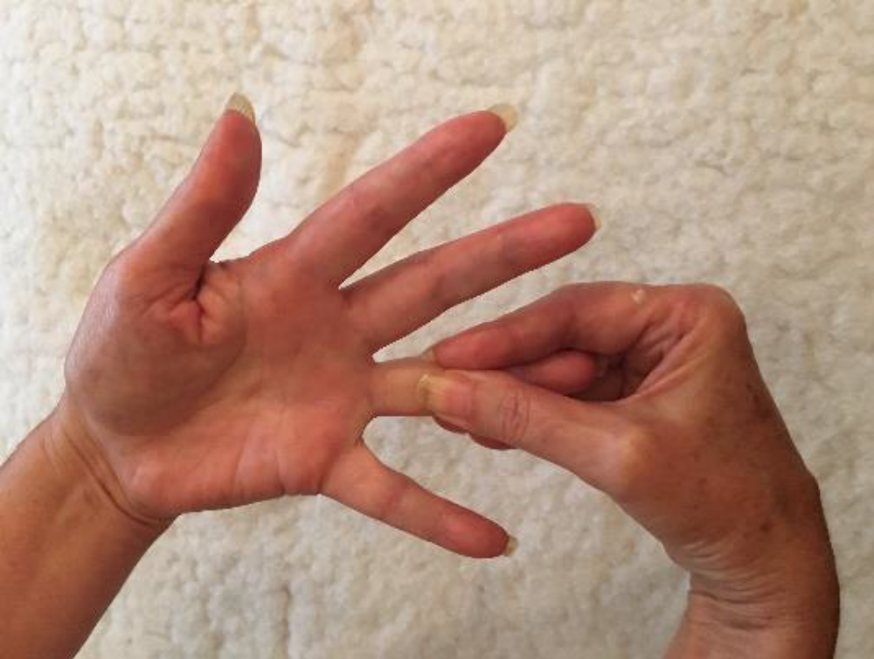
7. Rub and squeeze each finger, slowly massaging the inner and outer parts of your fingers, starting where the fingers meet the palm of the hand and working your way to the fingertips.
* Rub each finger slowly and deliberately, emphasizing the knuckles as you pass them.
* Allow breath to enter and leave the body on its own easily and without force, relaxing you with each passing moment.
* Feel every finger relax as you release tension, worry, concern, and any unwanted thoughts.

Slide 41
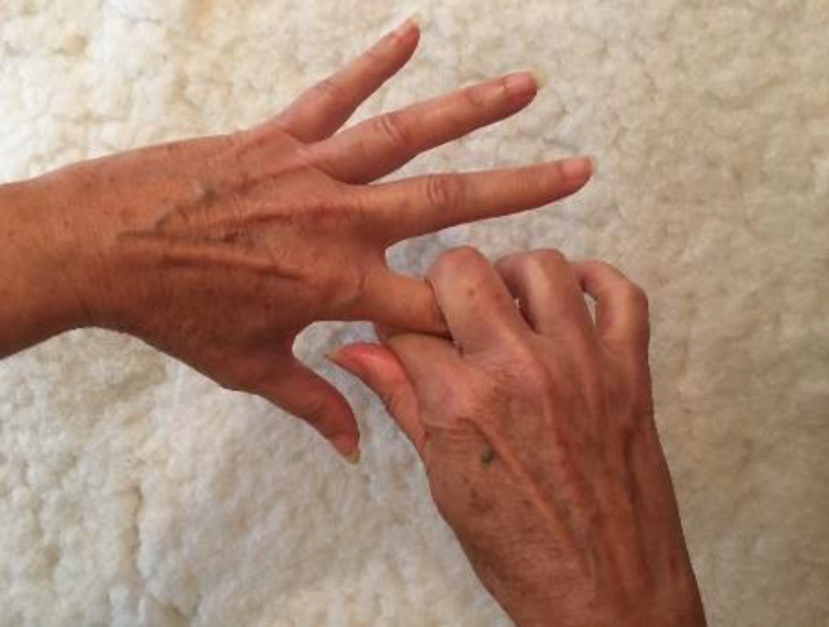
8. Wrap your index and middle fingers around a finger on your other hand, pulling from your palm to the fingertips.
* Do this for each finger, gently squeezing as you go.
* Exhale, exhale, exhale.
* Find a rhythmical sequence to your declarations and breath - you are affirming with the totality of your engaged emotion and consciousness.

Slide 42

Massage isn’t just about relaxation—it’s about relief, healing, and giving your body (and mind) permission to rest for a moment. Sometimes, that one hour can make all the difference in how someone feels for days… even weeks.

