Slide 1
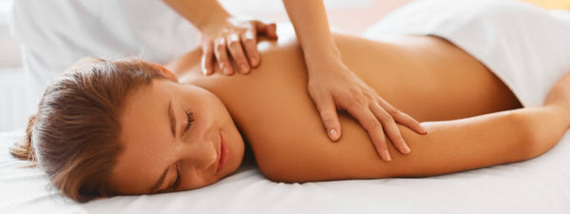
Massage Techniques 5A
The Arm

Slide 2
Overview of the Region. Pain in the arm and hand presents a clinical challenge, because it can originate in so many different places. Nerve entrapments at the cervical roots, thoracic outlet, pectoralis minor attachment to the coracoid process, or in the arm itself, including the wrist, may be responsible for arm or hand pain. Arm or hand pain may also be referred from trigger points in the muscles of the neck, shoulder, upper arm, or forearm. An assessment of arm or hand pain must include these possibilities.
In anatomy, the word arm (Latin brachium) is reserved for what we normally call the upper arm. The term forearm is used to denote the lower arm. The arm consists of a single bone, the humerus, which articulates with the scapula via the glenohumeral joint. We have already seen the muscles that cross the glenohumeral joint from the scapula. The muscles that reside on the humerus and cross the glenohumeral joint are: biceps brachii, triceps brachii, coracobrachialis

Slide 3
The elbow consists of two joints: the humero-radial and humeroulnar joints. The muscles crossing this pair of joints are: biceps brachii, triceps brachii, Brachialis, Anconeus, brachioradialis
The forearm allows not only flexion and extension in relation to the humerus, but also rotation of the radius around the ulna, called supination (lateral or upward rotation) and pronation (medial or downward rotation). These movements take place through motion at the humeroradial joint and the proximal and distal radioulnar joints. Rotation is accomplished primarily by biceps brachii, supinator, pronator quadratus, and pronator teres. Distally, the radius and ulna articulate with the carpal bones of the wrist and with each other at the distal radioulnar joint.
One wrist structure that deserves special clinical attention is the carpal tunnel, formed by the carpal bones deep and on either side, and the flexor retinaculum superficially. This tunnel permits passage of the flexor tendons and the median nerve to the hand. When these tendons become inflamed and swollen, they compress the median nerve, producing pain and numbness in the radial aspect of the hand, known as carpal tunnel syndrome.

Slide 4
The muscles that cross the wrist are the flexors and extensors of the hand and fingers, which will be addressed in some detail later.
NOTE: Directional terms used here include volar to indicate the anterior aspect of the forearm and palmar to indicate the anterior aspect of the hand in anatomical position. The opposite of both these terms is dorsal or posterior.
Etymology
Latin vola, palm of the hand or sole of the foot
Latin palma, palm of the hand
Latin dorsum, back

Slide 5
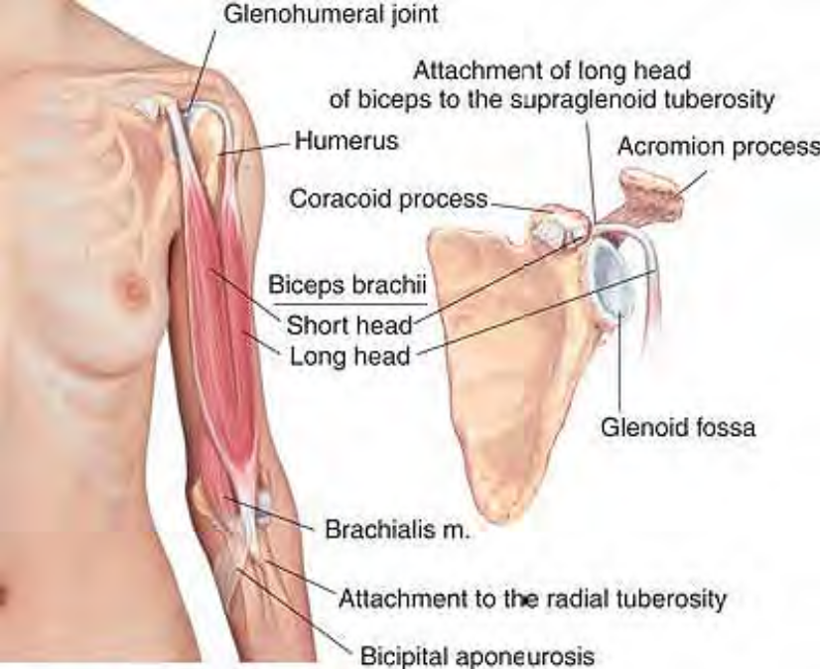
Biceps Brachii BI-seps BRAY-kee-eye
Overview. Biceps brachii crosses two joints: the glenohumeral and the elbow. It resides on the humerus but has no attachments to it. Although we think of it as the flexor of the elbow, biceps brachii is also the most powerful supinator of the forearm.
Attachments. Proximally, the long head from supraglenoid tuberosity of scapula, the short head from coracoid process Distally, to the tuberosity of radius and antebrachial fascia by the bicipital aponeurosis

Slide 6
Palpation. Proximal: Architecture of biceps brachii is parallel, and its fibers are largely parallel to the humerus. Long head: Follow the muscle up to the intertubercular groove of the humerus, beyond which it passes under the acromion process and is no longer palpable. Short head: Follow the muscle into the axilla and up to the coracoid process. Distal attachments are not discernible.
Action. Flexes the elbow and supinates the forearm
Referral Areas. Over the area of the muscle itself, to the inner aspect of the elbow, to the area of the middle deltoid, and to the area just proximal to supraspinatus
Other Muscles to Examine. Brachialis, Supinator, Brachioradialis, Middle deltoid, Rotator cuff muscles

Slide 7
Manual Therapy
Stripping. The client lies supine. The therapist stands beside the client at the hip. Place the knuckles on the muscle at the elbow. Pressing firmly into the tissue, slide the knuckles proximally along the muscle to the head of the humerus. Beginning at the same spot, repeat this procedure, following the short head medially to the axilla.

Slide 8
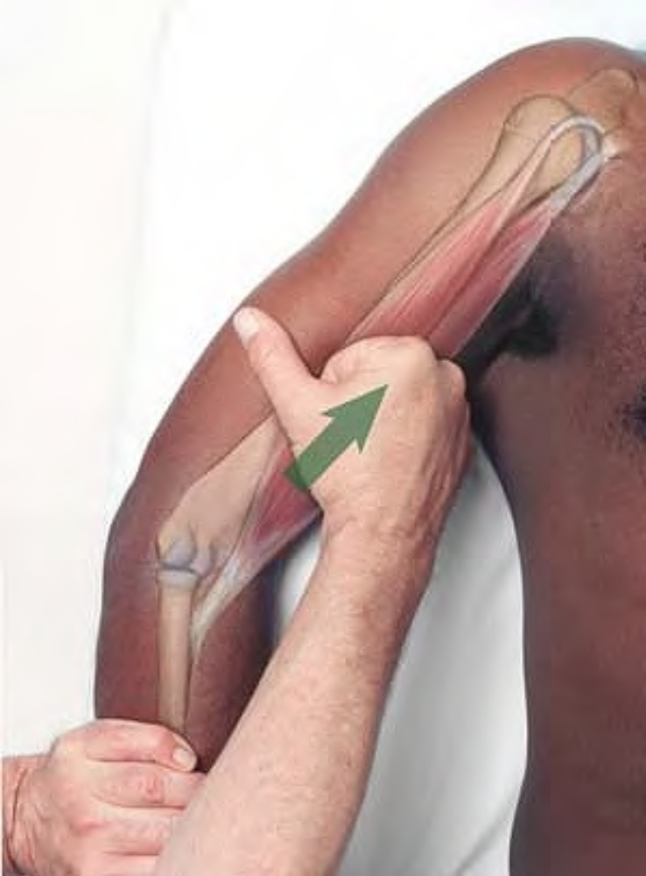
Stripping massage of biceps using knuckles

Slide 9
Brachialis BRAY-kee-AL-is
Etymology Latin brachium, arm
Overview. Brachialis is a prime flexor of the elbow. Biceps brachii must be displaced to work on this muscle.
Attachments. Proximally, to the lower two-thirds of anterior surface of humerus. Distally, to the coronoid process of the ulna
Palpation. Brachialis can be palpated from the distal half of the medial side of the arm between biceps and the humerus. The muscle is discernible here and its architecture is parallel. Its fibers are parallel to the humerus.
Action. Flexes the elbow

Slide 10
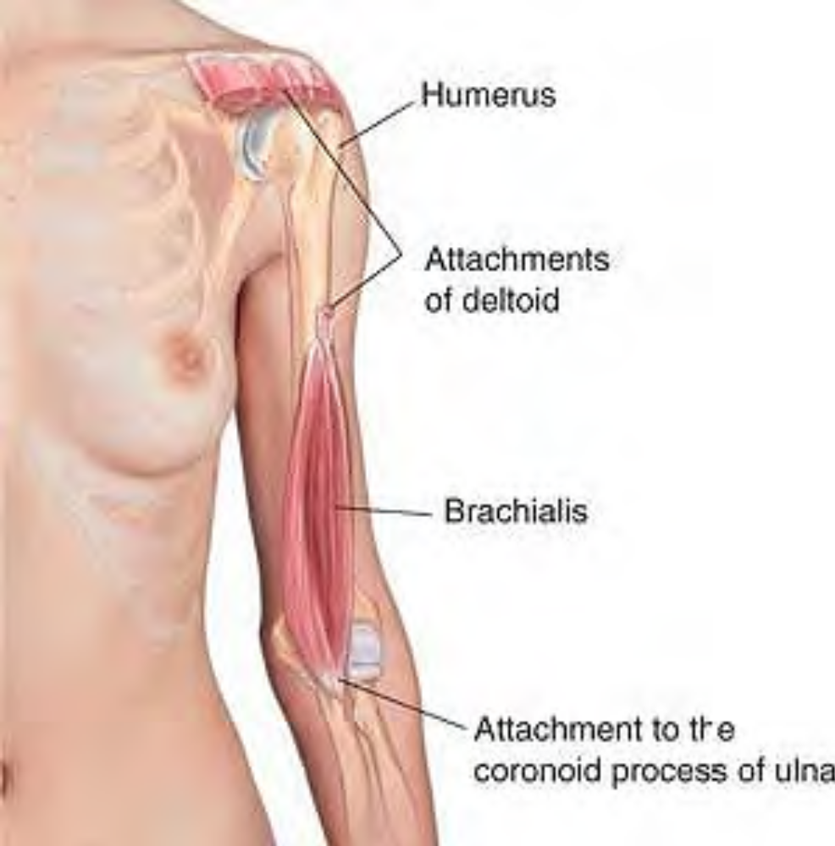
Anatomy of brachialis

Slide 11
Referral Areas. To the anterior surface of the arm up to the acromion, to the anterior aspect of the elbow, and to the lateral and posterior aspect of the base of the thumb.
Other Muscles to Examine. Biceps brachii, Supinator, Brachioradialis, Opponens pollicis, Adductor pollicis
Manual Therapy
Stripping. The client lies supine. The therapist stands beside the client at the hip. Place the thumb on the lateral aspect of the distal extent of brachialis just proximal to the elbow, pushing biceps brachii medially out of the way.

Slide 12
Pressing firmly into the tissue, slide the thumb along brachialis to its attachment on the humerus just distal to the attachment of the middle deltoid.
Repeat the stroke on the medial side of the muscle, continuing about halfway up the humerus.

Slide 13
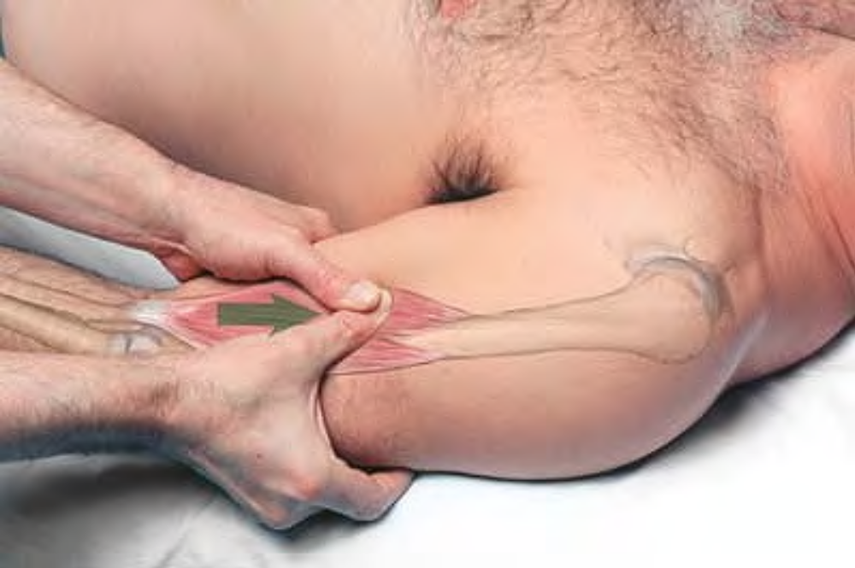
Stripping massage of brachialis using supported thumb (from lateral side)

Slide 14
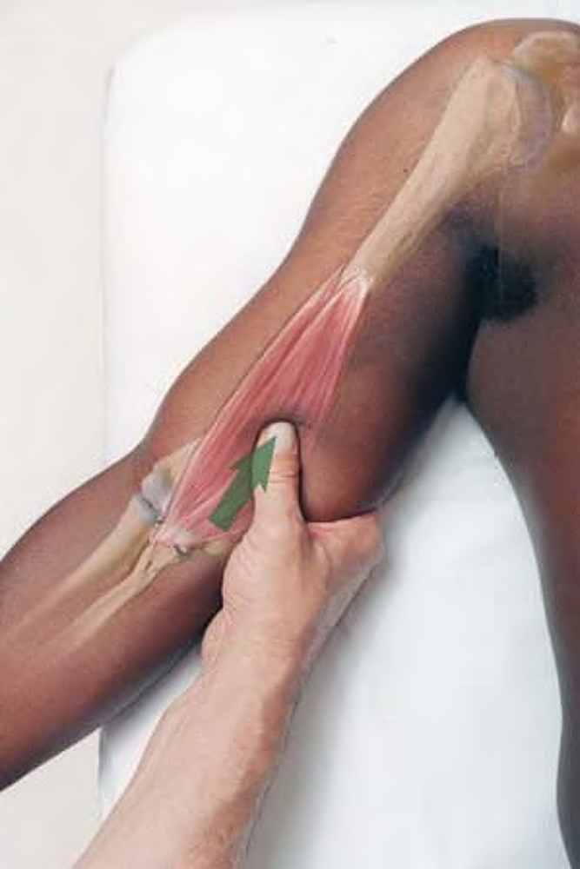
Stripping massage of brachialis using thumb (from medial side)

Slide 15
Triceps Brachii TRY-seps BRAY-kee-eye
Etymology Latin triceps, three-headed + brachii, of the arm
Overview. Two of the three heads of triceps brachii (Fig. 5-6) cross only the elbow joint, while the long head crosses both the elbow and shoulder joints. This muscle opposes biceps brachii and brachialis. Its trigger points can cause pain in an area ranging from the neck to the fingers.
Attachments. Proximally: long or scapular head: to the infraglenoid tubercle at the lateral border of scapula inferior to the glenoid Fossa lateral head: to the lateral and posterior surface of humerus below greater tubercle. medial head: to the distal posterior surface of humerus. Distally, to the olecranon of ulna
Palpation. Palpate from the olecranon process to (1) long head: the upper, outer edge of the scapula; (2) medial head: upper posterior surface of humerus; and (3) lateral head: outer posterior surface of humerus. It is discernible. Its architecture as a whole is bipennate, and fibers of its main body are parallel to the humerus.

Slide 16
Action. Extends elbow
Referral Areas. To the dorsal surface of the arm proximally over the back of the shoulder and distally to the back of the hand into the fourth and fifth fingers; also over the volar surface of the forearm and just proximal to the elbow.
Other Muscles to Examine
All the muscles of the arm and forearm, Rotator cuff muscles, Pectoralis minor, Pectoralis major

Slide 17
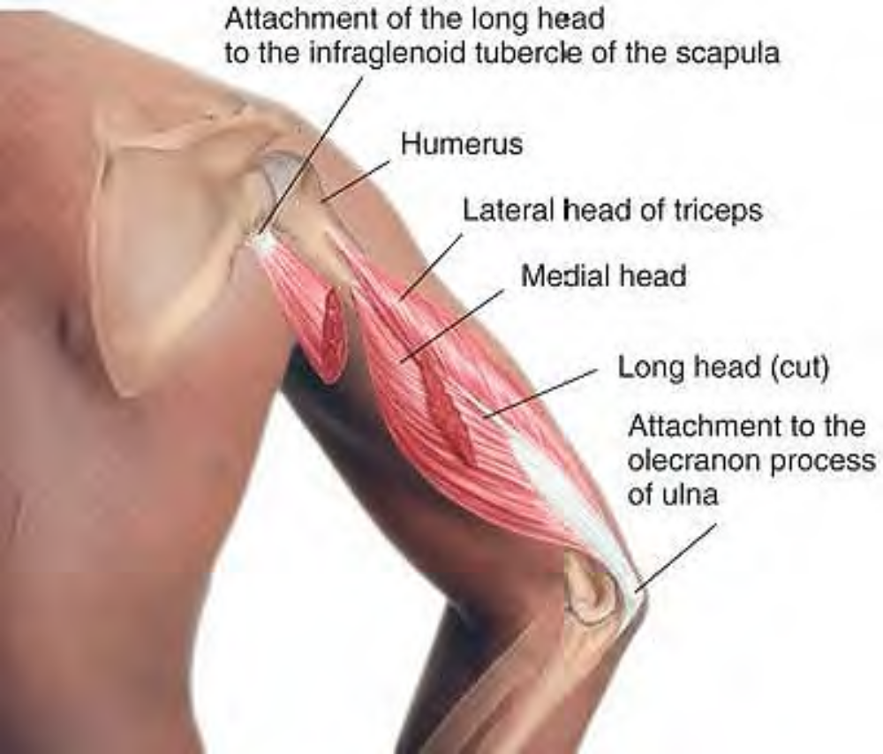
Anatomy of triceps brachii

Slide 18
Manual Therapy
Stripping. The client lies prone. The therapist stands beside the client at the waist.
Place the thumb, knuckles, or fingertips on the muscle just proximal to the olecranon process.
Pressing firmly into the tissue, slide the thumb, knuckles, or fingertips along the muscle to the attachment of the posterior deltoid.

Slide 19
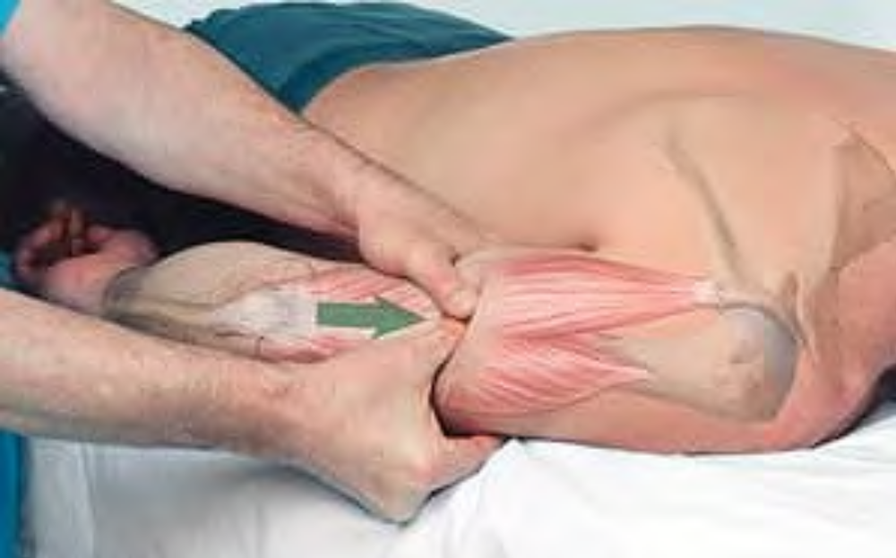
Stripping massage of triceps using thumbs

Slide 20
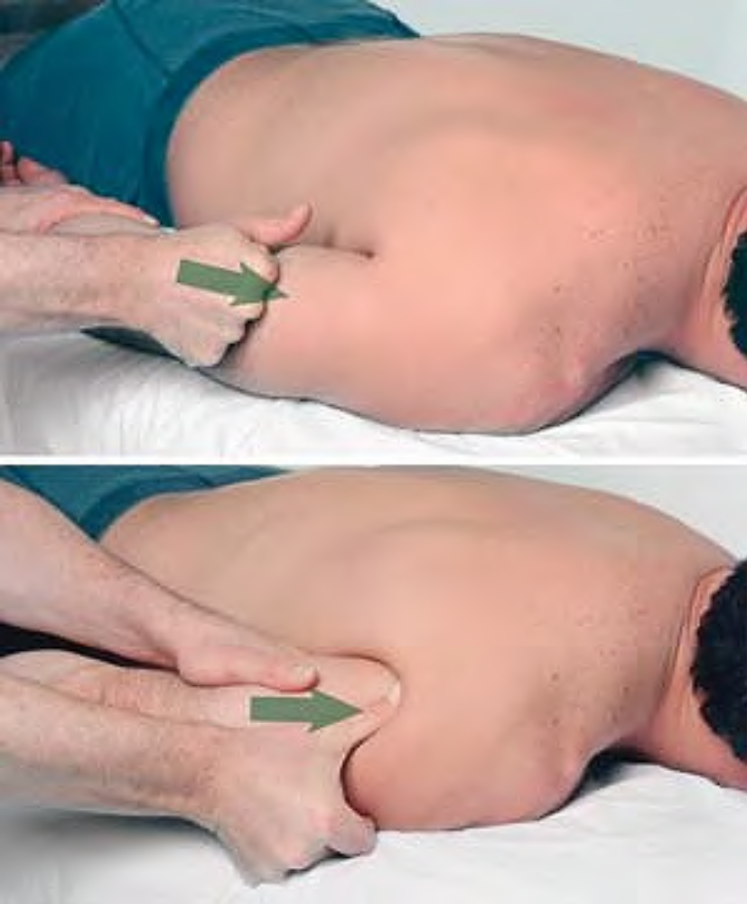
Stripping massage of triceps using knuckles and thumb

Slide 21
The client lies supine. The therapist stands at the client head. Position the client's hand under the shoulder. Place the heel of the hand just proximal to the olecranon process. Pressing firmly into the tissue, slide the heel of the hand along triceps to the attachment on the scapula.

Slide 22
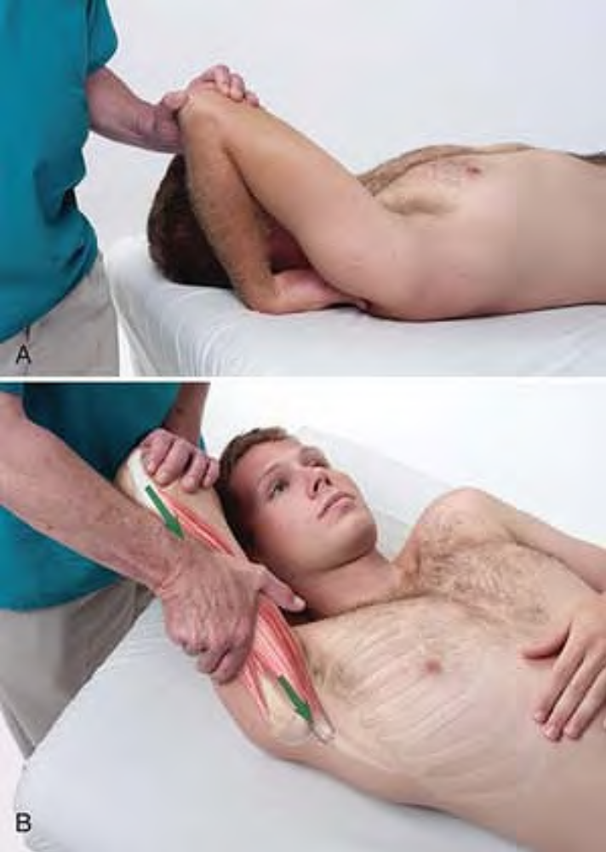
Stripping of triceps in supine position with heel of hand. (A) Positioning of client, (B) stripping

Slide 23
Anconeus an-KO-knee-us
Etymology Latin ancon, from Greek ankon, elbow
Overview. Anconeus is a small muscle that assists triceps brachii in elbow extension. Its pain referral zone is local.
Attachments. Proximally, to the posterior aspect of the lateral condyle of the humerus. Distally, to the olecranon process and the posterior surface of the ulna
Palpation. Palpable just distal to the funny bone, the point between the medial epicondyle of the humerus and the olecranon process. Its architecture is convergent, and its fibers are diagonal to the forearm. Action. Extends elbow
Referral Areas. Area over the lateral condyle of humerus

Slide 24
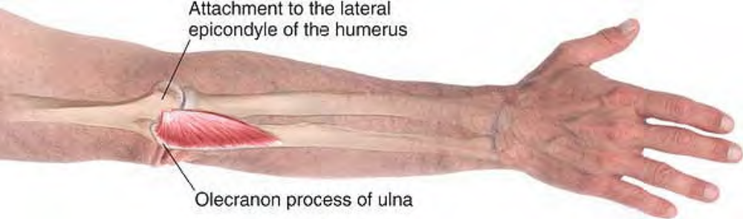
Anatomy of anconeus, dorsal (posterior) view

Slide 25
Other Muscles to Examine. Triceps brachii, Scalenes, Supraspinatus, Serratus posterior superior
Manual Therapy
Stripping. The client may be in any position that makes the dorsal aspect of the elbow easily accessible. Place the thumb on the proximal posterior aspect of the ulna just distal to the olecranon. Pressing firmly into the tissue, slide the thumb along the muscle diagonally to its attachment on the lateral epicondyle of the humerus (a very short distance!).

Slide 26
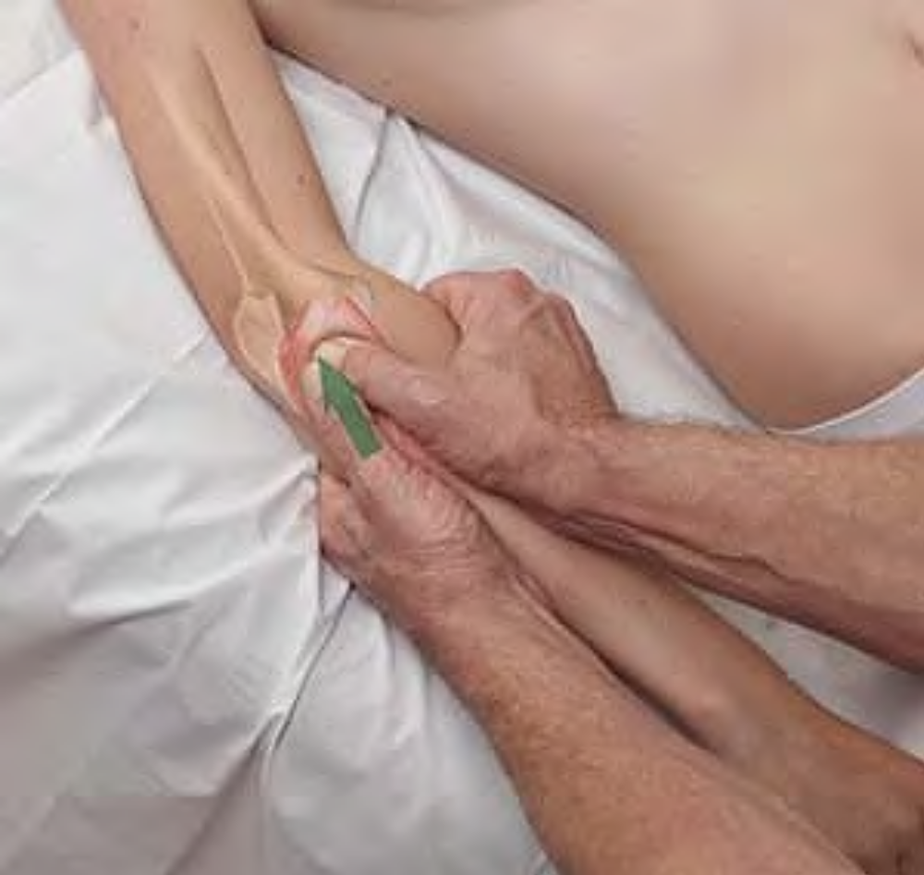

Slide 27
Coracobrachialis KOR-a-ko-BRAKE-ee-AL-is
Etymology From coracoid (Greek korakodes, like a raven's beak, from korax, raven + eidos, resemblance) + Latin brachialis, relating to the arm (brachium)
Overview. Coracobrachialis is one of three muscles that attach to the coracoid process of the scapula, and that maintain the complex, three-way interaction of the arm, scapula, and chest (rib cage). The other two muscles are biceps brachii and pectoralis minor.
Attachments. Proximally, to the coracoid process of the scapula. Distally, to the middle of the medial border of the humerus

Slide 28
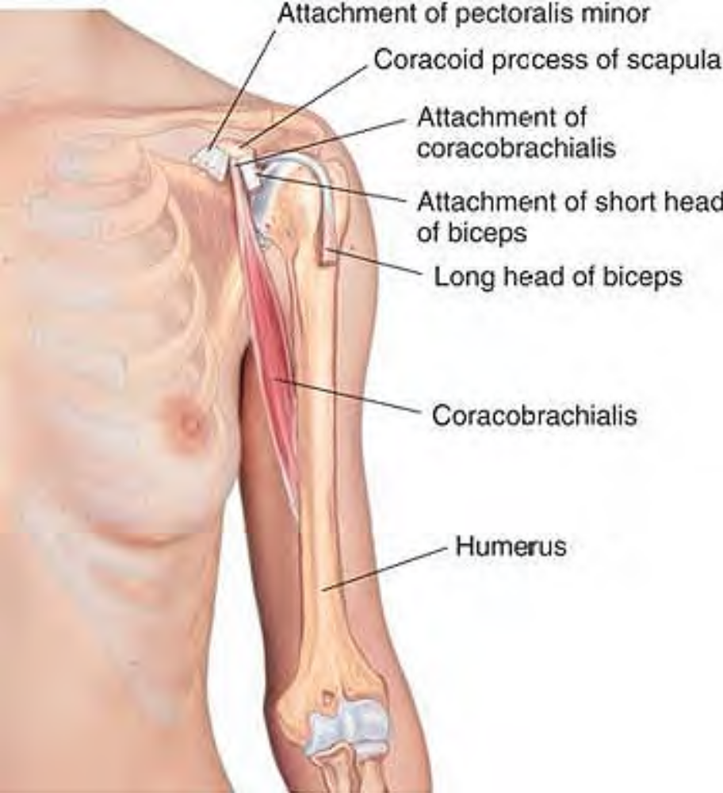
Anatomy of coracobrachialis

Slide 29
Palpation. Palpable on medial upper half of humerus up to the coracoid process of scapula. Its architecture is parallel, and its fibers are diagonal.
Actions. Adducts and flexes the humerus. Resists downward dislocation of shoulder joint.
Referral Areas. To the posterior aspect of the upper arm, forearm, and hand, and to the area of the middle and anterior deltoid
Other Muscles to Examine. All the muscles of the arm and forearm, Rotator cuff muscles, Deltoids

Slide 30
Manual Therapy
Stripping and Compression. The client lies supine. The therapist stands at the client's side, facing the client's head. The therapist holds the arm to be treated at the elbow with the non-treating hand. With the treating hand (i.e., the hand nearest the client), grasp the upper arm from the medial side in such a way that the thumb can comfortably extend along the medial side of the humerus. Press the thumb under biceps brachii to the medial side of the humerus about halfway up the humerus, seeking the distal attachment of coracobrachialis. Hold for release. Glide the thumb proximally along the muscle, holding for release where tenderness is found. The thumb will finally follow the muscle deep into the axilla to the upper attachment to the coracoid process.
Caution. In working in the axilla, take care to maintain contact with the muscle, and avoid the nerves and blood vessels that pass under the coracoid process into the arm.

Slide 31
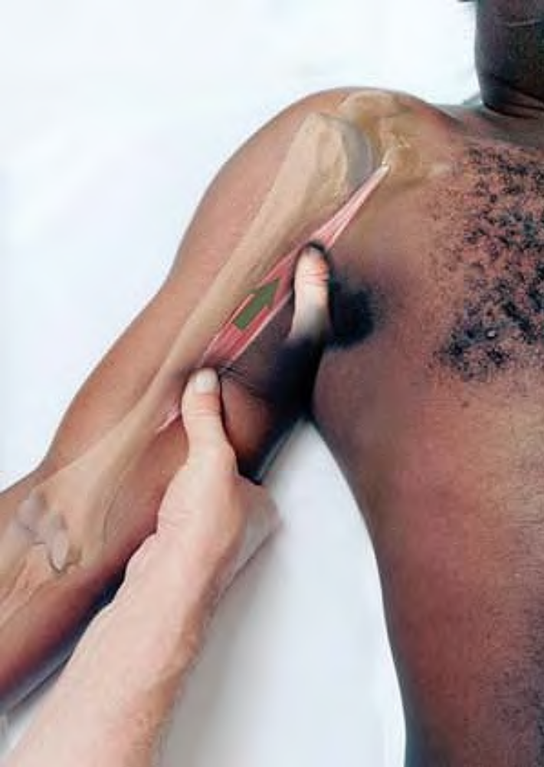
Stripping and compression of coracobrachialis using thumb

