Slide 1
Irritable bowel syndrome
Dr. Anand Kumar MD MBA

Slide 2
Irritable bowel syndrome
Irritable bowel syndrome is also known as spastic colon, spastic constipation, irritable colon, and nervous indigestion.
It is a motility disorder which is strongly associated with anxiety, stress, depression in over half the cases.
More common in women.
There is generally no underlying organic cause or physical abnormality in the G I tract.

Slide 3
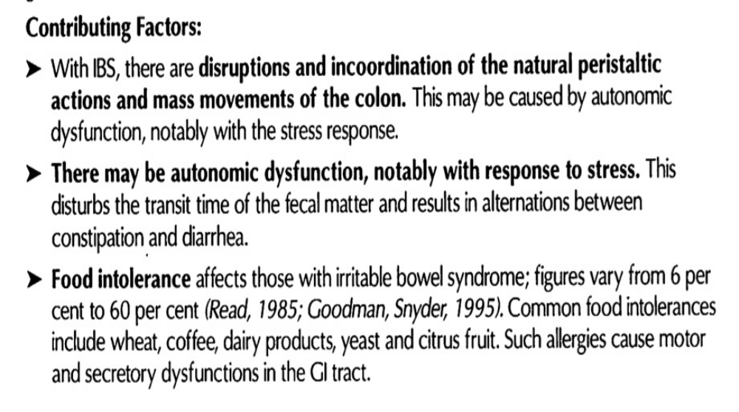
Contributing factors

Slide 4
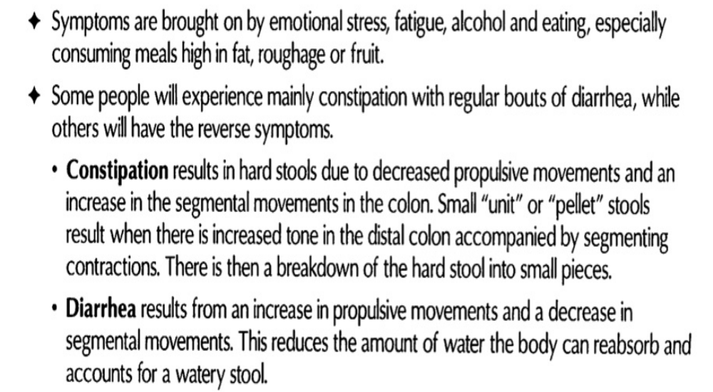
Symptom picture

Slide 5
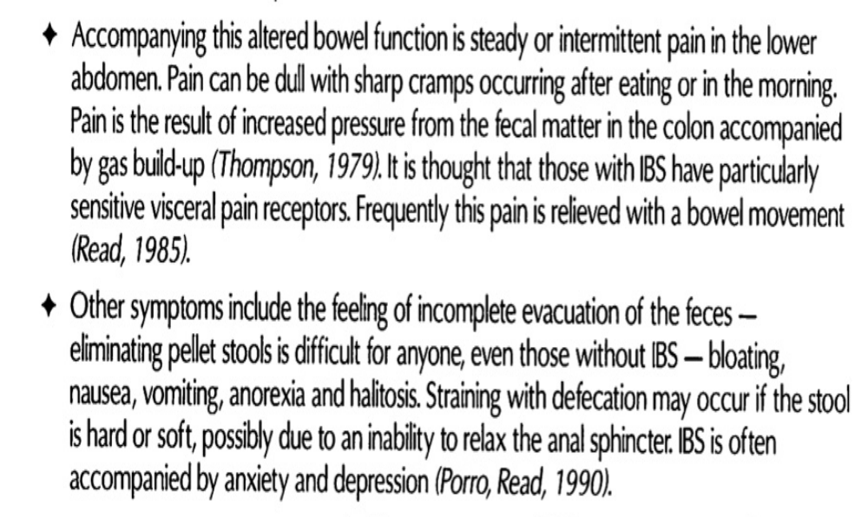
Symptoms

Slide 6
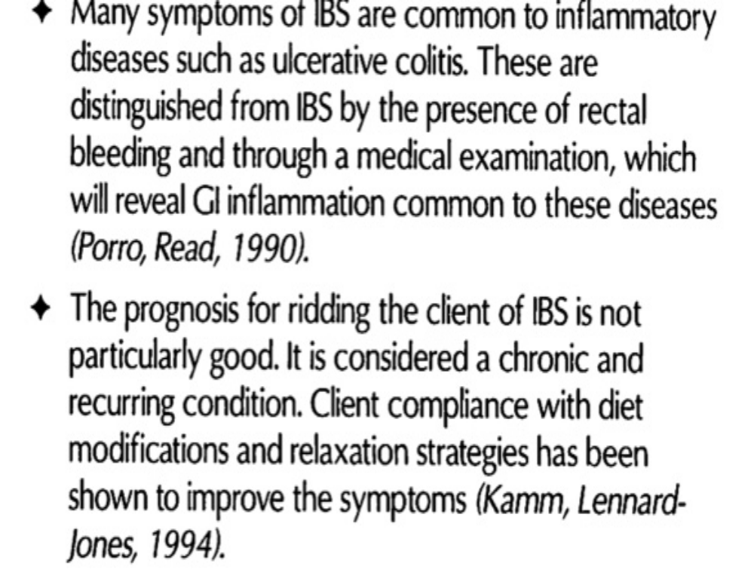
Symptoms

Slide 7
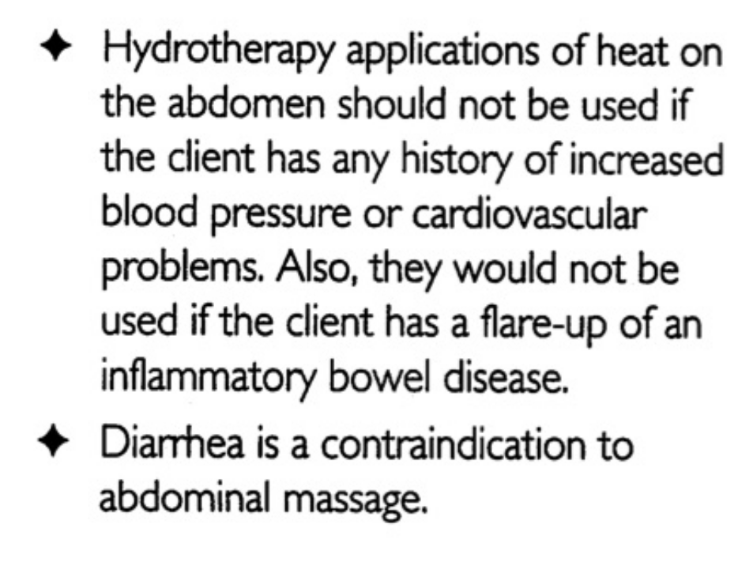
Contraindications

Slide 8
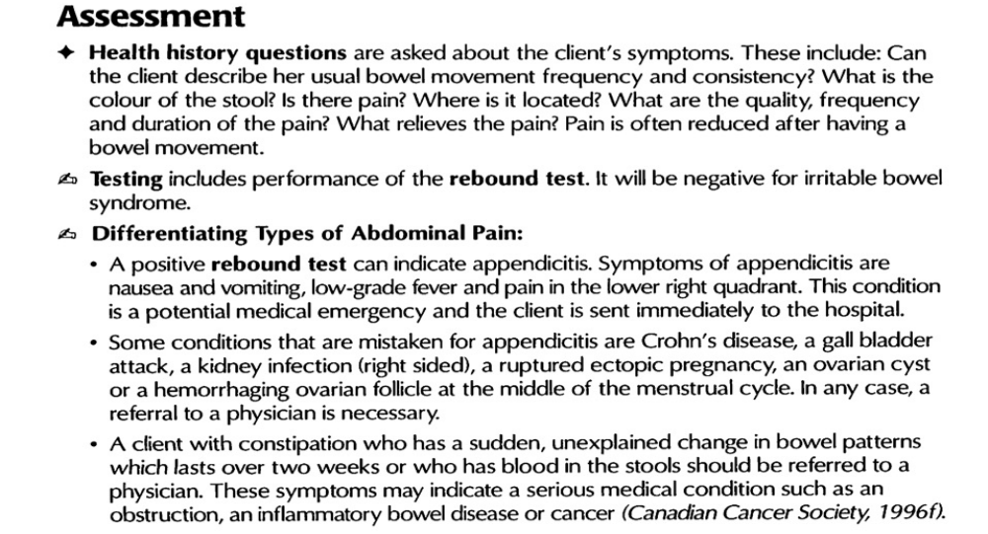

Slide 9
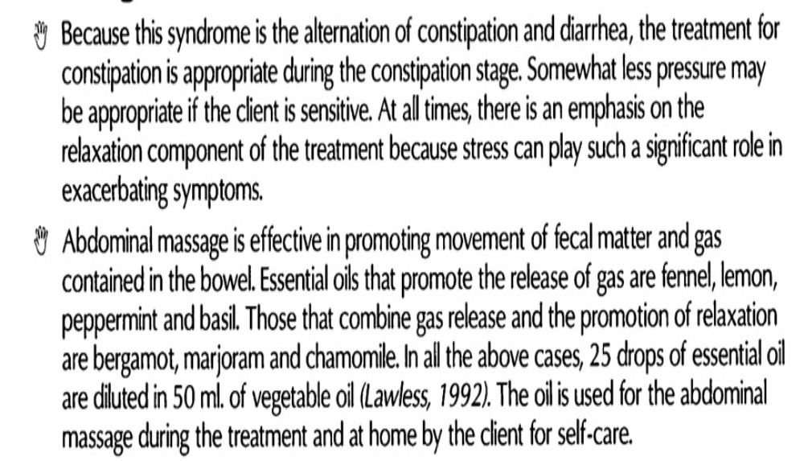
Massage

Slide 10
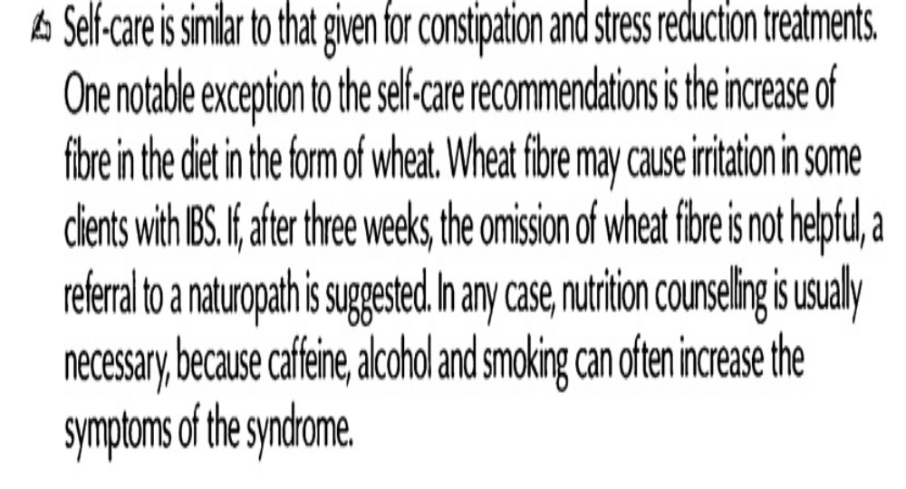
Self care

