Slide 1
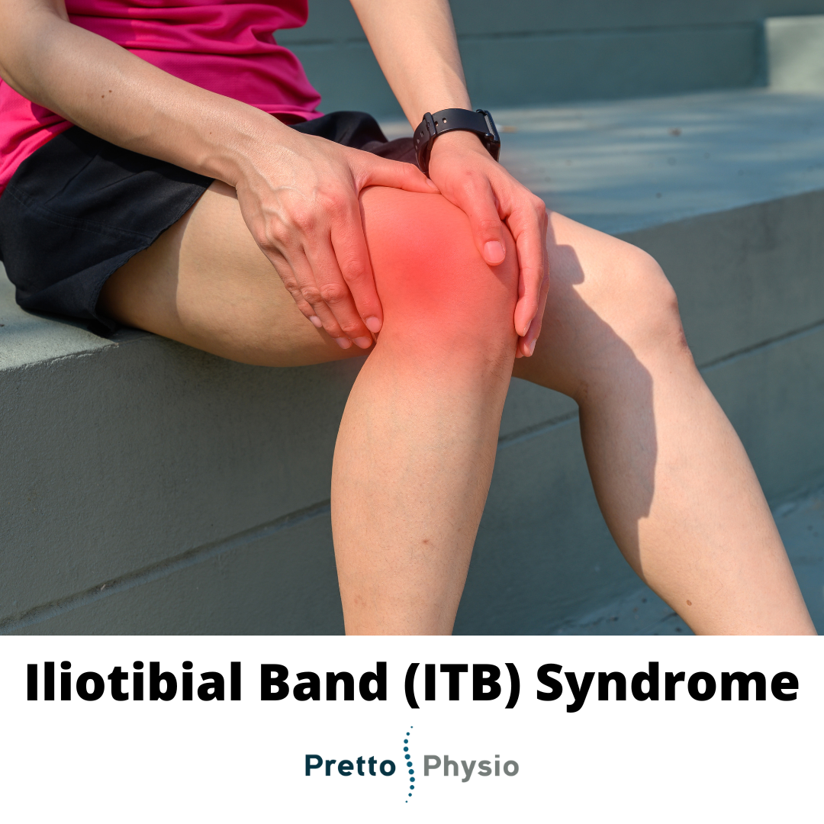
Iliotibial Band Syndrome
An inflammatory
condition resulting
from repeated distal
iliotibial band friction over
the lateral femoral condyle
of the knee.

Slide 2
GENERAL INFORMATION
• Primary cause: knee overuse during running or cycling
• Secondary causes: prolonged lower extremity immobility and/or prolonged sitting; habitual unilateral, lower extremity weight-bearing stance
• Contributing factors: running on hard or banked surfaces, inefficient or improper running techniques, worn-out or improperly fitting shoes, foot pronation, cycling long distances with improperly adjusted bicycle seat • Gradual onset
• Prevalent in active and casual athletes, ages 15–50
• Presentation usually unilateral
• Second most common running-related sports injury

Slide 3
PATHOPHYSIOLOGY
The iliotibial (IT) band is located in almost a straight line from the anterior superior iliac spine (ASIS) to the lateral aspect of the tibial condyle. Originating at the tensor fascia lata and ending in a ligament-like structure, this dense fascial band crosses and helps stabilize the knee joint. This stringy, strong, mobile band also assists the lower extremity during inward and outward hip rotation, and extension and flexion of the knee. The only fi rm bony attachments exist at the proximal ASIS and the distal tibial condyle. The two, very distant, bony attachments allow this long structure to move freely, while continuously adjusting anteriorly and posteriorly during normal gait.

Slide 4
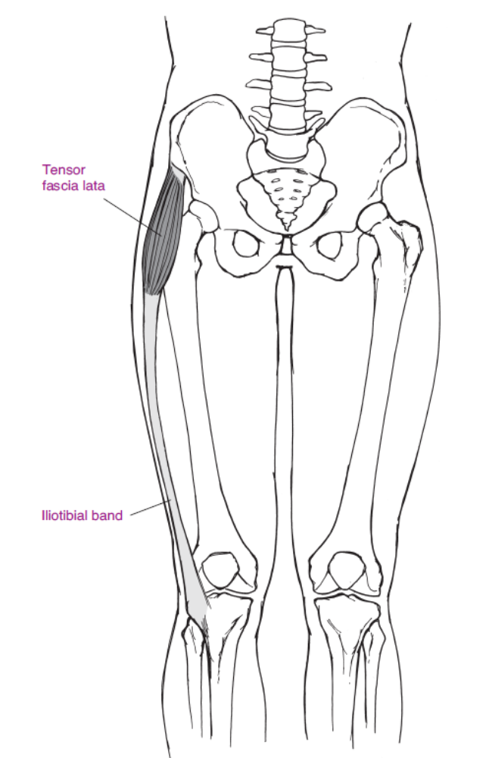

Slide 5
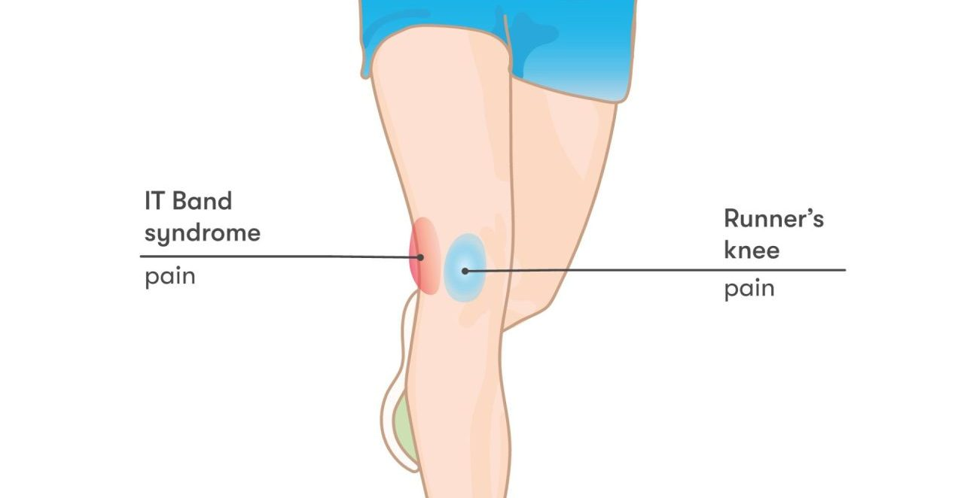
ITBS develops when irregular knee movement causes repeated unusual friction over the embedded bursa lateral to the knee joint. As mild inflammation develops, pain ensues, subtle abnormal gait or leg use follows, and the entire IT band becomes shortened and hypertonic, producing a cycle of pain and stiffness. Although ITBS is clinically an inflammatory condition, the classic symptoms of heat, redness, and swelling are usually absent, and only localized pain is used as a diagnostic indicator.

Slide 6
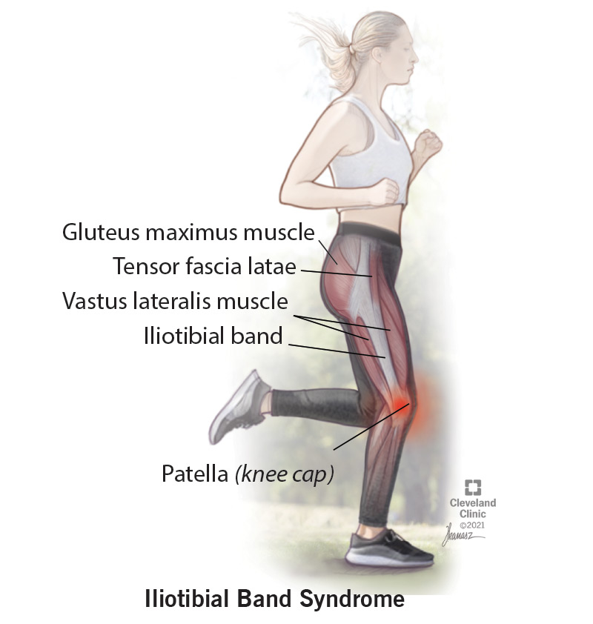
Diagnosis is confirmed based on clinical symptoms, the patient’s complaints and history, palpation indicating a hypertonic IT band, reproducible localized pain, and occasionally the presence of an abnormal, stiffened gait. The patient can clearly identify point tenderness at the lateral knee and often complains of radiating pain up the lateral thigh. Leg and hip strength testing may indicate weakness in knee flexors and extensors and/or hip abductors. Knee pain experienced at rest, with no history of repetitive use or trauma, is not indicative of ITBS.

Slide 7
OVERALL SIGNS AND SYMPTOMS
Develops early in syndrome:
• Local aching or burning at the lateral aspect of the knee during activity; resolves, but sometimes worsens, with activity
• Radiating pain up the lateral aspect of the thigh during activity; resolves, but sometimes worsens, with activity
• Pain when ascending or descending the stairs or running downhill
• IT band hypertonicity

Slide 8
Develops later in syndrome:
• Feeling a “snap” or hearing a “pop” while walking, running, or cycling
• Pain during non training walking
• IT band hypertonicity and thickening
• Anterior pelvic tilt; hyperlordosis

Slide 9
Develops if untreated:
• Pain at rest
• Stiff-legged gait
• Extreme IT band hypertonicity
• Adhesions along the IT band

Slide 10
SIGNS AND SYMPTOMS MASSAGE THERAPY CAN ADDRESS
Since the IT band is an easily accessible soft tissue structure with clearly defined bony origins and insertions, ITBS is effectively addressed with massage therapy techniques.
• Hypertonicity is addressed with deep, aggressive manual techniques combined with heat applications.
• The shortened IT band is stretched using both on-the-table and homework exercises.
• The low-level knee joint inflammation is addressed with tissue flushing techniques.

Slide 11
TREATMENT OPTIONS
ITBS usually disappears if the person reduces, stops, or corrects the offending activity. If symptoms persist, treatment is conservative. Manual therapies, including massage, heat application, and stretching are effective. Physical therapy techniques help strengthen the patient’s lower extremities if he wants to maintain and continue his exercise regimen. Non-weight-bearing cross-training techniques, such as swimming using only the upper body and arms, are suggested for the dedicated athlete who wishes to maintain his cardiovascular routine while his lower extremities heal. Although conservative, treatment must be continuous—even after activity correction and pain relief—if the patient wants to remain symptom-free.

Slide 12
Inflammation is easily controlled with the use of ice, rest, and nonsteroidal antiinfl ammatory drugs (NSAIDs). Heat is used for chronic, dull, aching discomfort. Ice is applied for local fl are-ups and more intensive pain. Local corticosteroid injections are used only when the ITBS does not respond to more conservative techniques. Surgery is rarely necessary.
Common Medications
• NSAIDs, such as ibuprofen (Motrin, Advil)

Slide 13
MASSAGE THERAPIST ASSESSMENT
A “weekend warrior” or consistent runner or cyclist may or may not have visited a physician’s office before seeking massage therapy for ITBS. Assessment, not diagnosis, is straightforward based on the client’s history and simple palpation techniques.
The therapist should ask the client about his athletic habits, including questions about the condition of his running shoes, whether the track he runs on is slanted, and in which direction he consistently runs. He can describe the duration of his bicycle rides and whether his bicycle seat has been professionally fitted for his cycling habits and leg length. The therapist should also have him remove his shoes and observe whether the inside edges are more worn than the outside edges (indicating overpronation).

Slide 14
With the client standing in front of the therapist, she asks permission to palpate the bilateral IT bands from the ASIS all the way down to the lateral sides of the knees. She notes hypertonicity and tenderness on the affected side. Reproducible lateral knee pain should be evident upon deep palpation and when the client is asked to walk swiftly or run across the office. (A normal walking gait may not reproduce the pain.) The therapist can ask if he has heard a popping or snapping sound while running or cycling. The therapist observes the client from a sideways position and looks for hyper lordosis (swayback). Finally, the therapist inquires about self-care measures, other health care professionals the client has visited, and medication intake.

Slide 15
THERAPEUTIC GOALS
There are two primary massage therapy goals for clients with ITBS: decreasing hypertonicity
and increasing IT band flexibility. In addition, teaching home stretching
exercises and encouraging clients to return to a regular exercise regimen as soon as
possible are essential.

Slide 16
MASSAGE SESSION FREQUENCY
• 60-minute sessions once a week, until pain and hypertonicity completely resolve
• 60-minute sessions once a month, for maintenance

Slide 17
MASSAGE PROTOCOL
Helping a client who has ITBS is a classic work for the massage therapist. You can use many of the simplest, highly effective techniques you learned in massage school to achieve significant results. The approach must be aggressive and deep to be effective. However, “no pain, no gain” is not a massage therapist’s mantra. Effective, deep techniques are best accomplished this way:
1. Begin with warming techniques (jostling, vibrating, and shaking the tissue).
2. Stay keenly aware of the client’s response.
3. Follow the tissue with hands intelligently aware of anatomy.
4. Work sufficiently deeply that you feel as if you have the entire IT band at your disposal.

Slide 18
Before beginning the session, your communication with the client should clarify that he may experience some discomfort, but that you will never work to the point of causing pain. Light, superficial massage for ITBS is ineffective.

Slide 19
Getting Started
If the client has a dull, aching pain, use hot packs. If he complains of a sharp, nagging pain, use ice packs. Review the table and homework stretches you will perform and assign for ITBS, so that you’re comfortable and confident before you begin. Have adequate pillows to provide for a prolonged, comfortable side-lying position. Regardless of his level of athleticism, remember to praise your client for his efforts and encourage him to continue exercising.

Slide 20
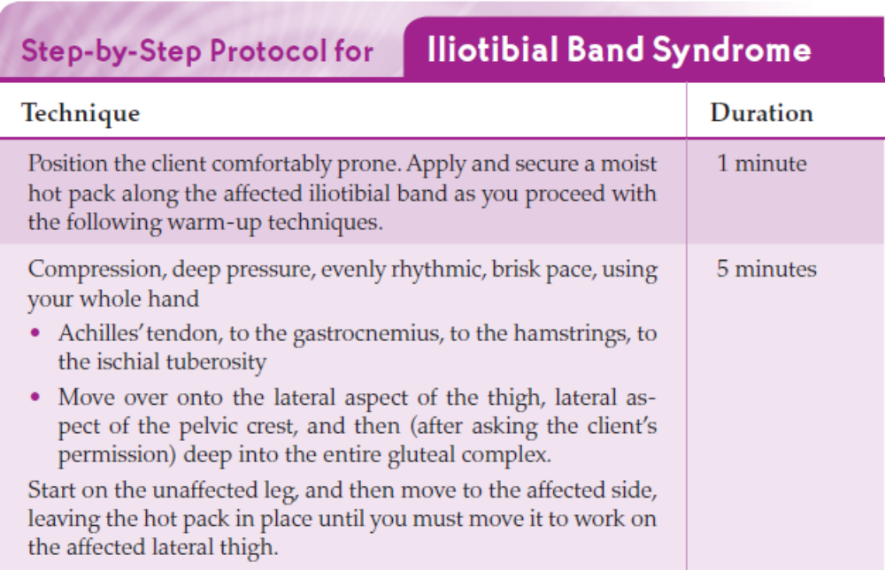

Slide 21
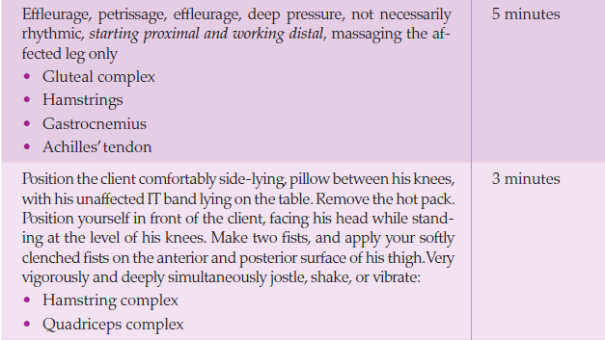

Slide 22
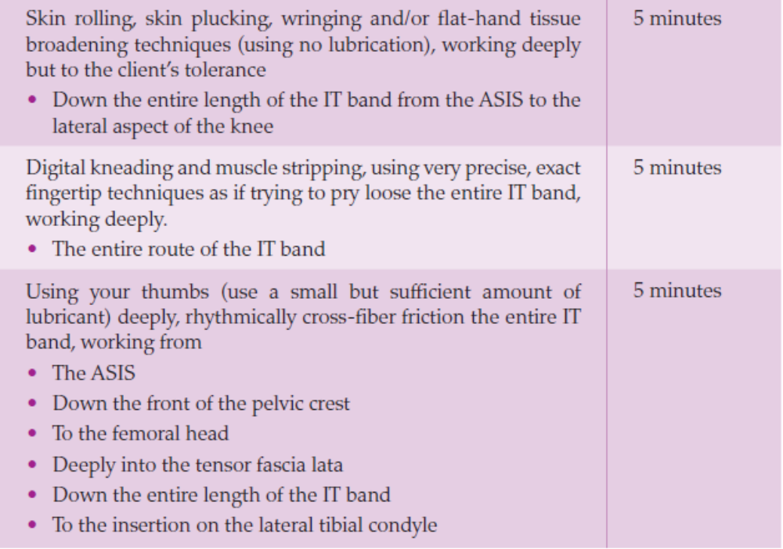

Slide 23
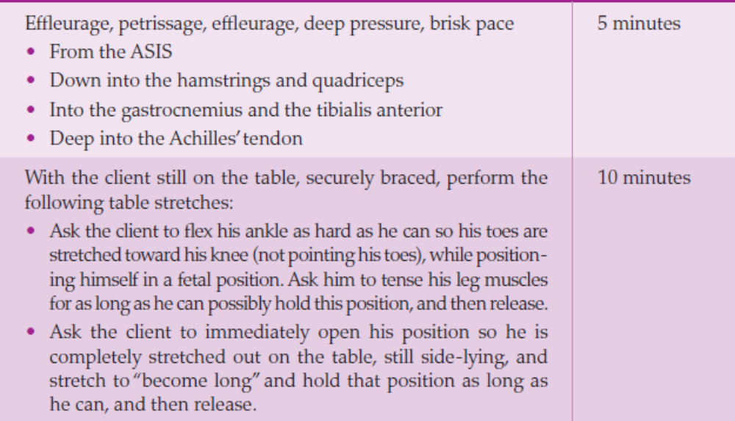

Slide 24
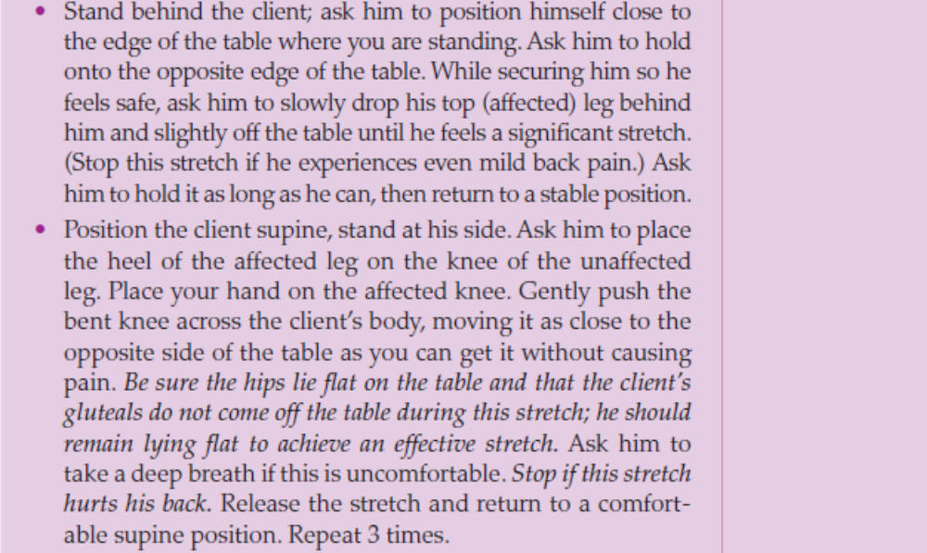

Slide 25
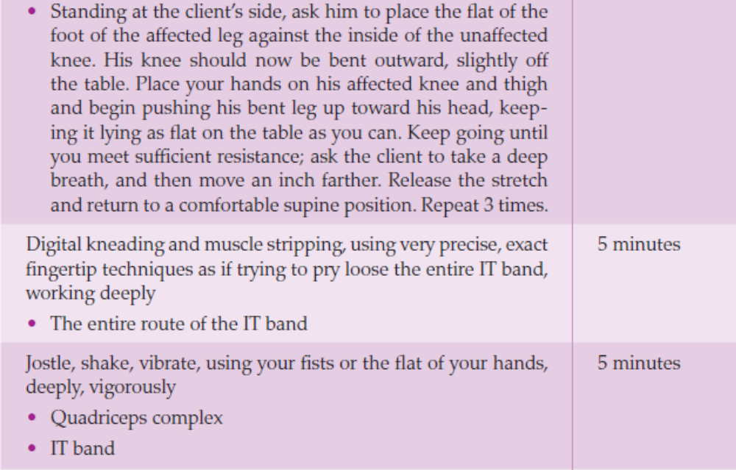

Slide 26
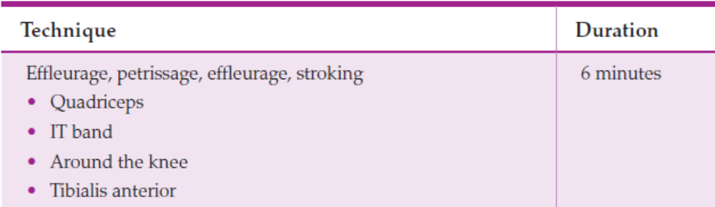

Slide 27
Massage therapy must be accompanied by consistent, daily self-care if your client isto remain pain-free and return to his exercise program or athletic regimen. Applying moist hot packs when he experiences a deep, dull pain and ice when he experiences sharper pain are two active measures he can take toward self-care. Although you cannot suggest taking medication, you can counsel your client to call his family physician for over-the-counter (OTC) pain medication suggestions. Most important, however, are the following daily exercises, which will stretch his IT band and surrounding muscles.

Slide 28
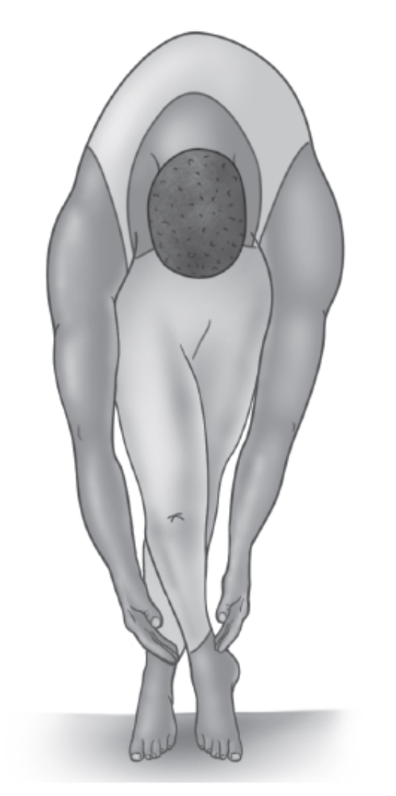
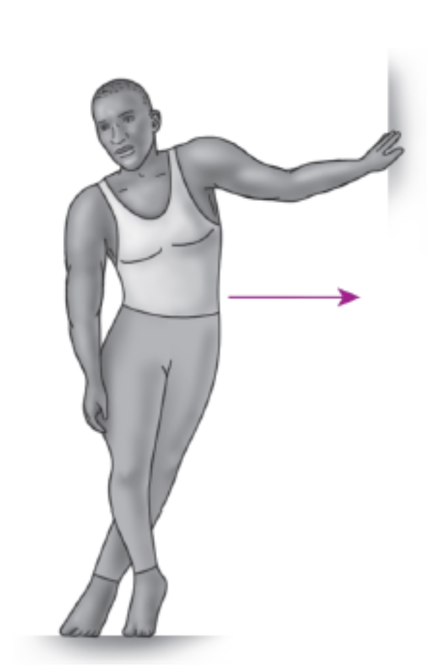

Slide 29
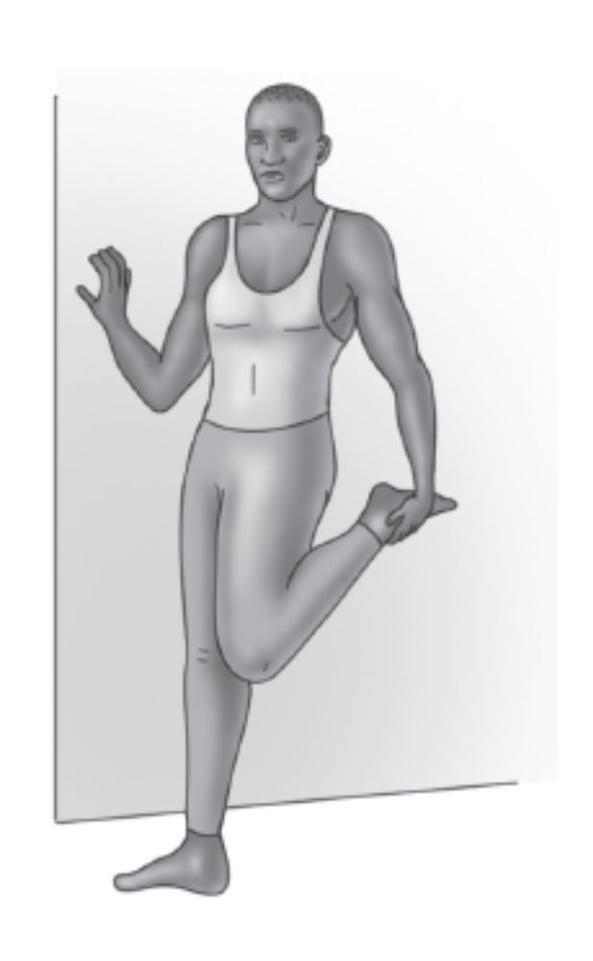
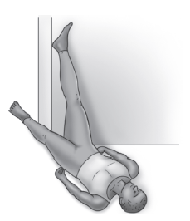

Slide 30
