Slide 1
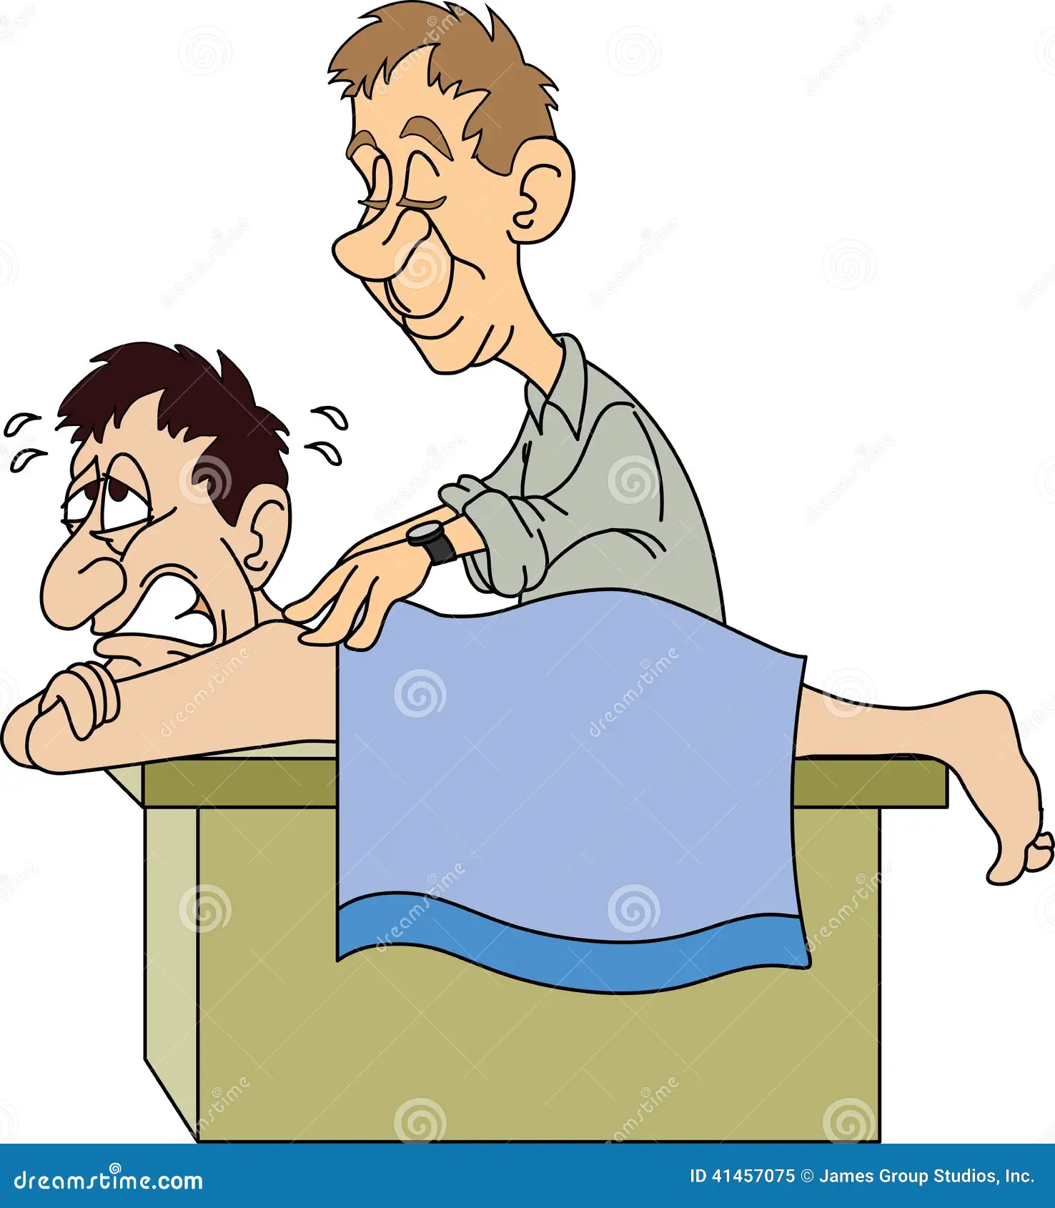
Hyperlordosis
EXAGGERATED LUMBAR LORDOSIS

Slide 2
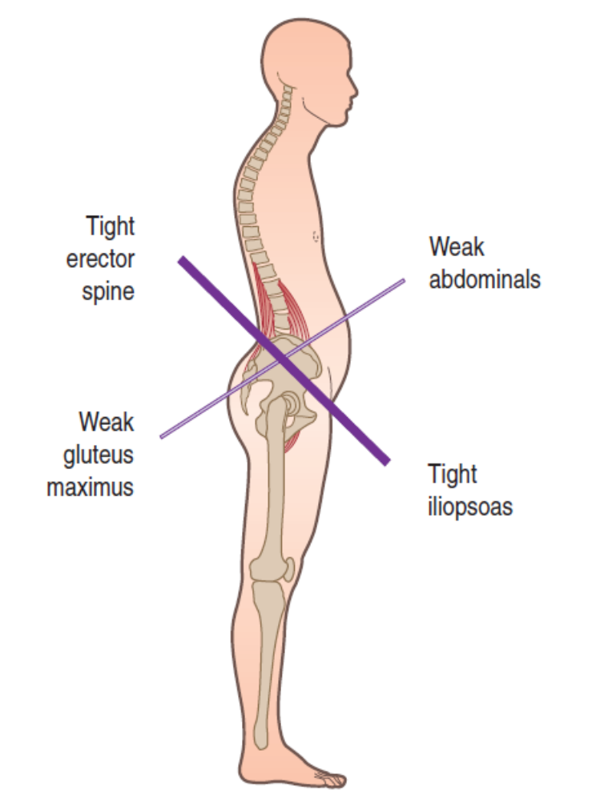
Description
There is a natural lordotic curve in the lumbar region that is necessary for shock absorption. The lordotic curve is exaggerated during extension and is reduced during flexion. The primary muscles that produce spinal extension are the erector spinae group, quadratus lumborum, and several small intrinsic spinal muscles including the multifidi, rotators, interspinal, and intertransversarii. LBP and myofascial trigger points can develop from hypertonicity in these muscles and exaggerate the lordosis.

Slide 3
In a normal lumbar lordosis the vertebral body is the primary weight-bearing structure. With an excessive lumbar lordosis, more of the body’s weight is transferred to the posterior portion of the vertebrae. Increased weight is then borne by posterior vertebral arch structures such as the lamina, pedicle, pars interarticularis, posterior portion of the intervertebral disc, and facet joints. These structures are not designed for the weight increase and spinal pathology such as facet joint dysfunction, disc herniation, spondylolysis, or spondylolisthesis can result. Increased lumbar extension also narrows the intervertebral foramen and can lead to spinal nerve root compression.

Slide 4
Dysfunctional patterns of muscular activation and poor posture can perpetuate an excessive lordosis. An example is the lower crossed syndrome, originally described by Vladimir Janda. He categorizes the body’s muscles into two groups: postural or phasic muscles, which differ in their fiber type and activation patterns. When overused and fatigued, postural muscles tend to become hypertonic, while phasic muscles tend to become weak and inhibited. The phasic muscles are antagonists to postural muscles. Because postural muscles tend toward hypertonicity, they create a functional weakness in the phasic muscles through the process of reciprocal inhibition.

Slide 5
Postural muscles in the lumbar spine include the erector spinae, quadratus lumborum, and iliopsoas. Phasic muscles in this region include the abdominals, gluteus maximus and medius. An exaggerated lumbar lordosis also produces an anterior pelvic tilt and a postural distortion called the lower crossed syndrome. A graphical comparison of the functional and positional relationships of certain lumbopelvic muscles shows how they interact and where the term lower crossed syndrome originates from . See the anterior pelvic tilts for additional descriptions of the lower crossed syndrome and reciprocal inhibition.

Slide 6
Treatment
Traditional treatment approaches for exaggerated lumbar lordosis and the resulting lower crossed syndrome are the same as those described under the section on anterior pelvic tilt.

Slide 7
Soft-tissue manipulation
Soft-tissue treatment and rehabilitation protocol considerations for an excessive lumbar lordosis are the same as those described for anterior pelvic tilt.

Slide 8
Cautions and contraindications
Use caution with any iliopsoas treatment technique that uses direct pressure through the abdomen. There is a risk of adverse vascular responses with the external iliac artery if an aortic aneurysm exists. Some clients may report increased back pain or discomfort with MET stretching techniques for the iliopsoas performed from the supine position. To reduce client discomfort, have the client increase the level of flex in the opposite hip, which posteriorly rotates the pelvis, straightens the spine, and reduces facet joint compression.

Slide 9
Clinical Tip
One of the errors that health professionals make is looking at problems in certain regions as isolated mechanical or structural disorders. An excessive lumbar lordosis, for example, creates numerous patterns in other regions of the body. There is mechanical stress in the low back to be certain. However, the biomechanical ramifications of this postural distortion can produce numerous other pathologies. The excessive lumbar lordosis produces an anterior pelvic tilt. That anterior pelvic tilt causes increased length in the hamstring muscles. The increased hamstring length in an anterior pelvic tilt is associated with a higher incidence of hamstring strains. Therefore, preventive treatment of hamstring strains may need to focus on the low back region.

Slide 10
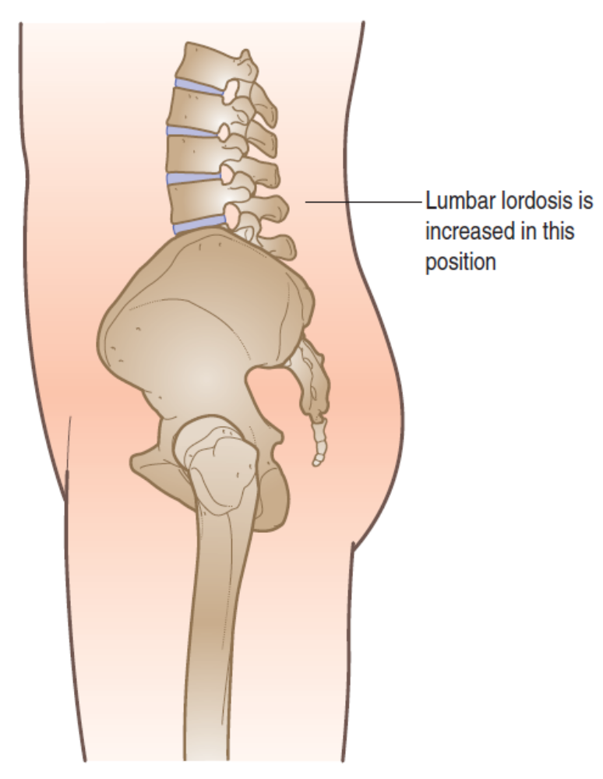
ANTERIOR PELVIC TILT
Description
In an anterior pelvic tilt, both innominates (halves of the pelvis) are rotated in an anterior direction. The increased anterior pelvic tilt also causes an exaggeration of the lumbar lordosis. It is valuable to measure the innominates separately as sometimes one may rotate more than the other. Several factors may contribute to an anterior pelvic tilt, but typically it is from an imbalance of muscles pulling on the pelvis and/or lumbar region.

Slide 11
An anterior pelvic tilt is part of a postural distortion pattern affecting the low back and pelvic muscles called the lower crossed syndrome. The lower crossed syndrome got its name from the pattern of tension in the muscles when the body is viewed from the side. There are two types of muscles in the body that play a central role in the lower crossed syndrome. The postural muscles are important for maintaining erect posture during locomotion. When fatigued, the postural muscles have a tendency to become hypertonic.

Slide 12
The phasic muscles play a greater role in creating movement. Containing a higher concentration of fast-twitch muscle fibers, the phasic muscles have a tendency to fatigue more easily and become weakened when overstressed. The tendency for the phasic muscles to weaken is exaggerated by the law of reciprocal inhibition. The law of reciprocal inhibition that when one muscle gets a stimulus to contract, its opposite – or antagonist –muscle is neurologically inhibited to contract. If the postural muscles are hypertonic, they naturally inhibit the phasic muscles. A look at these two groups of muscles illustrates this point.

Slide 13
Primary postural muscles that tend toward hypertonicity in the low back and pelvic region include the iliopsoas, erector spinae, rectus femoris, and quadratus lumborum. When hypertonic, these muscles exaggerate the lumbar lordosis and create an anterior pelvic tilt. In addition, the postural muscles are susceptible to the development of myofascial trigger points as they become hypertonic. In the graphic above the line connecting the regions where these muscles are located demonstrates one side of the cross.

Slide 14
Opposing this group are the phasic muscles of the abdomen and pelvis. The phasic muscles in this region include the gluteus maximus, gluteus medius, and rectus abdominis. The line connecting between the phasic muscles establishes the other side of the cross. Our current sedentary lifestyle encourages overuse of the postural muscles at the expense of the phasic muscles. The phasic muscles can become weak from disuse.

Slide 15
Treatment
Traditional approaches
The treatment protocol suggested is usually for the individual to strengthen the abdominal muscles, often through sit-ups or crunches. However, these exercises can recruit the iliopsoas as a flexor of the trunk if the legs or feet are held on the floor in the sit-up. This is counter-productive if the desire is to reduce hypertonicity in the iliopsoas.

Slide 16
While strengthening of the abdominal musculature can be beneficial, these muscles are often weak primarily because they are phasic muscles and the hypertonic postural muscles are inhibiting them. Clinical experience has shown that an effective resolution is to reduce hypertonicity in the postural muscles, and not necessarily attempt to increase strength in the inhibited phasic ones. It is also important for the client to engage in postural re-education to deal with established biomechanical patterns.

Slide 17
Soft-tissue manipulation
General guidelines Soft-tissue treatment for anterior pelvic tilt focuses on the hypertonic muscles creating the distortion. Emphasis is on reducing tightness in spinal extensor muscles, quadratus lumborum, iliopsoas, and rectus femoris. A variety of techniques including sweeping cross fiber, deep longitudinal stripping, pin and stretch, and active assisted stretching are used to treat these muscles.

Slide 18
Direct massage is used to address the muscles responsible for creating the anterior pelvic tilt. Treatment of the iliopsoas is more challenging. Soft-tissue practitioners often treat this muscle with techniques that apply pressure through the abdomen to get to the muscle. Because the iliopsoas attaches to the anterior aspect of the lumbar vertebral bodies, it is very deep in the abdomen. It is contacted with finger pressure by pressing on the lateral side of the abdomen in a posterior and medial direction.

Slide 19
However, there are potentially dangerous contraindications to performing palpatory treatment of the iliopsoas in this region. This muscle lies directly adjacent to the external iliac artery. Pressure on the external iliac artery can cause a back flow of pressure in the vascular structures, and could eventually cause the rupture of an aortic aneurysm. For that reason, performing the deep abdominal approach described above is not advised and it is beneficial to have alternative methods for treating the iliopsoas muscle. The MET procedure described in D below is effective in reducing muscle tightness, but does not put pressure directly on the iliopsoas and so concerns of vascular pressure are eliminated.

Slide 20
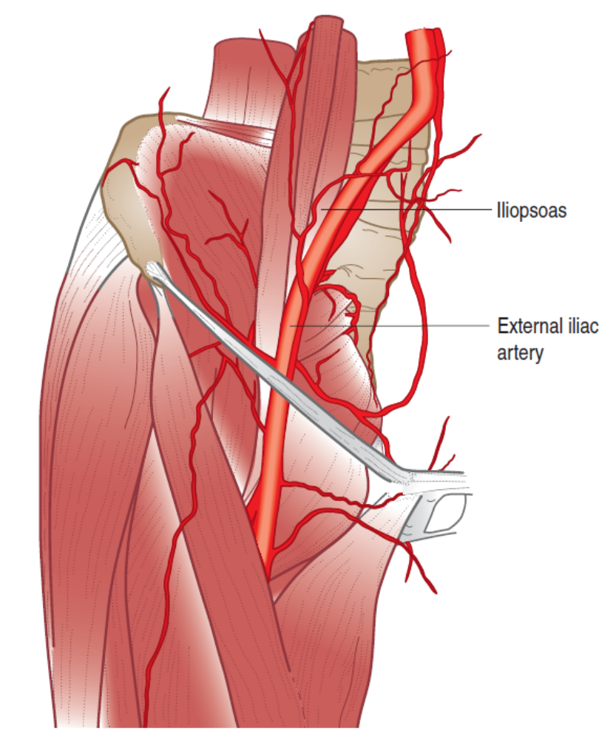


Slide 21
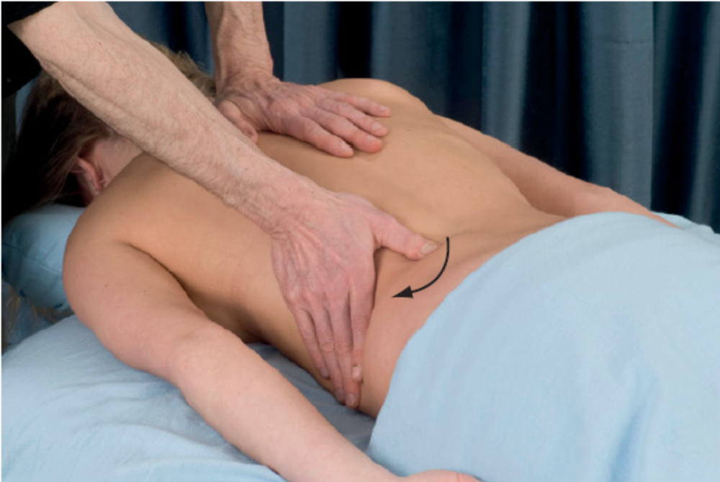
Suggested techniques and methods
A. Effleurage and sweeping cross fiber to lumbar muscles Superficial muscle tension is reduced in the lumbar muscles with long gliding effleurage and sweeping cross fiber techniques are applied to the lumbar muscles. These techniques are performed prior to deep stripping applications. Use the thumb, back-side of the fingers, base of the hand, or other broad contact surface.

Slide 22
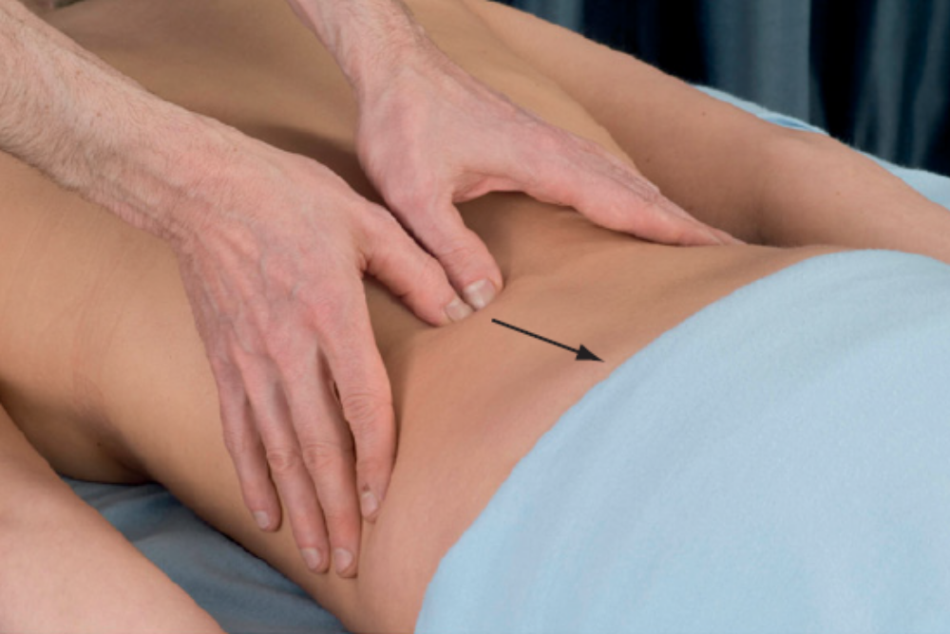
B. Deep longitudinal stripping on the spinal extensors Deep stripping techniques are applied to the erector spinae and other lumbar extensor muscles close to the spine. Encourage elongation in the specific myofascial fibers with small contact surface pressure such as the fingertips, thumb, or pressure tool.

Slide 23
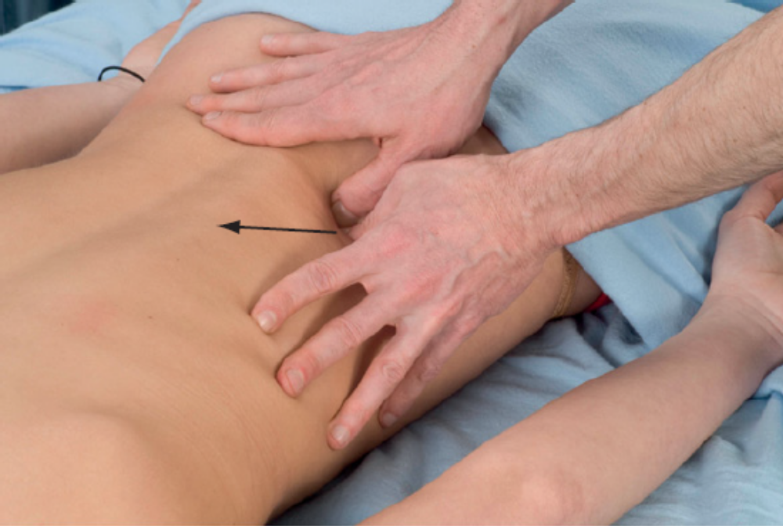
C. Deep stripping for quadratus lumborum The client is in a prone position. Use the thumb or fingertips to perform a longitudinal stripping technique on the quadratus lumborum. Use stripping motions from the iliac crest to the transverse processes, iliac crest to twelfth rib, and transverse processes to twelfth rib as the quadratus lumborum has fibers running in all these directions. When working from lateral to medial on the fibers running from the iliac crest to the transverse processes, apply pressure deep enough to treat up under the lateral edge of the erector spinae muscle group. However, use caution not to apply too much pressure directly against the tips of the transverse processes.

Slide 24
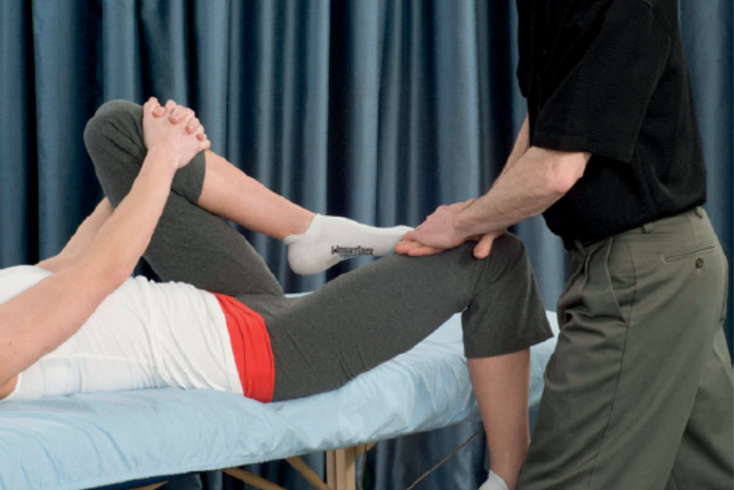
D. MET for iliopsoas The client is in a supine position with one thigh hanging off the side of the table. The client holds the opposite thigh in a fully flexed and bent knee position. The client attempts hip flexion of the hanging thigh, while the practitioner offers resistance. The client holds the contraction for about 5–8 seconds, and then releases the contraction. As the client releases the contraction, the practitioner pushes the thigh into extension to stretch the iliopsoas muscle. If the client experiences discomfort, instruct the client to further flex the opposite hip, which will increase rotation of the pelvis, straighten the spine, and reduce facet joint compression.

Slide 25
Perform soft-tissue treatment methods several times before engaging in strength training for muscles in this region. The body needs to readjust to different proprioceptive and neuromuscular patterns.
Strength training methods are routinely used to address the postural distortion of anterior pelvic tilt. Studies on the use of strength training have indicated that if hypertonic muscles are not properly addressed, dysfunctional compensation and recruitment patterns develop. That is why strength training should not be the first intervention, but should come at a point after soft tissue treatment interventions.

Slide 26
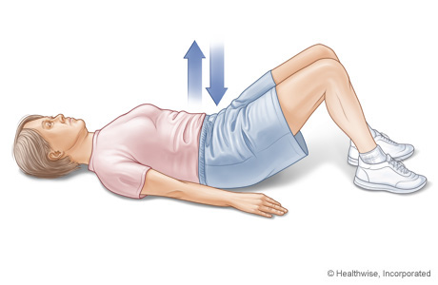
Many postural disorders such as anterior pelvic tilt persist because neuromuscular patterns of tension are continually reinforced. Despite soft-tissue treatment or strengthening activities, correction of many anterior pelvic tilts will not have a lasting change unless the client engages in some form of postural re-training which reinforces corrected biomechanical patterns.

Slide 27
Cautions and contraindications
Use great caution with any iliopsoas treatment technique that uses direct pressure through the abdomen. As mentioned above, there is a risk of adverse vascular responses. When performing MET for the iliopsoas above, be aware that some clients experience back discomfort with this technique due to compression of the lumbar facet joints.

