Slide 1

Hyperkyphosis
An exaggerated, often progressive increase in the normal posterior thoracic spinal curvature.

Slide 2
GENERAL INFORMATION
Hyperkyphosis is the correct term used for an exaggerated thoracic curve.
• Two forms: structural and postural
• Causes of structural hyperkyphosis: congenital factors, thoracic spine fracture, osteoporosis, arthritis, degenerative disc disease, ankylosing spondylitis, spinal cancers or tumors, paralytic conditions, spinal trauma
• Causes of postural hyperkyphosis: slouching, rounded-shoulder sleep posture (fetal position), persistent work-related postures• Onset immediate or gradual, depending on etiology• Duration: lifelong in structural form, short-term in postural form • Prevalence of both structural and postural forms fairly evenly distributed among children, adolescents, and adults

Slide 3
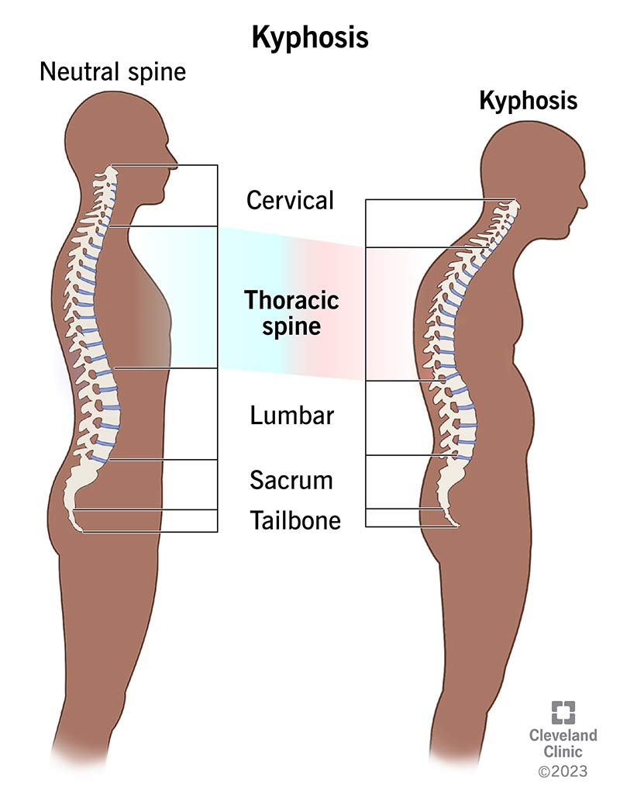
PATHOPHYSIOLOGY
The term kyphosis, correctly used, refers to the normal posterior thoracic curvature that develops after an infant gains control of her head, begins crawling, and eventually stands upright. Normal spinal anatomy manifests a slight thoracic kyphotic curve.
The exaggerated forward rounding of the shoulders in both structural and postural hyperkyphosis compromises the musculature of the entire spinal column. The forward-head thrust position commonly assumed by people with hyperkyphosis leads to postural and structural problems, as well as head and jaw pain.

Slide 4
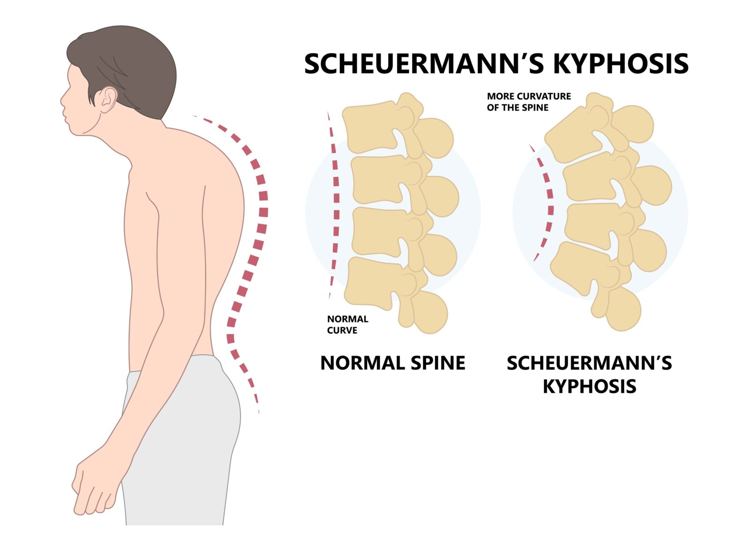
Scheuermann’s kyphosis, a primary hyperkyphosis of unknown origin, develops in children (more often in males) between the ages of 10 and 15, and noticeably deforms the vertebrae. If untreated, Scheuermann’s kyphosis results in lifelong deformity, muscular and joint pain, and/or organ compromise. Congenital hyperkyphosis, which occurs during fetal development, often worsens after the child is born; if untreated, it can lead to paralysis of the lower body.

Slide 5
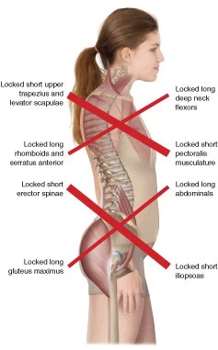
Adolescent girls with poor posture, large-breasted women, anyone working at a computer or leaning over a desk, and those who frequently sleep in a fetal position have an increased risk of developing postural hyperkyphosis. This nonpathologic form of the condition usually disappears with normal physical development, changes in postural habits, physical therapy, weight loss, or breast reduction. Older adults with spinal arthritis or osteoporosis, or the long-term effects of an earlier trauma, are at greater risk for developing the less resilient, structural form of hyperkyphosis.

Slide 6
Untreated at any age, hyperkyphosis can lead to irreversible physical deformity, body image difficulties, ineffective breathing patterns, neurologic problems, and organ damage. Decreased lung capacity, which can develop regardless of the severity of the condition, is a continued medical concern because inefficient breathing patterns often result in bronchitis or pneumonia, both of which are more serious, and possibly life threatening, than the original hyperkyphosis.

Slide 7
The initial diagnosis is often made via a simple clinical intake and spinal palpation, followed by the patient assuming various spine-bending positions. X-rays reveal arthritic changes and identify spinal fusion, and they are essential if the patient manifests neurologic difficulties in the lower extremities. An MRI will indicate spinal tumors or soft tissue infection surrounding the bones or discs. Breathing tests determine the extent of thoracic compromise.
Hyperkyphosis does not usually directly shorten the person’s life span. However, secondary conditions, such as recurring pneumonia, can affect the quality and quantity of years lived.

Slide 8
OVERALL SIGNS AND SYMPTOMS
Mild, transient, postural hyperkyphosis is often asymptomatic. Once muscles and bones compensate repeatedly over time, however, the following muscular signs occur:
• Shoulder protraction (drawing forward) and elevation (rising upward), combined with weaker middle and lower trapezius muscle, from shortened upper trapezius and levator scapula
• Rounded-shoulder effect from shortened and tightened pectoralis major and minor
• Noticeable “winging” of the scapula from weak serratus anterior

Slide 9
Signs and symptoms occurring as a result of the previous muscular signs include:
• Slouching posture
• Mild-to-moderate back pain
• Back pain upon movement
• Shoulder height imbalance
• Spinal stiffness and/or tenderness
• Forward-head posture
• Inefficient breathing patterns

Slide 10
SIGNS AND SYMPTOMS MASSAGE THERAPY CAN ADDRESS
A note of caution: Softening the surrounding musculature of a structurally hyperkyphotic spine that has been locked in hypertonicity for months or years can trigger extremely painful muscle spasms and result in an unstable spine. Therefore presupposes that the massage therapist is addressing postural hyperkyphosis only. Unless she is working as part of a health care team, with the client’s primary physician and/or physical therapist, or has advanced training, a massage therapist should not attempt to treat structural hyperkyphosis.

Slide 11
• The back pain, shoulder height imbalance, and spinal stiffness and tenderness associated with postural hyperkyphosis can be effectively treated with massage therapy techniques.
• The secondary effects of the forward-head posture can be reduced or eliminated by massage therapy.
• Thoracic capacity can be increased and inefficient breathing patterns can be corrected with the intelligent use of specialized massage techniques.
• The temporarily immobile shoulder girdle will yield to massage therapy techniques.

Slide 12
TREATMENT OPTIONS
Noticeable deformity and chronic back discomfort or pain are often the triggers that prompt a visit to a sports or physical medicine physician, or an orthopedic specialist. Treatment is directly related to the condition’s onset, severity, and symptoms. No matter how mild or severe the condition is, the treatment’s effectiveness correlates to early intervention.
Postural hyperkyphosis often does not progress and can improve with focused, noninvasive treatment, such as massage therapy, physical therapy, chiropractic adjustments, exercise, joint mobilization, and stretching.
In addition, improvements in workstation, posture, and sleeping habits can completely alleviate both the deformity and the pain associated with this milder form of hyperkyphosis. Over-the-counter (OTC) pain medication can relieve transient discomfort.

Slide 13
Depending on the age of onset and the progression, structural hyperkyphosis is generally treated more aggressively and invasively because of postural, breathing, neurologic, and organ complications, which are often accompanied by significant pain. In growing children and adolescents, wearing a back brace can prevent further curvature if the brace is applied early in the child’s development.
Full correction is sometimes possible using bracing alone. In adults where a slow, lifelong spinal compromise has caused a noticeable deformity, accompanied by only moderate pain, then pain medication, localized hot or cold packs, physical therapy, and breathing exercises may be helpful. Spinal surgery is indicated in the case of tumor- or infection-related hyperkyphosis, intractable pain, severe progressive curvature, and neurologic problems. Vertebroplasty and kyphoplasty are recently developed, less risky, less invasive surgical procedures involving the injection of an inert cement into the vertebrae.

Slide 14
Common Medications
• Nonsteroidal anti-inflammatory drugs (NSAIDs), such as ibuprofen (Motrin, Advil)

Slide 15
MASSAGE THERAPIST ASSESSMENT
To ensure that the client has postural—and not structural—hyperkyphosis, the therapist should first ask whether she has seen a medical professional. If the client’s response indicates that she experiences mild or moderate transient back pain and stiffness secondary to sleeping position, postural or work habits, or large breasts, the therapist can proceed.
Asking the client to bend forward, then observing her back for the absence of abnormal angles or curvatures, will further confirm postural hyperkyphosis. Finally, when lying supine on the massage table, the shoulders, after a few moments of relaxation and deep breathing, should naturally lie on the table with no abnormal, unmovable, or stiff shoulder forward rounding.

Slide 16
When the client is disrobed, under the sheets, and ready for treatment, palpation of the pectoralis major and minor; subclavius; sternocleidomastoid (SCM); levator scapulae; serratus anterior; suboccipitals; and anterior, lateral, and posterior intercostals and thoracic erector spinae will reveal hypertonicity, and the client may report tenderness. In addition, with the client in either the side-lying or the prone position, the hypertonic rhomboids, trapezius, and teres major and minor will render the scapula difficult, if not impossible, to move.
If the client has assumed the forward-head position in response to her rounded shoulders, the muscles surrounding her temporomandibular joint (TMJ) will be hypertonic, and she may complain of teeth clenching, which will result in tender anterior neck muscles and/or headache. The therapist should be aware of the client’s further attempts at self-care via visits to a chiropractor or physical therapist.

Slide 17
THERAPEUTIC GOALS
Easing the pain-spasm-pain cycle, flushing out local muscular waste products, stretching tight joints and shortened muscles, and improving thoracic capacity are all reasonable massage therapy goals for a client who has postural hyperkyphosis.
Achieving these goals, however, is not possible without the client’s adherence to daily self-care techniques.

Slide 18
MASSAGE SESSION FREQUENCY
• Ideally: twice a week for 2 weeks, then once a week for 6 weeks or until the postural abnormality is resolved
• Minimally: once a week for 2 months
• Infrequent, inconsistent sessions will be ineffective

Slide 19
MASSAGE PROTOCOL
Because of the extent of musculature involvement, the care that must be taken not to release hypertonic muscles too quickly, the various symptomatic differences clients will have, and the length of time and commitment required for the client to relearn postural adaptations, a single 60-minute protocol cannot address this condition. Instead, the protocol that follows offers a series of techniques with a suggested range of durations, you can use depending on your client’s symptomatic presentation before each session. Durations are suggestions only. Of all the recommended techniques, be sure to include those that address thoracic capacity in every session.

Slide 20
Some of this work is very aggressive and must be performed deeply. Be sure to soften the superficial tissue before going into the body with any invasive techniques.
During intercostal and parasternal digital kneading, ensure the client’s comfort and drape appropriately. This is most easily done by gripping the sheet with one hand to keep it close to the client’s chin while sliding your working hand under the sheet.
Hot packs can be applied to areas before they are massaged. Cold packs are effective if the client is experiencing spasm or pain.

Slide 21
Getting Started
A posturally hyperkyphotic client will be uncomfortable lying completely flat. Place pillows under her knees and under her head in the supine position. While prone, she may require a small pillow under her abdomen, or might want to hug a pillow close to her chest. Side-lying is ideal for treating postural hyperkyphosis, but be sure to provide cervical, thoracic, and pelvic pillowing support. Have hot and cold packs ready. With any deep work on delicate or thin tissue, such as the anterior neck, be sure to use plenty of lubrication to avoid irritating the skin.

Slide 22
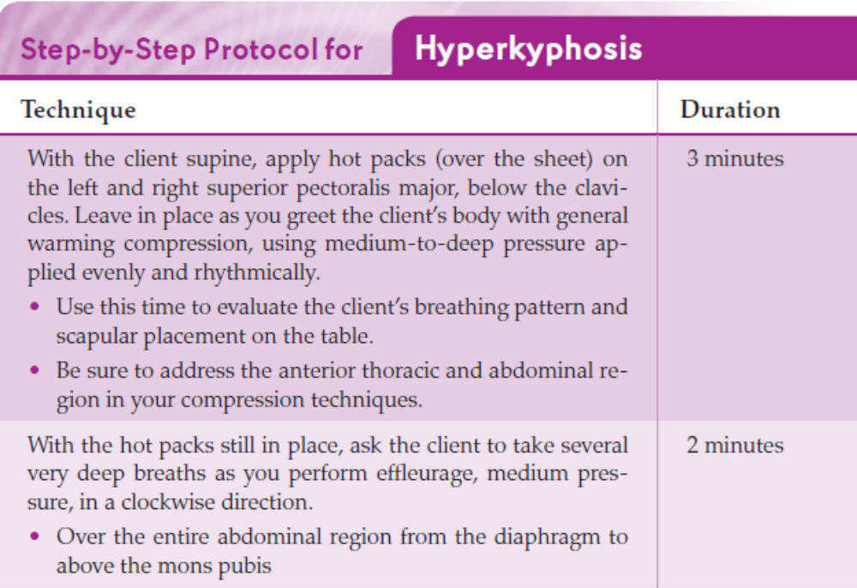

Slide 23
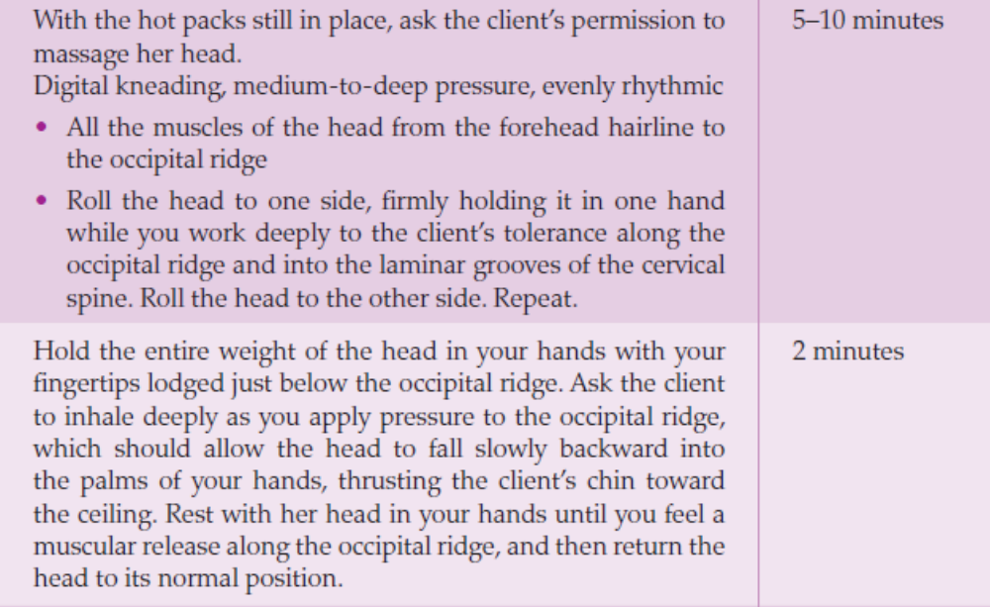

Slide 24
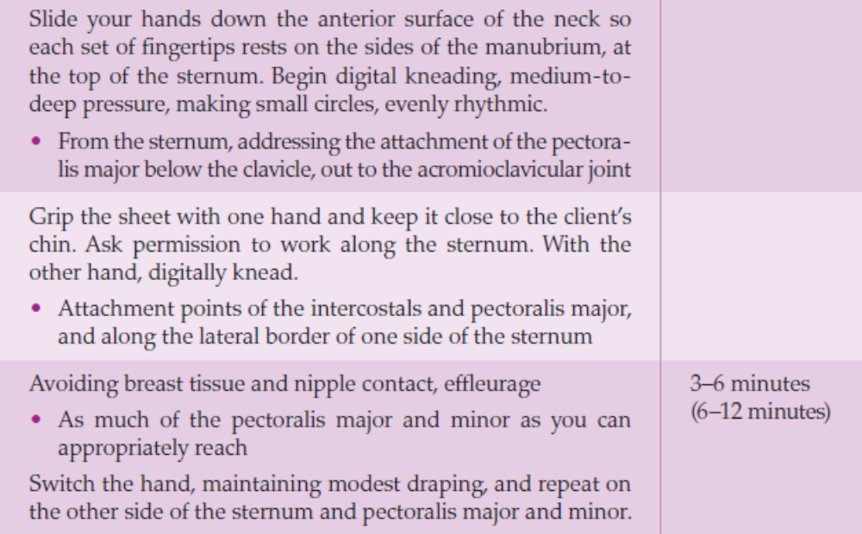

Slide 25
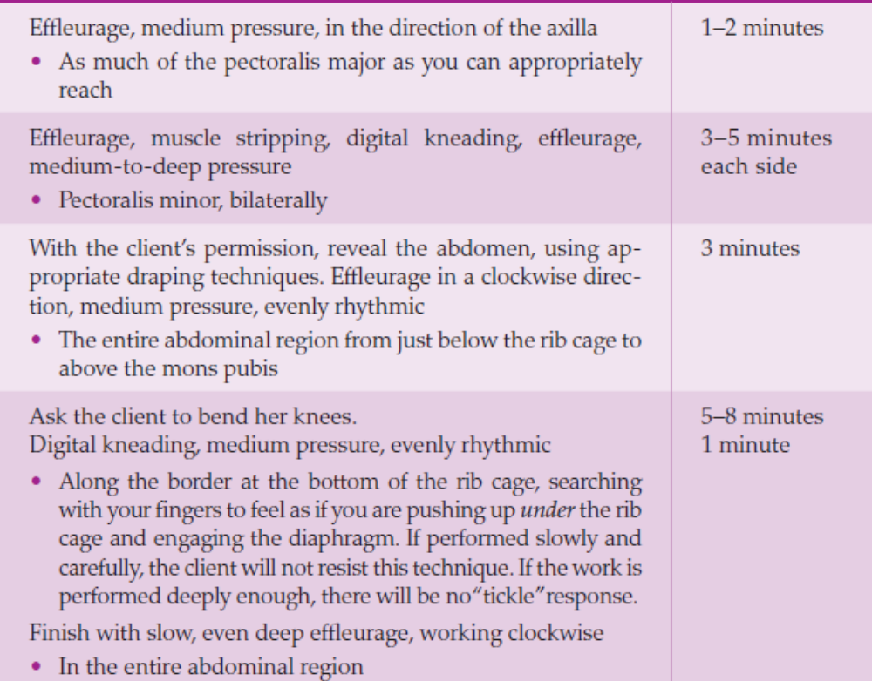

Slide 26
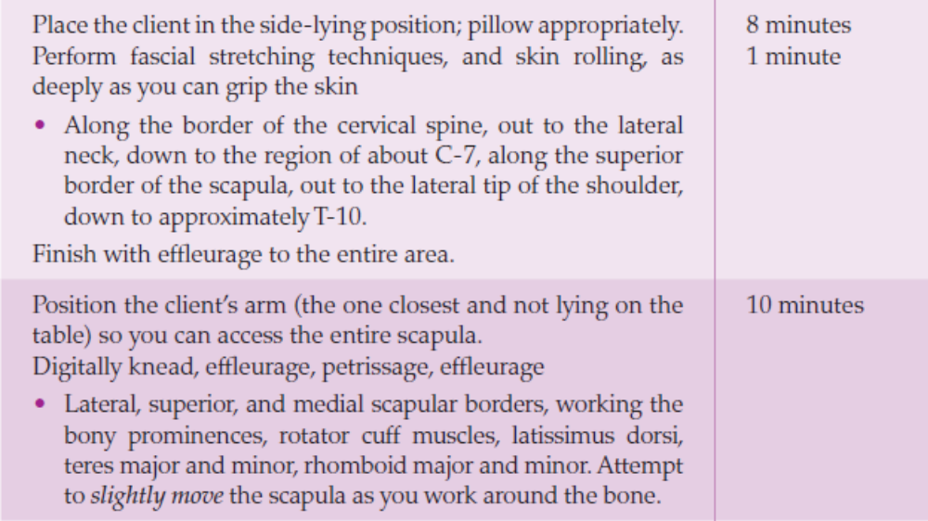

Slide 27
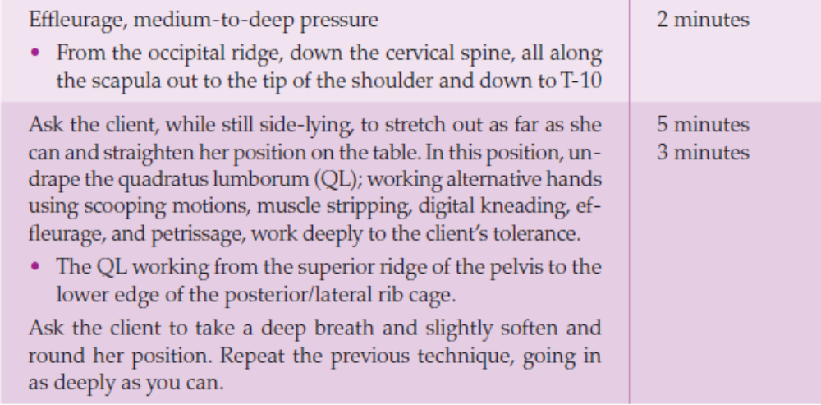

Slide 28
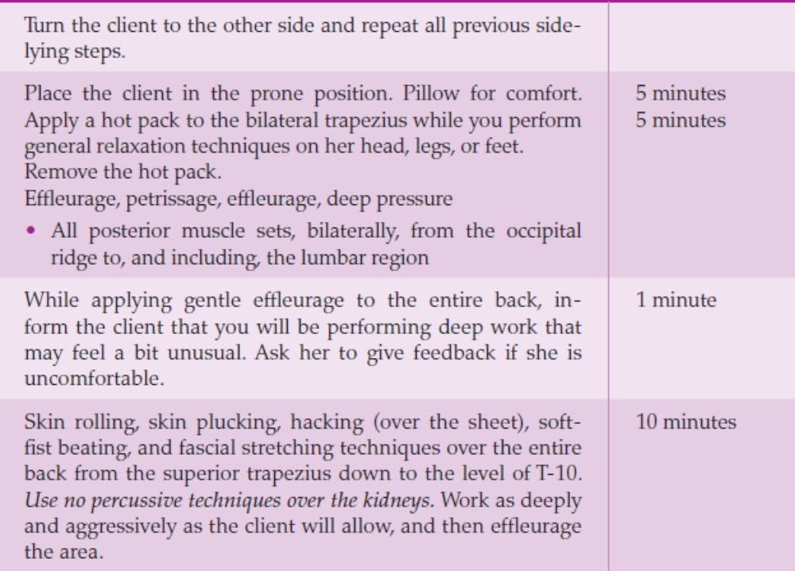

Slide 29
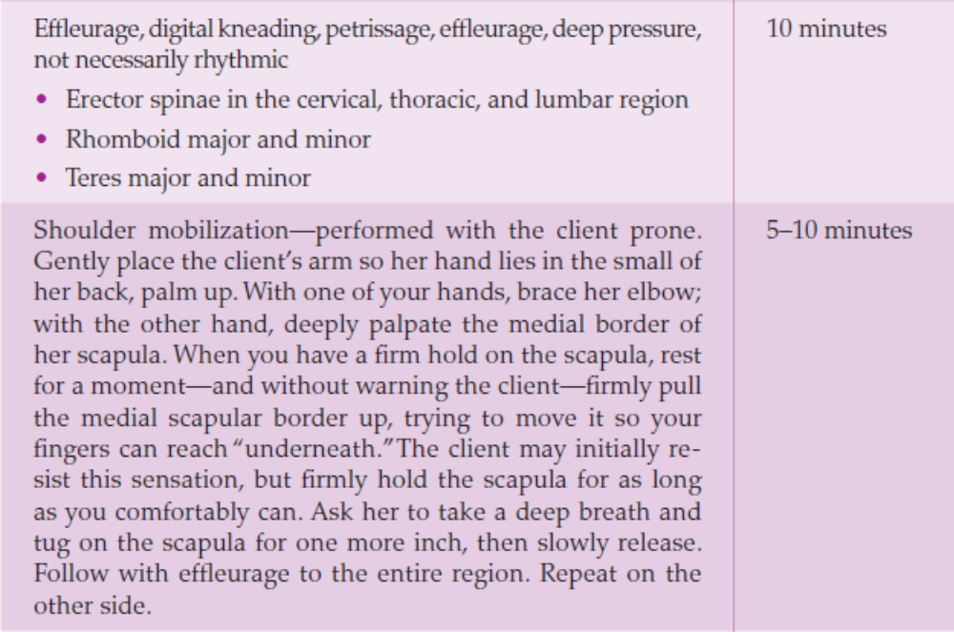

Slide 30
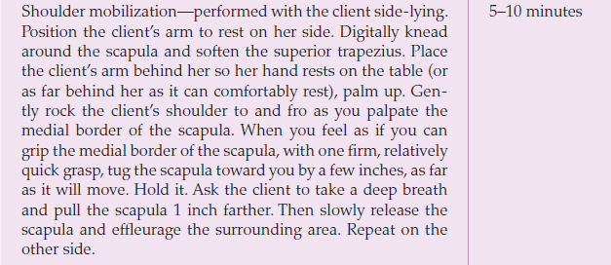

Slide 31
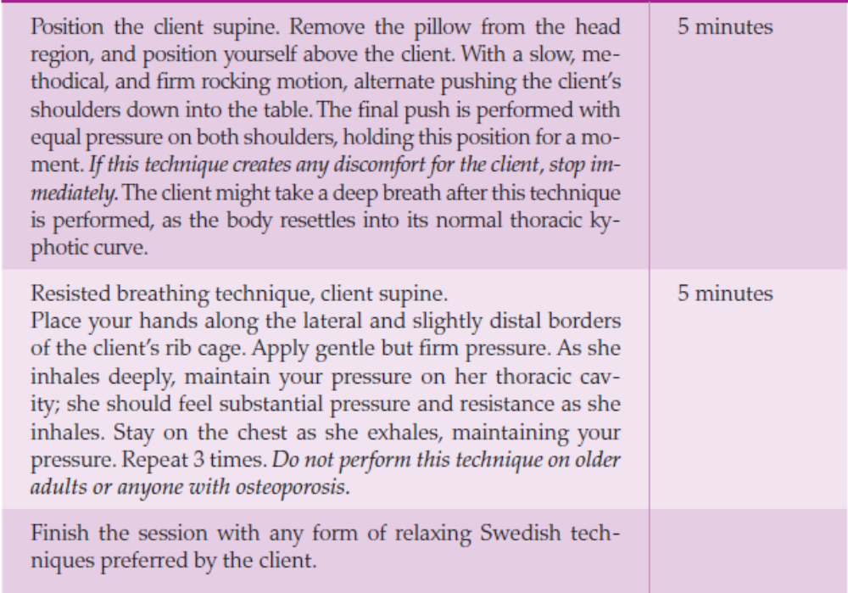

Slide 32
Contraindications and Cautions
• If the client believes she has postural hyperkyphosis but improvement is not demonstrated after a few massage therapy sessions, stop the therapy and refer the client to a physical medicine or orthopedic specialist.
• Spinal traction, forcible twisting, and extensive joint stretching are usually outside the massage therapist’s scope of practice. Work that is too aggressive on either a hypomobile or a hypermobile spine could result in neurologic damage or muscle spasm.
• Palpating hands must determine whether a muscle set is hypertonic, in spasm, or weak before aggressive soft tissue therapy is performed— especially on the cervical musculature. Overrelaxing weak muscles may compromise the neck’s ability to hold up the head and could cause muscle spasms,

