Slide 1
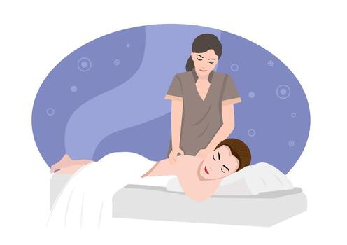
Degenerative disc disease

Slide 2
GENERAL INFORMATION
• Common causes: normal aging, prolonged sitting, spinal trauma
• Contributing lifestyle factors: repetitive, prolonged heavy lifting and twisting abdominal obesity; smoking; poor nutrition
• Accelerated by trauma at any age
• Genetic predisposition
• Equal frequency among athletes and nonathletes
• Usually occurs during third, fourth, and fifth decades of life, with higher prevalence in women

Slide 3
Morbidity and Mortality
More accurately termed a “condition” than a “disease,” DDD is often asymptomatic (manifesting no symptoms) because it results from the normal aging process. In fact, MRI studies indicate asymptomatic DDD is present in 25% of 40-year-olds and 60% of those older than 40 years of age. While the statistical prevalence of a sometimes symptomatic, ubiquitous condition is impossible to measure, low-back pain (LBP), the primary manifestation, is certainly measurable. From that standpoint, DDD statistically contributes to LBP prevalence, which is the leading cause of disability in the U.S. affecting those older than 45 years of age. In addition, 60–90% of the adult population annually suffers from LBP.

Slide 4
The prognosis, severity, and complications are directly related to the stage at which DDD is diagnosed and how promptly and effectively it is treated. The extent to which the disc can self-repair is unknown. Untreated, the degenerating discs can injure the nearby spinal cord or nerve roots, causing spinal stenosis (a narrowing of the canal through which the spinal cord passes), producing muscle weakness, and leading to damaged, nerve-related bowel and bladder dysfunction. Saddle anesthesia (perineal numbness) requires nerve-repairing surgery, which may relieve the pain but does not necessarily restore structure or function to the damaged disc itself. Intractable pain requiring surgical intervention is the most complicated and serious treatment of irreversible DDD.

Slide 5
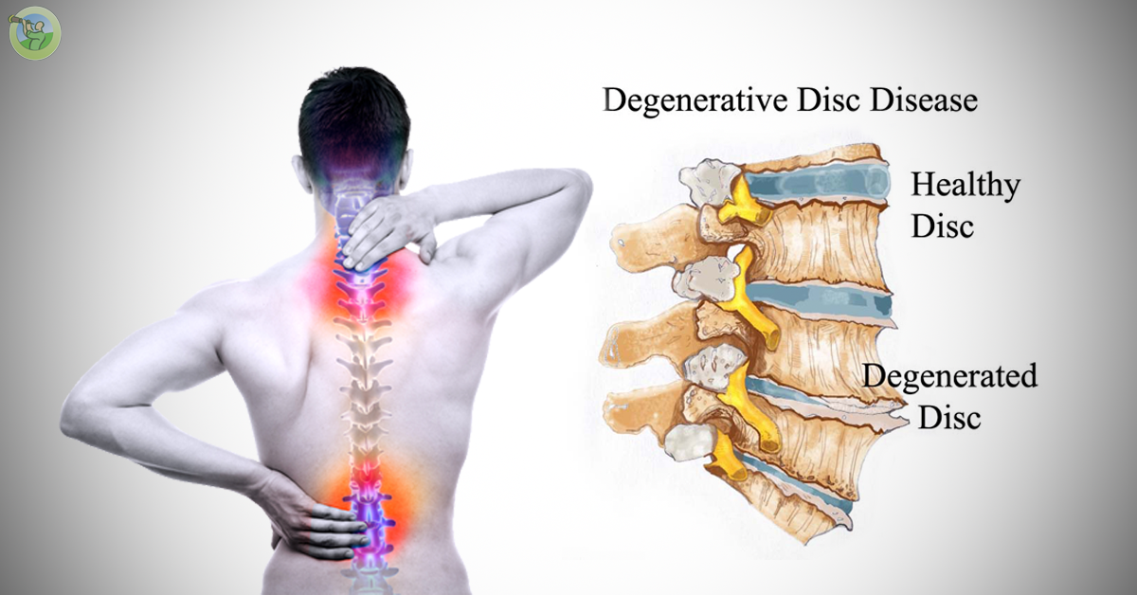

Slide 6
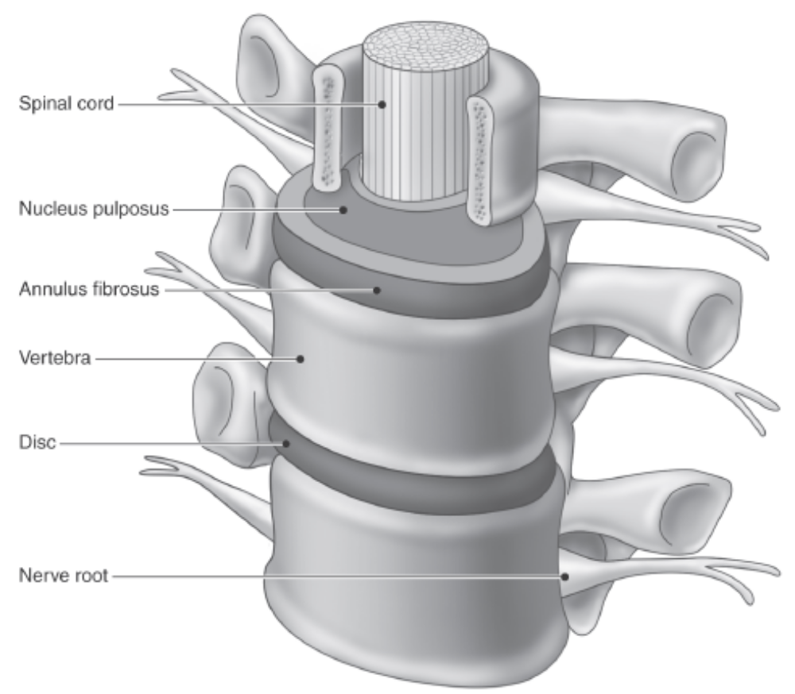
PATHOPHYSIOLOGY
Understanding the healthy structure and function of the fibrocartilaginous spinal discs is essential before discussing pathophysiology. These lubricated, mini shock absorbers allow normal spinal movements of flexion, extension, hyperextension (leaning backward), rotation, and lateral bending. Spine stabilizers also include the longitudinal ligaments, deep musculature (erector complex), abdominal and hip muscles, flexors, extensors, and abductors.

Slide 7
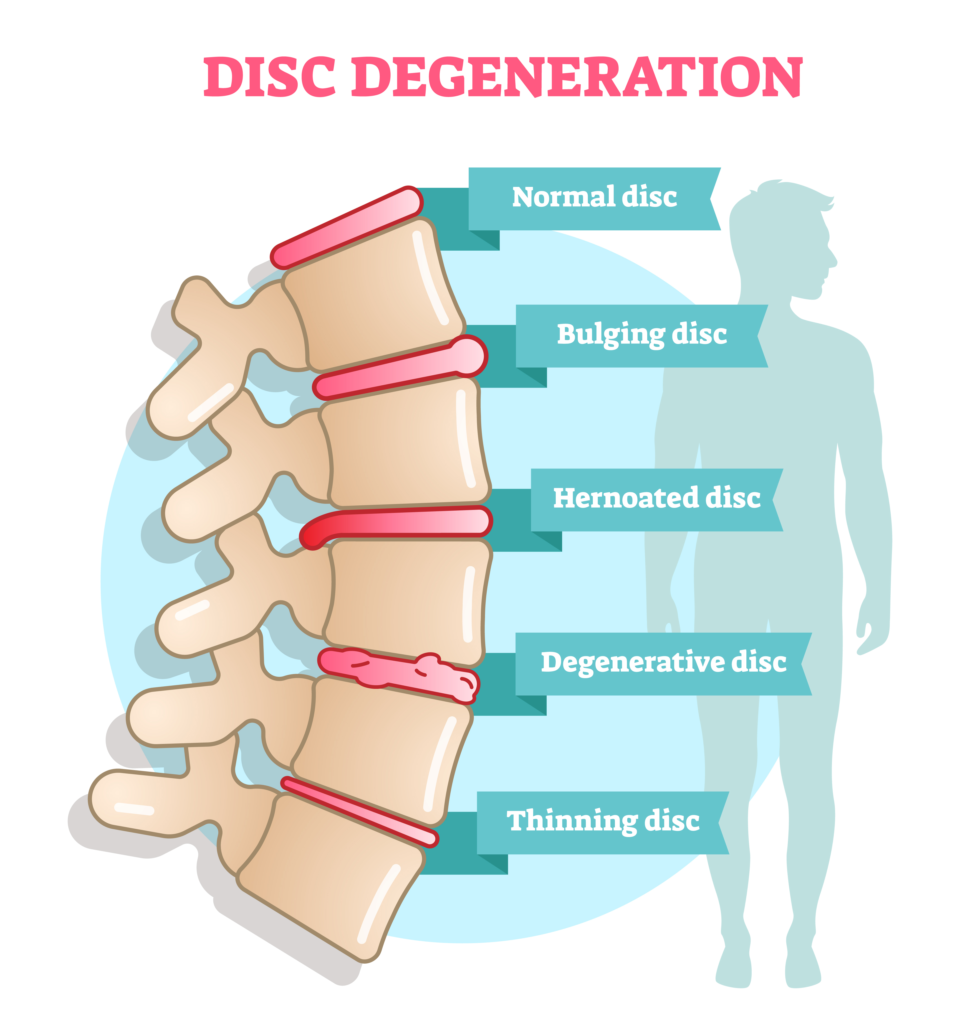
The relationship between the abdomen and the spine is key to explaining the causes of DDD. If you think of the classic image of a pregnant woman in her third trimester, holding onto her back as she attempts to sit, you can easily understand the relationship between strain on the spine due to temporary or permanent anterior forces and DDD. Weak and stretched abdominal muscles (secondary to pregnancy or obesity), combined with tight hip flexors, can contribute directly to spinal instability and pain, thereby exacerbating the normal aging process of the spina discs.

Slide 8
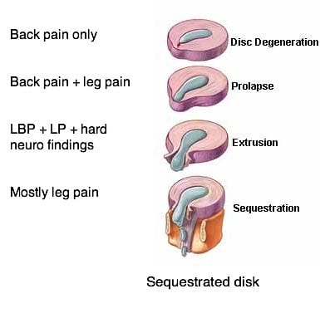
Just as increasing age leads to dry skin and brittle bones in even the healthiest of individuals, the intervertebral discs alter in structure and function after the second decade of life. The spinal disc’s nucleus (center portion), normally consisting of 85% water, dries substantially with age, and the disc’s annulus (concentric outer rings) turns from a relatively spongy consistency to that of old, tough, drying rubber. The height of the disc, usually about 0.25 inch, decreases, explaining in part why a person loses height with advancing years. Because of stiffness, and the lack of water, blood, and nutrients flowing into and out of the disc, the speed at which the disc can heal or repair itself is compromised.

Slide 9
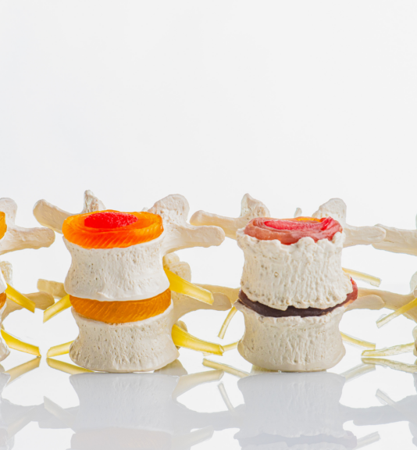
Since it is not possible to function normally without sitting, twisting, and side bending— all of which create insidious, accumulative tears in the discs—DDD occurs in stages that result in either serious dysfunction, mild back discomfort, or no symptoms at all.
Instability occurs first, as the usually tight-fitting discs start to slide around, bumping into nerve roots. The person may experience pain and discomfort. If treated at this stage, the condition can stabilize, and pain can be therapeutically controlled. During the second stage, osteophytes (new tiny bone growths [spurs]) begin to form from the constant, unusual wear and tear on the surrounding spinal joints. This further compromises nearby nerves and also causes stiffness. The damage from accumulated osteophytes is usually permanent.

Slide 10
Finally, during the stabilization stage, the bony spurs have decreased spinal range of motion (ROM), stenosis may occur, bone may be grinding on bone, voluntary splinting causes secondary pain in adjoining tissues and joints, and the entire trunk now compensates to adjust to an irreversible and very painful condition.
Other age-related conditions that mimic the symptoms of DDD include osteoarthritis of the spinal joints, herniated disc, ligament sprain, spinal stenosis, and, most seriously, spinal tumor.
A medical diagnosis is essential both to determine the stage of this condition and to rule out other symptom-mimicking conditions. A DDD diagnosis is confirmed with the aid of a physical examination, an assessment of movements that reproduce pain, X-rays, CT scan, and/or MRI.

Slide 11
OVERALL SIGNS AND SYMPTOMS
• Intermittent pain, worsening with prolonged sitting, twisting, or lifting
• Episodic pain characterized by flare-ups alternating with periods of moderate discomfort
• Radiating pain and/or pins-and-needles sensation following a dermatome pattern
• Muscle weakness in the area directly supplied by the affected (impinged) nerve
• Decreased spinal ROM

Slide 12
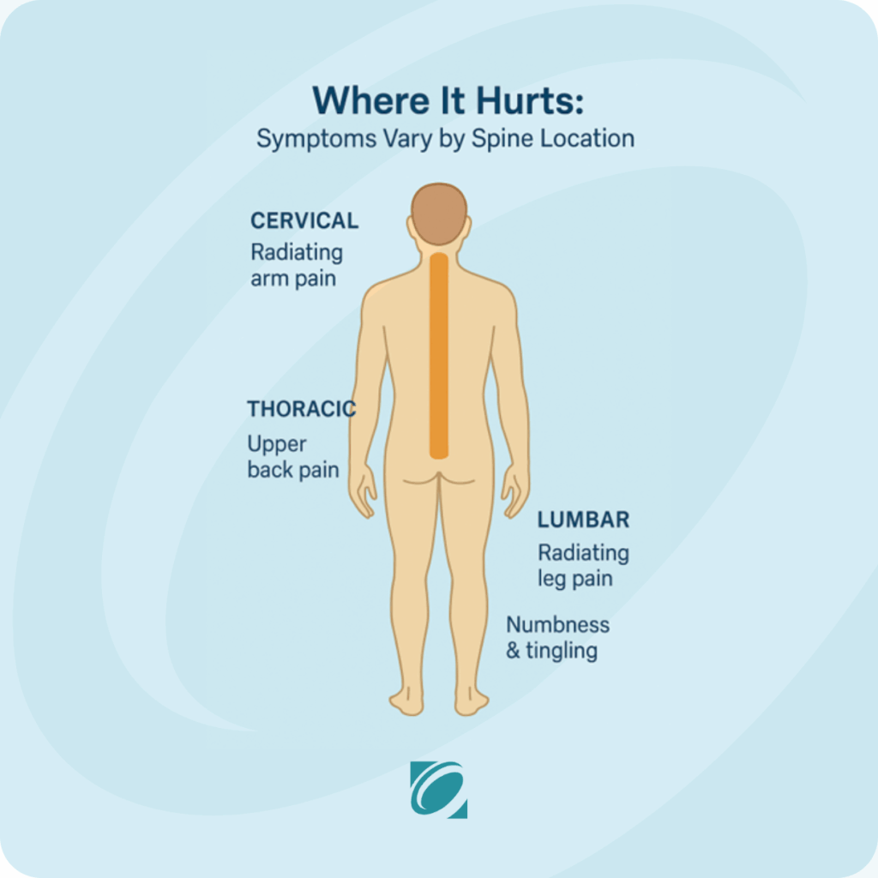
SIGNS AND SYMPTOMS MASSAGE THERAPY CAN ADDRESS
• The small, sturdy, stabilizing erector muscles that wrap around the spine become hypertonic as they attempt to hold the now unstable spine in place. The inevitable hypertrophy, muscle spasm, and pain-spasm-pain cycle can be relieved by massage therapy.
• The decreased ROM (and therefore secondary pain) resulting from prolonged immobility can be treated with massage techniques.
• The stress that accompanies living with chronic pain can be decreased with massage therapy.

Slide 13
TREATMENT OPTIONS
Treating symptomatic DDD ranges from conservative therapies to invasive surgery. Treatment goals include pain relief, increased ROM, and attempts to slow the normal degenerative process. If treated in the early stages, pain subsides within 1–4 weeks and a conservative treatment course follows.
During early treatment, the patient is encouraged to make symptom-reducing lifestyle changes. These include losing abdominal weight for the obese patient; quitting smoking for the cigarette smoker; avoiding high-impact, twisting sports for the athlete; and observing more efficient body mechanics and proper ergonomics, combined with regular stretches, for the desk jockey.

Slide 14
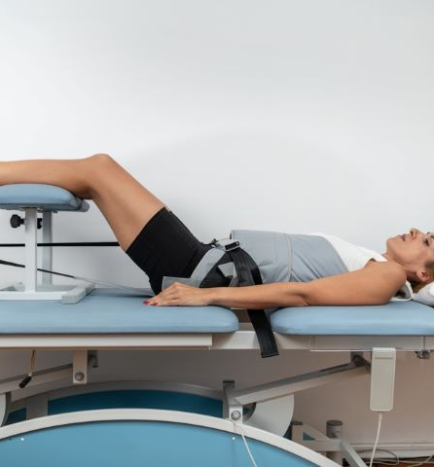
The application of heat for an aching back and cold for a severe flare-up is also considered conservative self-care during the early stages.
Physical therapy to improve lifelong poor postural habits and strengthen the abdominal core and surrounding back muscles, combined with retraining for safer bending and lifting, are additional effective conservative treatments. Traction can be effective if used judiciously. Exercise is considered essential, and a regimen of gentle, low-impact aerobic workouts, such as biking, swimming, and/or walking, is often combined with hamstring stretches and core strengthening.

Slide 15

Although, intuitively, bed rest seems appropriate for back pain, it is prescribed for very short-term periods of merely a day or two. Certainly, if the patient is experiencing intractable pain, bed rest will be called for. However, the secondary effects of immobility exacerbate DDD, and bed rest is not a common treatment. For the same reason, immobilizing back and neck braces is considered of limited, short-term value because the extended use of a brace, again, ultimately weakens surrounding muscles.
Chiropractic adjustments, application of TENS (transcutaneous electrical nerve stimulation performed by PTs), and epidural injections of anti-inflammatory steroids offer some relief. Long-term studies on the various treatment options show no single proven effective approach; the choices of modalities are usually based on an individual patient’s preference and the physician’s history of successfully treating DDD.

Slide 16
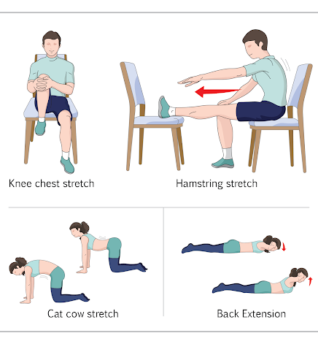
If unrelenting, severe pain and muscle spasm consistently interrupt the patient’s activities of daily living and make normal functioning impossible, surgical intervention is the last viable treatment option. Surgery is considered only after 4–6 months of aggressive therapy, medication, PT, and lifestyle changes have garnered no relief. Surgical options include a spinal fusion or a disc replacement, each carrying a measure of risk and accompanied by side effects.
Medications are used to decrease the secondary symptoms caused by DDD, but no medication has yet been formulated that can stop or slow the ultimate degeneration of the disc.

Slide 17
Common Medications
• Nonsteroidal anti-inflammatory drugs (NSAIDs), such as ibuprofen (Motrin, Advil)
• Adrenocorticosteroids, such as prednisone (Deltasone, Orasone, Meticorten)
• Nonopioid pain relievers and fever reducers, such as acetaminophen (Tylenol, Feverall, Anacin, Panadol)
• Skeletal muscle relaxants, such as cyclobenzaprine hydrochloride (Flexeril)
• Opioid analgesics, such as oxycodone hydrochloride (OxyContin)
• Synthetic analgesics, such as tramadol hydrochloride (Ultram)
• Anti-inflammatory analgesic and fever reducers, such as celecoxib (Celebrex)

Slide 18
MASSAGE THERAPIST ASSESSMENT
Performing as an informed and responsible health care team member is the only arena in which a massage therapist will be treating and therefore assessing a patient who has DDD. The condition’s symptomatic similarity to both serious and chronic disease,
combined with the risk of doing great harm with a simple well-intentioned leg or hip stretch, makes working with a PT or orthopedic surgeon imperative. It is very helpful to have, and completely appropriate to ask for, a copy of the written X-ray, CT scan, or MRI report, which will clarify the exact location and extent of degeneration.

Slide 19
With that understanding, the following assessment techniques are not intended for the therapist to assess the presence of DDD, but rather to assess the appropriate treatment for that day’s session. The assessment and the remaining focus of this chapter are for the treatment of DDD of the lumbar spine region:
• Palpation for paraspinal spasms
• Checking for trigger points and referred muscular tenderness, most commonly found (in lumbago) in the gluteal area and the hamstring complex
• Asking the patient if it is difficult to find a comfortable sitting or lying position
• Palpation of the hamstrings, gluteus maximus and minimus posteriorly, and the rectus femoris and the iliopsoas muscles anteriorly to determine hypertonicity

Slide 20
THERAPEUTIC GOALS
The chronic pain-spasm-pain cycle, trigger points, decreased ROM, and increased stress caused by DDD provide a clear-cut map for treating these patients. The therapist’s job is to attempt to provide symptomatic relief of pain, spasm, and stress. Further, deep-breathing exercises are essential to help bring the patient into a parasympathetic state, help maintain vigorous breathing capability, and help prevent secondary pneumonia, so often brought on by age and debilitating conditions.

Slide 21
MASSAGE SESSION FREQUENCY
• 60-minute sessions twice a week for 1 month, during active back discomfort, pain, and stiffness
• 60-minute sessions once a week until pain subsides and ROM increases
• 60-minute sessions at least monthly for maintenance

Slide 22
MASSAGE PROTOCOL
This therapy is hard work, as you knead and petrissage some of the strongest and largest muscles of the body. Focusing on the exact points of lumbar hypertonicity, muscle spasms, and radiating pain, you’ll be working on the gluteal complex, hamstrings, rectus femoris, iliotibial (IT) band, iliopsoas, quadratus lumborum (QL), and the entire set of erector spinae muscles. (Check your anatomy text to review the origins and insertions of these muscles.) Also, remember
you can ( carefully) use your forearms and elbows to get into the deeper gluteal muscles as well as the QL. If you have not been taught how to find and release the QL or the iliopsoas, spending an hour with a more experienced colleague could be helpful.

Slide 23
Getting Started
Comfortable positioning is vital; your patient may not be able to tolerate a flat prone or supine position. Have plenty of pillows available.
You’ll use hot packs to help soften hypertonic tissue and cold packs to quiet a flare-up or muscle spasm.
Although your therapeutic inclination will be to perform leg and spine stretches to address his limited spinal and hip joint ROM, these are best performed by the PT or orthopedic surgeon with whom you are consulting. For this reason, stretches are not included in the step-by-step protocol.

Slide 24
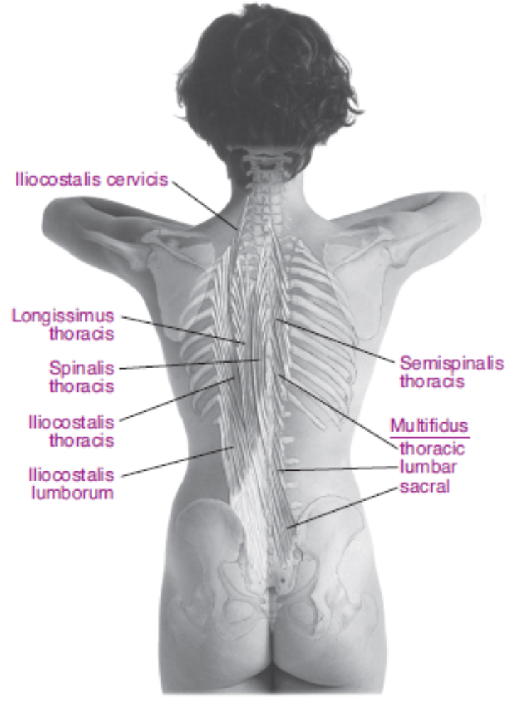

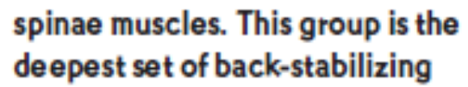

Slide 25
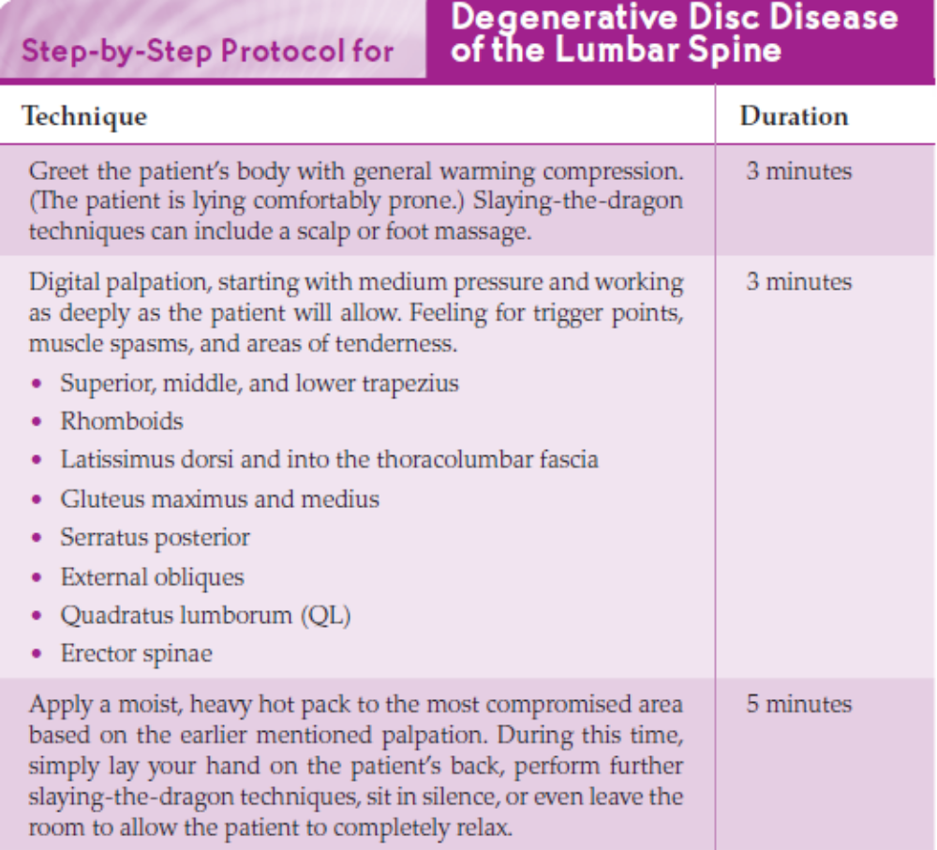

Slide 26
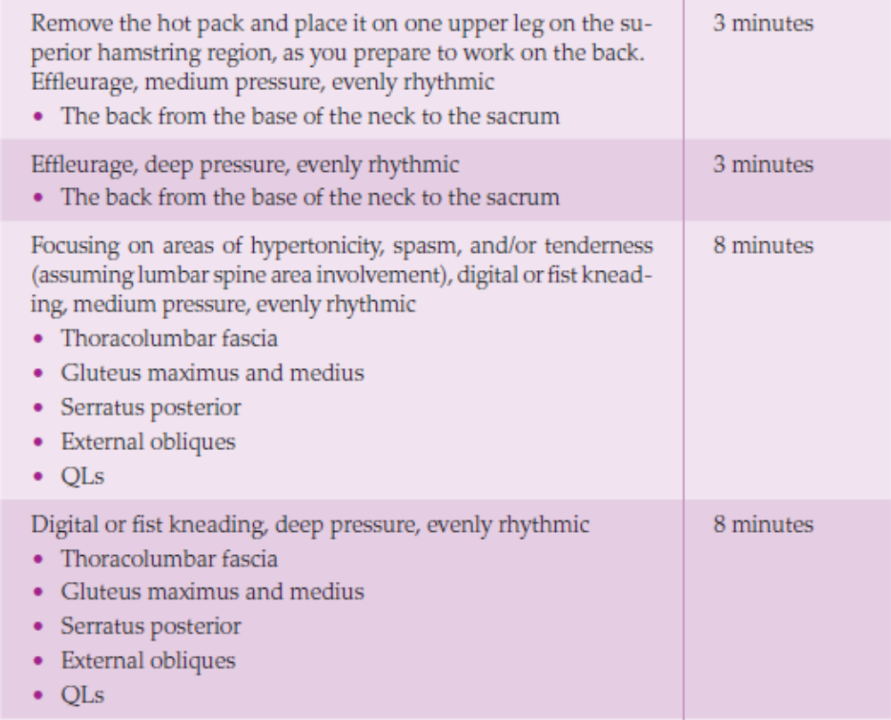

Slide 27
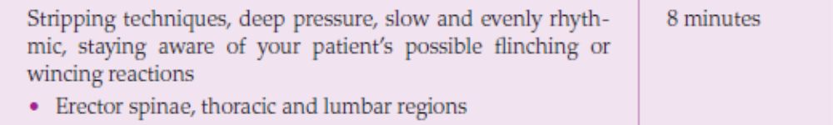
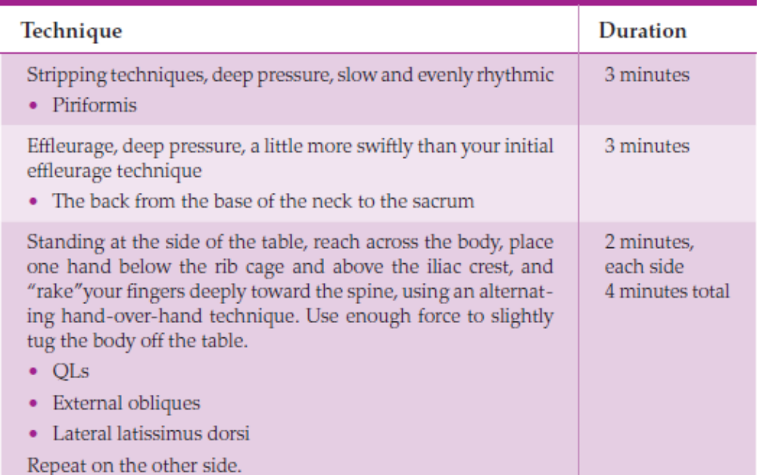

Slide 28
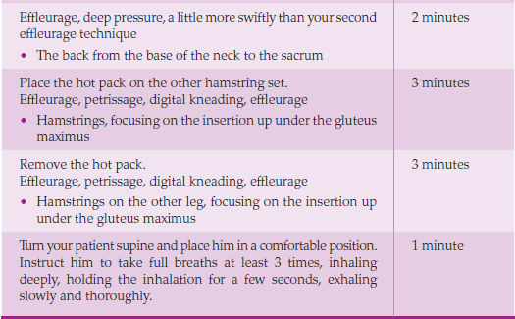

Slide 29
HOMEWORK
If your patient is seeing a PT, he will already be performing daily exercises and stretches. Encourage him to demonstrate these exercises at the end of your session and to continue in his efforts at home. If he is obese, you can diplomatically suggest a weight-loss program and/or give him a registered dietitian’s card. If he is a smoker, tactfully suggest a smoking-cessation program.
Without moving outside your scope of practice while simultaneously attending to the many lifestyle and preventive elements of your patient’s long-term care, you can recommend the following homework assignments. Notice that each point includes instruction and encouragement; your patient will often be overwhelmed after months or years of doctor’s appointments, and he may be taking narcotics. You want to make sure he understands why you are asking him to perform certain tasks.

Slide 30
• Take full, deep breaths throughout the day. Because you are in so much pain and your back is getting stiffer, it’s easy to fall into the habit of holding your breath or not breathing deeply. This habit can lead to more problems and sometimes pneumonia, which, of course, you want to prevent. Several times throughout your day, take a really deep inhalation, hold it for a few seconds, and then force out all the air with a strong exhalation.
• Keep moving. Immobility will only worsen your DDD. Check with your physician and consider taking the stairs instead of an elevator, parking your car farther away from the store, and walking instead of driving to do a nearby errand. Create excuses to keep moving.

Slide 31
• Apply moist hot packs to your back when you’re experiencing deep, aching pain. Apply ice packs when you’re experiencing a flare-up or when you feel the pain is particularly bad.
• Try not to slump when you’re sitting; sit upright. Good posture provides much better support for your spine and helps prevent the risk of further disc problems.

Slide 32
Contraindications and Cautions
• Your patient’s inability to find a comfortable lying position on the table or to lie still for any length of time is an indication that he needs to see his physician promptly.
• Suggesting or performing hip or spinal ROM exercises without knowing the exact status of the spinal disc involvement is contraindicated.
• Applying heat during a flare-up can lead to exacerbation of an inflammatory process and is therefore contraindicated.
• Performing manual traction to the spine, even simply involving myofascial releases, should not be performed without knowing the exact status of the spinal disc involvement.

Slide 33
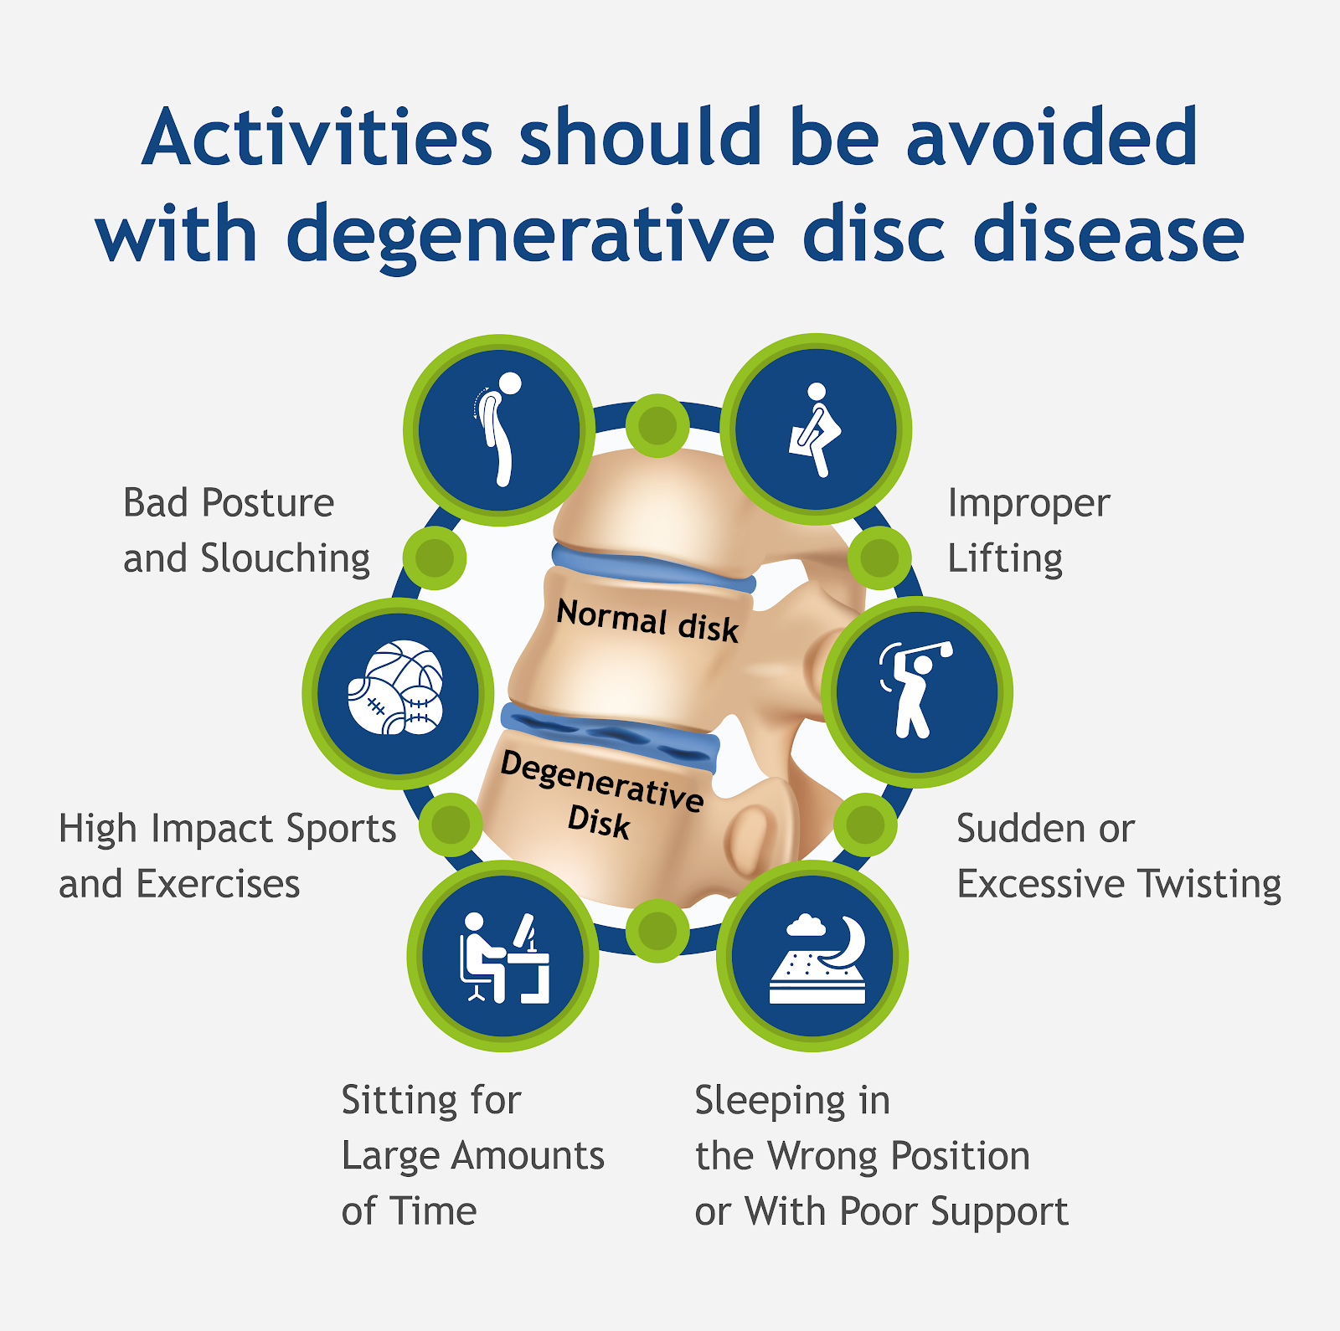
• Knowing your patient’s pain tolerance, combined with the knowledge of whether he’s taking narcotics and/or muscle relaxants, will determine the depth of your work and the accuracy of your patient’s response.

Slide 34
Thank you
Hamid Ghazvini, MD, DC, RMT
905-731-2555
info@ruhaniCollege.com
www.ruhanicollege.com

