Slide 1
Carpal Tunnel syndrome
Dr Manju Setia Khowal
RMT, BAMS

Slide 2
Carpal Tunnel
The carpal tunnel is located at the wrist just distal to the wrist creases. It is a fibrosseous canal, with the floor formed by the carpal bones and the roof formed by the flexor retinaculum, also referred to as the transverse carpal ligament.
This ligament is a dense fibrous band, approximately 1 to 2 millimetres thick.
It attaches to the pisiform and the hook of the hamate bone on the ulnar side of the wrist;
on the radial side, it attaches to the scaphoid tubercle and the trapezium.
The median nerve becomes increasingly superficial as it approaches the carpal tunnel.
Before passing through the tunnel, it gives off a nerve branch called the palmar cutaneous branch. This branch generally travels superior to, not through, the carpal tunnel
This is significant because the palmar cutaneous nerve supplies the skin over the thenar eminence. In turn, if the median nerve is compressed in the tunnel, the sensation to the thenar area is not affected.

Slide 3
Structures that travel through the carpal tunnel (Figure 69.1) are:
The median nerve;
The four tendons of the flexor digitorum superficialis;
The four tendons of the flexor digitorum profundus;
The tendon of the flexor pollicis longus.

Slide 4
Definition
Carpal Tunnel Syndrome (CTS) = compression of the median nerve at the wrist
Occurs within the carpal tunnel
Leads to:
  Numbness
  Tingling in lateral 3½ digits
Most common entrapment neuropathy of the arm

Slide 5
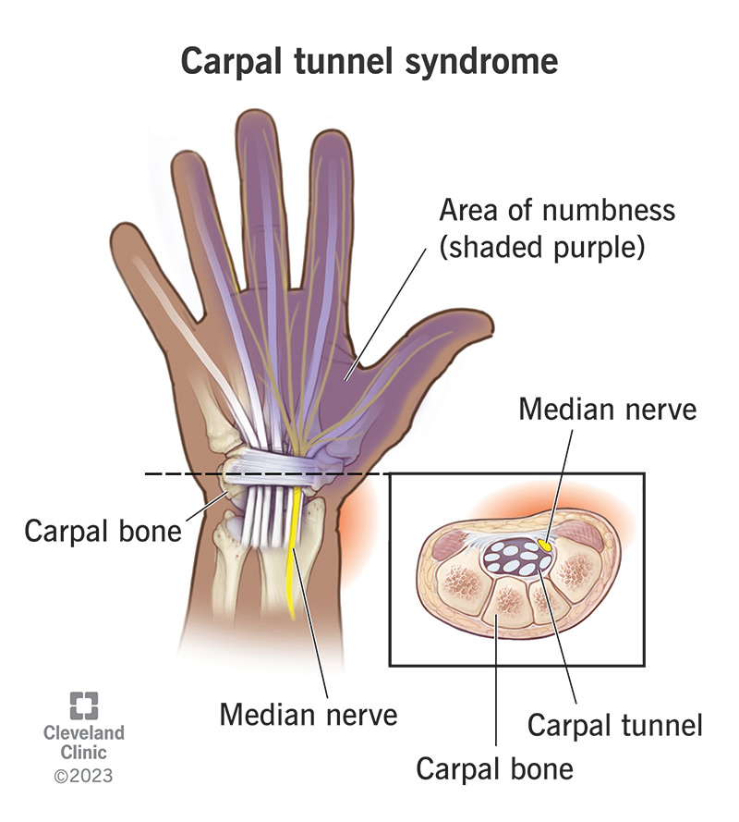

Slide 6
Incidence & Risk Factors
Seen in ~1% of population
Higher risk in:
  Repetitive wrist activities
  Keyboard workers, butchers, assembly workers
Often:
  Unilateral (dominant hand)
  Can be bilateral

Slide 7
Causes
Repetitive strain / overuse (most common)
Edema (pregnancy, hormonal changes)
Rheumatoid arthritis
Space-occupying lesions / bony changes
Occupational factors (keyboard, tools)

Slide 8
Causes
Chronic Causes
Repetitive wrist flexion/extension → edema → fibrosis
Thickening of flexor retinaculum
Systemic conditions:
  Diabetes
  Rheumatoid arthritis
  Pregnancy
Space-occupying causes
Ganglion, cyst, lipoma
Bony changes or fractures
Acute Causes
Trauma (fracture/dislocation)
Infection
Hematoma

Slide 9
Contributing Factors
Vitamin B6 deficiency
Familial tendency (small tunnel)
Double crush syndrome (proximal + distal compression)

Slide 10
Symptoms
Sensory Symptoms:
Numbness & tingling in median nerve distribution
Nocturnal dysesthesia (key feature)
Pain:Wrist → forearm → elbow → sometimes shoulder
Limited wrist movement due to pain
Thenar muscle wasting (late stage)
Client relief by:
Shaking hand
Massage
Water immersion

Slide 11
Functional Issues
Weak grip
Difficulty with fine motor tasks (e.g., buttoning)
Tissue & Structural Changes
Swelling (edema)
Hypertonic forearm flexors
Trigger points (forearm, scalenes, subscapularis)
Adhesions at flexor retinaculum
Thenar atrophy (late stage)

Slide 12
Assessment: Palpation
Tenderness over carpal tunnel and median nerve
Boggy tissue at wrist
Dense forearm muscles (metabolic waste)
Hypertonicity + fascial restrictions
Thenar atrophy (chronic cases)
Range of Motion (ROM)
↓ Wrist flexion and extension
Possible ↓ ulnar deviation
End feel: often empty
Empty end feel is a type of end feel felt during passive movement testing.
An empty end feel occurs when: Movement is stopped before the normal range ,There is no true mechanical resistance .The motion is limited mainly due to pain or patient guarding, not tissue restriction

Slide 13
B. Range of Motion (ROM)
↓ Wrist flexion and extension
Possible ↓ ulnar deviation
End feel: often empty
C. Strength Testing
Weakness in abductor pollicis brevis (chronic CTS)
Special Tests:
Phalen’s Test – positive
Reverse Phalen’s – positive
Tinel’s Sign – tingling in median nerve
Cyriax test – positive
Tourniquet test – less reliable

Slide 14
Differential Diagnosis
C6–C7 radiculopathy
  Neck pain present
  Reflex changes
Thoracic outlet syndrome
  Medial forearm + medial digits symptoms
Pronator teres syndrome
  Pain with elbow movement

Slide 15
Medical Treatment
Wrist splint (neutral position, especially at night)
Anti-inflammatories / diuretics
Steroid injections (temporary relief)
Vitamin B6
Surgery (moderate–severe cases):
Flexor retinaculum release
50–65% success rate

Slide 16
Treatment Goals
Reduce:
  Edema
  Fascial restrictions
  Hypertonicity
  Trigger points
  Stress
Decrease:
  Sympathetic nervous system activity

Slide 17
Hydrotherapy
Acute: cold applications
Chronic: contrast bath
Heat:
  Before deep work
  After trigger point therapy

Slide 18
Massage Techniques
Proximal Work
Neck, shoulder, axillary drainage
Treat scalenes, subscapularis trigger points
Local Wrist & Forearm
Effleurage (lymphatic drainage)
Petrissage (forearm muscles)
Thumb kneading (flexor retinaculum)
Frictions (adhesions – if indicated)
Avoid direct compression of median nerve

Slide 19
Hand Treatment
Fascial spreading (palm)
Gentle petrissage
Thenar muscle work (if healthy)
Joint Techniques
Joint play (elbow, wrist, metacarpals)
Passive ROM
Rhythmic movements

Slide 20
Acute vs Chronic
Acute:
  No local work
  Focus proximal + cold therapy
Chronic:
  Combine relaxation + specific techniques
  Pain may temporarily increase

Slide 21
Self-Care Plan
A. Postural Education
Neutral wrist position
Proper workstation ergonomics
Avoid repetitive strain

Slide 22
Hydrotherapy
Ice during activity
Contrast baths (10°C difference)
Stretching
Forearm flexors & extensors
Hold 10–20 seconds
Pain-free
Strengthening
Thenar muscles
Gradual progression
Daily exercises

Slide 23
Key Clinical Points
Nocturnal symptoms = hallmark sign
Thenar atrophy = late stage
Always rule out cervical + TOS causes
Massage = symptomatic + functional relief, not structural cure

Slide 24
Contraindications
No frictions if:
  Rheumatoid arthritis
  Edema present
  Diabetes with poor tissue health
  Anti-inflammatory use
Avoid:
  Vigorous joint play (instability, pregnancy)
  Local massage after corticosteroid injection (10 days)

Slide 25
Difference: Pronator Teres Syndrome vs Carpal Tunnel Syndrome
Feature | Pronator Teres Syndrome (PTS) | Carpal Tunnel Syndrome (CTS)
Site of Compression | Median nerve compressed at pronator teres (proximal forearm) | Median nerve compressed in carpal tunnel (wrist)
Onset | Gradual, insidious | Often gradual, may worsen with repetitive use
Pain Location | Anterior forearm pain | Wrist and hand pain
Pain Trigger | ↑ with repetitive elbow movement (pronation) | ↑ with wrist activity / repetitive hand use
Nocturnal Symptoms | ❌ Absent | ✅ Present (classic sign)
Sensory Symptoms | Numbness in thumb & index finger | Numbness in lateral 3½ digits
Thenar Atrophy | Mild or less common | Common in chronic CTS
Weakness | Thenar weakness possible | Thenar weakness (abductor pollicis brevis)
Tenderness | At proximal forearm (pronator teres) | At carpal tunnel (wrist)
Special Tests | Pain with resisted pronation | Positive Phalen’s, Tinel’s
Effect of Wrist Position | Not significant | Symptoms worsen with wrist flexion

Slide 26
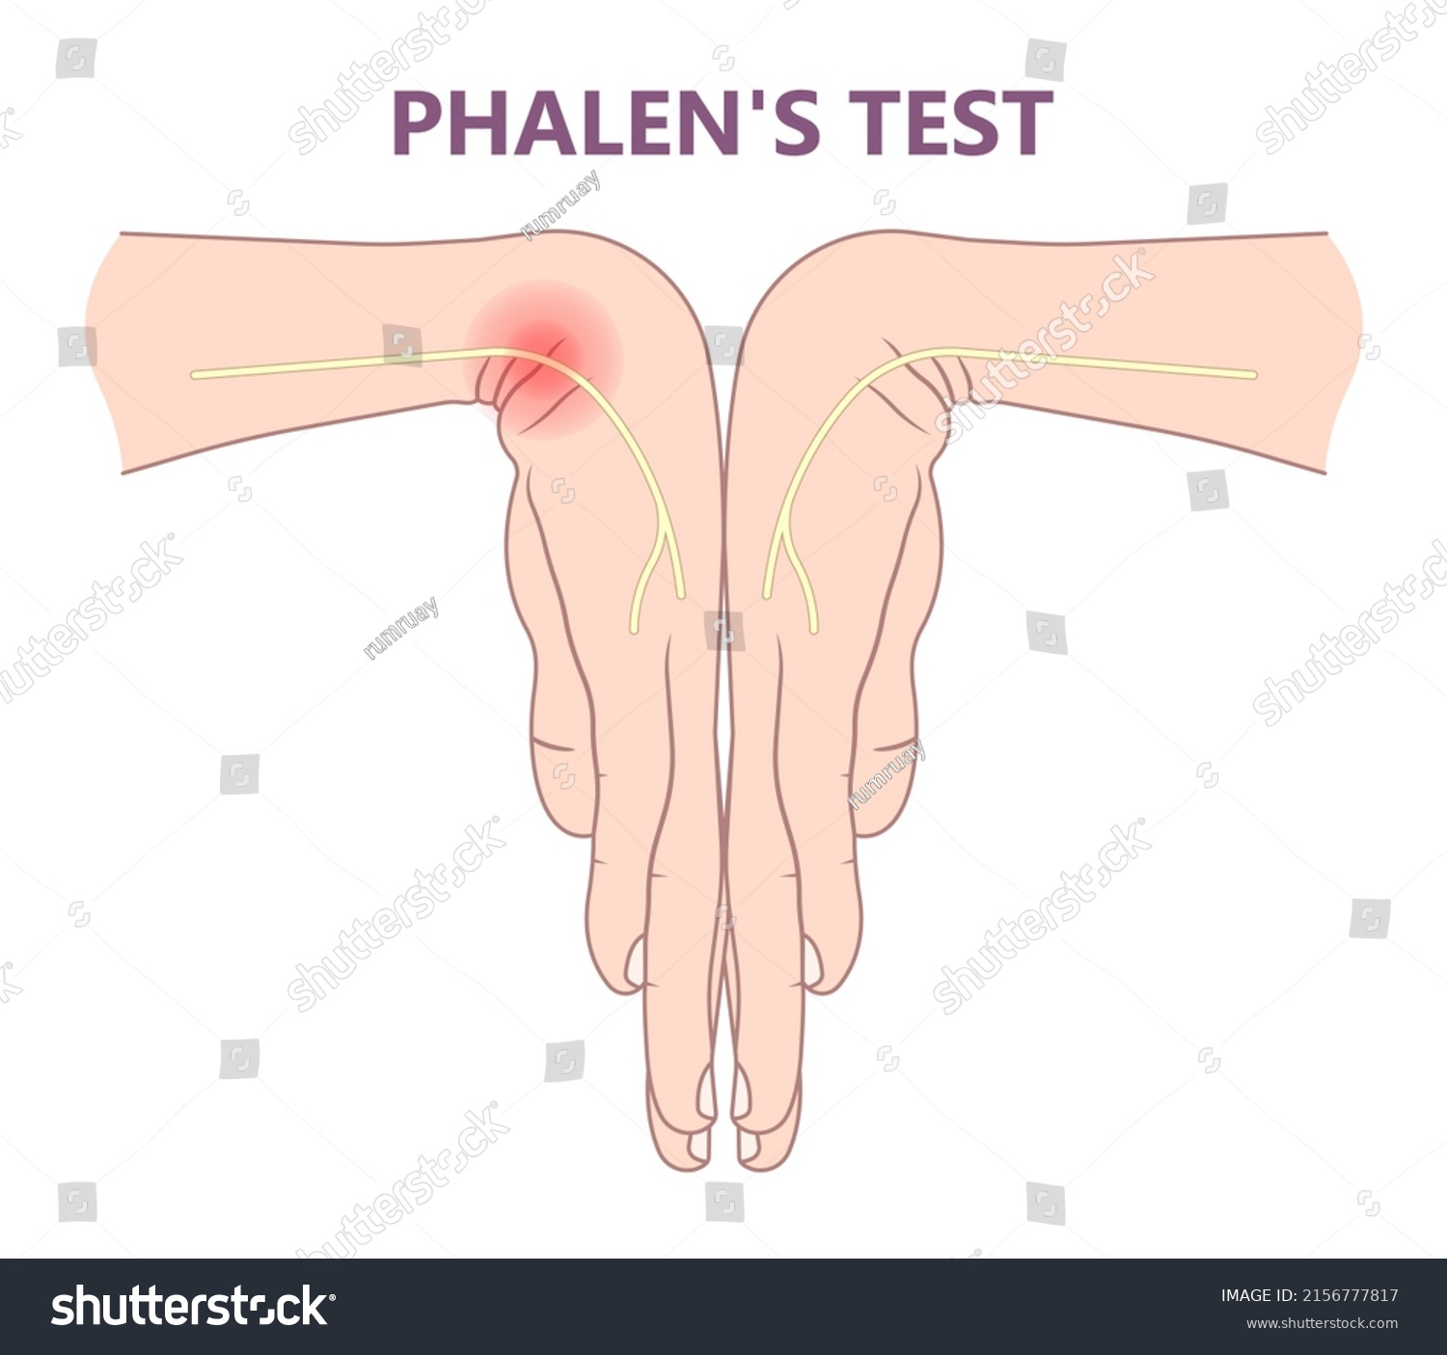
Phalen’s Test : CTS
Procedure
Ask the patient to flex both wrists maximally (pushing the dorsal surfaces of the hands together).
Maintain this position for 30–60 seconds.
Observe and ask the patient if they experience tingling, numbness, or pain in the median nerve area.
Interpretation
Positive Test: Tingling, numbness, or pain in the median nerve distribution.
Negative Test: No symptoms reproduced.

Slide 27
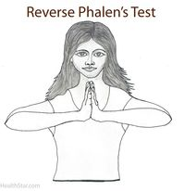
Reverse Phalen/Prayer Test:CTS
Purpose
To assess median nerve compression at the wrist.
It is essentially the opposite of the standard Phalen’s Test.
Procedure
Ask the patient to extend both wrists fully, with the palms facing downward (like a prayer position turned downward).
Maintain this position for 30–60 seconds.
Observe for tingling, numbness, or pain in the median nerve area (thumb, index, middle, lateral half of ring finger).
Interpretation
Positive Test: Tingling, numbness, or pain in the median nerve distribution.
Negative Test: No symptoms reproduced.

Slide 28
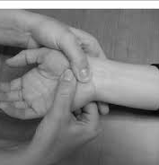
Cyriax Test / Carpal Compression Test
Definition
A special test used to detect median nerve compression in the carpal tunnel
Mentioned as positive in CTS cases
Procedure :Patient is seated or standing
Therapist applies direct pressure over the carpal tunnel (anterior wrist, over flexor retinaculum) Pressure is held for ~30 seconds
Positive Sign: Reproduction of: Pain ,Tingling ,Paresthesia In median nerve distribution (lateral 3½ digits)
Negative Sign:No reproduction of symptoms
Clinical Significance
Indicates median nerve irritation/compression
Helps confirm Carpal Tunnel Syndrome

Slide 29
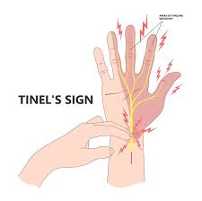
Tinel’s Sign
Purpose
To detect irritation or compression of the median nerve at the wrist.
Helps localize the site of nerve compression.
Procedure
The patient’s forearm is relaxed and resting.
The examiner taps gently over the median nerve at the volar aspect of the wrist (just proximal to the flexor retinaculum).
Observe for tingling, “pins-and-needles,” or pain radiating into the median nerve distribution (thumb, index, middle, lateral half of ring finger).
Interpretation
Positive Tinel’s Sign: Tingling or pain in the median nerve distribution.
Negative Tinel’s Sign: No symptoms reproduced

Slide 30


