Slide 1
Brachial Plexus & Median Nerve
Dr Manju Setia khowal
BAMS, RMT

Slide 2
Brachial Plexus
The Brachial plexus is a network of nerves that supplies the shoulder, arm, forearm, and hand. It carries motor (movement) and sensory (feeling) signals between the spinal cord and the upper limb.
Origin: Formed from the ventral rami of spinal nerves:
C5
C6
C7
C8
T1
It is the nerve network that controls the entire upper limb.

Slide 3
Brachial Plexus
Parts of the Brachial Plexus
The brachial plexus has 5 main parts ( Roots → Trunks → Divisions → Cords → Branches).
Roots
C5
C6
C7
C8
T1
These roots come directly from the spinal cord.

Slide 4
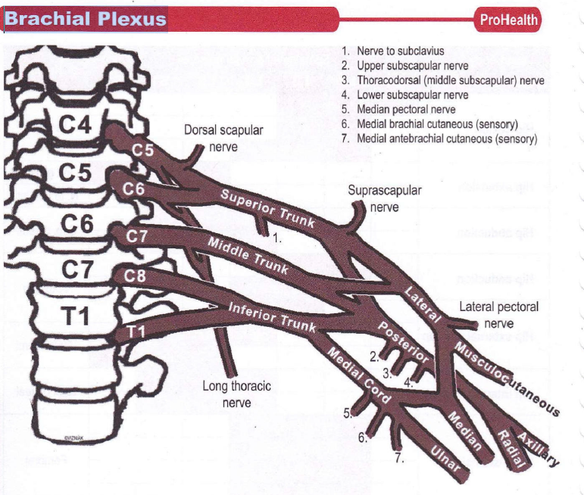

Slide 5
Trunks:
Roots join to form three trunks:
Upper trunk → C5 + C6
Middle trunk → C7
Lower trunk → C8 + T1
Divisions:
Each trunk divides into:
Anterior division
Posterior division
So there are 6 divisions in total.

Slide 6
Cords:
Divisions form three cords named according to their position around the axillary artery:
Lateral cord :formed by Ant. Division of upper & middle trunks
Medial cord: formed by Ant division of lower trunk
Posterior cord: formed by posterior division of all three trunks
Terminal Branches:
Musculocutaneous
Axillary
Radial
Median
Ulna
These nerves control movement and sensation of the arm and hand.

Slide 7
Function: Brachial Plexus
The brachial plexus provides:
Motor function:
Shoulder movement
Arm movement
Wrist movement
Finger movement
Sensory function:
Feeling from:
  Shoulder
  Arm
  Forearm
  Hand

Slide 8
Brachial Plexus
Clinical Importance:
Injury to the brachial plexus can cause:
Weakness or paralysis of the arm
Loss of sensation (anesthesia) in the upper limb
Altered sensation( Paresthesia)
Conditions like:
  Erb's palsy
  Klumpke's palsy

Slide 9
Erb's palsy
Erb's palsy is a condition caused by injury to the upper part of the Brachial plexus, usually involving the C5 and C6 nerve roots. It leads to weakness or paralysis of the shoulder and upper arm muscles.
Causes:
Birth injury during difficult delivery (excess traction on baby’s neck).
Trauma/falls/Accident that violently separates the neck & shoulder due to motor vehicle accident.(thrown and lands on the head and shoulder).
Sports injuries (e.g., strong shoulder stretch).

Slide 10
Erb's palsy
Nerves Involved:
Mainly C5 and C6 spinal nerves.
These nerves supply muscles responsible for:
  Shoulder abduction
  External rotation of shoulder
  Elbow flexion.
Muscles Affected:
Deltoid muscle
Biceps brachii
Brachialis muscle
Supraspinatus muscle
Infraspinatus muscle
These muscles help with lifting the arm and bending the elbow.

Slide 11
Characteristic Deformity
“Waiter’s Tip Position”
Arm position includes:
Arm adducted (close to the body)
Shoulder internally rotated
Elbow extended
Forearm pronated
Wrist flexed
This appearance is called the waiter’s tip posture/ deformity.

Slide 12
Erb's palsy
Symptoms:
Weakness in the shoulder and upper arm
Inability to lift the arm
Difficulty bending the elbow
Loss of sensation in the lateral arm
Reduced muscle reflexes (especially biceps reflex)

Slide 13
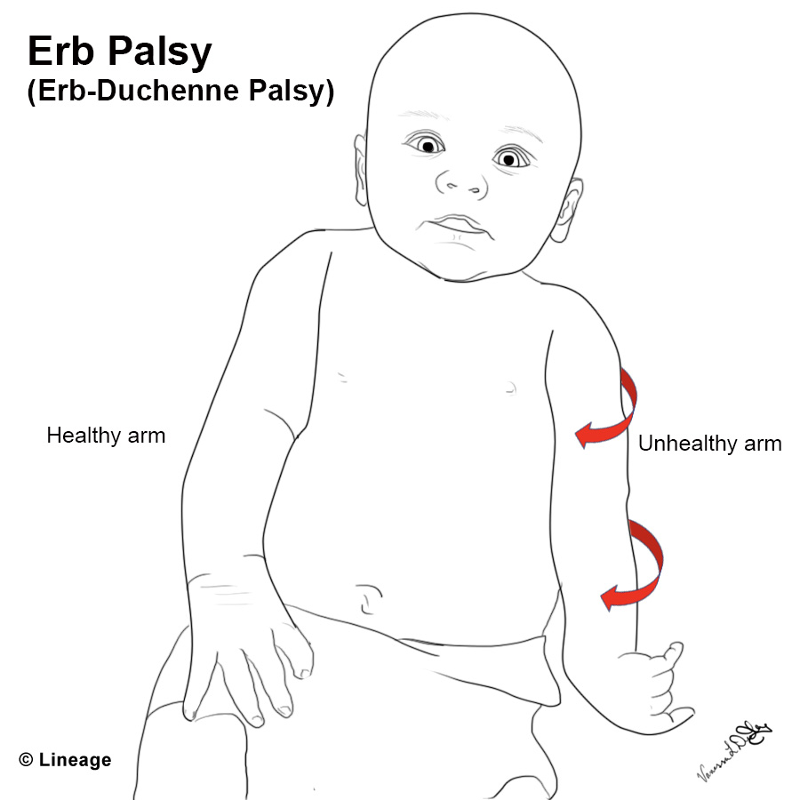

Slide 14
Klumpke’s Palsy
Klumpke's palsy is a paralysis caused by injury to the lower part of the Brachial plexus, mainly involving the C8 and T1 nerve roots. It mainly affects the hand and finger muscles.
Causes:
Traction injury of the arm upward (sudden pulling of the arm).
Birth injury when the baby’s arm is pulled during delivery.(Poor positioning at birth like breech/ forcep delievery
Falls or accidents where a person grabs something to stop the fall.
Tumors or compression affecting lower brachial plexus.

Slide 15
Klumpke’s Palsy-2
Nerves Involved
C8 and T1 spinal nerves
These nerves supply intrinsic muscles of the hand.
Important nerves affected:
Ulnar nerve
Median nerve (partly)
Muscles Affected
Mainly intrinsic hand muscles, such as:
Interossei muscles of hand
Lumbrical muscles of hand
Thenar and hypothenar muscles
These muscles control fine finger movements and grip strength.

Slide 16
Klumpke’s Palsy-3
Characteristic Deformity:
Claw Hand
Features include:
Hyperextension at metacarpophalangeal joints (MCP)
Flexion at interphalangeal joints
Fingers appear claw-like
This occurs because intrinsic hand muscles are paralyzed.
Symptoms
Weakness of hand and finger movements
Loss of grip strength
Difficulty with precise hand movements
Sensory loss on medial side of forearm and hand
Possible muscle wasting of the hand

Slide 17
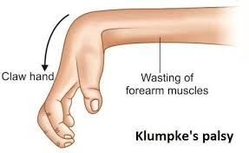

Slide 18
Simple summary:
Erb’s palsy → C5–C6 → shoulder/arm problem → waiter’s tip posture
Klumpke’s palsy → C8–T1 → hand muscles → claw hand.
Feature | Erb's palsy | Klumpke's palsy
Part of Brachial plexus affected | Upper brachial plexus | Lower brachial plexus
Nerve roots involved | C5 – C6 | C8 – T1
Main cause | Excessive separation of head and shoulder | Sudden upward traction of the arm
Muscles affected | Shoulder and upper arm muscles (deltoid, biceps, brachialis) | Intrinsic muscles of the hand
Characteristic deformity | Waiter’s tip position | Claw hand
Arm position | Arm adducted, internally rotated, elbow extended | Fingers clawed with MCP hyperextension
Movement loss | Loss of shoulder abduction and elbow flexion | Loss of finger movements and grip
Sensory loss | Lateral side of arm | Medial forearm and hand
Associated condition | Usually none | May be associated with Horner’s syndrome
Area mainly affected | Shoulder and upper arm | Hand and fingers

Slide 19
Median Nerve
The median nerve mainly innervates the flexor muscles of the forearm and hand.
It is especially important for precise hand movements, particularly of the thumb and index finger.
Precise hand movements:
Precise hand movements means very accurate, small, and controlled movements of the hand and fingers, especially used for fine tasks.
Example:
Writing with a pen
Buttoning a shirt
Picking up small objects (coin, pin)
Using a needle and thread
Typing on a keyboard
The nerve originates from the brachial plexus:
Medial cord → C8–T1
Lateral cord → C5–C7

Slide 20
Origin of Median Nerve
Median nerve arises from the brachial plexus
Formed by:
Medial cord (C8–T1)
Lateral cord (C5–C7)
Responsible for fine motor control of the hand
Especially important for thumb and index finger movements
Course of the Median Nerve:
Travels with the axillary-brachial artery.
Descends along the radial side of the arm from axilla to cubital fossa.
Passes between the two heads of pronator teres.
Continues deep beneath superficial finger flexor muscles.

Slide 21
Path in the Forearm and Wrist
Lies between:
Flexor pollicis longus
Flexor digitorum profundus
Near the wrist:
Located between flexor carpi radialis and palmaris longus tendons
Gives off palmar cutaneous branch before entering the carpal tunnel.
Enters the carpal tunnel with finger flexor tendon

Slide 22
Muscles Innervated by Median Nerve (Forearm)
Median nerve supplies:
Pronator teres
Flexor carpi radialis
Flexor digitorum superficialis
Flexor digitorum profundus (radial half)
Palmaris longus
Flexor pollicis longus
Pronator quadratus

Slide 23
Muscles Innervated in the Hand
Thenar muscles supplied by the median nerve:
Abductor pollicis brevis
Opponens pollicis
Flexor pollicis brevis
First and second lumbricals

Slide 24
Causes of Median Nerve Lesions
Common causes include:
Fractures
  Elbow
  Wrist
  Carpal bones
Dislocations
  Elbow
  Wrist
  Lunate and scaphoid bones
Compression
  Carpal tunnel syndrome
  Pronator teres syndrome
Trauma
  Traction injury
  Contusion (soft tissue injury caused by direct blunt force-that damages small blood vessels without breaking the skin)
  Laceration (open wound-from blunt or sharp trauma) of wrist or hand

Slide 25
Sites of Injury
Median nerve is most vulnerable where it is superficial:
Elbow region
Wrist region
These areas are more prone to trauma and compression.

Slide 26
Symptom
A complete lesion produces characteristic deformities.
Ape Hand:A condition in which the thumb lies in the same plane as the fingers due to loss of opposition, giving a flattened appearance of the hand.
Cause
Damage or compression of the median nerve
Common in:
  Carpal tunnel syndrome
  Wrist injuries
  Forearm trauma
Muscles Affected
Mainly thenar muscles:
Abductor pollicis brevis
Opponens pollicis
Flexor pollicis brevis
These muscles are responsible for thumb movement and opposition.

Slide 27
Characteristic Features
Thumb is:
  Adducted
  Laterally rotated
  Lies in the same plane as fingers
Loss of thumb opposition
Thenar eminence appears flattened (atrophy)
Functional Problems
Difficulty:
  Holding a pen
  Buttoning clothes
  Picking small objects
Loss of precise hand movements

Slide 28
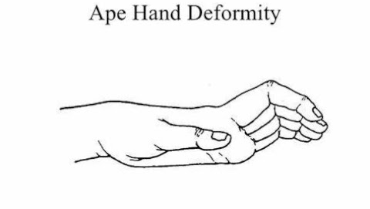

Slide 29
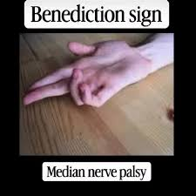
Other Symptoms
Oath Hand (Hand of Benediction)
Oath hand is a characteristic sign seen in Median nerve injury, especially when the patient tries to make a fist.
Cause:
Injury to the median nerve, usually at or above the elbow
Common causes:
  Supracondylar fracture of humerus
  Elbow trauma
  Deep lacerations
Muscles Affected
Flexor digitorum superficialis
Flexor digitorum profundus (lateral half)
Flexor pollicis longus
These muscles are responsible for finger flexion.

Slide 30
Oath Hand (Hand of Benediction)
Characteristic Sign
When asked to make a fist:
Index finger → remains straight
Middle finger → remains straight
Ring & little fingers → flex normally
Hand looks like taking an oath or blessing position
Functional Problems:
Inability to:
  Grip objects properly
  Make a full fist
Weak precision grip

Slide 31
Clinical Points to Remember :
Oath hand appears only when the patient tries to make a fist
Oath hand ,At rest, the hand may look normal
Oath hand → seen during movement (making a fist)
Ape hand → seen at rest (thumb position)

Slide 32
Autonomic(involuntary) functions of the body and Trophic Changes
Trophic changes are changes in the nutrition, growth, and health of tissues (skin, muscles, nails) that occur due to loss of proper nerve supply.
Because the median nerve contains autonomic fibers, lesions can cause:
Edema of hand and fingers
Nail ridges
Thin glossy skin
Loss of normal skin lines
Muscle atrophy may occur in:
Forearm flexors
Thenar muscles
There is also risk of causalgia (severe nerve pain).

Slide 33
Sensory Dysfunction
Loss or alteration of sensation occurs in:
Thumb
Index finger
Middle finger
Half of ring finger
Distal two-thirds of palm
Additional features:
Sensory changes extend to distal phalanges on the extensor surface.
Anesthesia at distal interphalangeal joints of index and middle fingers.

Slide 34
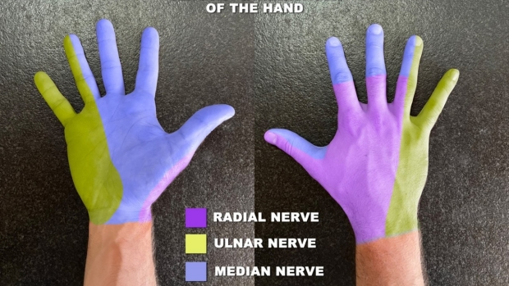

Slide 35


