Slide 1
Assessment 6
Cervical

Slide 2
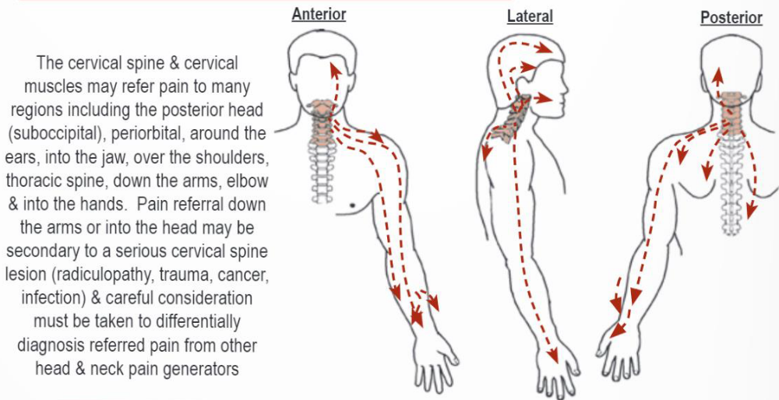

Slide 3
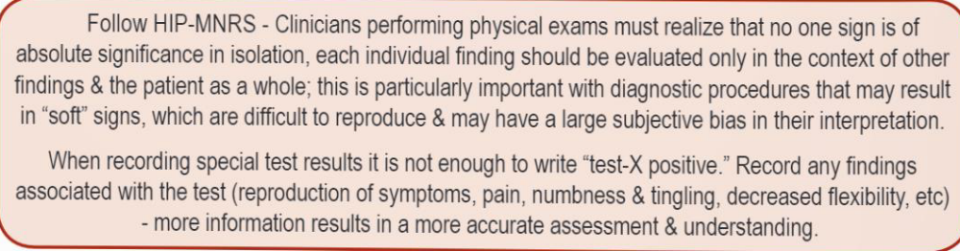

Slide 4
Cervical
Assessment
Flow
History
Inspection
Auscultation ( if indicated)
Palpation
Functional assessment
AROM
PROM
Myotomes
Cranial & EENT (if indicated)
Neurovascular
Orthopedic

Slide 5
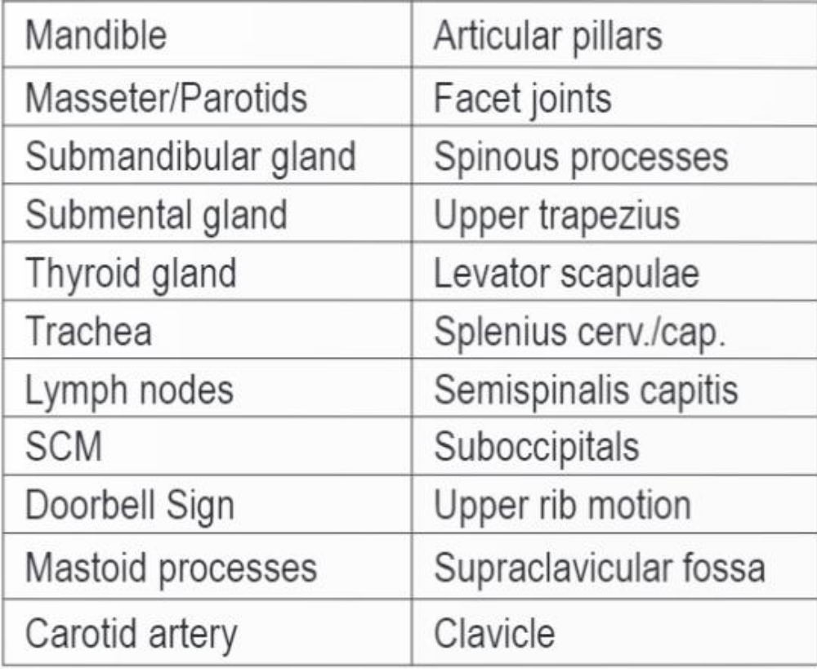
Cervical
Palpation

Slide 6
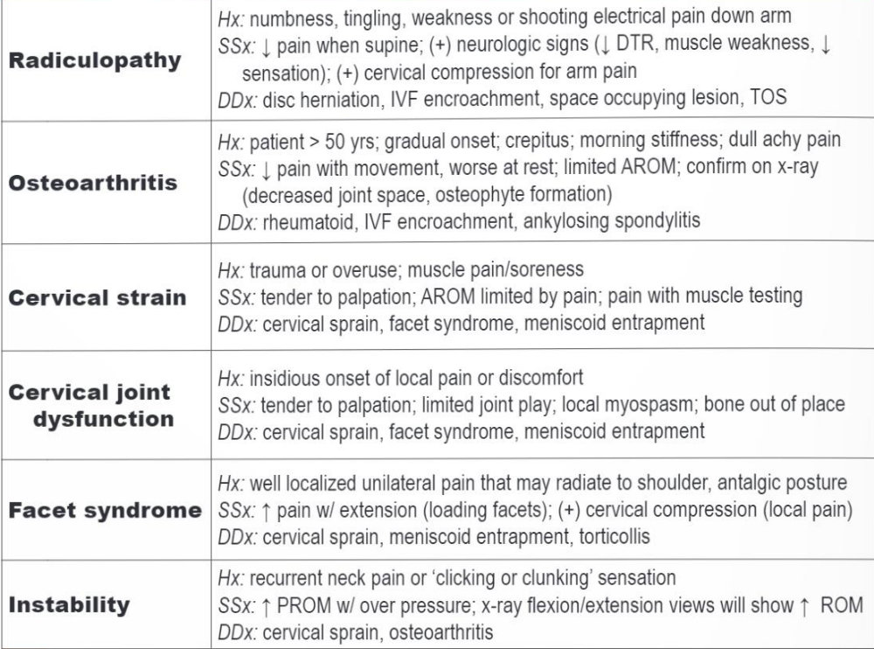
Neck Conditions
DDx

Slide 7
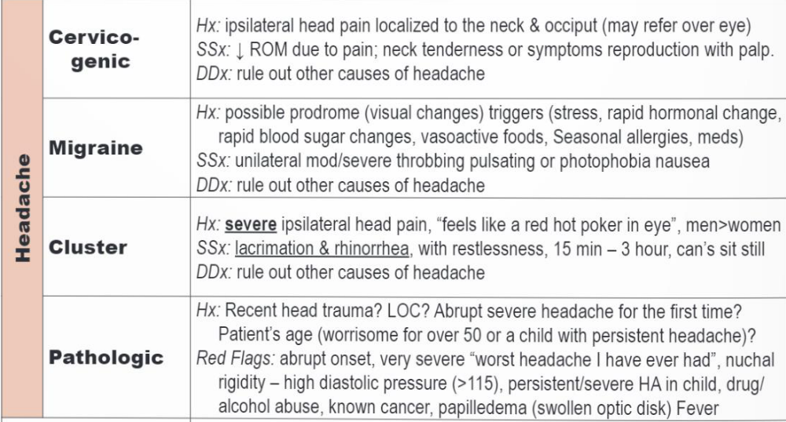
Headaches

Slide 8
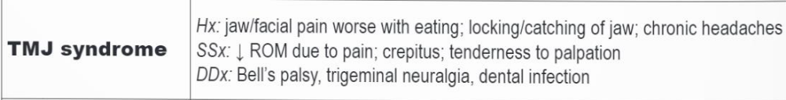
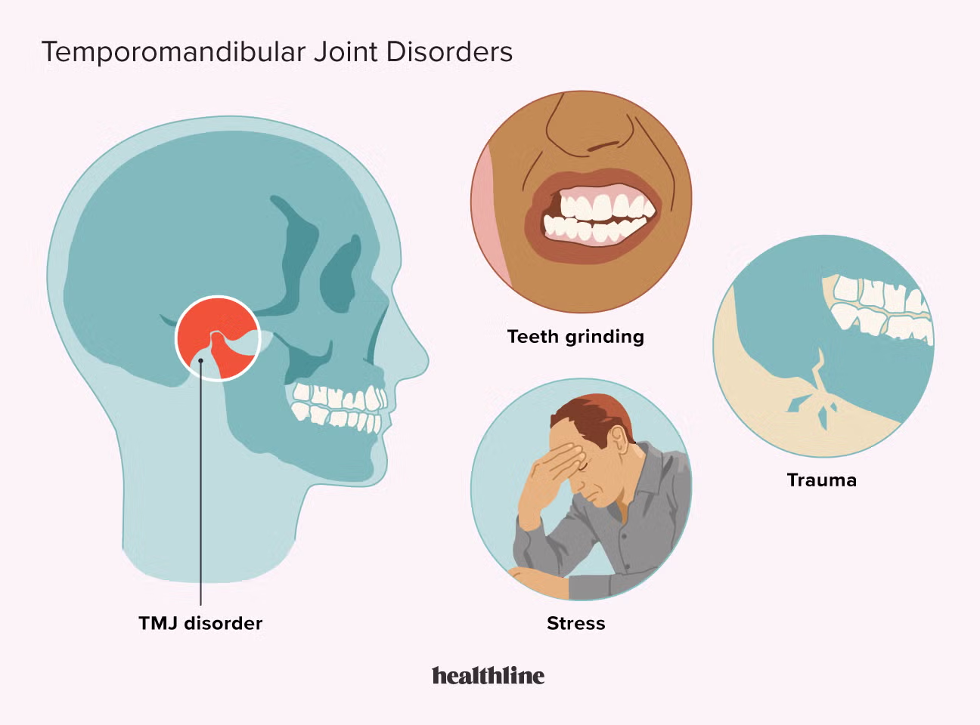
TMJ Syndrome

Slide 9
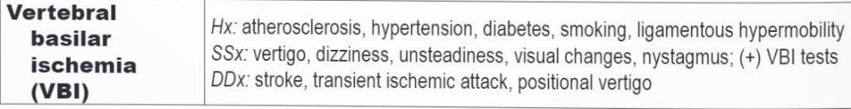
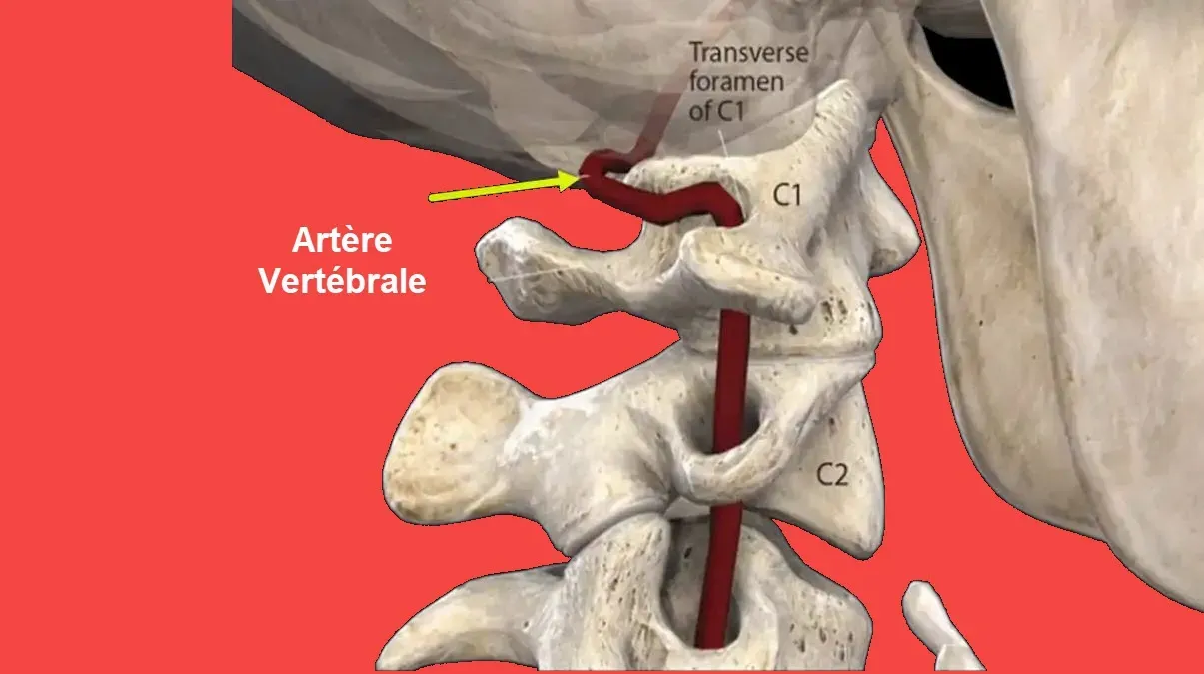
VBI

Slide 10
Cervical
Kinesiology
Joint type
Articular surfaces
AROM
Main muscles actions
Resting position
Close packed position
Capsular pattern of restriction
Normal end feel
Abnormal end feel
Coupled motion

Slide 11
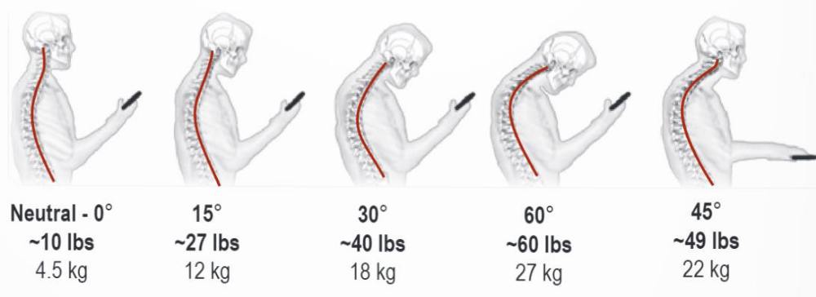
Computer
Spine

Slide 12
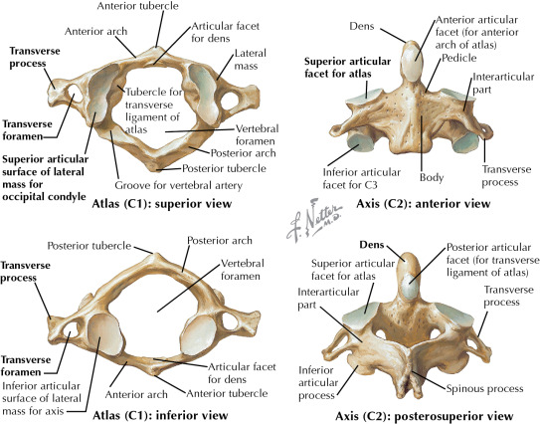
Cervical
Bones

Slide 13
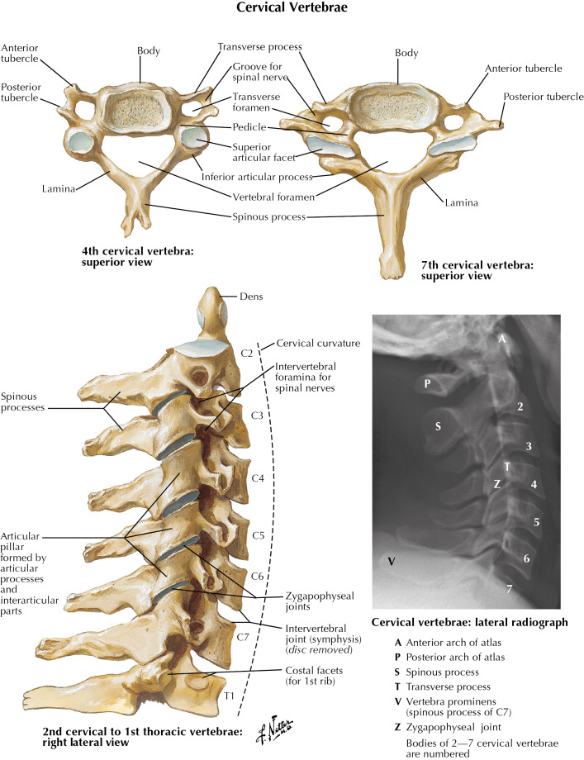
Cervical
Bones

Slide 14
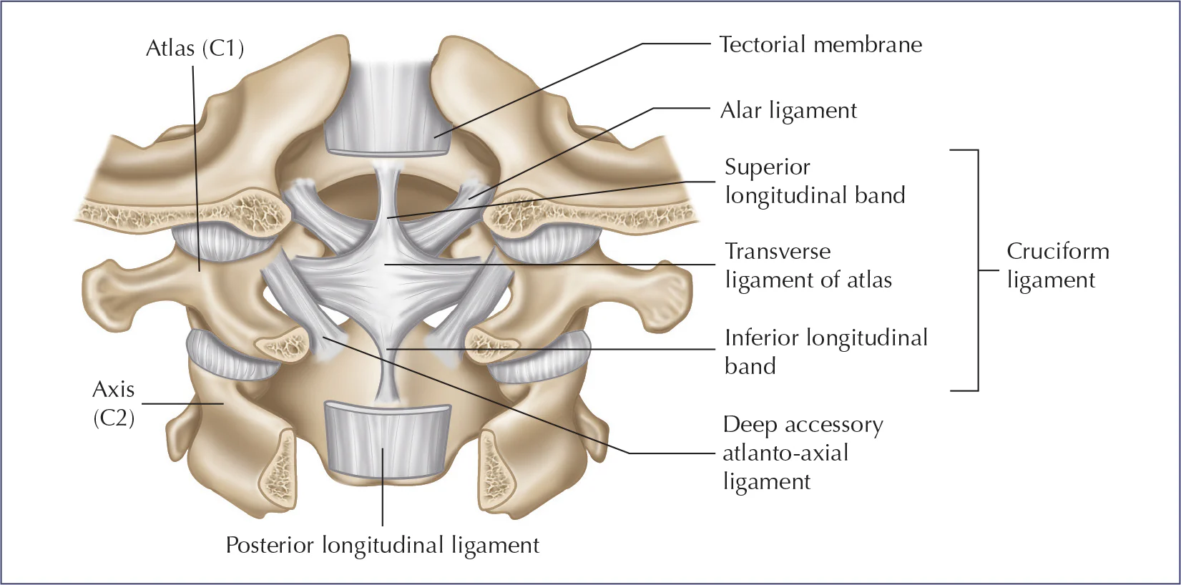
Cervical
Ligaments

Slide 15
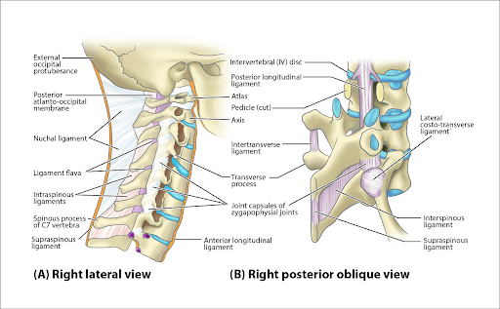
Cervical
Ligaments

Slide 16
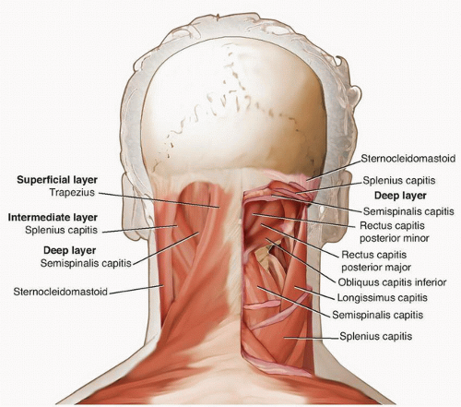
Cervical
Muscles

Slide 17
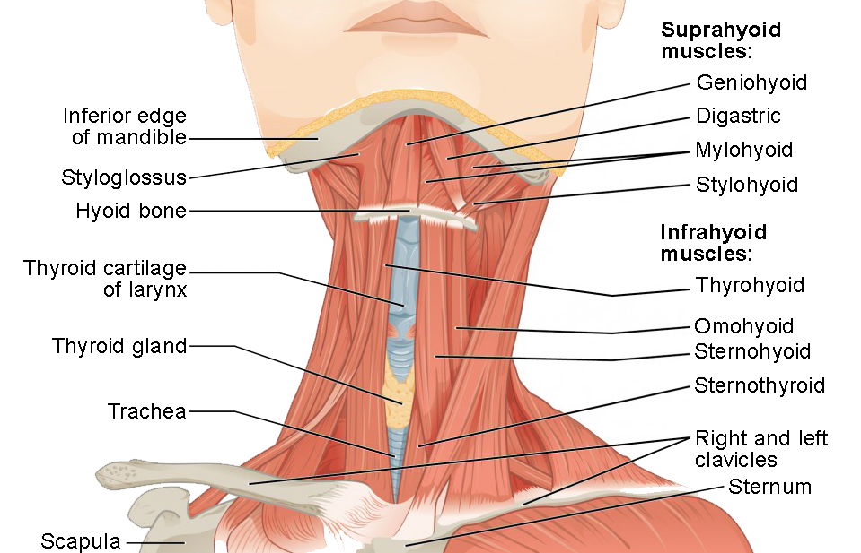
Cervical
Muscles

Slide 18
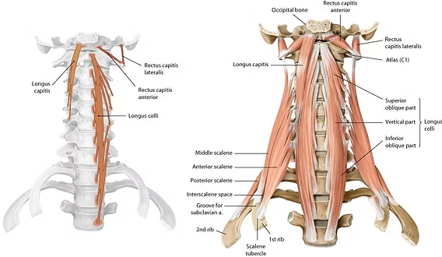
Cervical
Muscles

Slide 19
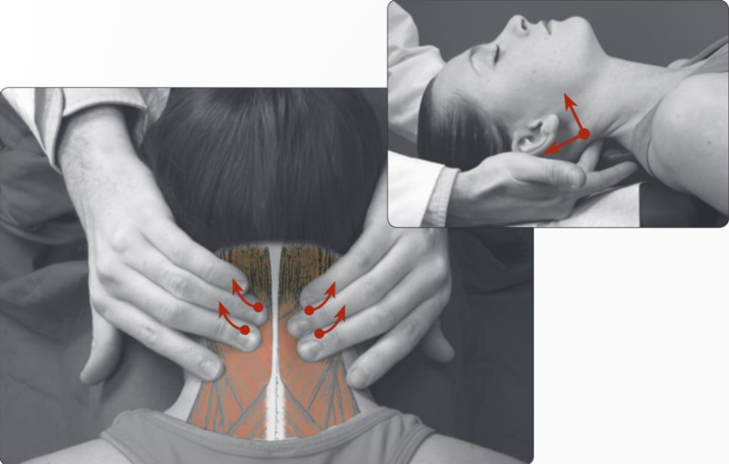
Palpation
(neck walk)

Slide 20
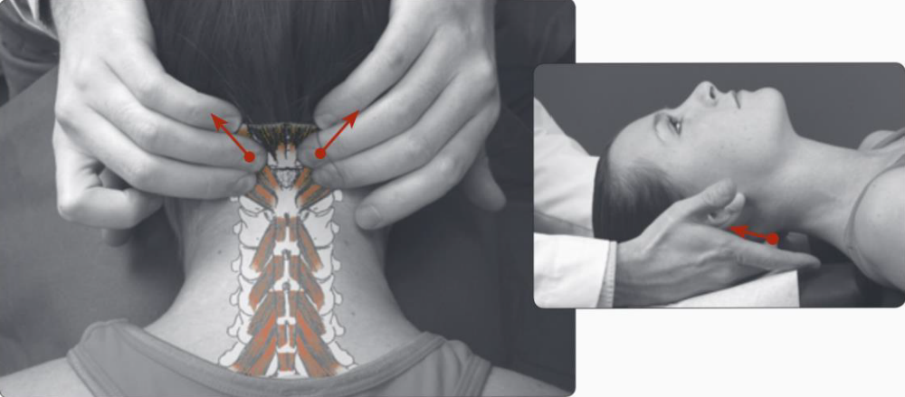
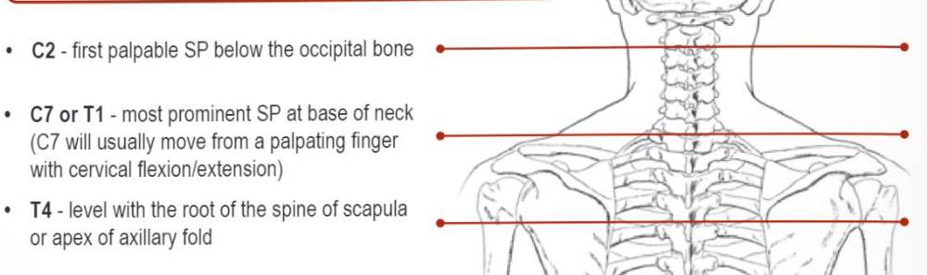
Palpation

Slide 21
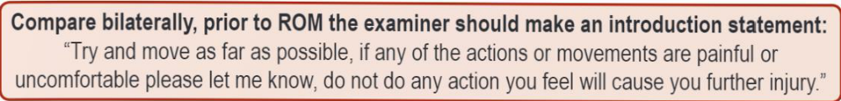
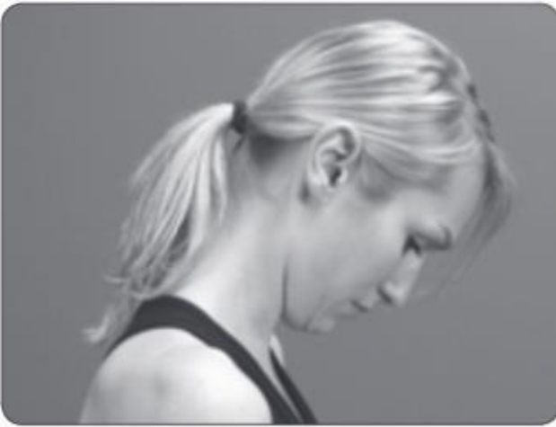
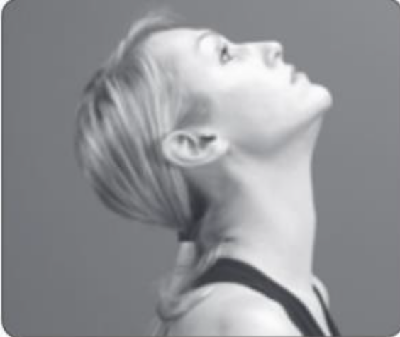
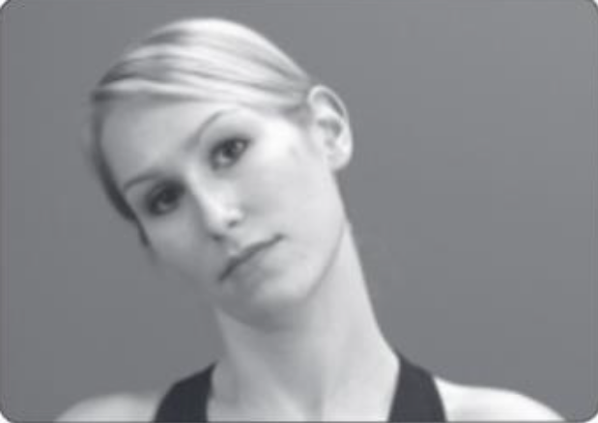
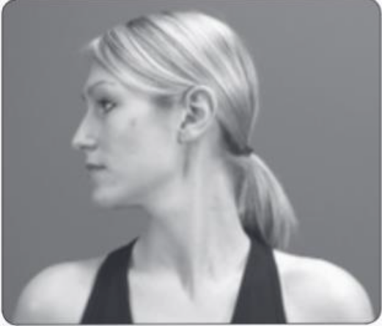
Cervical
AROM

Slide 22
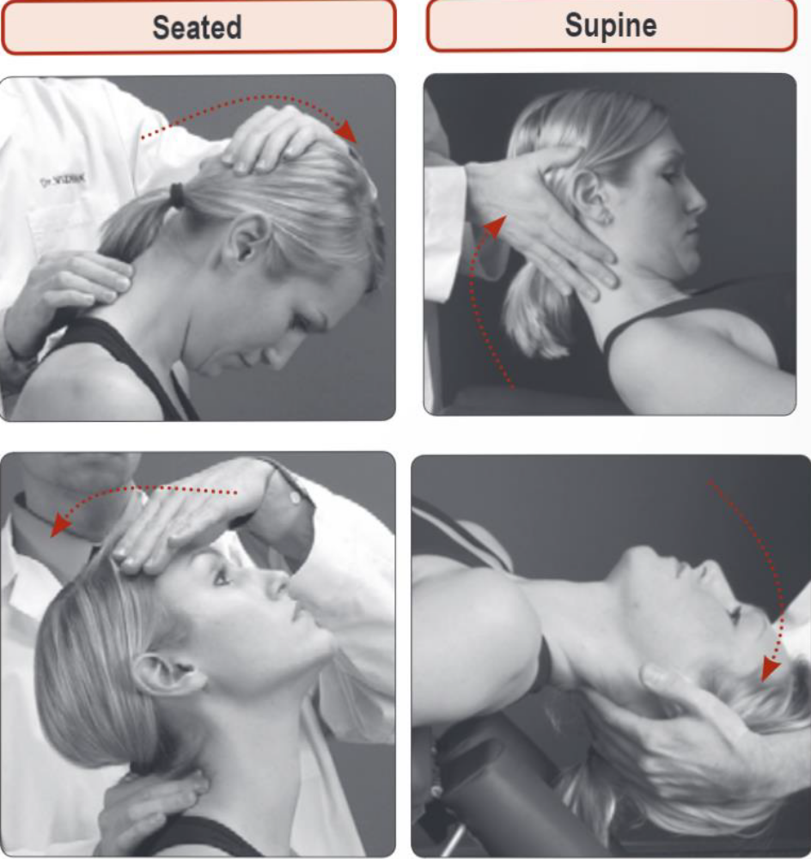
Cervical
PROM

Slide 23
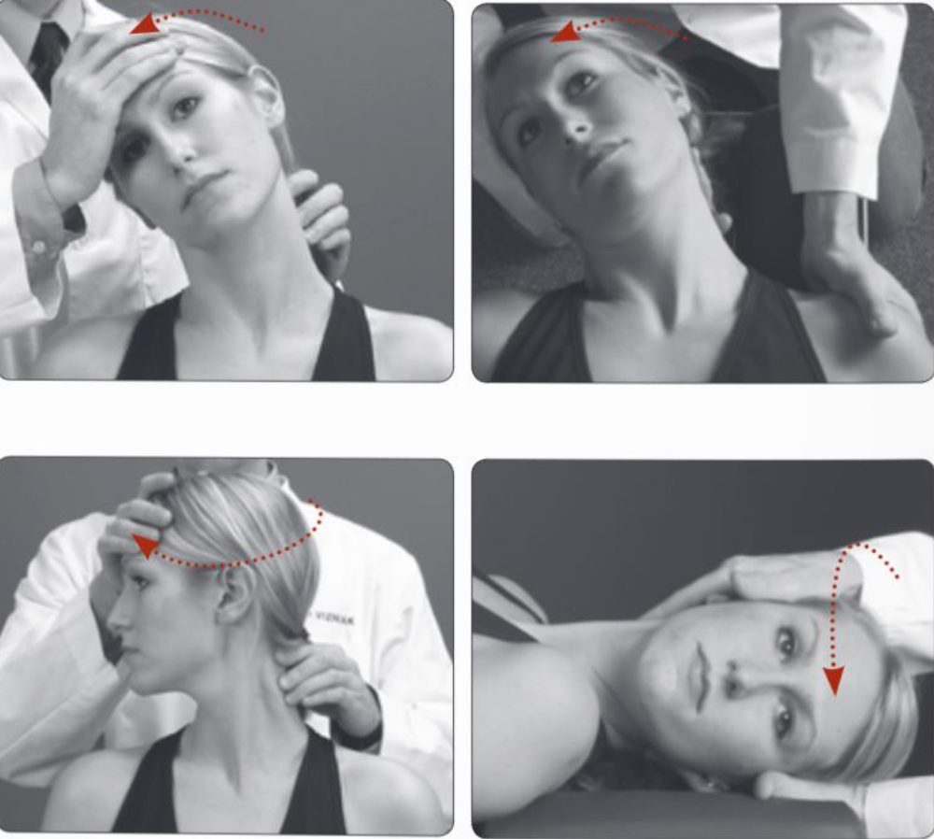
Cervical
PROM

Slide 24
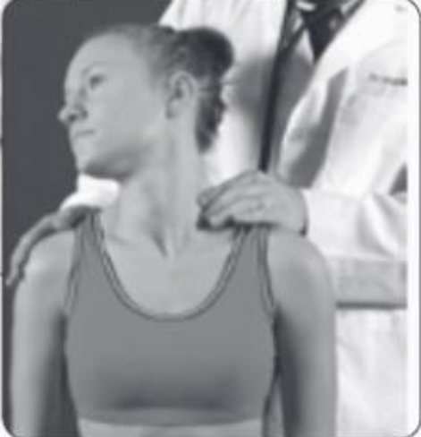
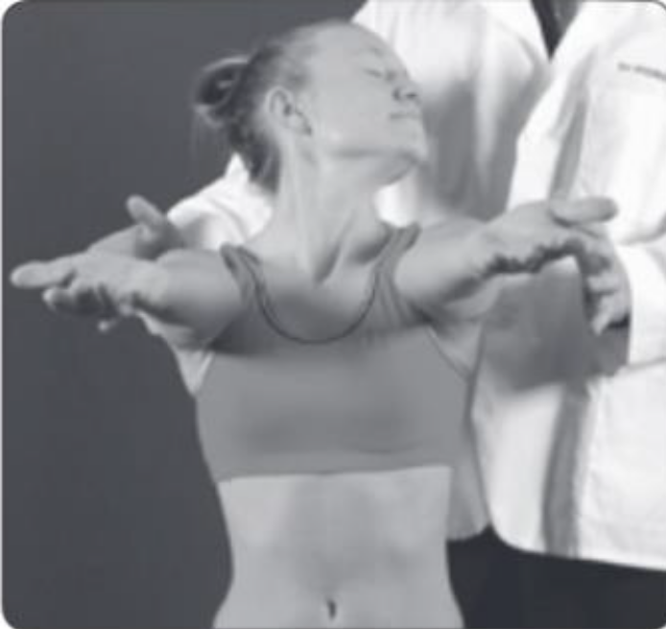
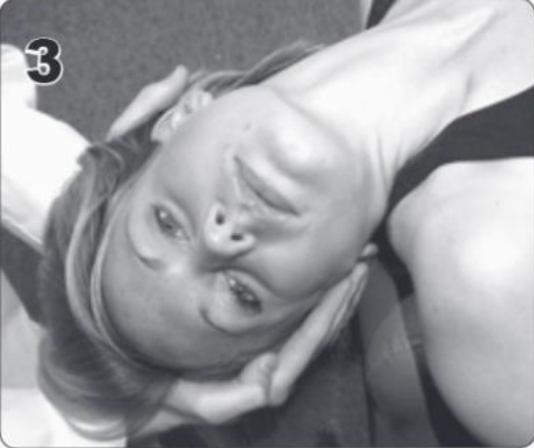


VBI Tests

Slide 25
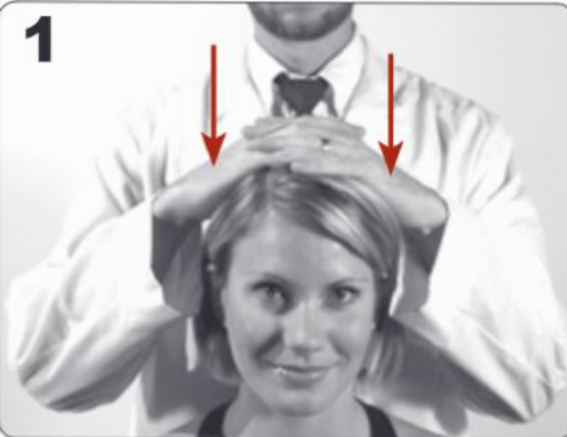
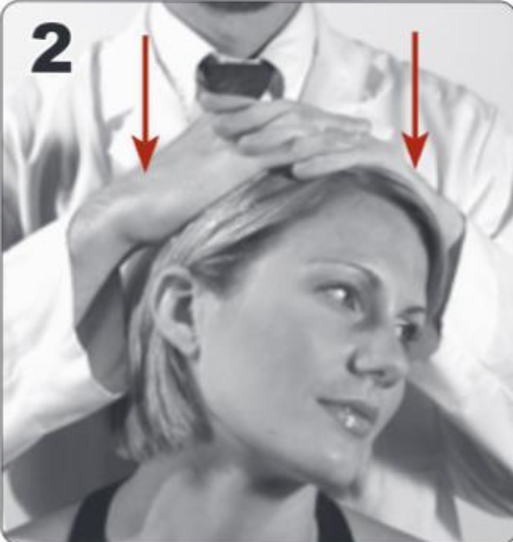

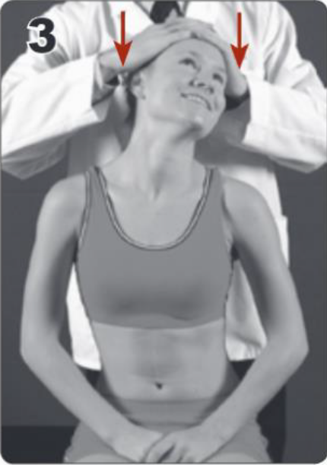
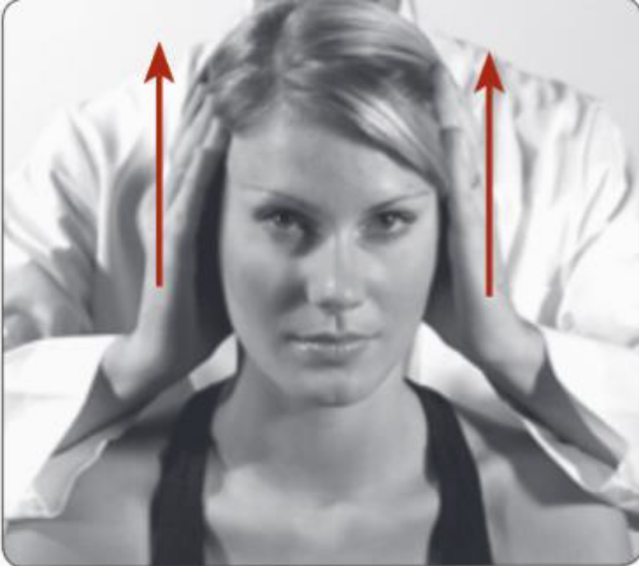

Cervical
Nerve Root
Tests
Jackson Test
Spurling Test

Slide 26
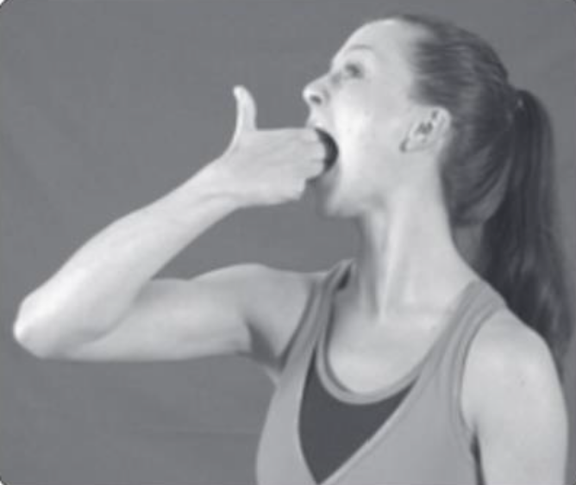

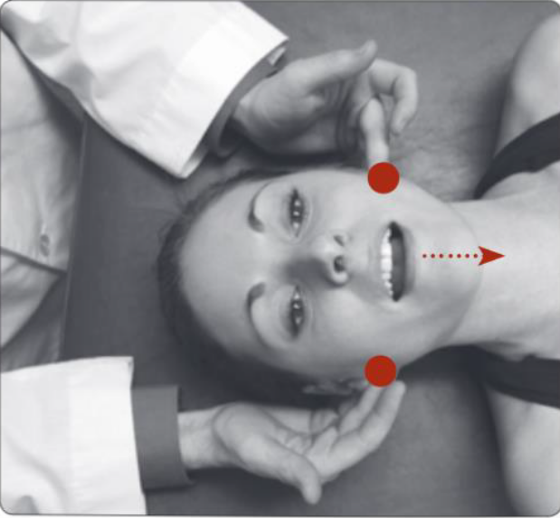
TMJ Tests
Observation, Palpation of TMJ

Slide 27
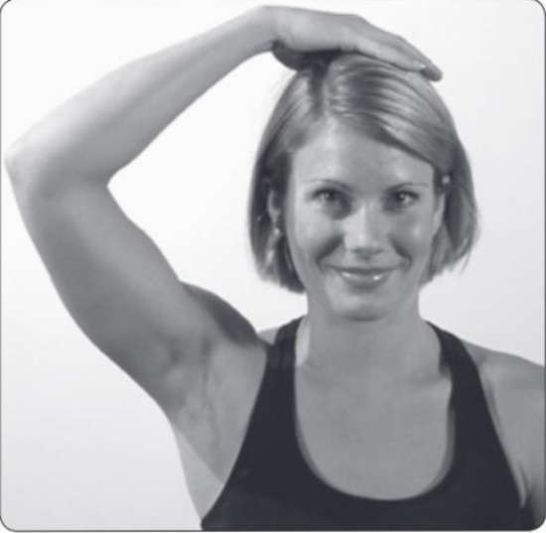
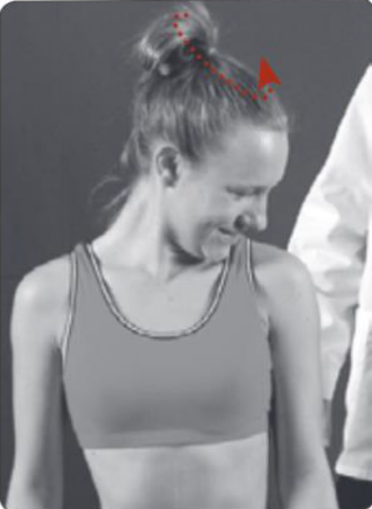
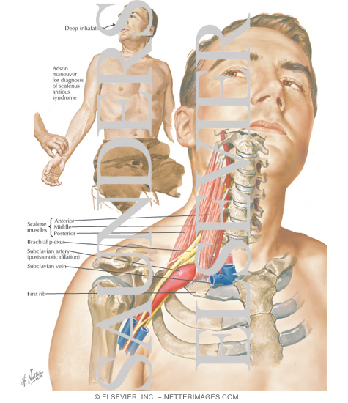

Scalene
Tests
Scalene relief
Scalene length Test

Slide 28
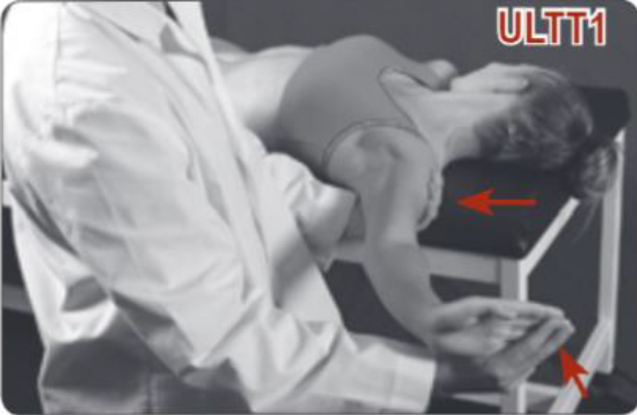
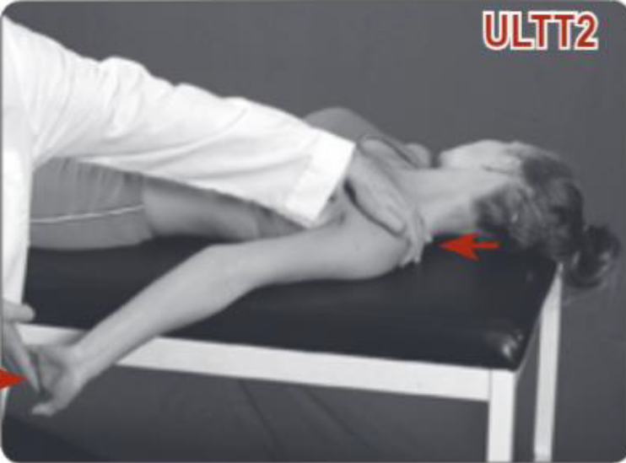
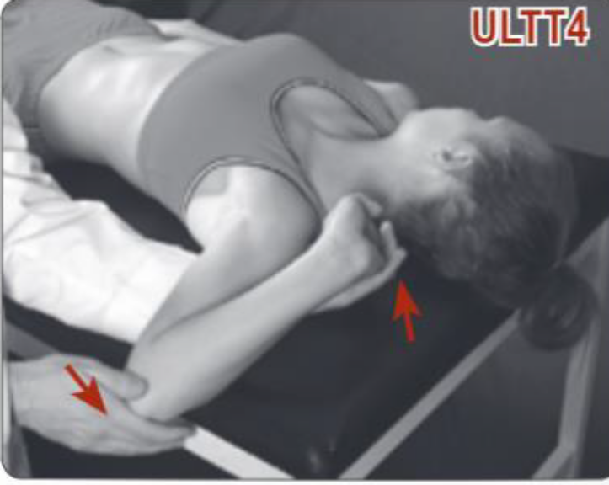
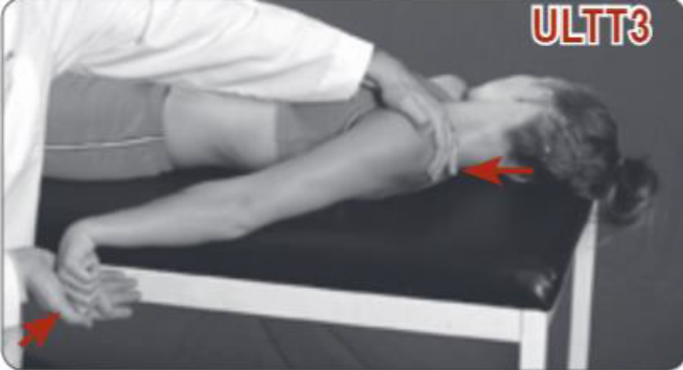
Upper Limb
Tension Tests
(ULTT)
Median Nerve
Median Nerve
Radial Nerve
Ulnar Nerve

Slide 29
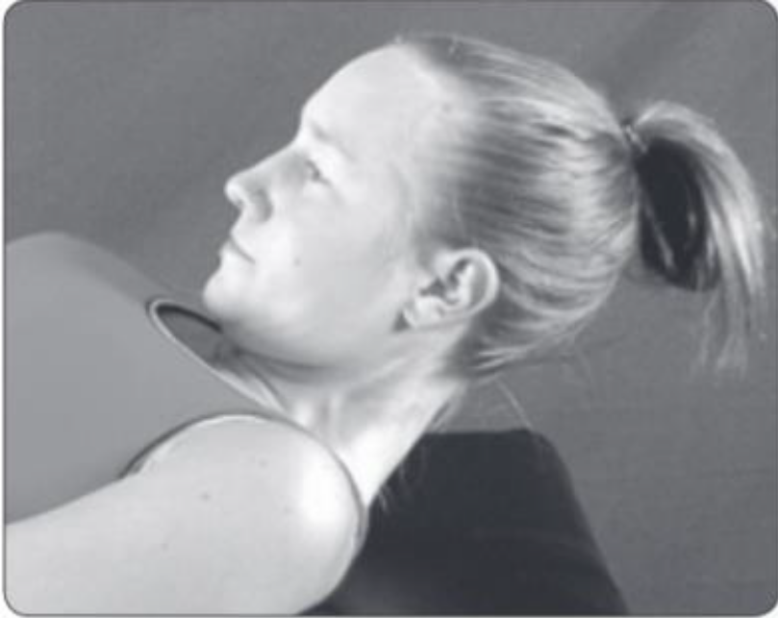
Deep
Flexors
Strength
Test

Slide 30
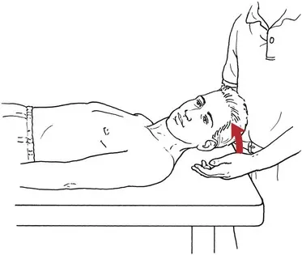
Anterolateral
Flexor
Strength

Slide 31
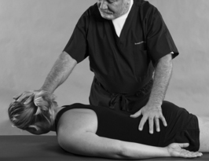
Posterolateral
Strength
Test

Slide 32
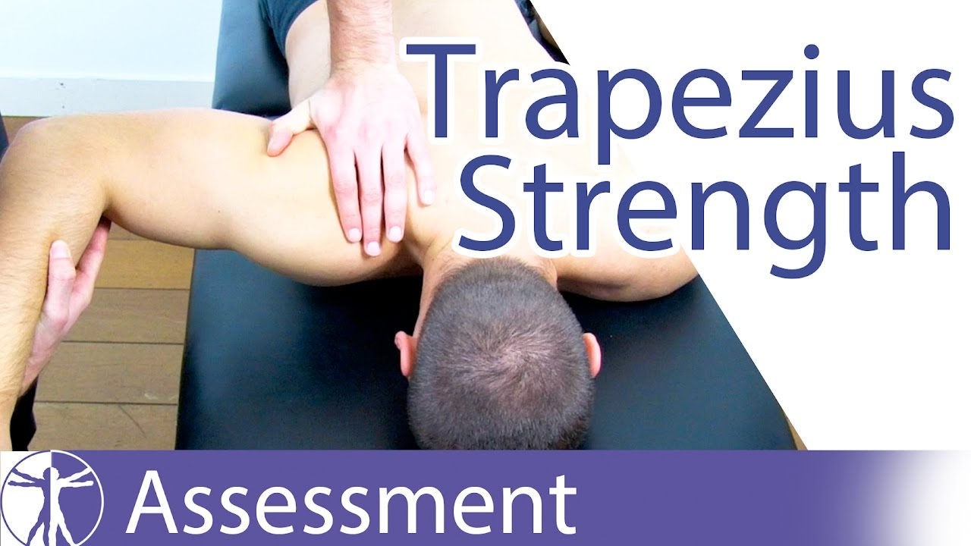
Upper Trapz
Strength
Test

Slide 33
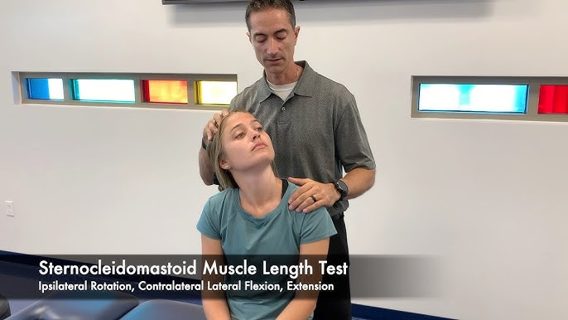
SCM
Length Test

