Slide 1
Radial Nerve
Dr Manju
RMT, BAMS

Slide 2
Anatomy Overview
Posterior cord of Brachial plexus (C5–T1)
Posterior Axillary wall between the long & medial heads of Triceps → Spiral groove of humerus → Deep to lateral head of triceps → Elbow
Divides into motor + sensory branches
The Radial artery travels on the nerves medial side.

Slide 3
Muscles Innervated
Triceps
Anconeus
Brachioradialis
ECRL
ECRB
Supinator
Extensor Digitorum
Extensor Carpi Ulnaris
Extensor digiti Minimi
Extensor pollicis longus
Extensor pollicis Brevis
Abductor pollicis longus
Extensor indicis

Slide 4
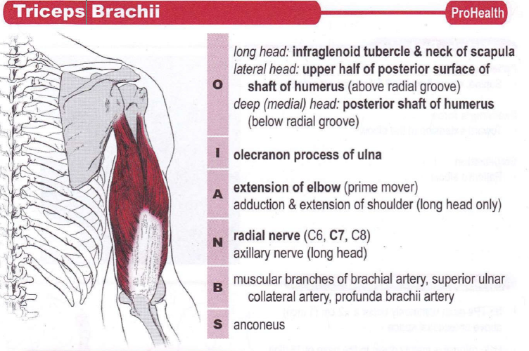

Slide 5
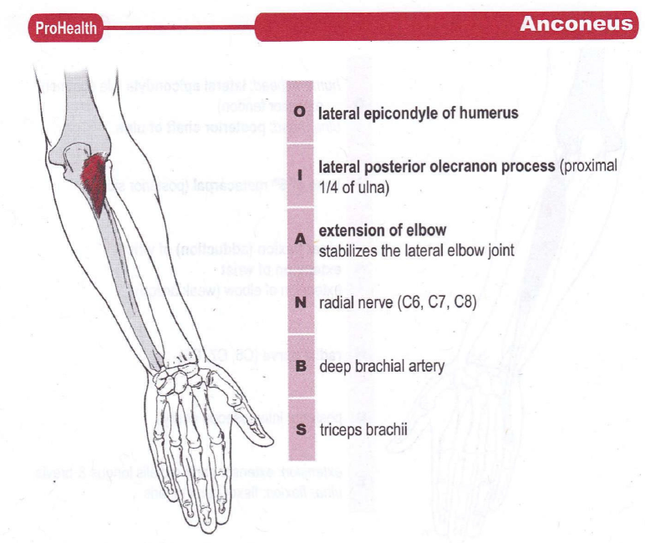

Slide 6
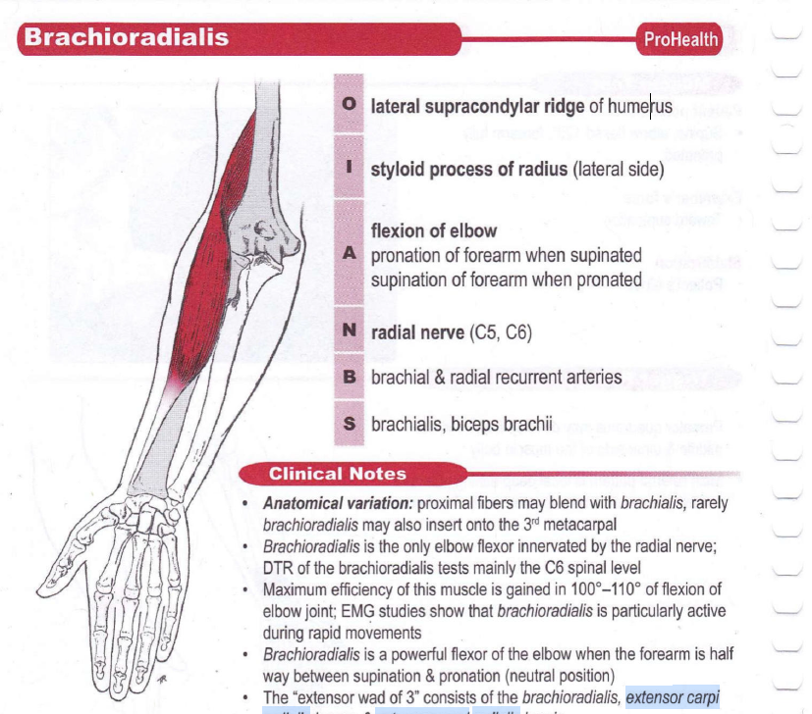

Slide 7
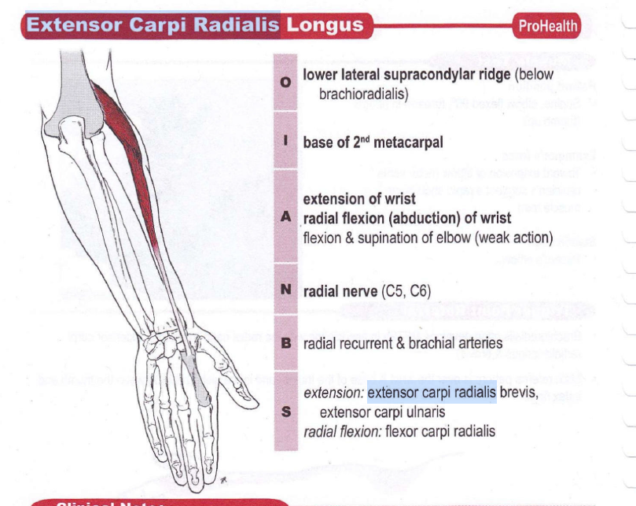

Slide 8
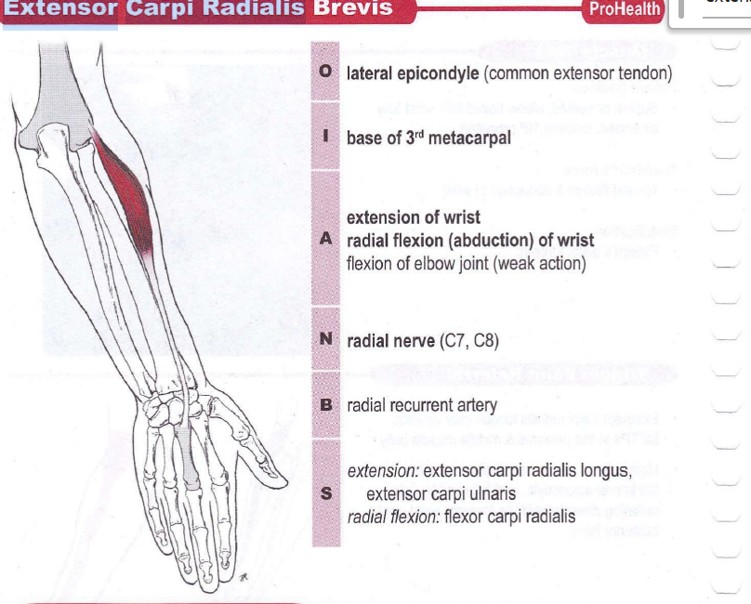

Slide 9
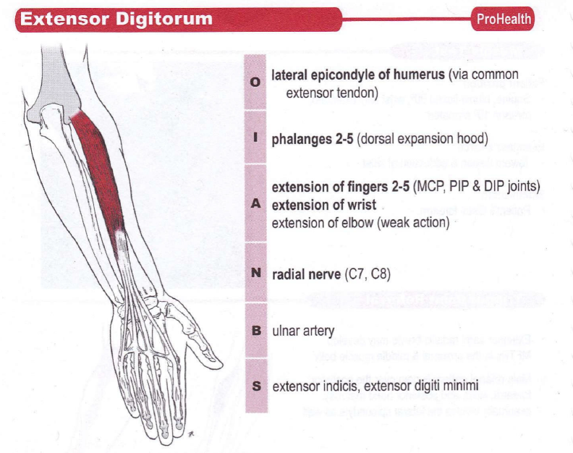

Slide 10
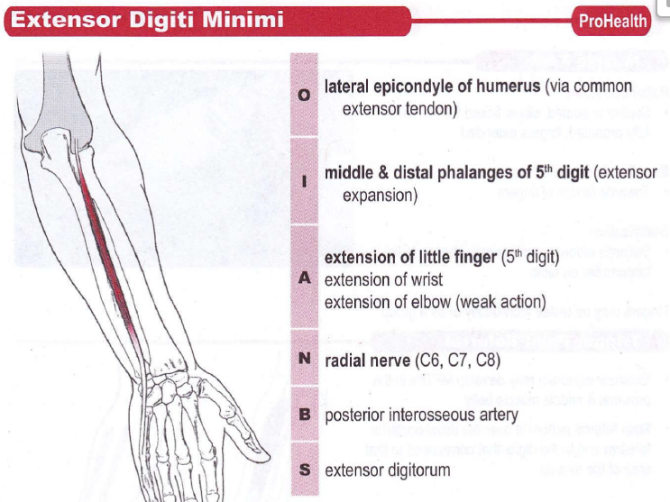

Slide 11
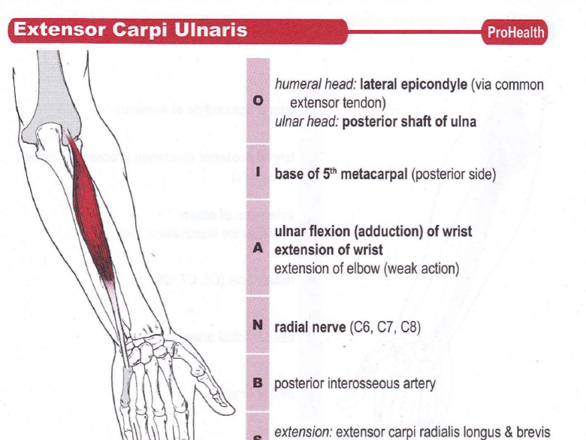

Slide 12
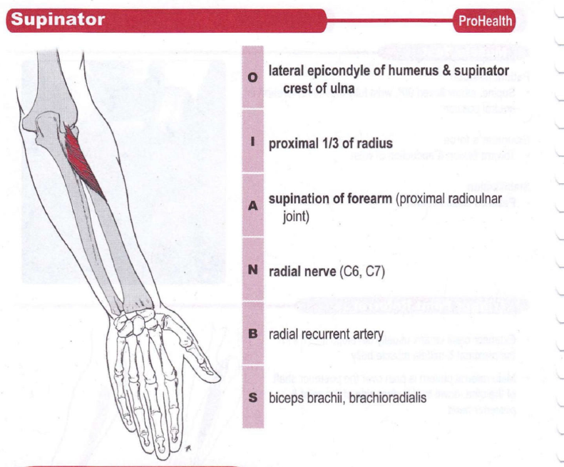

Slide 13
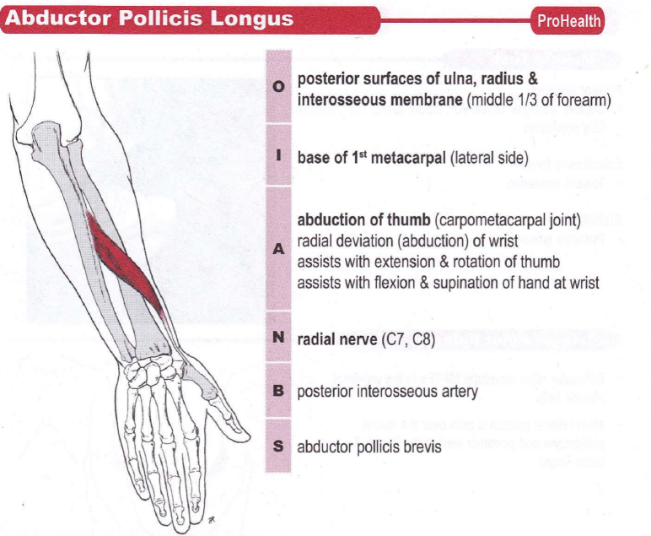

Slide 14
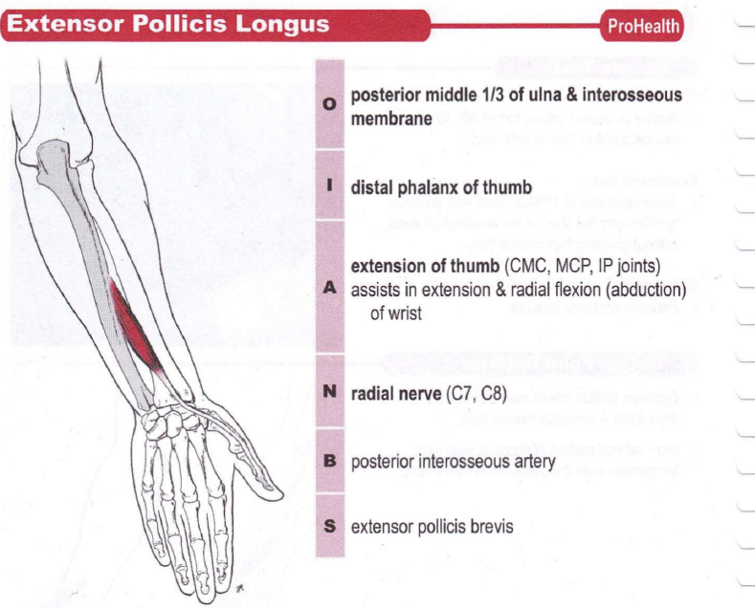

Slide 15
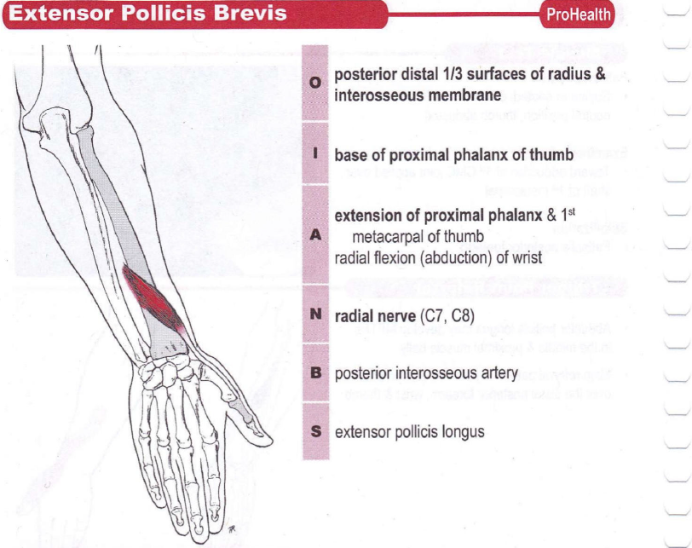

Slide 16
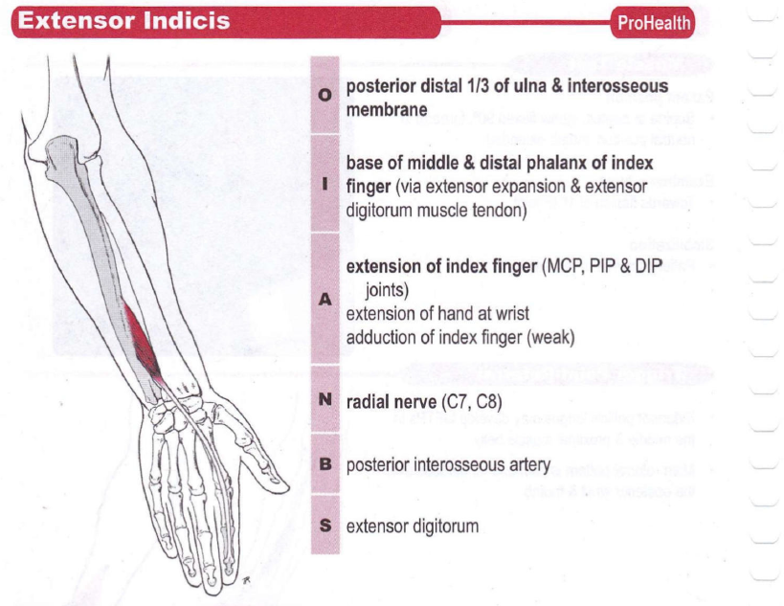

Slide 17
Causes
Fracture :Humerus (primarily at spiral radial groove) or at the supra condylar and upper 1/3rd of Radius.
Dislocation: Head of the Radius (Humeroradial or radioulnar joint)
Post Surgical Compression: Due to unrelieved pressure on the lateral armfrom the poor positioning during the surgery.
Compression:primarily at the axilla from crutch use or
Honeymoon Palsy / Saturday Night Palsy (Radial Nerve Compression)

Slide 18
Causes
Saturday Night Palsy:
Happens after:
  Falling asleep intoxicated (alcohol/drugs)
  Arm draped over chair/bench
Person doesn’t feel prolonged pressure → nerve gets compressed
Honeymoon Palsy:
Happens when:
  Partner sleeps on your arm for long time
Continuous pressure → radial nerve compression
Mechanism:
Prolonged external pressure
↓ Blood supply to nerve
→ Neuropraxia (temporary conduction block)
Supinator syndrome

Slide 19
Causes
Supinator syndrome:
Compression can occur in the Forearm.
Fibrosis (usually due to overuse)at the site where the nerve penetrates the supinator muscle leads to syndrome
Common Injury Sites:
Most common: mid-lower humerus
Also: proximal arm, forearm

Slide 20
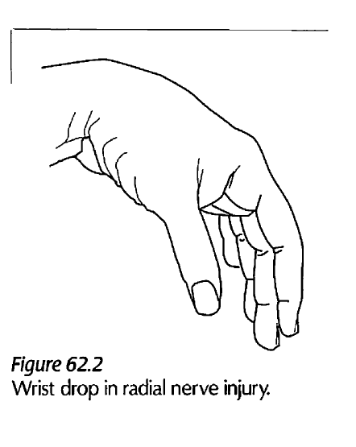
Symptom
Presentation of complete Radial Nerve lesion is also known as :Wrist Drop
Loss of wrist extension
Flexors act unopposed

Slide 21
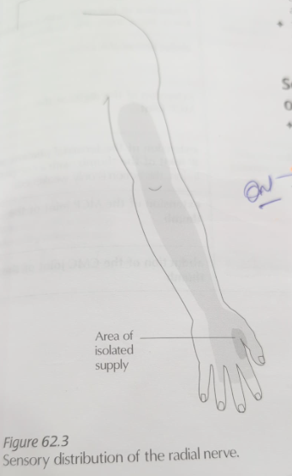
Sensory Loss
Posterior arm, forearm, hand
Digits: thumb, index, middle, ½ ring
Fingertips spared
Web space affected (Anesthesia occurs)

Slide 22
Motor Dysfunction
Loss of wrist & finger extension
Loss of thumb movement
Weak supination
Functional Impact:
Weak grip
Difficulty holding & releasing objects

Slide 23
Lesion Levels
Above elbow: motor + sensory
Below elbow: selective deficits (Either motor or sensory)

Slide 24
Assessment
Observe wrist drop
Test extension
Check sensation

Slide 25
ULTT3 / ULTT2B – Radial Nerve Bias (Upper Limb Tension Test)
Purpose
Detect radial nerve irritation / entrapment
Reproduce symptoms like:
  Pain
  Tingling
  Stretch discomfort along radial nerve pathway
Patient Position
Supine (lying down)
Shoulder near edge of table

Slide 26
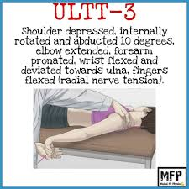
Test Sequence:
Scapular depression
Shoulder abduction (10–30°)
Elbow extension
Medial (internal) rotation of shoulder
Forearm pronation
Wrist flexion + ulnar deviation
Finger flexion

Slide 27
Add contralateral cervical side bending
↑ symptoms → neural involvement
Ipsilateral side bending → ↓ symptoms
Positive Test
Reproduction of:
  Pain/tingling along:
    Lateral arm
    Posterior forearm
    Dorsum of hand
Difference compared to opposite side

Slide 28



