Slide 1
Non- Swedish Technique
Dr Manju Setia Khowal
RMT, BAMS

Slide 2
What Are Non-Swedish Techniques?
Non-Swedish techniques include:
Advanced soft tissue techniques
Specific therapeutic methods
Deeper structural approaches
Neuromuscular & fascial techniques
Joint mobilization methods
These techniques are more specific and corrective compared to general Swedish massage.

Slide 3
What is Diaphragm?
The Diaphragm is a Dome shaped muscle that separates:
Chest cavity (Lungs & Heart) from Abdominal Cavity (Organs)
It is the main muscle of breathing/ primary muscle of Inspiration
Second most important muscle of the body next to Heart
The muscle has three large openings (hiatus) to allow the Oesophagus, Aorta & Inferior Vena Cava to pass through it.
Nerve to this muscle is Phrenic Nerve (C3,C4,C5)
A weak Diaphragm can contribute to Gastroesophageal Reflux Disease (GERD)

Slide 4
Diaphragmatic Breathing
Also called Belly Breathing. While Inhalation: Abdomen Rises and during Exhalation :Abdomen Falls. This means the Diaphragm is working properly.
To better understand , ask the client to specific visualisation such as “imagine a ballon in your stomach that you are inflating with your inhalation”
It is a key part of Every Massage Treatment, It is regularly recommended as self care
Normal breathing rate is 12-15 times per minute.
Effects: Increases Relaxation
Increases Lymphatic Flow
Increases efficiency of Gas Exchange
Facilitates Stretching Techniques
Decreases Pain & Stress

Slide 5
Diaphragmatic Breathing
Is a key part of Every Massage Treatment
Best way to achieve relaxation and to break the pain cycle
It is regularly recommended as self care
Normal breathing rate is 12-15 times per minute.

Slide 6
Manual Lymphatic Drainage
Purpose:
Enhance lymph flow
Reduce edema
Improve immune response
Decreases Pain Perception
Decrease SNS firing
Reduce formation of scar tissue formation done by removal of fibrin from the initial lymphatics.
Assist in post-surgical recovery
Lymphatic drainage in case of lymphedema leads to increase in urine output in which concentration of histamine, corticosteroids, and nor adrenaline

Slide 7
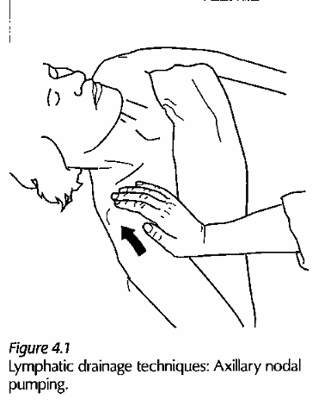
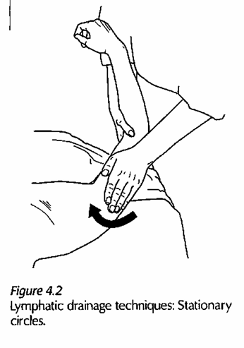
MLD
Axillary Nodal Pumping
Gentle rhythmic compression
Encourages lymph movement
Stationary Circles
Circular stretch of skin
No sliding
Local Thumb/Web Technique
Skin stretch using web between thumb & index
Used in small areas of swelling

Slide 8
Characteristics: Manual Lymphatic Drainage
Light Repetitive technique used to pump the lymphatic fluid through lymphatic capillaries.
During the technique therapist hands are soft and relaxed.
Fluid id Directed toward lymph nodes.
No lubricant is needed, talcum powder is used to facilitate drag.
Each manipulation must be repeated a minimum of 5-7 times in order to pump the Lymphatic fluid through the tissue.
The Strokes are unidirectional.
Pressure always applied Centripetally, starting at proximal nodes and working distally towards the edematous site.
Even a single limb treatment takes up to 20 min.
A pressure of 20-40mm of Hg is used to avoid collapsing the superficial lymphatic capillaries.

Slide 9
Characteristics: Manual Lymphatic Drainage
Pressure of more than 60 mm of Hg will compress & temporarily collapse the vessels.
An average 30 mm of Hg has been found to have greatest effect on moving the lymph.
Effects Of MLD:
Reduces Edema
Reduces Pain
Removal of Excess Fibrin & Metabolic products

Slide 10
Characteristics: Manual Lymphatic Drainage
In treating Acute, sub acute or chronic edema, nodal pumping or compression is applied to the lymphatic nodes of the most proximal part of the limb that has the edematous tissue.
These nodes are closest to the thoracic & right lymphatic ducts, which return lymph to the venous system.
In the arm it is axillary lymph nodes ,and in the leg it is inguinal lymph nodes.
To massage the nodes, palmar surface of the hand is used and pressure is applied In a wave like motion.
Stationary Circle: used to treat larger areas of the limb between the edema and the proximal nodes.
IMAGE

Slide 11
Contraindication : MLD
Chronic Heart Failure
Acute condition Due to bacterial or viral infection
Recent thrombosis
Low protein Edema due to kidney pathologies
Malignancy
Lymphatic obstruction by parasites.

Slide 12
Static Pressure Techniques
Golgi Tendon Organ (GTO) release
The Origin & Insertion Technique
Muscle Approximation
Myofascial trigger Point technique
Cross fibre frictions

Slide 13
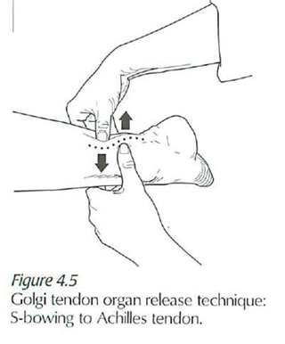
Golgi Tendon Organ (GTO) release
Proprioceptive Nerve Receptors or minute sensory organs
Located at musculotendon junction
These receptors detect the load placed on the tendon.
GTO is a part of muscle tension monitoring system
Alpha motor Neuron firing maintains the muscle contraction.
The GTO is able to slow/ Decrease this alpha motor neuron firing, causing relaxation of muscle
The inhibitory effect on muscle contraction is referred to as the lengthening reaction.

Slide 14
Golgi Tendon Organ (GTO) release
GTO is part of protective reflex to prevent muscle injury or rupture through relaxation of the muscles, this reflex is activated when an excessive load or stretch is placed on a tendon.
GTO can be used to reduce Muscle spasm & tone especially when on site massage is not possible.
GTO technique is effective on Long, Superficial and Easily palpable Tendon. Example: Achilles Tendon, hamstring tendon at the ischial tuberosity, suboccipital tendon
It can not be performed on small tendon
How to perform?
The therapist uses reinforced thumbs or fingers, holding for a minimum of 30 sec or until the muscle relaxes.
The tendon may also be bowed in to an “s” or “c” shape.
Rate is slow and pressure is moderate to deep(around two pounds)

Slide 15
Golgi Tendon Organ (GTO) release
Effects:
Releases Muscle Spasm
Reduces Muscle Tone
Contraindication:
Locally painful condition
Local acute condition affecting tendons to be treated
Hypotonic or atonic muscles
Tissue fragility
Pathologies of connective tissue
Skin lesions including healing incisions.

Slide 16
Origin & Insertion Technique
Introduction: It is a variation Of GTO
Origin and Insertion technique is a specific therapeutic muscle technique, used when the tendon to be treated is short.
It focuses on treating muscles at their attachment points.
Just like GTO it also inhibits the Alpha motor neuron firing
It is especially useful :
To reduce muscle spasm When direct work on muscle is not comfortable.
To Reduce tone When direct work on muscle is not comfortable.
Sports rehabilitation

Slide 17
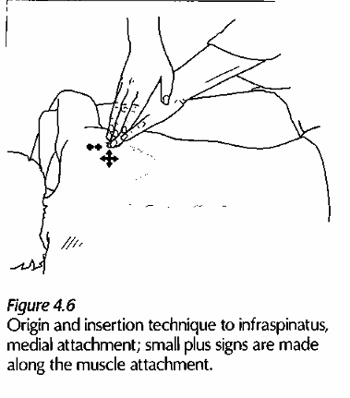
Origin & Insertion Technique
The Therapist thoroughly treats the Origin (attachment) of the muscle using either reinforced finger or thumb kneading and make a plus (+)sign on same location.
The therapist can repeat the technique on the entire origin and also the insertion of the muscle is treated in the same manner.
The rate is slow and the pressure is moderate to deep.
Effects: Reduces Muscle tone and Spasm

Slide 18
Origin and Insertion
Contraindication:
Locally painful condition
Local acute condition affecting tendons to be treated
Hypotonic or atonic muscles
Tissue fragility
Pathologies of connective tissue
Skin lesions including healing incisions.

Slide 19
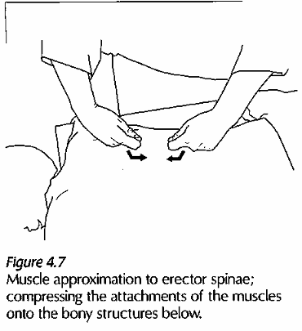
Muscle Approximation
Muscle spindles are proprioceptive nerve receptors or Minute Sensory organs located in the muscle belly.
These Nerve receptors monitor muscle length & help control muscle movement by detecting the amount of stretch placed on a muscle.
Muscle spindles protect the muscle from being overstretched.
This technique reduces the gamma firing.

Slide 20
Muscle Approximation
The muscle attachments are gently moved closer together.
The tissue is compressed toward its center
The position is held briefly before release
It is used primarily to reduce pain and muscle guarding.
What is Muscle Guarding?
When a structure is irritated (for example, spinal joints or soft tissue), the surrounding muscles tighten to:
Protect the area, Limit movement, Prevent further injury
This tightening is not voluntary — the client cannot simply “relax it.”
Example:In low back pain, the erector spinae muscles tighten to protect the spine.

Slide 21
Muscle Approximation
The Rate is slow. The therapist takes care not to slide over the surface of skin.
Approximation is held until the muscle relaxes.
The technique is primarily used on short muscles such as sections of Erector spinae group.
Effects: reduces muscle tone & Muscle Spasm
Contraindication:
Locally painful Conditions
Local Acute conditions
Hypotonic or Atonic muscle
Pathologies of connective tissue
Skin lesion including healing incisions

Slide 22
Myofascial trigger Points
A trigger point is:
A hyperirritable spot
Located within a taut band of skeletal muscle
Painful on compression
May produce referred pain
Characteristics of Trigger Points
Trigger points are characterized by:
Palpable taut band, Local tenderness
Referred pain pattern
Possible local twitch response
They are usually found in chronically overloaded muscles.

Slide 23
Myofascial trigger Points
Types of Trigger Points:
Active Trigger Point
  Produces spontaneous pain
  Causes referred pain
Latent Trigger Point
  Painful only when pressed
  Does not cause spontaneous pain
Primary Trigger Point
  Directly activated by Acute or Chronic Mechanical Strain
  Or Overload of Affected Muscle
Secondary Trigger Point
  Activated in the overworked synergist or Antagonist muscles
Satellite Trigger Point
  Found in the muscles that lies within the referral pattern of another trigger point

Slide 24
Myofascial trigger Points
Common Causes:
Muscle overuse,
Poor posture
Repetitive strain,
Trauma
Emotional stress,
Sustained contraction
Impaired Sleep
Nutritional Inadequacies like vit B, C or folic acid deficiency
Metabolic Imbalance like Hypothyroidism, Hypo-glycaemia, Gout

Slide 25
Myofascial trigger Points
Signs & Symptoms
Deep aching pain
Referred pain pattern
Muscle stiffness
Restricted range of motion
Weakness without atrophy
Palpation Method
Identify the muscle
Palpate perpendicular to fibers
Feel for taut band
Locate tender nodule

Slide 26
Myofascial trigger Points
Trigger points are treated by variety of techniques:
Skin Rolling
Repetitive muscle stripping
Ischemic compression
Intermittent Cold Distraction And Stretch
Percussion & Stretch
Post Isometric Relaxation

Slide 27
Myofascial trigger Points
Ischemic compression:
Static Compression applied by therapist’s Thumbs, fingertips or olecranon to the trigger point.
The pressure used is sufficient to cause local ischemia (Decreased or restricted blood supply to a tissue) in the tissue that is compressed, with in clients pain tolerance
The length of time compression held varies from 7 seconds to 1 min.
The reactive Hyperemia (Increased blood flow to a specific area of the body)that follows the release of pressure may help to flush metabolites from the tissue.
After ischemic compression , stretch the muscle, followed by Heat Hydrotherapy

Slide 28
Myofascial trigger Points
Intermittent cold Distraction and Stretch:
Brief application of cold to the skin over the muscle containing the trigger point.
Followed by careful stretch of affected muscle to just before the onset of pain.
Percussion & Stretch:
is a slow tapping of the trigger point using a reflex hammer (8-10 times)
Followed by a pain free Stretch

Slide 29
Cross Fibre Friction
Effect: This technique is used in the Sub Acute and Chronic stages of healing to breakdown Adhesions in the muscles, tendons & ligaments.
The therapist ‘s fingers or thumb do not slide over the skin, instead the superficial tissues are moved over the deeper ones.
This technique can be applied perpendicular/transverse
A specific consent to treat is required prior using this technique, because initially it can be painful and deep.
Communication about pain levels continues throughout the technique.
CFF technique results as a temporary local Analgesic effect
After CFF technique stretch should be given followed by cold hydrotherapy.

Slide 30
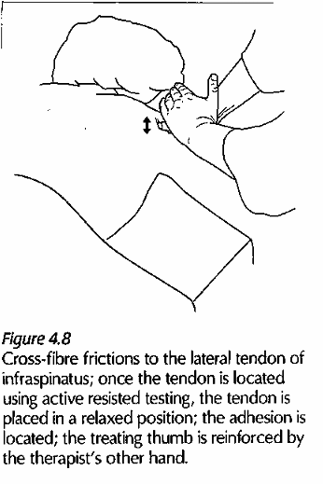
Cross Fibre Friction
Contraindication:
Peripheral Nerves with Acute injury
Rheumatoid Arthritis
Infective Arthritis
Structures that are too deep to be reached
Client’s use of Anti-inflammatories
Client’s use high dose long term steroid medication
Peripheral vascular disease
Fragility of the skin
Client discomfort with the treatment

Slide 31
Fascial or Connective tissue Techniques
What is Fascia?
Fascia is a thin but incredibly strong layer of connective tissue that wraps around and supports everything inside your body — muscles, bones, organs, nerves, and blood vessels.
Why Fascia Is Important
Supports posture
Helps muscles work together
Transmits force throughout the body
Contains many sensory nerve endings (important for pain and body awareness)
Can tighten or become restricted after injury, stress, or lack of movement

Slide 32
Fascial or Connective tissue Techniques
Types of Fascia :There are three main types:
1. Superficial Fascia: Quite mobile, accumulation of tissue fluids
Located just under the skin
Contains fat, nerves, and blood vessels
Helps cushion and insulate the body
2. Deep Fascia
Surrounds muscles, bones, and joints
Helps transmit force and coordinate movement
Important in athletic performance
3. Subserous /Visceral Fascia
Surrounds internal organs (heart, lungs, stomach, etc.)
Helps hold organs in place while allowing them to move

Slide 33
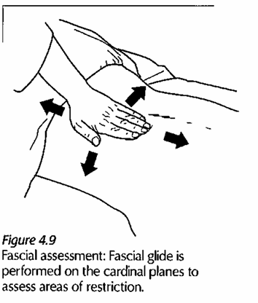
Fascial or Connective tissue Techniques
Fascia Assessment methods:
Skin rolling
Fascial glide
Positional testing
Skin rolling: Superficial restriction sometimes trigger points can be assessed & treated with Skin rolling.
Fascial glide: The therapist hand contact the skin and move or glide it over the deeper structures.
The skin is moved on the cardinal planes, anteriorly, posteriorly, superiorly, inferiorly, laterally or medially.
The pressure & direction of the glide depending on the fascia to be assessed.
Lighter pressure is used to assess more superficial fascia

Slide 34
Fascial or Connective tissue Techniques
Fascial Assessment: Positional testing
The limb or body part is passively moved through its range until a barrier to motion is encountered.
A fascial barrier occurs before a ligamentous or joint capsule barrier.
Two main categories :Direct & Indirect Techniques
To release fascia: Little or no lubricant is used

Slide 35
Fascial or Connective tissue Techniques
Direct Fascial Techniques:
Skin Rolling
Crossed hand Fascial Stretch
Fascial Spreading
Cutting technique
Fascial Torquing
S-Bowing
C- Bowing
J-stroke

Slide 36
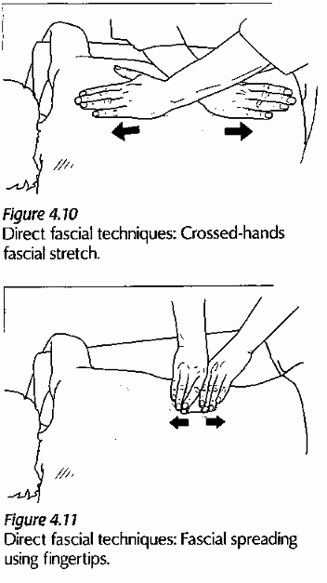
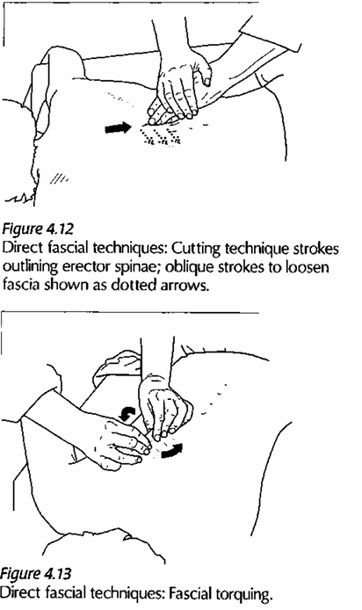
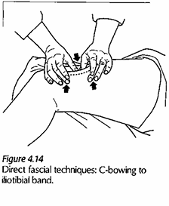
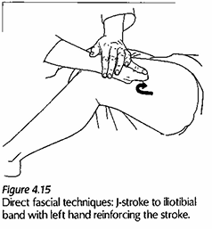

Slide 37
Fascial or Connective tissue Techniques
Fascia and Pain
When fascia becomes tight, it may contribute to:
Muscle stiffness
Reduced mobility
Chronic pain
Trigger points
Effects Fascial Techniques:
Reduce pain
Reduce Hypertonicity
Increased Local Circulation
Decreased SNS

Slide 38
Fascial or Connective tissue Techniques
Contraindication:
Acute injury
Hypotonic
Atonic
Fragile skin
Skin lesions
Recent incisions
Painful conditions
Anticoagulant Medication use

Slide 39
Fascial or Connective tissue Techniques
Contraindication:
Acute injury
Hypotonic
Atonic
Fragile skin
Skin lesions
Recent incisions
Painful conditions
Anticoagulant Medication use

Slide 40
Indirect Fascial Techniques
Indirect fascial technique is a gentle manual therapy approach where the practitioner moves tissue toward ease and comfort, rather than into restriction.
Effects:
It increases the Excursion (Range of movement)
It increases the flexibility of fascia
Indirect Fascia vs Direct Fascia Technique
Direct Technique | Indirect Technique
Moves into restriction | Moves away from restriction
Often uses stretch or pressure | Uses gentle positioning
Can be more intense | Usually very gentle
Good for chronic tightness | Good for acute or sensitive tissue

Slide 41
Indirect Fascia Technique
Contraindication:
Acute inflammation
Undiagnosed Lumps
Recent Head Trauma
Neurosurgery

Slide 42
Joint Mobilization Technique
Joint mobilization is a passive manual technique performed by the therapist to:
Restore joint play
Reduce pain
Improve range of motion (ROM)
Decrease joint stiffness
Shaking:
Two Types: Direct Shaking & Indirect Shaking
Direct Shaking: Therapist grasps the muscle belly for direct shaking.
Indirect Shaking: Therapist shakes the distal limb for indirect shaking.
It is used for tight muscles
It helps to reduce muscle tone
It increases Relaxation

Slide 43
Joint Mobilization Technique
Shaking Effects:
It is used for tight muscles
It helps to reduce muscle tone
It increases Relaxation
Indirect shaking creates succussive action at the joint.
What is succussive action means?
The movement passes from one segment to another in a chain like sequence
Contraindication:
Acute Injuries to bones
Acute injuries to muscles
Acute injuries to nerves

Slide 44
Joint Mobilization Technique
Rocking:
It is a non-Swedish massage technique in which the therapist applies gentle, rhythmic oscillatory movements to the body or a body part.
The movement is performed in a smooth, repetitive rocking motion, causing the client’s body to sway back and forth.
Effects:
Promotes deep relaxation
Reduces muscle tone
It also helps mobilize the joint capsule
It increases the succussive action at the moving joint which helps to move synovial fluid necessary for joint nutrition
Contraindication:
Acute injuries to Bones, Muscles and Nerves

Slide 45
Joint Mobilization Technique
Tractioning:
A slow pull along the axis of the body part (long axis traction) is applied.
The joint surfaces are distracted, or slightly pulled apart, by this action. It means It creates a separating force between joint surfaces.
Purpose:
To reduce joint compression
To increase joint space
To relieve pressure within the joint
To promote relaxation
To reduce stiffness

Slide 46
Joint Mobilization Technique
Tractioning Effects:
Reduces joint pressure
Improves joint mobility
Decreases compression
Reduces pain
Relaxes surrounding muscles
Improves circulation around the joint
Contraindication:
Acute injury
Unhealed fractures
Ruptured Ligaments
Rheumatoid Arthritis (especially C1&C2)
Hypermobile joints

Slide 47
Recoil
Also called Rib springing done for Chest Mobility.
It can be used on the posterior, Anterior or lateral part of the rib cage, depending on the location of restrictions.
They are used to reduce connective tissue adhesions and to mobilize joints and stretch fascia.
Contraindication:
Hypermobile joints
Joint restricted by pins , screws, wires
Acute injury
RA
Inflammation of costal cartilage
osteoporosis

Slide 48
Joint play
Joint play refers to the small, involuntary movements that occur within a joint.
These movements are necessary for full, pain-free physiological motion.
They cannot be performed actively by the client.
Effects of Joint Play Techniques
Reduce joint stiffness
Decrease pain
Stretch tight joint capsule
Improve overall range of motion
Reduce muscle spasm
Encourage successive action of joint

Slide 49
Joint Play
Types of Joint Play Movements
Common joint play techniques include:
Distraction (traction) always 1st step to perform joint play
Gliding (translation)
Compression
Spin
Indications :Joint play techniques are used in cases of:
Hypomobility
Capsular restriction
Post-immobilization stiffness
Painful joint conditions (within tolerance)
Muscle guarding secondary to joint restriction

Slide 50
Joint Play
Kaltenborn’s Sustained translatory joint play technique:
To treat painful joints, distraction at right angle to the joint surface is applied for 10 sec and than released, foe several repetitions.
To treat restricted joints, it is applied for 6 seconds and than partially released. This is repeated at 3-4 sec intervals.
Grade I: Distraction is applied to loosen up the joint. No stress placed on the capsule.
Grade II: Distraction, then glide, is applies sufficiently to take up tissue slack and tighten the capsule.
(tissue slack means the loose, relaxed state of soft tissue before it becomes tight.)
To decrease pain & Spasm Grade I & Grade II
Grade III: Distraction, then glide is applied sufficiently to place a stretch on the joint capsule (Increases joint mobility).

Slide 51
Joint Play
Contraindication:
Acute conditions like joint effusions or infections
Joint restricted by pins, screws, rods
Joint hypermobility
Unhealed fractures
Osteoarthritis when osteophytes are present
Osteoporosis
Client is on corticosteroids

Slide 52
THANKYOU

