Slide 1
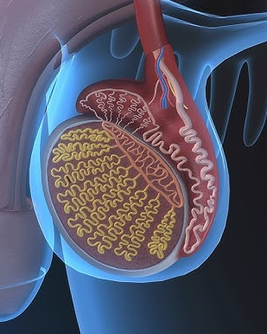
Physiology IV

Slide 2
The reproductive system 2

Slide 3
Agenda
3
Male reproductive system
Human development

Slide 4
Male reproductive system
4
The male reproductive system is shown here.The functions of the male reproductive organs are:
• production, maturation and storage of spermatozoa
• delivery of spermatozoa in semen into the female reproductive tract. The urethra is also the passageway for urine excretion.
Scrotum
The scrotum is a pouch of pigmented skin, fibrous and connective tissue and smooth muscle. It is divided into two compartments, each of which contains one testis, one epididymis and the testicular end of a spermatic cord. It lies below the symphysis pubis, in front of the upper parts of the thighs and behind the penis.

Slide 5
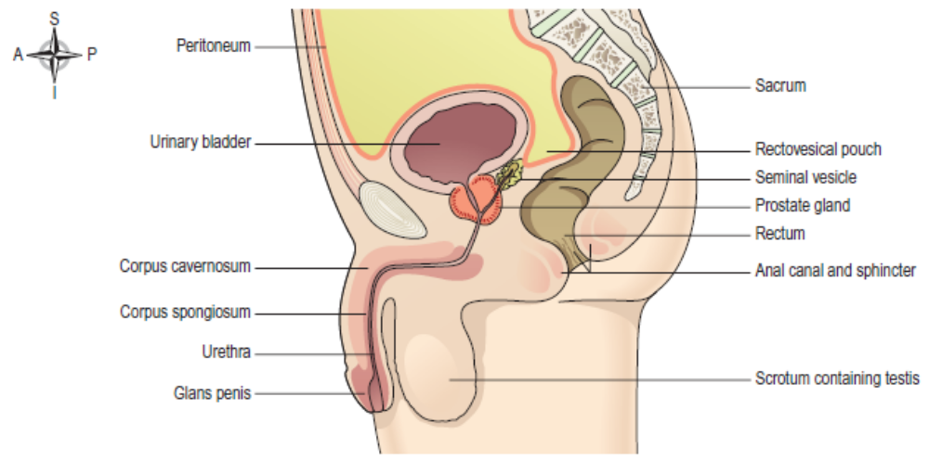
The male reproductive organs and their associated structures.

Slide 6
Testes
The testes are the male reproductive glands and are the equivalent of the ovaries in the female. They are about 4.5 cm long, 2.5 cm wide and 3 cm thick and are suspended in the scrotum by the spermatic cords. They are surrounded by three layers of tissue.
Tunica vaginalis. This is a double membrane, forming the outer covering of the testes, and is a downgrowth of the abdominal and pelvic peritoneum. During early fetal life, the testes develop in the lumbar region of the abdominal cavity just below the kidneys. They then descend into the scrotum, taking with them coverings of peritoneum, blood and lymph vessels, nerves and the deferent duct. The peritoneum eventually surrounds the testes in the scrotum, and becomes detached from the abdominal peritoneum. Descent of the testes into the scrotum should be complete by the 8th month of fetal life.

Slide 7
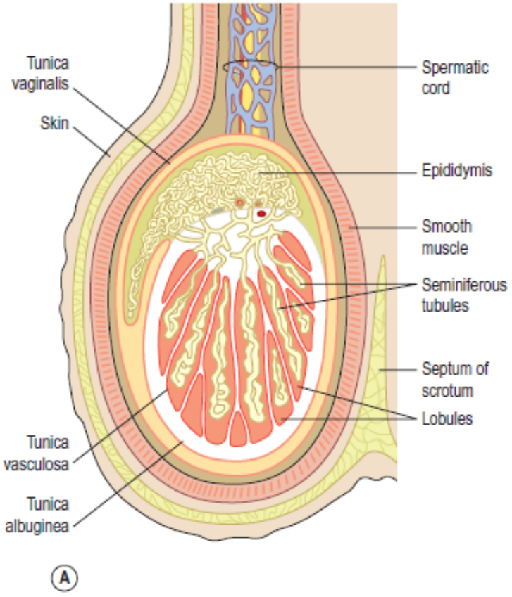
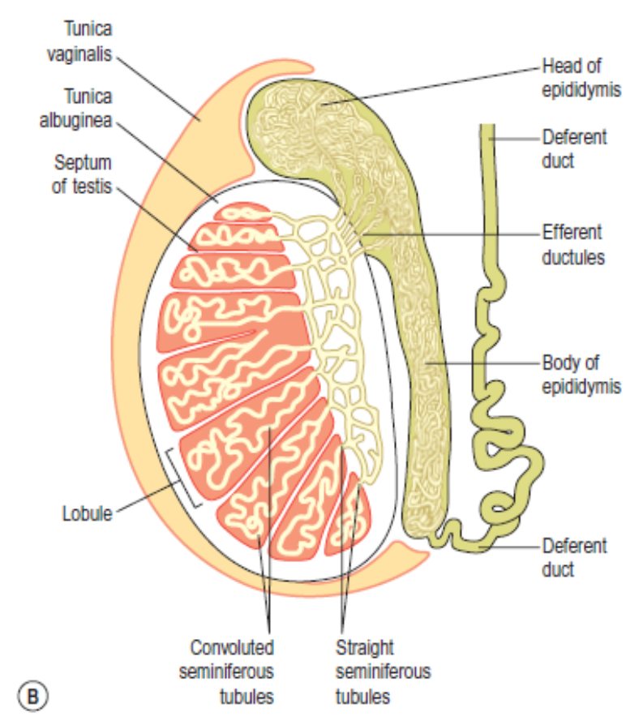

Slide 8
Tunica albuginea. This is a fibrous covering beneath the tunica vaginalis. Ingrowths form septa, dividing the glandular structure of the testes into lobules.
Tunica vasculosa. This consists of a network of capillaries supported by delicate connective tissue.
Structure
In each testis are 200–300 lobules, and within each lobule are 1–4 convoluted loops of germinal epithelial cells, called seminiferous tubules. Between the tubules are groups of interstitial cells (of Leydig) that secrete the hormone testosterone after puberty. At the upper pole of the testis the tubules combine to form a single tubule. This tubule, about 6 m in its full length, is repeatedly folded and tightly packed into a mass called the epididymis. It leaves the scrotum as the deferent duct (vas deferens) in the spermatic cord. Blood and lymph vessels pass to the testes in the spermatic cords.

Slide 9
Functions
Spermatozoa (sperm) are produced in the seminiferous tubules of the testes, and mature as they pass through the long and convoluted epididymis, where they are stored. FSH from the anterior pituitary (p. 220) stimulates sperm production. A mature sperm has a head, a body, and a long whip-like tail used for motility. The head is almost completely filled by the nucleus, containing its DNA. It also contains the enzymes required to penetrate the outer layers of the ovum to reach, and fuse with, its nucleus. The body of the sperm is packed with mitochondria, to fuel the propelling action of the tail that powers the sperm along the female reproductive tract. Successful spermatogenesis takes place at a temperature about 3°C below normal body temperature. The testes are cooled by their position outside the abdominal cavity, and the thin outer covering of the scrotum has very little insulating fat. 18.9 Unlike females, who produce no new gametes after birth, sperm production in males begins at puberty and continues throughout life, often into old age, under the influence of testosterone.

Slide 10
Spermatic cords
The spermatic cords suspend the testes in the scrotum. Each cord contains a testicular artery, testicular veins, lymphatics, a deferent duct and testicular nerves, which come together to form the cord from their various origins in the abdomen. The cord, which is covered in a sheath of smooth muscle and connective and fibrous tissues, extends through the inguinal canal and is attached to the testis on the posterior wall.
Blood supply, lymph drainage and nerve supply
Arterial supply. The testicular artery branches from the abdominal aorta, just below the renal arteries.
Venous drainage. The testicular vein passes into the abdominal cavity. The left vein opens into the left renal vein and the right into the inferior vena cava.

Slide 11
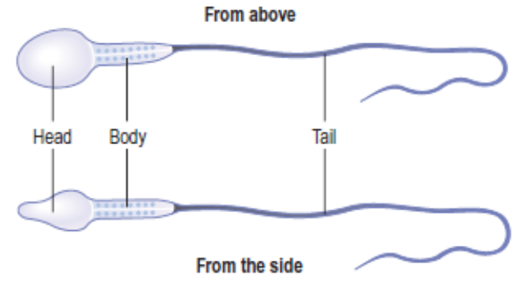
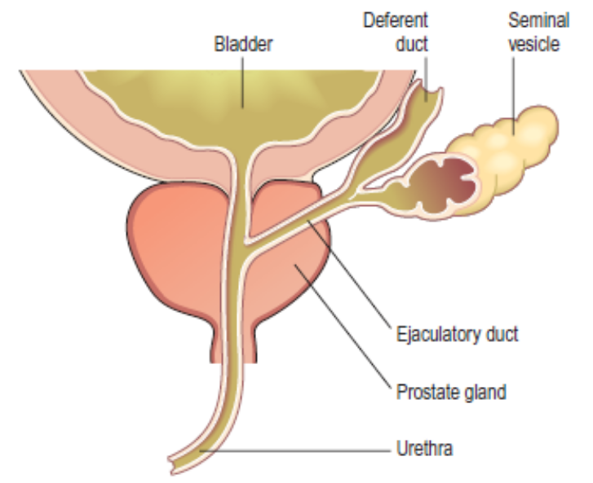
Section of the prostate gland and associated reproductive structures on one side

Slide 12
Lymph drainage. This is through lymph nodes around the aorta.
Nerve supply. This is provided by branches from the 10th and 11th thoracic nerves.
The deferent duct
This is some 45 cm long. It passes upwards from the testis through the inguinal canal and ascends medially towards the posterior wall of the bladder where it is joined by the duct from the seminal vesicle to form the ejaculatory duct.
Seminal vesicles
The seminal vesicles are two small fibromuscular pouches, 5 cm long, lined with columnar epithelium and lying on the posterior aspect of the bladder. At its lower end each seminal vesicle opens into a short duct, which joins with the corresponding deferent duct to form an ejaculatory duct.

Slide 13
Functions
The seminal vesicles contract and expel their stored contents, seminal fluid, during ejaculation. Seminal fluid, which forms 60% of the volume of semen, is alkaline to protect the sperm in the acidic environment of the vagina, and contains fructose to fuel the sperm during their journey through the female reproductive tract.
Ejaculatory ducts
The ejaculatory ducts are two tubes about 2 cm long, each formed by the union of the duct from a seminal vesicle and a deferent duct. They pass through the prostate gland and join the prostatic urethra, carrying seminal fluid and spermatozoa to the urethra. The walls of the ejaculatory ducts are composed of the same layers of tissue as the seminal vesicles.

Slide 14
Prostate gland
The prostate gland lies in the pelvic cavity in front of the rectum and behind the symphysis pubis, completely surrounding the urethra as it emerges from the bladder. It has an outer fibrous covering, enclosing glandular tissue wrapped in smooth muscle. The gland weighs about 8 g in youth, but progressively enlarges (hypertrophies) with age and is likely to weigh about 40 g by the age of 50.
Functions
The prostate gland secretes a thin, milky fluid that makes up about 30% of the volume of semen, and gives it its milky appearance. It contains a clotting enzyme, which thickens the semen in the vagina, increasing the likelihood of semen being retained close to the cervix.

Slide 15
Urethra and penis
Urethra
The male urethra provides a common pathway for the flow of urine and semen. It is about 19–20 cm long and consists of three parts. The prostatic urethra originates at the urethral orifice of the bladder and passes through the prostate gland. The membranous urethra is the shortest and narrowest part and extends from the prostate gland to the bulb of the penis, after passing through the perineal membrane.
The spongiose or penile urethra lies within the corpus spongiosum of the penis and terminates at the external urethral orifice in the glans penis. There are two urethral sphincters. The internal sphincter is a ring of smooth muscle at the neck of the bladder above the prostate gland. The external sphincter is a ring of skeletal muscle surrounding the membranous part.

Slide 16
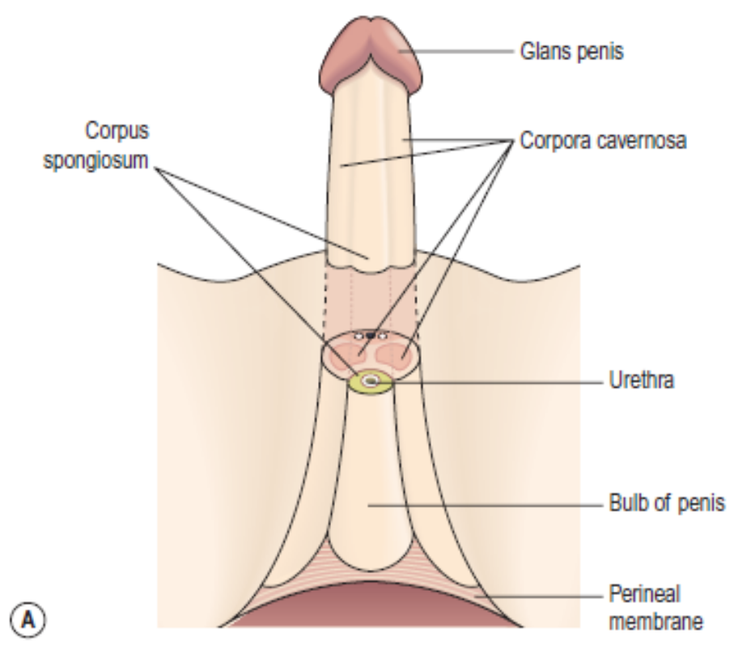
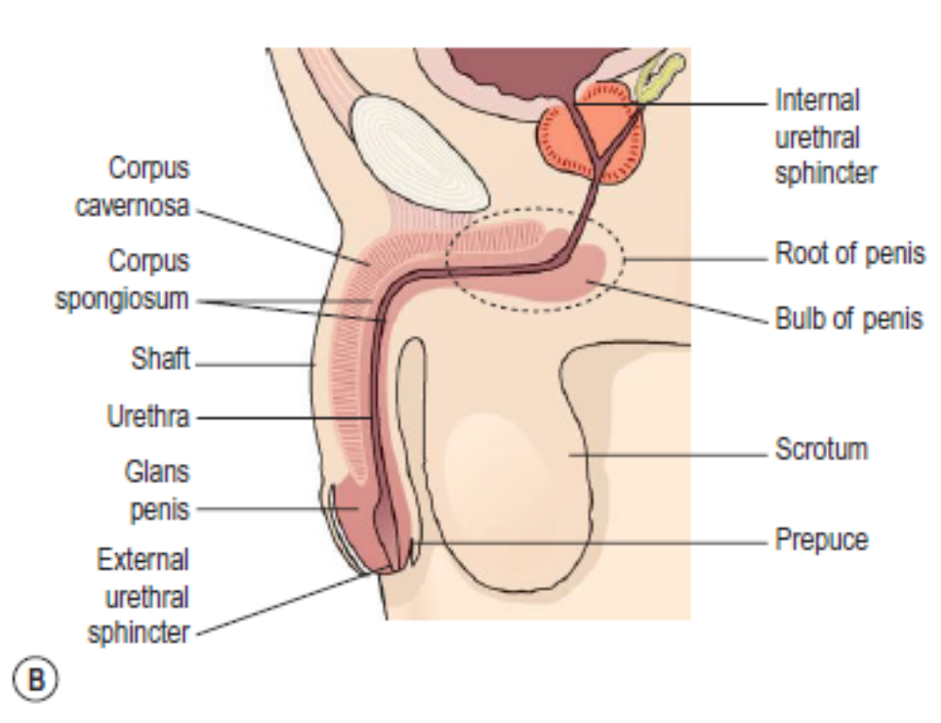

Slide 17
Penis
The penis has a root and a shaft. The root anchors the penis in the perineum and the shaft (body) is the externally visible, moveable portion of the organ. It is formed by three cylindrical masses of erectile tissue and smooth muscle. The erectile tissue is supported by fibrous tissue and covered with skin and has a rich blood supply. The two lateral columns are called the corpora cavernosa and the column between them, containing the urethra, is the corpus spongiosum. At its tip it is expanded into a triangular structure known as the glans penis. Just above the glans the skin is folded upon itself and forms a movable double layer, the foreskin or prepuce. Arterial blood is supplied by deep, dorsal and bulbar arteries of the penis, which are branches from the internal pudendal arteries. A series of veins drain blood to the internal pudendal and internal iliac veins. The penis is supplied by autonomic and somatic nerves. Parasympathetic stimulation leads to filling of the spongy erectile tissue with blood, caused by arteriolar dilation and venoconstriction, which increases blood flow into the penis and obstructs outflow. The penis therefore becomes engorged and erect, essential for sexual intercourse.

Slide 18
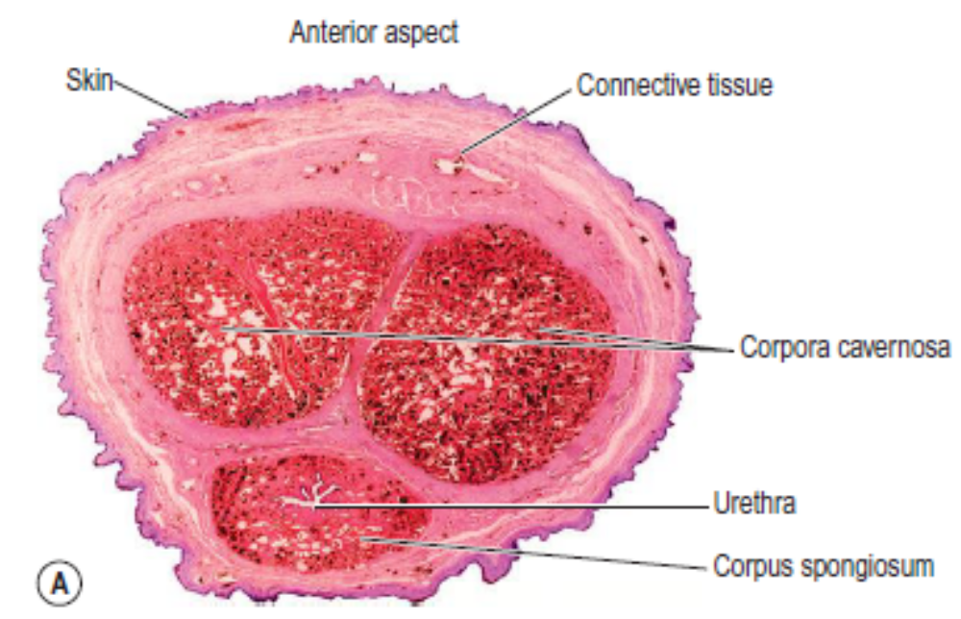
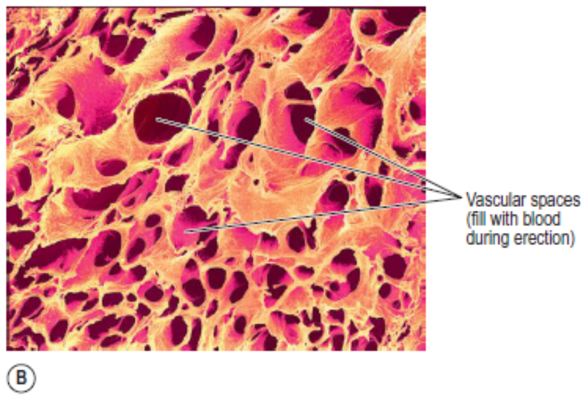
The penis. A. Transverse section (light micrograph). B. Erectile tissue (scanning electron micrograph).

Slide 19
Ejaculation
During ejaculation, which occurs at male orgasm, spermatozoa are expelled from the epididymis and pass through the deferent duct, the ejaculatory duct and the urethra. The semen is propelled by powerful rhythmical contraction of the smooth muscle in the walls of the deferent duct; the muscular contractions are sympathetically mediated. Muscle in the walls of the seminal vesicles and prostate gland also contracts, adding their contents to the fluid passing through the genital ducts. The force generated by these combined processes leads to emission of the semen through the external urethral sphincter. Sperm comprise only 10% of the final ejaculate, the remainder being made up mainly of seminal (50–60%) and prostatic fluids (20–30%), which are added to the sperm during male orgasm, as well as mucus produced in the urethra. Semen is slightly alkaline, to neutralize the acidity of the vagina. Between 2 and 5 mL of semen are produced in a normal ejaculate and contain between 40and 100 million spermatozoa per mL . If not ejaculated, sperm gradually lose their fertility after several months and are reabsorbed by the epididymis.

Slide 20
Puberty in the male
This occurs between the ages of 10 and 14. Luteinizing hormone from the anterior lobe of the pituitary gland stimulates the interstitial cells of the testes to increase the production of testosterone. Under the influence of testosterone, sexual maturation and other characteristic changes take place, including:
• growth of muscle and bone and a marked increase in height and weight
• enlargement of the larynx and deepening of the voice – it ‘breaks’
• growth of hair on the face, axillae, chest, abdomen and pubis
• enlargement of the penis, scrotum and prostate gland
• maturation of the seminiferous tubules and production of spermatozoa
• the skin thickens and becomes oilier.

Slide 21
Human Development
Growth of a new human being begins when an ovum is fertilised by a spermatozoon, usually in the uterine tube. The resulting cell is called a zygote. Because the ovum and spermatozoon each had 23 chromosomes, it has the full complement of 46 chromosomes. The period between fertilisation and birth (gestation) takes about 40 weeks. The first 8 weeks of development is called the embryonic period and thereafter the developing individual is called a fetus.
Aided by peristalsis of the uterine tube, the zygote travels towards the uterus, a journey that takes about a week, and by 10 days after fertilization is firmly embedded in the uterine lining. During this time, it undergoes rapid and repeated cell divisions so by the time it implants in the endometrium it has become a blastocyst, a hollow ball of 70–100 cells. The blastocyst contains an inner mass of cells, which develops into the fetus and its amniotic sac, a bag of membranes enclosing it. The outer layer, the trophoblast, becomes an important layer of the placenta.

Slide 22
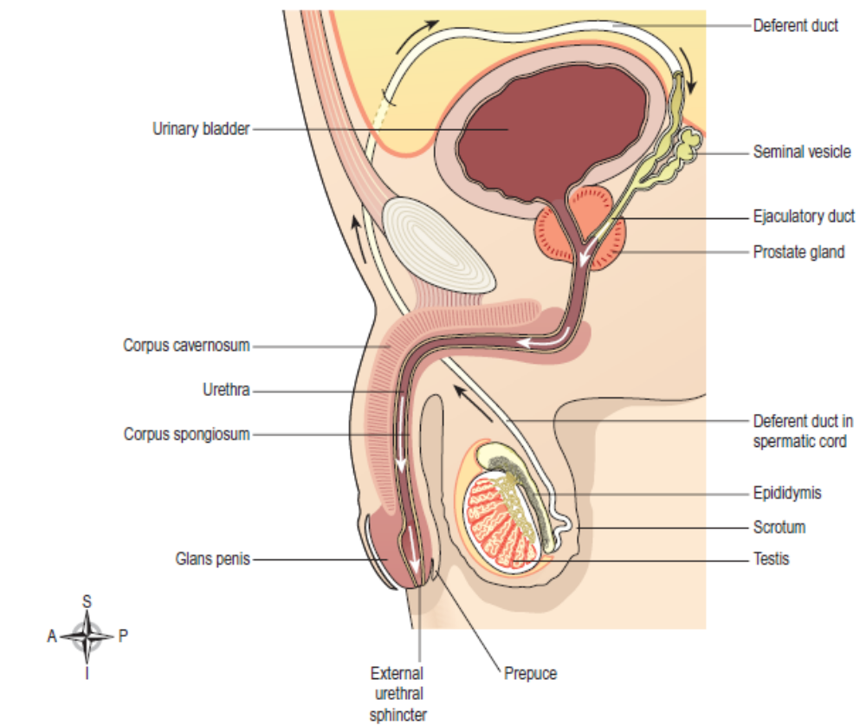

Slide 23
Nourishment during intrauterine growth. In the early stages, the embryo is small enough that simple diffusion is adequate to supply the dividing cells but because embryonic growth is so rapid, this quickly becomes unsustainable and between the third and 10th weeks of pregnancy, the placenta (p. 115) develops, attached firmly to the uterine wall. The fetus is attached to the placenta by the umbilical cord, and absorbs oxygen and nutrients from the maternal bloodstream as well as excreting its waste products.
The first 3 months
A newborn baby is made up of trillions of cells and many different tissues, all of which have developed from the single-celled zygote formed at fertilisation. Differentiation of cells into specialised tissues, and the organization of these specialised tissues into the body systems, is largely completed in the first 12 weeks of gestation. A 12-week fetus is very similar to a 40-week fetus, although much smaller.

Slide 24
Later pregnancy
The final 6 months of pregnancy is devoted primarily to the rapid growth of the fetus in preparation for birth and independent life.

Slide 25
Thank You

