Slide 1
Urinary System
Conditions
basic functional unit of the kidneys

Slide 2
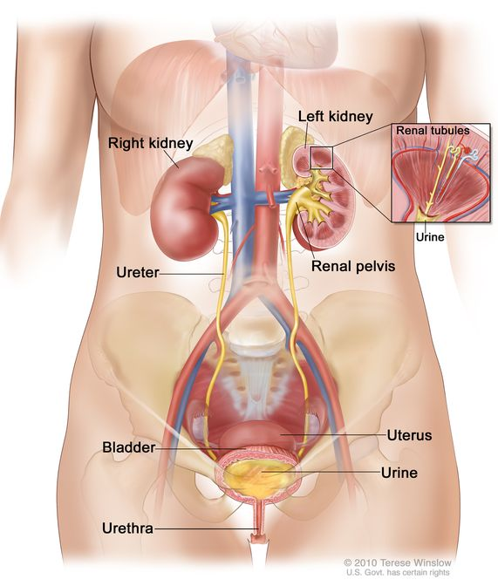
Urinary System Introduction

Slide 3
The urinary system is a relatively small system composed of the kidneys, ureters, bladder, and urethra .
The huge renal artery comes directly off the aorta and enters the kidneys. It rapidly decreases in diameter and splits up to form thousands of capillaries, terminating in tiny knots called glomeruli. Each of these is surrounded by a Bowman capsule, the entry point to the nephron.
Blood pressure forces fluid from the glomeruli into the Bowman capsule. Nephrons and circulatory capillaries exchange water and waste products as they intertwine along the loop of Henle.

Slide 4
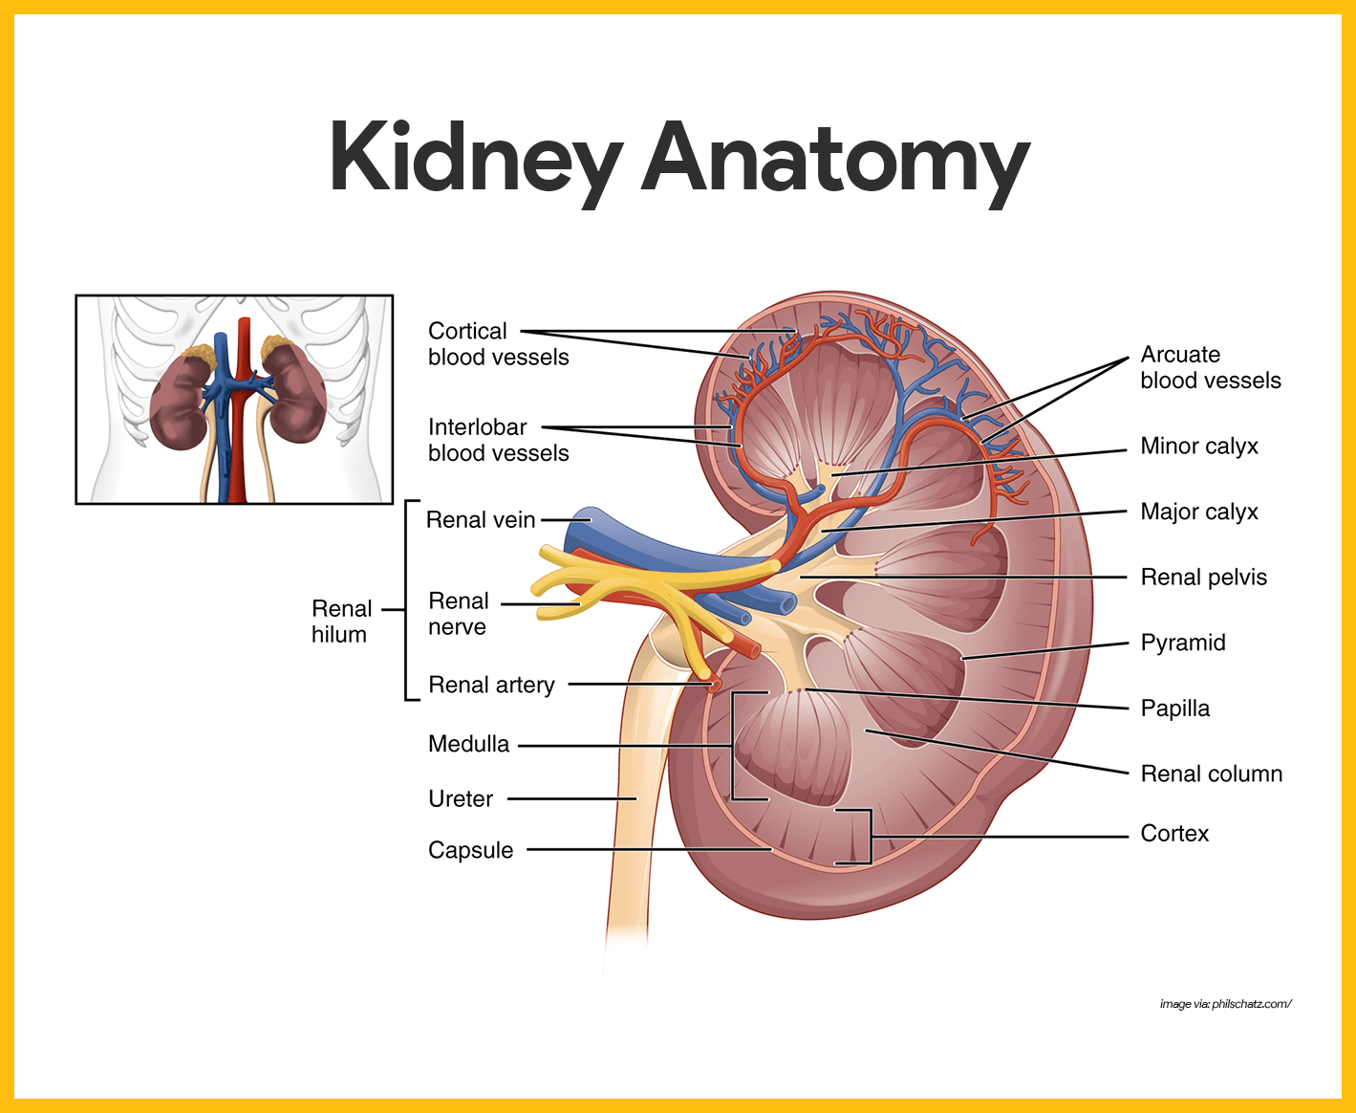
Anatomy

Slide 5
By the time fluid enters the collecting tubules, any water, electrolytes, or other material the body needs has been reabsorbed, so that only waste products are left. This fluid is urine. The collecting tubules pour their contents into the renal pelvis, the renal pelvis empties into the ureters, they lead to the urinary bladder, and urine is excreted from the bladder through the urethra.

Slide 6
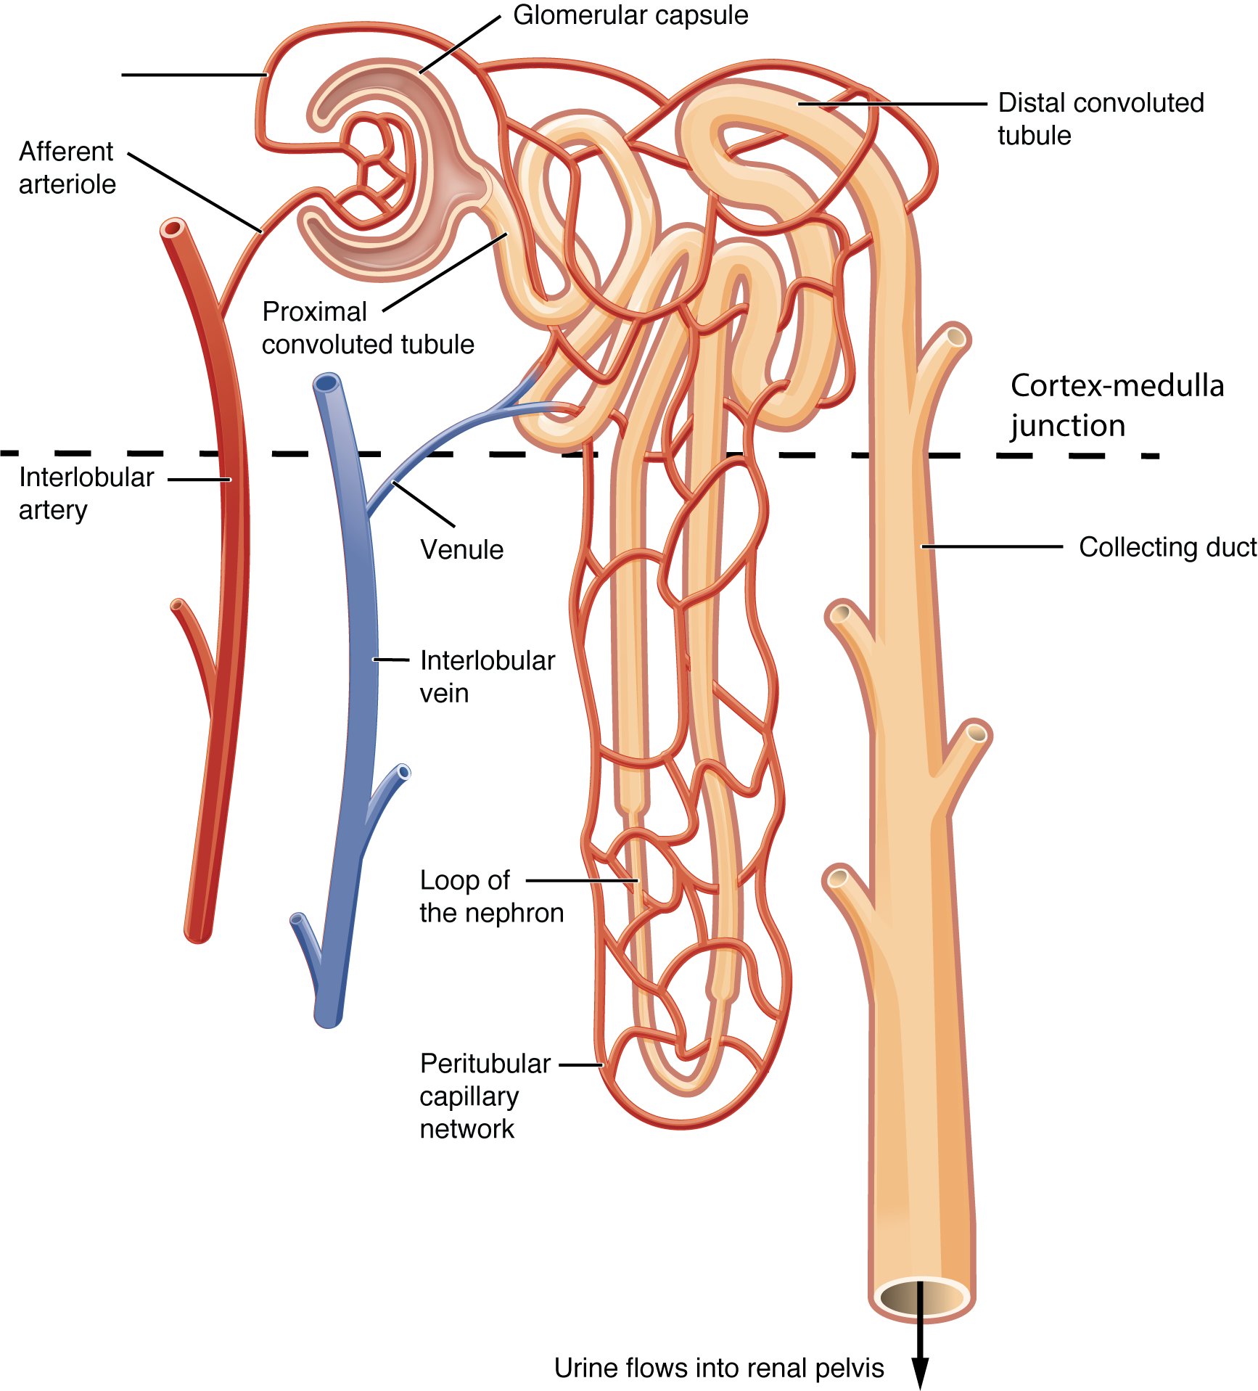
Nephron

Slide 7
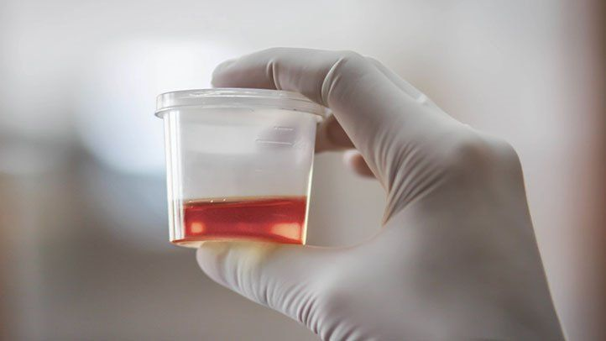
GFR
Kidneys are constructed primarily of epithelial tissue, which makes them vulnerable to injury. When the kidneys have been damaged, red blood cells leak from capillaries into the nephrons. This shows as blood in the urine (hematuria). It is evidence of trauma, infection, or another possibly dangerous condition in the kidneys.
Filtration, the movement of substances through a membrane by external mechanical pressure (in this case the blood pressure), is the mechanism that initially pushes waste-filled plasma into the kidneys. The speed with which this happens is called the glomerular filtration rate, or GFR. Normal GFR is 120 mL/min: this adds up to 180 L of fluid moving through the kidneys each day!

Slide 8
EPO
The kidneys have another function that is not directly involved in the removal of waste products from the blood. Erythropoietin (EPO), a hormone that stimulates red blood cell production, is produced in the kidneys. Damage to these delicate organs can therefore sometimes be identified by changes in red blood cell production.

Slide 9
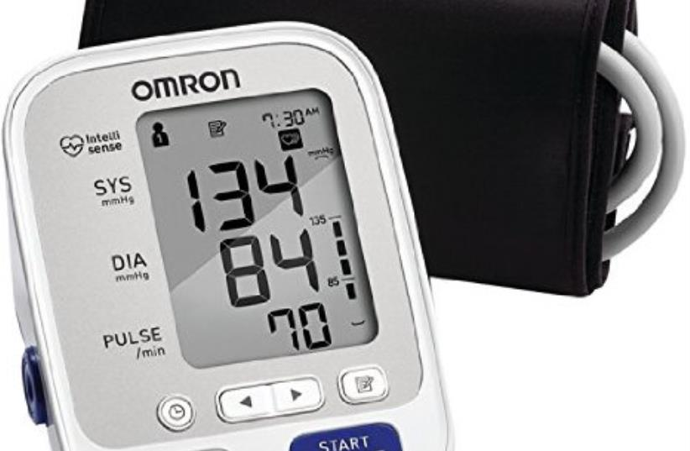
(Of course, most of the glomerular filtrate is reabsorbed into circulatory capillaries and put back into the bloodstream.) It is clear then, how closely blood pressure and kidney health are interrelated. If blood pressure is consistently too high, the kidneys sustain damage and become less efficient. Conversely, if the kidneys are not functioning adequately, the body accumulates excessive fluid, which raises blood pressure. This vicious circle is a recurring theme in kidney dysfunction.

Slide 10
Kidney Stones
What are they?
Kidney stones are solid deposits of crystalline substances inside the kidney.
How are they recognized?
Small stones may cause no symptoms at all, but when larger stones enter the ureters, they can cause blood in the urine and extreme pain called renal colic. Renal colic may be accompanied by nausea and vomiting. Fever and chills indicate that infection is part of the problem. Pain may refer from the back into the groin.
Massage risks and benefits
Risks: Massage won’t alter the progression of kidney stones, and if a client complains of extreme, severe back and flank pain with nausea and other symptoms, he or she is better off in the hospital than in a massage session.
Benefits: Clients who have fully recovered from kidney stones can enjoy the same benefits from massage as the rest of population.

Slide 11
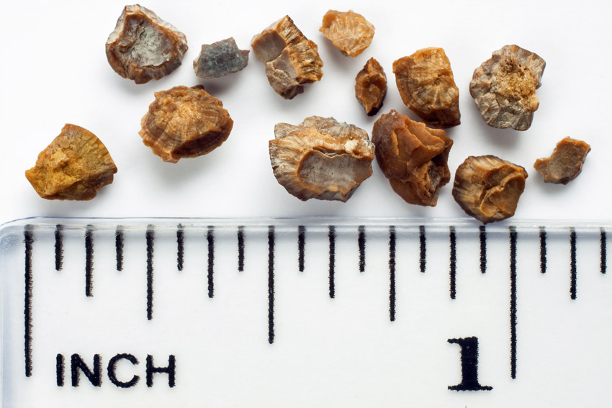
Types of Kidney Stones
Calcium stones: These account for most kidney stones. They are composed of calciumoxalate or calcium phosphate, and associated with problems with calcium metabolism or too much incoming calcium, usually in the form of calcium supplements or calcium-based antacids.
Struvite stones: These are composed of magnesium and ammonia and are associated with chronic UTIs.
Uric acid stones: These form in the kidneys of people whose blood is abnormally acidic. They are associated with a diet high in meat and purines. People who have uric acid kidney stones are also at high risk for gout.
Cystine stones: These are relatively rare. They are directly related to a genetic dysfunction with the metabolism of cystine, an amino acid.

Slide 12
Prevention
People who have passed a stone before will recognize the signs of another attack. They may be counseled to pass the stone at home, using over the counter painkillers, and urinating into a strainer, so the stone can be captured and analyzed later.
Prevention for persons susceptible to kidney stones depends on what the stones are made of. Possible interventions include removal of the parathyroid glands; medication to regulate metabolism, dietary adjustments; and most important: adequate hydration. Kidney stone patients need to drink up to one gallon of water every day to keep stones moving through the system before they become big enough to cause problems. Patients are also frequently advised to limit caffeine, alcohol, and oxalate-rich foods (dark leafy vegetables, nuts, and chocolate) to reduce the risk of future stones.

Slide 13
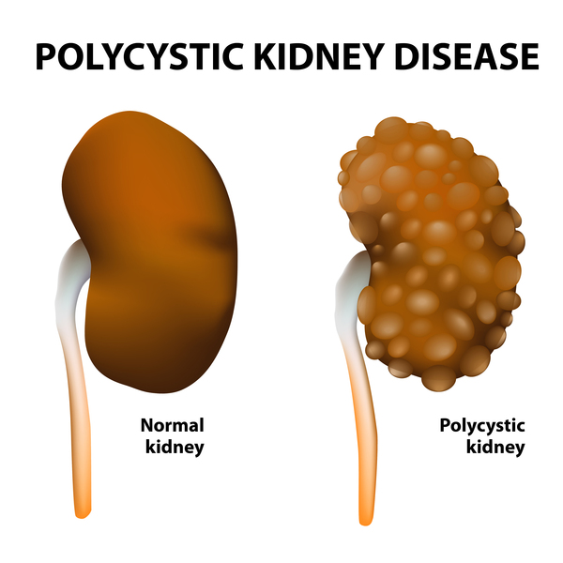
Polycystic kidney
What is it?
Polycystic kidney disease (PKD) is a genetic disorder leading to the formation of multiple cysts in the kidney and other organs. The cysts interfere with normal organ function, often leading to end-stage renal failure and the need for a kidney transplant.
How is it recognized?
Depending on the type of mutation, symptoms may appear in infancy or adulthood. Problems with urine production, enlarged liver, dangerously high hypertension, back pain, and headaches are among the signs and symptoms.
Massage risks and benefits
Risks: PKD involves problems with internal fluid management and a significant risk of other tissue anomalies that include liver cysts, diverticular disease, and cerebral aneurysms. Massage for a person with this condition must be gauged to fit within the challenges of their normal activities of daily living, which may be restricted.
Benefits: Massage may help to temporarily drop blood pressure, ease pain and anxiety, and add to general quality of life, as long as it doesn’t overchallenge an impaired fluid management system

Slide 14
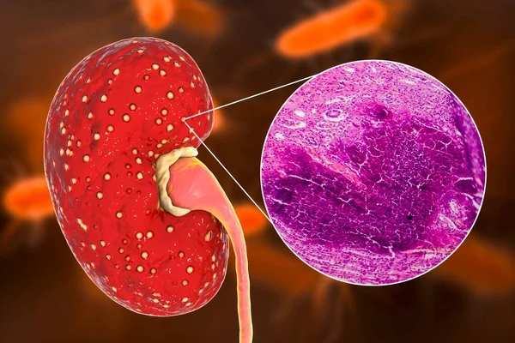
Pyelonephritis in Brief
Pronunciation: py-el-o-neh-FRY-tis
What is it?
Pyelonephritis is an infection of the kidney and/or renal pelvis.
How is it recognized?
Symptoms of acute pyelonephritis include burning pain with urination, back pain, fever, chills, nausea, and vomiting. Chronic infections may show no or only very subtle symptoms.
Massage risks and benefits
Risks: Acute kidney infections contraindicate rigorous massage not only because the body is undergoing a major challenge but also because the patient is likely to be in pain and uncomfortable on a table.
Benefits: In the midst of an infection, gentle energetic or noncirculatory bodywork may be soothing. A person who has fully recovered from pyelonephritis can enjoy the same benefits from bodywork as the rest of the population.

Slide 15
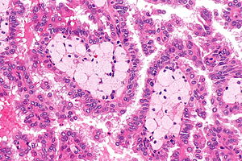
Renal cancer in Brief
What is it?
Renal cancer is any cancer that arises in the kidney. The most common type is renal cell carcinoma.
How is it recognized?
Signs and symptoms of renal cancer include blood in the urine, flank pain, unintended weight loss, and general malaise.
Massage risks and benefits
Risks: As with other cancers, renal cancer is treated aggressively with interventions that present specific cautions for massage therapists, including some skin problems.
Benefits: As with other cancers, massage has many benefits to offer as long as a session is designed to maximize the relaxing, anti-pain, anti-anxiety aspects of massage while minimizing any techniques that may overwhelm a client’s ability to adapt to the changes that brings about.

Slide 16
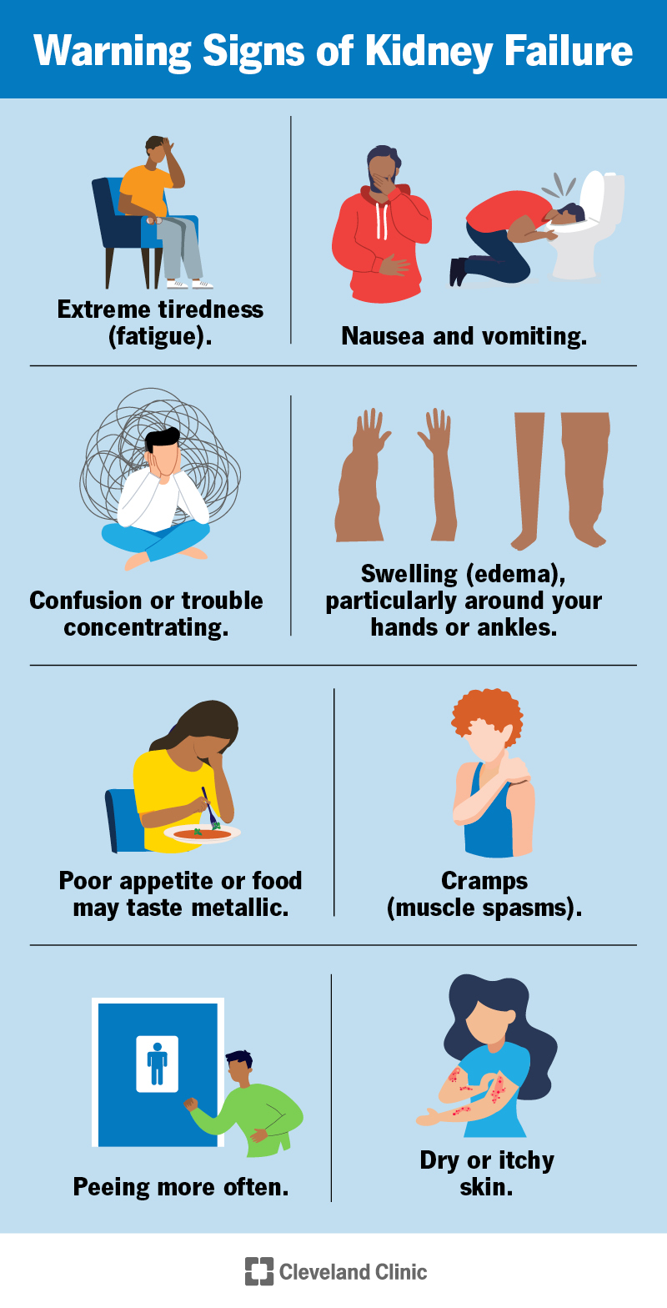
Renal failure
What is it?
Renal failure involves the inability of the kidneys to function at normal levels. It may be an acute or a chronic problem, and it can be life threatening.
How is it recognized?
Symptoms of acute and chronic renal failure differ in severity and type of onset, but some things they have in common are reduced urine output, systemic edema, and changes in mental state brought about by the accumulation of toxins in the blood.
Massage risks and benefits
Risks: Massage that has the intention to mechanically influence fluid flow may be overwhelming for a person with chronic or acute renal failure.
Benefits: Gentler forms of bodywork that are gauged to fit within a limited capacity for adaptation may be helpful for the stress of dealing with a very challenging disorder.

Slide 17
Chronic Renal failure
Kidney function is measured in terms of glomerular filtration rate (GFR), that is, how efficiently fluid moves from the glomeruli into the nephrons. Normal GFR is 120 mL/min.
Renal failure is a progression along a continuum of lost function, and is discussed in these stages:
• Stage I: Kidney damage is minor and GFR is above 90 mL/min.
• Stage II: Mild reduction in function; GFR is 60 to 89 mL/min.
• Stage III: Moderate reduction in function; GFR is 30 to 59 mL/min; chronic kidney disease is recognized at this stage.
• Stage IV: Severe reduction; GFR is 15 to 29 mL/min; dialysis may be recommended at this stage.
• Stage V: End-stage renal failure; GFR is less than 15 mL/min.

Slide 18
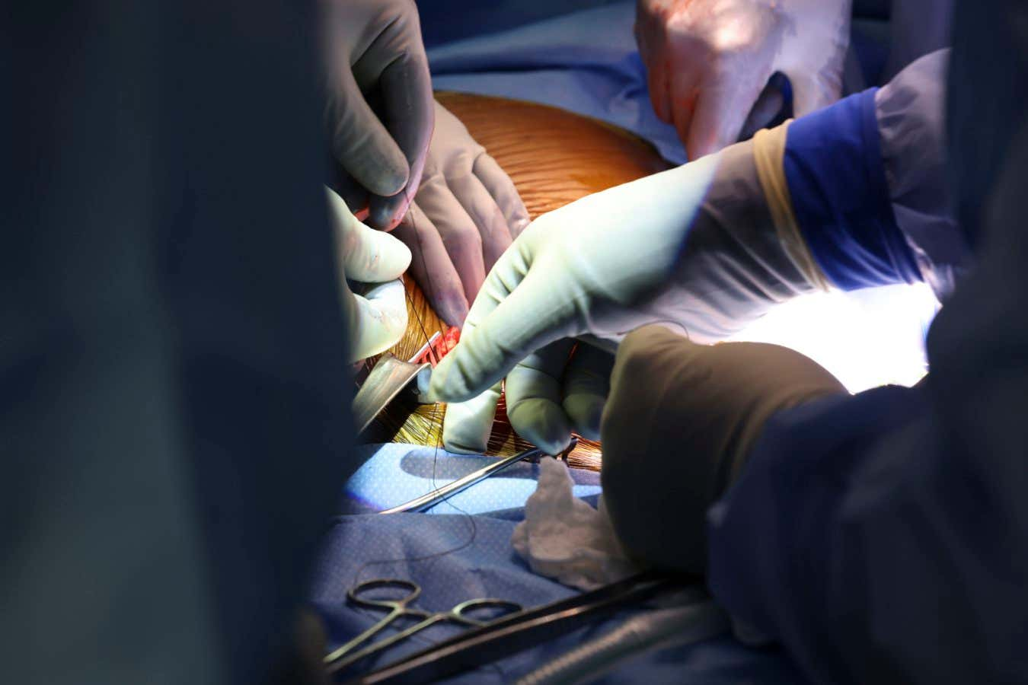
Kidney Transplant
The urinary system has about twice the capacity for urine production that any person actually needs. This is good news indeed, because it means that if it is necessary, we can get along with just one healthy kidney.
Kidney transplants replace a damaged organ with a healthy kidney from an appropriate donor. The new kidney is surgically implanted low in the abdomen, and the nonworking kidneys are usually left in place. Most kidney transplants use organs donated from people who have died, but if a good match is found, a kidney can be donated by a close relative or loved one.
Unfortunately, the shortage of suitable donated organs means that among the 84,000 people waiting for kidney transplants this year, only about 18,000 operations will be performed.

Slide 19
Bladder Cancer
What is it?
Bladder cancer is the growth of malignant cells in the urinary bladder. Most bladder cancer starts in the superficial layer of transitional epithelium.
How is it recognized?
The earliest sign of bladder cancer is painless blood in the urine, which may be red or rust colored. In later stages, the bladder may become irritable: painful urination, reduced urination, or increased urinary frequency may all occur.
Massage risks and benefits
Risks: As with most other types of cancer, the primary risk for bladder cancer patients receiving massage is that the challenges of both the disease and the treatment may reduce their capacity for adaptation. Most bladder cancer patients undergo surgery at some point, and this comes with risks as well.
Benefits: The soothing, anxiety-relieving effects of massage for bladder cancer patients can be enjoyed as long as the fragility of the client is respected.

Slide 20
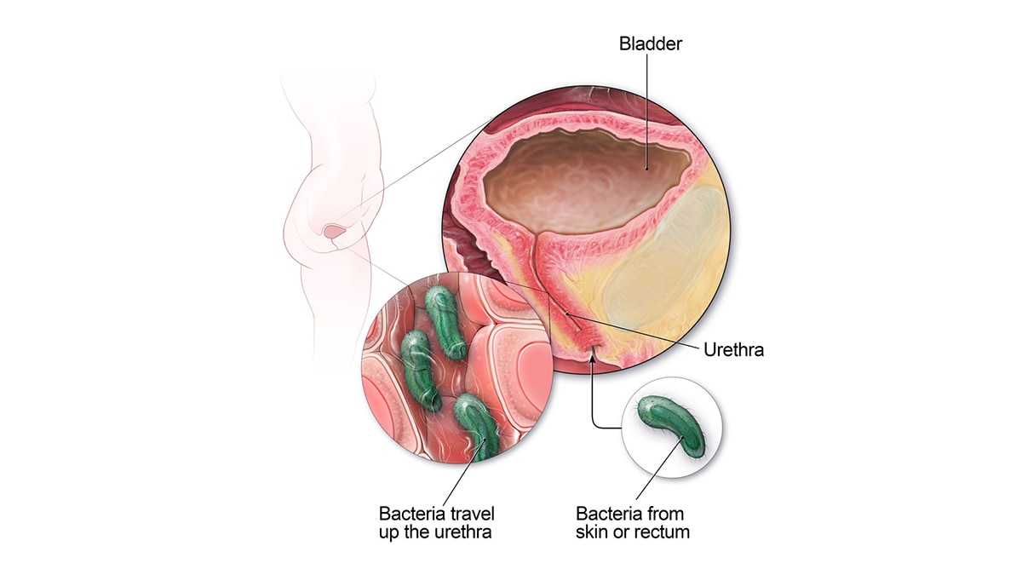
Urinary Tract Infections
What is it?
A UTI is an infection usually caused by bacteria that live harmlessly in the digestive tract finding their way into the urinary tract.
How is it recognized?
Symptoms of UTIs include pain and burning sensations during urination, increased urinary frequency and urgency, and cloudy or blood-tinged urine. Abdominal, pelvic, or low back pain may occur. In the acute stage, fever and general malaise may be present.
Massage risks and benefits
Risks: Acute UTIs are painful and may involve fever and malaise. Left untreated they carry a risk for complicating to pyelonephritis. For these reasons, it is best to delay any rigorous bodywork until after the infection has been resolved.
Benefits: Very gentle noninvasive bodywork may be soothing during a UTI. A client who has fully recovered from this condition can enjoy the same benefits from bodywork as the rest of the population.

Slide 21
UTI risk factors
Some women are more susceptible to UTIs than others, although the reasons for this are not completely clear; they may have to do with immune system differences and shortages of certain types of antibodies. Some factors, however, are reliable predictors of who is at risk for developing a UTI:
• Spermicide use. Spermicide foams and jellies used with a diaphragm or alone have been shown to raise the risk of UTIs in some women.
• Diaphragm use. Women who use a diaphragm show statistically higher rates of UTIs than women who do not.
• Pregnancy. Pregnant women do not necessarily get more UTIs than women who are not pregnant, but the risk of having a simple infection complicate into a more dangerous one is higher for these patients.

Slide 22
UTI risk factors
• Diabetes. Elevated sugar levels in the urine make a hospitable environment for bacteria to grow in the bladder.
• Neurogenic bladder. A neurogenic bladder has lost motor function and does not empty as completely as a normal one. This raises the potential for infection, as does the presence of catheter tubes, which are used for people with limited bladder function.

Slide 23
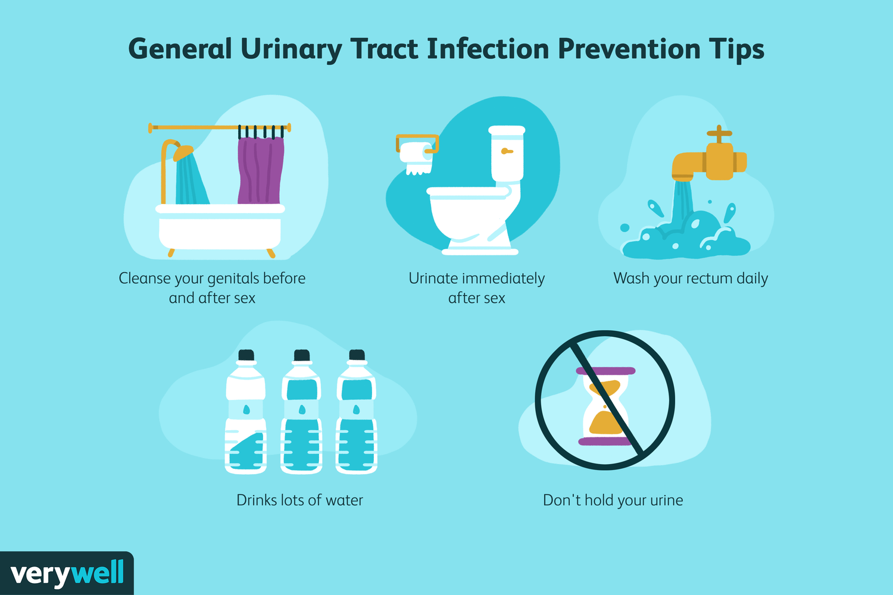
Prevention of UTIs
Some basic precautions can help prevent UTIs, especially for women who are especially vulnerable to them. These include drinking lots of water and acidic juices; urinating whenever necessary rather than holding it for a more convenient time; wiping from front to back after a bowel movement to prevent the introduction of digestive bacteria into the urethra; taking showers rather than baths; emptying the bladder after sex; and avoiding feminine hygiene sprays and douches, which can aggravate the urethra.

