Slide 1
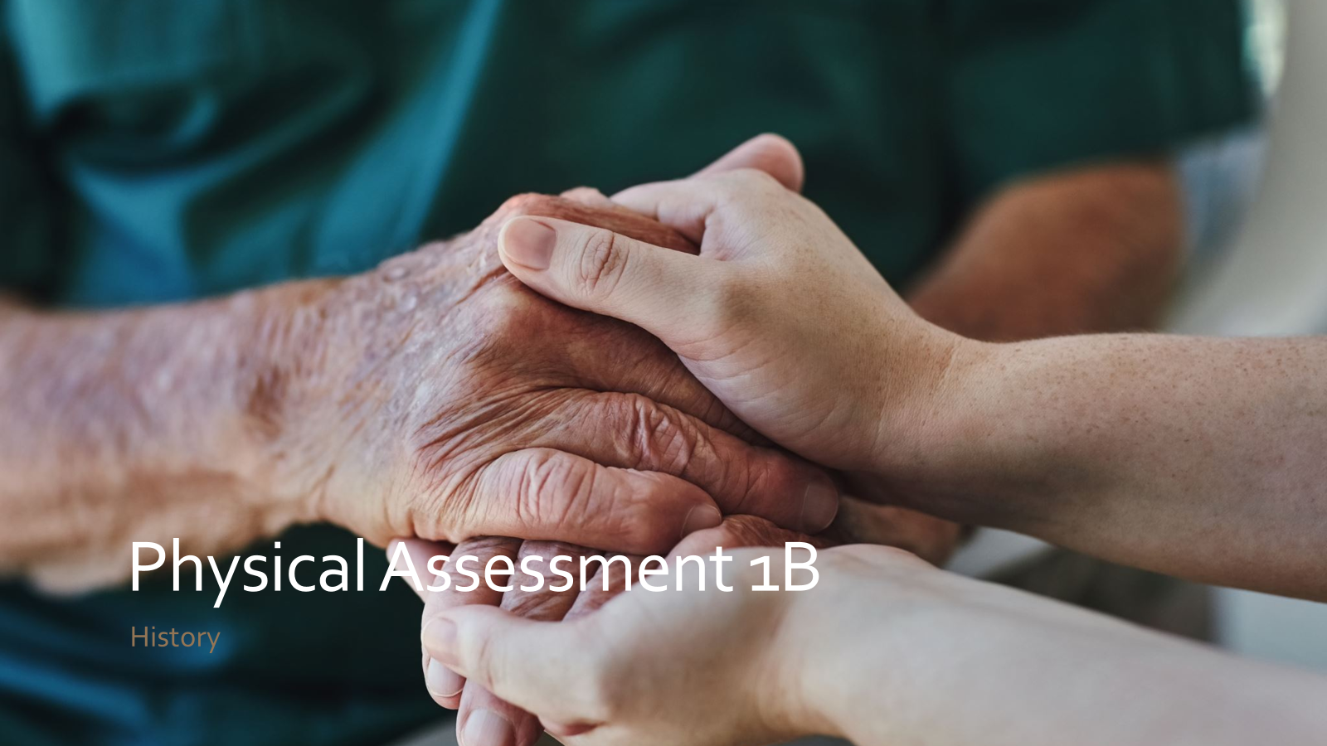
Physical Assessment 2

Slide 2
The goal of physical examination is the detection of abnormalities associated with disease…
The techniques and skills required for competent clinical examination are best learned through experience.
… in most cases no one sign is absolute significance in isolation, and each finding should be evaluated only in context of other findings.
As human being, clinicians have the greatest tool available, human body.

Slide 3
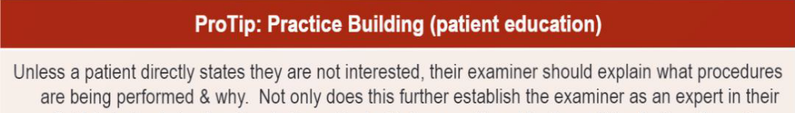
Diagnostic Physical Examination
Be professional
Voice clearly
Appropriate language
Communication
Patient comfort
Few change positions
Positions sequence:
standing, seated, supine, sidelying, prone

Slide 4
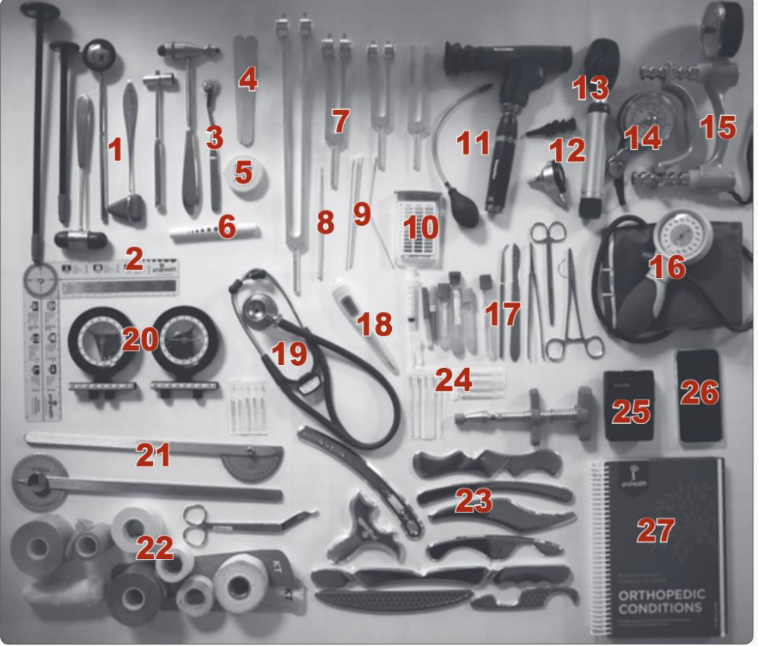
Diagnostic Equipment

Slide 5
General Exam Flow
Vitals
Standing
Seated
Cranial nerves
Neurologic exam upper
Cervical Orthopedic
Thorax
Supine
Neurologic exam lower
Side posture
Prone

Slide 6
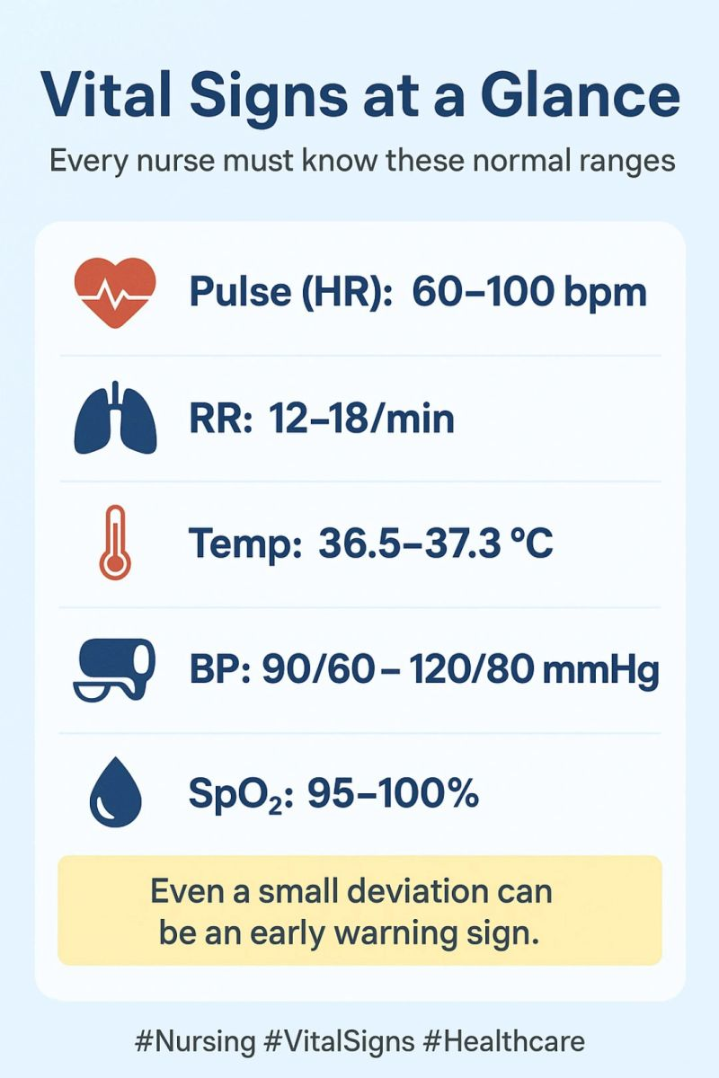
Vitals
Temperature (37’ C / 98.6’ F)
Pulse ( 60-100 bpm)
Respiration ( 12-20 bpm)
BP bilaterally ( < 120/80 mmHg)
Observe skin throughout exam

Slide 7
Standing
Height, weight, BMI
Snellen chart
Observe posture, gait, heel walk, toe walk
Spinal ROM (Adam’s sign, pain?, where?)

Slide 8
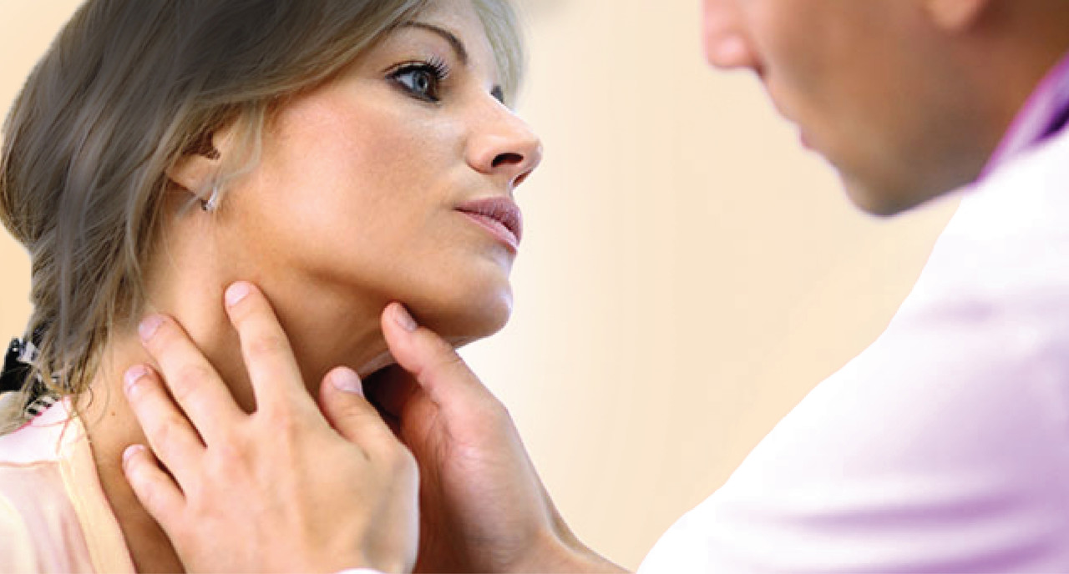
Seated
(standing in front of patient)
Inspection and palpation of head & neck

Slide 9
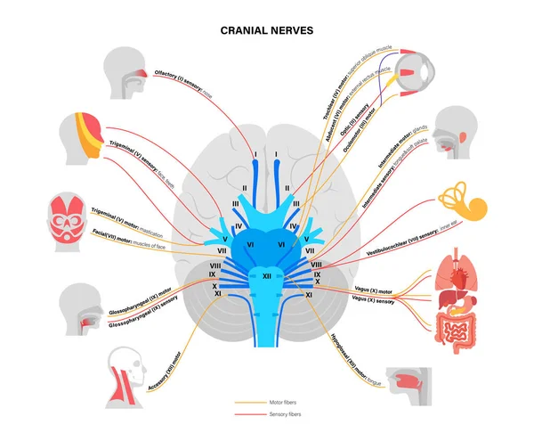
Cranial nerve exam
Smell (I)
Peripheral vision (II)
Cardinal fields of gaze (III,IV,VI)
Accommodation (III)
Facial expression (VII)
Stick out tongue (XII)
Trapz/SCM test (XI)
Hearing (VIII), if Webber, Rinne +
Consensual light reflex (II, III)
Examine mouth/ teeth
Say Ahhh (IX,X)
Bite (V)

Slide 10

Otoscopic exam
Rhinoscope exam

Slide 11
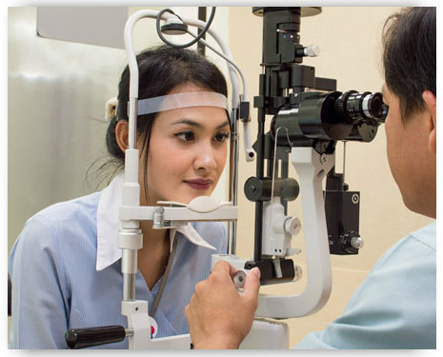
Ophtalmic exam

Slide 12
Neurologic exam upper limbs
Sensory
light touch/sharp,dull(face, arm)
vibration(DIP, 3rd digit)
DTR
biceps (C5), brachioradialis (C6), triceps (C7)
Motor
deltoid(C5,6) auxillary
brachioradialis(C5,6) radial
biceps(C5,6) musculocutaneus
triceps(C6,7,8,T1) radial
wrist extensors(C6,7,8) radial
wrist flexors(C6,7) median, ulnar

Slide 13
finger flexors(C7,8,T1) median, ulnar
interossei(C7,8,T1) ulnar

Slide 14
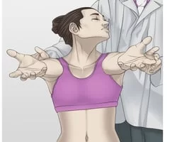
Cervical orthopedic exam
VBI screening
Muscles of neck test
Cervical compression/distraction
TOS tests( if arm/hand symptoms present)

Slide 15
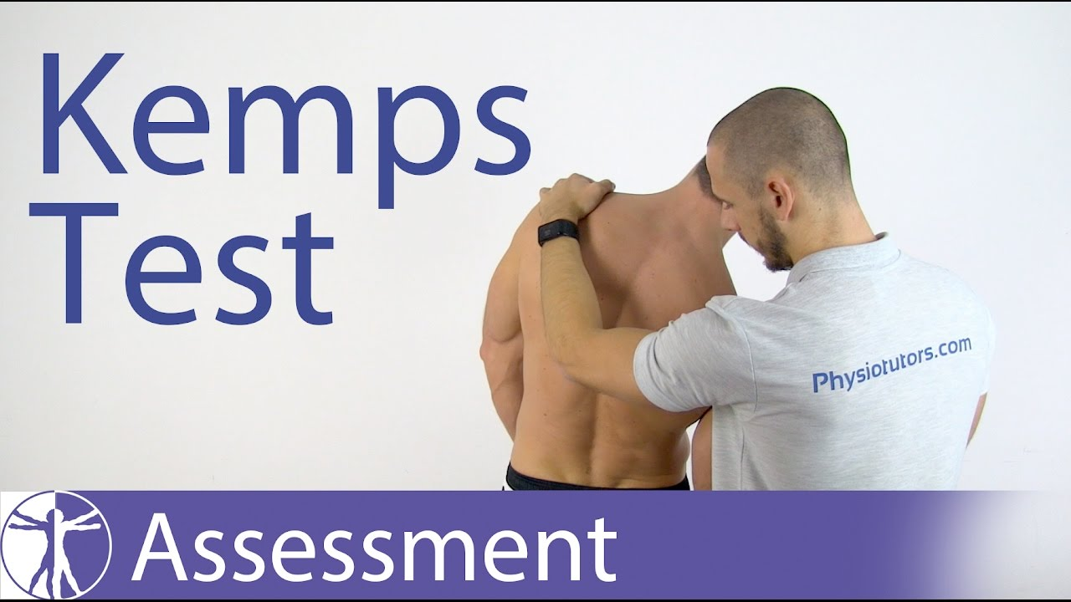
Thorax
Percuss lung fields, check respiratory excursion
Auscultate lungs, heart and carotid artery
Spinal percussion, Kemp test
Lumbar, thoracic, and ribs motion palpation

Slide 16
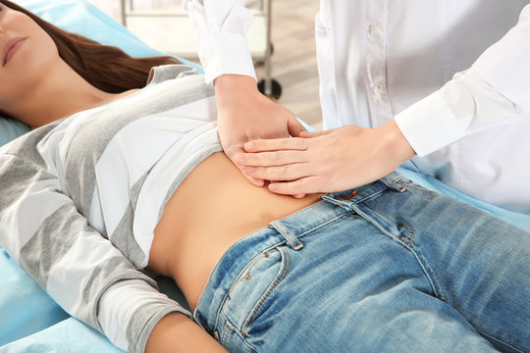
Supine side of table
Abdominal exam
inspect, auscultate, percuss, palpate,
abdominal strength, palpate inguinal
lymph nodes

Slide 17
Supine foot of table
Inspect feet, palpate temperature of feet
Dorsal pedis, posterior tibial pulses
Leg length evaluation
Internal/external rotator muscle test

Slide 18
Neurologic exam of lower limbs
Sensory
light touch, sharp/dull, pinwheel
vibration, Babinski (L1 and above)
DTR
Patella(L4), Hamstring(L5), Achilles(S1)
Motor
Tibialis anterior(L4,5) deep peroneal
Extensor hallucis longus(L4-S1) deep peroneal
Peroneus longus(L5,S1) superficial peroneal

Slide 19
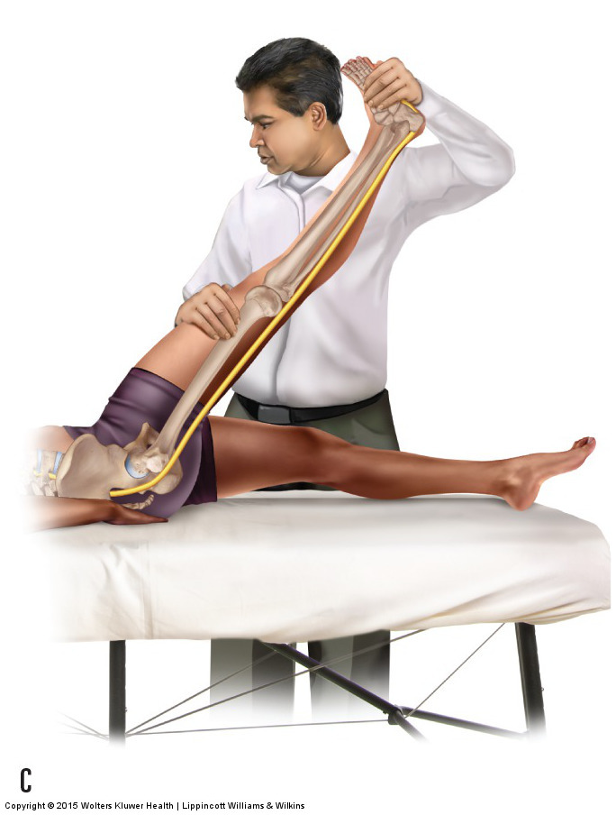
Supine side of table
Low back/ pelvis orthopedic tests
active SLR, double SLR, passive SLR
Braggard, goldwaith(if there is back pain)
Patrick FABER, hip circumduction
Thomas(leg off the table)

Slide 20
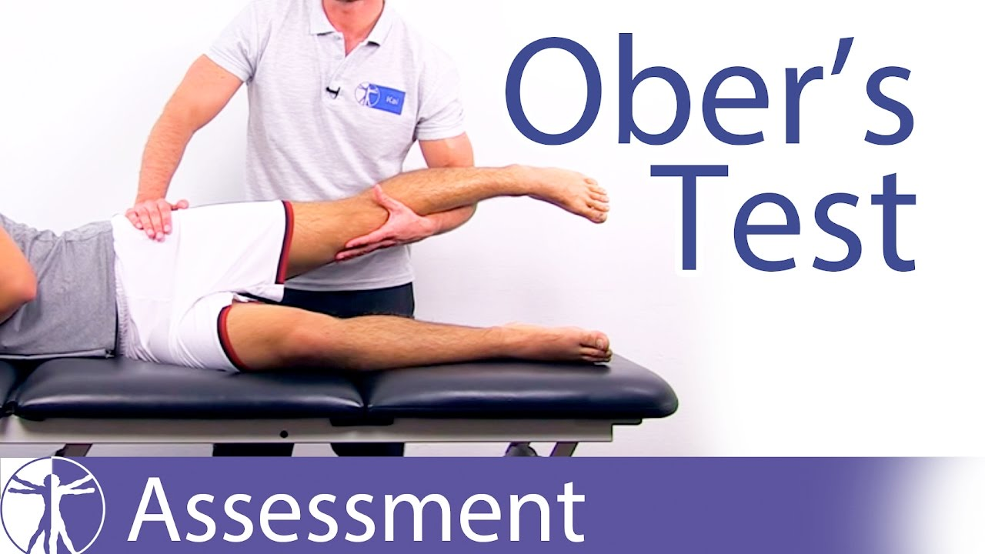
Side posture
Active hip abduction, ober’s test
SI compression

Slide 21
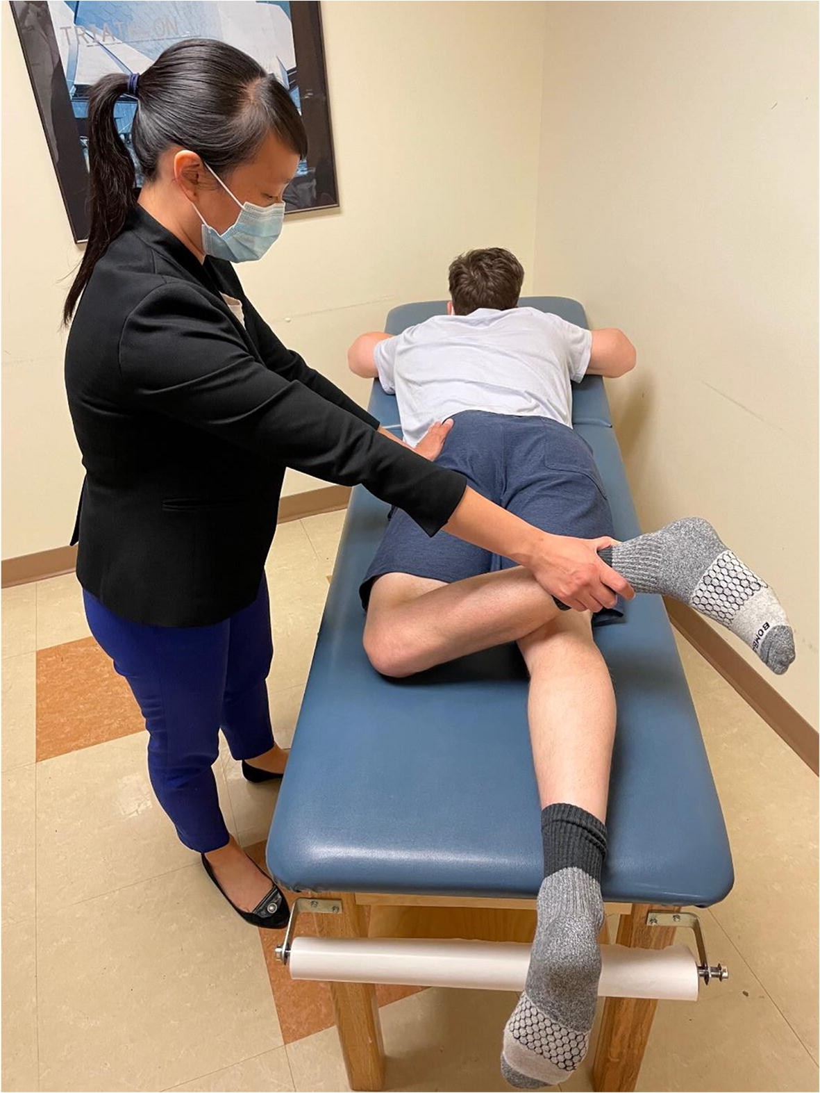
Prone
Internal / external rotation( bent knee)
Palpation of calf

Slide 22
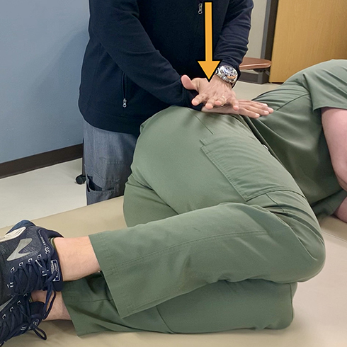
Prone side of table
Palpation hamstring, TFL, erector spinae, QL,
glut max, glut med
SI joint, PSIS, crest height
Lumbar, thoracic spine, ribs

Slide 23
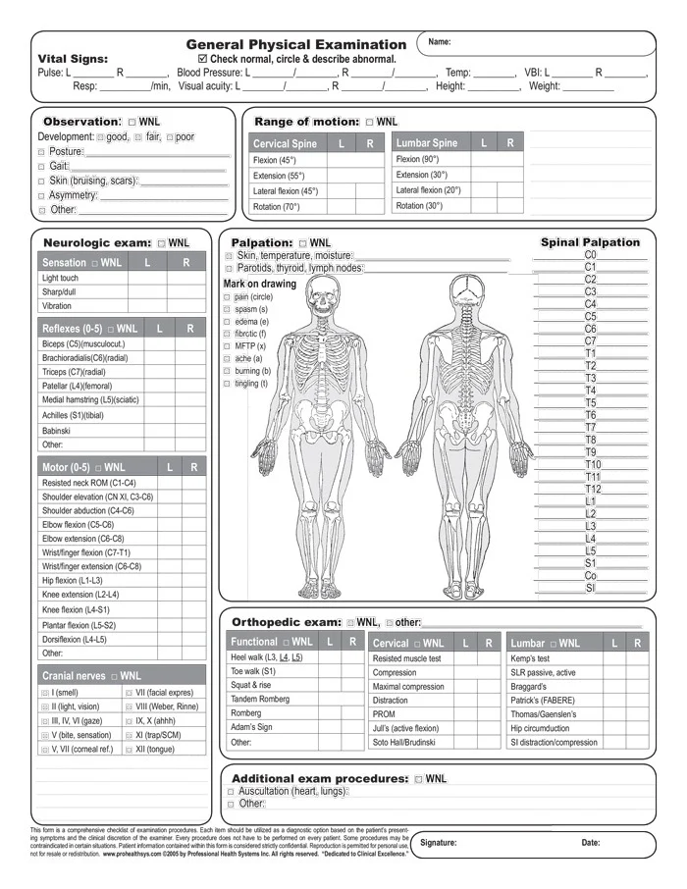
General physical exam form

Slide 24
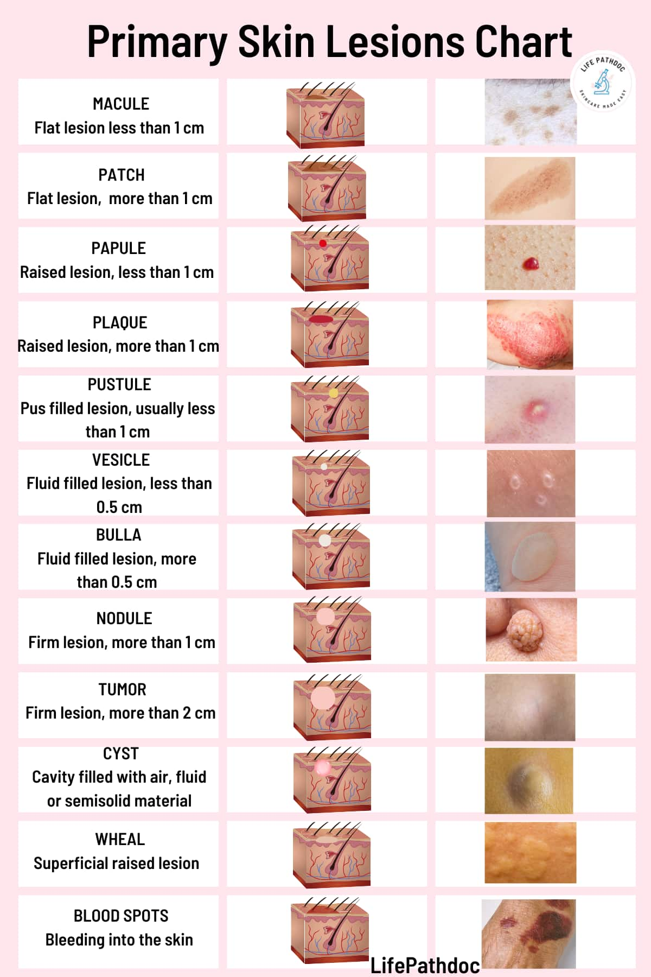
Skin Examination
Macule
Papule
Nodule
Wheal
Vesicle
Bulla
Pustule
Crust
Scales
Ulcer
Erosion
Fissure
Atrophy

Slide 25
Posture assessment
Evaluation of a person’s body position and/or structure in standing and seated.
Patient assessed in their relaxed, habitual standing posture.
Performed from feet up to the head (plumb line)
Observe 4 positions(ant, post, lateral L/R)

Slide 26
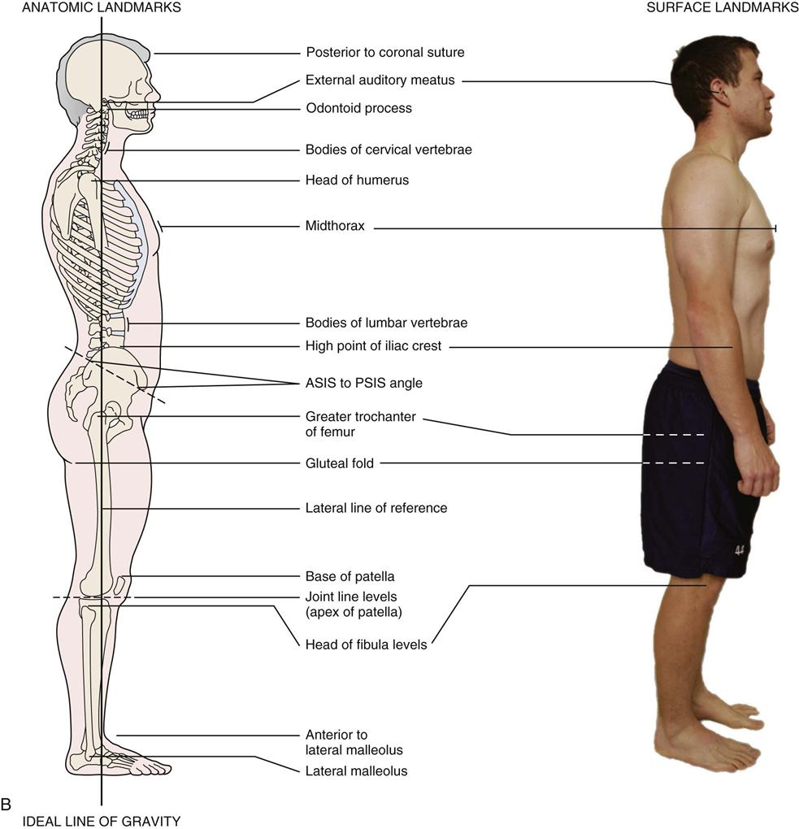
Plumb line

Slide 27
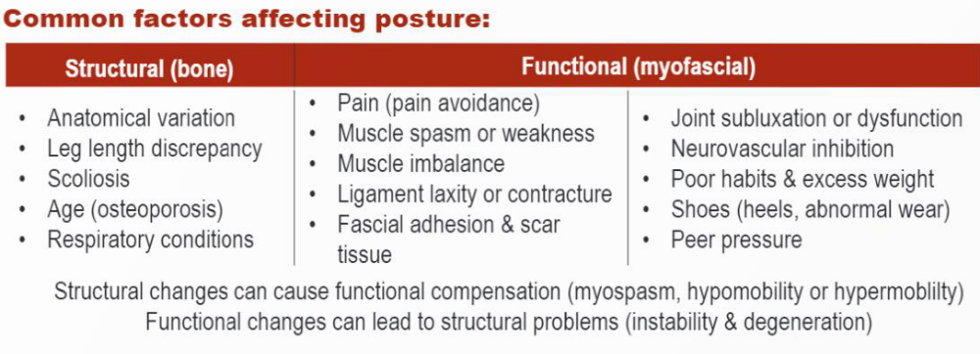

Slide 28
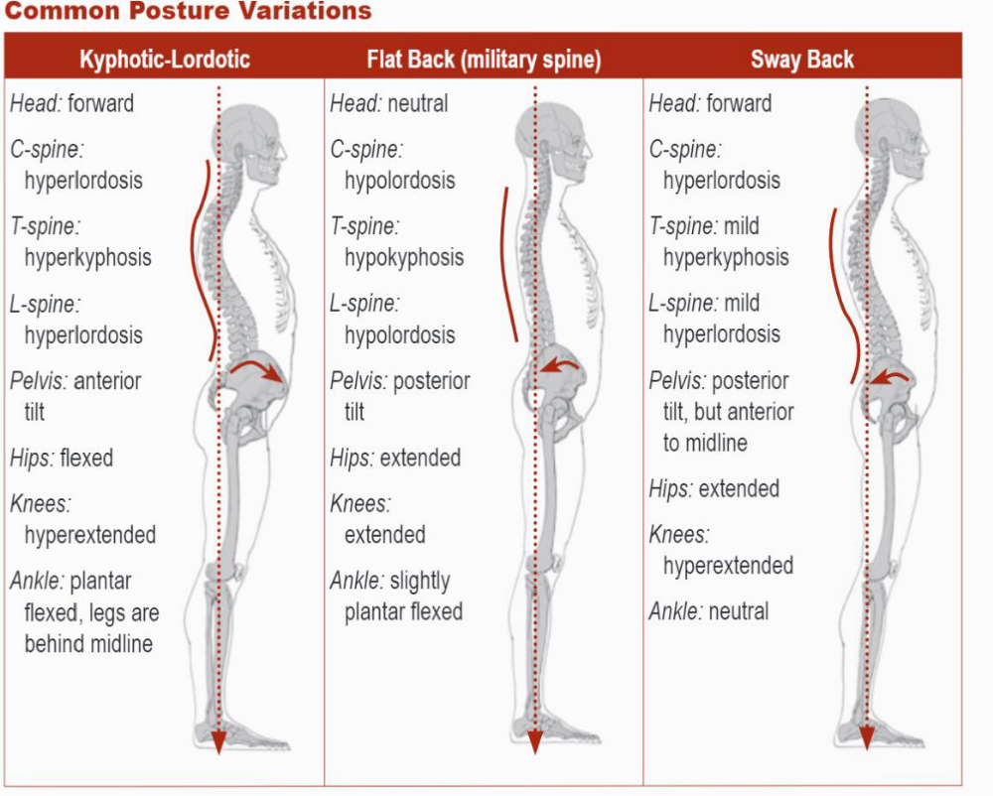
Posture Assessment

Slide 29
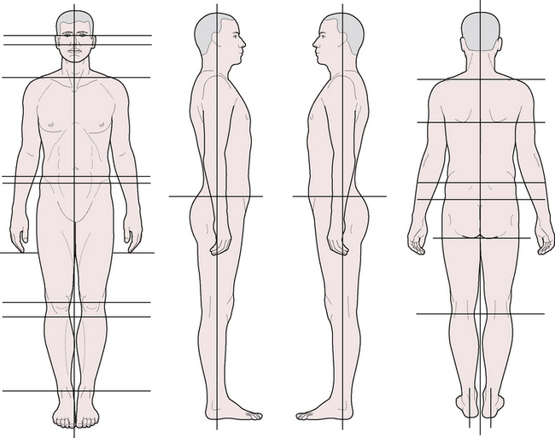
Posture assessment

Slide 30
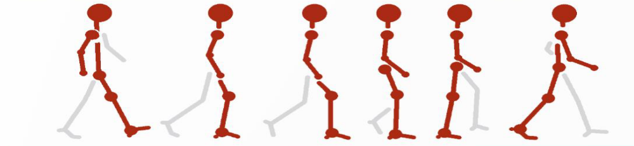
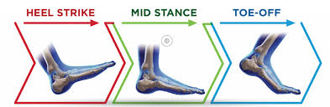
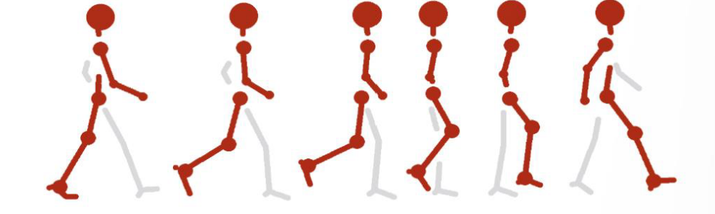
Gait cycle
Antalgic gait, knee back gait, hemiplegic gait, scissors gait, short leg gait, steppage gait, Trendelenburg gait

Slide 31
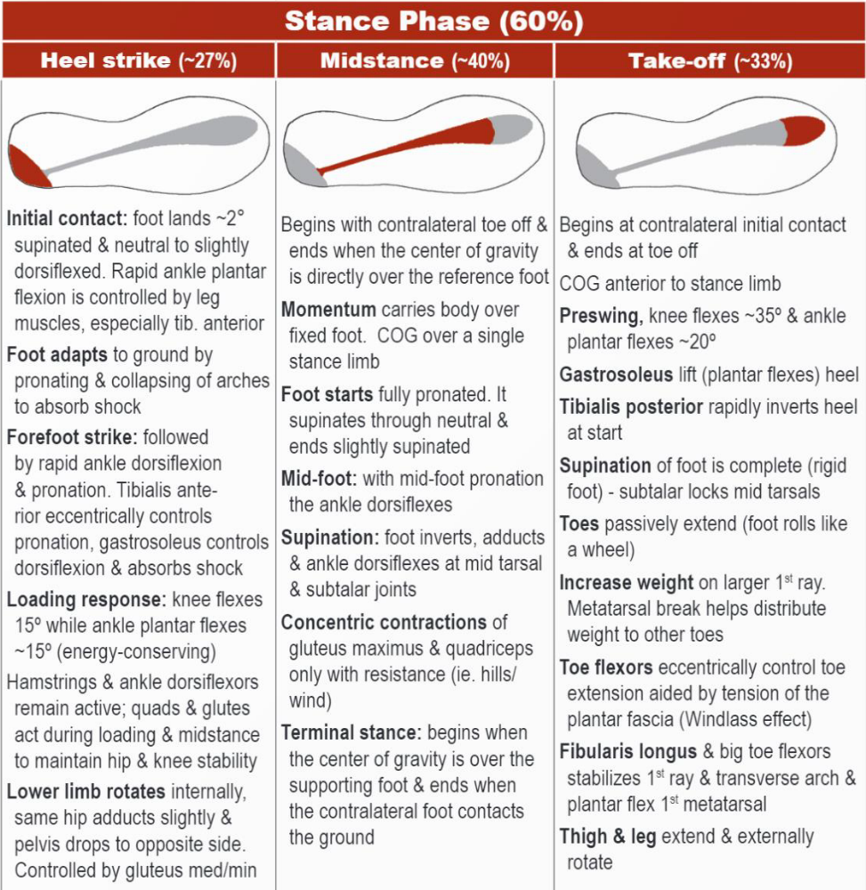
Gate cycle

Slide 32
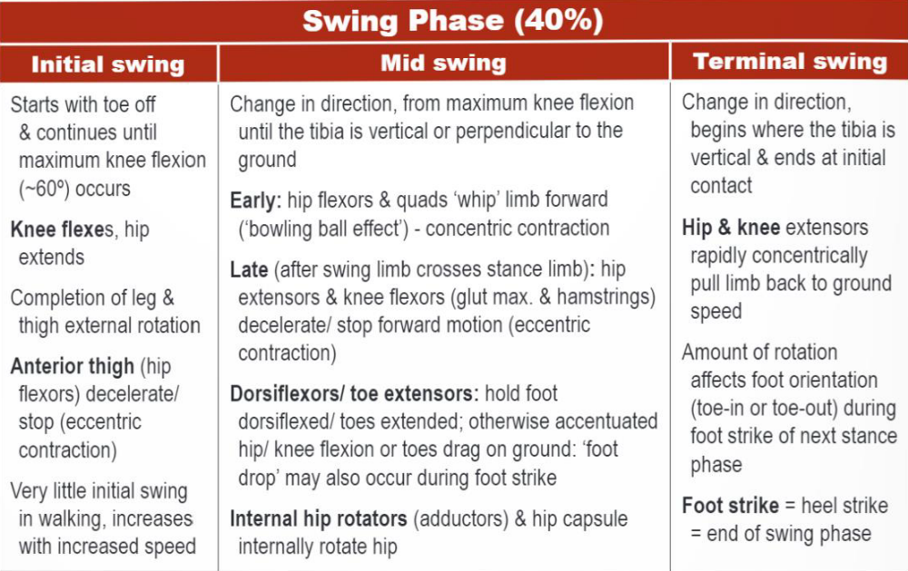
Gait cycle

Slide 33
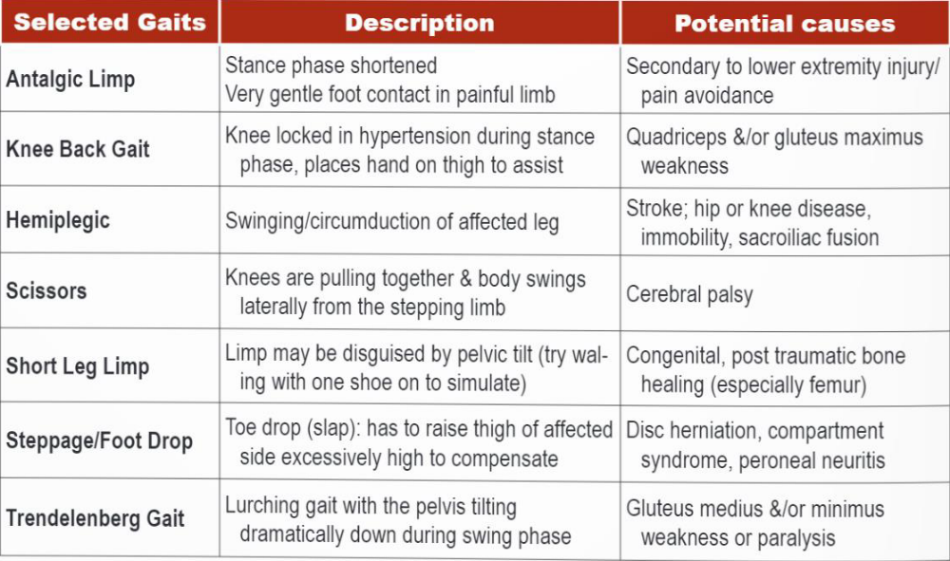
Abnormal
Gait

Slide 34
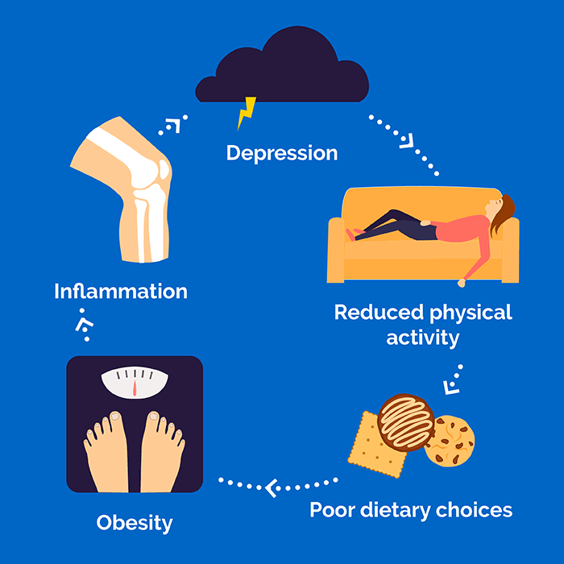
Weight gain& weight loss
Weight gain: excess caloric, fluid retention, endocrine disorders, pregnancy, childhood obesity, physical finding, diagnosis, treatment
Weight loss: non-deliberate, mechanism of weight loss, endocrine, GI weight loss, infection, malignancy, psychologic, diagnostic tests

Slide 35
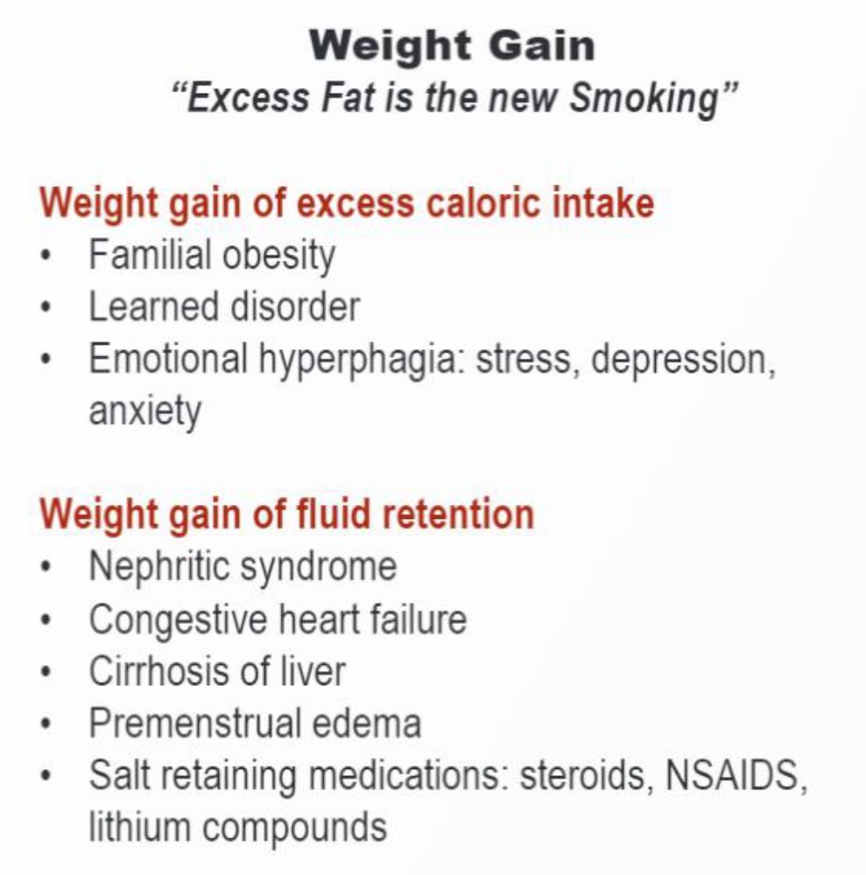
Weight
Gain

Slide 36
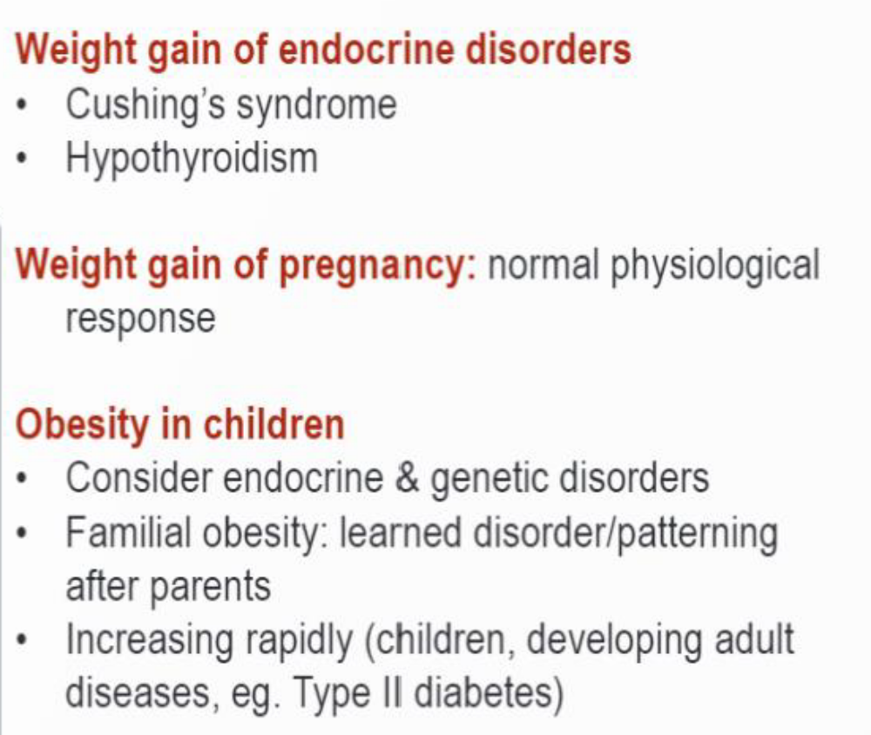
Weight
Gain

Slide 37
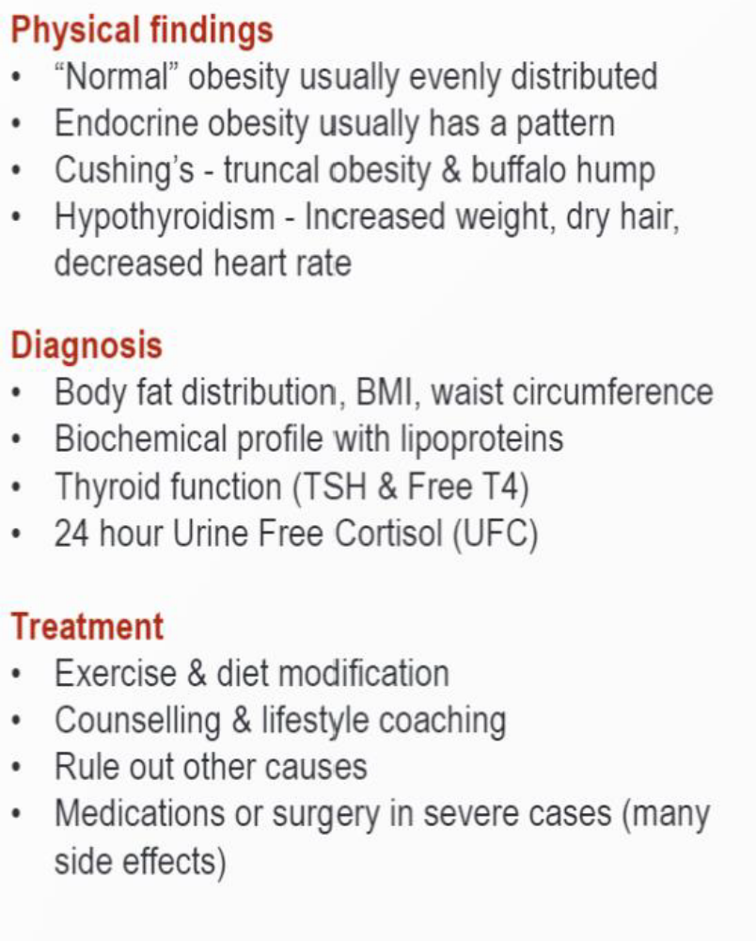
Weight
Gain

Slide 38
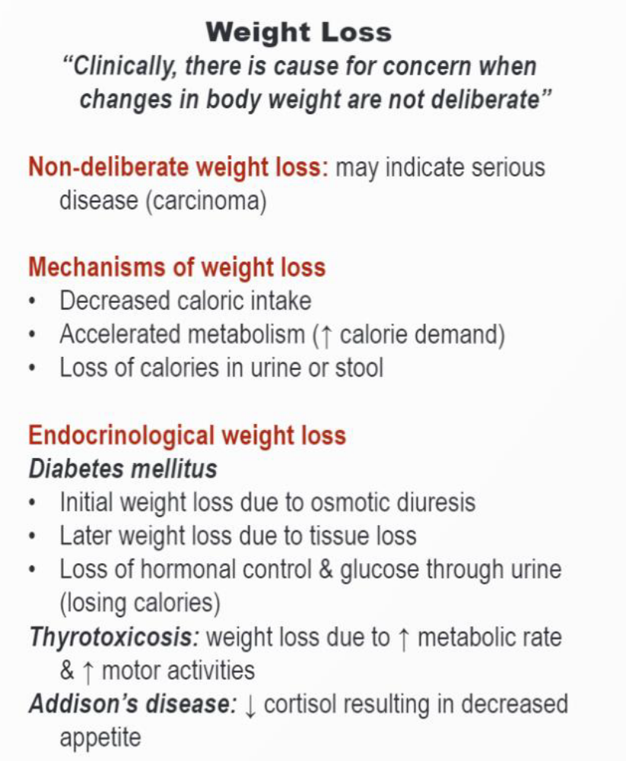
Weight
Loss

Slide 39
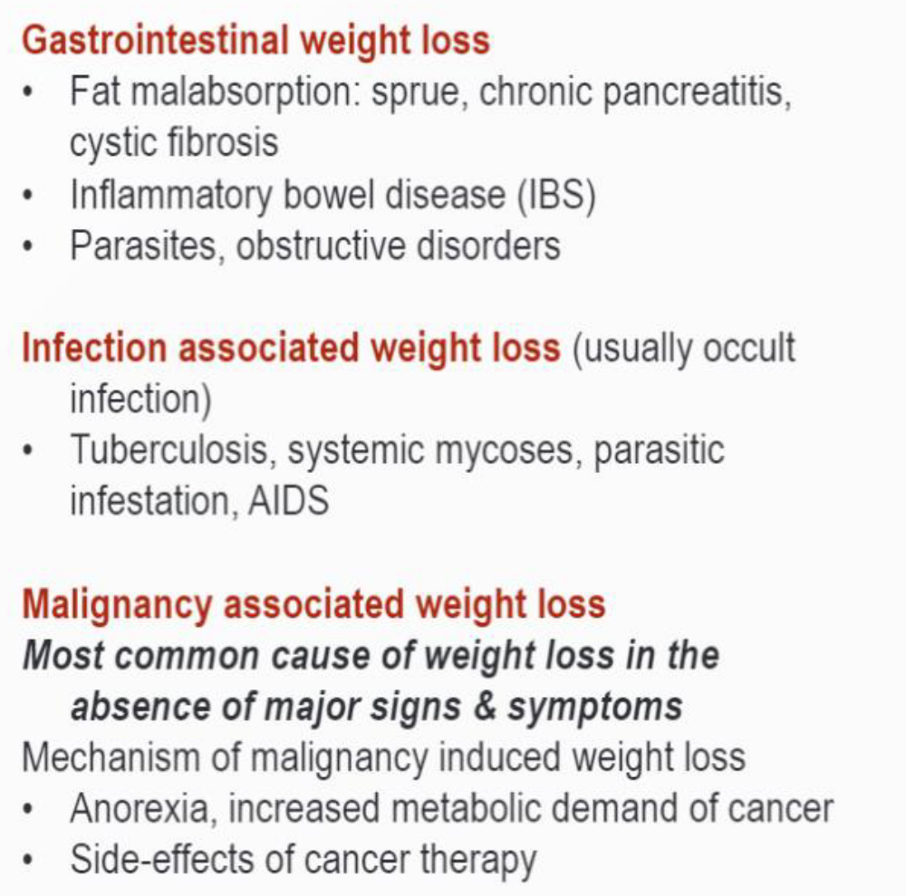
Weight
Loss

Slide 40
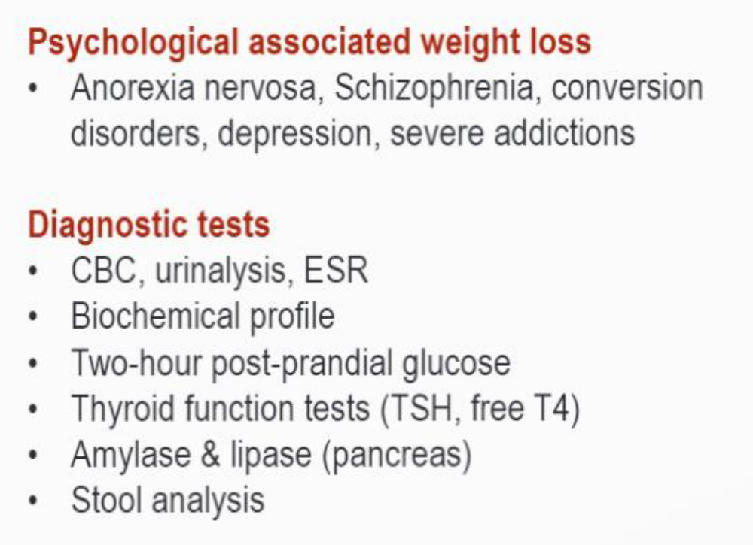
Weight
Loss

Slide 41
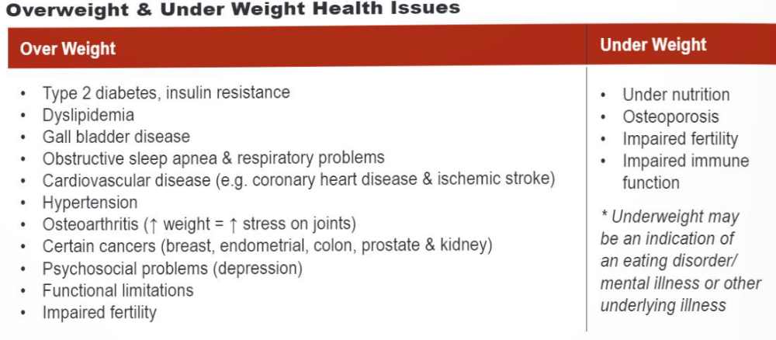
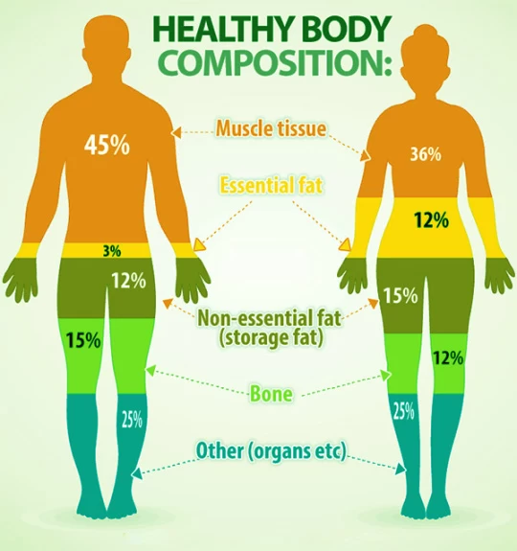
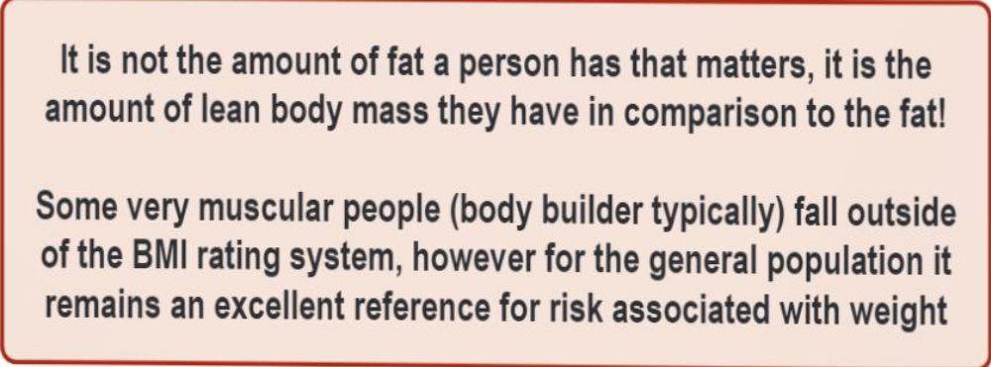
Body Composition

Slide 42
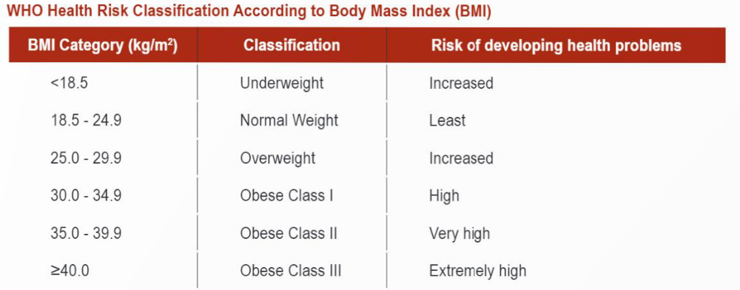
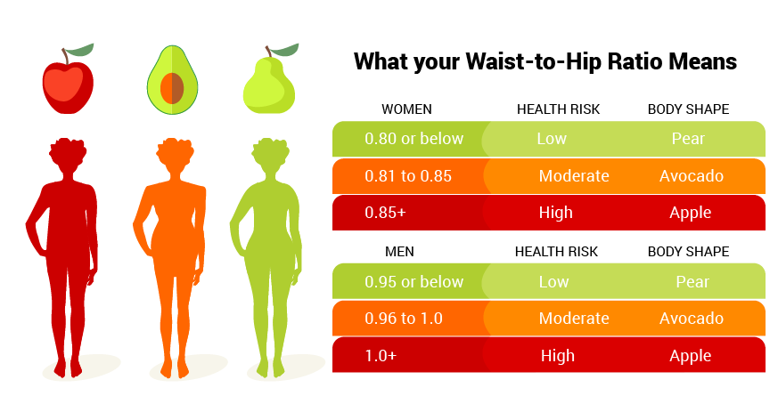
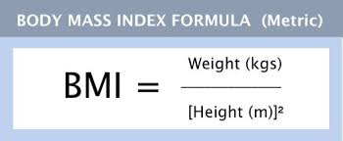
BMI
Waist circumference: index of health risks of obesity

Slide 43
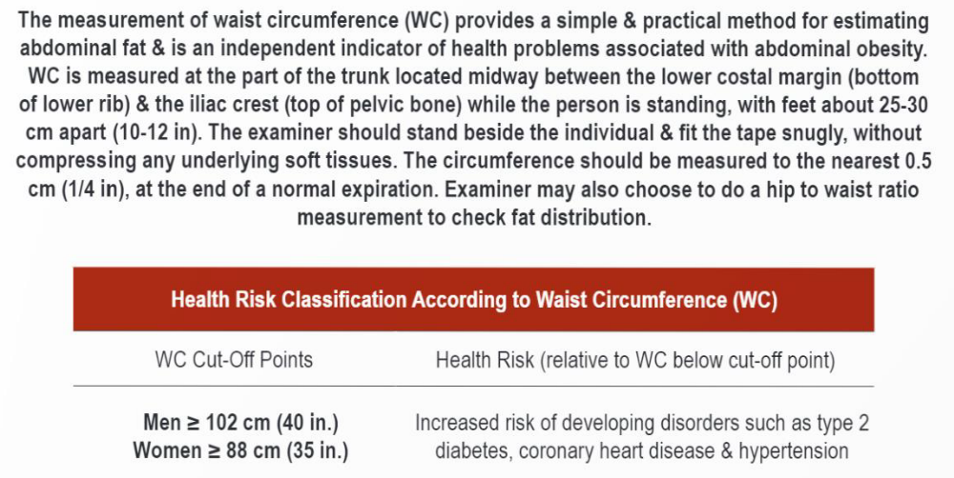
Waist
Circum- ference

Slide 44
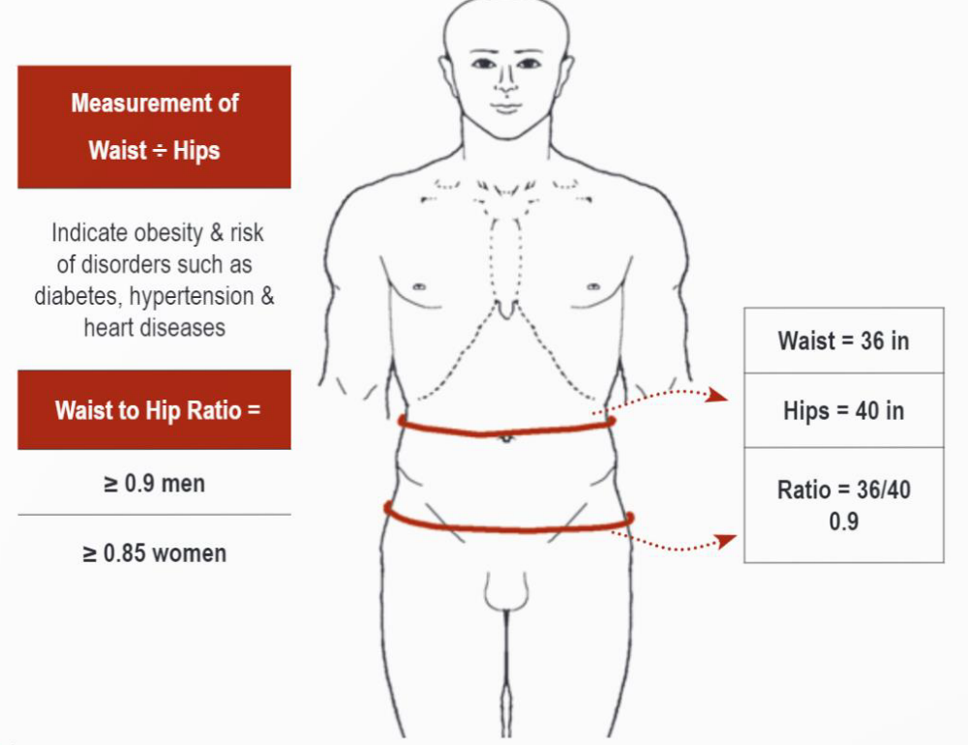
Waist to
Hip ratio

Slide 45
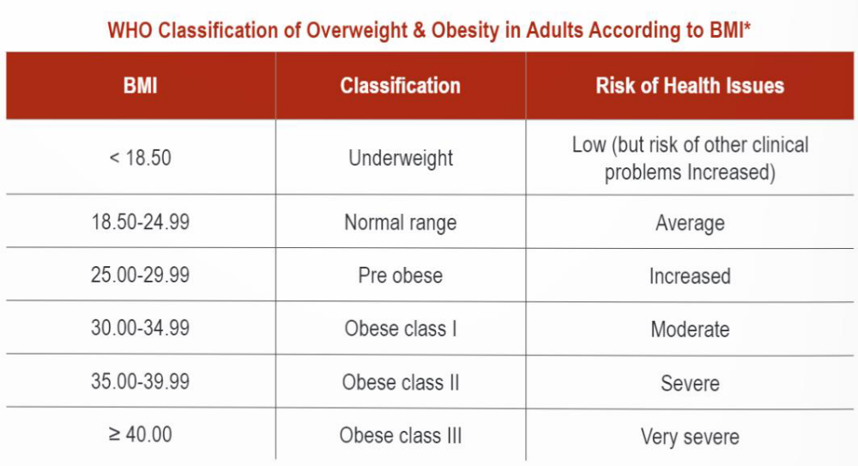
WHO classification

