Slide 1

Physical Assessment 1B
History

Slide 2
History
The patient history is most useful diagnostic tool available 80% of outpatient clinic assessment , based on interview
The interview should continue entire course of treatment
Start with open-ended questions… then progress close-ended
The accuracy of information collected , influences assess and treatment

Slide 3
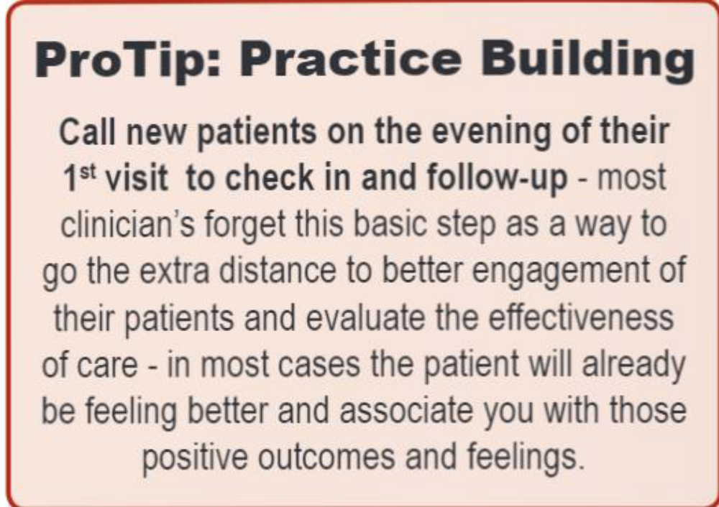

Slide 4
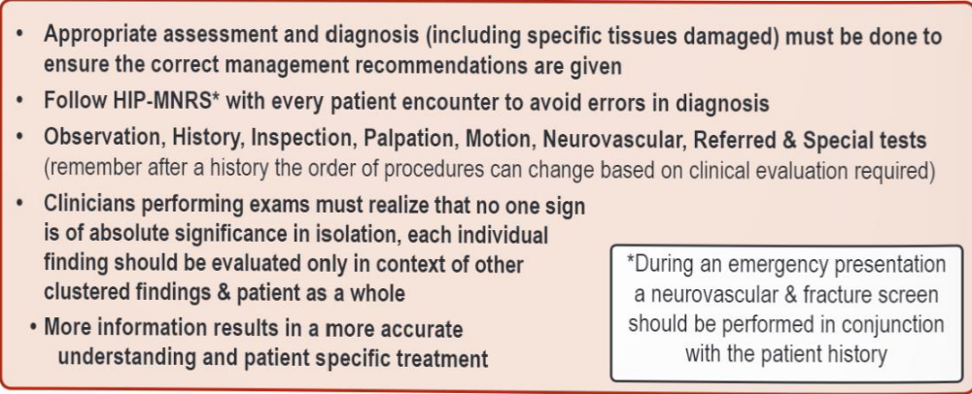

Slide 5
Infection and Hygiene
Wash hands
Use mask
Protect open wound
Avoid dripping perspiration
Breath odors
Hand and fingernail cleanliness
Jewelry and watch
Wipe tables and…
Coughing and sneezing

Slide 6
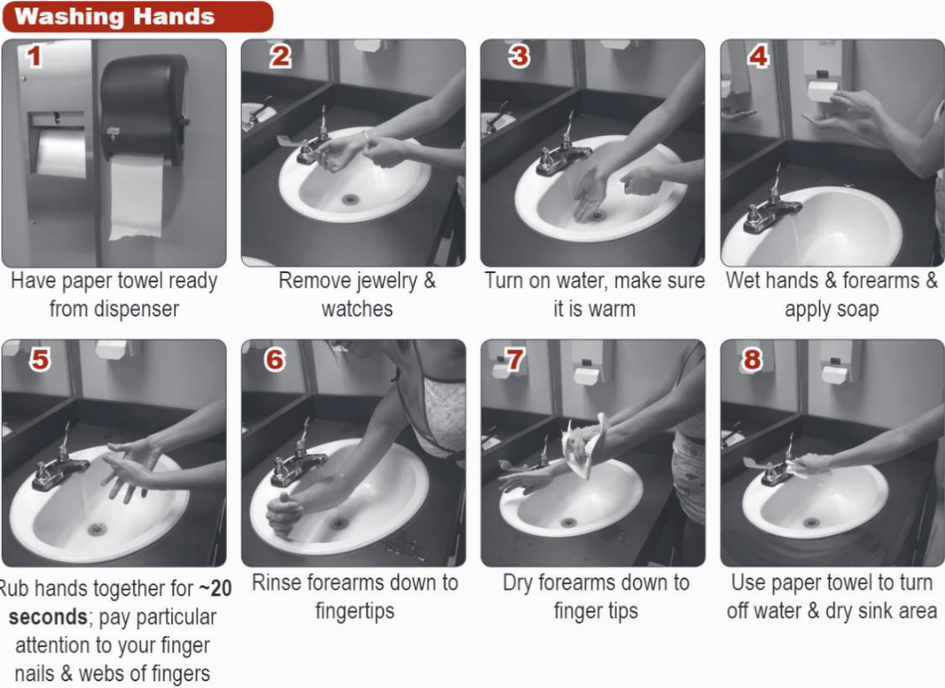

Slide 7
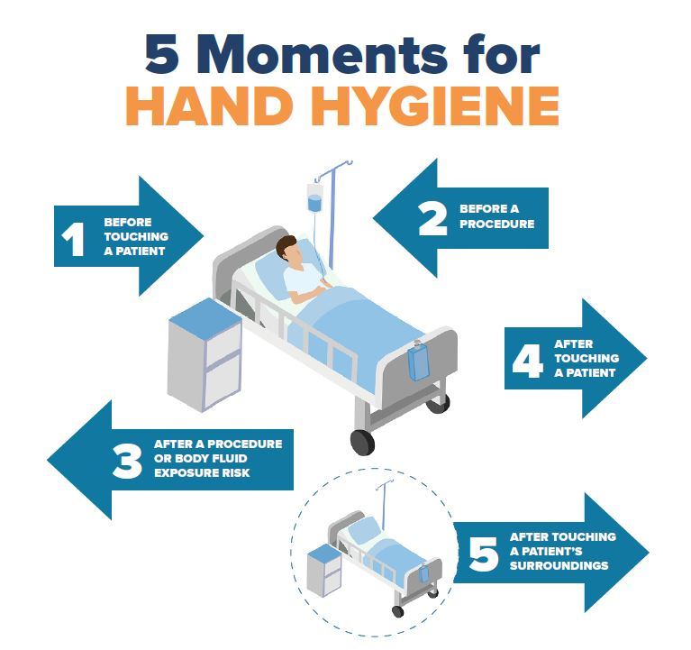

Slide 8
Manual medicine tips
RMTs must always be aware of their biomechanic
Pick the correct table height
Anticipate direction of movements
Adjust posture according to technique and body part
Keep shoulders relaxed
Stand with feet apart, Knees and hips slightly flexed, back straight
Lift heavy limbs close to your body
Use your body weight

Slide 9
Patient movement tips
Practice
Awareness when they are guarding
Firm and solid hand contacts
Voice commands
Smooth movements
Always support injured joints
Axial distraction

Slide 10
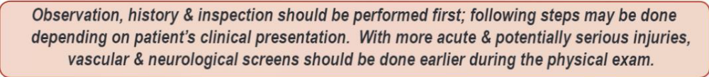
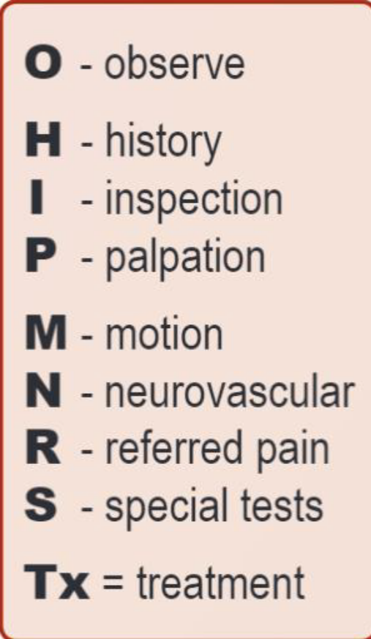
Clinical Encounter
Process

Slide 11
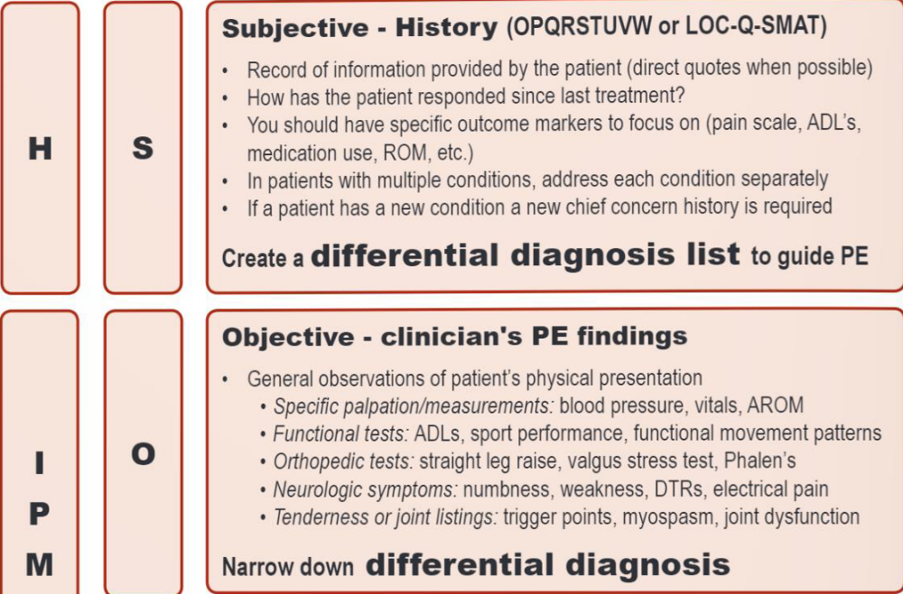
Clinical
Encounter
Records

Slide 12
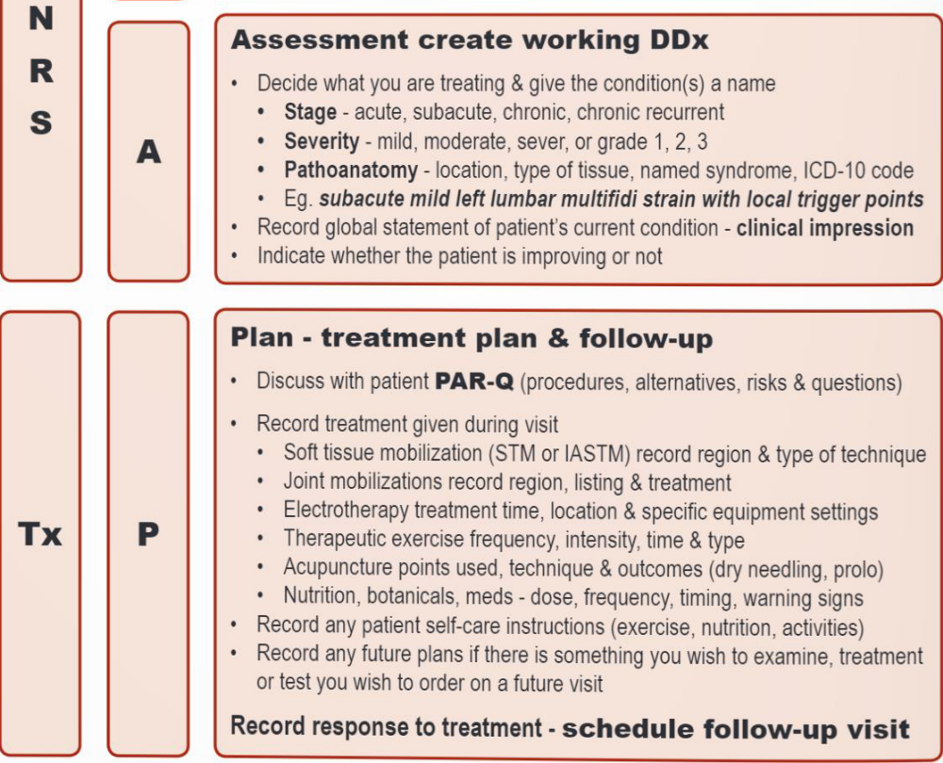
Examiner must sign & date each entry, use ink and write legibly .

Slide 13
Examination Flow
O- observe
H- history
I- inspection
P- palpation
M- motion
N- neurovascular
R- referred pain
S- special tests
Tx- treatment

Slide 14
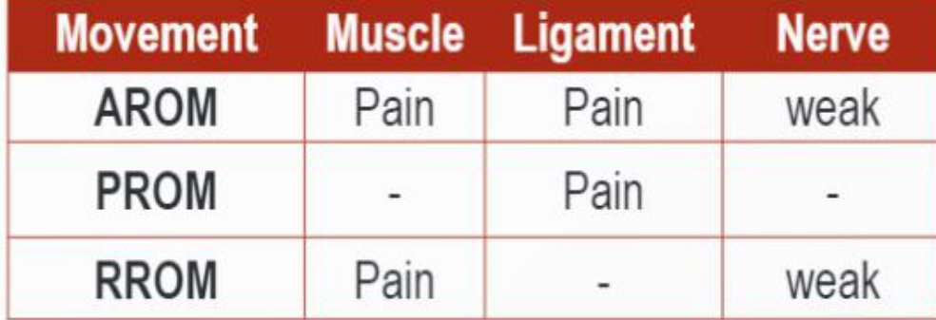
Strain vs Sprain and Neuropathy

Slide 15
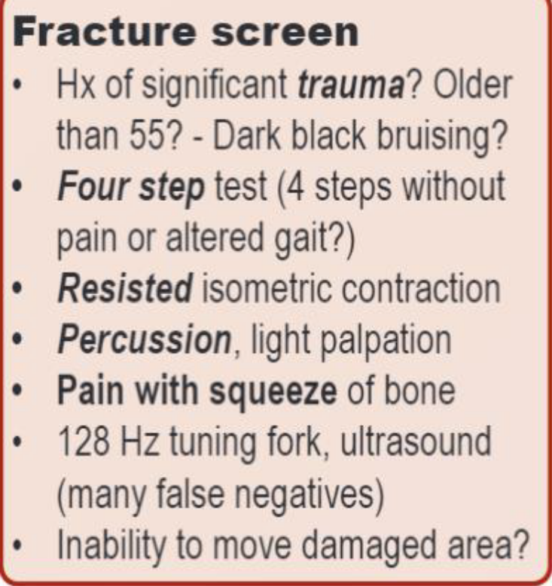
Fracture Screening

Slide 16
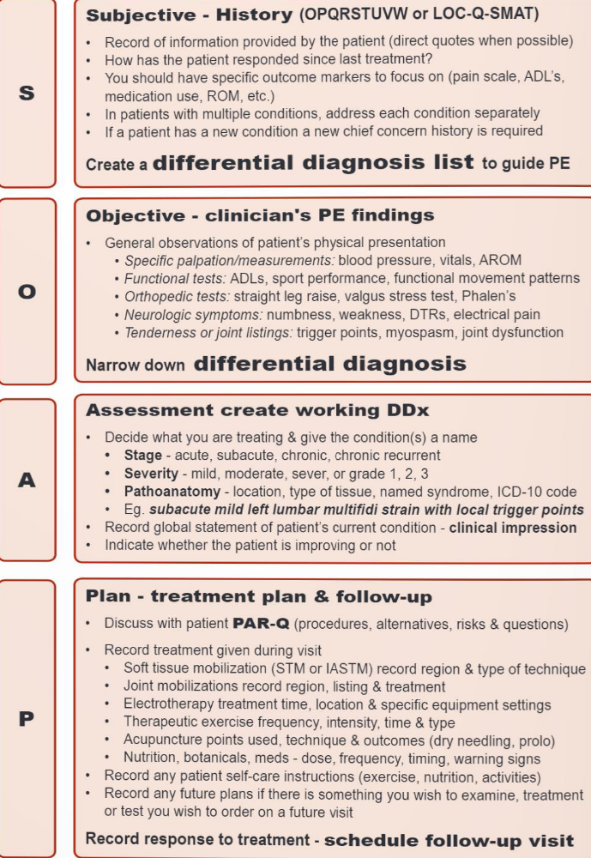
S O A P

Slide 17
Red Flags
History of… Signs and symptoms:
Violent trauma Fever ( >37.8 ‘ C)
Carcinoma High blood pressure ( 160/ 95 )
Systemic steroid use Pulse > 100 bpm
Drug abuse Respiration rate> 25
HIV, Hepatitis Auscultation of bruits
Unexplained weight loss Wide neurological deficits
Constant, progressive pain Saddle paresthesia
Bowel & bladder dysfunction

Slide 18
Chief complaint
Location
Onset
Chronology
Quality
Severity
Modifying factors
Associated symptoms
Treatments previous
Relevant injuries/xrays
Review of systems
Goals

Slide 19
Past Medical History
Serious illness
Hospitalization/surgeries
General trauma, MVA
Menses, menopause
Contraceptive, pregnancies
Medications
Allergies
Xrays, MRIs
Prior care
Last physical exam

Slide 20
Family & personal history
Family health problem
Living situations
Occupation
Exercise
Interests/other activities
Diet
Sleep
Bowel habits
Urinary habits
Habits
Domestic violence
Stress factors/ supporting system

Slide 21
Review of Systems
General Musculoskeletal
Skin Neurologic
HEENT Hematologic
Neck Psychiatric
Breast
Respiratory
Cardiovascular
Gastrointestinal
Genitourinary
Female
Male
Endocrine

Slide 22
Outcome Markers
Pain
Activities of daily living (ADLs)
Orthopedic tests/ Range of motion
Strength
Endurance
Flexibility ( ROM )
Neurological
Quality of life
Outcome Assessment Questionnaires

Slide 23
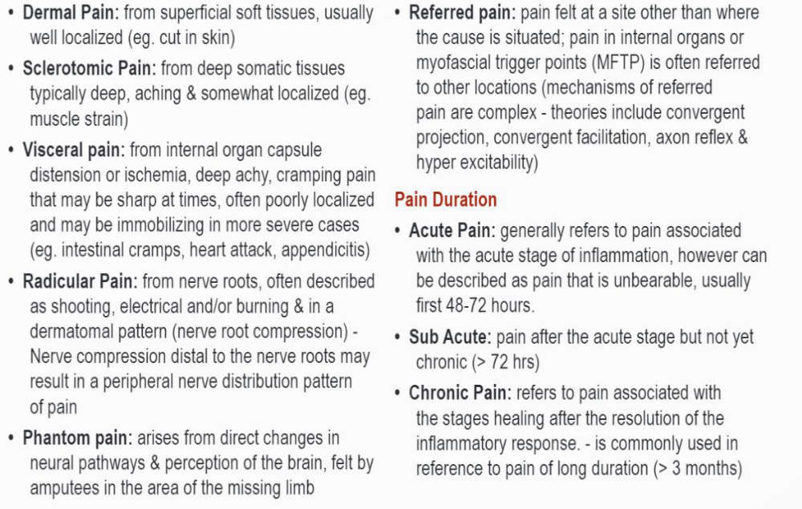
Pain parameters

Slide 24
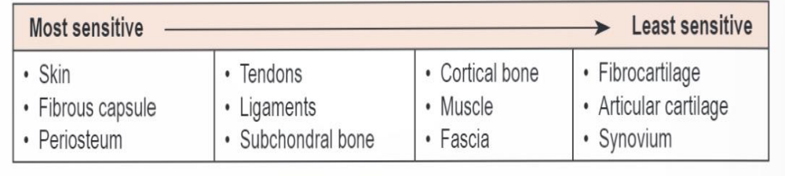
Pain Assessment
What is your current pain?
What is your usual pain level?
What is the pain in its worst?
What is the pain at its least?
0-10 scale can be applied to different symptoms( discomfort, nausea, fatigue, stress…)
(

Slide 25
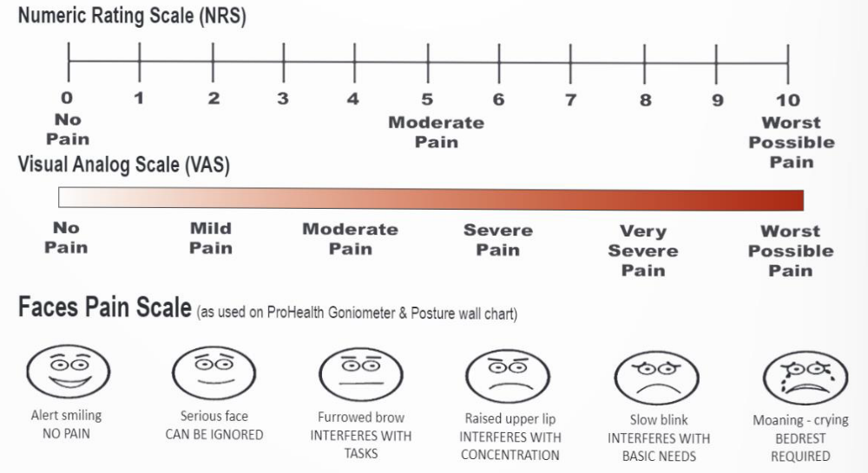
Pain assessment

Slide 26
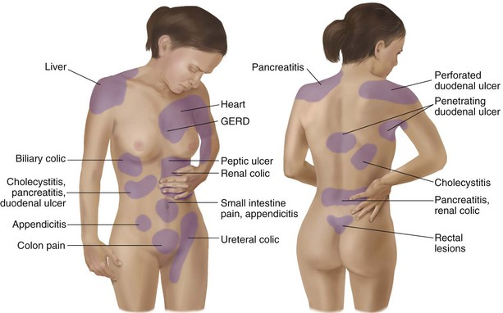
Visceral pain Referral

Slide 27
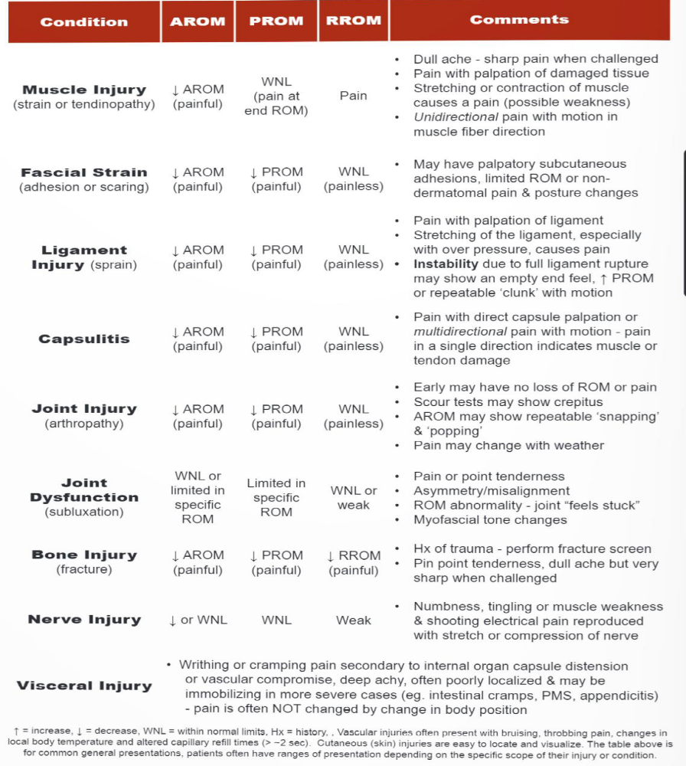
Tissue specific Differential

Slide 28
Problem list
Once you did history and physical exam, decide which problems are active, and should be in problem list.
The problem list may include: diagnosis, physical exam signs, symptoms, laboratory tests, psychosocial history or risk factors ( alcohol, obesity, smoking ).
Chronological summary of important problems.

Slide 29
Prognosis estimate of the potential outcome of a given condition
General information: age, general health, severity, pathogenesis, complicating factors( diabetes, DJD…), experiencing before, operant factors( patient compliance, lifestyle, occupation…)
Vocabulary: prognosis is… (excellent, good, fair, guarded, poor, pending)
Attempt to: discuss your opinion, differentiate cure and relief, indicate recurrence and residual, symptomatic care, remember you can change prognosis

Slide 30
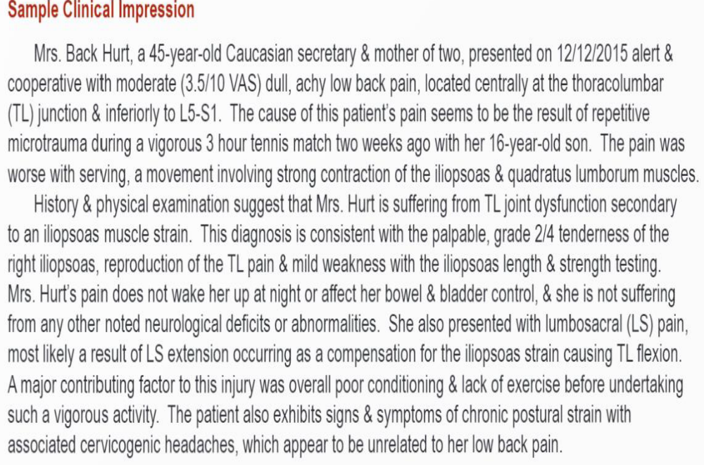
Clinical Impression

Slide 31
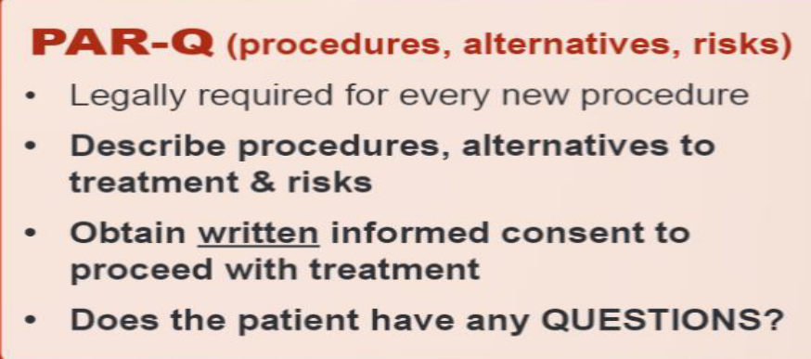
Review of Finding is given to patient after history & physical exam
Greeting: current status, review finding, Tx recommendation
Describe conditions: what cause
Described treatment: frequency & duration, type
Establish goals: outcome measures
Describe compliance: patient role, address barriers
Describe expectation: when to re-evaluate
Conclusion: patient questions,and education

Slide 32
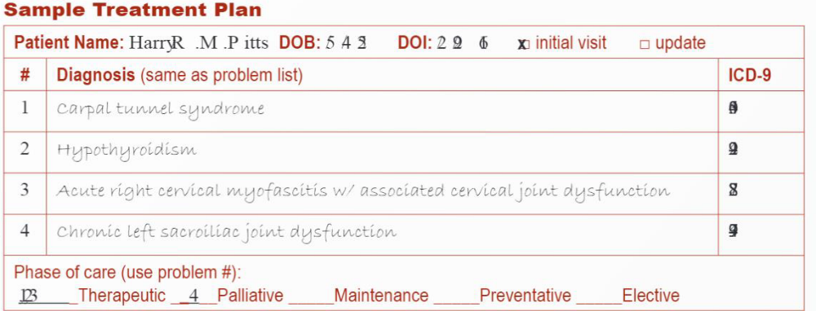
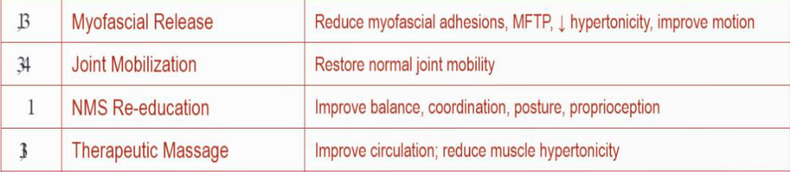
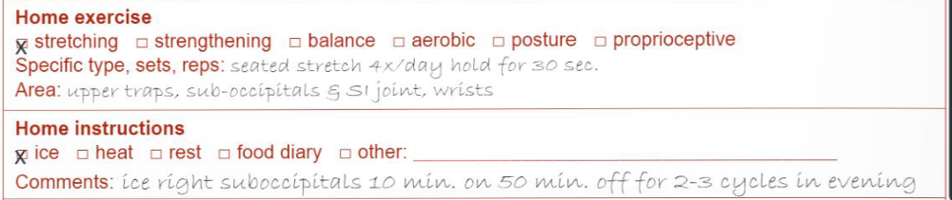
Treatment Plan

Slide 33
Narrative Report
Introductory statement
History
Past health history
Family history
Social/personal history
Initial physical exam
Follow up exam
Working condition
Clinical impression
Treatment plan
Prognosis
Comments
Closing statements

Slide 34
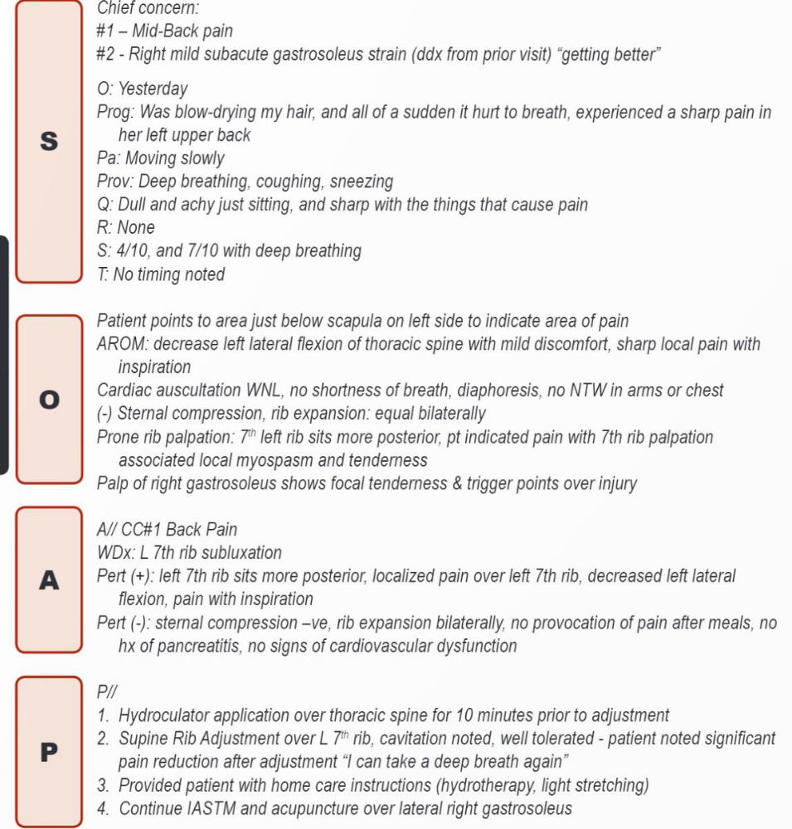
SOAP notes sample

