Slide 1

Physical Assessment 1
Introduction

Slide 2
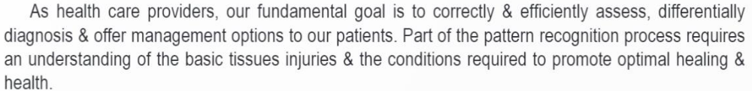
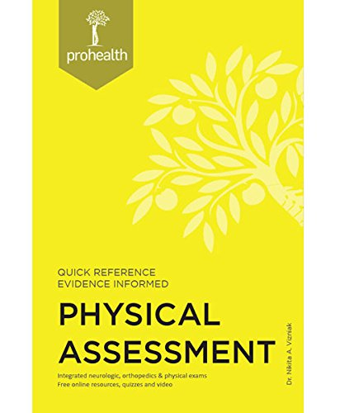

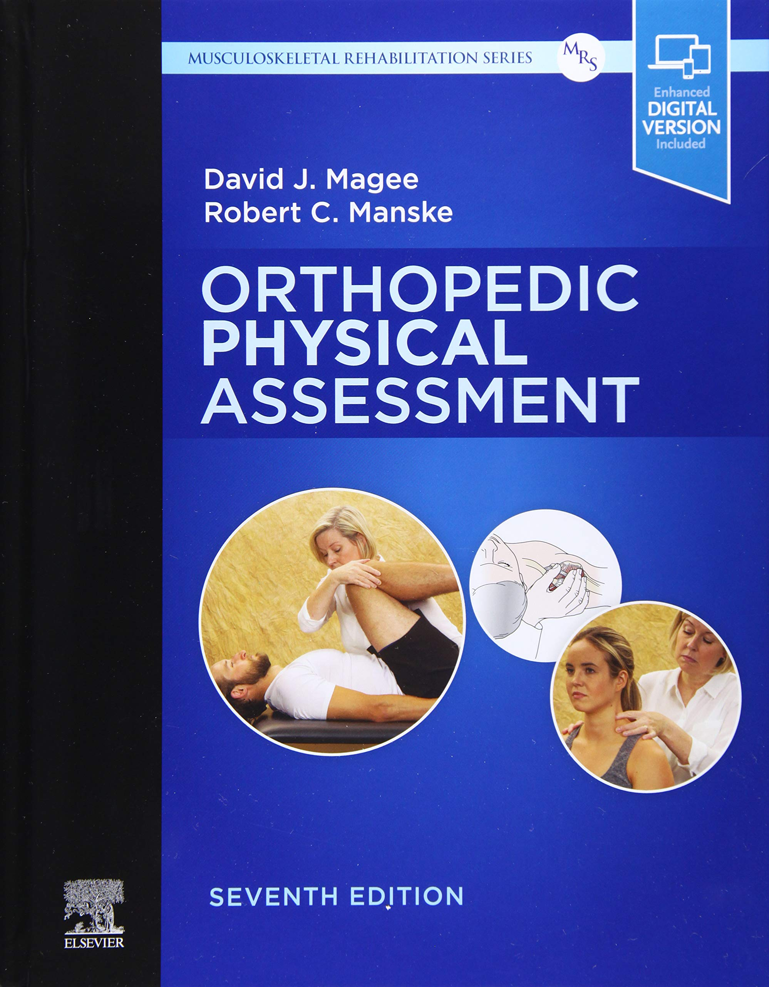
References

Slide 3
1. First do not harm
2. The healing power of nature
3. Identify & Treat the causes
4. Therapist as teacher
5. Treat the whole person
6. Disease prevention & Health promotions

Slide 4
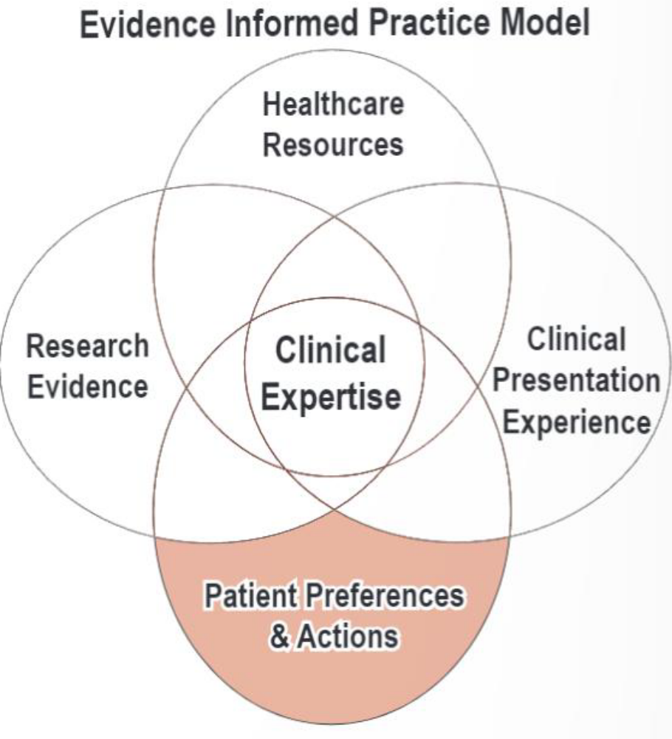
Evidence informed practice

Slide 5
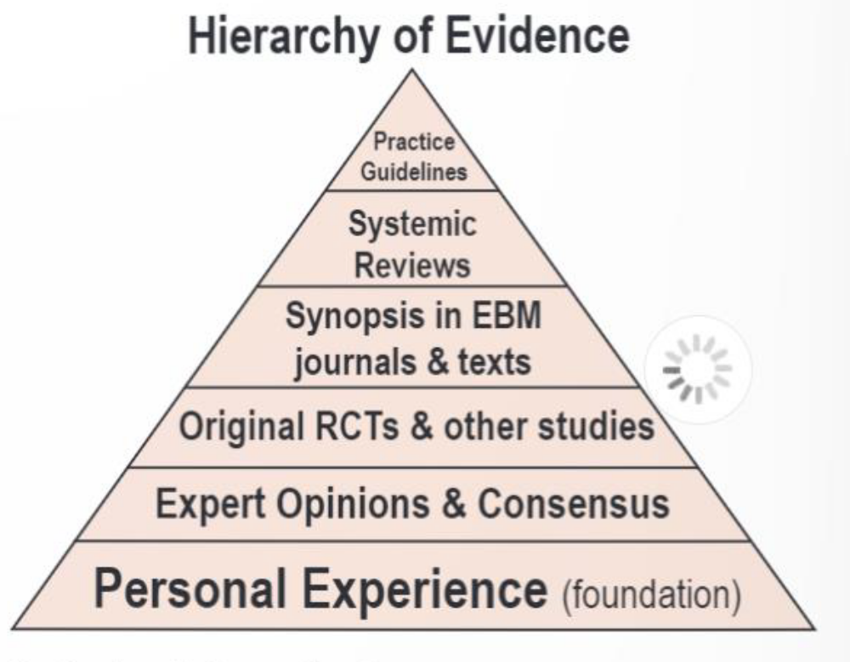

Slide 6
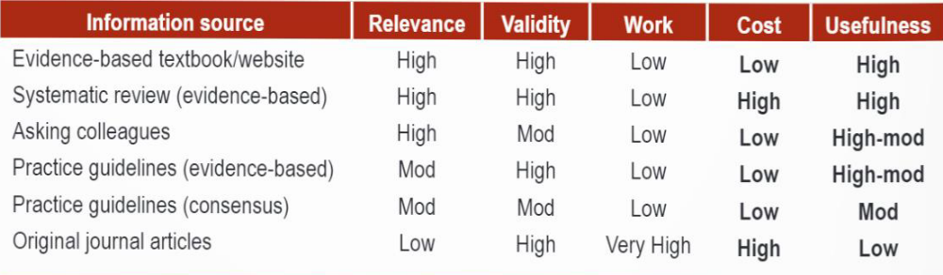

Slide 7
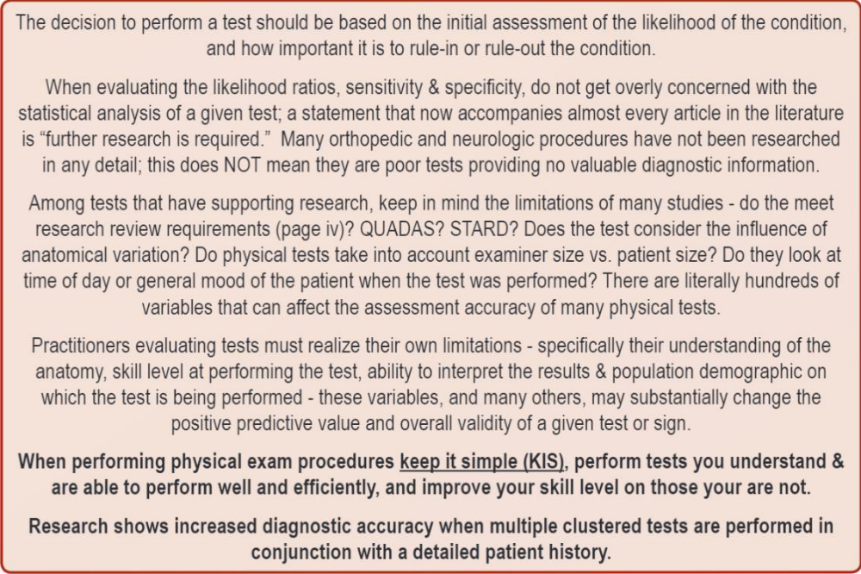

Slide 8
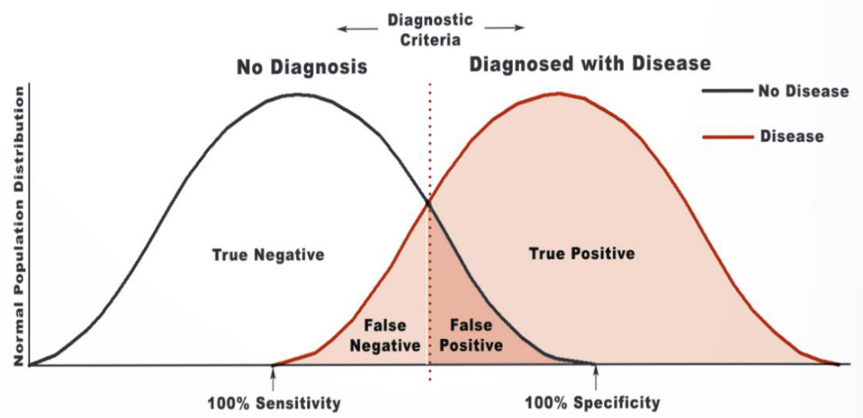
Sensitivity &
Specificity

Slide 9
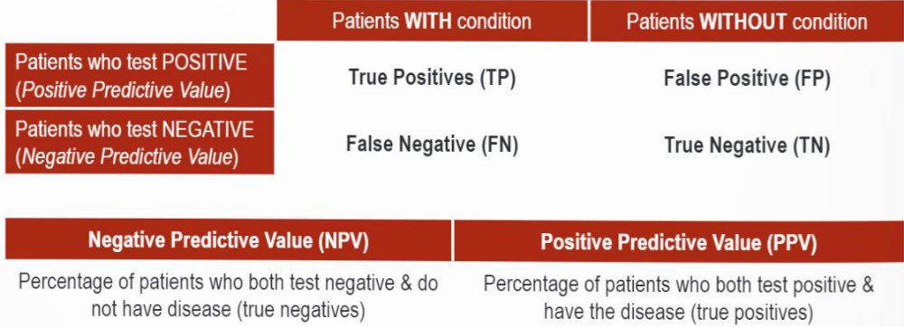

Slide 10
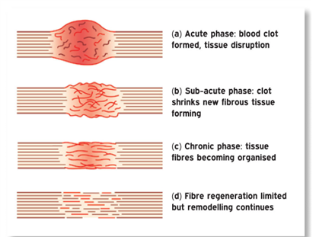
Soft Tissue
Healing
1. Acute inflammation
2. Post-acute repair/proliferation
3. Remodelling

Slide 11
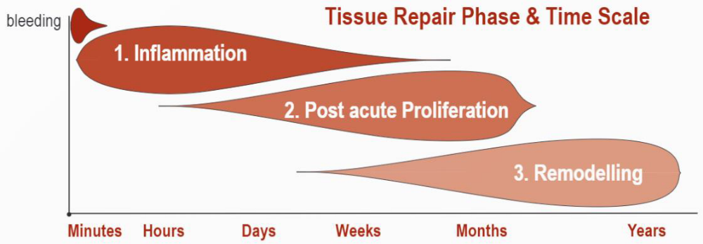

Slide 12
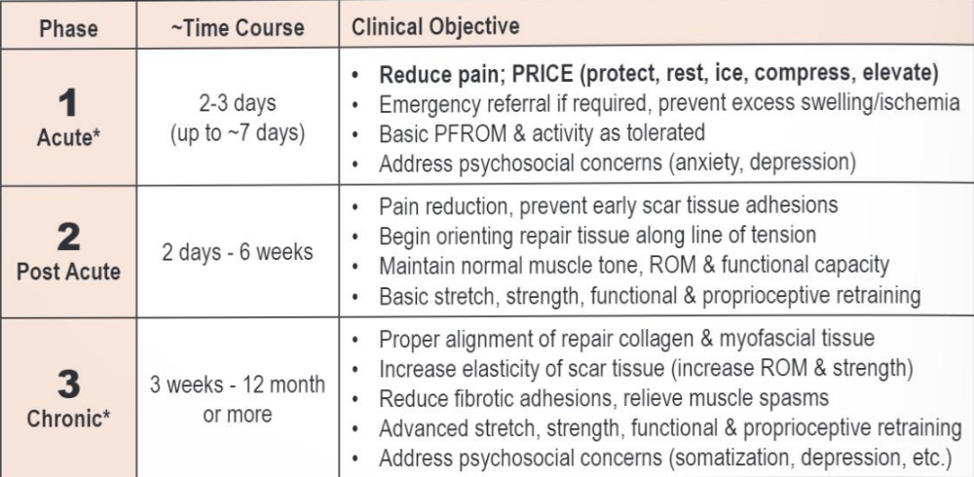
Treatment Guidelines

Slide 13
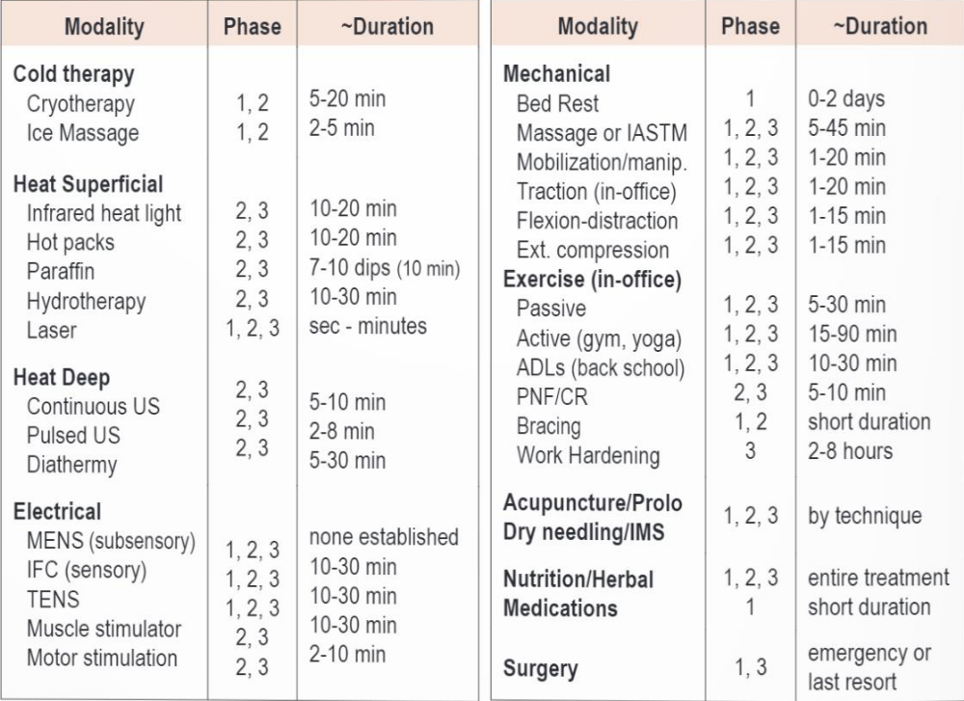
Modality
Guidelines

Slide 14
Psychology of Chronic
Injury
Psychological factors that predicts worse outcome:
1. Signs of depression
2. Passive coping strategies
3. Job dissatisfaction
4. Higher disability levels
5. Disputed compensation claims
6. Fear avoidance beliefs
7. Somatization

Slide 15
Coping statements:
1. Diverting attention
2. Hoping or praying
3. Increasing behavioral activity
4. Ignoring or reinterpreting the pain
5. Catastrophizing

Slide 16
