Slide 1

Pathologic Treatment 2
Understanding Fascia

Slide 2
Understanding Fascia
Previously thought to be a passive connective tissue
Research showed, an essential element in the long-term resolution of many chronic conditions
Fascia is soft but dense…forming 3D matrix that provides support and shock absorption… communicates vital information of tensions… facilitates nutrients and removal metabolites.
There are 3 types of fascia: superficial, deep, viceral

Slide 3
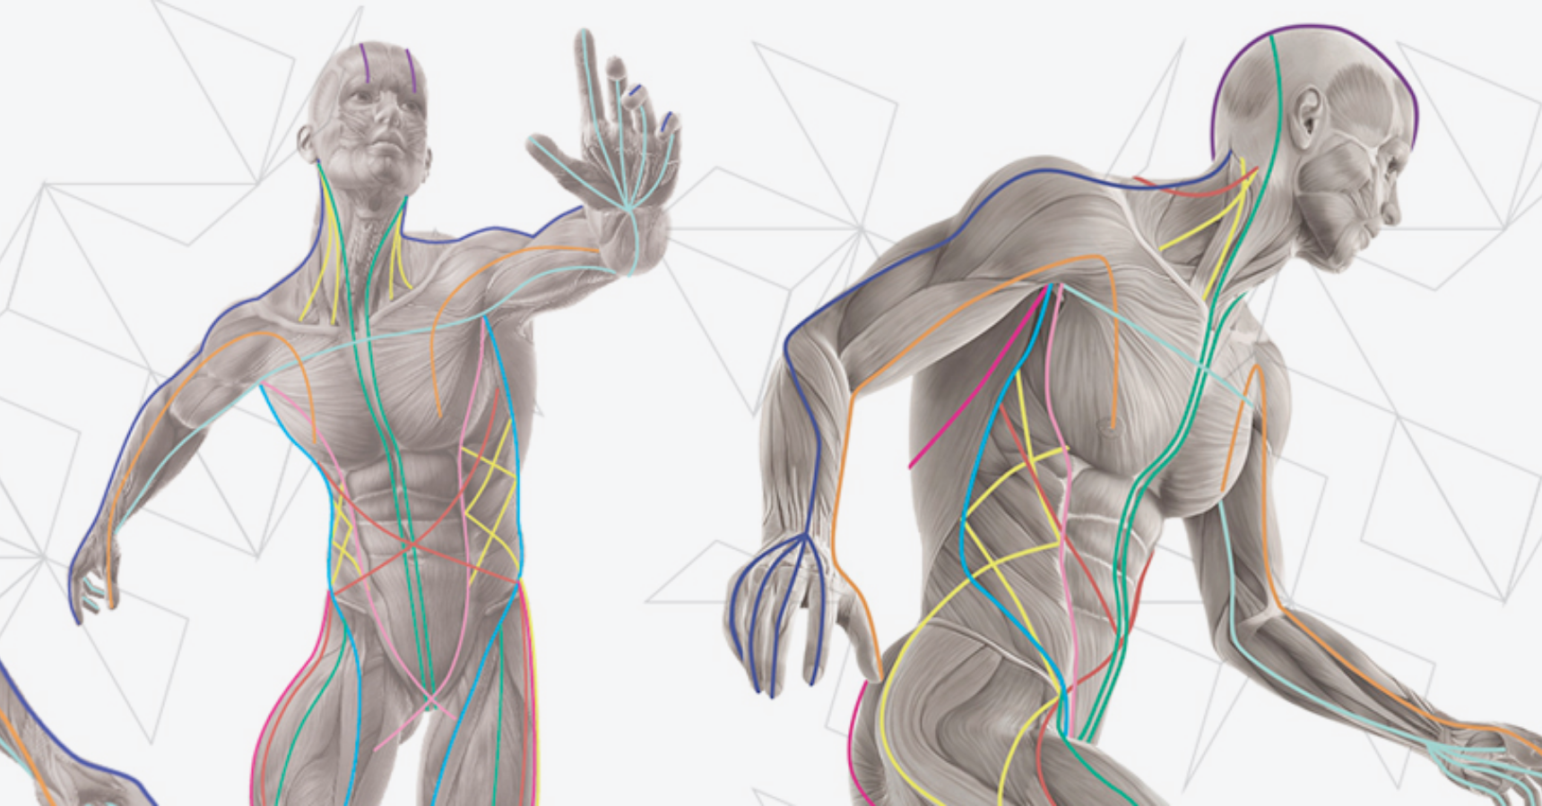
Human fascia

Slide 4
Fascia primarily comprises ground substance (diluted gel- fluid character) , collagen( strength and resilience of fascia) and elastin( makes fascia flexible and stretchy) …
Fascia is also packed with integrins-receptors that detect tension and compression…
Fascia thoroughly innervated by mechanoreceptors such as Golgi, Ruffini and Pacini corpuscles providing both sensory and motor functions…
Myofascial lines support the common lines of pull…

Slide 5
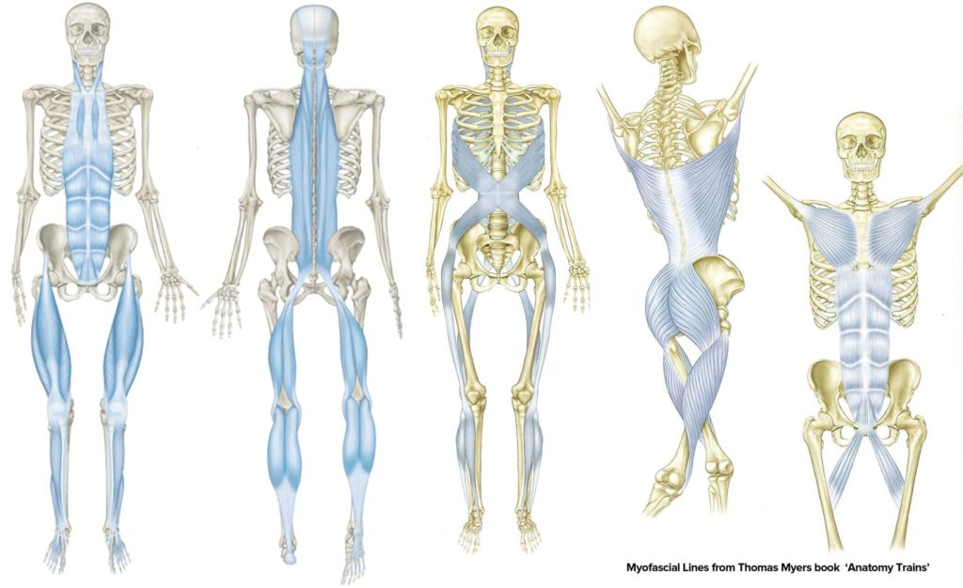

Slide 6
Tensegrity( tensional integrity) in structure means tension in one part of the structure must be balanced by tension in another.
This is much like when you pull the ends of cotton ball.
When an area repeatedly stress, the muscle becoming short, thick and local fascia loses function and falls out of balance .
Ultimately, adhesion, hypertonicity, trigger points and chronic pain syndrome may develop.

Slide 7
Possible Causes and Contributing Factors
Mechanical overload, whether caused by an acute injury, repetitive misuse, or postural imbalance is a primary contributing factor in the development of myofascial restrictions.
Immobility following an injury for long periods cause the thickening of ground substance and adhesion.
Daily regular exercise reduces the risk of developing myofascial restrictions.
Scar formation binds fibers together and increases adhesion.
Pathologies including chronic inflammation, infection, hormonal imbalance and nutritional deficiencies can also function of fascia.

Slide 8
Contraindications and Special Considerations
Infection
Acute injury
Producing symptoms
Hypermobile joints and overstretched muscles
Treatment duration and pressure
Frictions

Slide 9
Assessing and Treating Myofascia
A client will not likely complain specifically about fascial restrictions but will likely refer to a general or specific area of pain or tension.
As a general rule, you want to move fascia in the direction that you want the affected structure to move.
After postural assessment, palpation will give you accurate picture of client’s myofascial health.
It is best to assess and treat myofascial restrictions before applying emollient to prevent gliding over the restrictions.
Assess the texture, temperature, tone and tenderness of areas.

Slide 10
Cross fiber strokes are an effective way of initially breaking up adhesions and increasing space between structures or fibers.
Skin rolling is an excellent technique for both assessing and treating superficial myofascial.
Rrestrictions may also be recognized as tissues that do not spring back after compression or stretching.
Without gliding, move your fingers away from each other in the direction you intended to stretch the fascia until you feel movement.

Slide 11
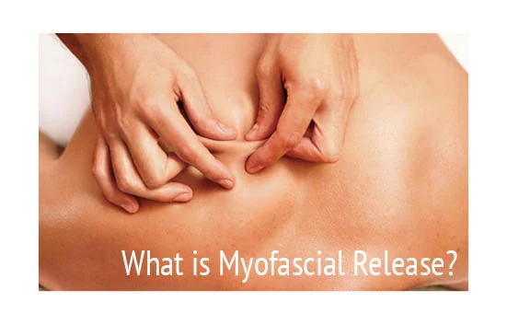
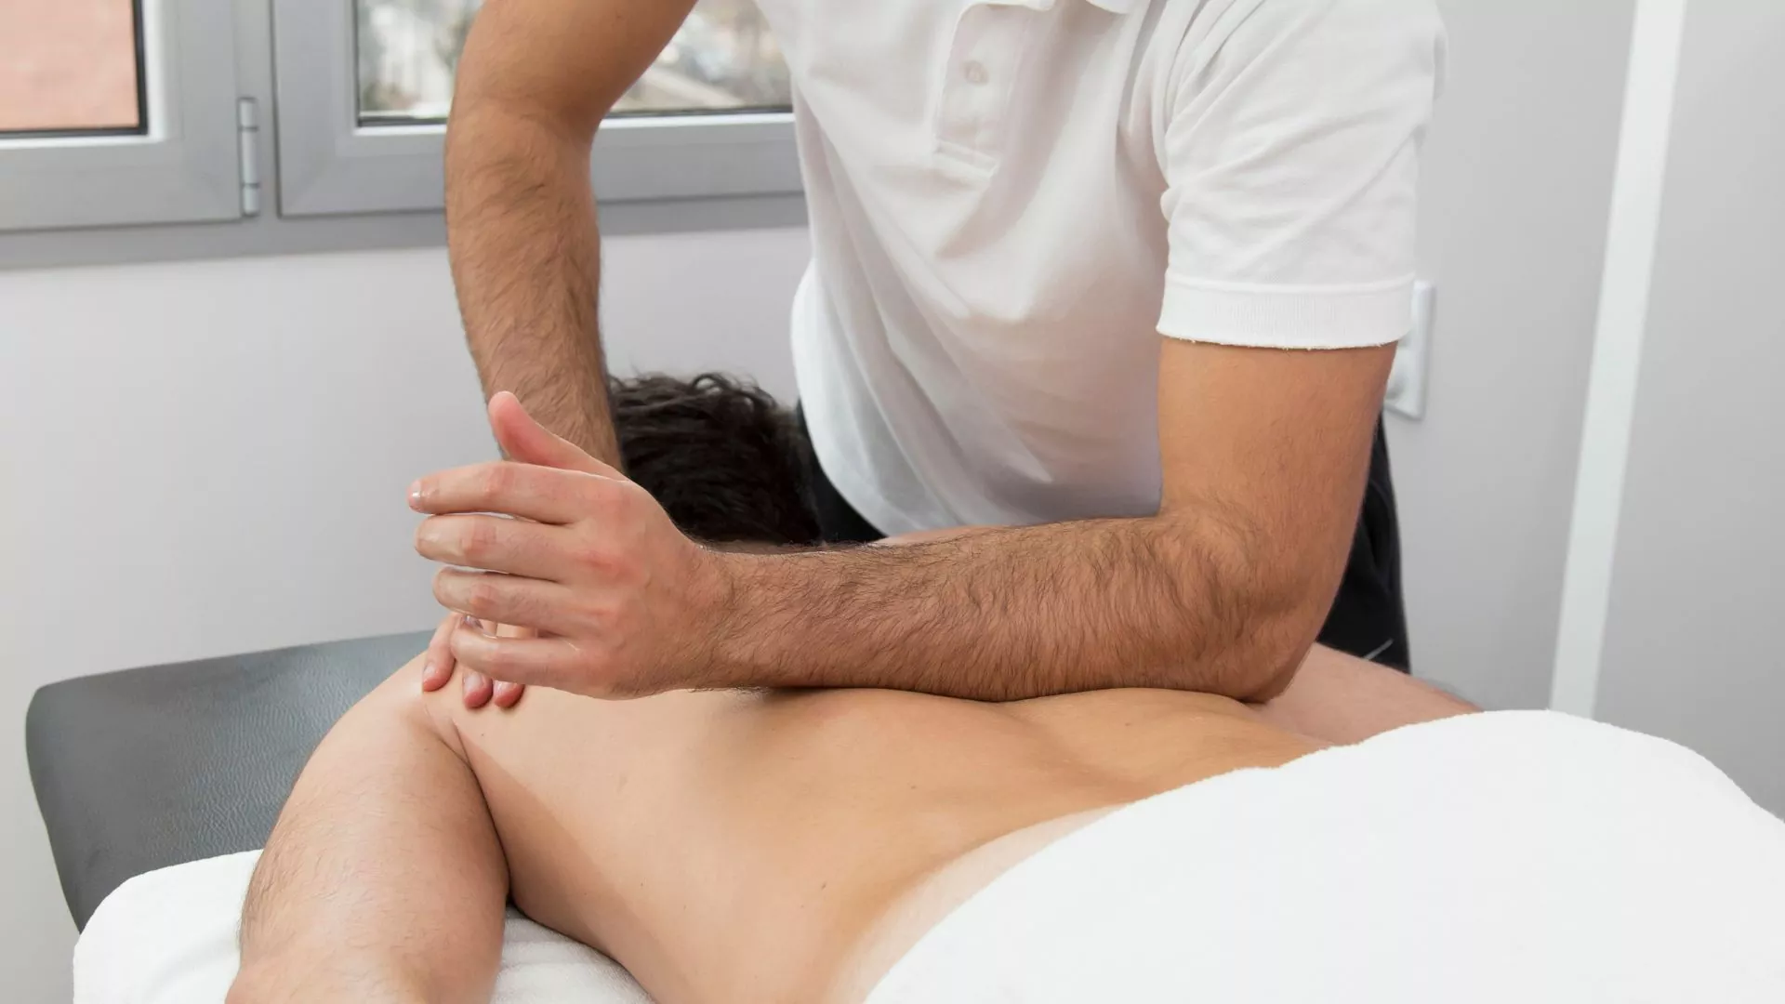
Skin rolling
Myofascial release

Slide 12
Superficial and deep fascial restrictions can also be released by distorting the shape of tissue, with C-stroke and S-stroke.
Slow cross-fiber strokes are a good assessment tool for deeper myofascial restrictions and an excellent tool for releasing them.
During your assessment and treatment, the client may report sensations such as burning, itching, scratching or pinpricks.
Instruct your client to breath deeply while treating painful areas, and take care not to cause a level of pain not tolerated.
To get the best results, hold an myofascial stretch until release.

Slide 13
Massage Therapy Research
Some of researches:
Tenegrity principle in massage(2009)
Effects of myofascial release(2008)
Efficacy of myofascial release techniques(2008)

Slide 14
Case Study
Maria is a 28-year old gardener, with heel pain…
Subjective
Objective
Action
Plan

Slide 15
Critical Thinking Exercises
1.become more familiar with texture of muscles
2. begin with an area of restriction on partner with 2 fingers
3. area of superior angle scapula is often dense
4. learn about MRT and chronic infections, thyroid dysfunction, diabetes, stress…

