Slide 1
Kinesiology 12B
Gait

Slide 2
Age-Related Gait Patterns
Not all gait patterns that don’t comply with “normal” gait characteristics are the result of pathology. The walking patterns of young children and elderly adults have characteristic differences from the walking pattern of younger adults. These are considered age-related, not pathological, changes. The differences seen in young children tend to disappear as they get older. They tend to walk with a wider walking base, cadence is faster, and stride length is shorter. Initial contact with the floor is with a flat foot, as opposed to heel strike. Their knees remain mostly extended during stance phase. In other words, they tend to take more steps that are shorter and choppy in a faster period of time. They also have little or no reciprocal arm swing. This is easy to observe as a child walks with an adult.

Slide 3
Even in the absence of pathology, an elderly adult’s walking pattern undergoes change. Although there is not universal agreement on the reasons for these changes, it is generally felt that security and fear of falling are major contributors. Typically, older adults lose muscle mass, are less active, and often have poorer hearing and vision. It should be recognized that the effects of age are relative to many factors such as health, activity level, and even attitude. Some 70-year-old people may appear “older” than others ten or more years their senior. Given all of these qualifiers, some general statements can be made regarding the changes in the walking pattern of elderly individuals. They tend to walk slower, spending more time in stance phase. Therefore, there are longer periods of double support. They take shorter steps, thus, vertical displacement is less. They walk with a wider base, and so have greater horizontal displacement. There are fewer, or slower, automatic movements, which may be another factor increasing the chance of stumbling or falling. In turn, this may contribute to increased toe-floor clearance.

Slide 4
Abnormal (Atypical) Gait
The causes of an abnormal gait are numerous. It may be temporary, due to a sprained ankle, or permanent, following a stroke. There can be great variation depending upon the severity of the problem. If a muscle is weak, how weak is it? If joint motion is limited, how limited is it? As with all causes of abnormal motion, severity or degree of involvement will always result in a range of variations from minor ones to major ones. There are many methods of classifying abnormal gait. The following is a listing of abnormal gaits based on general cause or basis for the abnormality:

Slide 5
Muscular weakness/paralysis
Joint muscle range-of-motion (ROM) limitation
Neurological involvement
Pain
Leg length discrepancy

Slide 6
Muscular Weakness/Paralysis
Depending upon the cause or severity of the condition, muscle weakness can range from slight weakness to complete paralysis, in which there is no strength at all. Generally speaking, with muscle weakness, the body tends to compensate by shifting the center of gravity over, or toward, the part that is involved. Basically, this reduces the moment of force (torque) on the joint, lessening the muscle strength required. Obviously, the portion of the gait cycle affected will be that portion in which the muscles or joints have a major role. Traditional terminology will be used with RLA terms in italics when there is a difference in terms.

Slide 7
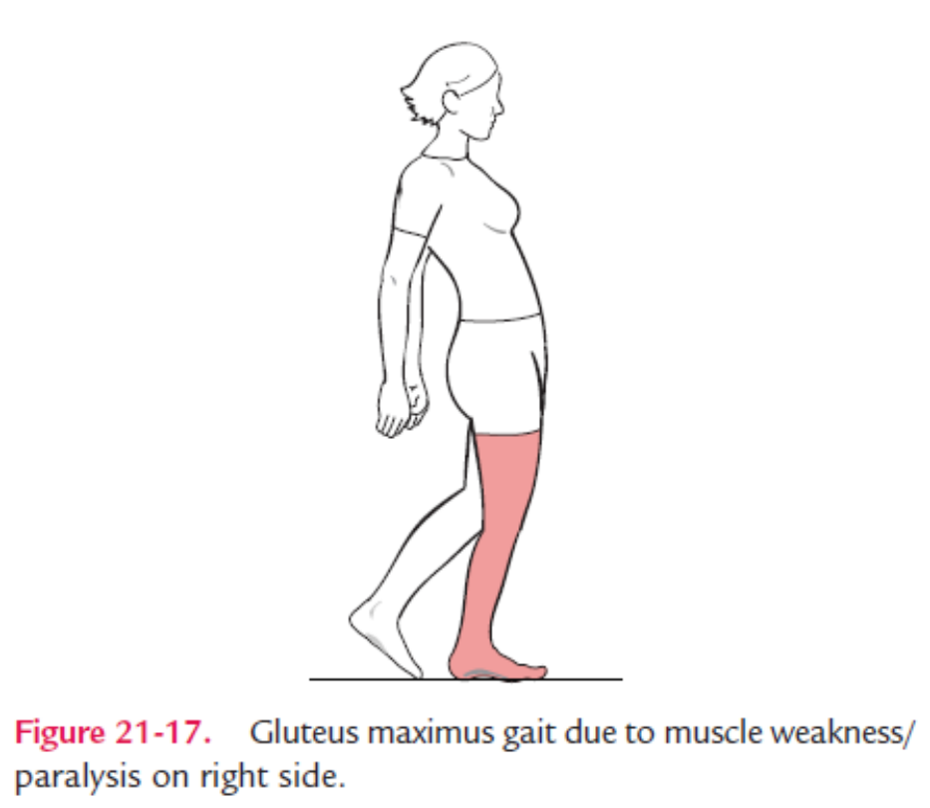
In the case of the gluteus maximus gait, the trunk quickly shifts posteriorly at heel strike (initial contact). This will shift the body’s center of gravity (COG) posteriorly over the gluteus maximus, moving the line of force posterior to the hip joints.
With the foot in contact with the floor, this requires less muscle strength to maintain the hip in extension during stance phase. This shifting is sometimes referred to as a “rocking horse” gait because of the extreme backward- forward movement of the trunk.

Slide 8
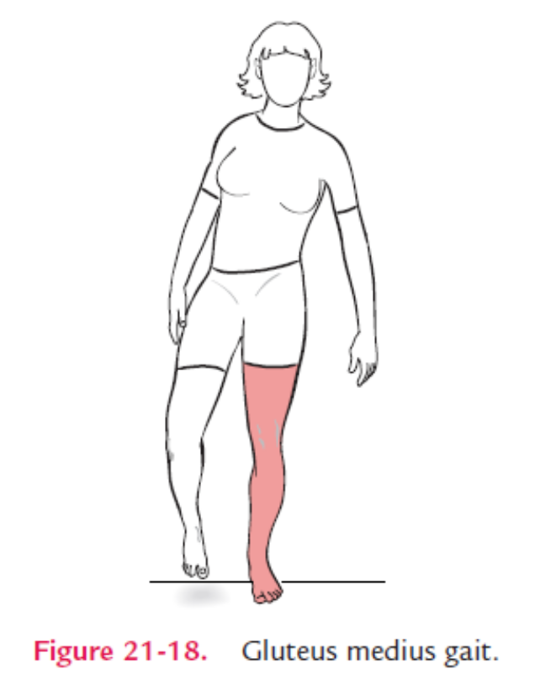
With a gluteus medius gait, the individual shifts the trunk over the affected side during stance phase. In Figure, the right gluteus medius, or hip abductor, is weak causing two things to happen: (1) the body leans over the left leg during stance phase of the left leg, and (2) the right side of the pelvis will drop when the right leg leaves the ground and begins swing phase. This gait is also referred to as a “Trendelenburg” gait. Do not confuse this with the normal amount of dipping of the pelvis. Shifting the trunk over the affected side is an attempt to reduce the amount of strength required of the gluteus medius to stabilize the pelvis.

Slide 9
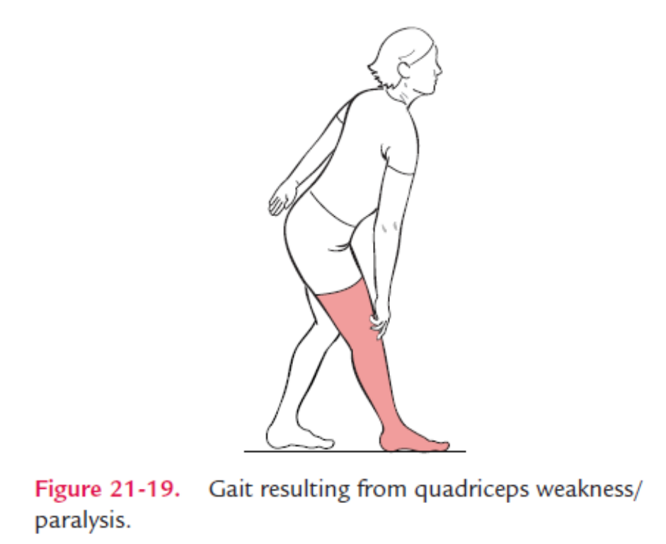
When there is weakness in the quadriceps muscle group, several different compensatory mechanisms may be used. Depending upon whether only the quadriceps muscles are weak, or if there are additional weaknesses in the extremity, various compensatory maneuvers may be used. With quadriceps weakness, the individual may lean the body forward over the quadriceps muscles at the early part of stance phase, as weight is being shifted on to the stance leg. Normally, at this time, the line of force falls behind the knee, requiring quadriceps action to keep the knee from buckling. By leaning forward at the hip, the COG is shifted forward and the line of force now falls in front of the knee. This will force the knee backward into extension. Another compensatory maneuver to use is the hip extensors and ankle plantar flexors in a closed chain action to pull the knee into extension at heel strike (initial contact).

Slide 10
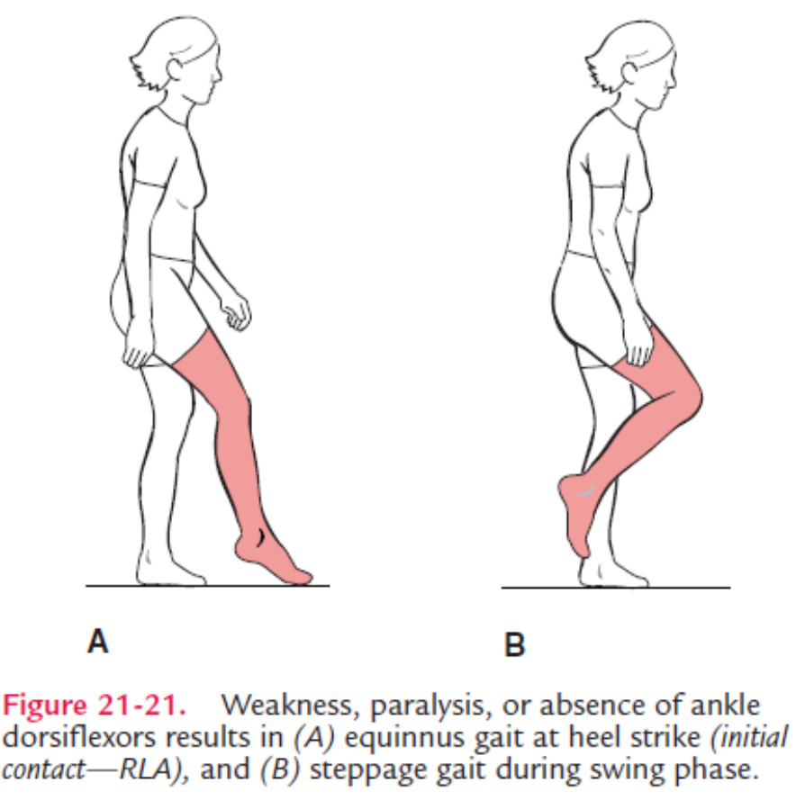
This reversal of muscle action can be seen in this Figure. In addition, the person may physically push on the anterior thigh during stance phase, holding the knee in extension just like previous figure.

Slide 11
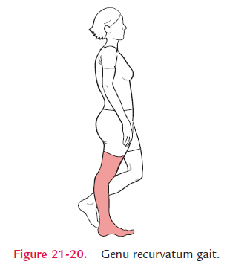
If the hamstrings are weak, two things may happen. During stance phase, the knee will go into excessive hyperextension, sometimes referred to as “genu recurvatum” gait. During the deceleration (terminal swing) part of swing phase, without the hamstrings to slow down the swing forward of the lower leg, the knee will snap into extension. shifted forward and the line of force now falls in front of the knee. This will force the knee backward into extension. Another compensatory maneuver to use is the hip extensors and ankle plantar flexors in a closed chain action to pull the knee into extension at heel strike (initial contact).

Slide 12
An individual may compensate in several ways depending on the amount of weakness of the ankle dorsiflexors. If there is insufficient strength to move the ankle into dorsiflexion at the beginning of stance phase, the foot will land with a fairly flat foot. However, if there is no ankle dorsiflexion, the toes will strike first, which is commonly referred to as an equinnus gait. Next, weak ankle dorsiflexors may not be able to support the body weight after heel strike moving toward foot flat (loading response) as they eccentrically contract. The result is “foot slap.” With the dorsiflexors not being able to slow the descent of the foot, the foot slaps into plantar flexion as more weight is put on the leg. During swing phase, they may not be able to dorsiflex the ankle during swing phase. Gravity will cause the foot to fall into plantar flexion when it is off the ground. This is called “drop foot.” As a result, the knee will need to be lifted higher for the dropped foot to clear the floor and “steppage gait” will result . The drum major in a marching band will utilize the elements of this gait when performing.

Slide 13
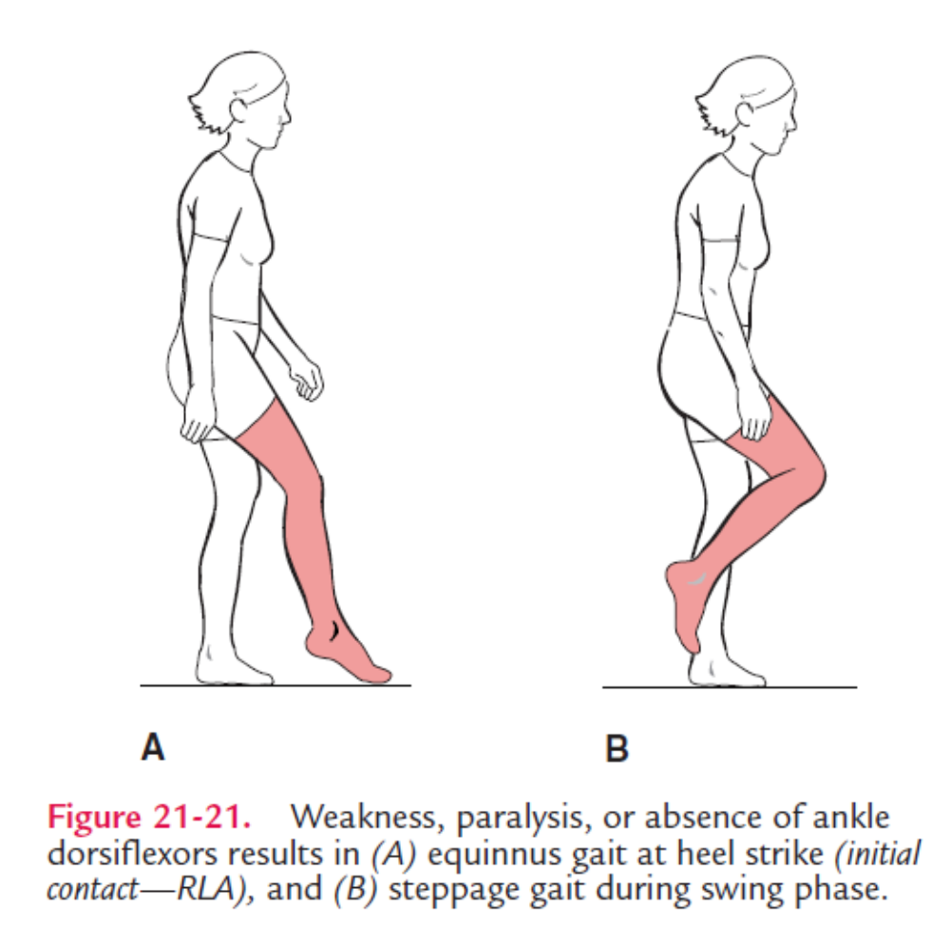

Slide 14
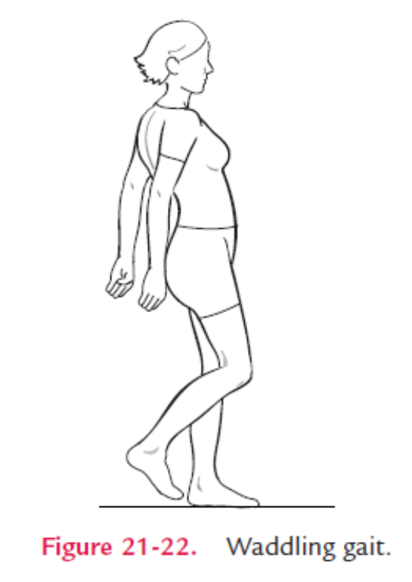
When the triceps surae group (the gastrocnemius and soleus) is weak, there is no heel rise at push off (terminal stance), resulting in a shortened step length on the unaffected side. This is sometimes referred to as a “sore foot limp.” Although this gait is noticeable on level ground, it becomes most pronounced when walking up an incline.
A waddling gait is commonly seen with muscular and other types of dystrophies because there is diffuse weakness of many muscle groups. The person stands with the shoulders behind the hips, much like a person with paraplegia would balance resting on the iliofemoral ligament of the hips.

Slide 15
There is an increased lumbar lordosis, pelvic instability, and Trendelenburg gait. Little or no reciprocal pelvis and trunk rotation occur. To swing the leg forward, the entire side of the body must swing forward. Normally, for example, as the right leg swings forward, the right arm swing backward. In this case, the right arm and leg swing forward together. Add this to the excessive trunk lean of Trendelenburg gait bilaterally, and one can see the waddling nature of the gait. A steppage gait is often present.

Slide 16
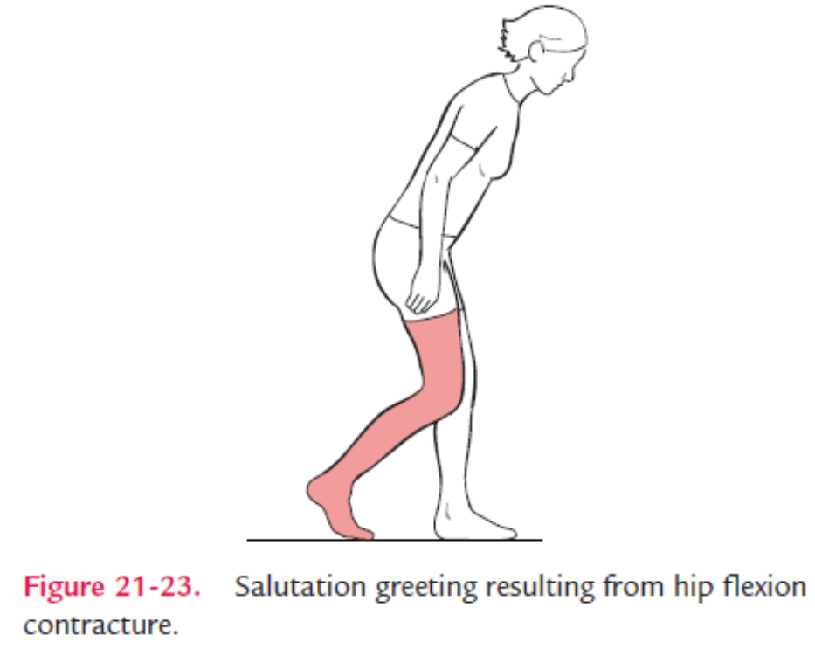
Joint/Muscle Range-of- Motion Limitation
In this grouping, the joint is unable to go through its normal range of motion because either there is bony fusion or soft tissue limitation. This limitation can be the result of contractures of muscle, capsule, or skin. When a person has a hip flexion contracture, the involved hip is unable to go into hip extension and hyperextension during the midstance and push-off phases (terminal stance). To compensate, the person will commonly assume the salutation or greeting position in which the hip is flexed and the person’s trunk leans forward as if bowing. The involved leg may also simultaneous flex the knee when it normally would be extended.

Slide 17
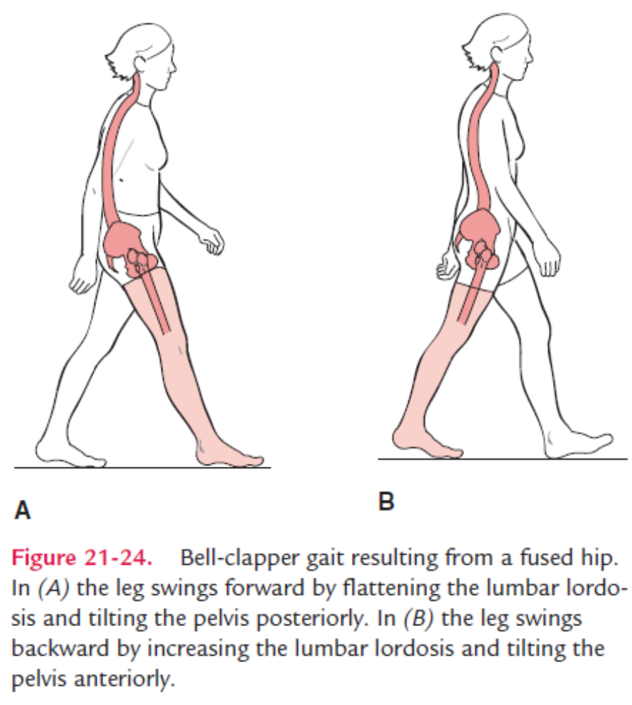
With a fused hip, increased motion of the lumbar spine and pelvis can greatly compensate for hip motion. A decreased lordosis and posterior pelvic tilt will allow the leg to swing forward, whereas an increased lordosis and anterior pelvic tilt will swing the leg posteriorly. This is sometimes referred to as a “bell-clapper gait.” A bell swings back and forth causing the clapper inside to also move back and forth.

Slide 18
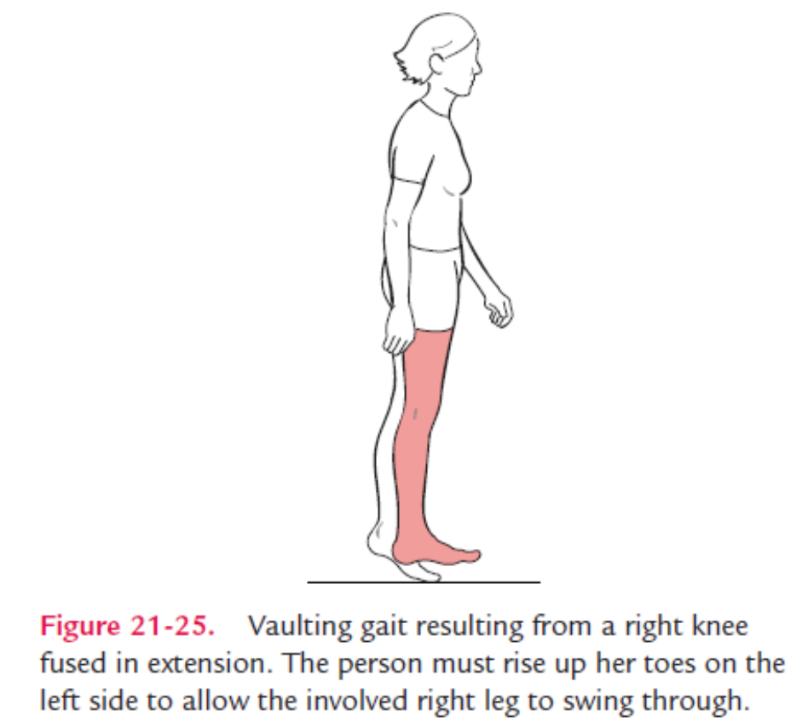
A knee flexion contracture will result in excessive dorsiflexion during midstance and an early heel rise during push-off (terminal stance). There is also a shortened step length of the unaffected side. If a knee fusion is present, the lower leg will be at a fixed length. That length will depend on the position of the joint. If the knee is in extension, the leg will be unable to shorten during swing phase. Therefore, to compensate, the person (1) must rise up on the toes of the uninvolved leg in a vaulting gait…

Slide 19
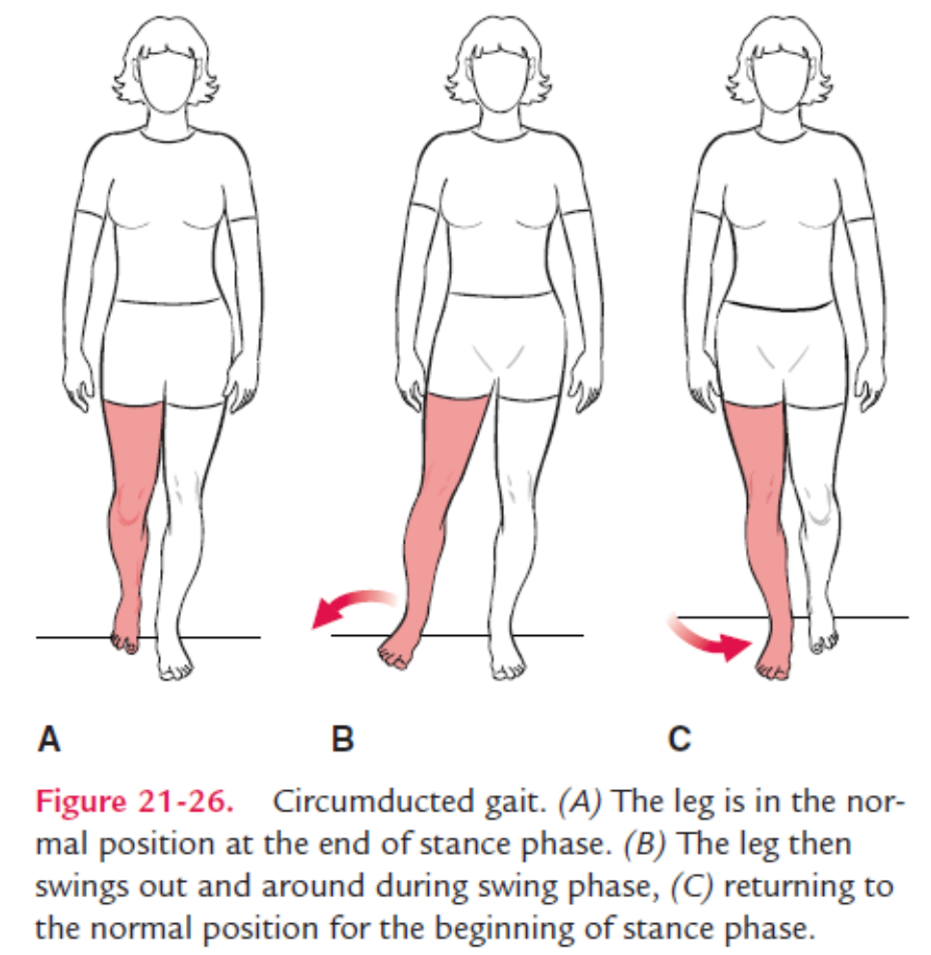
(2) hike the hip of the involved side, (3) swing the leg out to the side, or (4) some variation of the three methods. With a “circumducted gait,” the leg begins near the midline at push-off (terminal stance), swings out to the side during swing phase, then returns to the midline for heel strike. It is called an “abducted gait” if the leg remains in an abducted position throughout the gait cycle.

Slide 20
Depending on the severity of a triceps surae contracture, several things may result. The knee can be forced into excessive extension during midstance because there is insufficient length of the plantar flexors to allow dorsiflexion. If the gastrocnemius does not have enough extensibility to be stretched over both the ankle and knee, something must give. Therefore, either there will be limited ankle dorsiflexion or the knee will be pulled into extreme extension. Remember that the gastrocnemius is a two-joint muscle that plantar flexes the ankle and flexes the knee. In weight-bearing, body weight may force a certain amount of dorsiflexion, thus forcing a tight gastrocnemius to pull the knee into extension.

Slide 21
In addition, an early heel rise can occur during push-off (terminal stance), the knee will be lifted higher during swing phase, and the toes will land first during heel strike (initial contact). The latter is called a “steppage gait.”
An ankle fusion is commonly called a triple arthrodesis because of fusion of the subtalar joint and the two articulations making up the transtarsal joint. This will result in loss of ankle pronation and supination. Plantar flexion and dorsiflexion will remain but will be limited. Usually, there is a shortened stride length. The person will have more difficulty walking on uneven ground because the ability to pronate and supinate the foot has been lost.

Slide 22
Neurological Involvement
As would be expected, the amount of gait disturbance will depend on the amount and severity of neurological involvement. For example, spasticity of the hip flexors affects moving the leg forward in mid- and terminal stance. Hamstring spasticity can keep the knee in a flexed position, which can interfere with moving the leg forward during stance, and limit the effectiveness of straightening the leg at the end of swing. Spasticity of the triceps surae can keep the ankle plantar flexed creating problems during both stance and swing phase. Spasticity tends to put the foot in a varus position, and flaccidity tends to put the foot in a valgus position.

Slide 23
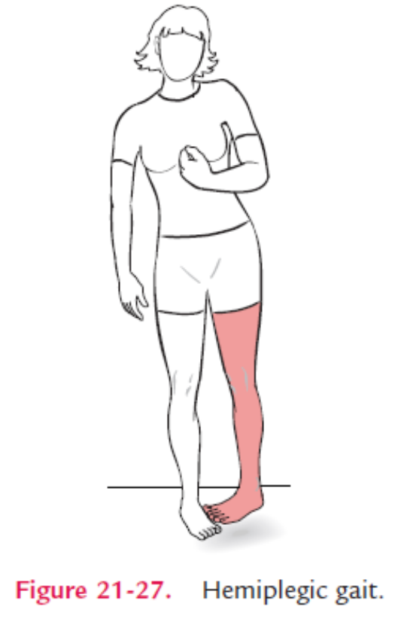
A hemiplegic gait will vary depending on the severity of neurological involvement and the presence and amount of spasticity. Generally speaking, with spasticity, there is an extension synergy in the involved lower extremity. The hip goes into extension, adduction, and medial rotation. The knee is in extension, though often unstable. The ankle demonstrates a drop foot with ankle plantar flexion and inversion (equinovarus), which is present during both stance and swing phases. The involved upper extremity may typically be in a flexion synergy. Usually, there will be no reciprocal arm swing. Step length tends to be lengthened on the involved side and shortened on the uninvolved side.

Slide 24
Cerebellar involvement often results in an ataxic gait. Lacking coordination leads to jerky uneven movements. Balance tends to be poor, and the person walks with a wide base of support (abducted gait). The person usually has difficulty walking in a straight line, and tends to stagger. Reciprocal arm motion also appears to be jerky, and uneven. All movements appear exaggerated.

Slide 25
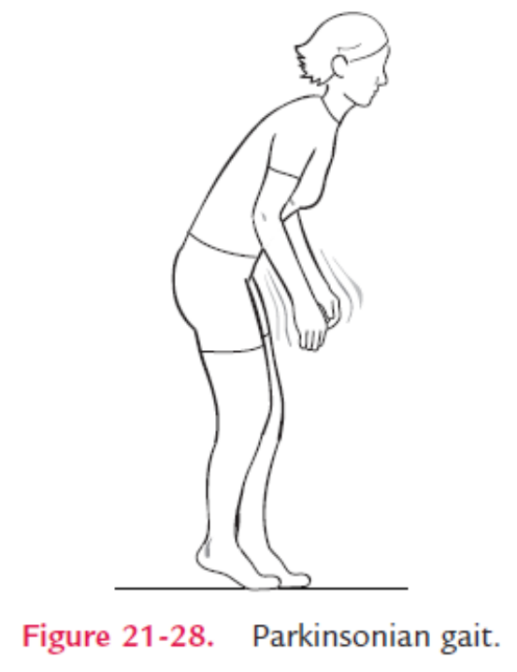
A parkinsonian gait demonstrates diminished movement. The posture of the lower extremities and trunk tends to be flexed. The elbows are partially flexed and there is little, or no, reciprocal arm swing. Stride length is greatly diminished and the forward heel does not swing beyond the rear foot. The person walks with a shuffling gait with the feet flat and weight mostly forward on the toes. The person has difficulty initiating movements. This shuffling gait tends to start slowly and increase in speed, and the person often has difficulty in stopping. It gives the appearance that the person’s feet are trying to catch up to the forward leaning trunk. This is called a festinating gait.

Slide 26
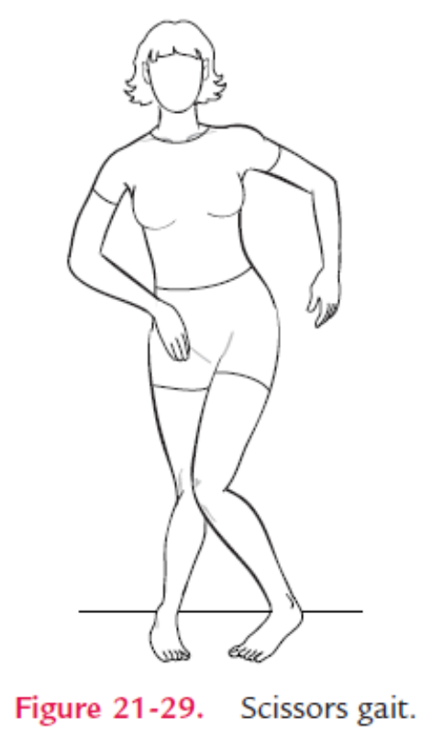
Spasticity in the hip adductors results in a scissors gait. This gait is most evident during the swing phase in which the unsupported leg swings against or across the stance leg. Needless to say, the walking base is narrowed. The trunk may lean over the stance leg as the swing phase leg attempts to swing past it.

Slide 27
A crouch gait describes the bilateral lower extremity involvement seen in spastic diplegia associated with cerebral palsy. There is often great variation in the gait from what is considered “typical.” There is excessive flexion, adduction, and medial rotation at the hips, and flexion at the knees. The ankles are plantar flexed. The pelvis maintains an anterior pelvic tilt and there is an increased lumbar lordosis. To compensate, the reciprocal arm swing and horizontal displacement are exaggerated.

Slide 28
Pain
When a person has pain in any of the joints of the lower extremity, the tendency is to shorten the stance phase. In other words, if it hurts to stand on it, do not stand on it. A shortened, often abducted, stance phase on the involved side results in a rapid and shortened step length of the uninvolved side. Compensation in the reciprocal arm swing also is evident. Reciprocal arm swinging is shortened as the step length is shortened, exaggerated, and often abducted. This gait is often referred to as antalgic gait. If the pain is caused by a hip problem, the person will lean over that hip during weight-bearing. This will decrease the torque placed on the joint and the amount of pressure placed on the femoral head. Magee (1997) stated that the amount of pressure will be decreased from more than twice the body weight to approximately that of the person’s body weight.

Slide 29
Unequal Leg Length
We all have legs of unequal length, usually a discrepancy of approximately 1/4 inch between the right and left legs. Clinically, these smaller discrepancies are often corrected by inserting heel lifts of various thicknesses into the shoe. When there is minimal leg length discrepancy, compensation occurs by dropping the pelvis on the affected side. Although this may not look abnormal, it does place added stress on the low back. The person may compensate by leaning over the shorter leg. Leg length discrepancies of up to 3 inches can be accommodated with these techniques.

Slide 30
When there is moderate discrepancy, approximately between 3 and 5 inches, dropping the pelvis on the affected side will no longer be effective. A longer leg is needed, so the person usually walks on the ball of the foot on the involved (shorter) side. This is called an equinnus gait.
A severe leg length discrepancy is usually any discrepancy of more than 5 inches. The person may compensate in a variety of ways. Dropping the pelvis and walking in an equinnus gait plus flexing the knee on the uninvolved side is often used. To gain an appreciation for how this may feel or look, walk down the street with one leg in the street and the other on the sidewalk.

Slide 31
Thank you
Hamid Ghazvini, MD, DC, RMT
905.731.2555 | info@ruhanicollege.com
www.ruhanicollege.com

