Slide 1
Kinesiology 11
Posture

Slide 2
In general, posture is the position of your body parts in relation to each other at any given time. Posture can be static, as in a stationary position such as standing, sitting, or lying. It can be dynamic as the body moves from one position to another. Posture deals with alignment of the various body segments. These body segments can be compared to blocks. If you start stacking blocks one directly on top of the other, the column would remain relatively stable. However, if you stack them off center from each other, the column will remain upright only if the block, or blocks, above counter the block or blocks below, and remain within the base of support. In the human body, each joint involved with weight-bearing can be considered a postural segment.

Slide 3
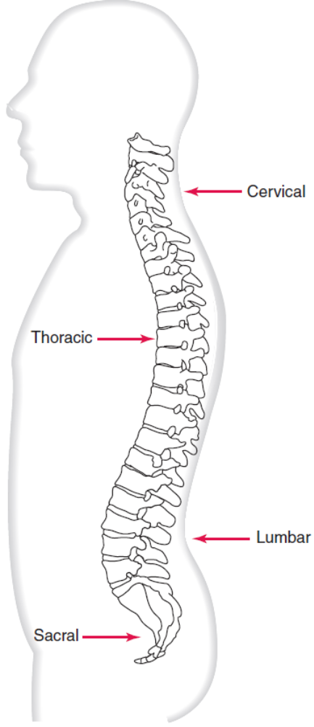
Vertebral Alignment
The vertebral column can be compared to the column of blocks. It is not completely straight but has a series of counterbalancing anterior-posterior curves. These curves, which must be maintained during rest and activity, act as shock absorbers and reduce the amount of injury. The thoracic and sacral curves counter the cervical and lumbar curves. The thoracic and sacral curves are concave anteriorly and convex posteriorly. Conversely, the lumbar and cervical curves are convex anteriorly and concave posteriorly. Remember that a curve has two sides to it: a concave side and a convex. Therefore, whether a curve is concave or convex depends on to which side you are referring.

Slide 4
When one or more of these vertebral curves either increases or decreases significantly from what is considered good posture, poor posture results. For example, a “sway back” is an increased lumbar curve, whereas a “flat back” is a decreased thoracic curve. In most cases, if there is an increased lumbar curve, there is also an increased thoracic curve. No lateral curves should exist. Any lateral curvature of the spine is a pathologic condition called scoliosis.

Slide 5
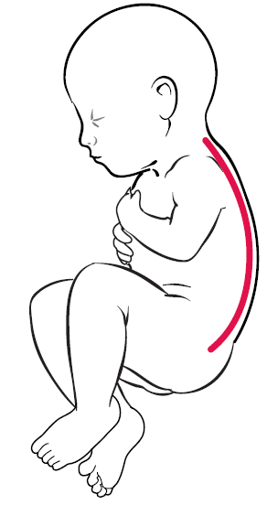
Development of Postural Curves
At birth, the entire vertebral column is concave anteriorly. This concave curve is called a primary curve. The thoracic and sacral curves are considered primary curves for this reason. As the child grows, secondary curves develop. These are the anteriorly convex curves of the cervical and lumbar regions.

Slide 6
The position of the pelvis has great influence on the vertebral column, especially the lumbar region. The pelvis should be in a neutral position. This position is defined as (1) when the anterior superior iliac spine (ASIS) and posterior superior iliac spine (PSIS) are level with each other in a transverse plane; and (2) when the ASIS is in the same vertical plane as the symphysis pubis. When the pelvis is in a neutral position, the lum

Slide 7
The position of the pelvis has great influence on the vertebral column, especially the lumbar region. The pelvis should be in a neutral position. This position is defined as (1) when the anterior superior iliac spine (ASIS) and posterior superior iliac spine (PSIS) are level with each other in a transverse plane; and (2) when the ASIS is in the same vertical plane as the symphysis pubis. When the pelvis is in a neutral position, the lumbar curve has the desired amount of curvature. When the pelvis is tilted anteriorly, there is an increased amount of lumbar curvature, or lordosis. When the pelvis is tilted posteriorly, there is a decreased amount of curve, or flat back.

Slide 8
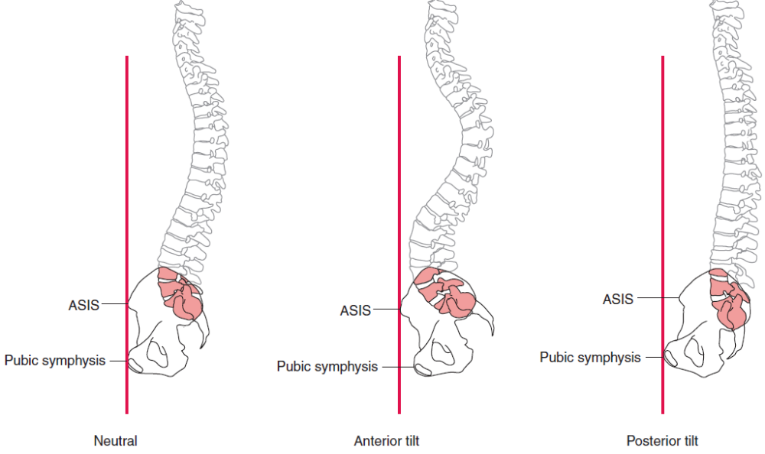

Slide 9
With weight evenly distributed on both legs, the pelvis should remain level from side to side, with both ASISs being at the same level. During walking, however, the pelvis dips from side to side as weight is shifted from stance to swing phase. This lateral pelvic tilt is controlled by the hip abductors, mainly the gluteus medius and gluteus minimus, and the trunk lateral benders, mainly the erector spinae and quadratus lumborum. If you bend your left knee and lift your foot off the ground, your pelvis on the left side becomes unsupported and will drop. Force couple action of the hip abductors and trunk lateral benders hold the pelvis level. The right hip abductors on the opposite side contract to pull the pelvis down on the right side while trunk lateral benders on the left (same side) contract to pull the pelvis up on the left side. These motions are illustrated in Figure here. An abnormal lateral pelvic tilt can also occur if both legs are not of equal length. This will result in a lateral curvature, or scoliosis.

Slide 10
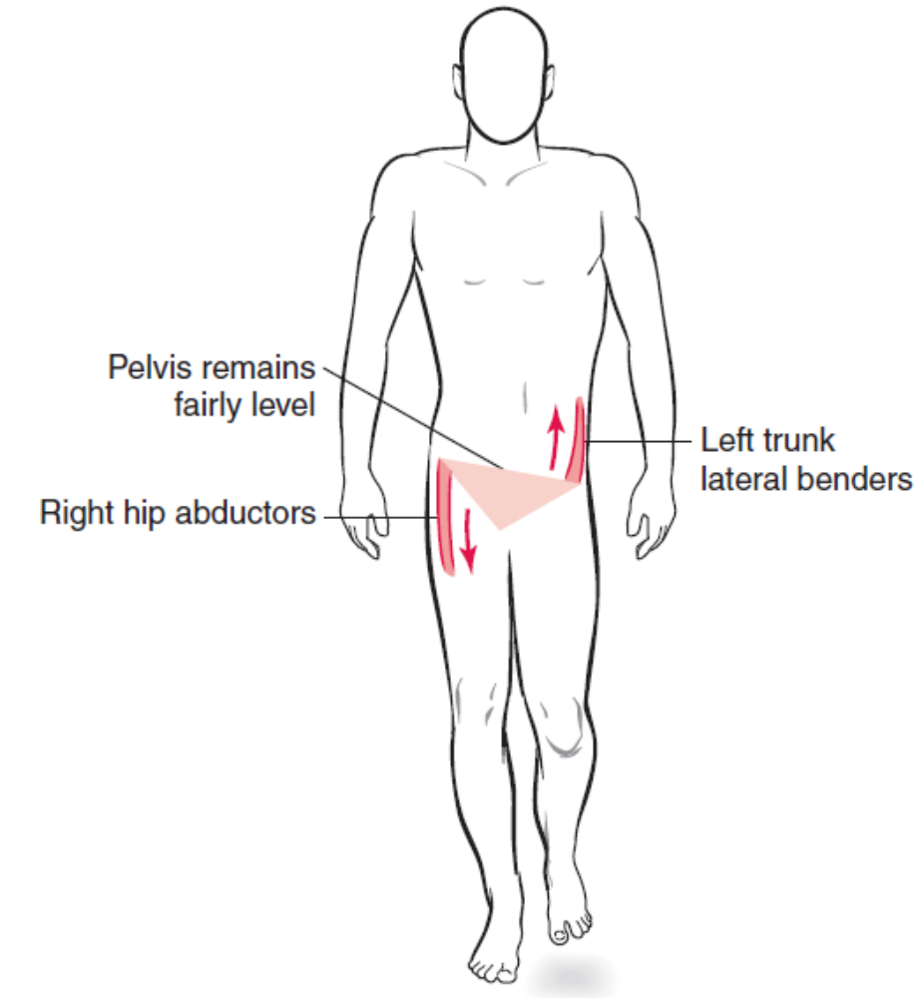
Force couple keeps the pelvis level in the frontal plane. In a reversal of muscle action, the left trunk lateral benders pull up while the right hip abductors pull down. This keeps the pelvis fairly level as opposed to letting the pelvis drop on the unsupported side.

Slide 11
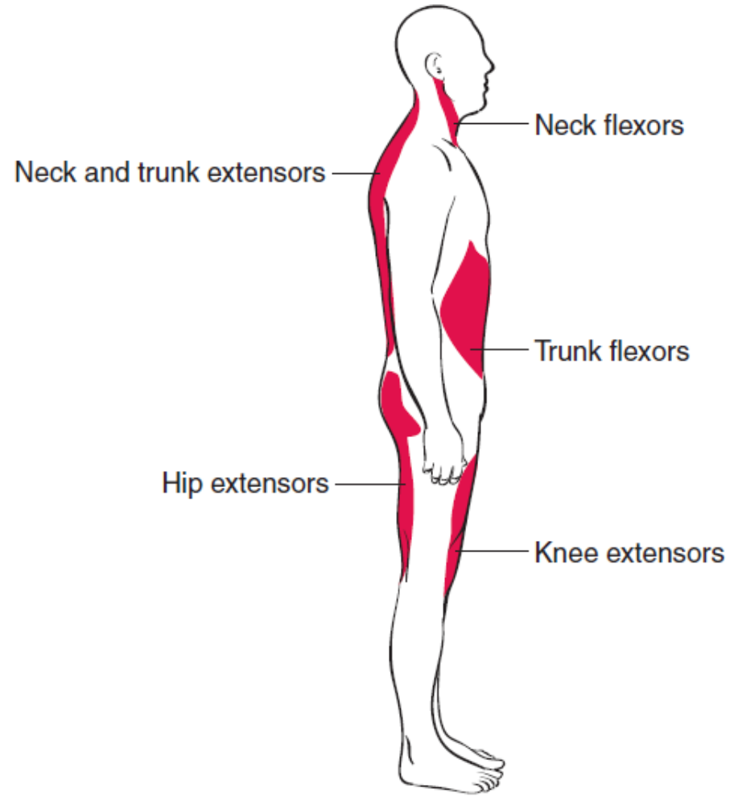
Muscle contractions are primarily responsible for keeping the body in the upright position in both static and dynamic posture. The muscles most involved are called antigravity muscles. These muscles are the hip and knee extensors, and the trunk and neck extensors. Other muscles, perhaps less involved, but also important in maintaining the upright position, are the trunk and neck flexors and lateral benders, hip abductors and adductors, and the ankle pronators and supinators. If all of these muscles were to relax, the body would collapse.

Slide 12
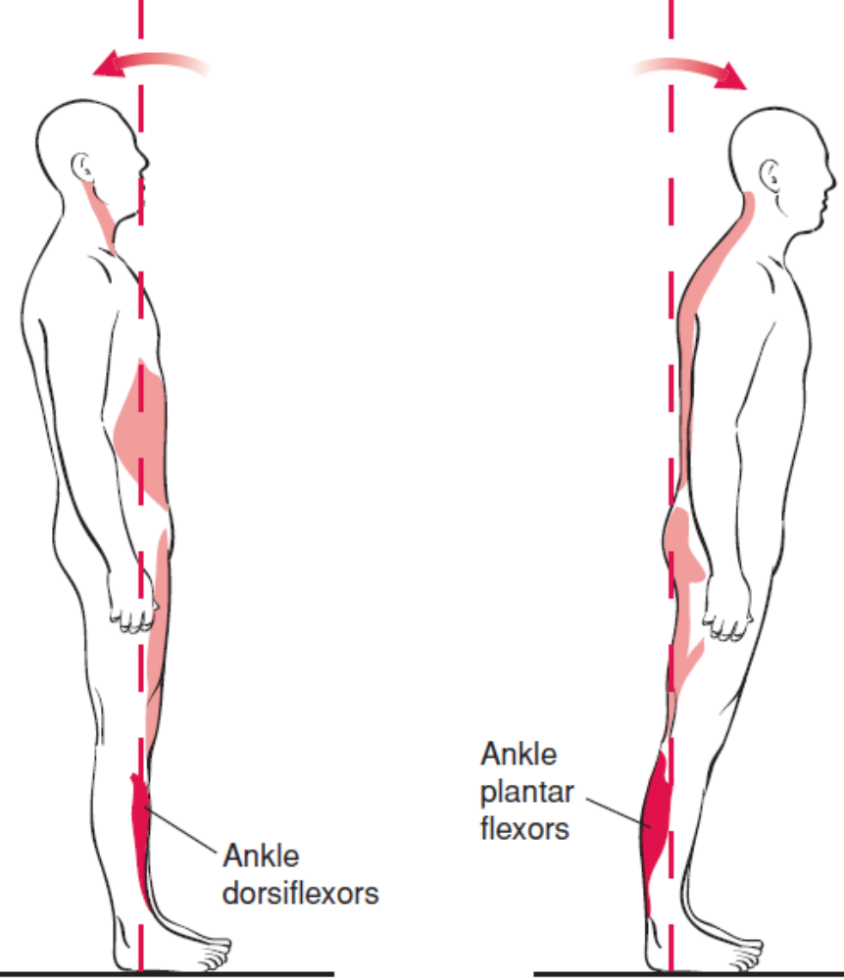
The ankle plantar flexors and dorsiflexors are important in controlling postural sway. Postural sway is anterior-posterior motion of the upright body caused by motion occurring primarily at the ankles. This sway is the result of constant displacement and correction of the center of gravity within the base of support. Stand upright with your feet slightly apart. Lean your entire body slowly forward by bending at the ankles. You will reach a point where you will need to either correct the forward lean or you will lose your balance forward. Notice that your ankle plantar flexors contract to bring you back to an upright position.

Slide 13
Next, lean backward and notice what happens. Again, you will reach a point where you either need to correct the lean or lose your balance. Notice that your ankle dorsiflexors contract to bring you back to an upright position.
A high center of gravity and small base of support tend to increase the amount of postural sway. To demonstrate this, stand upright with your feet slightly apart. Notice how much your body tends to move back and forth. Next, observe the amount of sway when you stand on your toes in the upright position with your feet close together. You should notice much more motion in the latter position, because you have raised your center of gravity higher and made your base of support smaller.

Slide 14
Good posture, which means good alignment, is important because it decreases the amount of stress placed on bones, ligaments, muscles, and tendons. Good alignment also improves function and decreases the amount of muscle energy needed to keep the body upright. For example, if the knee is in full extension, little muscle contraction is needed to keep the knee from buckling. However, when the knee is partially flexed, the muscles at that joint (knee extensors) must contract to keep the knee from collapsing. Because standing is a closed-chain activity, muscles at the hip and ankle must also contract to keep the body’s center of gravity over its base of support.

Slide 15
Standing Posture
Posture is easier to describe in a static standing position because, except for a slight amount of sway when standing, the body is not moving. However, many of the guidelines for static posture can be applied to dynamic posture. Assessing a person’s posture can be done most accurately with the use of a plumb line suspended from the ceiling or a posture grid behind the person as a point of reference. A plumb line is a string or cord with a weight attached to the lower end. Because the string is weighted, it makes a perfectly straight vertical line of gravity.

Slide 16
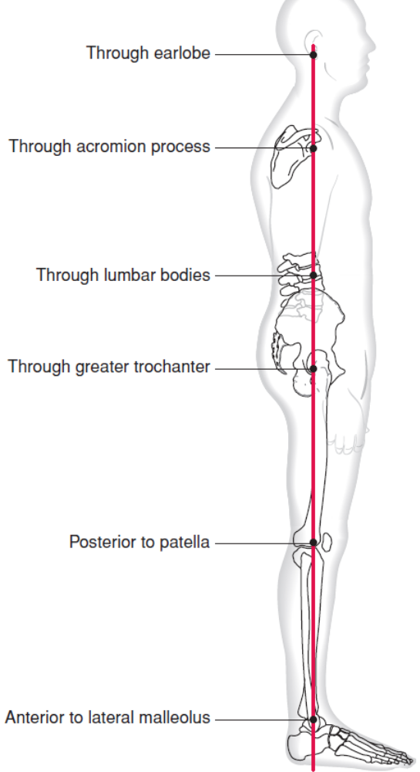
Lateral View
In the standing position and viewed from the lateral position, the plumb line should be aligned so that it passes slightly in front of the lateral malleolus. For ideal posture, the body segments should be aligned so that the plumb line passes through the landmarks listed below as follows:

Slide 17
Head Through the earlobe
Shoulder Through the tip of the acromion process
Thoracic spine Anterior to the vertebral bodies
Lumbar spine Through the vertebral bodies
Pelvis Level
Hip Through the greater trochanter (slightly Posterior to the hip joint axis)
Knee Slightly posterior to the patella (slightly anterior to the knee joint axis) with the knees in extension
Ankle Slightly anterior to the lateral malleolus with the ankle joint in a neutral position between dorsiflexion and plantar flexion

Slide 18
Common postural deviations that can be detected from the side view are summarized in Table 20-1. Because standing is a closed kinetic chain activity, the position or motion of one joint will effect the position or motions of other joints.

Slide 19
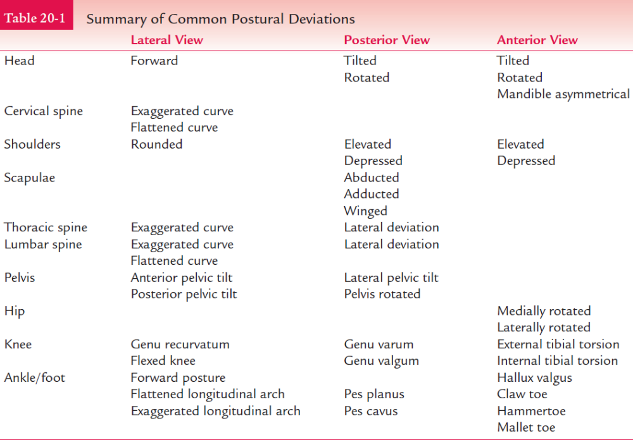

Slide 20
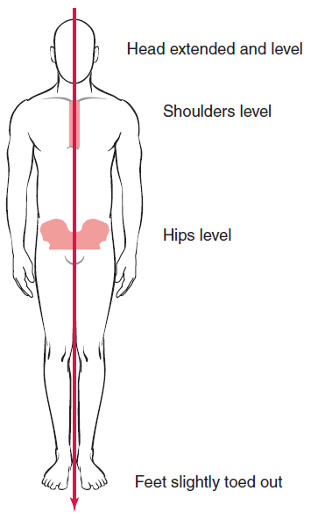
Anterior View
In the standing position and viewed from the anterior position, the plumb line should be aligned to pass through the midsagittal plane of the body, thus dividing the body into two equal halves. The body segments listed below should be aligned as follows:

Slide 21
Head Extended and level, not flexed or hyperextended
Shoulders Level and not elevated or depressed
Sternum Centered in the midline
Hips Level with both ASISs in the same plane
Legs Slightly apart
Knees Level and not bowed or knock-kneed
Ankles Normal arch in feet
Feet Slight outward toeing

Slide 22
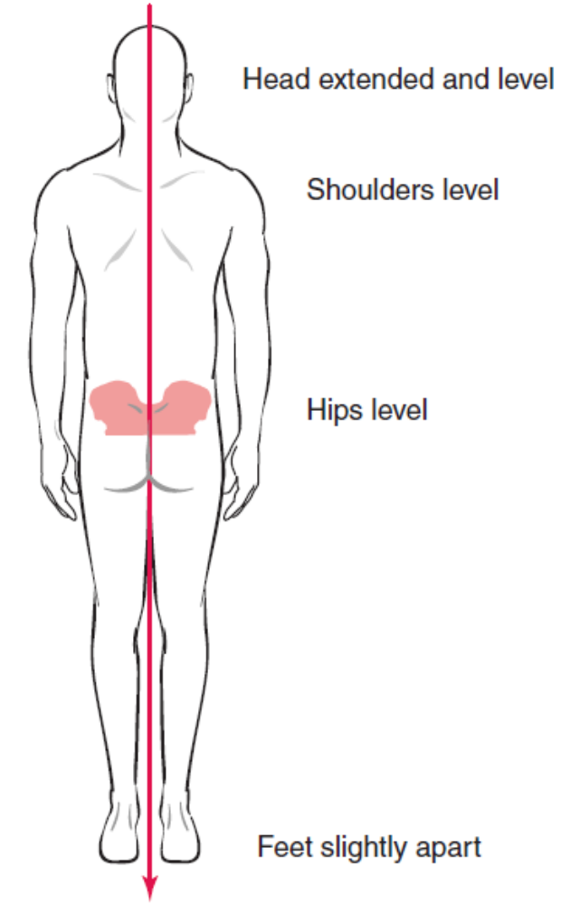
Posterior View
In the standing position and viewed from the posterior position, the plumb line should also be aligned to pass through the midsagittal plane of the body, dividing the body into two equal halves. The following body segments should be aligned as follows:

Slide 23
Head Extended, not flexed or hyperextended
Shoulders Level and not elevated or depressed
Spinous processes Centered in the midline
Hips Level with both PSISs in the same plane
Legs Slightly apart
Knees Level and not bowed or knock-kneed
Ankles Calcaneus should be straight

Slide 24
Sitting Posture
Good postural alignment while sitting is important because sitting is an activity that can place a great deal of pressure on the intervertebral disk. Studies have shown that disk pressure in the sitting position increases by slightly less than half of the amount of disk pressure in the standing position. To state the obvious, shifting weight on to the front part of the vertebrae will increase the amount of pressure placed on the intervertebral disks. As the person leans forward, disk pressure increases. As a person reaches, and/or picks up a weight, disk pressure further increases as the weight and/or length of the lever arm increases. Disk pressure is least when lying supine. It increases as you stand, and increases more as you sit. Leaning forward in these positions increases the disk pressure, and leaning forward with an object in your hand obviously also increases it.

Slide 25
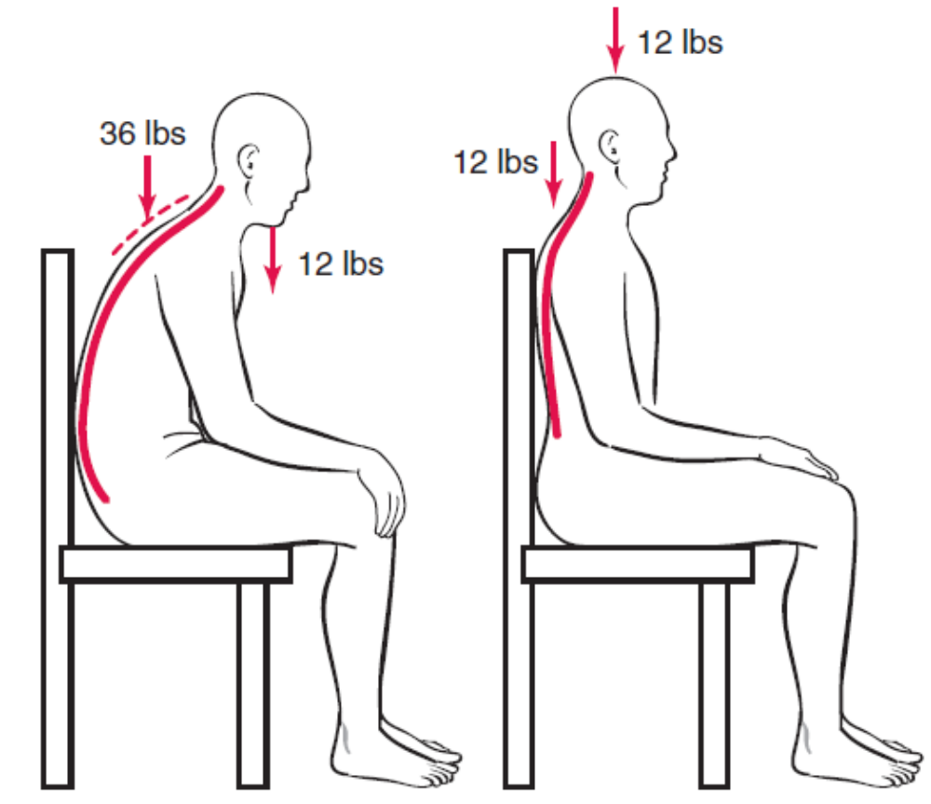
If the lumbar curve is decreased, such as often happens when sitting with the back unsupported, the pressure on the intervertebral disks and posterior structures increases. A chair with the seat inclined anteriorly, such as the kneeling stool, can decrease disk pressure by tilting the pelvis forward slightly. This helps to maintain the lumbar curve. However, because the back is unsupported, increased and sustained muscle contraction is required to keep the body upright. Shifting weight on to the front part of the vertebra is not always a problem. Although disk pressure increases in this position, the stresses placed on the posterior part of the vertebra, the facet joints, decreases.

Slide 26
Therefore, a person has a facet joint problem, generally speaking, a flexed position is more desirable. Conversely, if a person has a disk problem, an extended position is usually more desirable.
With sitting postures, a chair that has a lumbar support that maintains the lumbar lordosis will place the least amount of pressure on the disks. Maintaining the vertebral curves, keeping the feet flat on the floor, having the low back supported, and keeping the upper body in good alignment are key elements of good sitting posture. Figure next demonstrates the best posture while working at a computer. The neck and trunk are upright, the trunk is supported, and the lumbar spine has a

Slide 27
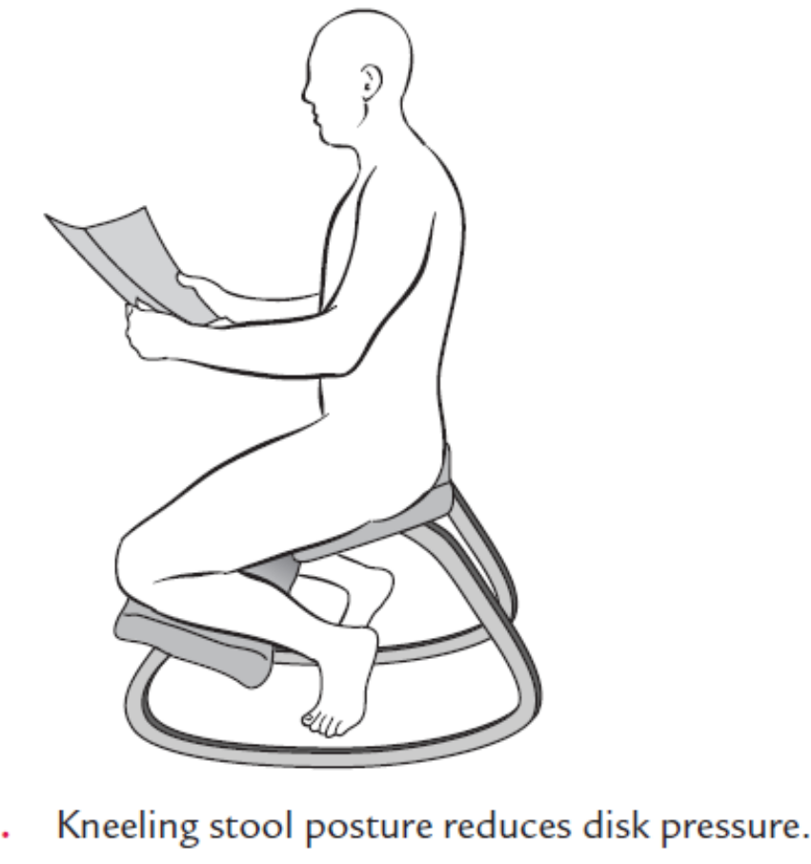
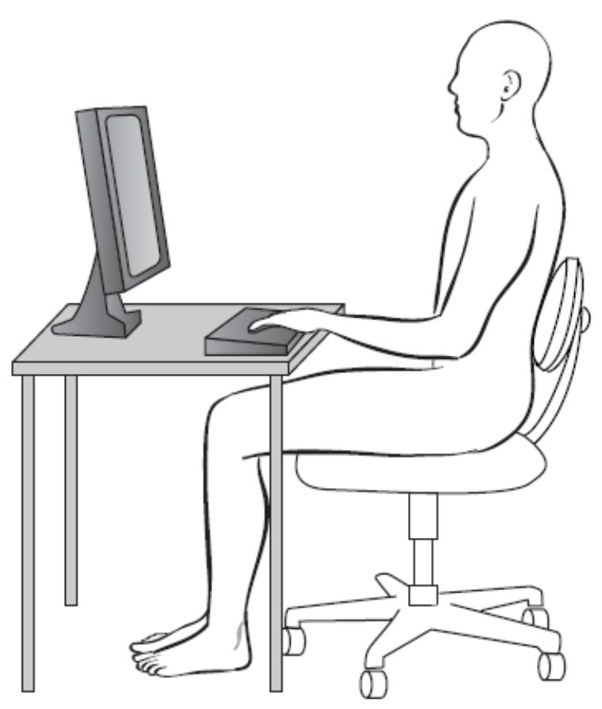

Slide 28
support. The top of the monitor is at eye level. A person should not have to hyperextend the head to view the screen. The shoulders are relaxed. The elbows are flexed and close to the body. The hands, wrists, and forearms are straight and parallel to the ground. The chair should allow the hips and knees to be flexed. The thighs are parallel to the ground and the lower legs are vertical, allowing the feet to be flat on the floor or a footrest.

Slide 29
Supine Posture
Lying down is considered a resting position. The least amount of intervertebral disk pressure occurs while lying supine. If you could run a plumb line horizontally, it would intersect many of the same landmarks as in the standing position. Good alignment in this position is also important. A good resting surface should be firm enough to avoid loss of the lumbar curve, yet soft enough to conform and give support to the normal curves of the body. In the sidelying position, the bottom leg is extended and the top leg is flexed. Placing a pillow between the legs can increase comfort by keeping the hips in good alignment. Lying prone is usually not recommended because of the

Slide 30
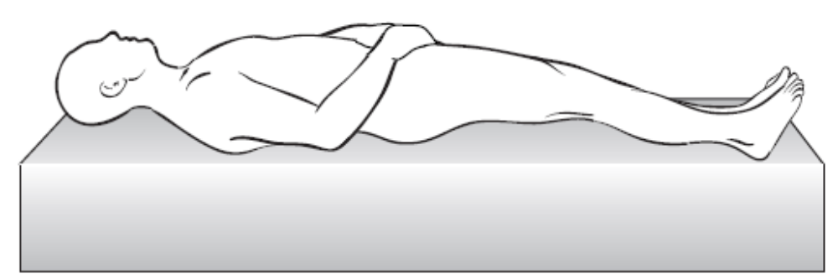
increased pressure placed on the neck. In this position, using a pillow only increases the stresses on the neck. When actively moving about and changing positions, whether vacuuming the rug, picking up a box from the floor, or raking leaves, keeping the body, especially the trunk, in good postural alignment is important. Most principles of good body mechanics involve avoiding stress to the trunk and maintaining the spinal curves, which involve maintaining good posture

Slide 31
Common Postural Deviations
Table 20-1 is a summary of common postural deviations seen when assessing posture. It is not within the scope of this book to describe the individual causes and effects of postural problems. However, some general statements regarding cause and effect should be made.
Deviation from “good” posture is considered “poor” or “bad” posture. Causes of poor posture can be the result of structural problems. These structural problems may be the result of a congenital malformation such as a hemivertebra. The deviation may be an acquired deformity caused by trauma such as a compression

Slide 32
Compression fracture. Postural deviations also may be the result of neurological conditions causing paralysis or spasticity. In addition, postural problems may also be functional, or nonstructural, in nature. A person who sits or stands for long periods of time will tend to slouch. This can result in a muscle imbalance. Generally, if a person tends to maintain a posture in which a curve is increased, the muscles on the concave side will tend to tighten while the muscles on the convex side tend to weaken. For example, you would expect a person with a lumbar lordosis to have tight back extensors and weak abdominal muscles.

Slide 33
Also, postures that tend to increase the lordotic curves (cervical and lumbar) will increase the pressure on the more posterior facet joints and decrease the pressure on the more anterior intervertebral disks. Conversely, an increase in the kyphotic curves (thoracic and sacral) will increase the pressure on the intervertebral disks while decreasing the pressure on the facet joints.
It should be noted that the terms “kyphotic” and “lordotic” can lead to confusion. They are used to describe both the normal amount of curvature, as well as the abnormal or excessive. Scoliosis is a term that refers to a lateral curvature. However, any amount of scoliosis is considered abnormal.

