Slide 1
Kinesiology 12
Gait

Slide 2
Walking is the manner or way in which you move from place to place with your feet. Gait is the process or components of walking. Each person has a unique style, and this style may change slightly with mood. When you are happy, your step is lighter, and there may be a “bounce” in your walk. Conversely, when sad or depressed, your step may be heavy. For some people, their walking pattern is so unique that they can be identified from a distance even before their face can clearly be seen. Regardless of the numerous different styles, the components of normal gait are the same.
In the most basic sense, walking requires balancing on one leg while the other leg is moved forward. This requires movement not only of the legs but also of the trunk and arms as well. To analyze gait, you must first determine what joint motions occur. Then, based up on that information, you must decide which muscles or muscle groups are acting.

Slide 3
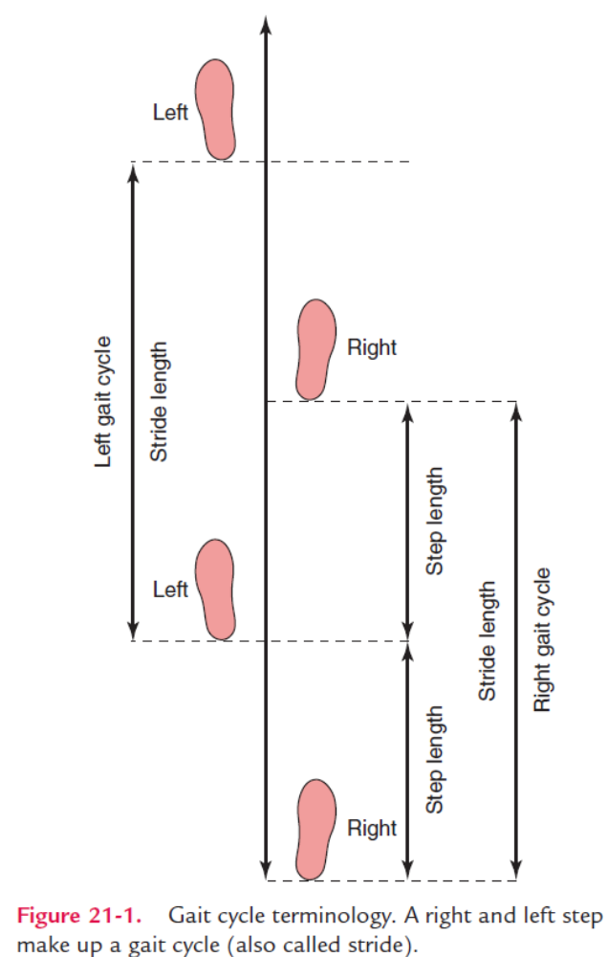
Definitions
Certain definitions must be made to describe gait. Gait cycle, also called stride, is the activity that occurs between the time one foot touches the floor and the time the same foot touches the floor again. A stride length is the distance traveled during the gait cycle.
A step is basically one-half of a stride. It takes two steps (a right one and a left one) to complete a stride or gait cycle. These steps should be equal. A step length is that distance between heel strike of one foot and heel strike of the other foot. With an increased or decreased walking speed, the step length will increase or decrease respectively. Regardless of speed, the step length of each leg should remain equal.

Slide 4
Walking speed, or cadence, is the number of steps taken per minute, and can vary greatly. Slow walking may be as slow as 70 steps per minute. However, students on their way to an examination have been clocked at much slower speeds. Fast walking may be as fast as 130 steps per minute, although race walkers will walk much faster. Regardless of speed, the gait cycle is the same; that is, all parts occur in their proper place at the proper time.
There are two phases of the gait cycle. Stance phase is the activity that occurs when the foot is in contact with the ground. It begins with heel strike of one foot and ends when that foot leaves the ground. This phase accounts for about 60 percent of the gait cycle.

Slide 5
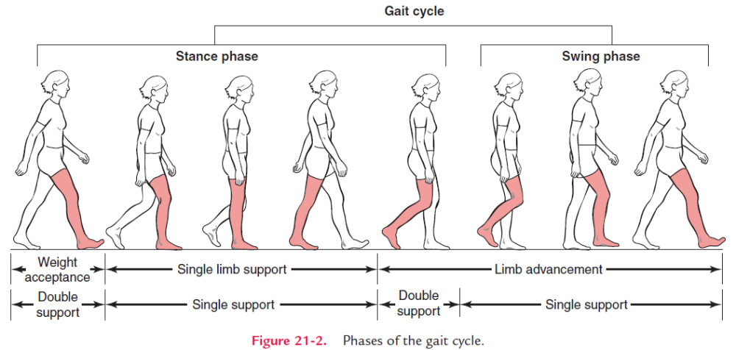

Slide 6
Swing phase occurs when the foot is not in contact with the ground. It begins as soon as the foot leaves the floor and ends when the heel of the same foot touches the floor. The swing phase makes up about 40 percent of the gait cycle.
Perry (1992) identifies three tasks that need to be accomplished during these phases of the gait cycle. Those tasks are (1) weight acceptance, (2) single leg support, and (3) leg advancement. They have been identified in Figure above. Weight acceptance occurs at the very beginning of stance phase when the foot touches the ground and the body weight begins to be shifted onto that leg. Single leg support occurs next as the body weight shifts completely onto the stance leg so that the opposite leg can swing forward. The task of leg advancement occurs during swing phase.

Slide 7
The gait cycle has two periods of double support and two periods of single support. These periods have been identified in Figure above. When both feet are in contact with the ground at the same time, this is a period of double support. This occurs as one leg is beginning its stance phase and the other leg is ending its stance phase. For example, the first period of double support occurs as the right leg is beginning stance phase and the left leg is ending stance phase. The second period of double support occurs as the right leg is ending its stance phase and the left leg is beginning its stance phase. Each period of double support takes up about 10 percent of the gait cycle at an average walking speed. If you increase your walking speed, you spend less time with both feet on the ground. Conversely, you spend more time in double support when you walk slowly.
A period of nonsupport, that is, a time during which neither foot is in contact with the ground, does not occur during walking. However, nonsupport does occur during running.

Slide 8
Other than speed, this may be the biggest difference between running and walking. Other activities, such as hopping, skipping, and jumping, have a period of nonsupport but lose the order of progression that walking and running have. In other words, these activities do not include all the parts of stance and swing phase that walking and running have.
The period of single support occurs when only one foot is in contact with the ground. Thus, two periods of single support occur in a gait cycle: once when the right foot is on the ground as the left foot is swinging forward, then again when the left foot bears weight and the right leg swings forward. Each single support period takes up about 40 percent of the gait cycle.

Slide 9
Many sets of terms have been developed from the original, or traditional, terminology to describe the components of walking. In many cases, although the terminology may be accurate, it is often cumbersome. However, terminology developed by the Gait Laboratory at Rancho Los Amigos (RLA) Medical Center has been gaining in acceptance. Perhaps the biggest difference between the two sets of terms is that the traditional terms refer to points in time whereas RLA terms refer to periods of time. Traditional terminology accurately reflects key points within the gait cycle, whereas RLA periods accurately reflect the moving or dynamic nature of gait. It is best to be familiar with both sets of terms, because both terminologies will be seen in the literature. Table 21-1 provides the definitions of traditional terminology compared to the RLA terms. One can see that they are similar with a few exceptions. Table 21-2 describes the activities of each phase and the key points to observe. The reader is reminded of the slight differences between the two sets of terms. However, the key points are in the same sequence of the gait cycle, regardless of which terminology is used.

Slide 10
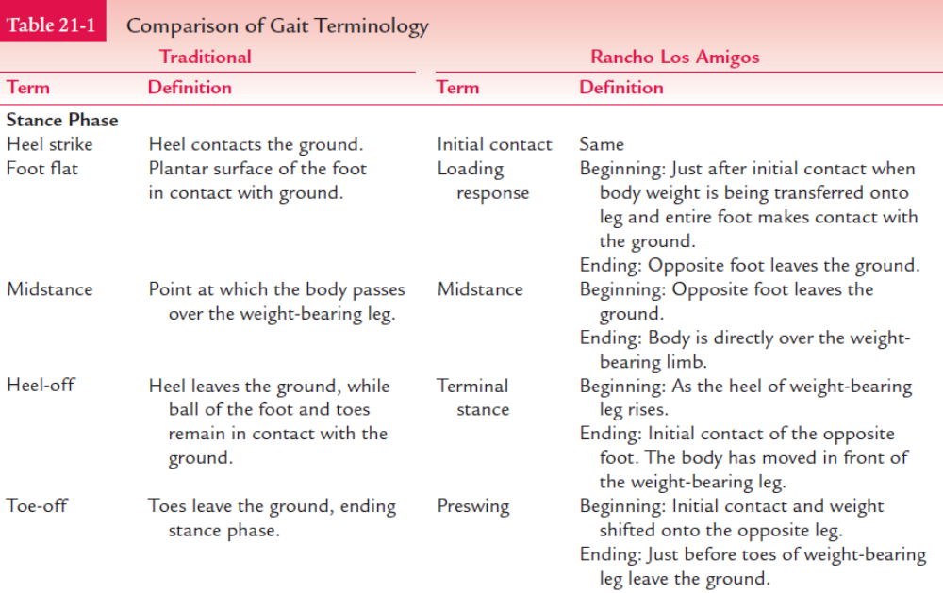

Slide 11
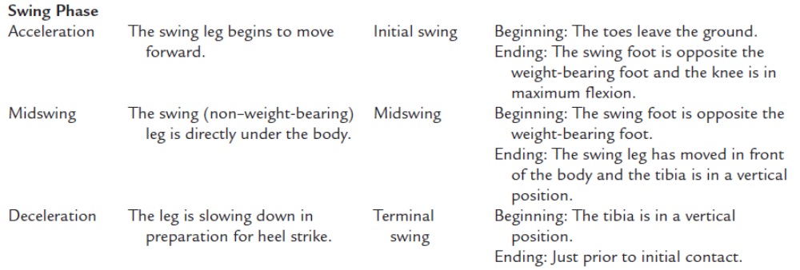

Slide 12
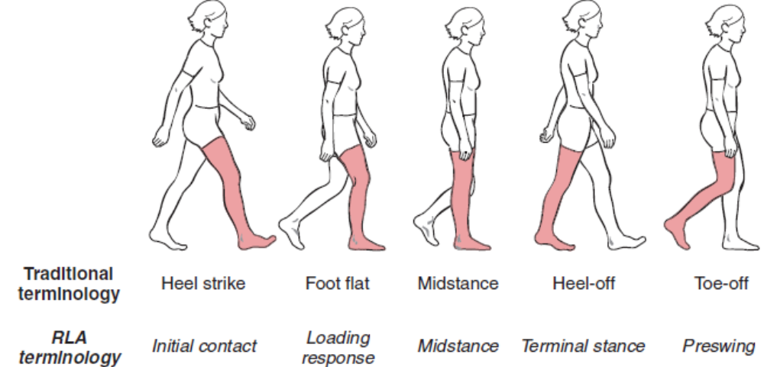
Analysis of Stance Phase
As defined earlier, stance is that period in which the foot is in contact with the floor. Traditionally, the stance phase has been broken down into five components consisting of (1) heel strike, (2) foot flat, (3) midstance, (4) heel-off, and (5) toe-off. Some sources give stance phase only four components by combining heel-off and toe-off into one, and calling it “push-off.” Because significantly different activities occur during these two periods, it is best to keep them separated.

Slide 13
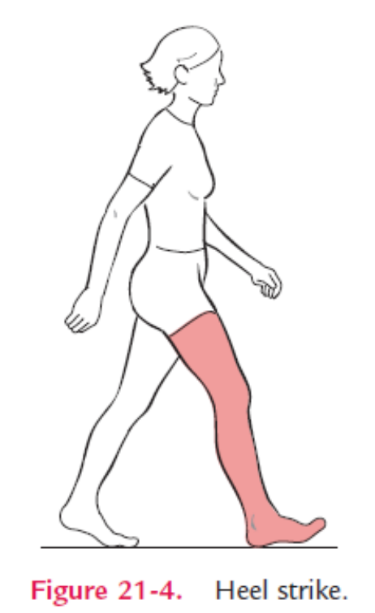
Heel strike signals the beginning of stance phase the moment the heel comes in contact with the ground. At this point the ankle is in a neutral position between dorsiflexion and plantar flexion, and the knee begins to flex. This slight knee flexion provides some shock absorption as the foot hits the ground. The hip is in about 25 degrees of flexion. The trunk is erect and remains so throughout the entire gait cycle. The trunk is rotated toward the opposite (contralateral) side, the opposite arm is forward, and the same-side (ipsilateral) arm is back in shoulder hyperextension. At this point, body weight begins to shift onto the stance leg. In RLA, this is the period of initial contact.

Slide 14
The ankle dorsiflexors are active in putting the ankle in its neutral position. The quadriceps, which have been contracting concentrically, switch to contracting eccentrically to minimize the amount of knee flexion. The hip flexors have been active. However, the hip extensors are beginning to contract, keeping the hip from flexing more. The erector spinae are active in keeping the trunk from flexing. The force of the foot hitting the ground transmits up through the ankle, knee, and hip to the trunk. This would cause the pelvis to rotate anteriorly, flexing the trunk somewhat, if it were not for the erector spinae counteracting this force.

Slide 15
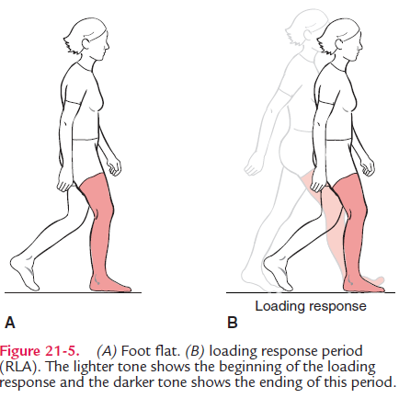
Foot flat, when the entire foot is in contact withthe ground, occurs shortly after heel strike. The ankle moves into about 15 degrees of plantar flexion with the dorsiflexors contracting eccentrically to keep the foot from “slapping” down on the floor. The knee moves into about 20 degrees of flexion. The hip is moving into extension, allowing the rest of the body to begin catching up with the leg. Weight shift onto the stance leg continues. Foot flat is roughly comparable to the RLA period called loading response, which is that period between the end of heel strike and the end of foot flat.

Slide 16
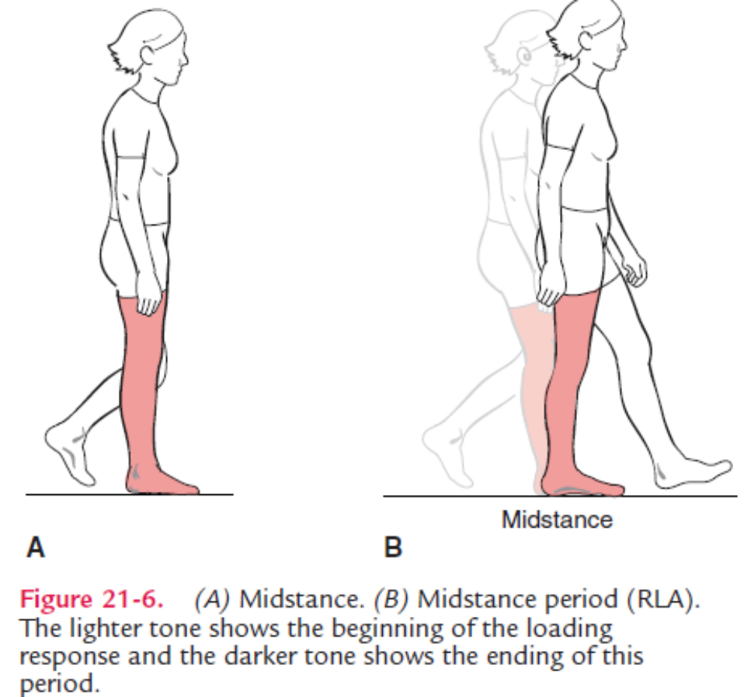
The point at which the body passes over the weightbearing foot is called midstance. In this phase, the ankle moves into slight dorsiflexion. However, the dorsiflexors become inactive. The plantar flexors begin to contract, controlling the rate at which the leg moves over the ankle. The knee and hip continue to extend, both arms are in shoulder extension essentially parallel with the body, and the trunk is in a neutral position of rotation. In RLA, midstance is the period between the end of foot flat and the end of midstance.

Slide 17
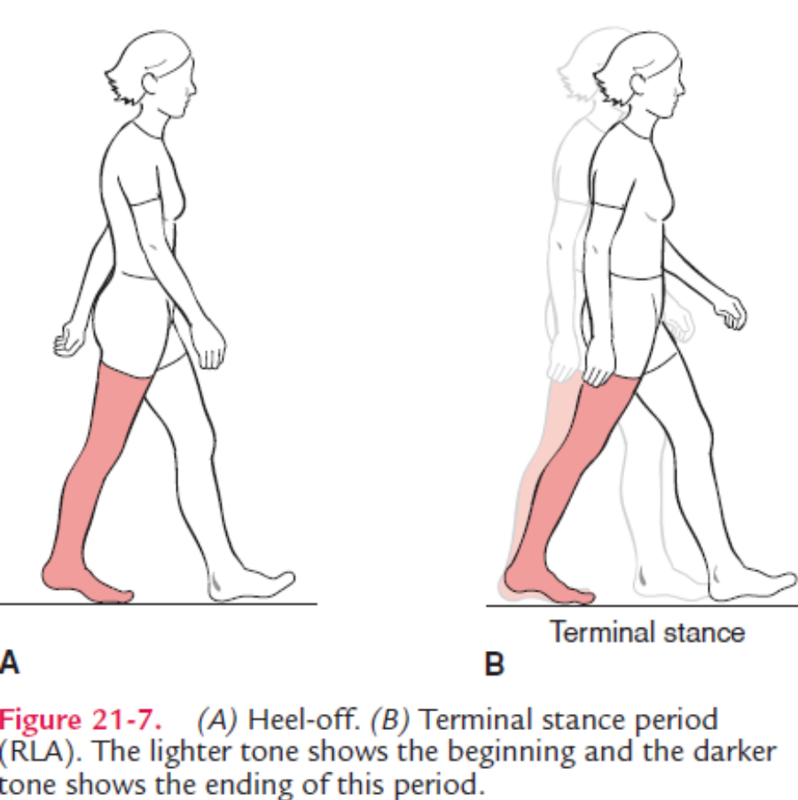
Following midstance is heel-off, in which the heel rises off the floor. The ankle will dorsiflex slightly (approximately 15 degrees) and then begin to plantar flex. This is the beginning of the push-off phase, which is sometimes called the propulsion phase, because the ankle plantar flexors are actively pushing the body forward. The knee is in nearly full extension, and the hip has moved into hyperextension. The leg is now behind the body. The trunk has begun to rotate to the same side, and the arm is swinging forward into shoulder flexion. In RLA, terminal stance is that period between the end of midstance and the end of heel-off.

Slide 18
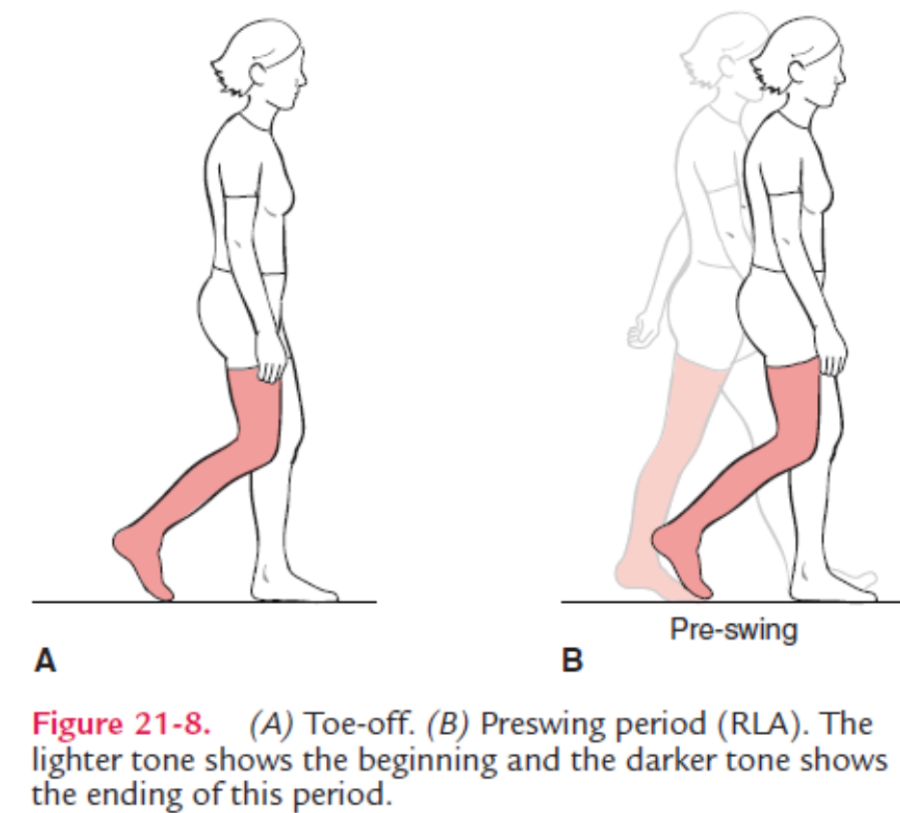
The end of the push-off portion of stance is toe-off. The toes are in extreme hyperextension at the MP joints. The ankle moves into about 10 degrees of plantar flexion, and the knee and hip are flexing. The thigh is parallel to the ground. In RLA, preswing is the period just before and including when the toes leave the ground, signaling the end of stance phase and the beginning of swing phase.

Slide 19
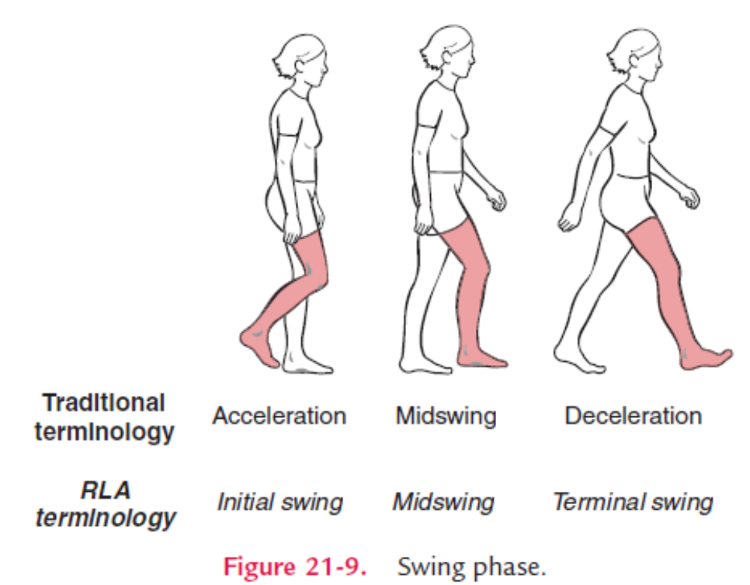
Analysis of Swing Phase
The swing phase consists of three components: acceleration, midswing, and deceleration. These components are all non–weight-bearing activities. The first part is acceleration. The leg is behind the body and moving to catch up. The ankle is dorsiflexing, and the knee and hip continue to flex, which is moving the leg forward. In RLA, initial swing is that period between the end of toe-off and the end of acceleration.

Slide 20
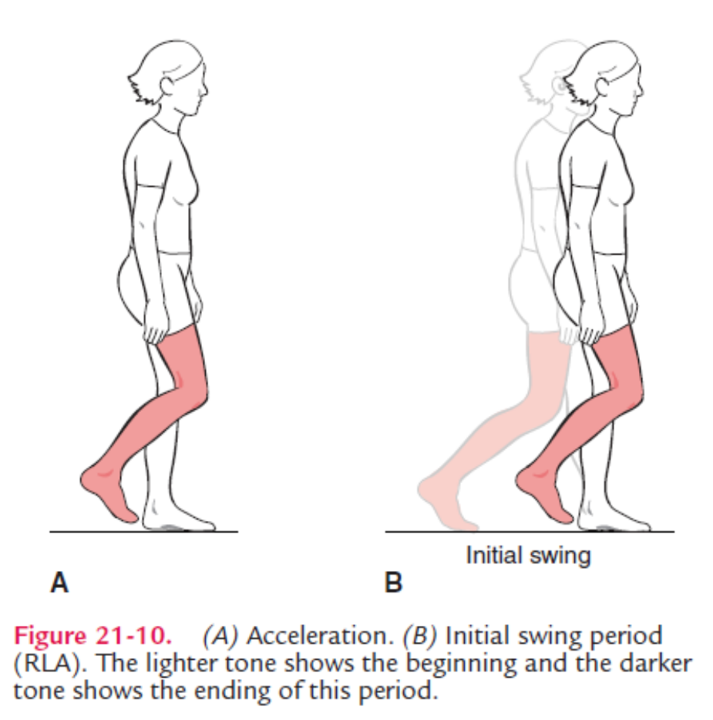

Slide 21
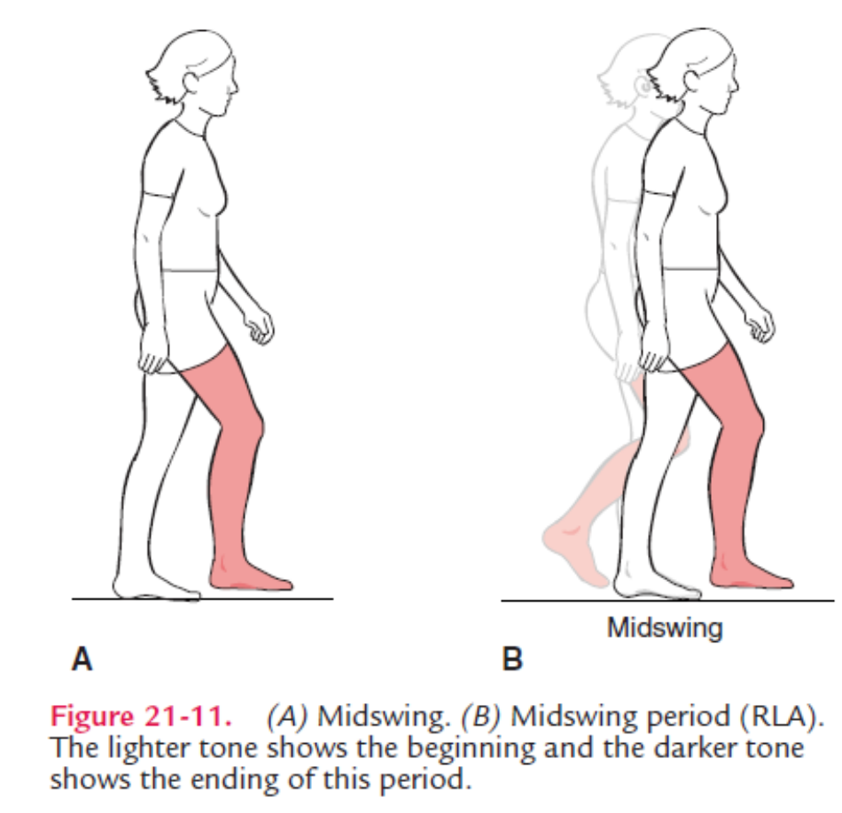
At midswing, the ankle dorsiflexors have brought the ankle to a neutral position. The knee is at its maximum flexion (approximately 65 degrees) as is the hip (at about 25 degrees of flexion). These motions act to shorten the leg, allowing the foot to clear the ground as it swings through. Further hip flexion moves the leg in front of the body and puts the lower leg in a vertical position. In RLA, midswing is that period between the end of acceleration and the end of midswing.

Slide 22
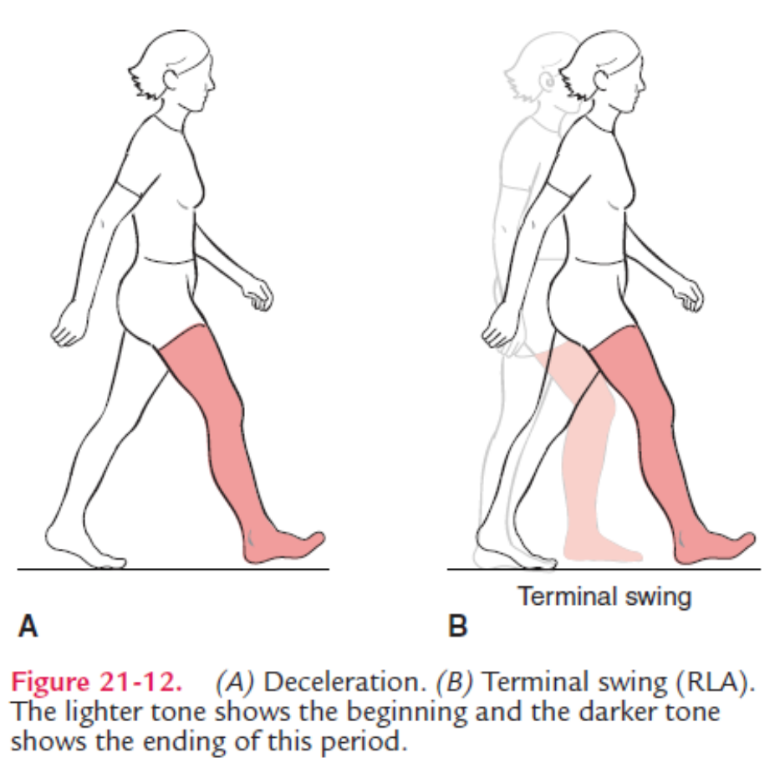
In deceleration, the ankle dorsiflexors are active to keep the ankle in a neutral position in preparation for heel strike. The knee is extending, and the hamstring muscles are contracting eccentrically to slow down the leg, keeping it from snapping into extension. The leg has swung as far forward as it is going to. The hip remains in flexion. In RLA, terminal swing is that period between the end of midswing and the end of deceleration.

Slide 23
Additional Determinants of Gait
To this point, the description of gait has centered mostly on the lower legs. However, other events are occurring in the rest of the body that must also be considered. If you were to hold a piece of chalk against the blackboard and walk the length of the blackboard, you would see that the line drawn bobs up and down in wavelike fashion. This is described as the vertical displacement of the center of gravity. The normal amount of this displacement is approximately 2 inches, being highest at midstance and lowest at heel strike (initial contact). There is also an equal amount of horizontal displacement of the center of gravity as the body weight shifts from side to side. This displacement is greatest during the single support phase at midstance. In other words, this represents the distance the body must shift horizontally on to one foot so that the other foot can swing forward. This side-to-side displacement is usually about 2 inches.

Slide 24
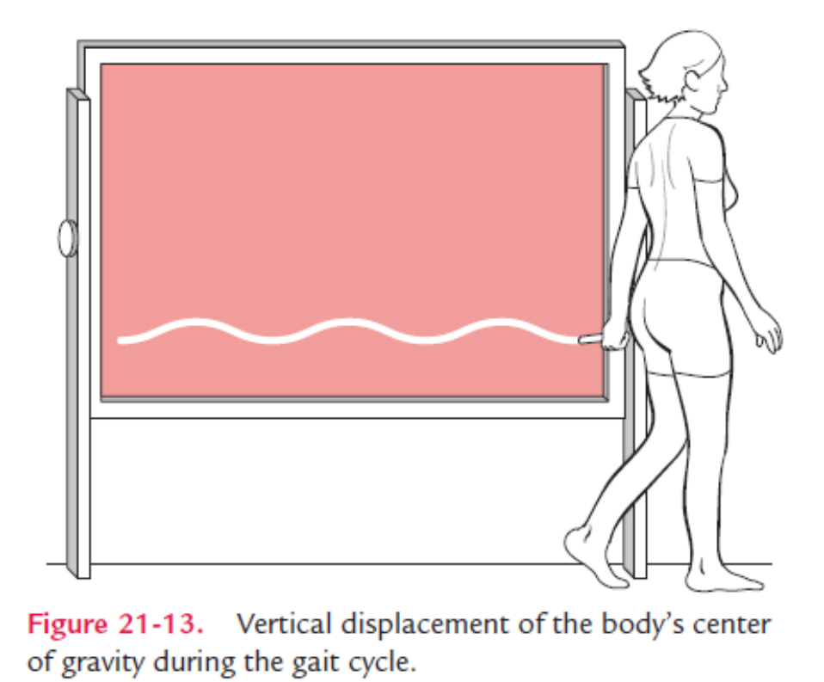

Slide 25
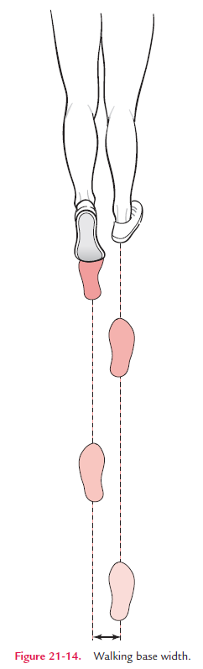
When you walk, you do not place your feet one step in front of the other but slightly apart. If lines were drawn through the successive midpoints of heel contact (initial contact) on each foot, this distance would range from 2 to 4 inches. This is described as the width of walking base.

Slide 26
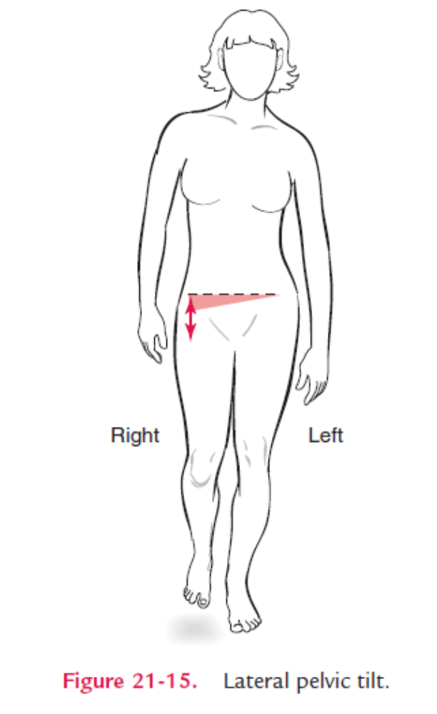
If you were to walk across the room with your hands on your hips, you would notice that they move up and down as your pelvis on each side drops down slightly. This lateral pelvic tilt occurs when weight is taken off the leg at toe-off (preswing). This slight drop is sometimes referred to as the “Trendelenburg sign.” This dip would be greater if it were not for the hip abductors on the opposite side (weight-bearing) and the erector spinae on the same side working together, keeping the pelvis essentially level.

Slide 27
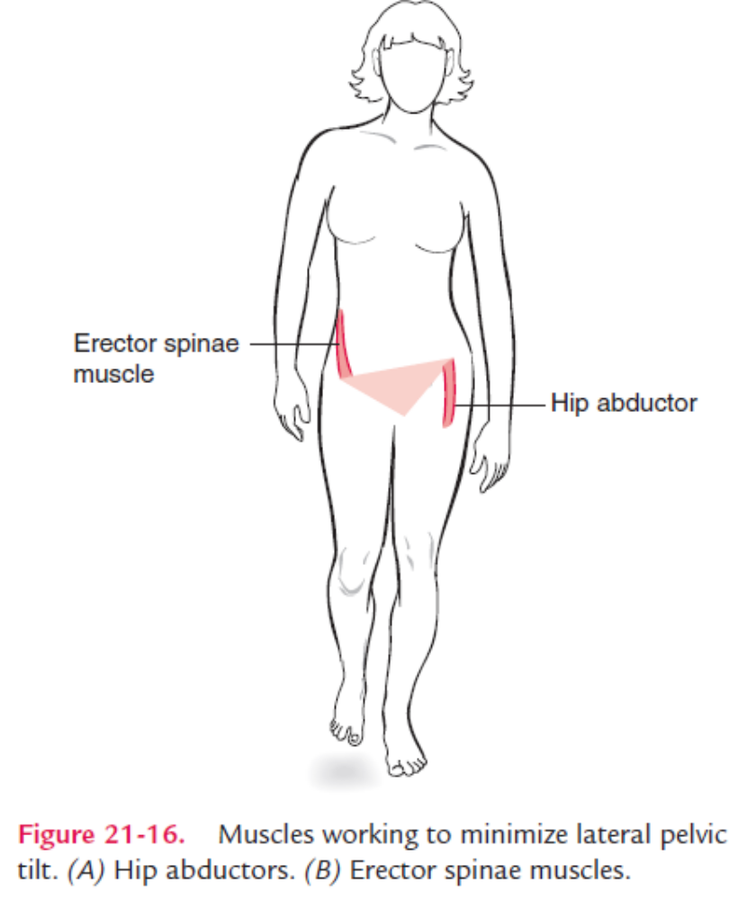
When the pelvis drops on the right side (non–weight-bearing side), the left hip (weight-bearing side) is forced into adduction. To keep the pelvis level, although it actually dips slightly, the left hip abductors contract to prevent hip adduction. At the same time the right erector spine muscle, which has attachment on the pelvis, contracts and “pulls up” on the side of the pelvis that wants to drop.

Slide 28
In addition, step length should be equal in both distance and time. The arms should swing with the opposite leg. The trunk rotates forward as the leg progresses through the swing phase. Arms swinging in opposition to trunk rotation control the amount of trunk rotation by providing counterrotation. The head should be erect, shoulders level, and trunk in extension. When analyzing someone’s gait, it is best to view the person from both the side and the front (and sometimes the back). Step length, arm swing, position of head and trunk, and the activities of the lower leg are usually best viewed from the side. Width of walking base, dip of the pelvis, and position of the shoulders and head should be viewed from the front or back.

